Slide 1

HTML Lists
A Detailed Technical Presentation
By
Manjeet Kumar Maurya

Slide 2
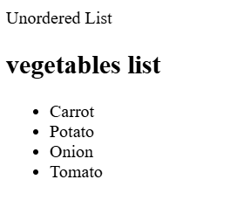
HTML List = An HTML list organizes content into ordered or unordered formats, making information clear and easy to read.
Type Of List
1. Unordered List : An unordered list is a type of HTML element used to create a bulleted listing.
Therefore, they are also called bulleted lists in HTML.
You can change the style using the type attribute on the <ul>
The elements are typically indicated by bullet points (•) but can be customized with disc (◦), circle (o), and square shapes (■).
.

Slide 3
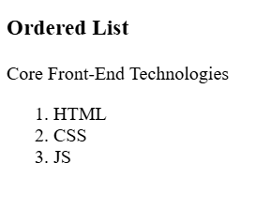
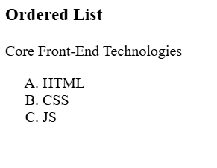
Ordered List : An ordered list in HTML is used to display items in a specific, sequential order using numbers, letters, or Roman numerals
Use the HTML <ol> element to define an ordered list
Use the HTML type attribute to define the numbering type
Use the HTML <li> element to define a list item
You can change the numbering style using the type attribute on the <ol>

Slide 4
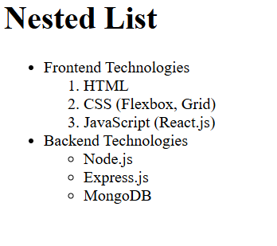
Nested List : A nested list is a list within another list. It is used to represent hierarchical data or a 'sub-category' relationship between different items in HTML.
Hierarchical Structure
Mix & Match Flexibility

Slide 5
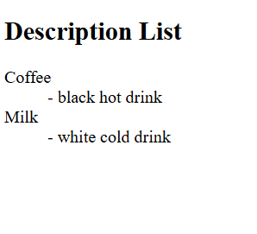
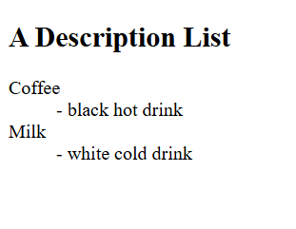
Description List : A description list is a list of terms, with a description of each term.
Use the HTML <dl> element to define a description list
The <dt> Element: Used to specify the Description Term (the name or title of the item).
The <dd> Element: Used to provide the Description Detail (the actual explanation or definition of the term).

Slide 6
Thank You

