Slide 1
Smart Robotic Car
Team Members:
Simran(12203073)
Dilpreet Kaur(
Manjeet Kumar(12200996)

Slide 2
Table Of Contents
Introduction………………………………………………………………………………………………………………1
Objectives…………………………………………………………………………………………………………………2
Components……………………………………………………………………………………………………………….3.
Block Diagram……………………………………………………………………………………………………….....4
Flow Chart……………………………………………………………………………………………………………………5
Circuit Diagram…………………………………………………………………………………………………………..6
Advantages……………………………………………………………….............................................................7
Disadvantages……………………………………………………………………………………………………………8
Applications………………………………………………………………………………………………………………….9
Results…………………………………………………………………………………………………………………………….10
Future Scope………………………………………………………………………………………………………………..11
Conclusion……………………………………………………………………………………………………………………..12

Slide 3
Introduction
The dust cleaning robotic car revolutionizes household cleaning with its autonomous operation, efficiently collecting dust and debris while users focus on other tasks. Equipped with advanced sensors and mapping technology, it navigates indoor spaces, recognizing obstacles and optimizing its cleaning route. Its versatility allows it to clean various floor surfaces, including hardwood, carpet, and tile, reaching even the most inaccessible areas with ease.

Slide 4
Obstacle avoidance and navigation
Safety Enhancement:
01
02
03
Efficient cleaning:
04
Accessibility:
Objectives
Robotic car detects obstacles, navigates safely.
Robotic cars enhance road safety, reducing accidents.
Robotic cars improve accessibility for diverse users.
Robotic car: Efficiently cleans various types of floors.

Slide 5
Components
NodeMcu Board
Ultrasonic Sensor
Servo Motor
DC motors
L298N Motor shield
Jumper Wires

Slide 6
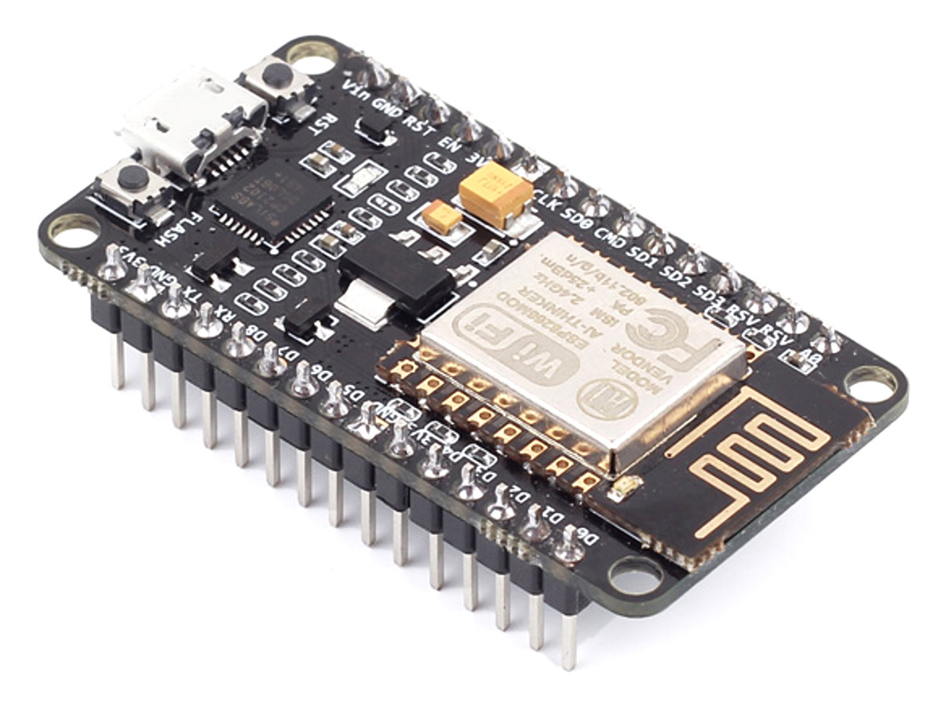
NodeMcu Board
NodeMcu board is the central controller, coordinating functions and movements for efficient cleaning. It integrates with sensors to gather data and enables Wi-Fi connectivity for remote monitoring and control, adding convenience for users. Its compact design and low power consumption make it ideal for powering the smart features of the robotic cleaner

Slide 7
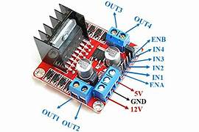
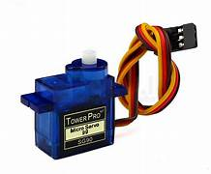
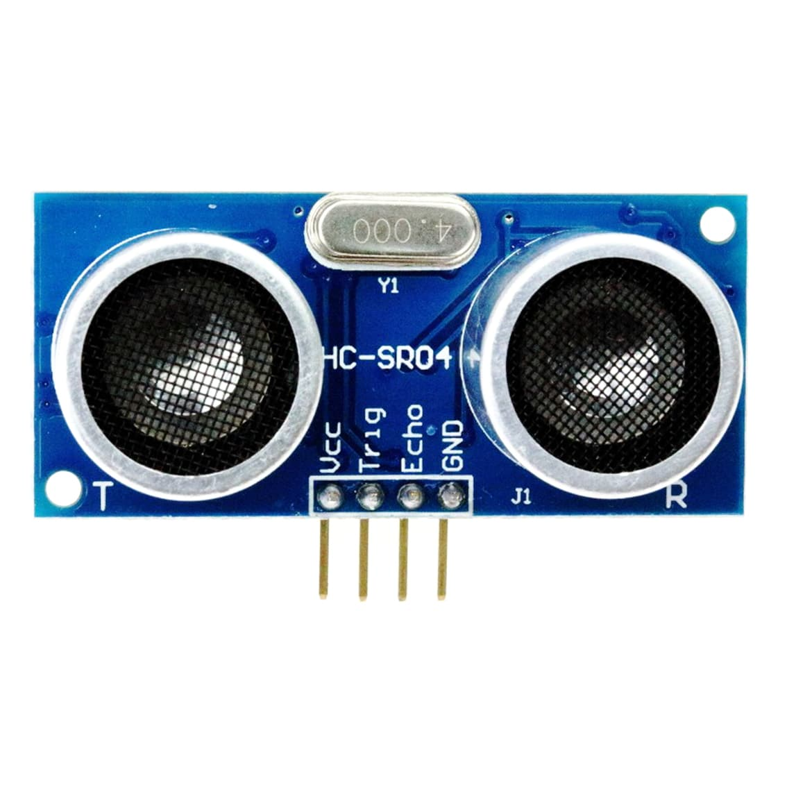
Components
Ultrasonic Sensor
L298N Motor Driver
Servo Motor
In a robotic car, an ultrasonic sensor is used to detect obstacles and measure distances, enabling navigation and collision avoidance.
The L298N Motor Driver Module empowers precise control over DC and stepper motors with its high-power capabilities and integrated regulator.
Servo motors enable accurate and controlled movement in robotics and automation.

Slide 8
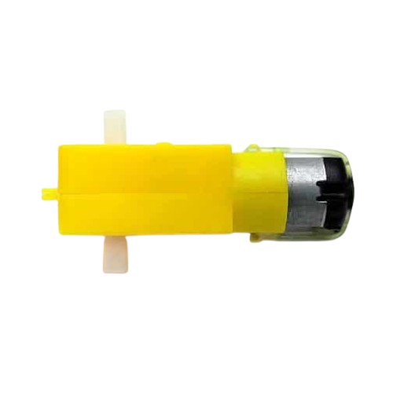
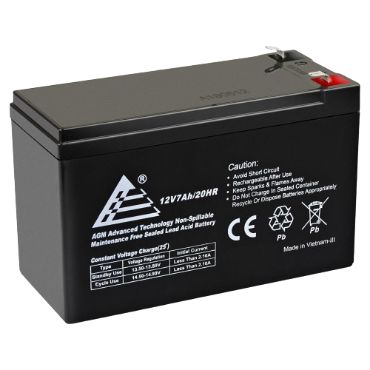
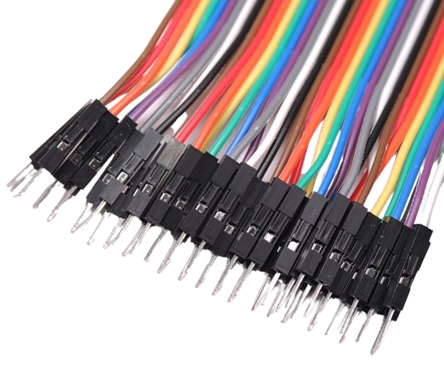
Components
DC Motors
12v Battery
Jumper Wires
A 12V battery serves as the power source, providing energy to drive the motors and electronics in the vacuum cleaner.
DC motors in the vacuum cleaner drive the suction mechanism, powering the movement and cleaning actions.
Jumper wires are essential for establishing electrical connections between components in electronic circuits.

Slide 9
Block Diagram

Slide 10
Flow Chart
START ROBOT
START VACCUME
CHANGE DIRECTION
CHECK FOR OBSTACLES
STOP
STOP
CONTINUE CLEANING
MOVE FORWARD

Slide 11
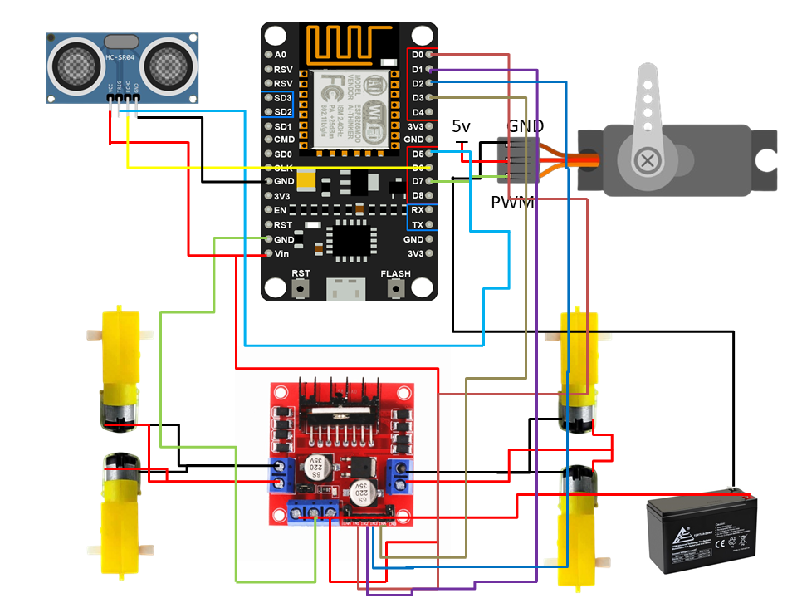
Circuit Diagram

Slide 12
Advantages
Hands-free operation for convenience.
Efficient navigation ensures thorough cleaning.
Versatile on all types of floors.
Time-saving automation simplifies household chores.
Low noise operation for minimal disturbance during cleaning.
Wi-Fi connectivity for remote monitoring and control.

Slide 13
Disvantages
Initial high cost compared to traditional vacuum cleaners.
Limited capacity for large debris due to smaller dustbin size.
Potential navigation issues in complex or cluttered environments.
Reliance on battery power, requiring periodic recharging.
Limited effectiveness on uneven or highly textured surfaces.

Slide 14
Applications
Home Cleaning: Efficiently cleans various floor surfaces in homes, reducing manual vacuuming.
Office Spaces: Maintains cleanliness in offices, promoting a hygienic workplace.
Hospitality Industry: Enhances guest satisfaction by keeping hotel rooms and public areas clean.
Healthcare Facilities: Contributes to infection control by maintaining sanitary conditions in hospitals.
Retail Spaces: Ensures clean and welcoming environments for customers in retail stores.

Slide 15
Results
Smart cleaning robotic cars have produced encouraging results, demonstrating their efficacy in a variety of household cleaning tasks. Below are some major conclusions from studies and user feedback:
Efficient Cleaning Performance: Smart cleaning robotic cars demonstrate excellent cleaning efficacy on various surfaces, removing dust, grime, and debris comparably or better than manual methods. Their autonomous navigation enables thorough cleaning even in hard-to-reach areas.
Time-Saving Automation: These robots significantly save users' time by autonomously performing cleaning tasks, reducing the need for manual intervention. Users can allocate their time to other activities while benefiting from the convenience of automated cleaning.

Slide 16
4,498,300,000
Big numbers catch your audience’s attention

Slide 17
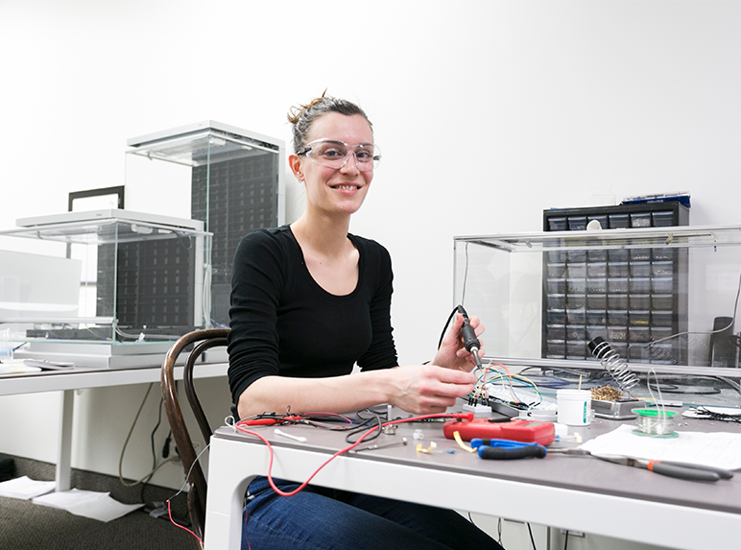
PRODUCT DEMO
Insert your multimedia content here

Slide 18

TRACTION
Venus has a beautiful name and is the second planet from the Sun. It’s terribly hot—even hotter than Mercury
To modify this graph, click on it, follow the link, change the data and paste the new graph here

Slide 19
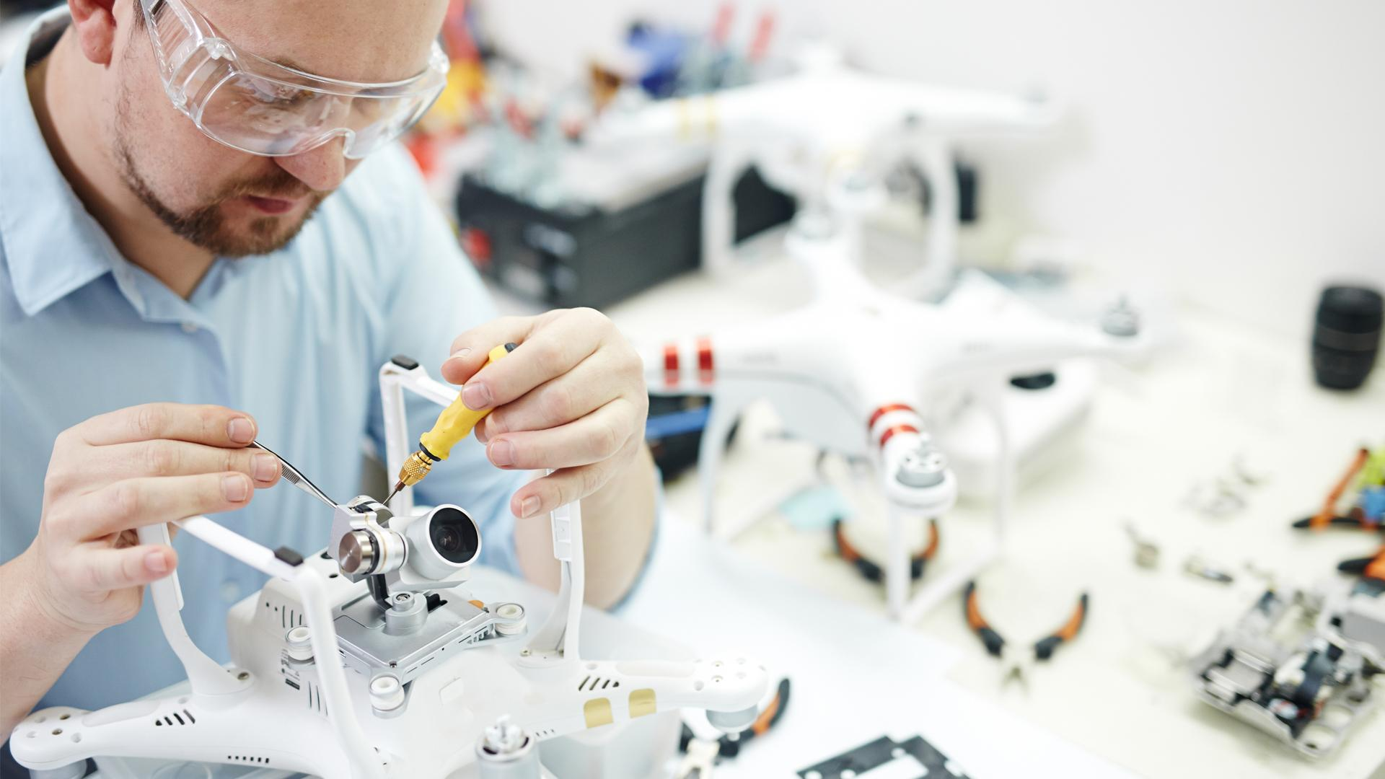
A PICTURE ALWAYS REINFORCES THE CONCEPT
Images reveal large amounts of data, so remember: use an image instead of a long text

