Slide 1
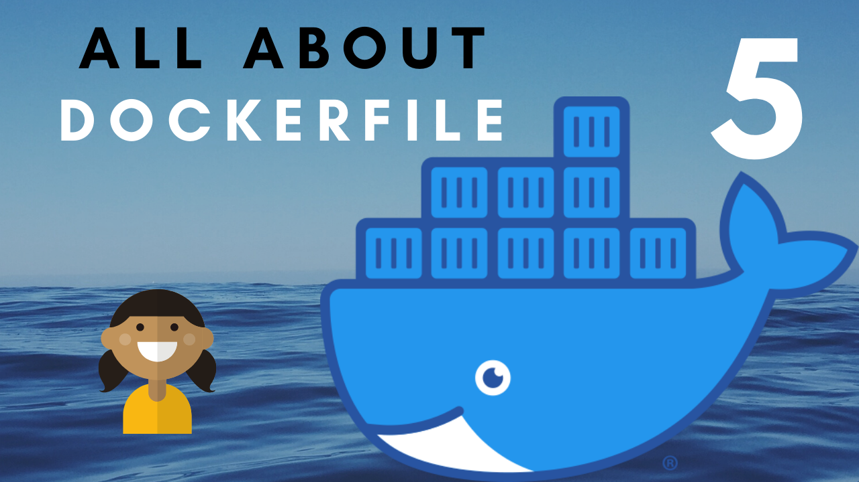

Slide 2

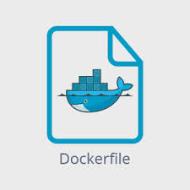

Slide 3
What is Dockerfile ?
Dockerfile Directives
Creating Dockerfile - DEMO
.dockerignore file

Slide 4
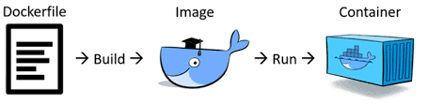
Dockerfile
It is a text file normally with name Dockerfile.
Docker uses this file to build the image. The Dockerfile is build instructions to build the image.
Images are composed of layers. Layers are files that are generated from individual commands in the Dockerfile.
Once we have built an image, we can run an instance of it: a container.

Slide 5
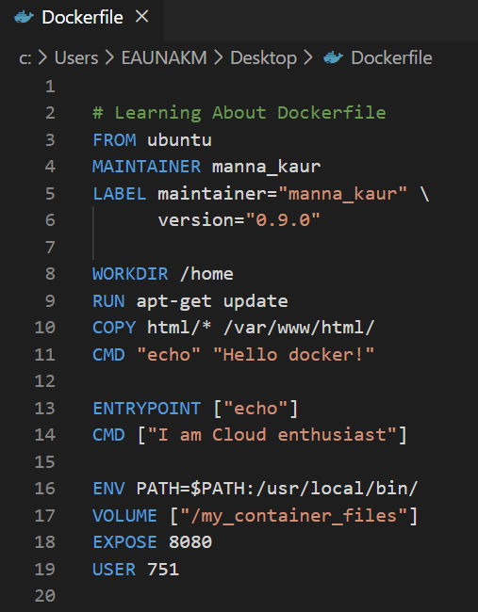
Dockerfile Directives
Command | Description
FROM | Base image from which new image will be created
MAINTAINER | Metadata about who owns this
LABEL | Using label you can organize images in a proper way
WORKDIR | Sets where CMD is executed from
RUN | Executing directive used to build an image
COPY | Lets you copy content to the image
CMD | Provides defaults arguments to the ENTRYPOINT
ENTRYPOINT | Defined when using the container as an executable
ENV | Used to set environment variable.
VOLUME | Used to create a mount point.
EXPOSE | Exposes port(s) on which container listens for connection
USER | Sets the UID to run the next command as

Slide 6
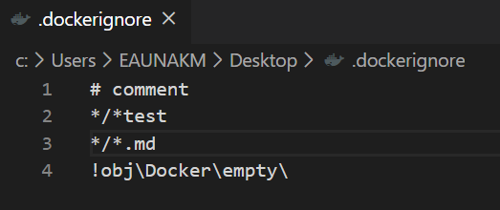
.dockerignore file
Command | Description
# | Comment
* | One/more character wildcard
? | One character wildcard
[ ] | Range of characters
! | Exception (not)
It is used to exclude files and directories.
It is useful to prevent large files from being added to Docker images.
Using the “dockerignore” file prevents our local modules and other unwanted files from being copied onto the Docker image.
It should be present in the same directory in which Dockerfile is present.
It improves build performance of Docker Image.

Slide 7


