Slide 1
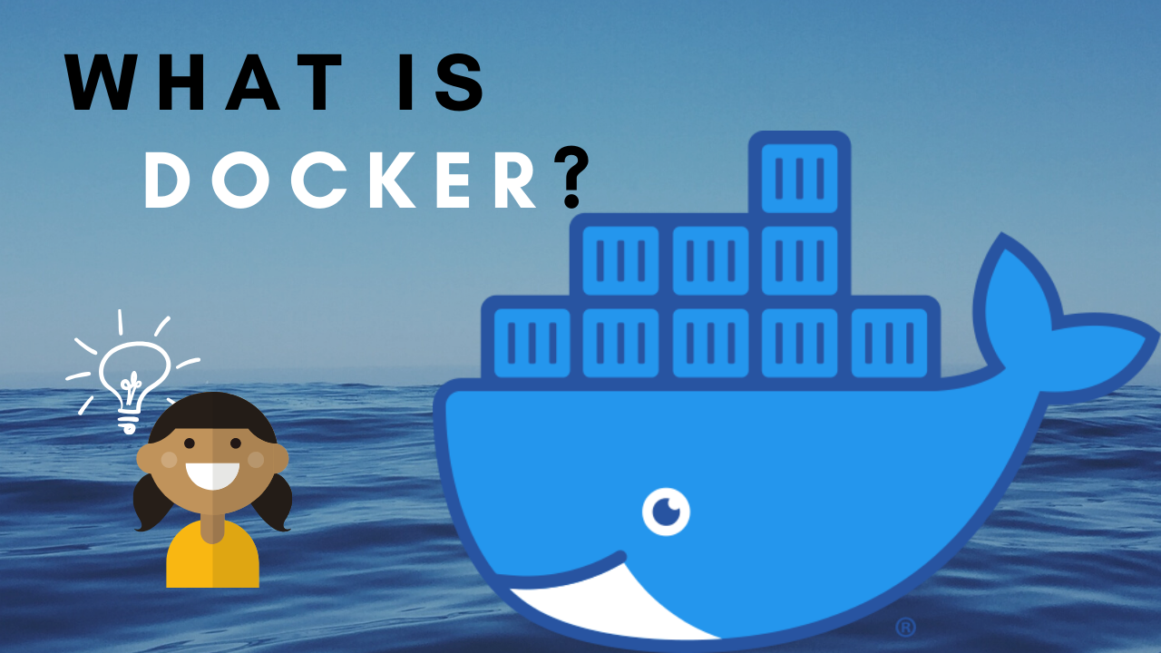

Slide 2

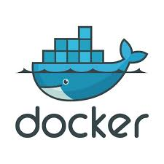

Slide 3
What are Containers ?
What is Docker ?
Why Docker?
Virtualization v/s Containerization

Slide 4

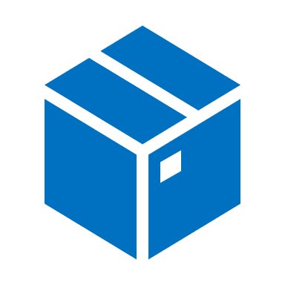

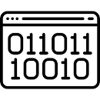
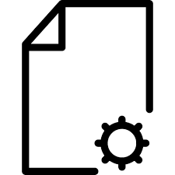
Container
Application
Dependencies
Containers are package consisting of an Application with all its dependencies such as binaries, libraries and conf. files.

Slide 5
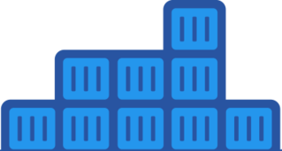

Docker
Docker is an open source software container platform.
Build
Ship
Run

Slide 6
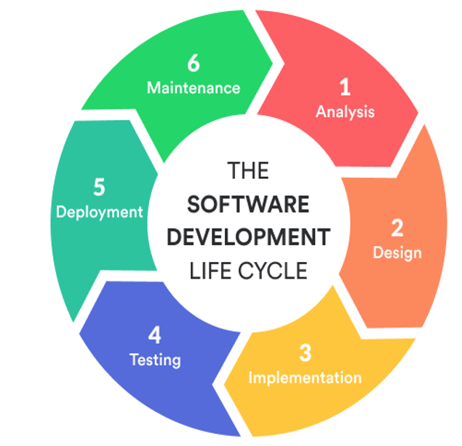
Why Docker ?
With containerization feature of docker it ensures that the application works in any environment – platform independent.
Docker is used to improve :
Application Deployment
Application Development
With Dockers Development, QA and Operations Teams can work seamlessly.

Slide 7
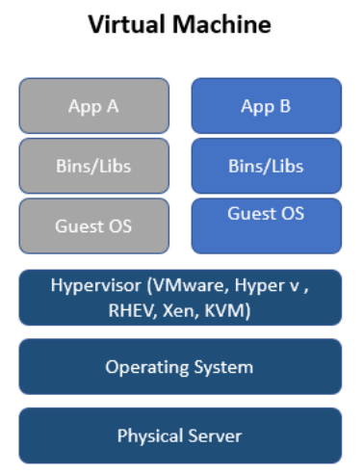
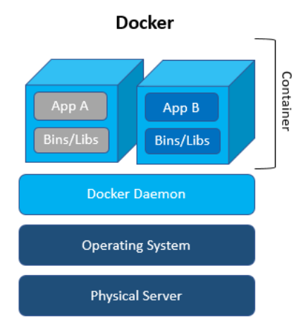
Virtualization vs Containerization
The physical hypervisor hardware is virtualized.
Starting Virtual Machine means waiting for OS boot.
Virtual Machine contains all OS files.
The OS is virtualized and not the hardware.
Starts much quickly than Virtual Machine.
Contains only application related files.

Slide 8


