Slide 1
Image Classification Of Dogs and Cats Using CNN
By
Manjeet Singh- 1609113061

Slide 2
TOC
Introduction
Motivation
Scope
Research
Tools And Libraries Used
Technical Feasibility
Dataset
Data Preprocessing
Model Overview
Model Implementation
Result And Analysis
Conclusion
References

Slide 3
Introduction
I am creating an algorithm to classify whether an image contains a dog or a cat.
The image input given to the system will be analyzed and the predicted result will be given as output. Machine learning algorithm [Convolutional Neural Networks] is used to classify the image.
The learning task is to learn a classification model to determine the decision boundary for the training dataset.
The performance task is to apply the learned classification model to classify images from the test dataset, and then evaluate the classification accuracy.

Slide 4
Motivation
While image classification has many uses, I am particularly motivated by the application in web accessibility.
To increase efficiency and accessibility for users, screen reader technologies should automatically detect the image’s content.
The Dogs vs. Cats competition from Kaggle is trying to solve the CAPTCHA challenge, which relies on the problem of distinguishing images of dogs and cats.
To understand the working and processes involved in making of image classifier.

Slide 5
Scope
This project gives a general idea of how image classification can be done efficiently.
Own image can be tested to verify the accuracy of the model.
This code can directly be can be extended as a mobile application or a site.
The project can be extended to classify different entities, change the dataset accordingly and train the model.
The scope of the project can be extended to the various industries where there is a huge scope for automation, by just altering the dataset which is relevant to the problem.
The application of the project can be extended to a personal photo organization.

Slide 6
Research
CONVOLUTIONAL NEURAL NETWORK (CNN)
CNNs are regularized versions of multilayer perceptrons.
CNNs take a different approach towards regularization: they take advantage of the hierarchical pattern in data and assemble more complex patterns using smaller and simpler patterns.
The basic CNN structure is as follows:
Convolution --> Pooling --> Convolution --> Pooling --> Fully Connected Layer --> Output

Slide 7
LAYERS IN CONVOLUTIONAL NEURAL NETWORK (CNN)
Convolutional Layer :-- Convolutional layer is the very first layer where we extract features from the images in our datasets.
Pooling Layer :-- We insert pooling layers after each convolution layer to reduce the spatial size of the representation to reduce the parameter counts which reduces the computational complexity.
Fully-Connected Layers :-- A fully connected network is our RegularNet where each parameter is linked to one another to determine the true relation and effect of each parameter on the labels.

Slide 8
Tools And Libraries Used
Python 3.7
Anaconda Prompt
Jupyter Notebook
Keras – Tensorflow backend
OpenCV
Numpy

Slide 9
Dataset
Dataset :- Dogs vs Cats
Provider :- Microsoft Research
Description :- Binary classification -- Classify dogs and cats
Training :- 19790 images (9895 per class)
Validation :- 4948 images (2474 per class)
Testing :- 1500 unlabeled images (Test any image which is not in training dataset)
File Format :- All the image files are in “.jpg” format.

Slide 10
Data Preprocessing
Extract image and convert into Grayscale
Reshape image
Balance The data
Shuffle The data
Create the features and labels
Convert the labels of "dog" and "cat" to 0 and 1

Slide 11
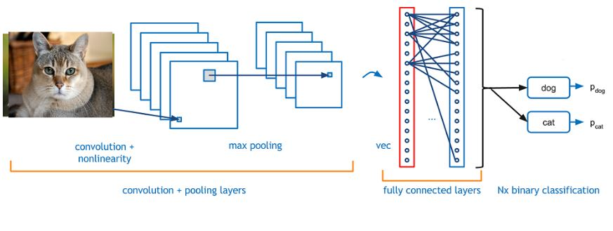
Model Overview

Slide 12
Model Implementation
Define a Sequential model
Add 3 convolution layers
Add a flatten layer
Add final Dense layer
Compile the model
Fit the model with training data
Feed the model with test data to predict

Slide 13
Result And Analysis
Output contains the probabilities of the input image being a dog or a cat.
I am able to achieve a training accuracy of 87.20.% and a validation accuracy of 84.05% using CNN Algorithm.
The algorithm is also performing very good on the unseen testing image dataset.
After testing for various nodes and Conv2D layer combinations we finally achieved our best classification accuracy with a sequential model having three Conv2D layers with 32 nodes and using “relu” activation function and “adam” optimizer.

Slide 14
Conclusion
I’ve learned the underlying concepts of how computers see (Image Classification) by implementing simple yet very powerful image classification system.
The CNN Algorithm outperforms the Logistic Regression Model by a huge margin. Thus, proving CNN’s algorithms give a much better performance on Computer Vision tasks as compared to other machine learning algorithms.
I tried various experiments to improve the performance on the test dataset, and finally I was able to achieve a training accuracy of 87.20.% and a validation accuracy of 84.05% using CNN Algorithm.
There is vast scope of improvement for the model by using data augmentation.

Slide 15
References
Rajat Garg, ”Kaggle “Dogs vs. Cats” Challenge”,Medium, Feb 8, 2019 https://medium.com/@mrgarg.rajat/kaggle-dogs-vs-cats-challenge-complete-step-by-step-gui de-part-2-e9ee4967b9
Anchit Jain , “Creating a simple dog versus cat image classifier using Keras”, Medium, May 26, 2018 https://medium.com/@jayeshbahire/introduction-to-word-vectors-ea1d4e4b84bf
Greg Surma , “Image Classifier - Cats vs Dogs”, Towards Data Science , Nov 19, 2018 https://towardsdatascience.com/image-classifier-cats-vs-dogs-with-convolutional-neural-netw orks-cnns-and-google-colabs-4e9af21ae7a8

Slide 16
Thank you

