Slide 2
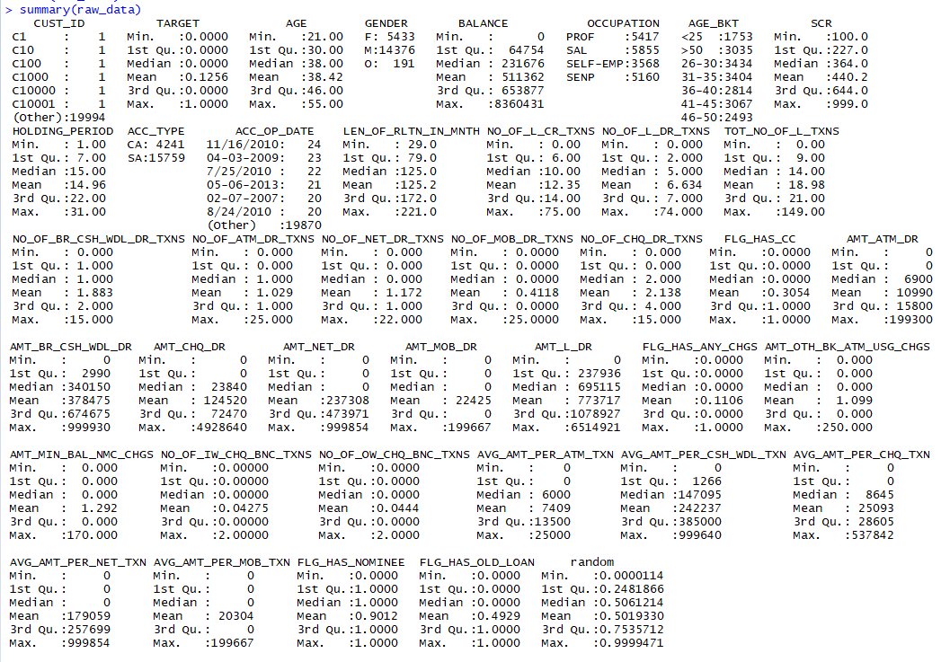
Summary of Raw Data
Code Snippet
#import dataset for modelling
raw_data <- read.csv("Data/PL_XSELL.csv")
View(raw_data)
summary(raw_data)

Slide 3
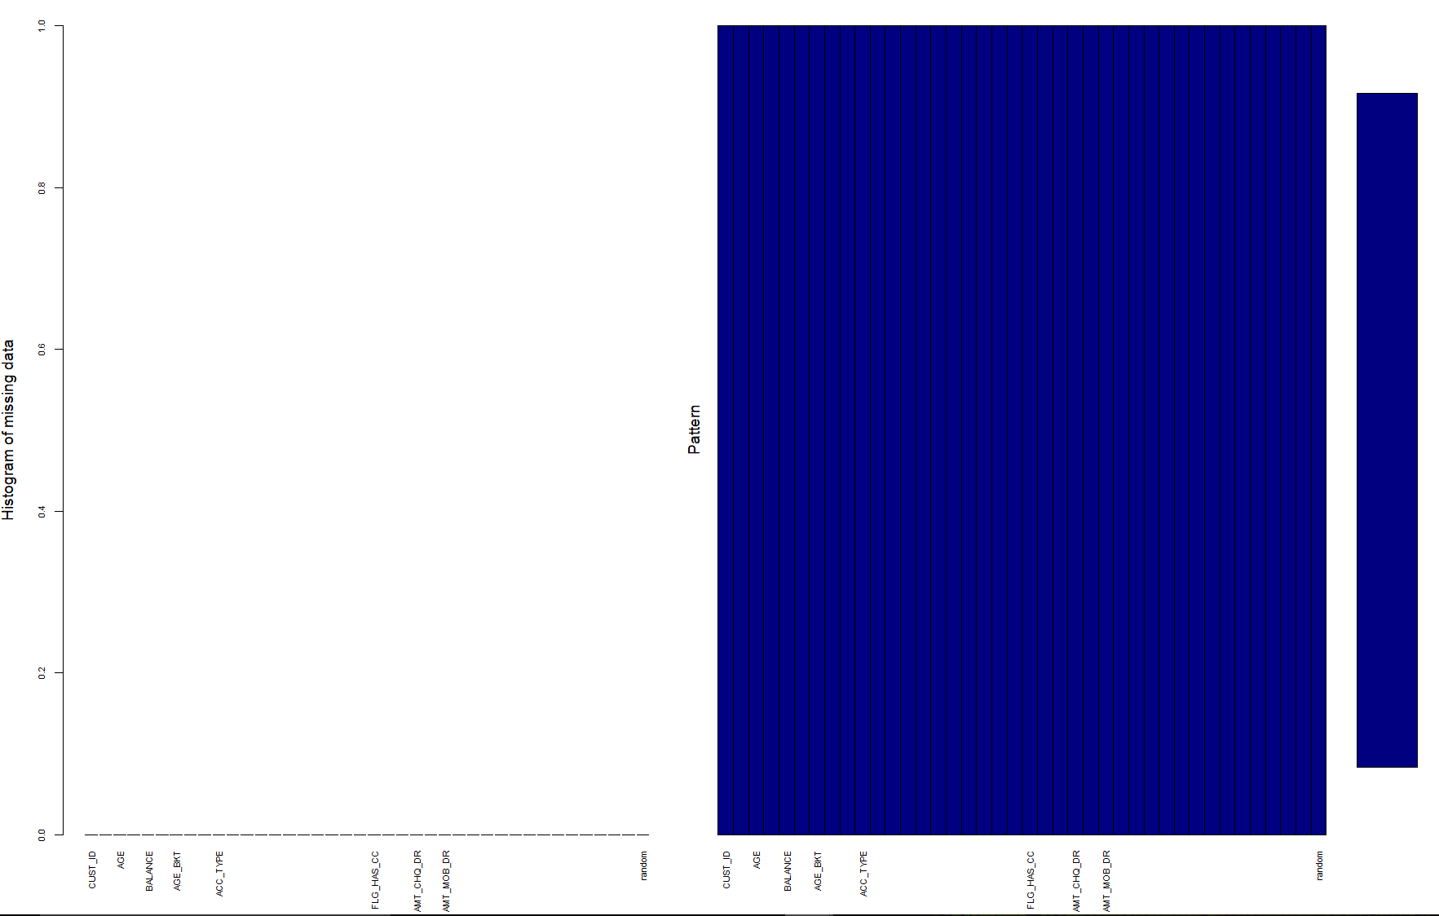
Is there any missing data?
Code Snippet:
#Check if there are any missing values
aggr_plot <- aggr(raw_data,
col=c('navyblue','red'),
numbers=TRUE,
sortVars=TRUE,
labels=names(data),
cex.axis=.7,
gap=3,
ylab=c("Histogram of missing data","Pattern"))
Red Colour for missing data and Blue colour for Valid Data.
From the above histogram we conclude that there is no missing data.

Slide 4
Percentile Distribution
TARGET AGE BALANCE SCR HOLDING_PERIOD LEN_OF_RLTN_IN_MNTH NO_OF_L_CR_TXNS NO_OF_L_DR_TXNS TOT_NO_OF_L_TXNS
1% 0 21 1677.63 106 1 31 0 0 0
5% 0 24 8930.58 133 1 39 0 1 2
10% 0 26 19259.77 157 3 49 2 1 4
25% 0 30 64754.03 227 7 79 6 2 9
50% 0 38 231675.85 364 15 125 10 5 14
75% 0 46 653876.85 644 22 172 14 7 21
90% 1 52 1408112.43 833 27 202 24 15 38
95% 1 54 1993079.06 897 29 211 39 21 56
99% 1 55 3412760.31 970 31 219 64 31 79
100% 1 55 8360430.57 999 31 221 75 74 149

Slide 5
NO_OF_BR_CSH_WDL_DR_TXNS NO_OF_ATM_DR_TXNS NO_OF_NET_DR_TXNS NO_OF_MOB_DR_TXNS NO_OF_CHQ_DR_TXNS FLG_HAS_CC AMT_ATM_DR
1% 0 0 0 0 0 0 0
5% 0 0 0 0 0 0 0
10% 0 0 0 0 0 0 0
25% 1 0 0 0 0 0 0
50% 1 1 0 0 2 0 6900
75% 2 1 1 0 4 1 15800
90% 4 2 4 1 5 1 28600
95% 7 2 6 1 7 1 41200
99% 11 4 9 2 11 1 66400
100% 15 25 22 25 15 1 199300

Slide 6
AMT_BR_CSH_WDL_DR AMT_CHQ_DR AMT_NET_DR AMT_MOB_DR AMT_L_DR FLG_HAS_ANY_CHGS AMT_OTH_BK_ATM_USG_CHGS AMT_MIN_BAL_NMC_CHGS
1% 0 0 0.0 0.0 0.0 0 0 0
5% 0 0 0.0 0.0 9500.0 0 0 0
10% 0 0 0.0 0.0 40427.0 0 0 0
25% 2990 0 0.0 0.0 237935.5 0 0 0
50% 340150 23840 0.0 0.0 695115.0 0 0 0
75% 674675 72470 473970.5 0.0 1078927.0 0 0 0
90% 867460 156260 779187.0 109395.3 1563678.7 1 0 0
95% 933440 653870 897686.1 154254.0 1815155.0 1 0 0
99% 988660 2738097 977006.9 190805.0 3767742.7 1 0 0
100% 999930 4928640 999854.0 199667.0 6514921.0 1 250 170

Slide 7
NO_OF_IW_CHQ_BNC_TXNS NO_OF_OW_CHQ_BNC_TXNS AVG_AMT_PER_ATM_TXN AVG_AMT_PER_CSH_WDL_TXN AVG_AMT_PER_CHQ_TXN AVG_AMT_PER_NET_TXN
1% 0 0 0.0 0.00 0.00 0.0
5% 0 0 0.0 0.00 0.00 0.0
10% 0 0 0.0 0.00 0.00 0.0
25% 0 0 0.0 1265.45 0.00 0.0
50% 0 0 6000.0 147095.00 8645.00 0.0
75% 0 0 13500.0 385000.00 28605.00 257699.0
90% 0 0 18000.0 696840.00 67064.29 692846.0
95% 0 0 19600.0 846412.00 102805.67 839978.0
99% 1 1 23700.5 969542.20 245505.00 969391.7
100% 2 2 25000.0 999640.00 537842.22 999854.0

Slide 8
AVG_AMT_PER_MOB_TXN FLG_HAS_NOMINEE FLG_HAS_OLD_LOAN random
1% 0.00 0 0 0.009698501
5% 0.00 0 0 0.048754528
10% 0.00 1 0 0.097605773
25% 0.00 1 0 0.248186558
50% 0.00 1 0 0.506121361
75% 0.00 1 1 0.753571207
90% 94188.75 1 1 0.901568478
95% 145150.00 1 1 0.953501441
99% 188382.00 1 1 0.991278322
100% 199667.00 1 1 0.999947081

Slide 9
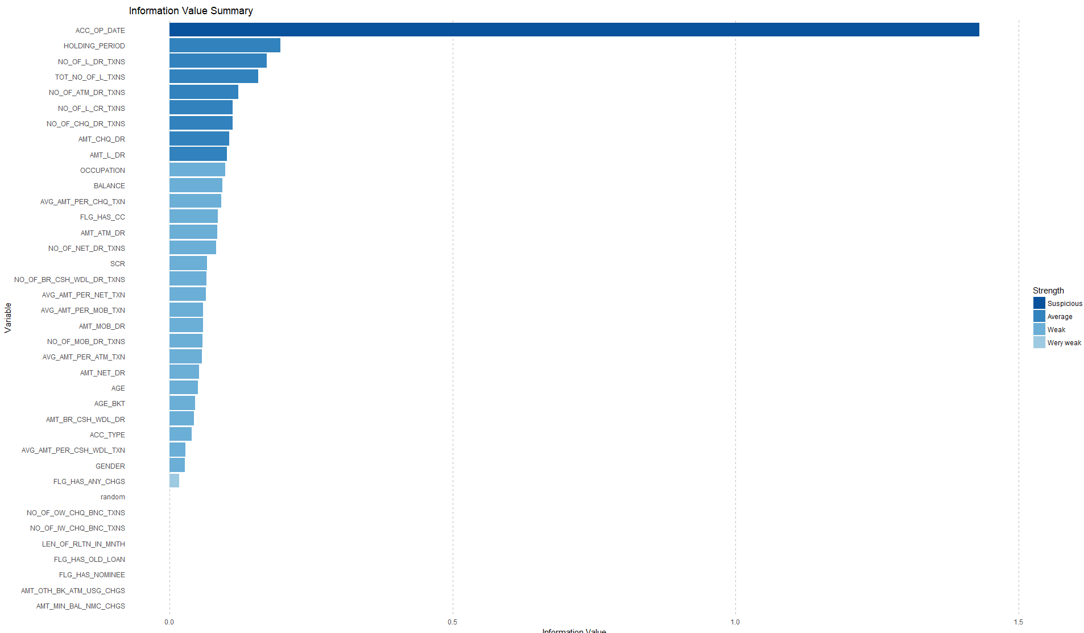
Information Value

Slide 10
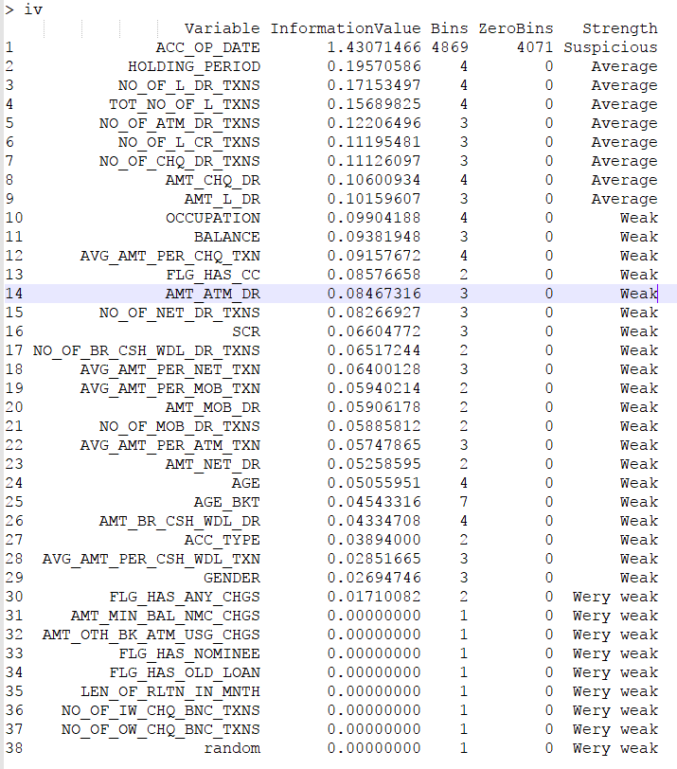
Summary

Slide 11
Outlier Treatment of Significant Variables
Box Plots

Slide 12
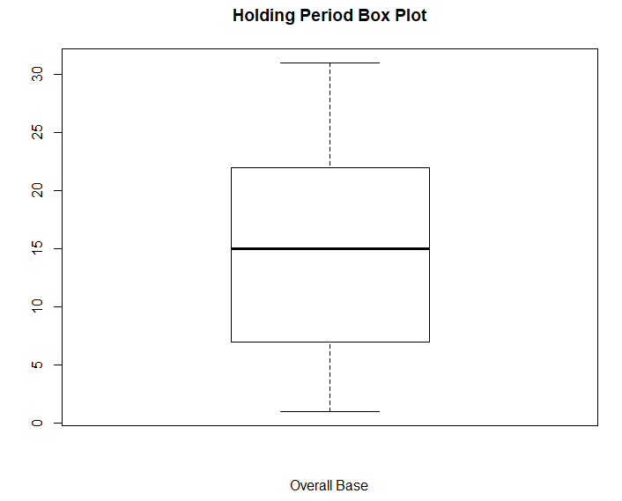
Ability to hold money in the account (Range 0 - 31)

Slide 13
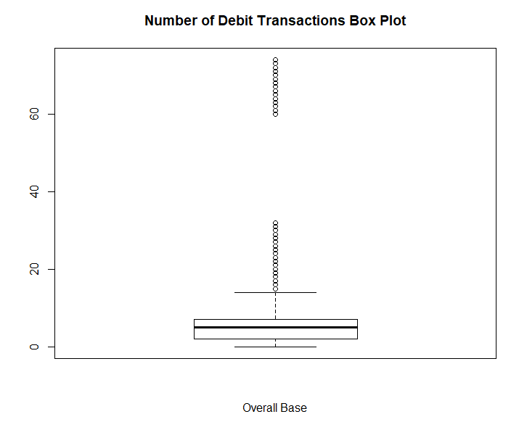
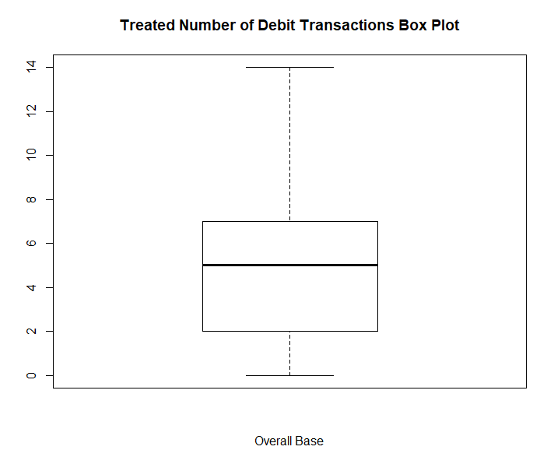
No. of Debit Transactions

Slide 14
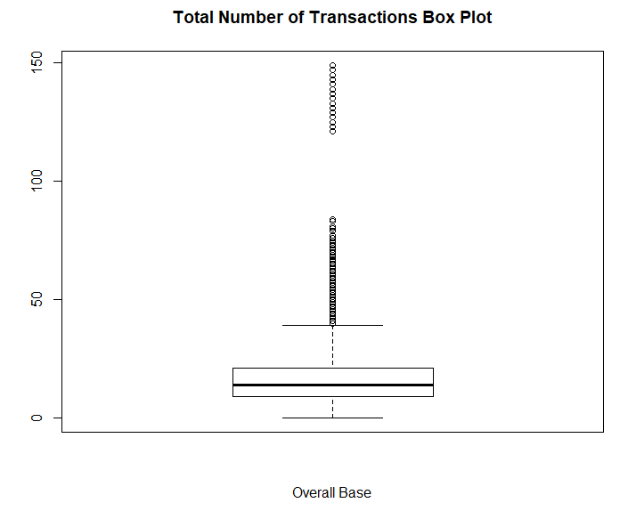
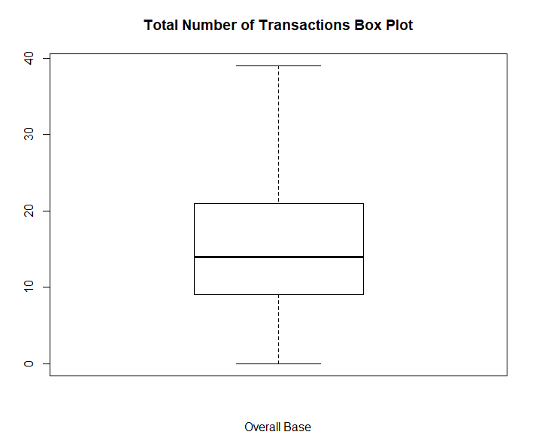
Total No. of Transaction

Slide 15
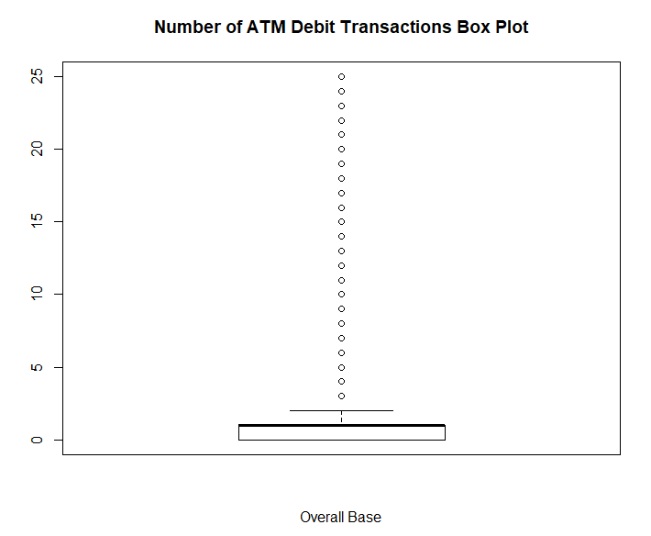
No. of ATM Debit Transactions

Slide 16
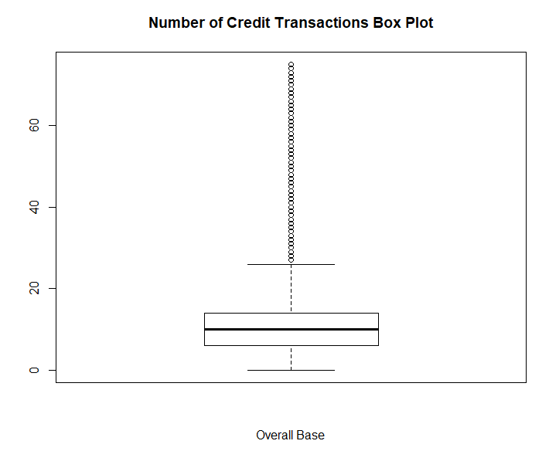
No. of Credit Transactions

Slide 17
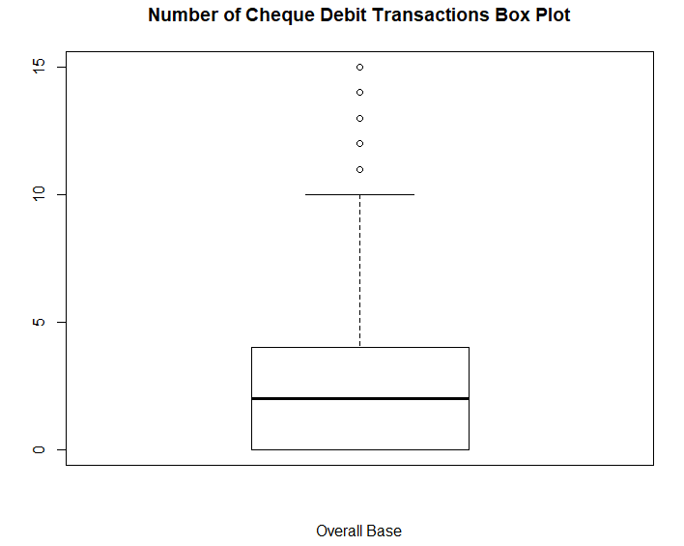
No. of Cheque Debit Transactions

Slide 18
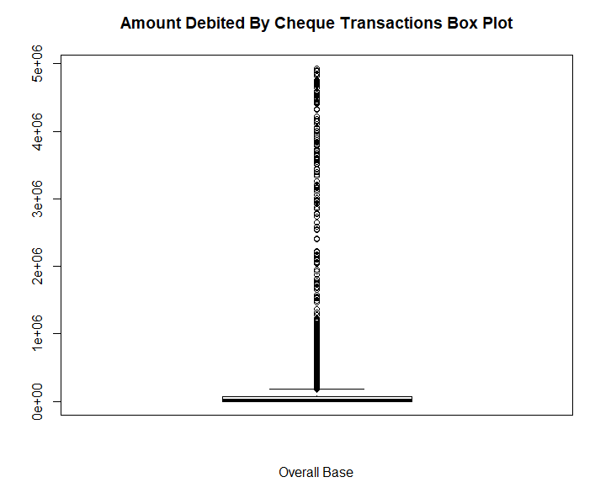
Amount debited by Cheque Transactions

Slide 19
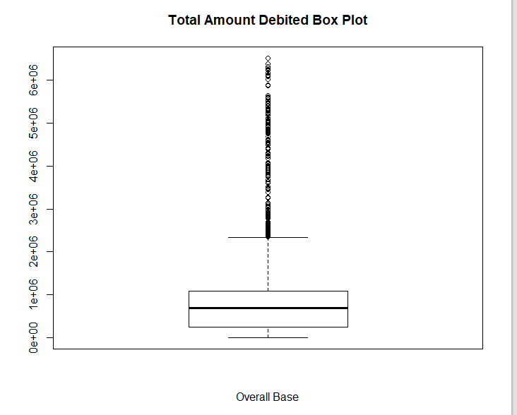
Total Amount Debited

Slide 20
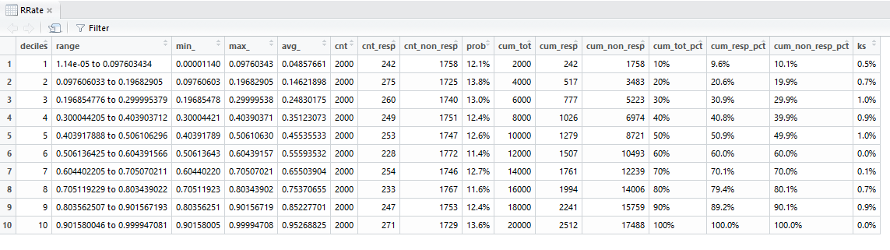
Pattern Of Data

Slide 21
Holding Period

Slide 22
Number of Debit Transactions

Slide 23
Total Number of Transactions

Slide 24
Number of ATM Transactions

Slide 25
Number of Credit Transactions

Slide 26
Number of Cheque Debit Transactions

Slide 27
Amount debited by Cheque Transactions

Slide 28
Total Amount Debited

