Slide 1
NetChain
A deep dive into the platform and how it works
Confidential multilateral netting with atomic settlement on Canton. AI proposes, the ledger disposes.
Live on Canton Devnet · netchain.vercel.app · every screen in this deck is a real screenshot of the live app

Slide 2
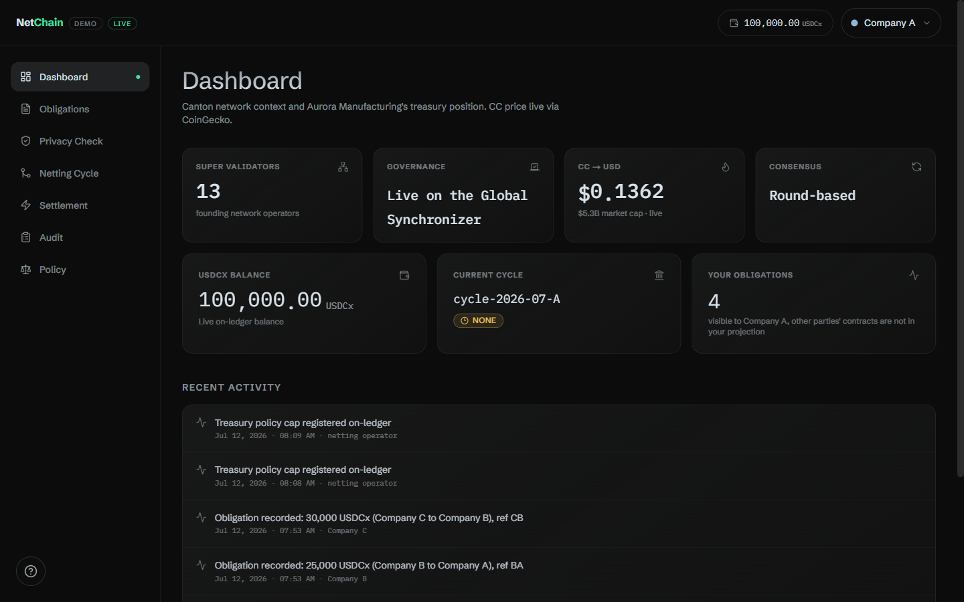
IN ONE SCREEN
What NetChain does
Companies that owe each other net down to one payment each, then settle.
The catch everywhere else: to net, someone sees the whole web of who-owes-whom.
NetChain keeps counterparties blind to each other AND settles every net leg atomically, in one Canton transaction.
An on-ledger policy bounds it, so even an AI agent driving it cannot overspend.
The live dashboard, LIVE badge = reads come straight from the Canton validator
NetChain deep dive
netchain.vercel.app

Slide 3
THE CAST
One operator, three companies
Operator
netting bank / coordinator
Company A
Aurora Manufacturing
Company B
Borealis Logistics
Company C
Cirrus Components
The operator observes every obligation and runs the netting cycle. It is the one trusted, regulated coordinator, exactly the CLS / in-house-bank model.
Each company sees ONLY its own slice of the ledger (per-party projection). A never sees B's dealings with C.
In the demo all four are driven by one shared machine identity on the shared Devnet; per-user signing is the named next step.
NetChain deep dive
netchain.vercel.app

Slide 4
ARCHITECTURE
The stack, top to bottom
Browser · Next.js 14 App Router + Zustand
lib/ledger.ts client wrappers (LIVE/mock switch, silent fallback)
Server routes · /api/ledger/[op] + /api/cron/net
hold the M2M secret; the browser never touches a credential
lib/ledger-server.ts
builds JSON Ledger API commands, maps ledger ids <-> company-a/b/c
JSON Ledger API v2 · 5N Devnet validator
/v2/commands, /v2/state/active-contracts, /v2/updates
Canton · Daml package (netchain, LF 2.3, PV35)
Obligation · NettingCycle · TreasuryPolicy(+Proposal) · Account · NetPosition
One request's path is the same every time: wrapper → route → ledger-server → validator → Daml, and back.
NetChain deep dive
netchain.vercel.app

Slide 5
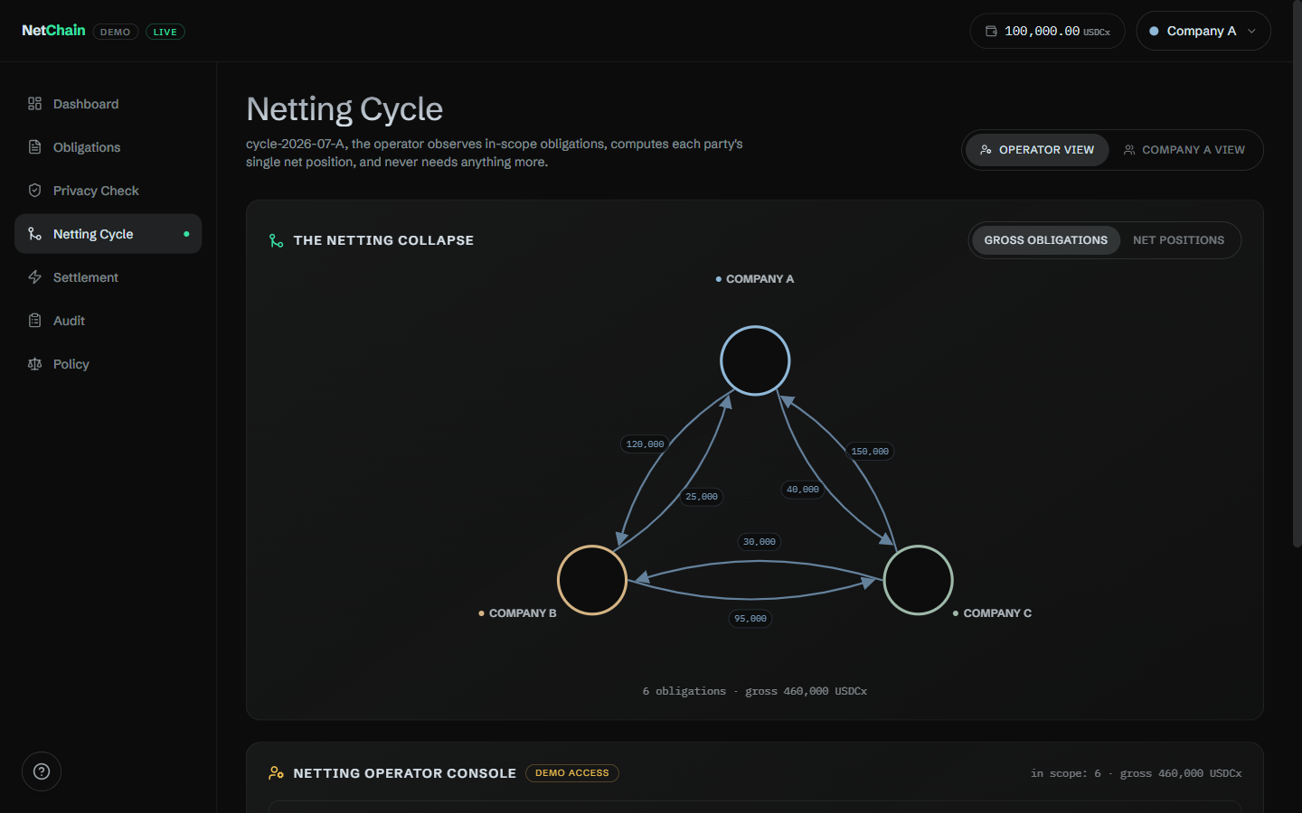
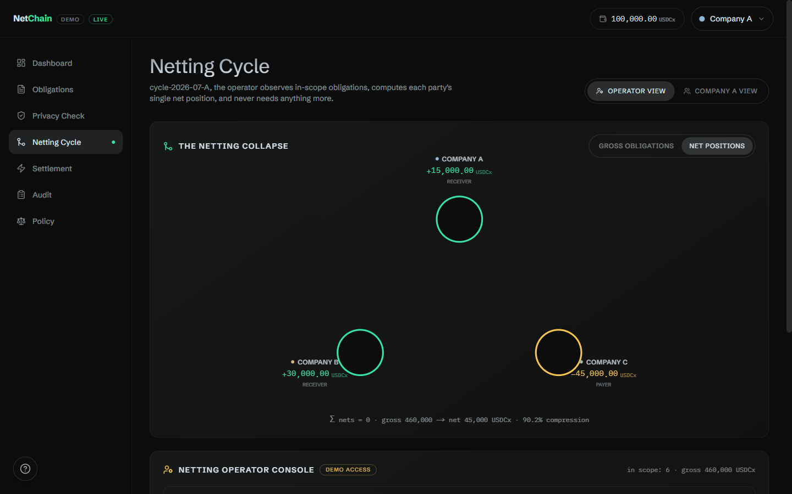
CORE CONCEPT
Multilateral netting: 460k gross collapses to 45k net
GROSS: 6 bilateral obligations, 460,000 USDCx
NET: one figure per party, sum = 0
A owes B 120k, B owes C 95k, C owes A 150k, A owes C 40k, B owes A 25k, C owes B 30k -> A +15k B +30k C -45k (Σ = 0)
90% less value has to actually move. The graph animates the collapse live (Gross <-> Net toggle).
NetChain deep dive
netchain.vercel.app

Slide 6
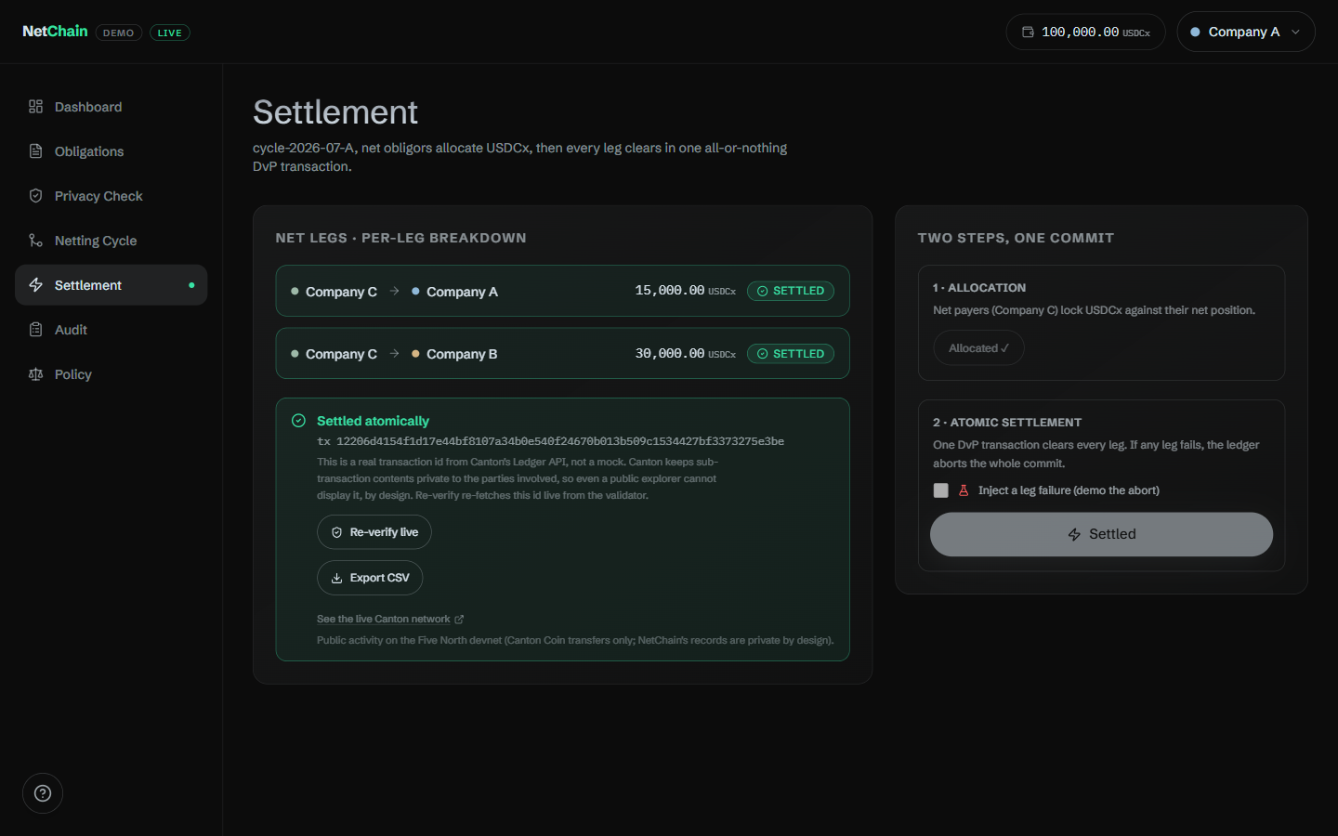
CORE CONCEPT
Atomic settlement: all legs move, or none do
Settle moves every party's balance inside ONE Canton transaction.
Any failed assertion rolls back the WHOLE commit: no partial fills, no timing risk.
An over-cap attempt aborts in-transaction and moves nothing, not by a cent, verifiable on the balances.
This all-or-nothing DvP is the whole reason to settle on a ledger instead of over SWIFT.
Funding is checked first; an underfunded party is dropped and the solvent remainder re-nets and settles.
Settlement page: every net leg flips to Settled together, with a real tx id
NetChain deep dive
netchain.vercel.app

Slide 7
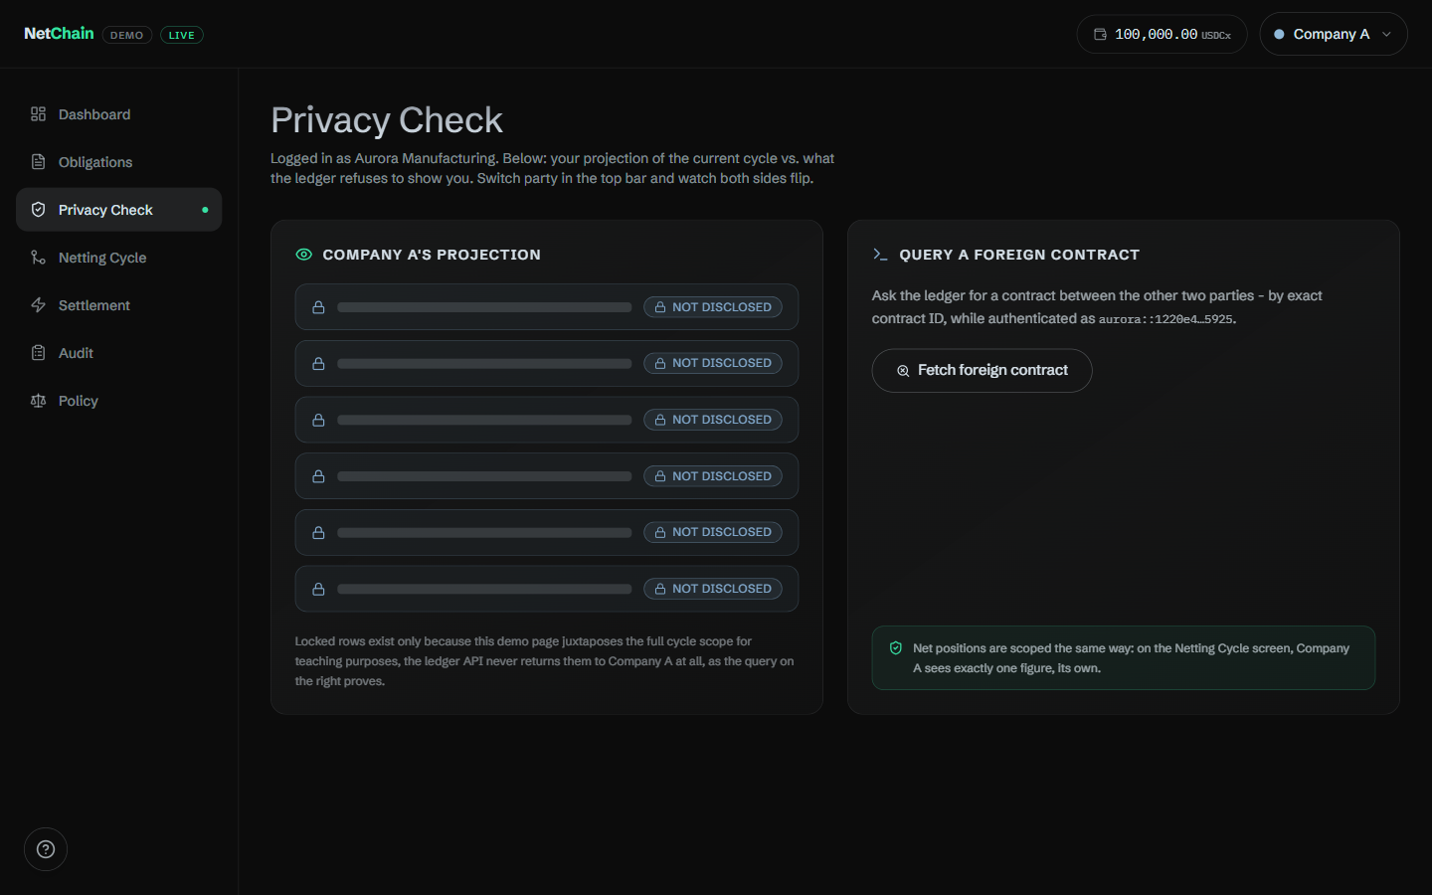
CORE CONCEPT
Per-party privacy is a ledger property, not a UI mask
How it works
Canton projects each party only the sub-transactions it is a stakeholder in.
Ask for a foreign contract as C: the validator returns HTTP 404, it will not even confirm it exists.
Same id as Company A (a real stakeholder): resolves 200 with the amount.
There is no `if (party != owner) hide()` in app code, the boundary is the node's.
Impossible to fake with database access control, where a DB admin can always peek.
Privacy Check: as Company C, an A<->B contract returns a real 404
NetChain deep dive
netchain.vercel.app

Slide 8
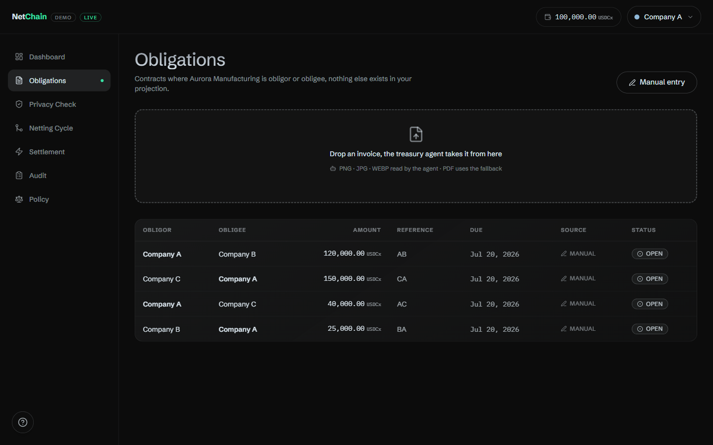
CAPABILITY
Obligations: from a raw invoice to an on-ledger contract
Drop an invoice image: an AI agent (NVIDIA NIM vision) reads amount, counterparty, due date, reference.
It proposes an on-ledger Obligation, stamped source = agent, with a UETR-style trace id.
Manual entry is always right there as the always-works fallback.
Signed by the obligor; observed only by the obligee and operator, so no third party sees it.
Obligations table, each row is a real Daml Obligation in this party's projection
NetChain deep dive
netchain.vercel.app

Slide 9
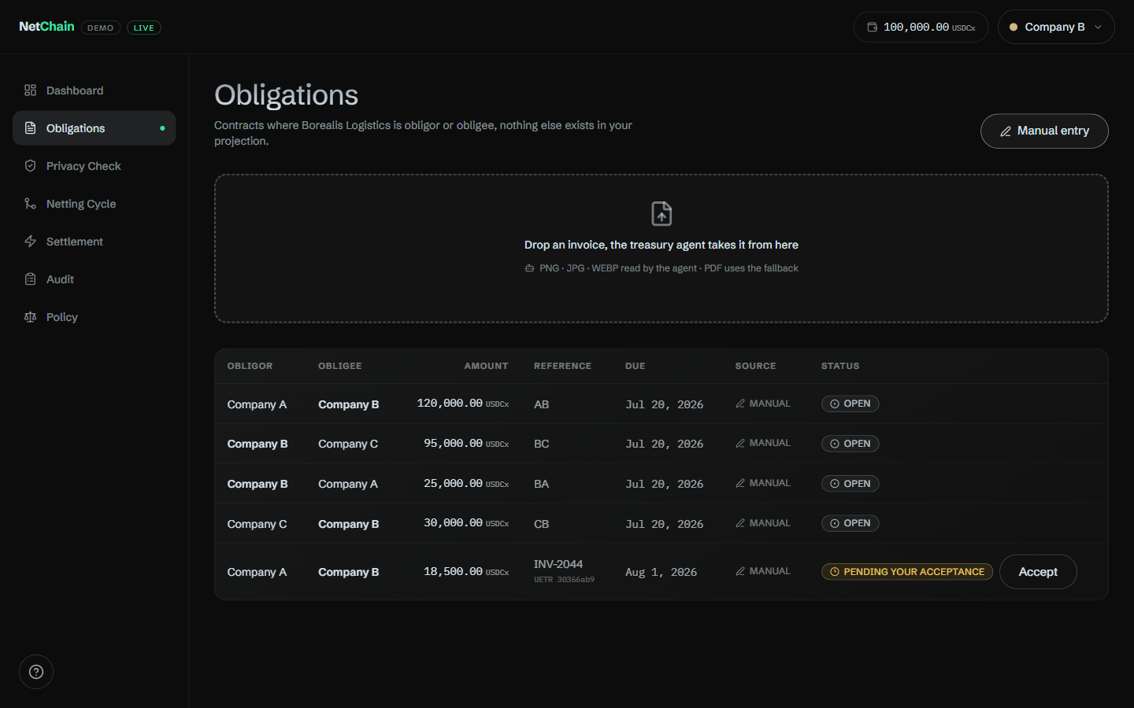
TRUST SAFEGUARD
Bilateral confirmation: a fake invoice can't settle
1 Obligor records it
lands PENDING, excluded from netting
2 Obligee Accepts (on-ledger)
the second signature
3 Now it nets
both parties have consented
Enforced in the contract: ComputeNetPositions / Settle only count obligations where accepted = Some True. Neither a rogue party nor an AI agent can fabricate a debt that settles.
As the obligee: 'Pending your acceptance' with an Accept button
NetChain deep dive
netchain.vercel.app

Slide 10
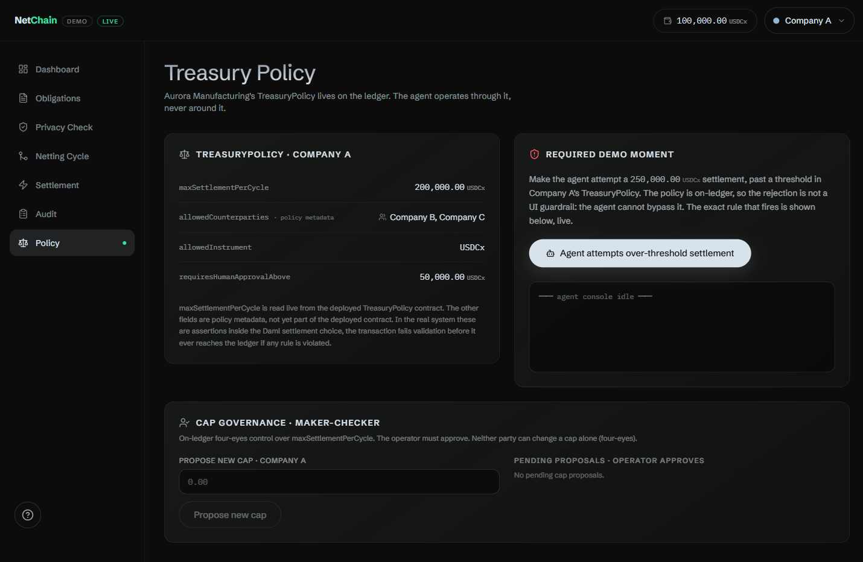
GOVERNANCE
TreasuryPolicy cap + maker-checker cap changes
The cap the ledger enforces
maxSettlementPerCycle is asserted INSIDE the Settle transaction, not in the UI.
Over-cap settle is refused on-ledger; no override flag exists for an agent to set.
Changing a cap: four-eyes
Party proposes a new cap (maker); operator approves (checker). Neither acts alone.
The operator still cannot unilaterally RAISE a cap, only approve what the party proposed.
The SOX / Basel / treasury segregation-of-duties standard, modeled on-ledger.
Policy page: the enforced cap + the maker-checker governance panel
NetChain deep dive
netchain.vercel.app

Slide 11
AUTOMATION
Netting runs itself, on a schedule
Vercel Cron
free daily, or an agent
/api/cron/net
CRON_SECRET-gated
Funding check
+ Settle
policy-bounded
Self-heal
reseed to clean
The operator does not have to click every time: a scheduled job runs the whole cycle and settles.
Automating the trigger changes nothing about correctness, the cap and funding checks are enforced on-ledger regardless of who fires it.
Scheduled batch windows are also the industry-correct model (CLS / CHIPS run daily cutoffs); netting compresses more with batching.
After each run it self-heals the public demo back to the clean open state, so it is always ready to show.
NetChain deep dive
netchain.vercel.app

Slide 12
AGENTIC (TRACK 3)
An AI agent drives it, bounded by the ledger
AI agent
Claude or any MCP client
NetChain MCP
16 tools, thin pass-through
HTTP API
same routes as UI
Canton
the ledger decides
TreasuryPolicy blocks over-cap
The agent can propose any obligation, cycle, or settlement, list/create/accept/net/settle, propose or approve caps.
It CANNOT make the ledger accept an over-cap settle, raise its own cap, or self-approve a debt: those live in the Daml, not the prompt.
'AI proposes, the ledger disposes.' A concrete answer to agent authority without an unbounded blast radius.
NetChain deep dive
netchain.vercel.app

Slide 13
PROOF
Every settlement is a verifiable on-ledger fact
updateId = the ledger receipt
GET /api/ledger/verify?updateId=1220ab1b… {
"confirmed": true,
"effectiveAt": "2026-07-12T07:29:51Z",
"validator":
"ledger-api.validator.devnet…fivenorth.io"
}
Settle returns a real updateId from the validator's submit-and-wait, not a client-side hash.
'Re-verify live' re-fetches that exact id via /v2/updates/update-by-id: confirmed = true + effectiveAt.
A bogus/forged id returns confirmed = false.
Look it up on Lighthouse (a public Canton explorer): the updateId resolves to its envelope, verdict ACCEPTED, round, acting parties; only the amounts stay private.
NetChain deep dive
netchain.vercel.app

Slide 14
LIVE ON CANTON
Shipped as live Smart Contract Upgrades, no downtime
v1.0.0
netting + atomic settle + privacy
v1.0.1
settle-correctness fix
v1.0.2
provenance + UETR trace
v1.0.3
bilateral confirmation
v1.0.4
maker-checker cap governance
Adding Optional fields, choices, and whole templates as valid upgrades, the running demo was never taken down. Each step is reversible by pointing the app back at the prior package id.
current: netchain v1.0.4 · 8ae58d7ccd979213f10c78a328da0f7edfa3614060a4cf7250216837a7768cbb
NetChain deep dive
netchain.vercel.app

Slide 15
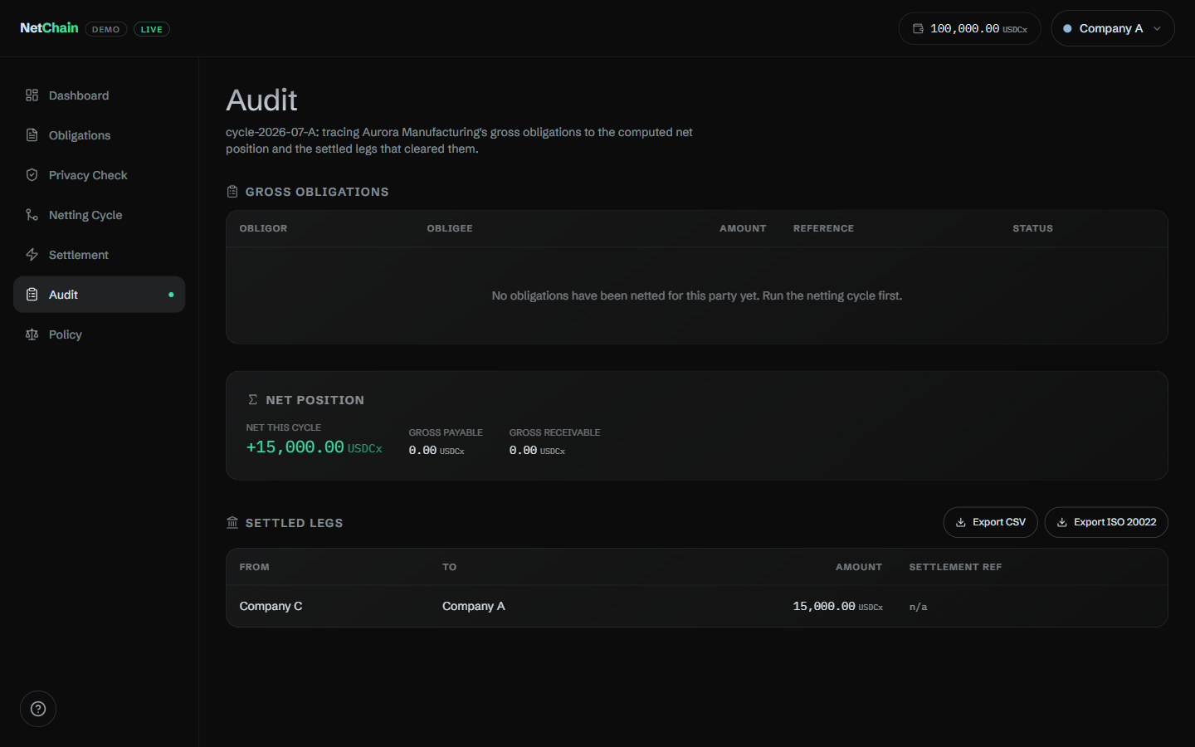
CAPABILITY
Audit trail + regulator-ready exports
The full chronological activity feed comes from real on-chain transaction history (/v2/updates).
Net positions are recovered from history, so the audit view survives Settle archiving them.
Export settled legs as CSV and as ISO 20022 pain.001 (one PmtInf per debtor), the format banks already ingest.
This is the reconciliation surface a treasury/SSC team lives in.
Audit page: gross obligations, net positions, and settled legs, all from the ledger
NetChain deep dive
netchain.vercel.app

Slide 16
HONEST FRAMING
"If the operator sees the graph, what's private?"
Counterparty privacy is the guarantee, and the valuable kind: A and C never see each other (the live 404). That is what a treasurer needs, your positions never leak to a competitor.
The operator is a trusted, regulated intermediary, the same model as CLS and every netting center today, not an eavesdropper.
That already beats incumbents (Kyriba / SAP), a ledger boundary instead of database access control.
Removing even operator visibility (operator-blind netting via MPC / ZK) is named as roadmap, honestly, in docs/SETTLEMENT_DESIGN.md, not faked.
Lead with the true claim, not overclaim
NetChain deep dive
netchain.vercel.app

Slide 17
WHERE IT SITS
The intersection nobody else occupies
Netting incumbents
DLT settlement players
Kyriba, Coprocess/GTreasury, SAP In-House Cash.
Compute the net, then hand off to non-atomic bank rails.
No cryptographic per-party privacy.
Partior, Fnality, J.P. Morgan Kinexys.
Settle atomically, but only bilaterally.
No confidential N-party net computation.
NetChain sits at both: confidential N-party netting + atomic settlement of every net leg, on Canton. J.P. Morgan bringing JPMD to Canton and Ripple/GTreasury fusing netting with a rail are independent 2026 validation that this combination is real and not yet commoditized.
NetChain deep dive
netchain.vercel.app

Slide 18
RECAP
Everything, on one slide
Confidential netting 460k -> 45k, counterparties blind
Atomic settlement all legs or none, one commit
Per-party privacy real 404, ledger-enforced
Bilateral confirmation obligee accepts, anti-fake-invoice
Non-bypassable policy cap asserted in Settle
Maker-checker caps four-eyes governance
Automated netting scheduled, self-healing
Agent-usable (MCP) 16 tools, ledger-bounded
Verifiable + upgradable real updateIds, live SCU chain
NetChain deep dive
netchain.vercel.app

Slide 19
Settle everything, reveal nothing.
Confidential netting · atomic settlement · bilateral consent · maker-checker limits · a policy the ledger enforces · an agent that can't overstep it.
Try it: netchain.vercel.app Repo: github.com/manjeetsharma0796/Net-chain
Live on Canton Devnet · package netchain v1.0.4 · every screen here is the real running app.

