Slide 1
Objective
Build a model that predicts the number of hits per session based on a database of user sessions of Trivago
Methodology
Cross Industry Standard Process for Data Mining (CRISP-DM)
Data Understanding
Data Preparation
Modeling
Evaluation
Results
After testing some models, I slected Gradient Boosting with the best Mean Squared Error
Manjeet Singh
Data Scientist- Icreon Communications

Slide 2
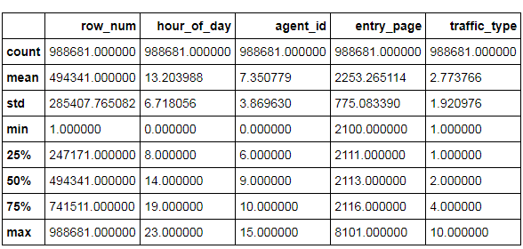
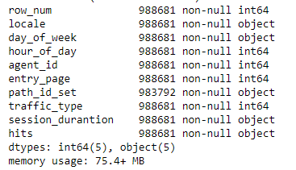
Lets have a glance at the dataset

Slide 3
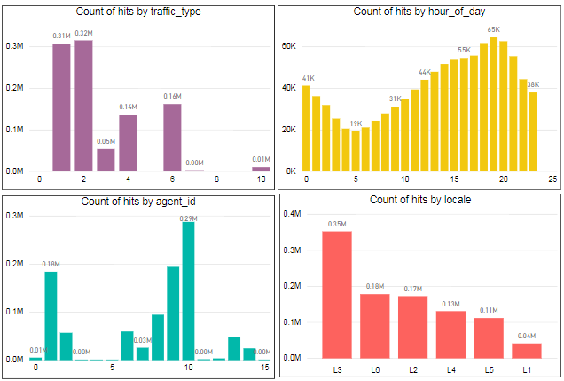
EDA

Slide 4
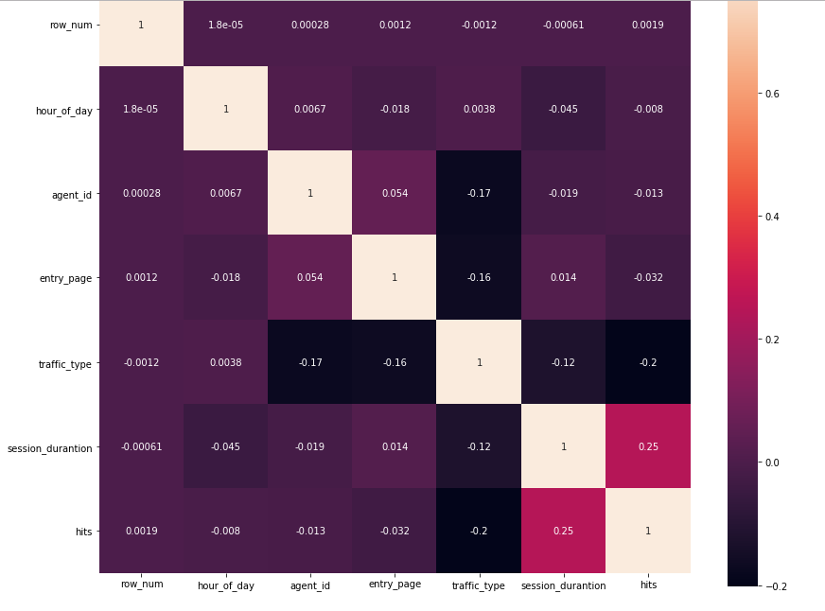

Slide 5
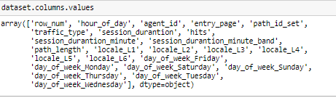
Feature Engineering
Created new feature named as path_length.
path_length (continuous): count how many paths id were visited from 'path_id_set'
We have to transform discrete features on binaries (one new column for each category of the feature)
Expand these two columns-
Locale
Day_of_week
List of column names after feature engineering and EDA – We have total 24 columns

Slide 6
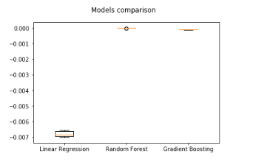

Modelling
Created Training and test dataset

Slide 7

Based on the comparison between these three models, the best performance achieved was from the Gradient Boosting algorithm. So, let's apply it and take a look deeper on the model parameters below.
Model’s Performance on Training and test set

