Slide 1

Anugrith V.
SCM Specialist, MBB LC IMS
Notes:
what is Git in a nutshell? This is an important section to absorb, because if you understand what Git is and the fundamentals of how it works, then using Git effectively will probably be much easier for you.
As you learn Git, try to clear your mind of the things you may know about other VCSs, such as Subversion and Perforce; doing so will help you avoid subtle confusion when using the tool.

Slide 2
Git Branching
Agenda
Branches in a Nutshell
Basic Branching and Merging
Branch Management
Branching Workflows
Remote Branches
Rebasing
Rebasing Vs Merging
Notes:
Nearly every VCS has some form of branching support.
Branching means you diverge from the main line of development and continue to do work without messing with that main line.
In many VCS tools, this is a somewhat expensive process, often requiring you to create a new copy of your source code directory, which can take a long time for large projects.
Some people refer to Git’s branching model as its “killer feature,” and it certainly sets Git apart in the VCS community.
Why is it so special? The way Git branches is incredibly lightweight, making branching operations nearly instantaneous, and switching back and forth between branches generally just as fast.
Unlike many other VCSs, Git encourages workflows that branch and merge often, even multiple times in a day.
Understanding and mastering this feature gives you a powerful and unique tool and can entirely change the way that you develop.

Slide 3
Branches in a Nutshell
Git doesn’t store data as a series of changesets or differences, but instead as a series of snapshots.
$ git add README LICENSE test.rb
$ git commit -m 'initial commit of my project’
1
3
2
Notes:
To really understand the way Git does branching, we need to take a step back and examine how Git stores its data.
<1st animation>
Git doesn’t store data as a series of changesets or differences, but instead as a series of snapshots.
When you make a commit, Git stores a commit object that contains a pointer to the snapshot of the content you staged.
This object also contains the author’s name and email, the message that you typed, and pointers to the commit or commits that directly came before this commit (its parent or parents): zero parents for the initial commit, one parent for a normal commit, and multiple parents for a commit that results from a merge of two or more branches.
To visualize this, let’s assume that you have a directory containing three files, and you stage them all and commit.
<2nd animation>
Staging the files checksums each one (the SHA-1 hash), stores that version of the file in the Git repository (Git refers to them as blobs), and adds that checksum to the staging area:
When you create the commit by running git commit, Git checksums each subdirectory (in this case, just the root project directory) and stores those tree objects in the Git repository.
<3rd animation>
Git then creates a commit object that has the metadata and a pointer to the root project tree so it can re-create that snapshot when needed.
Your Git repository now contains five objects:
<4th animation>
one blob for the contents of each of your three files,
<5th animation>
one tree that lists the contents of the directory and specifies which file names are stored as which blobs, and
<6th animation>
one commit with the pointer to that root tree and all the commit metadata.

Slide 4
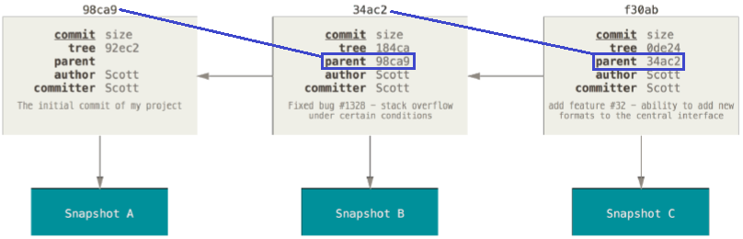
Branches in a Nutshell
Commits and their parents
A branch in Git is simply a lightweight movable pointer to one of these commits
The default branch name in Git is master
Notes:
If you make some changes and commit again, the next commit stores a pointer to the commit that came immediately before it.
A branch in Git is simply a lightweight movable pointer to one of these commits. The default branch name in Git is master.
As you start making commits, you’re given a master branch that points to the last commit you made. Every time you commit, it moves forward automatically.

Slide 5
Branches in a Nutshell
Branch and its commit history
Notes:
The “master” branch in Git is not a special branch. It is exactly like any other branch.
The only reason nearly every repository has one is that the git init command creates it by default and most people don’t bother to change it.
HEAD is nothing but the current active branch in that snapshot OR work copy.

Slide 6
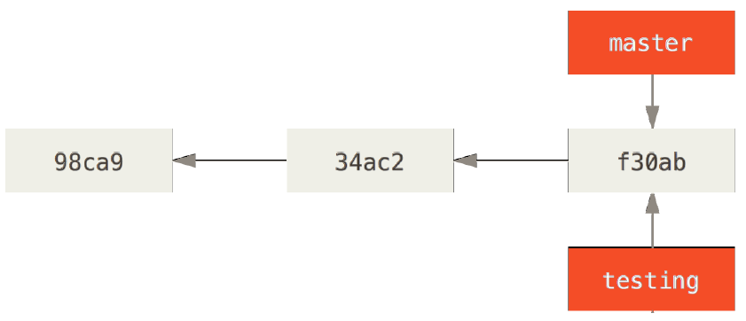
Branches in a Nutshell
Creating a New Branch
$ git branch testing
How does Git know what branch you’re currently on?
It keeps a special pointer called HEAD
$ git log --oneline --decorate
f30ab (HEAD, master, testing) add feature #32 - ability to add new
34ac2 fixed bug #1328 - stack overflow under certain conditions
98ca9 initial commit of my project
Notes:
What happens if you create a new branch?
Well, doing so creates a new pointer for you to move around. Let’s say you create a new branch called testing. You do this with the git branch command:
<1st animation>
This creates a new pointer at the same commit you’re currently on.
<2nd animation>
How does Git know what branch you’re currently on? It keeps a special pointer called HEAD.
Note that this is a lot different than the concept of HEAD in other VCSs you may be used to, such as Subversion or CVS.
In Git, this is a pointer to the local branch you’re currently on.
In this case, you’re still on master. The git branch command only created a new branch – it didn’t switch to that branch.
<3rd animation>
You can easily see this by running a simple git log command that shows you where the branch pointers are pointing. This option is called --decorate.
<4th animation>
You can see the “master” and “testing” branches that are right there next to the f30ab commit.

Slide 7
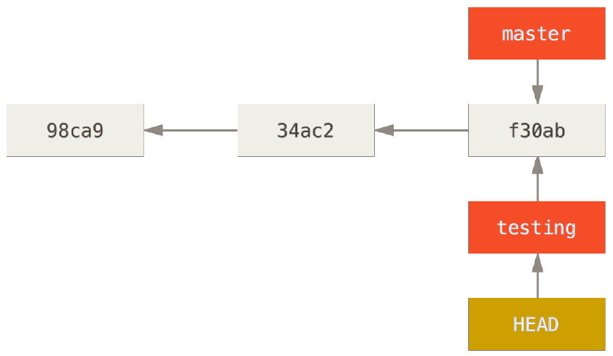
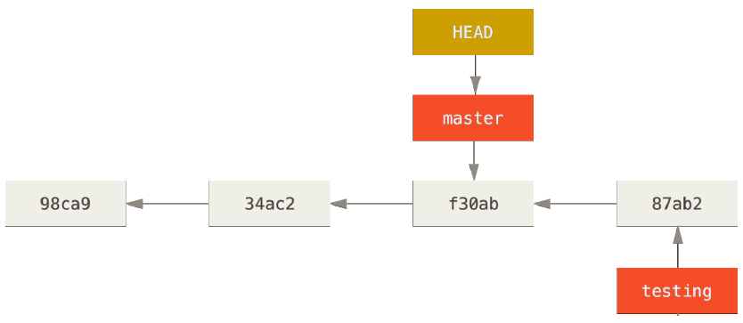
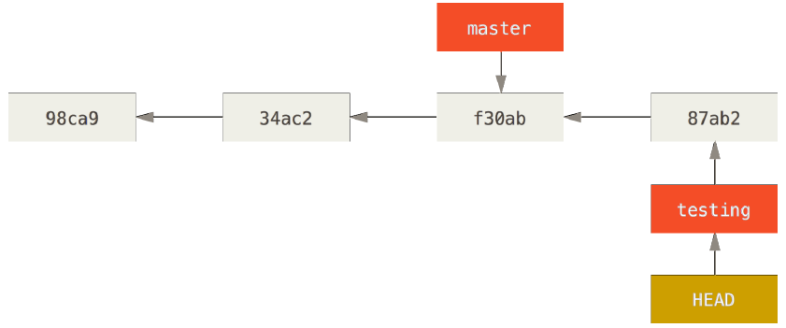
Branches in a Nutshell
Switching Branches
$ git checkout testing → This moves HEAD to point to the testing branch.
$ vim test.rb
$ git commit -a -m 'made a change‘ → testing branch has moved forward
$ git checkout master → HEAD moved to master branch and working directory
back to the snapshot that master points to
Notes:
To switch to an existing branch, you run the git checkout command. Let’s switch to the new testing branch:
<1st animation>
let’s do another commit.
<2nd animation>
This is interesting, because now your testing branch has moved forward, but your master branch still points to the commit you were on when you ran git checkout to switch branches.
Let’s switch back to the master branch:
<3rd animation>
That command did two things. It moved the HEAD pointer back to point to the master branch, and it reverted the files in your working directory back to the snapshot that master points to.
This also means the changes you make from this point forward will diverge from an older version of the project.
It essentially rewinds the work you’ve done in your testing branch so you can go in a different direction.
It’s important to note that when you switch branches in Git, files in your working directory will change.
If you switch to an older branch, your working directory will be reverted to look like it did the last time you committed on that branch.
If Git cannot do it cleanly, it will not let you switch at all.

Slide 8
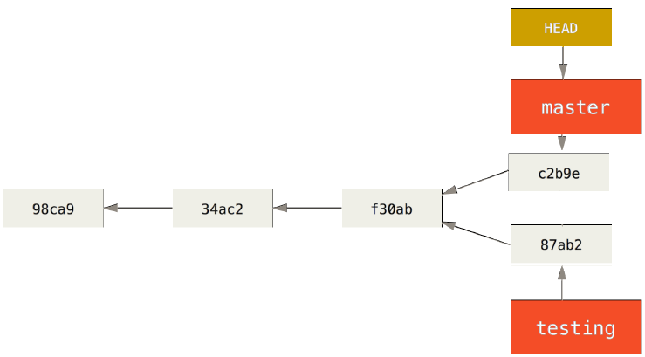
Branches in a Nutshell
Switching Branches
$ vim test.rb
$ git commit -a -m 'made other changes‘
$ git log --oneline --decorate --graph --all
* c2b9e (HEAD, master) made other changes
| * 87ab2 (testing) made a change
|/
* f30ab add feature #32 - ability to add new formats to the
* 34ac2 fixed bug #1328 - stack overflow under certain conditions
* 98ca9 initial commit of my project
Notes:
Let’s make a few changes and commit again.
<1st animation>
Now your project history has diverged.
<2nd animation>
You created and switched to a branch, did some work on it, and then switched back to your main branch and did other work.
Both of those changes are isolated in separate branches: you can switch back and forth between the branches and merge them together when you’re ready.
And you did all that with simple branch, checkout, and commit commands.
You can also see this easily with the git log command.
<3rd animation>
If you run git log --oneline --decorate --graph --all it will print out the history of your commits, showing where your branch pointers are and how your history has diverged.
Because a branch in Git is in actuality a simple file that contains the 40 character SHA-1 checksum of the commit it points to, branches are cheap to create and destroy.
Creating a new branch is as quick and simple as writing 41 bytes to a file (40 characters and a newline).
This is in sharp contrast to the way most older VCS tools branch, which involves copying all of the project’s files into a second directory.
This can take several seconds or even minutes, depending on the size of the project, whereas in Git the process is always instantaneous.
Also, because we’re recording the parents when we commit, finding a proper merge base for merging is automatically done for us and is generally very easy to do.
These features help encourage developers to create and use branches often. Let’s see why you should do so.

Slide 9
Basic Branching and Merging
Workflow
1. Do work on a web site.
2. Create a branch for a new story you’re working on.
3. Do some work in that branch.
At this stage, you’ll receive a call that another issue is critical and you need a hotfix.
1. Switch to your production branch.
2. Create a branch to add the hotfix.
3. After it’s tested, merge the hotfix branch, and push to production branch.
4. Switch back to your original story and continue working.
Notes:
Let’s go through a simple example of branching and merging with a workflow that you might use in the real world.
You’ll follow these steps:
<1st animation>
1. Do work on a web site.
2. Create a branch for a new story you’re working on.
3. Do some work in that branch.
<2nd animation>
At this stage, you’ll receive a call that another issue is critical and you need a hotfix. You’ll do the following:
<3rd animation>
1. Switch to your production branch.
2. Create a branch to add the hotfix.
3. After it’s tested, merge the hotfix branch, and push to production.
4. Switch back to your original story and continue working.

Slide 10
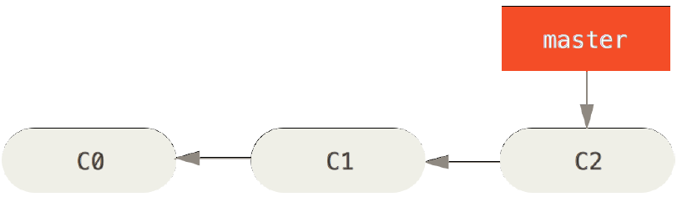
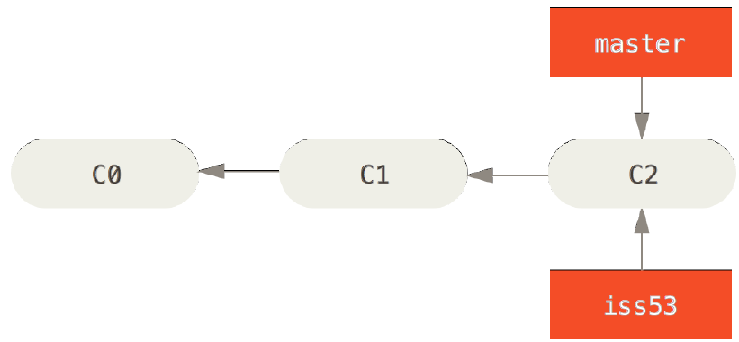
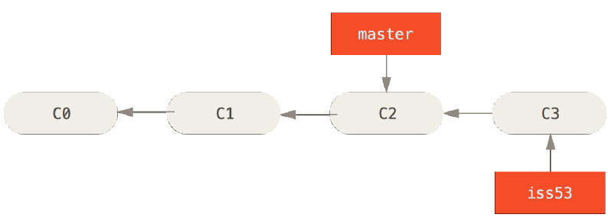
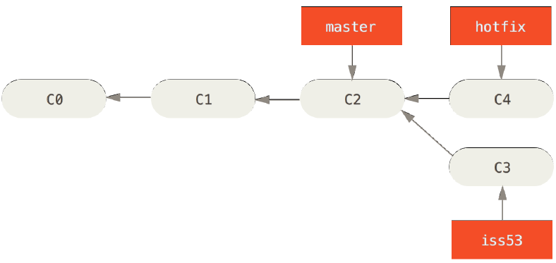
Basic Branching and Merging
Basic Branching
$ git checkout -b iss53
Switched to a new branch "iss53“
This is shorthand for:
$ git branch iss53
$ git checkout iss53
$ vim index.html
$ git commit -a -m 'added a new footer [issue 53]'
$ git checkout master
Switched to branch 'master'
$ git checkout -b hotfix
Switched to a new branch 'hotfix'
$ vim index.html
$ git commit -a -m 'fixed the broken email address‘
[hotfix 1fb7853] fixed the broken email address
1 file changed, 2 insertions(+)
Notes:
First, let’s say you’re working on your project and have a couple of commits already.
You’ve decided that you’re going to work on issue #53 in whatever issue tracking system your company uses.
To create a branch and switch to it at the same time, you can run the git checkout command with the -b switch:
<1st animation>
This is shorthand for:
git branch iss53 followed by git checkout iss53
You work on your web site and do some commits.
<2nd animation>
Doing so moves the iss53 branch forward, because you have it checked out (that is, your HEAD is pointing to it):
Now you get the call that there is an issue with the web site, and you need to fix it immediately.
With Git, you don’t have to deploy your fix along with the iss53 changes you’ve made, and you don’t have to put a lot of effort into reverting those changes before you can work on applying your fix to what is in production. All you have to do is switch back to your master branch.
However, before you do that, note that if your working directory or staging area has uncommitted changes that conflict with the branch you’re checking out, Git won’t let you switch branches.
It’s best to have a clean working state when you switch branches. There are ways to get around this (namely, stashing and commit amending) that we’ll cover later on.
Let’s assume you’ve committed all your changes, so you can switch back to your master branch:
<3rd animation>
At this point, your project working directory is exactly the way it was before you started working on issue #53, and you can concentrate on your hotfix.
This is an important point to remember: when you switch branches, Git resets your working directory to look like it did the last time you committed on that branch.
It adds, removes, and modifies files automatically to make sure your working copy is what the branch looked like on your last commit to it.
Next, you have a hotfix to make. Let’s create a hotfix branch on which to work until it’s completed:
<4th animation>
You can run your tests, make sure the hotfix is what you want.

Slide 11
Basic Branching and Merging
Basic Branching
$ git checkout master
$ git merge hotfix
Updating f42c576..3a0874c
Fast-forward
index.html | 2 ++
1 file changed, 2 insertions(+)
$ git branch -d hotfix
Deleted branch hotfix (3a0874c).
$ git checkout iss53
Switched to branch "iss53"
$ vim index.html
$ git commit -a -m 'finished the footer [issue 53]'
[iss53 ad82d7a] finished the footer [issue 53]
1 file changed, 1 insertion(+)
Notes:
After running tests successfully in hotfix branch, merge it back into your master branch to deploy to production. You do this with the git merge command:
<1st animation>
You’ll notice the phrase “fast-forward” in that merge. Because the commit pointed to by the branch you merged in was directly upstream of the commit you’re on, Git simply moves the pointer forward.
To phrase that another way, when you try to merge one commit with a commit that can be reached by following the first commit’s history, Git simplifies things by moving the pointer forward
because there is no divergent work to merge together – this is called a “fast-forward.”
<2nd animation>
Your change is now in the snapshot of the commit pointed to by the master branch, and you can deploy the fix.
After your important fix is deployed, you’re ready to switch back to the work you were doing before you were interrupted.
However, first you’ll delete the hotfix branch, because you no longer need it – the master branch points at the same place. You can delete it with the -d option to git branch:
<3rd animation>
Now you can switch back to your work-in-progress branch on issue #53 and continue working on it.
<4th animation>
<5h animation>
It’s worth noting here that the work you did in your hotfix branch is not contained in the files in your iss53 branch.
If you need to pull it in, you can merge your master branch into your iss53 branch by running git merge master, or you can wait to integrate those changes until you decide to pull the
iss53 branch back into master later.

Slide 12
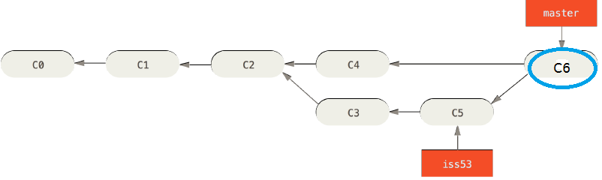
Basic Branching and Merging
Basic Merging
$ git checkout master
Switched to branch 'master'
$ git merge iss53
Merge made by the 'recursive' strategy.
README | 1 +
1 file changed, 1 insertion(+)
$ git branch -d iss53
Deleted branch iss53 (3b2564f).
Notes:
Suppose you’ve decided that your issue #53 work is complete and ready to be merged into your master branch.
In order to do that, you’ll merge in your iss53 branch, much like you merged in your hotfix branch earlier.
All you have to do is check out the branch you wish to merge into and then run the git merge command:
<1st animation>
This looks a bit different than the hotfix merge you did earlier. In this case, your development history has diverged from some older point.
Because the commit on the branch you’re on isn’t a direct ancestor of the branch you’re merging in, Git has to do some work.
In this case, Git does a simple three-way merge, using the two snapshots pointed to by the branch tips and the common ancestor of the two.
<2nd animation>
Instead of just moving the branch pointer forward, Git creates a new snapshot that results from this three-way merge and automatically creates a new commit that points to it.
<3rd animation>
This is referred to as a merge commit, and is special in that it has more than one parent.
It’s worth pointing out that Git determines the best common ancestor to use for its merge base; this is different than older tools like CVS or Subversion (before version 1.5), where the developer doing the merge had to figure out the best merge base for themselves.
This makes merging a heck of a lot easier in Git than in these other systems.
Now that your work is merged in, you have no further need for the iss53 branch.
<4th animation>
You can close the ticket in your ticket-tracking system, and delete the branch.

Slide 13
Basic Branching and Merging
Basic Merge Conflicts
$ git merge iss53
Auto-merging index.html
CONFLICT (content): Merge conflict in index.html
Automatic merge failed; fix conflicts and then commit the result.
$ git status
On branch master
You have unmerged paths.
(fix conflicts and run "git commit")
Unmerged paths:
(use "git add <file>..." to mark resolution)
both modified: index.html
no changes added to commit (use "git add" and/or "git commit -a")
<div id="footer">
please contact us at email.support@github.com
</div>
<<<<<<< HEAD:index.html
<div id="footer">contact : email.support@github.com</div>
=======
<div id="footer">
please contact us at support@github.com
</div>
>>>>>>> iss53:index.html
Notes:
Occasionally, this process doesn’t go smoothly. If you changed the same part of the same file differently in the two branches you’re merging together, Git won’t be able to merge them cleanly.
If your fix for issue #53 modified the same part of a file as the hotfix, you’ll get a merge conflict that looks something like this:
<1st animation>
Git hasn’t automatically created a new merge commit. It has paused the process while you resolve the conflict.
If you want to see which files are unmerged at any point after a merge conflict, you can run git status:
<2nd animation>
Anything that has merge conflicts and hasn’t been resolved is listed as unmerged. Git adds standard conflict-resolution markers to the files that have conflicts, so you can open them manually and resolve those conflicts. Your file contains a section that looks something like this:
<3rd animation>
This means the version in HEAD (your master branch, because that was what you had checked out when you ran your merge command) is the top part of that block
(everything above the =======),
while the version in your iss53 branch looks like everything in the bottom part.
In order to resolve the conflict, you have to either choose one side or the other or merge the contents yourself.
For instance, you might resolve this conflict by replacing the entire block with this:
<4th animation>
This resolution has a little of each section, and the <<<<<<<, =======, and >>>>>>> lines have been completely removed.
After you’ve resolved each of these sections in each conflicted file, run git add on each file to mark it as resolved.
Staging the file marks it as resolved in Git.

Slide 14
Basic Branching and Merging
Basic Merge Conflicts
$ git mergetool
This message is displayed because 'merge.tool' is not configured.
See 'git mergetool --tool-help' or 'git help config' for more details.
'git mergetool' will now attempt to use one of the following tools:
opendiff kdiff3 tkdiff xxdiff meld tortoisemerge gvimdiff diffuse diffmerge ecmerge p4merge
Merging:
index.html
Normal merge conflict for 'index.html':
{local}: modified file
{remote}: modified file
Hit return to start merge resolution tool (opendiff):
$ git status
On branch master
All conflicts fixed but you are still merging.
(use "git commit" to conclude merge)
Changes to be committed:
modified: index.html
Notes:
If you want to use a graphical tool to resolve these issues, you can run git mergetool, which fires up an appropriate visual merge tool and walks you through the conflicts:
<1st animation>
If you want to use a merge tool other than the default (Git chose opendiff in this case because the command was run on a Mac), you can see all the supported tools listed at the top after “one of the following tools.” Just type the name of the tool you’d rather use.
After you exit the merge tool, Git asks you if the merge was successful. If you tell the script that it was, it stages the file to mark it as resolved for you.
You can run git status again to verify that all conflicts have been resolved:
<2nd animation>
If you’re happy with that, and you verify that everything that had conflicts has been staged, you can type git commit to finalize the merge commit.

Slide 15
Branch Management
$ git branch
iss53
* master
testing
* character that prefixes the master branch: it indicates the branch that you currently have checked out
$ git branch –v (To see last commit in each branch)
iss53 93b412c fix javascript issue
* master 7a98805 Merge branch 'iss53'
testing 782fd34 add scott to the author list in the readmes
$ git branch –-merged (Already merged in iss53 branch)
iss53
* master
$ git branch --no-merged (Branch testing that isn’t merged yet)
testing
$ git branch -d testing (denies branch deletion that is not merged in)
error: The branch 'testing' is not fully merged.
If you are sure you want to delete it, run 'git branch -D testing'.
Notes:
Now that you’ve created, merged, and deleted some branches, let’s look at some branch-management tools that will come in handy when you begin using branches all the time.
The git branch command does more than just create and delete branches. If you run it with no arguments, you get a simple listing of your current branches:
<1st animation>
Notice the * character that prefixes the master branch: it indicates the branch that you currently have checked out (i.e., the branch that HEAD points to).
This means that if you commit at this point, the master branch will be moved forward with your new work.
To see the last commit on each branch, you can run git branch -v:
<2nd animation>
The useful --merged and --no-merged options can filter this list to branches that you have or have not yet merged into the branch you’re currently on.
To see which branches are already merged into the branch you’re on, you can run git branch --merged:
<3rd animation>
Because you already merged in iss53 earlier, you see it in your list.
Branches on this list without the * in front of them are generally fine to delete with git branch -d; you’ve already incorporated their work into another branch, so you’re not going to lose anything.
To see all the branches that contain work you haven’t yet merged in, you can run git branch --no-merged:
<4th animation>
This shows your other branch. Because it contains work that isn’t merged in yet, trying to delete it with git branch -d will fail:
<5th animation>
If you really do want to delete the branch and lose that work, you can force it with -D, as the helpful message points out.

Slide 16
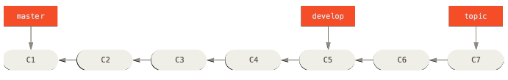
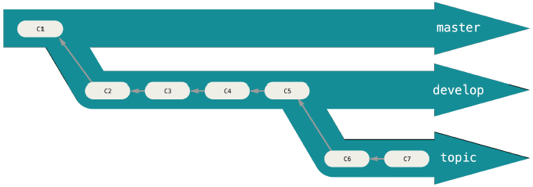
Branching Workflows
Long-Running Branches
A linear view of progressive-stability branching
A silo view of progressive-stability branching
Notes:
Now that you have the basics of branching and merging down, what can or should you do with them?
In this section, we’ll cover some common workflows that this lightweight branching makes possible, so you can decide if you would like to incorporate it into your own development cycle.
<1st animation>
Because Git uses a simple three-way merge, merging from one branch into another multiple times over a long period is generally easy to do.
This means you can have several branches that are always open and that you use for different stages of your development cycle; you can merge regularly from some of them into others.
Many Git developers have a workflow that embraces this approach, such as having only code that is entirely stable in their master branch – possibly only code that has been or will be released. They have another parallel branch named develop or next that they work from or use to test stability – it isn’t necessarily always stable, but whenever it gets to a stable state, it can be
merged into master.
It’s used to pull in topic branches (short-lived branches, like your earlier iss53 branch) when they’re ready, to make sure they pass all the tests and don’t introduce bugs.
In reality, we’re talking about pointers moving up the line of commits you’re making. The stable branches are farther down the line in your commit history, and the bleeding-edge branches are farther up the history.
<2nd animation>
It’s generally easier to think about them as work silos, where sets of commits graduate to a more stable silo when they’re fully tested.
You can keep doing this for several levels of stability.
Having multiple long-running branches isn’t necessary, but it’s often helpful, especially when you’re dealing with very large or complex projects.

Slide 17
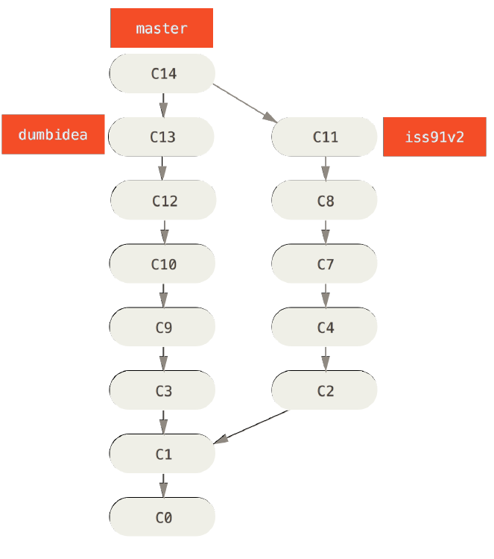
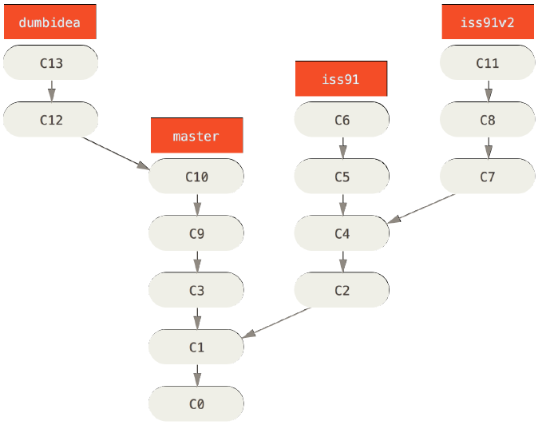
Branching Workflows
Topic Branches
All these branches are local
Consider both dumbidea and iss91 changes to master branch ➔
Notes:
Topic branches, however, are useful in projects of any size.
A topic branch is a short-lived branch that you create and use for a single particular feature or related work.
This is something you’ve likely never done with a VCS before because it’s generally too expensive to create and merge branches.
But in Git it’s common to create, work on, merge, and delete branches several times a day.
You saw this in the last section with the iss53 and hotfix branches you created. You did a few commits on them and deleted them directly after merging them into your main branch.
This technique allows you to context-switch quickly and completely – because your work is separated into silos where all the changes in that branch have to do with that topic, it’s easier to see what has happened during code review and such. You can keep the changes there for minutes, days, or months, and merge them in when they’re ready, regardless of the order in which they were created or worked on.
<1st animation>
Consider an example of doing some work (on master), branching off for an issue (iss91), working on it for a bit, branching off the second branch to try another way of handling the same thing (iss91v2), going back to your master branch and working there for a while, and then branching off there to do some work that you’re not sure is a good idea (dumbidea branch). Your commit history will look something like this:
Now, let’s say you decide you like the second solution to your issue best (iss91v2); and you showed the dumbidea branch to your coworkers, and it turns out to be genius.
You can throw away the original iss91 branch (losing commits C5 and C6) and merge in the other two. Your history then looks like this:
<2nd animation>
It’s important to remember when you’re doing all this that these branches are completely local.
<3rd animation>
When you’re branching and merging, everything is being done only in your Git repository – no server communication is happening.

Slide 18
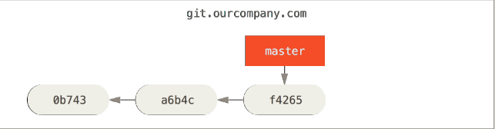
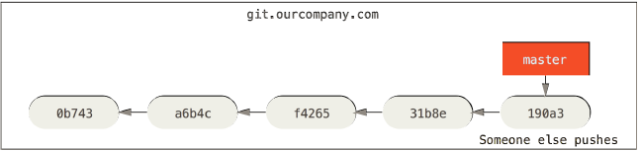
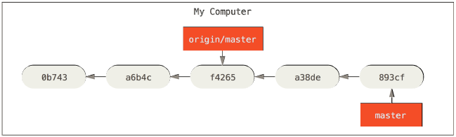
Remote Branches
Remote branches are references (pointers) to the state of branches in your remote repositories.
Notes:
Remote branches are references (pointers) to the state of branches in your remote repositories.
They’re local branches that you can’t move; they’re moved automatically for you whenever you do any network communication.
Remote branches act as bookmarks to remind you where the branches on your remote repositories were the last time you connected to them.
Let’s look at an example.
<1st animation>
Let’s say you have a Git server on your network at git.ourcompany.com.
If you clone from this,
<2nd animation>
Git’s clone command automatically names it origin for you, pulls down all its data, creates a pointer to where its master branch is, and names it origin/master locally.
<3rd animation>
Git also gives you your own local master branch starting at the same place as origin’s master branch, so you have something to work from.
If you do some work on your local master branch, and, in the meantime, someone else pushes to git.ourcompany.com
<4th animation>
and updates its master branch, then your histories move forward differently.
<5th animation>

Slide 19
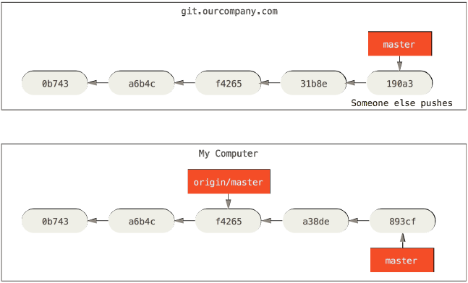
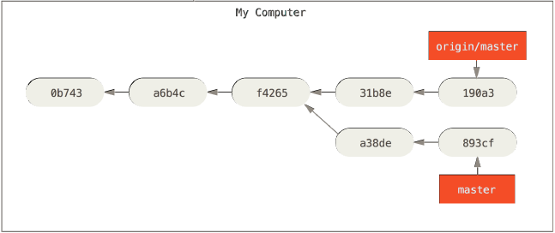
Remote Branches
31b8e & 190a3 someone else pushes
git fetch updates your remote references
a38de & 893cf changed in the local work copy
Notes:
Also, as long as you stay out of contact with your origin server, your origin/master pointer doesn’t move.
To synchronize your work, you run a git fetch origin command.
<1st animation>
This command looks up which server “origin” is (in this case, it’s git.ourcompany.com), fetches any data from it that you don’t yet have, and updates your local database, moving your origin/master pointer to its new, more up-to-date position.
<2nd animation>
git fetch command updates your remote references

Slide 20
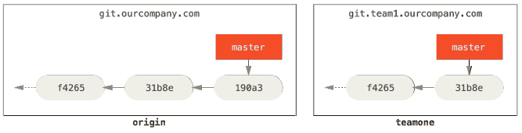

Remote Branches
Adding another server as Remote
Notes:
To demonstrate having multiple remote servers and what remote branches for those remote projects look like, let’s assume you have another internal Git server that is used only for development by one of your sprint teams.
<1st animation>
This server is at git.team1.ourcompany.com.
You can add it as a new remote reference to the project you’re currently working on by running the git remote add command as we covered in earlier module.
<2nd animation>
Name this remote teamone, which will be your shortname for that whole URL.
Now, you can run git fetch teamone to fetch everything the remote teamone server has that you don’t have yet.
<3rd animation>
Because that server has a subset of the data your origin server has right now, Git fetches no data but sets a remote branch called teamone/master to point to the commit that teamone has as its master branch.

Slide 21
Remote Branches
Pushing
$ git push origin serverfix (git push origin refs/heads/serverfix:refs/heads/serverfix)
Counting objects: 24, done.
Delta compression using up to 8 threads.
Compressing objects: 100% (15/15), done.
Writing objects: 100% (24/24), 1.91 KiB | 0 bytes/s, done.
Total 24 (delta 2), reused 0 (delta 0)
To https://github.com/schacon/simplegit
* [new branch] serverfix -> serverfix
$ git push origin serverfix:serverfix (Take my serverfix and make it the remote’s serverfix.)
$ git push origin serverfix:awesomebranch (take local serverfix branch to the awesomebranch branch on the remote)
$ git fetch origin
remote: Counting objects: 7, done.
remote: Compressing objects: 100% (2/2), done.
remote: Total 3 (delta 0), reused 3 (delta 0)
Unpacking objects: 100% (3/3), done.
From https://github.com/schacon/simplegit
* [new branch] serverfix -> origin/serverfix
$ git checkout -b serverfix origin/serverfix
Branch serverfix set up to track remote branch serverfix from origin.
Switched to a new branch 'serverfix'
Notes:
When you want to share a branch with the world, you need to push it up to a remote that you have write access to.
Your local branches aren’t automatically synchronized to the remotes you write to – you have to explicitly push the branches you want to share.
That way, you can use private branches for work you don’t want to share, and push up only the topic branches you want to collaborate on.
If you have a branch named serverfix that you want to work on with others, you can push it up the same way you pushed your first branch.
Run git push (remote) (branch):
<1st animation>
This is a bit of a shortcut. Git automatically expands the serverfix branchname out to refs/heads/serverfix:refs/heads/serverfix, which means,
“Take my serverfix local branch and push it to update the remote’s serverfix branch.” We’ll go over the refs/heads/ part in detail later, but you can generally leave it off.
<2nd animation>
You can also do git push origin serverfix:serverfix, which does the same thing – it says, “Take my serverfix and make it the remote’s serverfix.”
You can use this format to push a local branch into a remote branch that is named differently.
<3rd animation>
If you didn’t want it to be called serverfix on the remote, you could instead run git push origin serverfix:awesomebranch to push your local serverfix branch to the awesomebranch branch on the remote project.
The next time one of your collaborators fetches from the server, they will get a reference to where the server’s version of serverfix is under the remote branch origin/serverfix:
<4th animation>
It’s important to note that when you do a fetch that brings down new remote branches, you don’t automatically have local, editable copies of them.
In other words, in this case, you don’t have a new serverfix branch – you only have an origin/serverfix pointer that you can’t modify.
To merge this work into your current working branch, you can run git merge origin/serverfix.
If you want your own serverfix branch that you can work on, you can base it off your remote branch:
<5th animation>
This gives you a local branch that you can work on that starts where origin/serverfix is.

Slide 22
Remote Branches
Tracking Branches
$ git checkout -b serverfix origin/serverfix
Branch serverfix set up to track remote branch serverfix from origin.
Switched to a new branch 'serverfix'
$ git checkout --track origin/serverfix
Branch serverfix set up to track remote branch serverfix from origin.
Switched to a new branch 'serverfix‘
$ git checkout -b sf origin/serverfix
Branch sf set up to track remote branch serverfix from origin.
Switched to a new branch 'sf‘
$ git branch -u origin/serverfix
Branch serverfix set up to track remote branch serverfix from origin.
$ git branch -vv
iss53 7e424c3 [origin/iss53: ahead 2] forgot the brackets
master 1ae2a45 [origin/master] deploying index fix
* serverfix f8674d9 [teamone/server-fix-good: ahead 3, behind 1] this should do it
testing 5ea463a trying something new
For up-to-date after pulling from remote: git fetch --all; git branch -vv
Notes:
Checking out a local branch from a remote branch automatically creates what is called a “tracking branch” (or sometimes an “upstream branch”).
Tracking branches are local branches that have a direct relationship to a remote branch.
If you’re on a tracking branch and type git pull, Git automatically knows which server to fetch from and branch to merge into.
When you clone a repository, it generally automatically creates a master branch that tracks origin/master.
<1st animation>
The simple case is the example you just saw, running git checkout -b [branch] [remotename]/[branch].
This is a common enough operation that git provides the --track shorthand:
<2nd animation>
git checkout --track origin/serverfix
To set up a local branch with a different name than the remote branch, you can easily use the first version with a different local branch name:
<3rd animation>
Now, your local branch sf will automatically pull from origin/serverfix.
If you already have a local branch and want to set it to a remote branch you just pulled down, or want to change the upstream branch you’re tracking, you can use the -u or --set-upstream-to option to git branch to explicitly set it at any time.
<4th animation>
If you want to see what tracking branches you have set up, you can use the -vv option to git branch.
<5th animation>
This will list out your local branches with more information including what each branch is tracking and if your local branch is ahead, behind or both.
So here we can see that
<6th animation>
our iss53 branch is tracking origin/iss53 and is “ahead” by two, meaning that we have two commits locally that are not pushed to the server.
<7th animation>
We can also see that our master branch is tracking origin/master and is up to date.
<8th animation>
Next we can see that our serverfix branch is tracking the server-fix-good branch on our teamone server and is ahead by three and behind by one, meaning that there is one commit on the server we haven’t merged in yet and three commits locally that we haven’t pushed.
<9th animation>
Finally we can see that our testing branch is not tracking any remote branch.
It’s important to note that these numbers are only since the last time you fetched from each server.
This command does not reach out to the servers, it’s telling you about what it has cached from these servers locally.
If you want totally up to date ahead and behind numbers, you’ll need to fetch from all your remotes right before running this.
<10th animation>
You could do that like this:
$ git fetch --all; git branch –vv

Slide 23
Remote Branches
Pulling
$ git pull
Deleting Remote Branches
$ git push origin --delete serverfix
To https://github.com/schacon/simplegit
- [deleted] serverfix
Notes:
While the git fetch command will fetch down all the changes on the server that you don’t have yet, it will not modify your working directory at all.
It will simply get the data for you and let you merge it yourself.
<1st animation>
However, there is a command called git pull which is essentially a git fetch immediately followed by a git merge in most cases.
If you have a tracking branch set up as demonstrated in the last section, either by explicitly setting it or by having it created for you by the clone or checkout commands, git pull will look up what server and branch your current branch is tracking, fetch from that server and then try to merge in that remote branch.
Generally it’s better to simply use the fetch and merge commands explicitly as the magic of git pull can often be confusing.
<2nd animation>
Suppose you’re done with a remote branch – say you and your collaborators are finished with a feature and have merged it into your remote’s master
branch (or whatever branch your stable codeline is in). You can delete a remote branch using the --delete option to git push.
If you want to delete your serverfix branch from the server, you run the following:
<3rd animation>
Basically all this does is remove the pointer from the server.
The Git server will generally keep the data there for a while until a garbage collection runs, so if it was accidentally deleted, it’s often easy to recover.

Slide 24
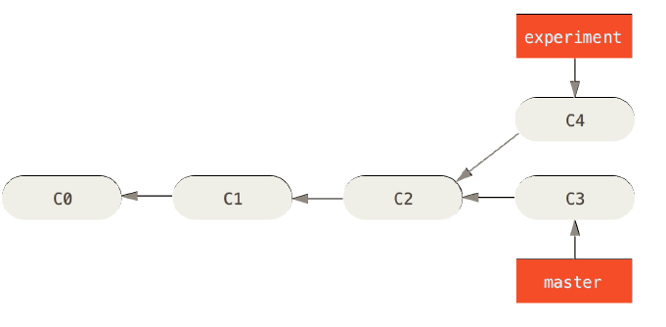
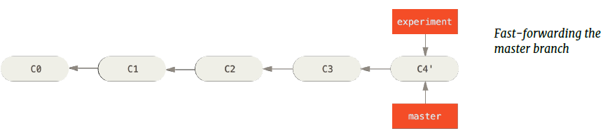
Rebasing
The Basic Rebase
$ git checkout experiment
$ git rebase master
First, rewinding head to replay your work on top of it..
Applying: added staged command
$ git checkout master
$ git merge experiment
Notes:
In Git, there are two main ways to integrate changes from one branch into another: the merge and the rebase.
In this section you’ll learn what rebasing is, how to do it, why it’s a pretty amazing tool, and in what cases you won’t want to use it.
<1st animation>
The easiest way to integrate the branches, as we’ve already covered, is the merge command.
<2nd animation>
It performs a three-way merge between the two latest branch snapshots (C3 and C4) and the most recent common ancestor of the two (C2), creating a new snapshot (and commit).
However, there is another way: you can take the patch of the change that was introduced in C4 and reapply it on top of C3. In Git, this is called rebasing.
With the rebase command, you can take all the changes that were committed on one branch and replay them on another one.
In this example, you’d run the following
<3rd animation>
It works by going to the common ancestor of the two branches (the one you’re on and the one you’re rebasing onto), getting the diff introduced by each
commit of the branch you’re on, saving those diffs to temporary files, resetting the current branch to the same commit as the branch you are rebasing onto,
and finally applying each change in turn.
<4th animation>
At this point, you can go back to the master branch and do a fast-forward merge.
<5th animation>
Now, the snapshot pointed to by C4' is exactly the same as the one that was pointed to by C5 in the merge example.
There is no difference in the end product of the integration, but rebasing makes for a cleaner history. If you examine the log of a rebased branch, it looks like a linear history: it appears that all the work happened in series, even when it originally happened in parallel.
Rebasing replays changes from one line of work onto another in the order they were introduced, whereas merging takes the endpoints and merges them together.

Slide 25
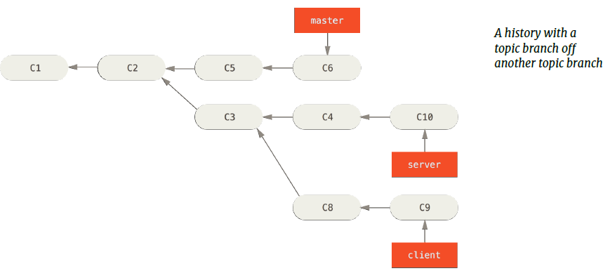
Rebasing
More Interesting Rebases
❸
❶
❷
$ git rebase --onto master server client
Notes:
You can also have your rebase replay on something other than the rebase target branch. Take a history like this for example.
<1st animation>
You branched a topic branch (server) to add some server-side functionality to your project, and made a commit.
<2nd animation>
Then, you branched off that to make the client-side changes (client) and committed a few times.
<3rd animation>
Finally, you went back to your server branch and did a few more commits.
<4th animation>
Suppose you decide that you want to merge your client-side changes into your mainline for a release, but you want to hold off on the server-side changes
until it’s tested further.
You can take the changes on client that aren’t on server (C8 and C9) and replay them on your master branch by using the --onto option of git rebase:
<5th animation>
This basically says, “Check out the client branch, figure out the patches from the common ancestor of the client and server branches, and then replay
them onto master.”
<6th animation>
It’s a bit complex, but the result is pretty cool.

Slide 26
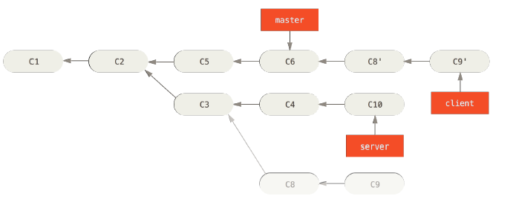
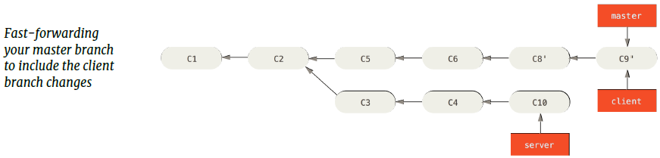
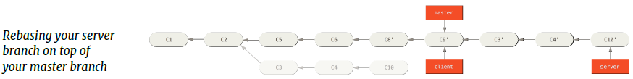
Rebasing
More Interesting Rebases
$ git checkout master
$ git merge client
$ git rebase master server
$ git checkout master
$ git merge server
$ git branch -d client
$ git branch -d server
Notes:
Now you can fast-forward your master branch
<1st animation>
Let’s say you decide to pull in your server branch as well.
You can rebase the server branch onto the master branch without having to check it out first by running git rebase [basebranch] [topicbranch] – which checks out the topic branch (in this case, server) for you and replays it onto the base branch (master):
<2nd animation>
This replays your server work on top of your master work, as shown here.
Then, you can fast-forward the base branch (master):
<3rd animation>
You can remove the client and server branches because all the work is integrated and you don’t need them anymore

Slide 27
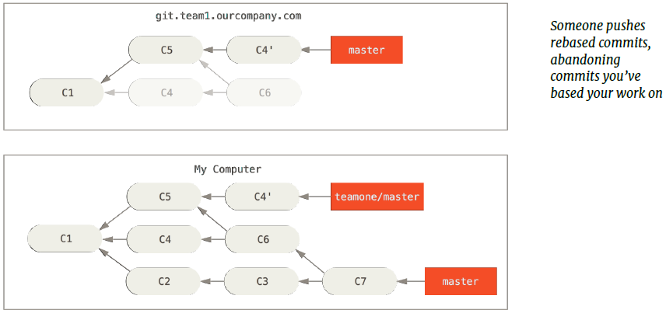
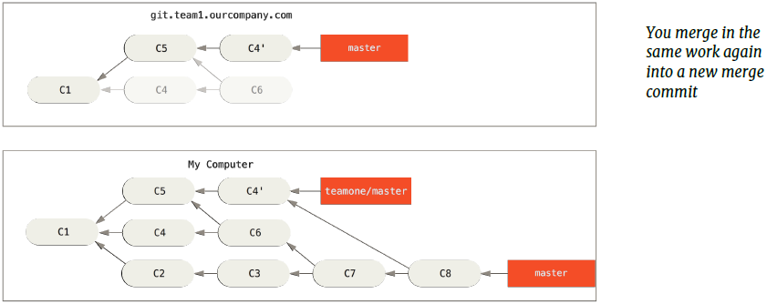
Rebasing
The Perils of Rebasing
Do not rebase commits that exist outside your repository.
Notes:
Rebasing isn’t without its drawbacks, which can be summed up in a single line:
<1st animation>
Do not rebase commits that exist outside your repository.
Let’s look at an example of how rebasing work that you’ve made public can cause problems.
Suppose you clone from a central server and then do some work off that. Your commit history looks like this:
<2nd animation>
Now, someone else does more work that includes a merge, and pushes that work to the central server.
You fetch them and merge the new remote branch into your work, making your history look something like this:
<3rd animation>
Next, the person who pushed the merged work decides to go back and rebase their work instead; they do a git push --force to overwrite the history
on the server. You then fetch from that server, bringing down the new commits.
<4th animation>
If you do a git pull, you’ll create a merge commit which includes both lines of history, and your repository will look like this:
<5th animation>
If you run a git log when your history looks like this, you’ll see two commits that have the same author, date, and message, which will be confusing.
Furthermore, if you push this history back up to the server, you’ll reintroduce all those rebased commits to the central server, which can further confuse people.
It’s pretty safe to assume that the other developer doesn’t want C4 and C6 to be in the history; that’s why she rebased in the first place.

Slide 28
Rebasing
Rebase Vs Merge
Merging is always the safest option, because it preserves all history.
Rebasing rewrites history, which can do real damage to a project by making it impossible to go back in time to see what happened. It can disrupt the work of contributors using the old history, and it may invalidate any previous testing.
Introducing new bugs via rebasing is unlikely to win friends. You can't go wrong with merging. The disadvantage, however, is being drowned in clutter and not being able to easily find what you want, because merging preserves everything. However, this could be strong motivation to get really good with advanced usage of git log commands.
The (greatly simplified) policy for the Linux kernel is:
Rebase only private history to make nice clean pull requests,
and never rebase work pushed by anyone else.
Rebasing private history is good. Rebasing public history is bad.
Notes:
To conclude,
Merging is always the safest option, because it preserves all history.
<1st animation>
Rebasing rewrites history, which can do real damage to a project by making it impossible to go back in time to see what happened. It can disrupt the work of contributors using the old history, and it may invalidate any previous testing.
<2nd animation>
Introducing new bugs via rebasing is unlikely to win friends. You can't go wrong with merging. The disadvantage, however, is being drowned in clutter and not being able to easily find what you want, because merging preserves everything. However, this could be strong motivation to get really good with advanced usage of git log commands.
<3rd animation>
The (greatly simplified) policy for the Linux kernel is:
Rebase only private history to make nice clean pull requests,
and never rebase work pushed by anyone else.
Rebasing private history is good. Rebasing public history is bad.

Slide 29
Conclusion
You should feel comfortable creating and switching to new branches, switching between branches and merging local branches together.
You should also be able to share your branches by pushing them to a shared server, working with others on shared branches and rebasing your branches before they are shared.

Slide 30
Thank you

Slide 31


