Slide 1



Anugrith V.
SCM Specialist, MBB LC IMS

Slide 2

Why Git?
Git is a free and open source Distributed Version Control System designed to handle everything from small to very large
projects with speed and efficiency.
Git is easy to learn and has a tiny footprint with lightning fast performance.
It outclasses SCM tools like Subversion, CVS, Perforce, and ClearCase with features like local branching, convenient
staging areas, and multiple workflows.
Companies and projects using Git

Slide 3
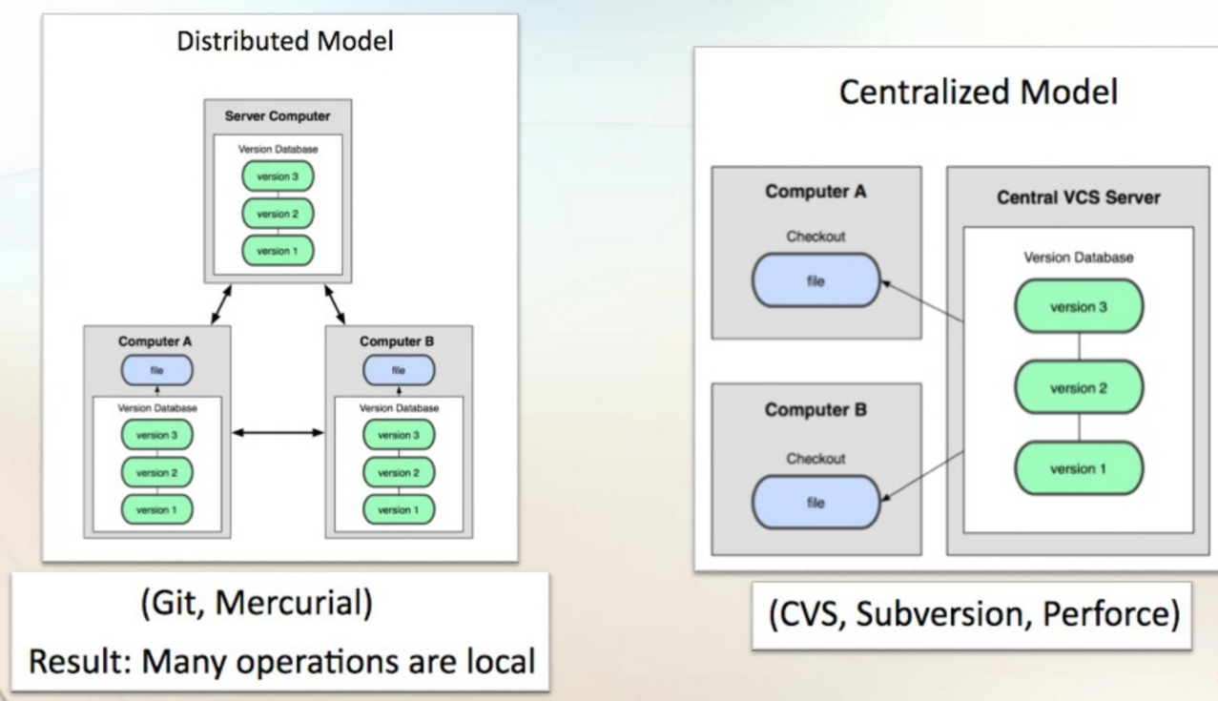
DVCS vs CVCS

Slide 4
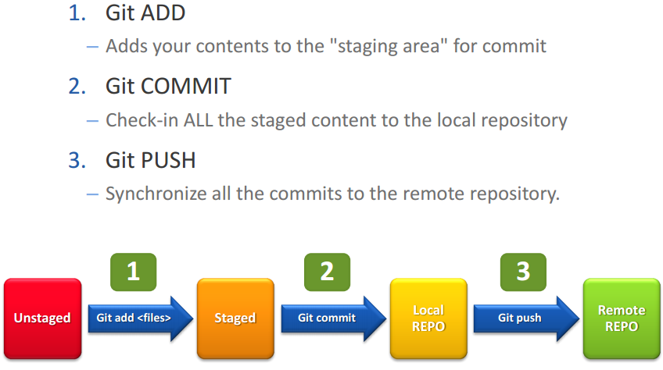
Git – Three states

Slide 5
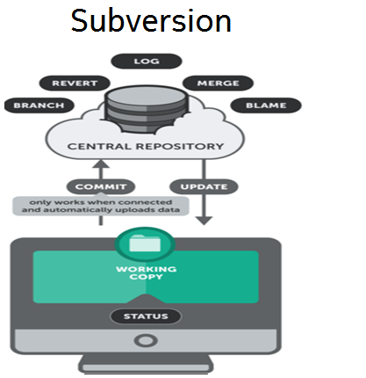
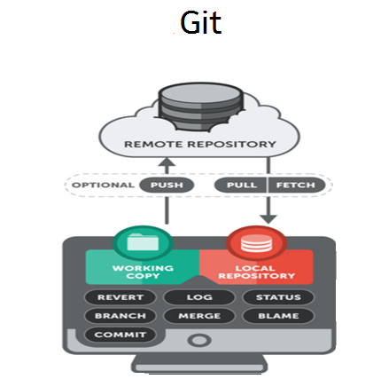
Subversion Vs Git

Slide 6
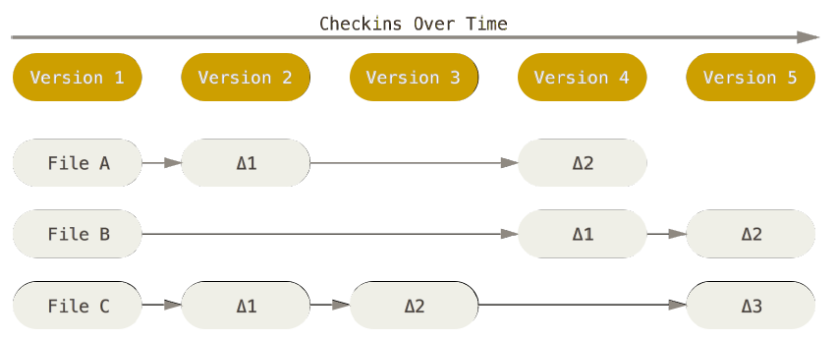
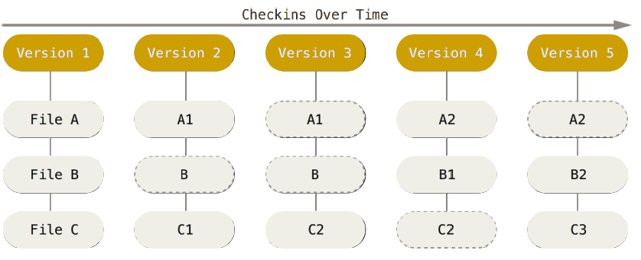
Storing data
CVCS
File-based changes
Git
Stores reference to snapshots
(Streams of snapshots)
Like mini file system

Slide 7
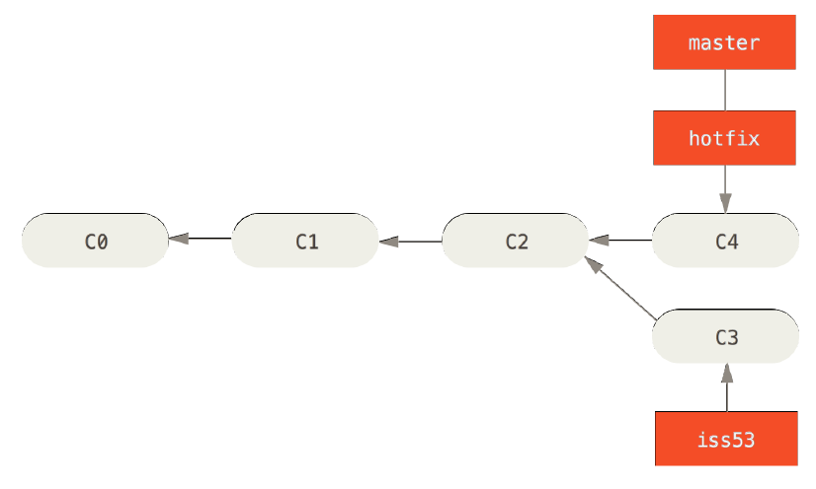
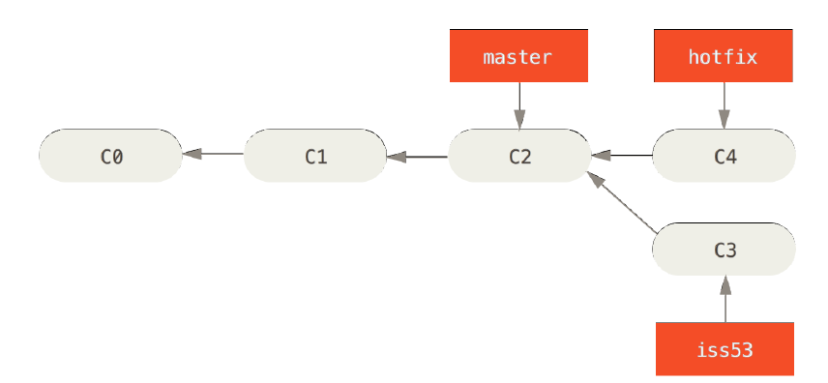
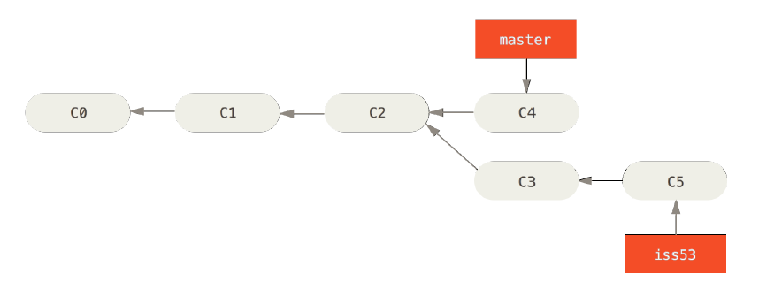
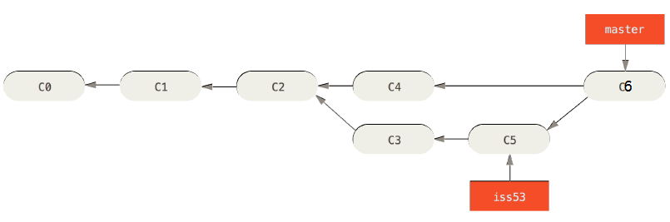
Git – branches & merge
master is fast-forwarded to hotfix
three-way / recursive merge

Slide 8
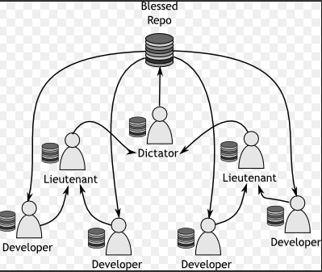
Git - Collaboration

Slide 9
Advantage of Git
Branching and Merging
Small and fast
Distributed
Data Assurance
Staging Area
Free and Open Source

Slide 10
Why Gerrit?
Gerrit is a free, web-based team software code review tool.
It integrates closely with Git, a Distributed Version Control System.
Access Control in Gerrit:
Access controls in Gerrit are group based.

Slide 11
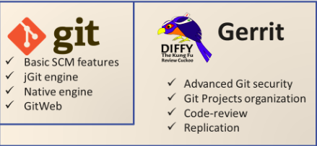
Git and Gerrit

Slide 12
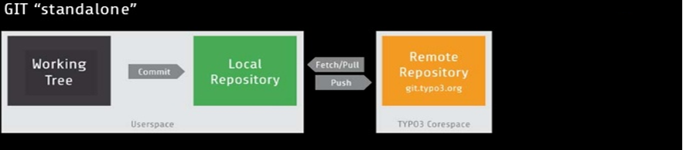
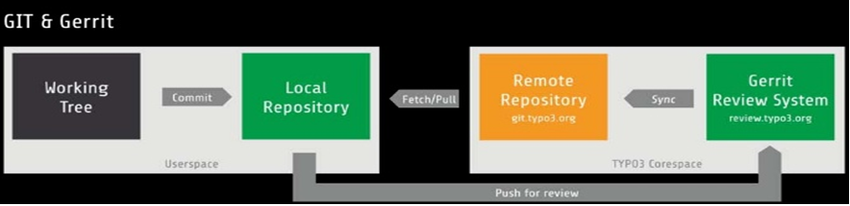
Git and Gerrit

Slide 13
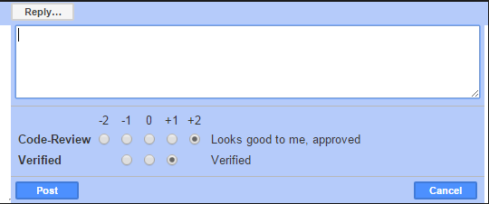
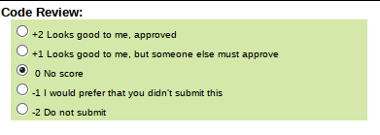
Git and Gerrit
Gerrit acts as an intermediate between the developers and the remote Git repository.
All commits are submitted to Gerrit, where each commit must be reviewed in order to send it upstream to the remote repository. Each commit must also be verified.
Generally, a build is run automatically on Jenkins, the continuous integration system. If Jenkins doesn't find any problems, the commit is set to verified. Before we can submit it to the remote repository, it also needs a positive review.

Slide 14
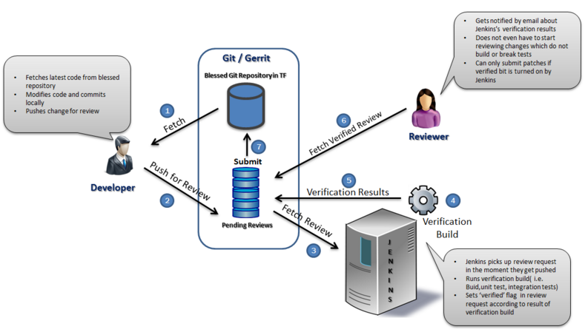
Gerrit staging area & Jenkins

Slide 15
Review workflow step-by-step
START
1. Create Change-Id
2. Push for review
Roles
Gerrit
4. Add/notify reviewers
Contributor
Reviewer
Committer
5. Code Review + Score
3. Build, test
+ Score
CI Build
6. Scoring validation rules
7. Change is rebased / reworked / amended
STOP
8. Change-Id ABANDONED
9. Change-Id SUBMITTED
10. Change-Id MERGED
STOP

Slide 16
Git & Gerrit references
A Git reference (aka ref-spec) is a path-based syntax for identifying a name space of Git objects
Standard Git References are:
refs/heads/* All the branches of the Git repository, represented as a path-based structure. refs/heads/master Is the main initial branch of development.
refs/tags/* All the tags assigned inside the Git repository, represented as a path-based structure.
Main refs-specs added by Gerrit for its internal settings and Code Review are:
refs/changes/* All the changes uploaded to Gerrit, represented in the format:
<Last two digits of change>/<change Nr>/<patch set Nr>.
refs/meta/config The Gerrit internal project configuration file, including security, groups, and submit rules.
refs/for/* The Gerrit magic branch for pushing changes for review.
refs/publish/*
refs/drafts/* The Gerrit magic branch for pushing draft changes, visible only to the change author and the invited reviewers.

Slide 17
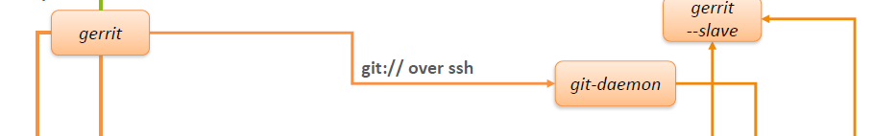

Gerrit Master & Slave setup
https:8443 ssh: 29418
https:8443 ssh: 29418
:3306
MySQL
MySQL
--standby
:3306
In general, all read operations are re-directed to slave
This configuration can be pushed centrally & end users don’t have to do any additional setup

Slide 18
Eclipse IDE - Integrated Functions
Navigation
Basic code navigation
Methods/function level navigation
Navigation after compilation error & warnings
Java
Function extended to C/C++ - prototype working for all the repos. Final rollout by 31/07.
Prompts for syntax errors during editing – basic errors can be caught without compiling
Gerrit functions
Gerrit being GUI based, has no direct plug-in
Gerrit page load is possible in eclipse.
Once page is loaded, all the gerrit operations are possible.
KW functions from Eclipse
KW parallel/automated analysis is possible ( example : file open/save can trigger KW run)
KW analysis for an entire repo is possible
Navigation from KW warnings possible.
FreeNX client replaces putty to accelerate connectivity
The following plug-ins are integrated
C/C++/JAVA/Go
Python/Perl/bash
GIT
Klockworks
All the GIT functions can be done from the Eclipse window
Git add
Git commit
Git pull/push
Git branch / switch branch
Git rebase / reset
Compilation
Common interface for different compilation use cases ( TSP, CAF, applications etc.,)
Compilation at the levels of directory, library or package

Slide 19
IMS Git/Gerrit setup

Slide 20

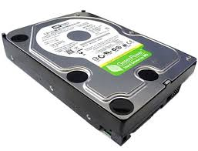





IMS Git & Gerrit setup
C
l oud
I ns
t ance
EBS volume
^{/imsgit_local/work/<user>}
User work space
Client 1
EBS volume
fetch/pull
^{/imsgit_local/work/<user>}
Git/Gerrit Server
User work space
Client 2
NFS
EBS volume
^{/imsgit_local/work/<user>}
User work space
Client 3
Elastic Block Store volume gives almost equivalent to local disk performance
Note: For few teams, existing physical server hard disk has been configured
Windows
push
SAMBA
\\<clientIP>\imsgit_local\work\<user>
User work space

Slide 21







Review workflow step-by-step
0
0
Gerrit Staging
1
Developer
Local Repo
Static code
analysis
Static code
analysis
Eclipse Pre-check
Gold Code Submit
CI Handover
Code Complexity
Code Duplication
Code Complexity, Duplication MT& Ccov
MT /UT Run & Code Coverage
Gerrit Review
SubmitGerrit Review
0
0
1

Slide 22


Migration strategies followed
- - Branches - -
- - Branches - -
Final sync from 11.0 P7
IMS 11.0 P7
master
main
ims11.0rur
---- Regular sync (one-way) →
merge
ims_11.0rur
ims_11.0rur
LOCKED
disable
Final sync from 11.0rur
CI
Code Check-in
APS
ims11.0_mrel
ims11.0_mrel
Regular sync from ims11.0_mrel
→ Cut-off date: ??

Slide 23
Benefits
CI build feedback time reduced from 6 hours (nightly) to 25 minutes (hourly)
Test bed bring up in 3 hours compared to one week (build/installation/image creation/smoke test)
Code Quality improved by adding more pre-checks in CI staging area
Klocworks (static code)
Code complexity (cmt ++)
Code duplication (cpd)
MT / UT – component wise
Process control (hooks) implemented in both client and server side
Integrated with JIRA bug/feature tracking system
ClearCase usage came down limiting to old maintenance releases
New branch roll out announcement in minutes compared to hours/days
Merge efforts reduced & handled centrally by CM Team
Build machines using EE Cloud service
Rolled out OpenGrok source code search and cross reference engine
Etc …

Slide 24
Demo?

Slide 25
Reference
Documentation
https://confluence.int.net.nokia.com/display/IMS/ClearCase+to+Git+migration

Slide 26


Slide 27
Backup slides

Slide 28
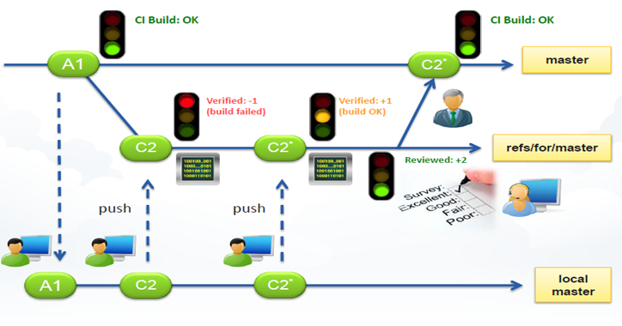
Gerrit staging area & Jenkins

Slide 29
Subversion Vs Git
Git is much faster than Subversion
Subversion allows you to check out just a subtree of a repository; Git requires you to clone the entire repository (including history) and create a working copy that mirrors at least a subset of the items under version control.
Git's repositories are much smaller than Subversions (for the Mozilla project*, 30x smaller)
Git was designed to be fully distributed from the start, allowing each developer to have full local control
Git branches are simpler and less resource heavy than Subversion's
Git branches carry their entire history
Git provides better auditing of branch and merge events
Git's repo file formats are simple, so repair is easy and corruption is rare.
Git repository clones act as full repository backups
Subversion's UI is more mature than Git's
Walking through versions is simpler in Subversion because it uses sequential revision numbers (1,2,3,..); Git uses unpredictable SHA-1 hashes. Walking backwards in Git is easy using the "^" syntax, but there is no easy way to walk forward.

Slide 30
Advantage of Git
Branching and Merging
The Git feature that really makes it stand apart from nearly every other SCM out there is its branching model. Git allows and encourages you to have multiple local branches that can be entirely independent of each other. The creation, merging, and deletion of those lines of development takes seconds. This means that you can do things like:
(1) Frictionless Context Switching : Create a branch to try out an idea, commit a few times, switch back to where you branched from, apply a patch, switch back to where you are experimenting, and merge it in.
(2) Role-Based code lines : Have a branch that always contains only what goes to production, another that you merge work into for testing, and several smaller ones for day to day work.
(3) Feature Based Workflow : Create new branches for each new feature you're working on so you can seamlessly switch back and forth between them, then delete each branch when that feature gets merged into your main line.
(4) Disposable Experimentation : Create a branch to experiment in, realize it's not going to work, and just delete it - abandoning the work—with nobody else ever seeing it (even if you've pushed other branches in the meantime).
Git branches are simpler and less resource heavy than other VCS like Subversion

Slide 31
Advantage of Git
Small and fast
Git is fast. With Git, nearly all operations are performed locally, giving it a huge speed advantage on centralized systems that constantly have to communicate with a server somewhere.
Git was built to work on the Linux kernel, meaning that it has had to effectively handle large repositories from day one. Git is written in C, reducing the overhead of runtimes associated with higher-level languages. Speed and performance has been a primary design goal of the Git from the start.

Slide 32
Advantage of Git
Distributed
One of the nicest features of any Distributed SCM, Git included, is that it's distributed.
This means that instead of doing a "checkout" of the current tip of the source code, you do a "clone" of the entire repository.
Data Assurance
The data model that Git uses ensures the cryptographic integrity of every bit of your project. Every file and commit is checksummed and retrieved by its checksum when checked back out.
It's impossible to get anything out of Git other than the exact bits you put in.

Slide 33
Advantage of Git
Staging Area
Unlike the other systems, Git has something called the "staging area" or "index". This is an intermediate area where commits can be formatted and reviewed before completing the commit.
One thing that sets Git apart from other tools is that it's possible to quickly stage some of your files and commit them without committing all of the other modified files in your working directory.
Free and Open Source
Git is released under the GNU General Public License version 2.0, which is an open source license.

Slide 34
Why Gerrit?
Gerrit is a free, web-based team software code review tool.
Software developers in a team can review each other's modifications on their source code using a Web browser and approve or reject those changes.
It integrates closely with Git, a Distributed Version Control System.
Access Control in Gerrit:
Access controls in Gerrit are group based.
Every user account is a member of one or more groups, and access and privileges are granted to those groups.
Groups cannot be nested, and access rights cannot be granted to individual users.

Slide 35
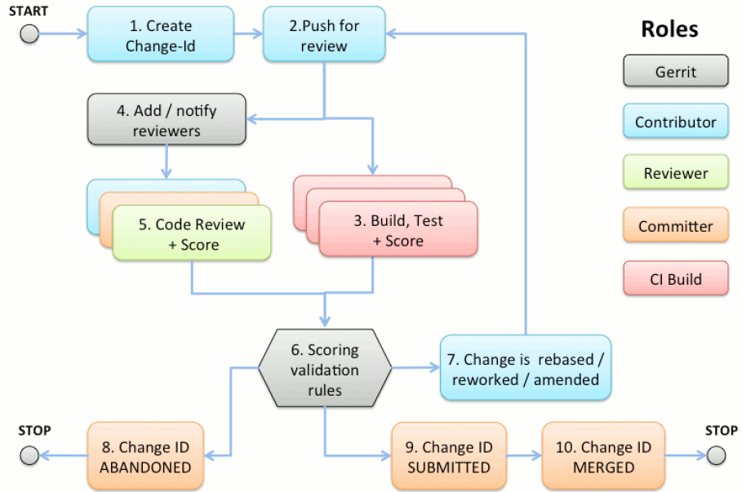
Review workflow step-by-step

