Slide 1
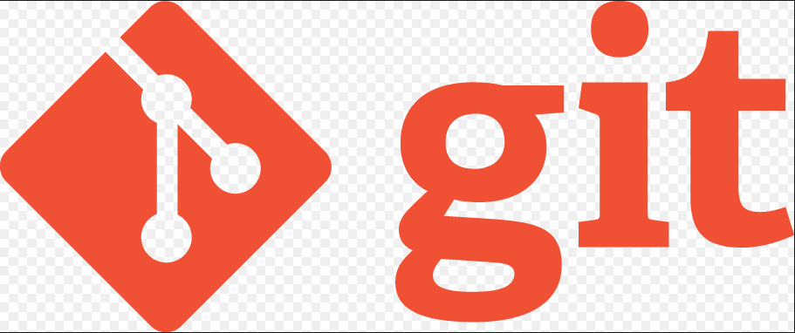
Anugrith V.
SCM Specialist, MBB LC IMS
Notes:
Hello & Welcome Everyone!
This session is just an overview of Git distributed version control system and how it could fit to your R&D organization needs.
Ok; let us get started...

Slide 2
What is Git?
Git is a free and open source
Distributed Version Control System
It has been designed with performance, security and flexibility in mind
Notes:
What is Git?
------------
By far, the most widely used modern version control system in the world today is Git. Git is a mature, actively maintained open source project originally developed in 2005 by Linus Torvalds, the famous creator of the Linux operating system kernel. A staggering number of software projects rely on Git for version control, including commercial projects as well as open source. Developers who have worked with Git are well represented in the pool of available software development talent and it works well on a wide range of operating systems and IDEs (Integrated Development Environments).
<1st animation>
Having a distributed architecture, Git is an example of a DVCS (hence Distributed Version Control System). Rather than have only one single place for the full version history of the software as is common in once-popular version control systems like CVS or Subversion (also known as SVN), in Git, every developer's working copy of the code is also a repository that can contain the full history of all changes.
<2nd animation>
In addition to being distributed, Git has been designed with performance, security and flexibility in mind.
Let us see these one by one in subsequent slides...

Slide 3
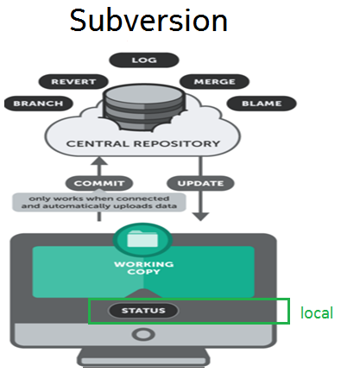
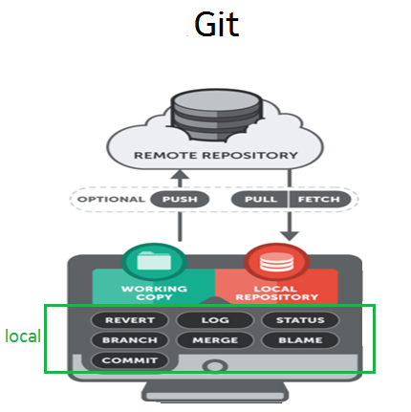
Performance
Notes:
Git is fast.
With Git, nearly all operations are performed locally, giving it a huge speed advantage on centralized systems like Subversion that constantly have to communicate with a server somewhere.
Git was built to work on the Linux kernel, meaning that it has had to effectively handle large repositories from day one. Git is written in C, reducing the overhead of runtimes associated with higher-level languages. Speed and performance has been a primary design goal of the Git from the start.

Slide 4
Performance
server copy
2.0
1.3
commit
branch
Notes:
Being distributed enables significant performance benefits as well.
For example, say a developer, Alice, makes changes to source code, adding a feature for the upcoming 2.0 release, then commits those changes with descriptive messages.
<1st animation>
She then works on a second feature and commits those changes too.
<2nd animation>
Naturally these are stored as separate pieces of work in the version history.
<4th animation>
Alice then switches to the version 1.3 branch of the same software to fix a bug that affects only that older version. The purpose of this is to enable Alice's team to ship a bug fix release, version 1.3.1, before version 2.0 is ready.
Alice can then return to the 2.0 branch to continue working on new features for 2.0
and all of this can occur without any network access and is therefore fast and reliable.
<5th animation>
When she is ready to send all of the individually committed changes to the remote repository, Alice can “push” them in one command.

Slide 5
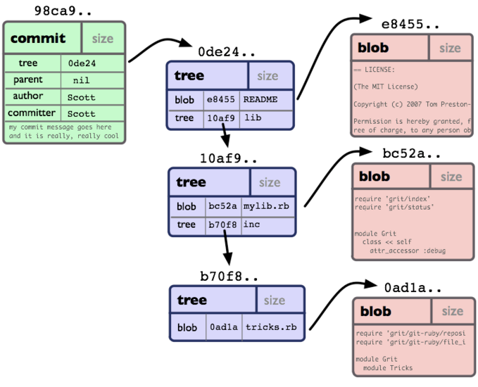
Security
blob: content of a file
tree: content of a directory; it can point to blobs and other trees
Notes:
Git has been designed with the integrity of managed source code as a top priority. The content of the files as well as the true relationships between files and directories, versions, tags and commits, all of these objects in the Git repository are secured with a cryptographically secure hashing algorithm called SHA1. This protects the code and the change history against any accidental change and ensures that the history is fully traceable.
With Git, you can be sure you have an authentic content history of your source code.
Some other version control systems have no protections against secret alteration at a later date. This can be a serious information security vulnerability for any organization that relies on software development.

Slide 6
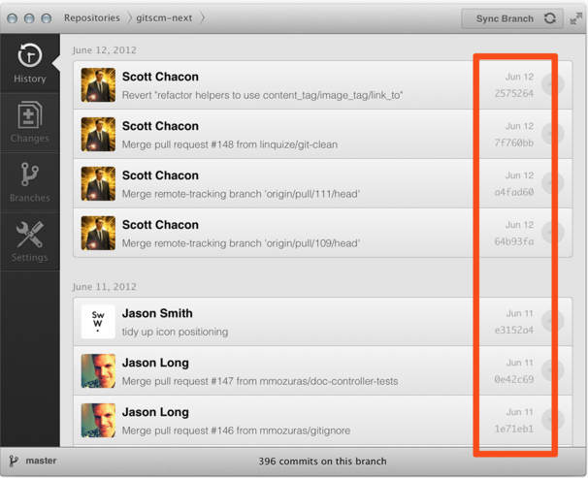
Security
Notes:
The data model that Git uses ensures the cryptographic integrity of every bit of your project. Every file and commit is checksummed and retrieved by its checksum when checked back out. It's impossible to get anything out of Git other than the exact bits you put in.
It is also Impossible to change any file, date, commit message, or any other data in a Git repository without changing the IDs of everything after it. This means that if you have a commit ID, you can be assured not only that your project is exactly the same as when it was committed, but that nothing in its history was changed.
Most centralized version control systems DOES NOT provide such integrity by default.

Slide 7
Flexibility
Efficiency in both small and large projects
Branching and Tagging as first-class citizens
Notes:
One of Git's key design objectives is flexibility. Git is flexible in several respects: in support for various kinds of nonlinear development workflows, in its efficiency in both small and large projects and in its compatibility with many existing systems and protocols.
<1st animation>
Git has been designed to support branching and tagging as first-class citizens (unlike SVN) and operations that affect branches and tags (such as merging or reverting) are also stored as part of the change history. Not all version control systems feature this level of tracking.

Slide 8
Version control with Git
Git is good
Git is a de facto standard
Integration to 3rd party tools
Git is a quality open source project
Great community support
Documentation
Open source – successor to Subversion
Notes:
Git is the best choice for most software teams today. While every team is different and should do their own analysis, here are the main reasons why version control with Git is preferred over alternatives:
Git is good
Git has the functionality, performance, security and flexibility that most teams and individual developers need. These attributes of Git are detailed above. In side-by-side comparisons with most other alternatives, many teams find that Git is very favorable.
<1st animation>
##Git is a de facto standard
Git is the most broadly adopted tool of its kind. This makes Git attractive.
In addition to the benefits of a large talent pool, the predominance of Git also means that many third party software tools and services are already integrated with Git including IDEs, and our own tools like DVCS desktop client SourceTree, issue and project tracking software, JIRA, etc...
If you are an inexperienced developer wanting to build up valuable skills in software development tools, when it comes to version control, Git should be on your list.
<2nd animation>
##Git is a quality open source project
Git is a very well supported open source project. The project maintainers have shown balanced judgement and a mature approach to meeting the long term needs of its users with regular releases that improve usability and functionality. The quality of the open source software is easily scrutinized and countless businesses rely heavily on that quality.
Git enjoys great community support and a vast user base.
Documentation is excellent and plentiful, including books, tutorials and dedicated web sites.
Being open source lowers the cost for developers as they can use Git without paying a fee. For use in open-source projects, Git is undoubtedly the successor to the previous generations of successful open source version control systems, SVN and CVS.

Slide 9
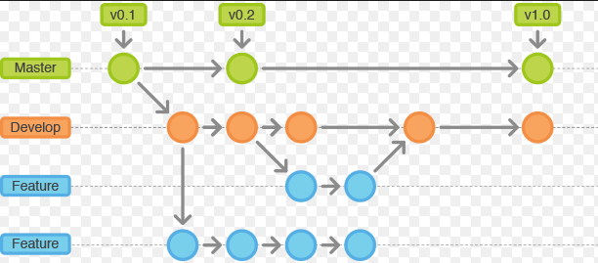
Why Git for your R&D Organization?
✓ Feature Branch Workflow
Notes:
Why Git for your R&D Organization
---------------------------------
Switching from a centralized version control system to Git changes the way your development team creates software.
And, if you have mission-critical applications, altering your development workflow impacts your entire business.
<1st animation>
##Feature Branch Workflow
One of the biggest advantages of Git is its branching capabilities. Unlike centralized version control systems, Git branches are cheap and easy to merge. This facilitates the feature branch workflow popular with many Git users.
Feature branches provide an isolated environment for every change to your codebase. When a developer wants to start working on something—no matter how big or small—they create a new branch. This ensures that the master branch always contains production-quality code.
Using feature branches is not only more reliable than directly editing production code, but it also provides organizational benefits. They let you represent development work at the same granularity as your agile backlog. For example, you might implement a policy where each JIRA ticket is addressed in its own feature branch.

Slide 10
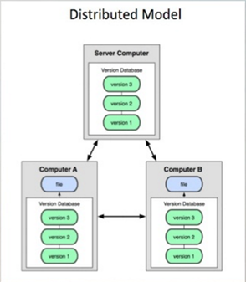
Why Git for your R&D Organization?
✓ Distributed Development
Notes:
##Distributed Development
In Centralized Version Control System like subversion, each developer gets a working copy that points back to a single central repository.
Instead of a working copy, each developer gets their own local repository, complete with a full history of commits.
Having a full local history makes Git fast, since it means you don’t need a network connection to create commits, inspect previous versions of a file, or perform diffs between commits.
Distributed development also makes it easier to scale your engineering team. If someone breaks the production branch in SVN, other developers can’t check in their changes until it’s fixed. With Git, this kind of blocking doesn’t exist. Everybody can continue going about their business in their own local repositories.
And, similar to feature branches, distributed development creates a more reliable environment.
Even if a developer removes his/her own repository, he/she can simply clone someone else’s and start new.

Slide 11
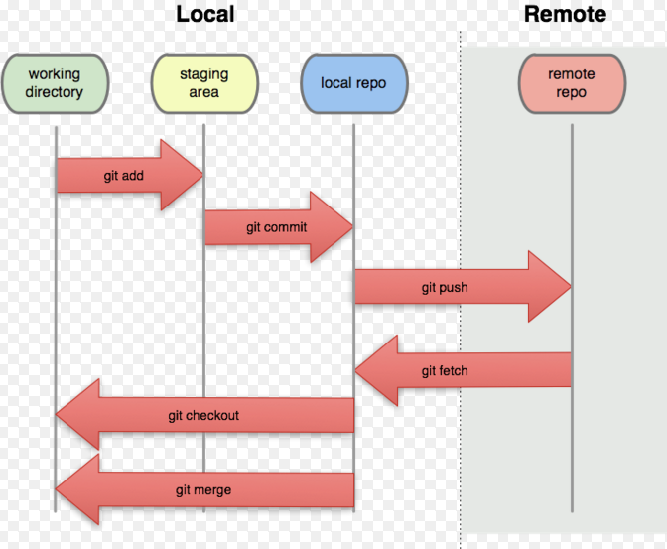
Why Git for your R&D Organization?
✓ Pull/fetch Requests
Notes:
##Pull/fetch Requests
A pull request is a way to ask another developer to merge/rebase one of your branches into their repository. This not only makes it easier for project leads to keep track of changes, but also their work before integrating it with the rest of the codebase.

Slide 12
Why Git for your R&D Organization?
✓ Community
Notes:
##Community
In many circles, Git has come to be the expected version control system for new projects. If your team is using Git, you won’t have to train new hires on your workflow, because they’ll already be familiar with distributed development.
In addition, Git is very popular among open source projects. This means it’s easy to leverage 3rd-party libraries and encourage others to fork your own open source code.

Slide 13
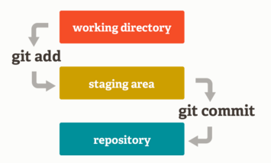
Why Git for your R&D Organization?
✓ Staging area
Notes:
##Staging area
Unlike the other systems, Git has something called the "staging area" or "index". This is an intermediate area where commits can be formatted and reviewed before completing the commit.
One thing that sets Git apart from other tools is that it's possible to quickly stage some of your files and commit them without committing all of the other modified files in your working directory or having to list them on the command line during the commit.

Slide 14
Why Git for your R&D Organization?
✓ Faster Release Cycle
Notes:
##Faster Release Cycle
The ultimate result of feature branches, distributed development, pull requests, and a stable community is a faster release cycle.
These capabilities facilitate an agile workflow where developers are encouraged to share smaller changes more frequently.
In turn, changes can get pushed down the deployment pipeline faster than the monolithic releases common with centralized version control systems.
As you might expect, Git works very well with continuous integration and continuous delivery environments. Git hooks allow you to run scripts when certain events occur inside of a repository, which lets you automate deployment to your heart’s content. You can even build or deploy code from specific branches to different servers.
For example, you might want to configure Git to deploy the most recent commit from the develop branch to a test server whenever anyone merges a pull request into it. Combining this kind of build automation with peer review means you have the highest possible confidence in your code as it moves from development to staging to production.

Slide 15
Thank you
Notes:
Ok; that is the end of this session.
As mentioned in the introduction, This is just an overview of Git Distributed Version Control Tool & how it could fit in your development environment.
For further technical training sessions, please refer to the different modules provided.
THANK YOU VERY MUCH!

Slide 16


