Slide 1
BrandShoes Style that make fashion
Module-2
Assignment-1
Presentation by:
Manjesh M

Slide 2
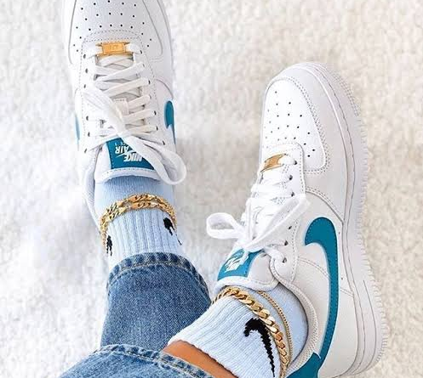
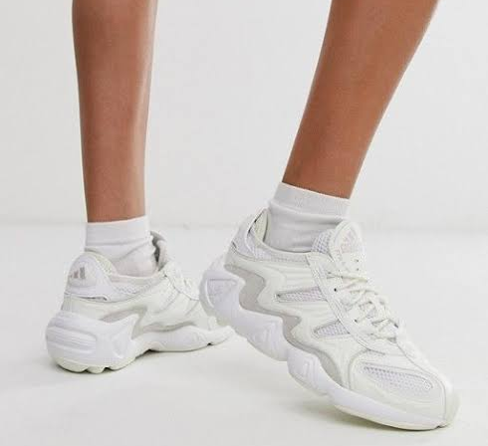
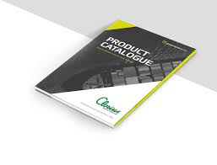
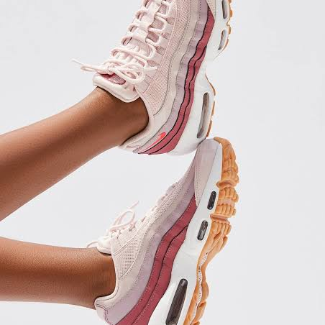
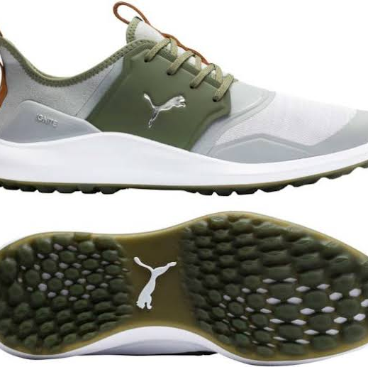
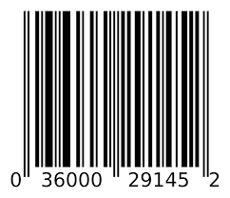
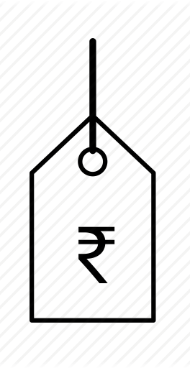
Requirements
BrandShoes quality and premium shoes from the catalogue
Each shoe has
Identifier
One or more shoe types
Price Range
Description
Price
Quality
Billing and Invoice generation

Slide 3
Current System to Proposed System
Current System
Call from a registered phone number and place the order
Mail from a registered email id and place the order
Proposed System
Brand Shoes is willing to offer internet based ordering services via its new software application

Slide 4
Online ordering system
The process would be as mentioned below
The user should able to
Register to the application
Login to the application
Search for the item
Add the item to the cart
Select the quantity with size
Checkout and Pay via secured gateway (Debit Card/Net Banking)
So the application will
Auto generate and send email invoice to the users registered email id
Sends an order confirmation via message to the registered mobile number

Slide 5
Problem Domain
One of the problem identified is as mentioned below:
Disorganized and Inefficient Delivery System
Customers order from the BrandShoes store when they like to wear something Brand or need any flexiable quality shoes and at that moment most of the times and expect it to reach them without any delay.
Many people still prefer to visit the store rather than ordering things online. As most of the people are working, they are not available to collect their stuff when it is delivered home.
Solution: This can be solved only if the companies follow some standard delivery schedules. A buyer should be able to receive his order within certain time like 30 min’s!, which must be implemented by BrandShoes delivery app development. By this, the buyer can get a clear picture of the delivery so that they can manage their time.

Slide 6
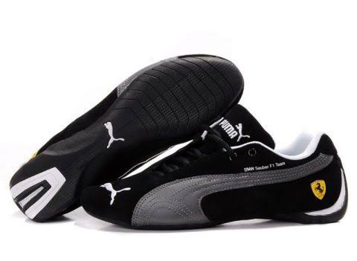
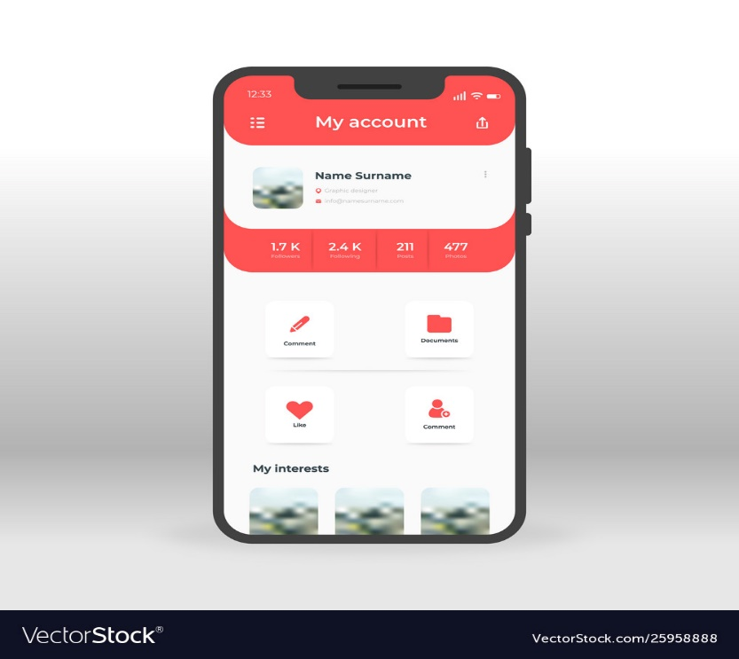
Identifying Object
The objects can be Physical or Conceptual
The Shoe is a physical object
The user account is a conceptual

Slide 7
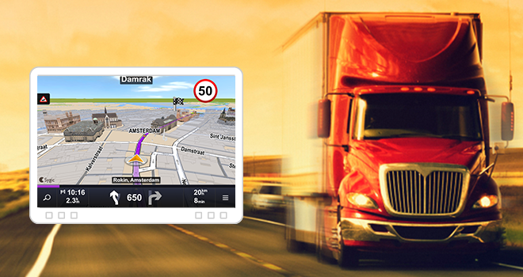
Additional criteria for recognizing objects
Relevant to the problem domain
The order (shoe) contains a object.
As per the problem definition, carrier (vehicle) will also be considered as object, since it will be captured as part of navigation control.
The user should get the precise information of the vehicle carrying goods and time of delivery expected

Slide 8

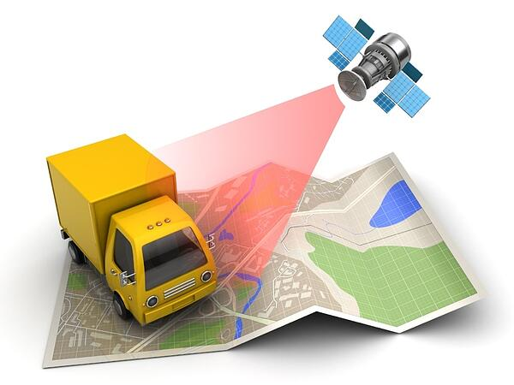
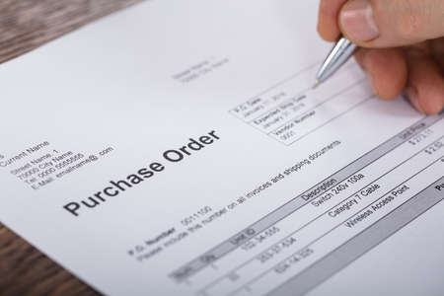
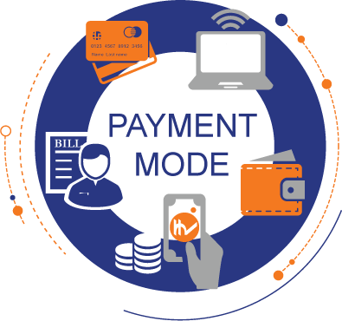
Possible Objects
Catalog
Customer
Shoe
Order
Vehicle location
Mode of Payment

Slide 9
Identifying Object Attributes and Operations
Shoe
ORDER
Attributes
Shoeid
Quantity in stock
Price
Brand
Description
Order id
Date
Total Price
Status
*Shoe(s)
Add Stock
Remove Stock
Display Shoe
Information
Add Shoe to order
Remove Shoe from order
Submit order
Put order on Hold
Operations

Slide 10
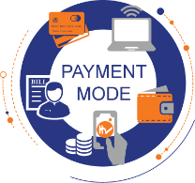
Identifying Relations between Objects
Shoe
Order
Catalog
Order id
Total Price
Status
*Shoe(s)
*Form if payment
Shoes
Shoe id
Price
Brand
Description
Quantity in Stock
Add a Shoe
Remove a Shoe
Add Shoe to order
Remove Shoe from order
Submit order
Put order on Hold
Add Stock
Remove Stock
Display Shoe Information
Form of Payment
Customer
Check No.
Debit Card No.
Expiration Date
Customer id
Name
Address
Phone No.
Email Address
Order
Display Debit Card No.
Verify Payment
Place Order
Cancel Order

Slide 11
Class Design
ClassName
Fruit
attributeVariableName [range of values]
attributeVariableName [range of values]
attributeVariableName [range of values]
Shoe id
Price
Description
Size
methodName()
methodName()
methodName()
calculatePrice()
displayShoeInfo()
Next Steps to be Followed
Implementation
Testing

Slide 12
Thank You

