Slide 1
Predicting the best place to open an Italian restaurant in Toronto,Canada.
https://assets.entrepreneur.com/content/3x2/2000/1405612741-airbnb-why-new-logo.jpg?width=600&crop=16:9

Slide 2

Our Project Goal:
The objective of this project is to find the best neighborhood in Toronto to open an Italian restaurant. In this project, we'll be trying to find ideal places to start a Italian restaurant using Foursquare location data and clustering analysis.
Target Audience
Italian chef's trying to open their own restaurant. Investors looking to establish a business related to Italian food. Tourists who are interested in Italian cuisine.

Slide 3
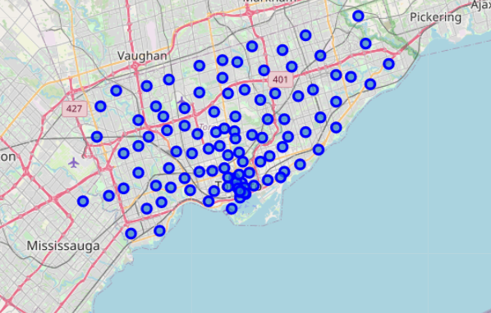
Our Data:
Data Source 1 – Neighborhood Data The dataset about neighborhoods of toronto will be extracted from a Wikipedia page. Features such as borough, neighbourhood, postal code will be extracted. Source: https://en.wikipedia.org/wiki/List_of_postal_codes_of_Canada:_M Data Source 2 – Geographical Coordinates Geographical coordinates for each neighborhood will be obtained with the aid of GEOPY Library such as latitude and logitude. Data Source 3 – Venue categories I will use the Foursquare API to retrieve venues, using the coordinates obtained in Data Source 2 above.

Slide 4
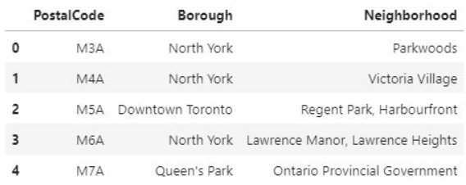
Methodolody Used
1. Webscrape the data from city info webpage

Slide 5
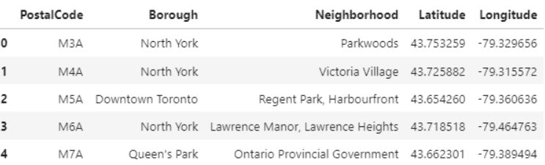
Methodolody Used
2. Get and connect the Postal Codes to the neighborhoods

Slide 6
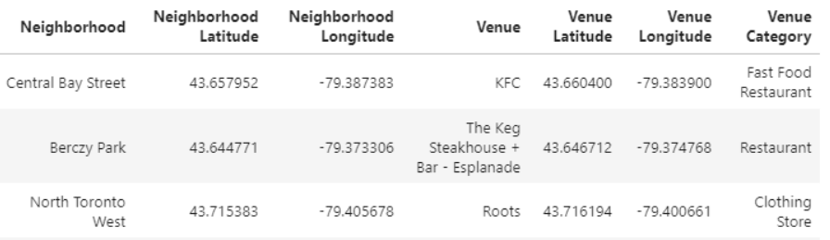
Methodolody Used
3. Check the business venues in the vicinity of the neighborhood using Foursquare

Slide 7
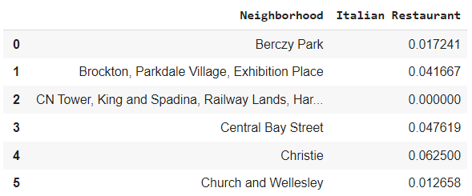
Analysis and discussion
1. Taking account of only Italian restaurants

Slide 8
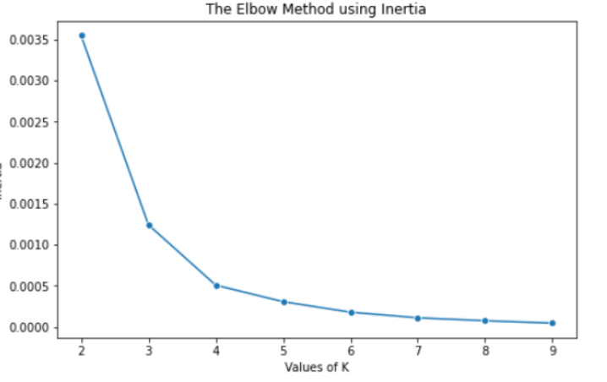
Analysis and discussion
2. Use K-means clustering to group
the neighborhoods
Our results show that the optimal K
value is 4.
Hence, K=4 will be used to divide
our dataset.

Slide 9
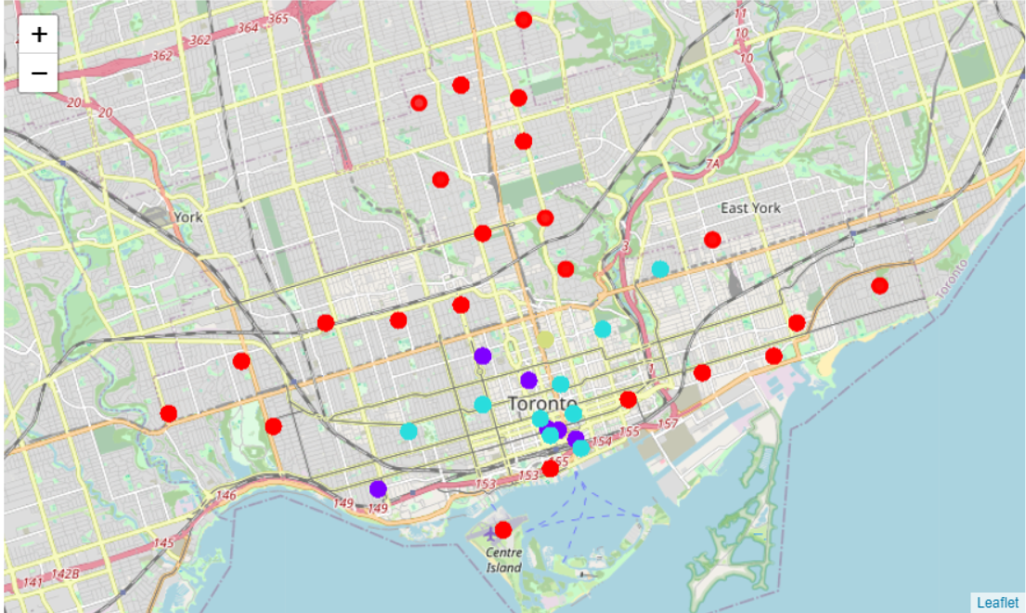
Results
Applying the K-mean clustering
With K=4, we applied the
K-means clustering method
to divide and
label the locations.

Slide 10
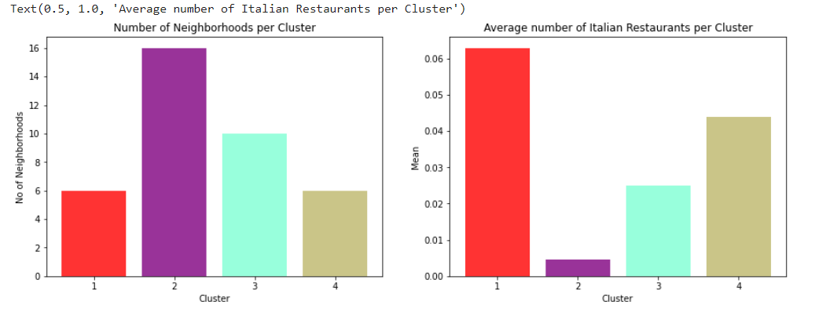
Results

Slide 11
Conclusion
From the perspective of a tourist, it may be best to go to the neighborhoods in cluster 1 to eat Italian food. There are a lot of Italian restaurants that will cater to the adventurous pallete. From the perspective of a businessman, the optimal location to open a new Italian restaurant is in cluster 2, that is in neighbourhoods such as Kensington Market, Chinatown, Grange Park, Harbourfront East, Union Station, Toronto Islands,Garden District, Ryerson where there are a lot of potential demands for an Italian restaurant while having the least competition around the vicinity. Of course it might be possible that these neighborhoods are less commercialize as compared to cluster 1.

