Slide 1

SmartPlate: ML Based Meal delivery System
Group members with Student Id
Shweta Bhutada 21104007
Manjiri Gole 21104006
Akshata Nalavade 21104003
Project Guide
Ms. Geetanjali Kalme

Slide 2
Contents
Introduction
Objectives
Scope
Literature Survey
Features / Functionality
Technology Stack
Block Diagram
Use Case/DFD
Suggestions in Review-1
Result and Discussion
Conclusion and Future Scope
References

Slide 3
1. Introduction
A user-friendly website for an online recipe box ordering service that enables customers to easily browse, customize, and order recipe boxes with pre-portioned ingredients and step-by-step cooking instructions.
Problem Identified :
Busy lifestyle mean less time for meal planning, grocery shopping, and cooking.
People enjoy cooking but lack time/resources for ingredients.
People cook the same dishes repeatedly due to routine.
Solution Proposed :
Caters to busy individuals and families, streamlining meal planning.
Delivers fresh ingredients and recipes to your door, saving time.

Slide 4
2. Objectives
To offer a convenient solution for busy individuals.
To implement a user-friendly interface for easy navigation and recipe selection.
To provide a variety of recipes so users can explore various cuisines and recommend recipes to users based on their past shopping experience and feedbacks of other users.
To integrate a dynamic ingredient selection that adjusts ingredient quantities based on user preferences, minimizing waste and optimizing ingredient usage.

Slide 5
3. Scope
Can be the platform that suggests and recommends recipes to users based on feedback from other users. The platform can suggest recipes that align with individual tastes and dietary preferences.
Can be the platform that customizes recipes to their dietary requirements and ingredient preferences, providing a tailored cooking experience.
Can be the platform that incorporates a chatbot feature to address basic user queries effectively. Users can interact with the chatbot to receive instant assistance.

Slide 6
4. Literature Survey
Sr. No | Title of Paper | Year of Publication | Technology used | Drawbacks
1. | NLP and ML approaches for food categorization and nutrition quality prediction compared with traditional methods | 2023 | Natural Language Processing (NLP), Word Embeddings, Machine Learning (ML) | Inadequate feature selection can harm model performance. Deploying complex ML models often demands substantial computational resources.
2. | Food Demand Prediction using Statistical and Machine Learning Models | 2022 | multiple linear regression, lasso, ridge, Bayesian ridge regression, SVR, decision tree, random forest, and Gradient boosting regression models such as Gradient Boosting, XG- Boosting, | Inaccurate or incomplete data can lead to poor prediction performance. May suffer from overfitting, where the model captures noise in the training data instead of underlying patterns

Slide 7
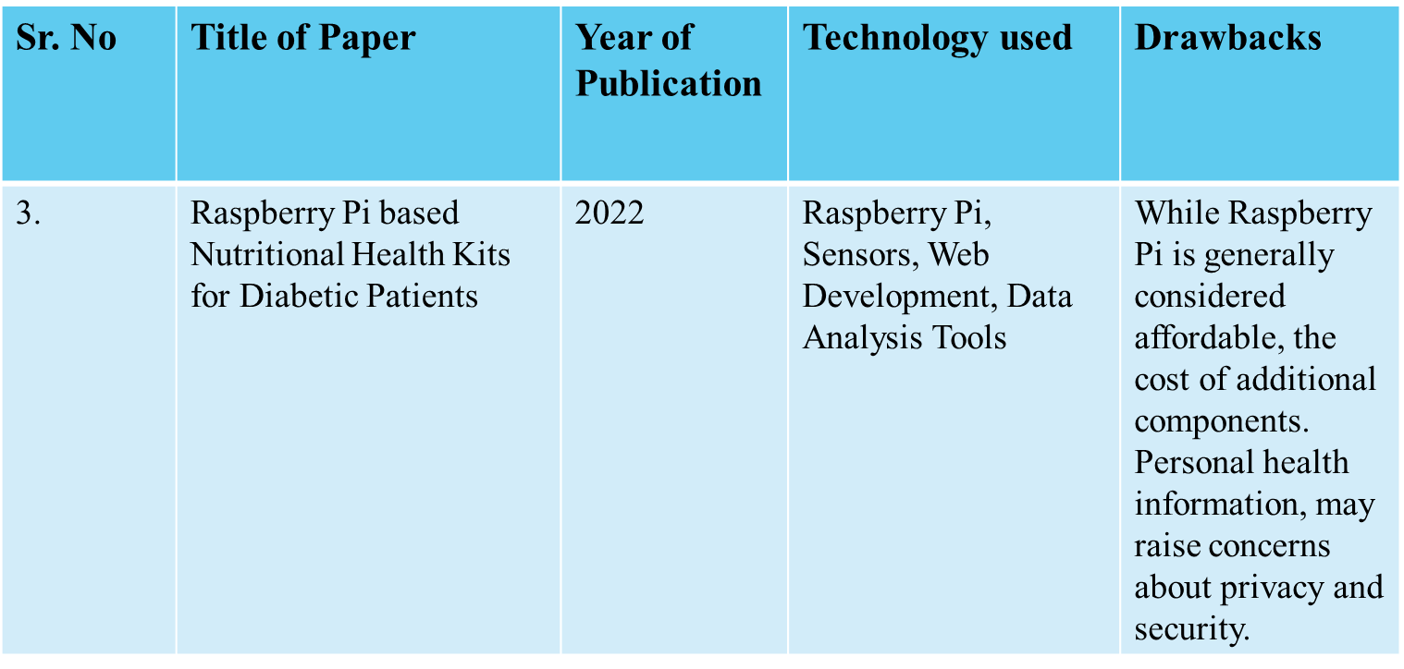

Slide 8
5. Feature /Functionality
1. Explore categorized recipes with detailed pages, images, and nutritional info. Includes user login for personalized experience.
2. Recommendation System
Based on the user input and user preferences our system can recommend recipes that user may like.
3. Chatbot
If the users have any frequently asked questions or any query regarding something they can use the Chat-bot to solve their query.

Slide 9
6. Technology Stack
Write what you have planned to develop front end ( GUI ) & Backend (Database if applicable)
--HTML & CSS
- JavaScript
- Python
- Database - MongoDB

Slide 10
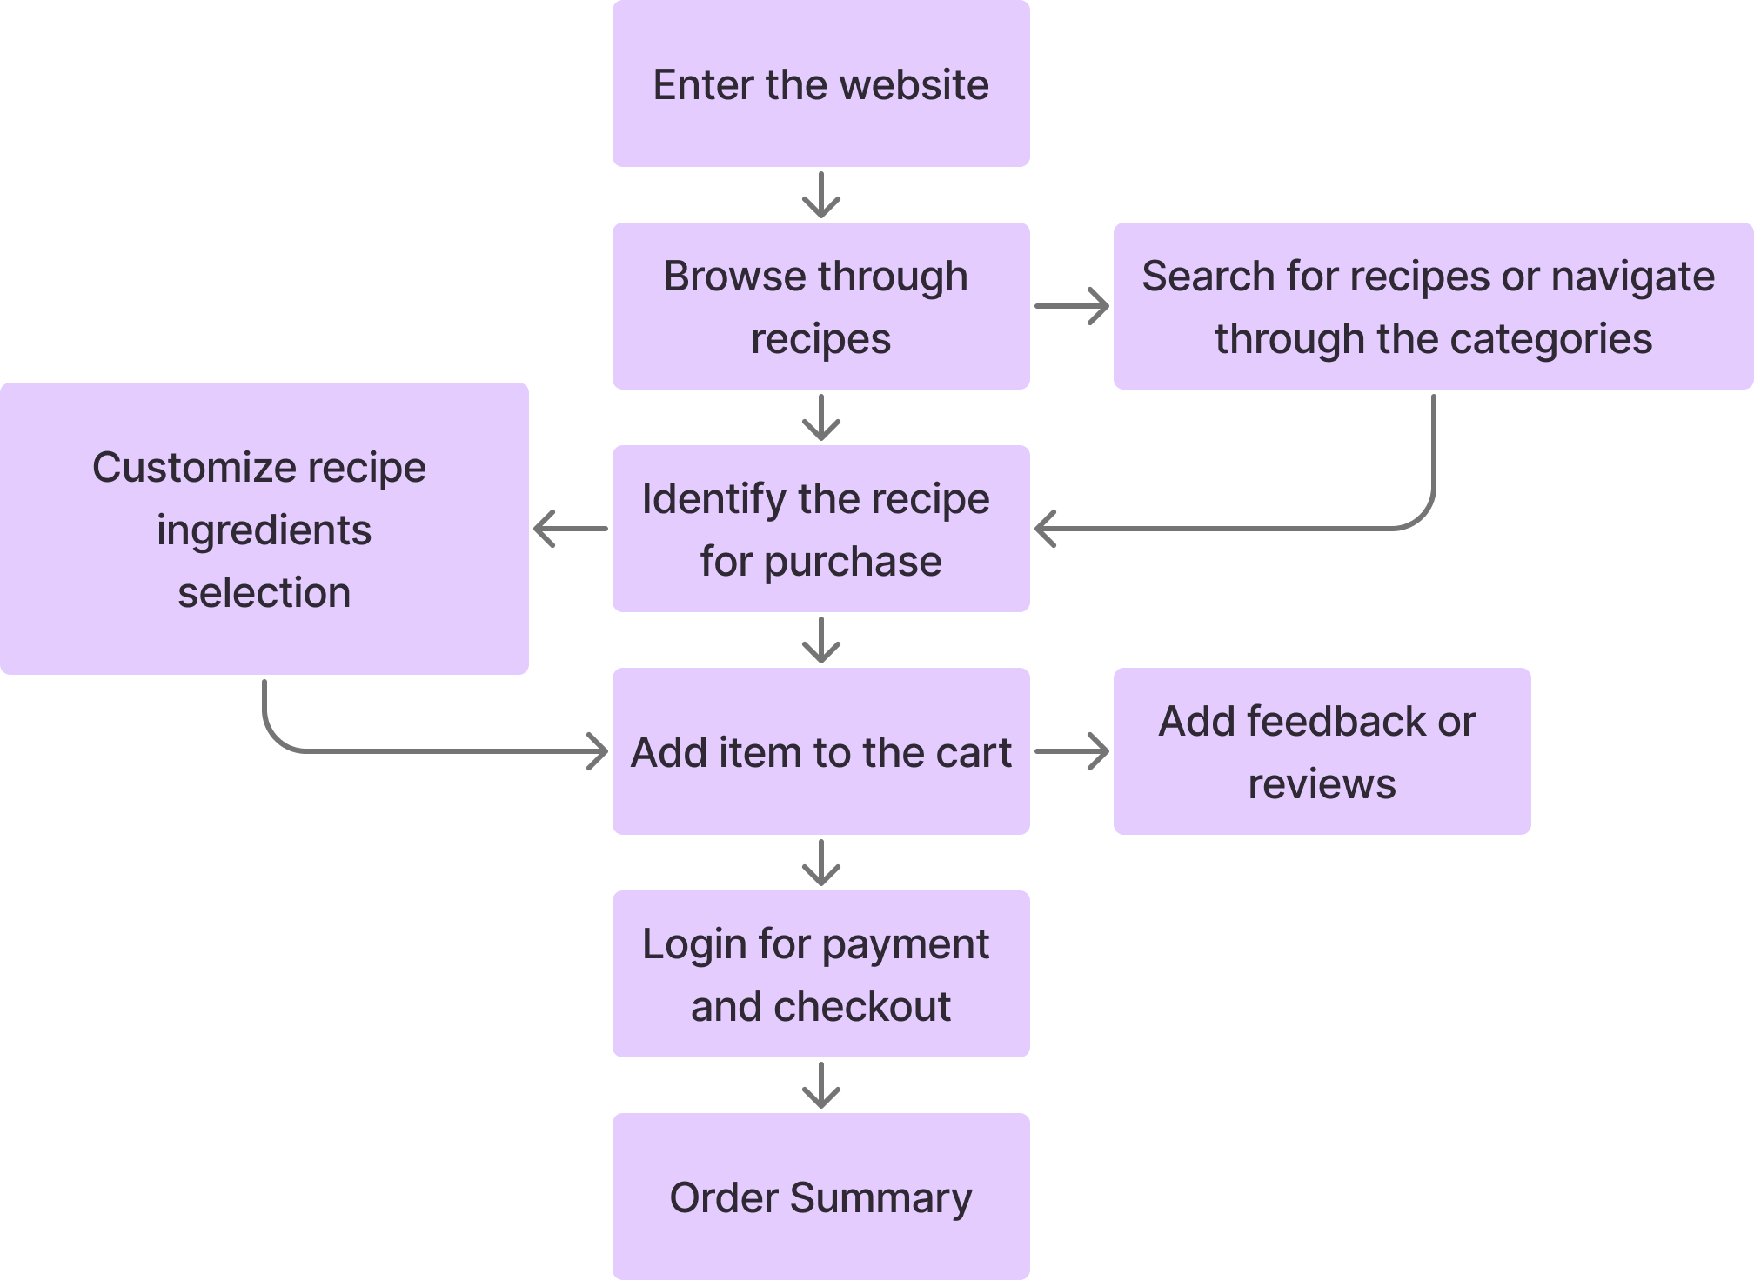
7. Block Diagram

Slide 11
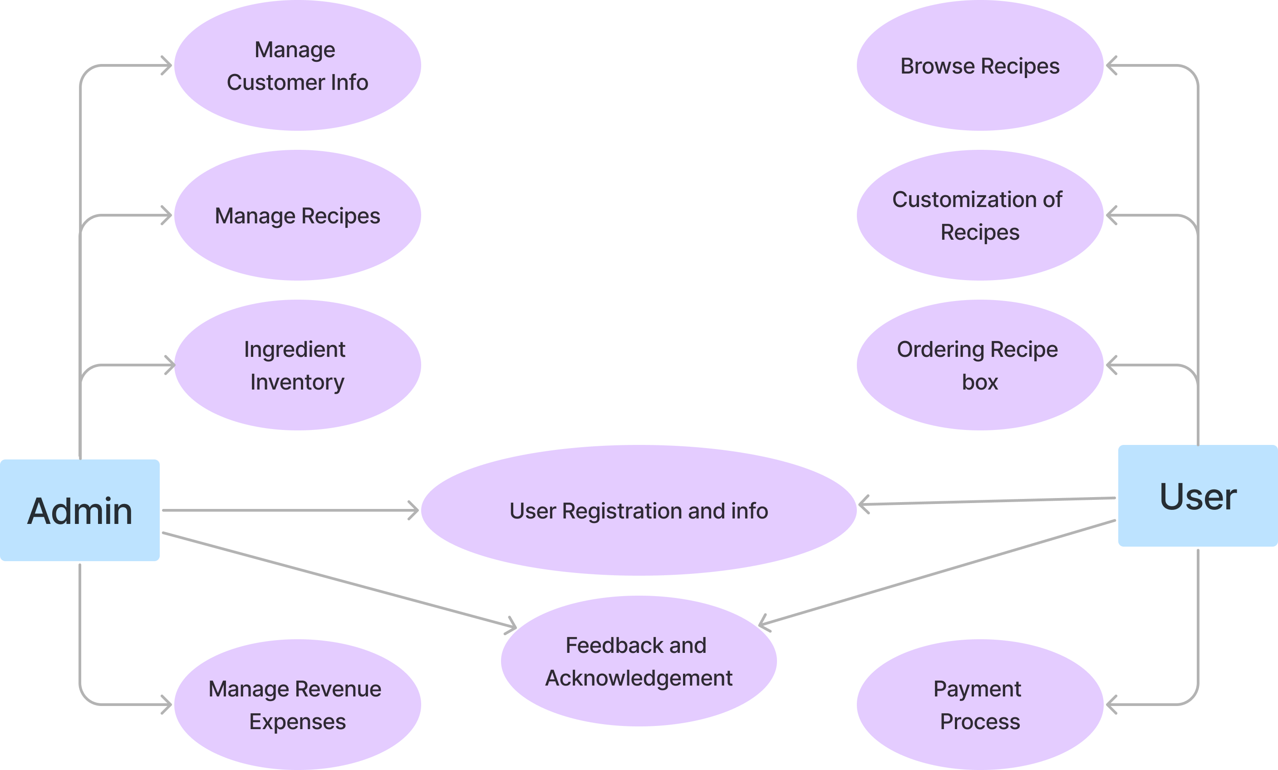
8. Use Case/Data Flow Diagram

Slide 12
9. Suggestions in Review-1
Complete Checkout page.
The project should start from the Home page rather than the login page.
Implement review and ratings in terms of stars or smilies.

Slide 13
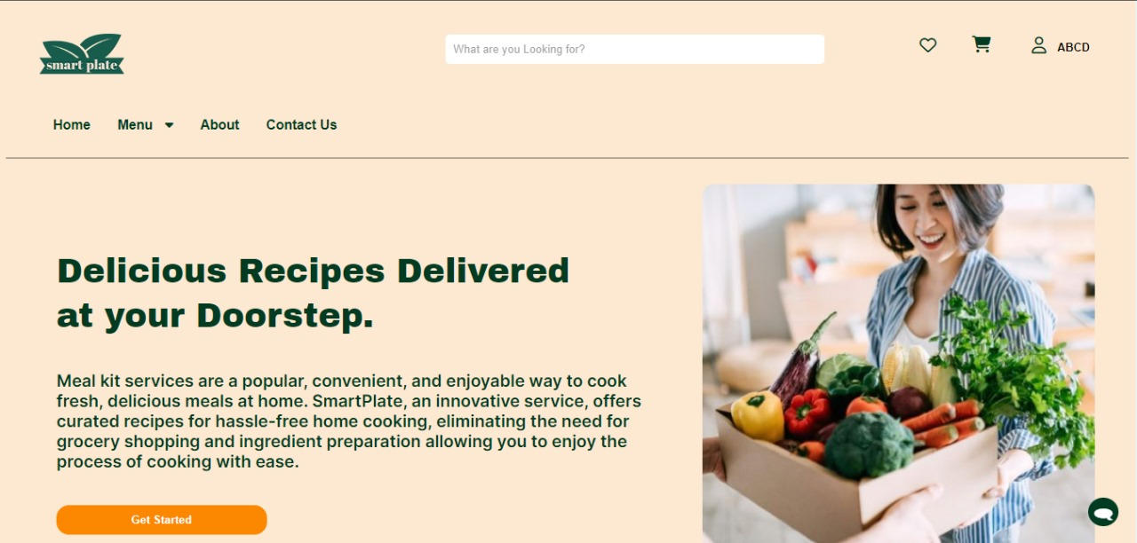
Result and Discussion
Fig.1. Home Page

Slide 14
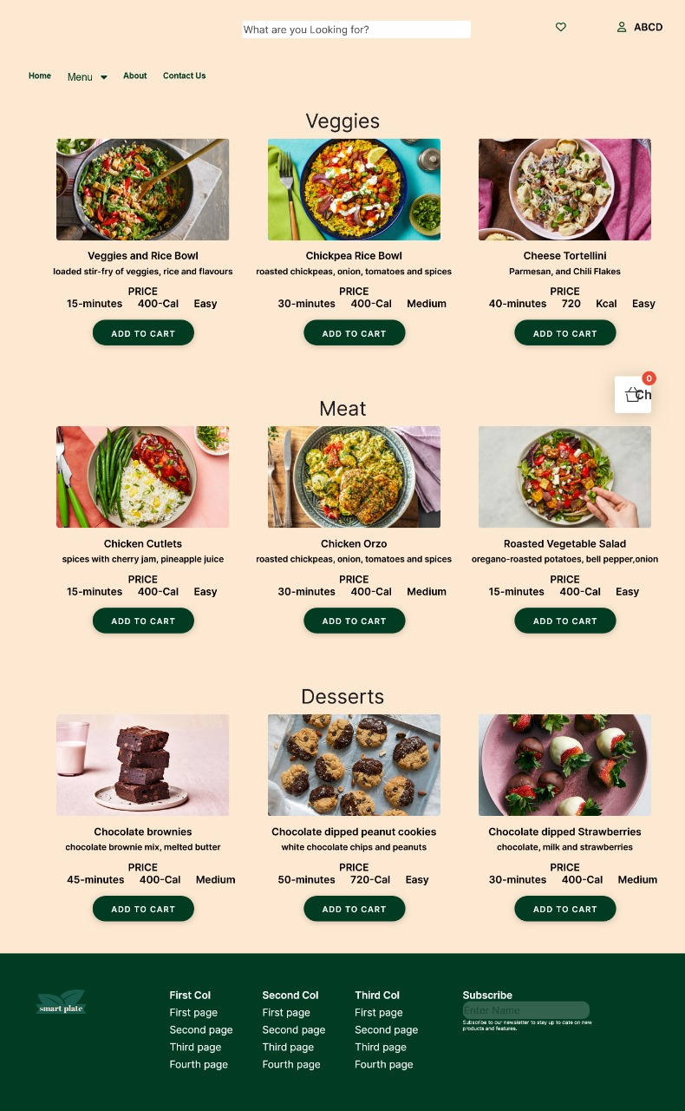
Fig. 2. Categories page

Slide 15
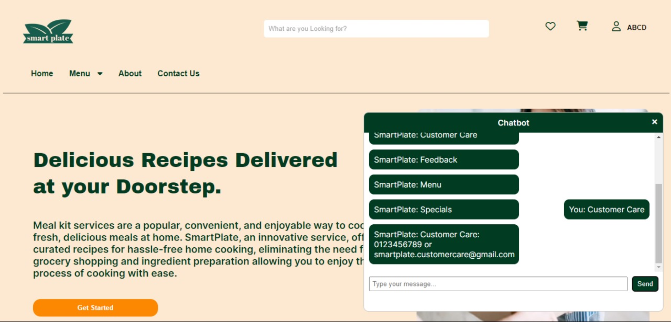
Fig. 3. Chatbot

Slide 16
Conclusion
Extensive research and thoughtful implementations have led to the development of a recipe website.
The journey started with understanding the challenges of busy individuals passionate about cooking.
Features are user-centric, shaped by feedback and preferences, creating a dynamic environment.
The visually appealing design is continually refined for intuitiveness and accessibility.
Users can navigate diverse recipes easily and enjoy a seamless ordering process.

Slide 17
Future Scope
Enable Delivery Tracking: Implement a delivery tracking system that provides users with real-time updates on the status of their orders. Users should be able to see the estimated delivery time and track the delivery's location as it progresses.
Serving Adjustments: Users to adjust portion sizes to match the number of servings they require, ensuring meals are perfectly portioned for their needs. This empowers users to create dishes that suit their needs.
Cooking Tutorials and tips: Tutorial videos can demonstrate step-by-step instructions for preparing recipes, while cooking tips provide helpful insights and shortcuts to improve efficiency and quality. Chef recommendations can offer expert advice on cooking methods.

Slide 18
References
[1] Natural language processing and machine learning approaches for food categorization and nutrition quality prediction. (Guanlan Hu, Mavra Ahmed, Mary R.)
[2] Food Demand Prediction using Statistical and Machine Learning Models (Sasikumar Jayapal)
[3] Raspberry Pi based Nutritional Health Kits for Diabetic Patients(Preethi Mannepally, Krishna Chaithanya, Bhaskar Bhanavath)
[4] On the potential of recommendation technologies for efficient content delivery networks
[5] https://medium.com/bithubph/payment-integration-with-node-js-express-request-and-paystack-api-8cebf51c1f52

Slide 19
Thank You...!!

