Slide 1
COLLEGE CAPSTONE PROJECT PRESENTATION
NeerDrishti (नीरदृष्टि)
GPU-Accelerated, Explainable Flood Risk Assessment & Water Body Analytics
Combining Cartographic Analysis, Multi-Spectrum Computer Vision & Interactive Web GIS
Presented by: Student / Project Team | Department of Computer Science & Engineering
Supervisor: Project Guide / Faculty Mentor | Academic Session 2026
Notes:
Welcome professors and faculty members. Today, I am proud to present 'NeerDrishti' - The Vision of Water. NeerDrishti is an explainable AI and computer-vision powered flood risk prediction system engineered to analyze aerial and satellite imagery in real-time, compute multi-zone risk heatmaps, and provide fully transparent decision metrics for disaster relief authorities.

Slide 2
01 • THE CHALLENGE
Problem Statement & Practical Motivation
1. Recurring Floods
• Urban and riverine flooding creates massive economic destruction and loss of life every year.
• Flash floods in low-drainage areas occur faster than traditional rescue teams can survey.
• Disaster response teams lack instant access to aerial flood boundary mappings.
2. Existing System Flaws
• Traditional satellite hydrology has multi-hour or multi-day revisit latency.
• Asphalt roads, shadows, and roof surfaces cause false positives with naive CV classifiers.
• Black-box deep learning models fail to explain WHY an area is flagged as high-risk.
3. The NeerDrishti Solution
• Sub-second local inference: Analyzes map screenshots and drone feeds offline without cloud lock-in.
• Multi-spectrum color fusion (HSV + LAB + Gray) eliminates road/water ambiguity.
• Explainable AI (XAI): Transparent metrics with water density, buffer zones, and confidence scores.
Notes:
Flooding remains one of the world's most catastrophic natural hazards. The core engineering problem is twofold: First, standard computer vision models frequently confuse dark asphalt highways and tree canopies with water bodies. Second, most modern AI models act as black boxes—they output an arbitrary danger score without explaining the rationale. NeerDrishti solves both gaps by pairing physics-guided color space fusion with an Explainable AI panel.

Slide 3
02 • TECHNICAL METHODOLOGY
System Architecture & Algorithmic Pipeline
Step 1: Ingestion
• Input: Satellite imagery, aerial drone photos, or live video feeds.
• Preprocessing: OpenCV frame decoding, normalization & multi-spectrum color space conversion (BGR to HSV and CIELAB).
Step 2: Detection
• Multi-band thresholding for clear, sediment-heavy, and muddy flood waters.
• Vegetation-aware luminance mask (CIELAB L-channel variance < 20).
• Mixed debris & water signature extraction using Gaussian smoothing.
Step 3: Road Filter
• Sobel gradient magnitude check: Water displays low gradient variance (<15), roads have high texture.
• Contour aspect ratio filtering: Discards elongated linear road strips (aspect ratio > 12).
• Morphological opening/closing.
Step 4: Heatmap
• Zone A: Core Water Bodies (morphological closing).
• Zone B: Buffer Risk Zone (dilation buffer).
• Zone C: Low-Risk Moisture spread.
• Multi-scale Gaussian convolutions (scales 5, 10, 20, 30) for smooth risk heatmaps.
Notes:
Here is our end-to-end processing pipeline. When an image is fed to NeerDrishti, it undergoes four stages: Stage 1 converts the frame to HSV and CIELAB color spaces. Stage 2 extracts water signatures, including difficult brown muddy floodwaters and vegetation shadows. Stage 3 applies our road suppression filter using Sobel gradients and contour aspect ratios. Stage 4 classifies the terrain into Zones A, B, and C, generating a research-grade multi-scale density heatmap.

Slide 4
03 • ENGINEERING SPECIFICATIONS
Technology Stack & Core Implementation
Backend Engine & APIs
• FastAPI: Asynchronous high-throughput REST API with automatic JSON validation.
• Uvicorn: ASGI server handling concurrent image & video stream requests.
• PyTorch & Torchvision: Auto-detecting CUDA GPU hardware with CPU fallback.
• ImageIO-FFmpeg: Transcodes video outputs to H.264 (yuv420p) for universal browser streaming.
Classification Risk Matrix
• < 3% Water Coverage: MINIMAL RISK (Normal seasonal basin)
• 3% – 8% Coverage: LOW RISK (Minor shoreline expansion)
• 8% – 15% Coverage: GUARDED (Noticeable water spread)
• 15% – 25% Coverage: ELEVATED (Water approaching inhabited zones)
• 25% – 35% Coverage: SEVERE (Widespread flood inundation)
• > 35% Coverage: EXTREME (Catastrophic water submergence)
•
• Automated Water Body Geometry Classifier:
• • Circularity > 0.6 & inland = Lake
• • Aspect ratio > 4 & inland = River basin
• • Edge boundary contact ratio > 0.1 = Coastal / Ocean
Frontend & Cartographic GIS
• Interactive Leaflet.js GIS: Real-time map rendering with coordinate analysis.
• Multi-Basemap Switching: Esri Dark Canvas, Esri World Satellite, and OpenStreetMap.
• Modern Glassmorphism UI: Native HTML5/CSS3/ES6 responsive dashboard.
• Offline-Safe Architecture: Gracefully operates offline without crashing if external CDNs are unavailable.
Notes:
On the engineering side, NeerDrishti is designed as a unified full-stack platform. The backend is built in FastAPI for asynchronous speed, with automated GPU hardware detection. On the frontend, we built an interactive Leaflet GIS dashboard with custom basemaps including Esri Dark Gray and Satellite Imagery. Notice the classification matrix: our system assesses relative flood risk from Minimal to Extreme, and automatically classifies whether the detected body is a river, lake, or ocean.

Slide 5
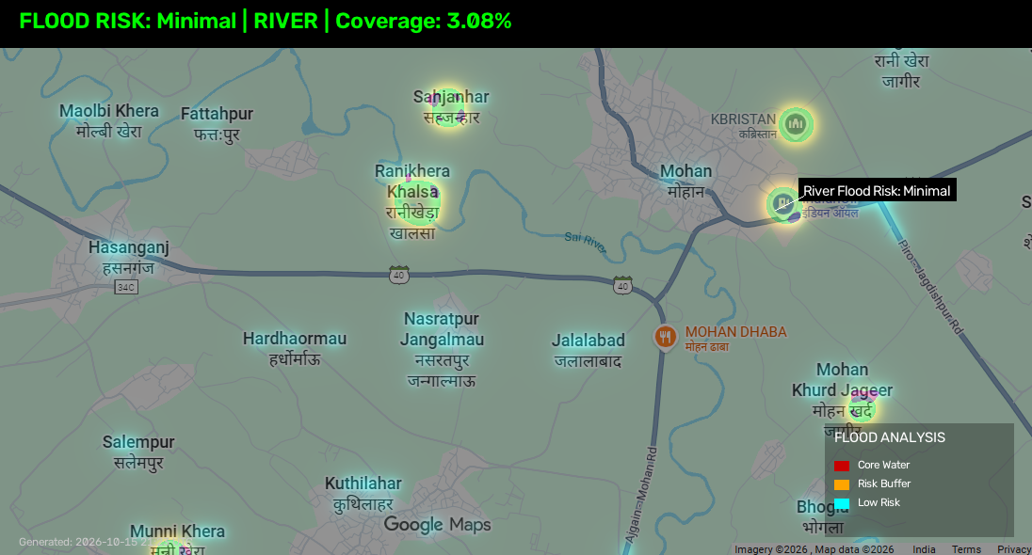
04 • RESULTS & EVALUATION
Visual Results & Explainable AI (XAI) Output
Real-Time Explainability Dashboard
• Transparent Decision Breakdown:
• • Total Detected Water Coverage: Precise percentage
• • Zone A (Core Bodies): High-risk water mass
• • Zone B (Buffer): Saturated adjacent perimeter
• • Zone C (Moisture): Peripheral spread & soil saturation
• • Edge Confidence Score: Derived from Canny perimeter validation
• • Road False Positives Suppressed: Verified via gradient filter
•
• Key Scientific Benefit:
• Relief teams are never presented with an unexplained danger score. Every prediction is accompanied by an audit trail of detected zones, moisture gradients, and water body classifications.
Notes:
Here you can see the actual output generated by NeerDrishti during test evaluations. On the left, notice how the algorithm overlays multi-zone color heatmaps: deep red for core water bodies, orange for the buffer danger zone, and cyan for moisture spread. On the right is our Explainable AI panel. Relief workers don't have to guess why a zone is flagged; they receive the exact pixel density, edge confidence, and zone ratios.

Slide 6
05 • SUMMARY & VISION
Conclusion, Future Work & Impact
Key Achievements
• End-to-End Functional System: Complete pipeline from upload to visual heatmap.
• Zero Cloud Dependency: Fully capable of running on local laptops or edge hardware in field stations.
• High Accuracy: Eliminates road and shadow false positives through gradient texture fusion.
• Sub-second Execution: Fast enough for aerial drone video streams.
Future Enhancements
• Live Satellite API Ingestion: Direct integration with Sentinel-2 / Landsat-9 multispectral feeds.
• Synthetic Aperture Radar (SAR): Penetrate dense storm cloud covers during live cyclones.
• IoT Telemetry Fusion: Ingest live ultrasonic river-gauge water level sensors.
• Mobile PWA: Offline smartphone app for NDRF / SDRF field officers.
Thank You!
Questions & Faculty Feedback
"Technology that empowers disaster response through speed and explainability."
Notes:
In conclusion, NeerDrishti bridges computer vision and real-time hazard analytics. By delivering fast, explainable, and offline-capable flood risk mapping, it provides life-saving insights without needing high-end cloud servers. In the future, we plan to fuse Synthetic Aperture Radar and live river-gauge telemetry. Thank you for your time, and we now welcome any questions and feedback from the faculty panel.

