Slide 1
Number Representation
Within a digital logic system, information is typically represented using a binary format.
the basic building block is a single bit.
signal one_bit : std_logic;
An electrical node with a voltage (v_{H} or v_{L}) exists for every bit (1 or 0) within a design.
numbers exist as arrays of such bits, nodes, & voltages.
signal one_byte : std_logic_vector(7 downto 0);
we need to define what a bit or vector represents and be able to interpret a bit or vector correctly from other devices or IP.

Slide 2
Number Representation
The statement std_logic_vector(7 downto 0) can be interpreted as 8 bits with the first having bit address 7 and the last having bit address 0.
Unless we (as a designer) define the format of these 8-bits, they cannot be related to a numerical value.
ADDR7
ADDR6
ADDR5
ADDR4
ADDR3
ADDR2
ADDR1
ADDR0

Slide 3
Number Representation
What are some types?
Integer vs. Floating Point – Pros and Cons
Types of Integers. BCD.
Why do we care about this?
In DSP48E1 User Guide, Chapter 1: Overview.
First bullet of the DSP Functionality ...
25 x 18 two’s complement multiplier
What does this mean?
What should I use at the inputs to multiply 5*7?
In the AD9694 Datasheet ...
“The format of the output is twos complement ...
“see Memory Map Section (Reg 0x0561) ...
Option to set for Offset Binary as well.

Slide 4
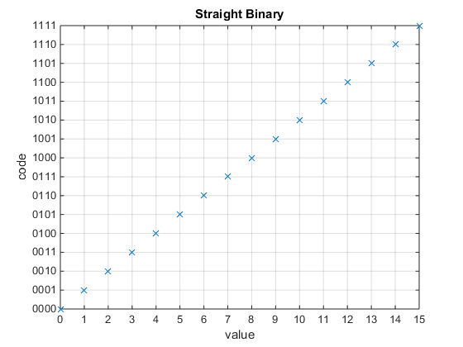
Transfer Characteristics (4-Bit)

Slide 5
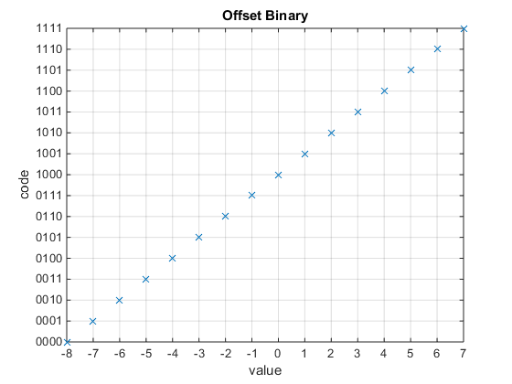
Transfer Characteristics (4-Bit)

Slide 6
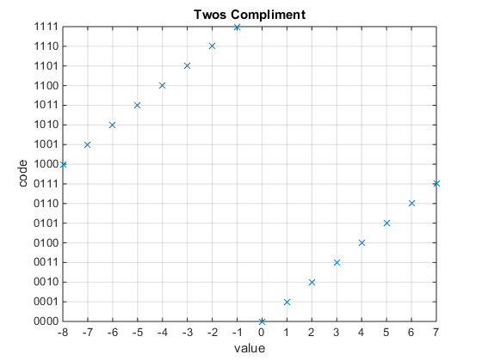
Transfer Characteristics (4-Bit)

Slide 7
Homework 1: Due Monday Jan 23
Describe the bit manipulation/mapping and requirements (to avoid bit overflow) needed to:
Convert Straight Binary to/from Offset Binary for Width N
Convert Straight Binary to/from Two’s Complement for Width N
Convert Offset Binary to/from Two’s Compliment for Width N
Increase the width of a Straight Binary number from N to M
Increase the width of a Offset Binary number from N to M
Increase the width of a Two’s Compliment # from N to M
Add two Straight Binary numbers
Add two Offset Binary numbers
Add two Two’s Compliment #’s
Subtract two Straight Binary numbers
Subtract two Offset Binary numbers
Subtract two Two’s Compliment #’s

Slide 8
Prep 1: Due Friday Jan 20
Read/Review materials for the Nexys Board
Send me an email and I will reply with access code for the digital design lab.

