Slide 1
FPGA Development Process
High level block diagram and design
Describes how parts are connected (Structural)
Describes how parts work (Functional)
Develop the code (Verilog, VHDL, Schematic)
Synthesize and Simulate (device independent)
Schematics (RTL and Synthesized)
Write a test-bench to simulate (first level of debug)
Place and Route (device specific)
Constraints (pin locations, clock speeds, timing req.)
Simulate (second level of debug)
Generate a programming file (.bit)
Program the device.
Chipscope logic analyzer (third level of debug)

Slide 2
FPGA Development Process
High level block diagram and design
Describes how parts are connected (Structural)
Describes how parts work (Functional)
Develop the code (Verilog, VHDL, Schematic)
Synthesize and Simulate (device independent)
Schematics (RTL and Synthesized)
Write a test-bench to simulate (first level of debug)
Place and Route (device specific)
Constraints (pin locations, clock speeds, timing req.)
Simulate (second level of debug)
Generate a programming file (.bit)
Program the device.
Chipscope logic analyzer (third level of debug)

Slide 3
Design Example 1
Basic Combinational Circuit
Design Specifics
4 input DIP switches: switch[3:0]
3 output LEDs: led[3:0]
Functional description ...

Slide 4
FPGA Development Process
High level block diagram and design
Describes how parts are connected (Structural)
Describes how parts work (Functional)
Develop the code (Verilog, VHDL, Schematic)
Synthesize and Simulate (device independent)
Schematics (RTL and Synthesized)
Write a test-bench to simulate (first level of debug)
Place and Route (device specific)
Constraints (pin locations, clock speeds, timing req.)
Simulate (second level of debug)
Generate a programming file (.bit)
Program the device
Chipscope logic analyzer (third level of debug)

Slide 5
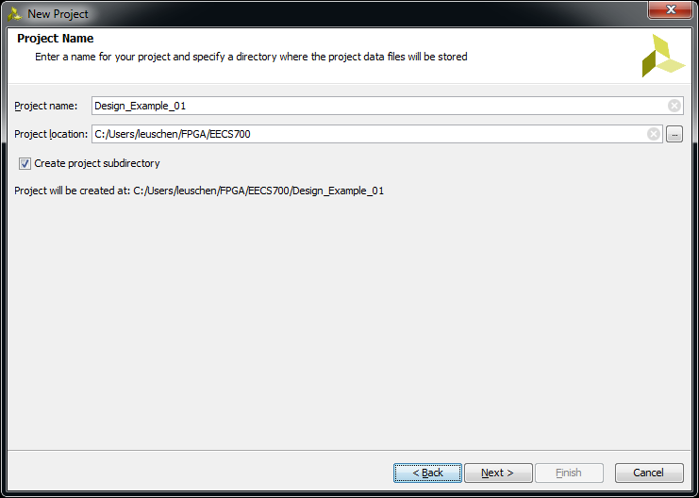
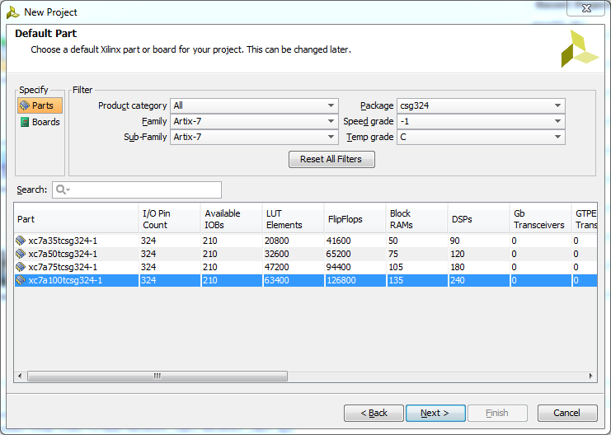
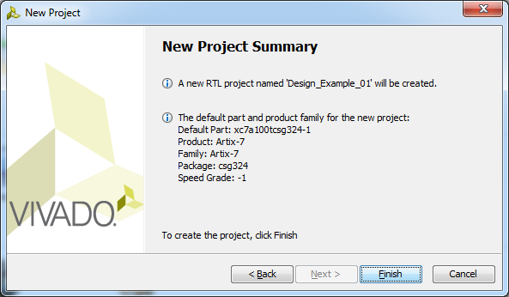
Design Example 1: ISE Project
Start ISE, File → New Project.
Set Name and Location, Next.
RTL Project, Next.
Choose Device, Next
From Nexys-4 User Guide.
Check the Project Properties.
Finish.

Slide 6
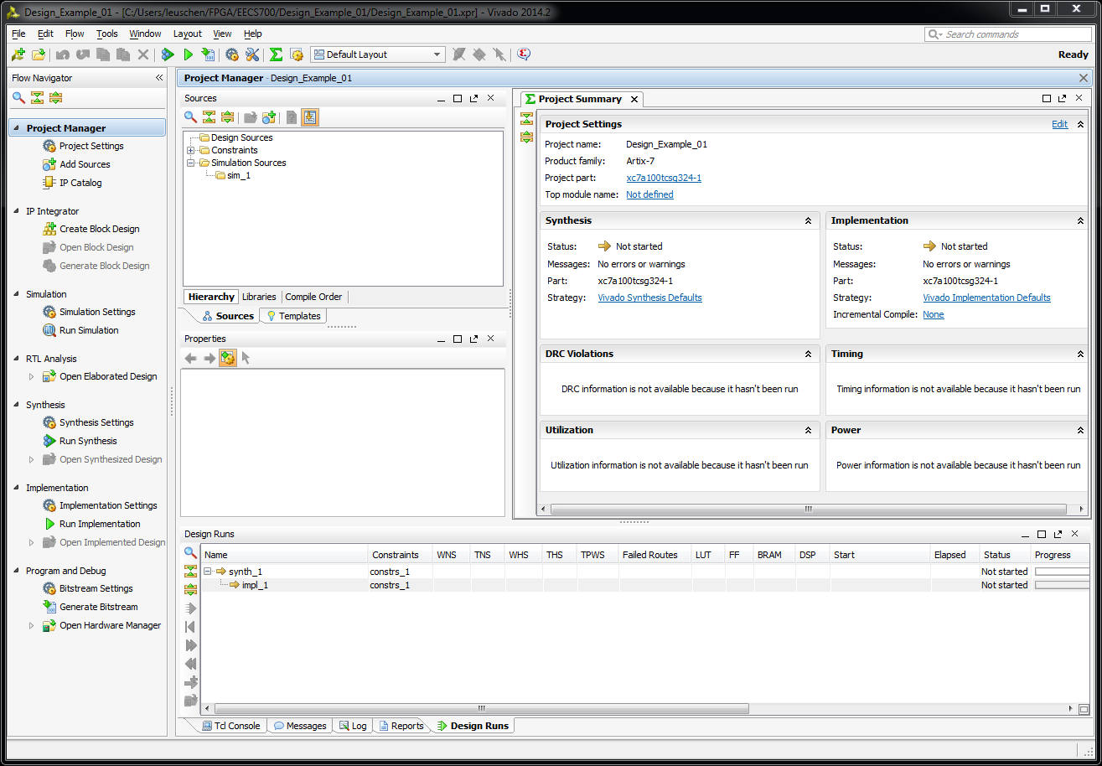
The Vivado Window Layout
NEW Design File

Slide 7
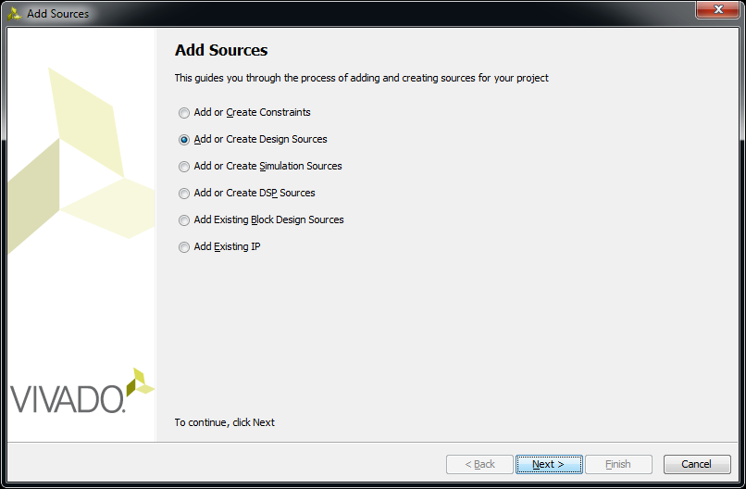
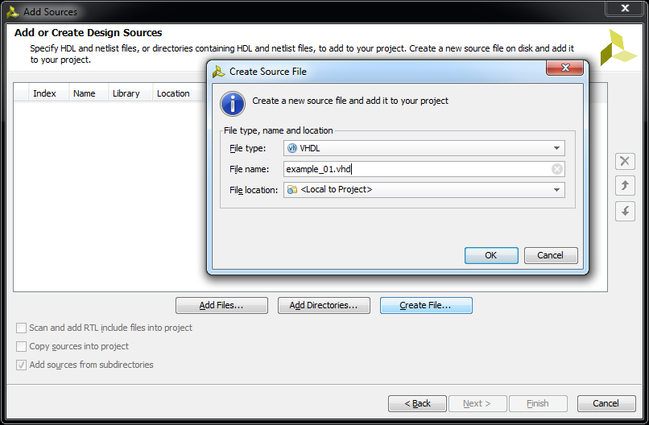
The Vivado Window: Add Sources

Slide 8
Design Files: example_01.vhd
library IEEE;
use IEEE.STD_LOGIC_1164.all;
entity example_01 is
port (
switch: in STD_LOGIC_VECTOR(3 downto 0);
led: out STD_LOGIC_VECTOR(3 downto 0)
);
end example_01;
architecture behavioral of example_01 is
begin
led(3) <= switch(2);
led(2) <= switch(3) and switch(2);
led(1) <= switch(3) or switch(2);
led(0) <= '0';
end behavioral;

Slide 9
FPGA Development Process
High level block diagram and design
Describes how parts are connected (Structural)
Describes how parts work (Functional)
Develop the code (Verilog, VHDL, Schematic)
Synthesize and Simulate (device independent)
Schematics (RTL and Synthesized)
Write a test-bench to simulate (first level of debug)
Place and Route (device specific)
Constraints (pin locations, clock speeds, timing req.)
Simulate (second level of debug)
Generate a programming file (.bit)
Program the device.
Chipscope logic analyzer (third level of debug)

Slide 10
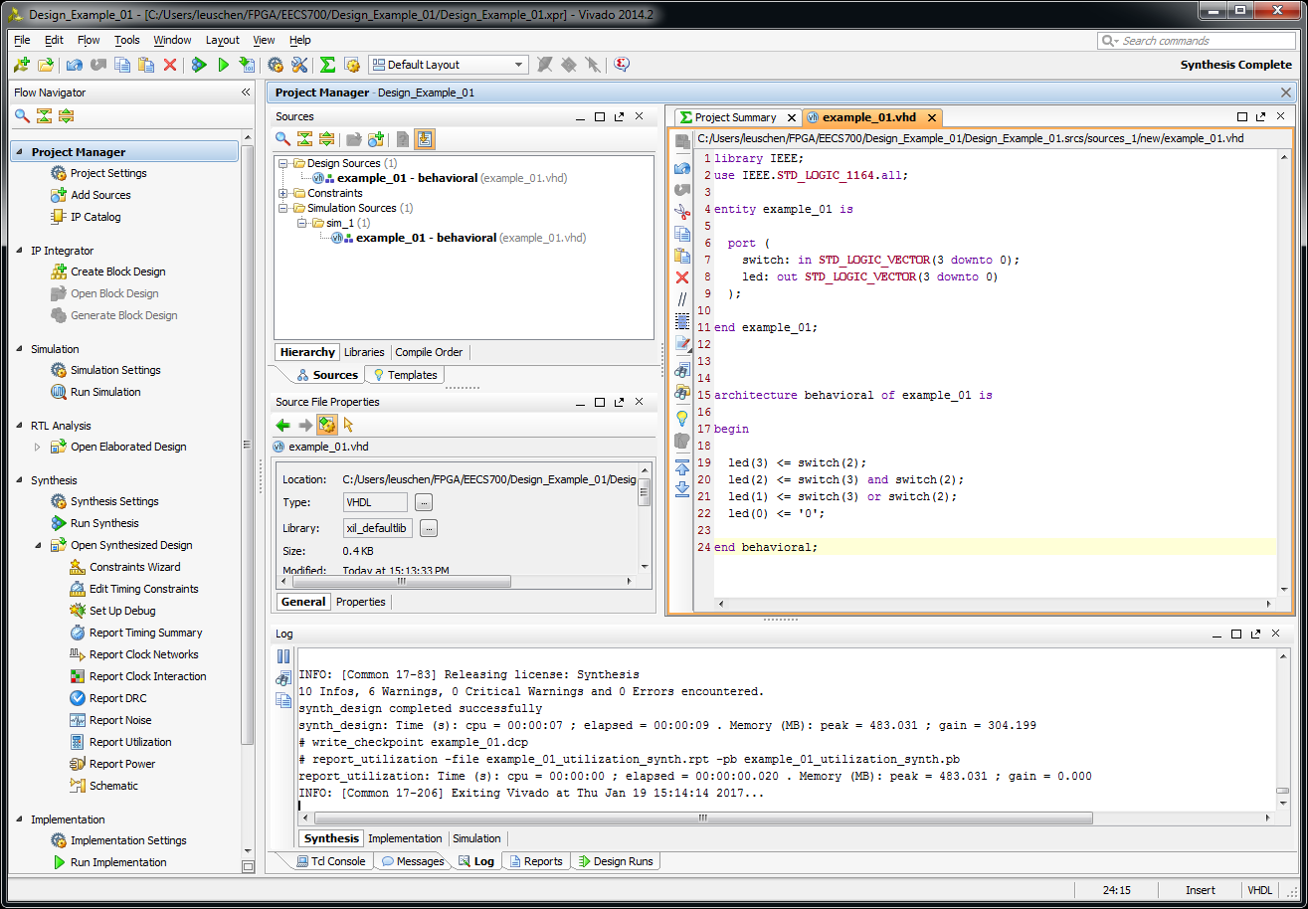
Synthesize

Slide 11
FPGA Development Process
High level block diagram and design
Describes how parts are connected (Structural)
Describes how parts work (Functional)
Develop the code (Verilog, VHDL, Schematic)
Synthesize and Simulate (device independent)
Schematics (RTL and Synthesized)
Write a test-bench to simulate (first level of debug)
Place and Route (device specific)
Constraints (pin locations, clock speeds, timing req.)
Simulate (second level of debug)
Generate a programming file (.bit)
Program the device.
Chipscope logic analyzer (third level of debug)

Slide 12
Schematic

Slide 13
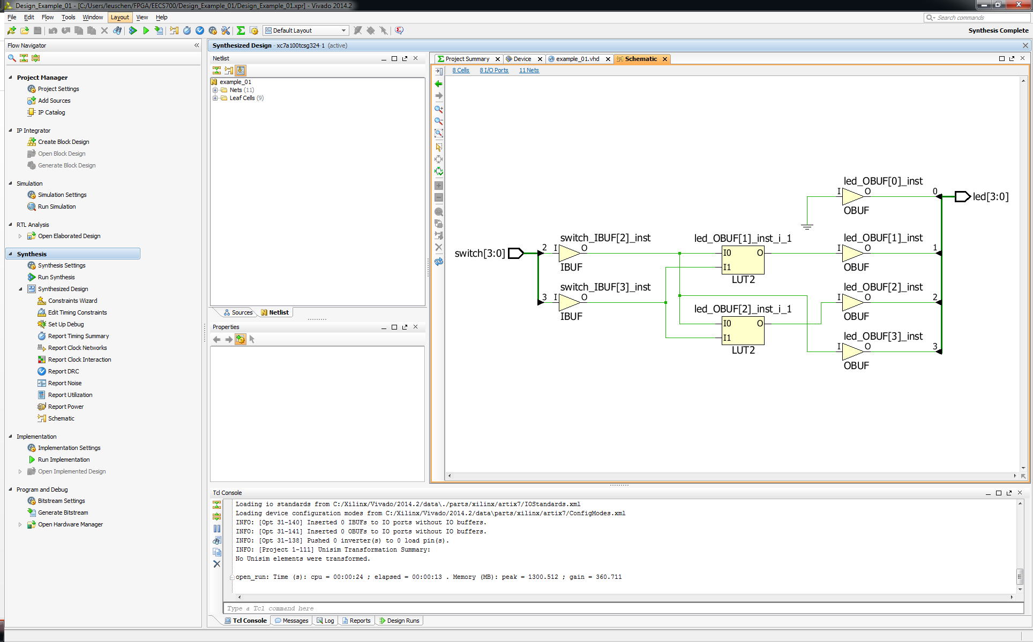
Schematics

Slide 14
FPGA Development Process
High level block diagram and design
Describes how parts are connected (Structural)
Describes how parts work (Functional)
Develop the code (Verilog, VHDL, Schematic)
Synthesize and Simulate (device independent)
Schematics (RTL and Synthesized)
Write a test-bench to simulate (first level of debug)
Place and Route (device specific)
Constraints (pin locations, clock speeds, timing req.)
Simulate (second level of debug)
Generate a programming file (.bit)
Program the device.
Chipscope logic analyzer (third level of debug)

Slide 15
Simulation Files: example_01_tb.vhd
library IEEE;
use IEEE.STD_LOGIC_1164.all;
entity example_01_tb is
end example_01_tb;
architecture simulation of example_01_tb is
component example_01
port (
switch: in STD_LOGIC_VECTOR(3 downto 0);
led: out STD_LOGIC_VECTOR(3 downto 0)
);
end component;
signal switch_tb: STD_LOGIC_VECTOR(3 downto 0) := "0000";
signal led_tb: STD_LOGIC_VECTOR(3 downto 0);
begin
dut: example_01
PORT MAP (
switch => switch_tb,
led => led_tb
);
stim_proc: process
begin
wait for 100 ns;
switch_tb <= "1010";
wait for 100 ns;
switch_tb <= "0101";
wait;
end process;
end;
No more VHDL coding.

Slide 16
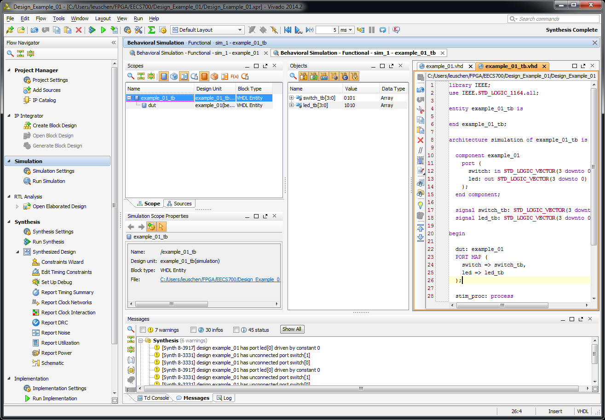
Simulate Testbench

Slide 17
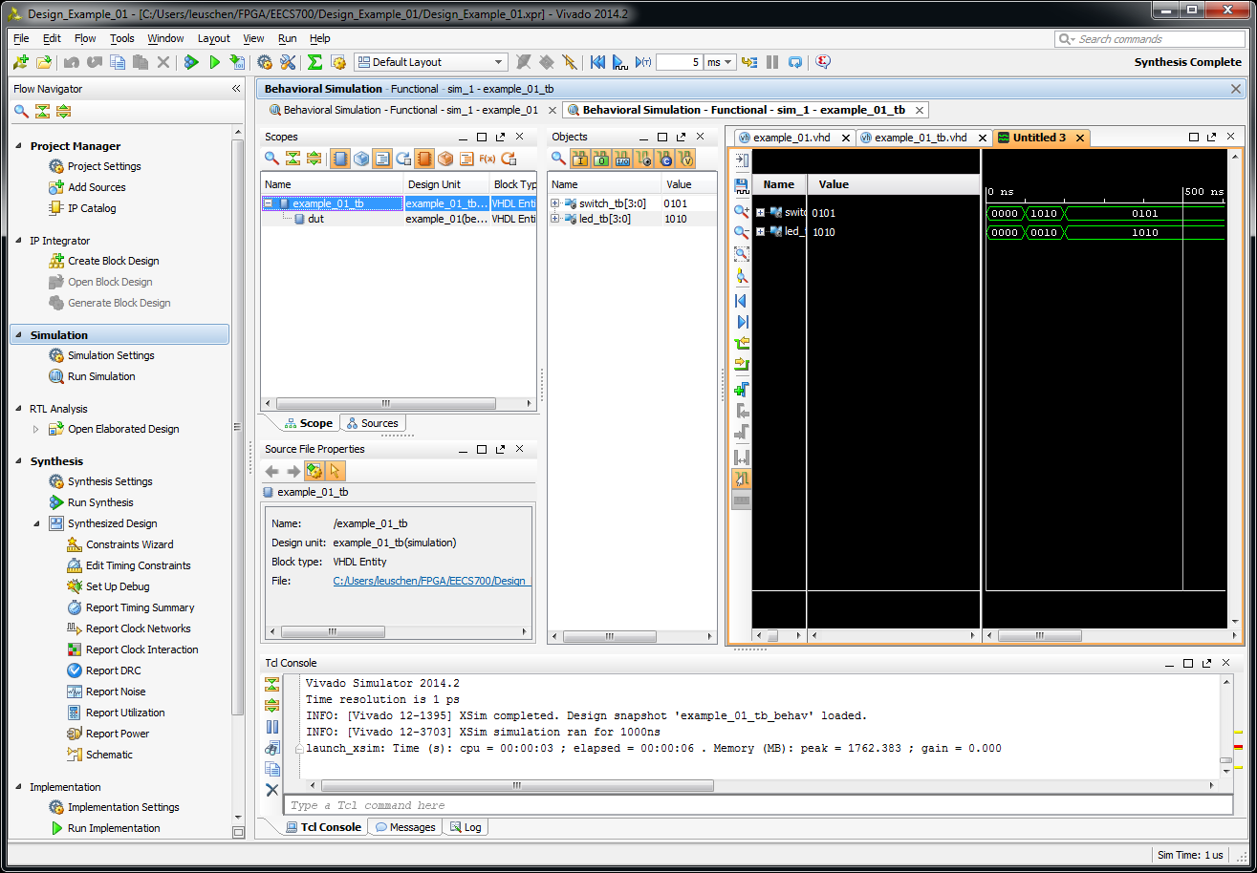
Results

Slide 18
FPGA Development Process
High level block diagram and design
Describes how parts are connected (Structural)
Describes how parts work (Functional)
Develop the code (Verilog, VHDL, Schematic)
Synthesize and Simulate (device independent)
Schematics (RTL and Synthesized)
Write a test-bench to simulate (first level of debug)
Place and Route (device specific)
Constraints (pin locations, clock speeds, timing req.)
Simulate (second level of debug)
Generate a programming file (.bit)
Program the device.
Chipscope logic analyzer (third level of debug)

Slide 19
Constraints File: example_01.xdc
set_property PACKAGE_PIN U9 [get_ports {switch[0]}]
set_property IOSTANDARD LVCMOS33 [get_ports {switch[0]}]
set_property PACKAGE_PIN U8 [get_ports {switch[1]}]
set_property IOSTANDARD LVCMOS33 [get_ports {switch[1]}]
set_property PACKAGE_PIN R7 [get_ports {switch[2]}]
set_property IOSTANDARD LVCMOS33 [get_ports {switch[2]}]
set_property PACKAGE_PIN R6 [get_ports {switch[3]}]
set_property IOSTANDARD LVCMOS33 [get_ports {switch[3]}]
#set_property -dict { PACKAGE_PIN U9 IOSTANDARD LVCMOS33 } [get_ports { switch[0] }];
#set_property -dict { PACKAGE_PIN U8 IOSTANDARD LVCMOS33 } [get_ports { switch[1] }];
#set_property -dict { PACKAGE_PIN R7 IOSTANDARD LVCMOS33 } [get_ports { switch[2] }];
#set_property -dict { PACKAGE_PIN R6 IOSTANDARD LVCMOS33 } [get_ports { switch[3] }];
set_property PACKAGE_PIN T8 [get_ports {led[0]}]
set_property IOSTANDARD LVCMOS33 [get_ports {led[0]}]
set_property PACKAGE_PIN V9 [get_ports {led[1]}]
set_property IOSTANDARD LVCMOS33 [get_ports {led[1]}]
set_property PACKAGE_PIN R8 [get_ports {led[2]}]
set_property IOSTANDARD LVCMOS33 [get_ports {led[2]}]
set_property PACKAGE_PIN T6 [get_ports {led[3]}]
set_property IOSTANDARD LVCMOS33 [get_ports {led[3]}]
#set_property -dict { PACKAGE_PIN T8 IOSTANDARD LVCMOS33 } [get_ports { LED[0] }];
#set_property -dict { PACKAGE_PIN V9 IOSTANDARD LVCMOS33 } [get_ports { LED[1] }];
#set_property -dict { PACKAGE_PIN R8 IOSTANDARD LVCMOS33 } [get_ports { LED[2] }];
#set_property -dict { PACKAGE_PIN T6 IOSTANDARD LVCMOS33 } [get_ports { LED[3] }];

Slide 20
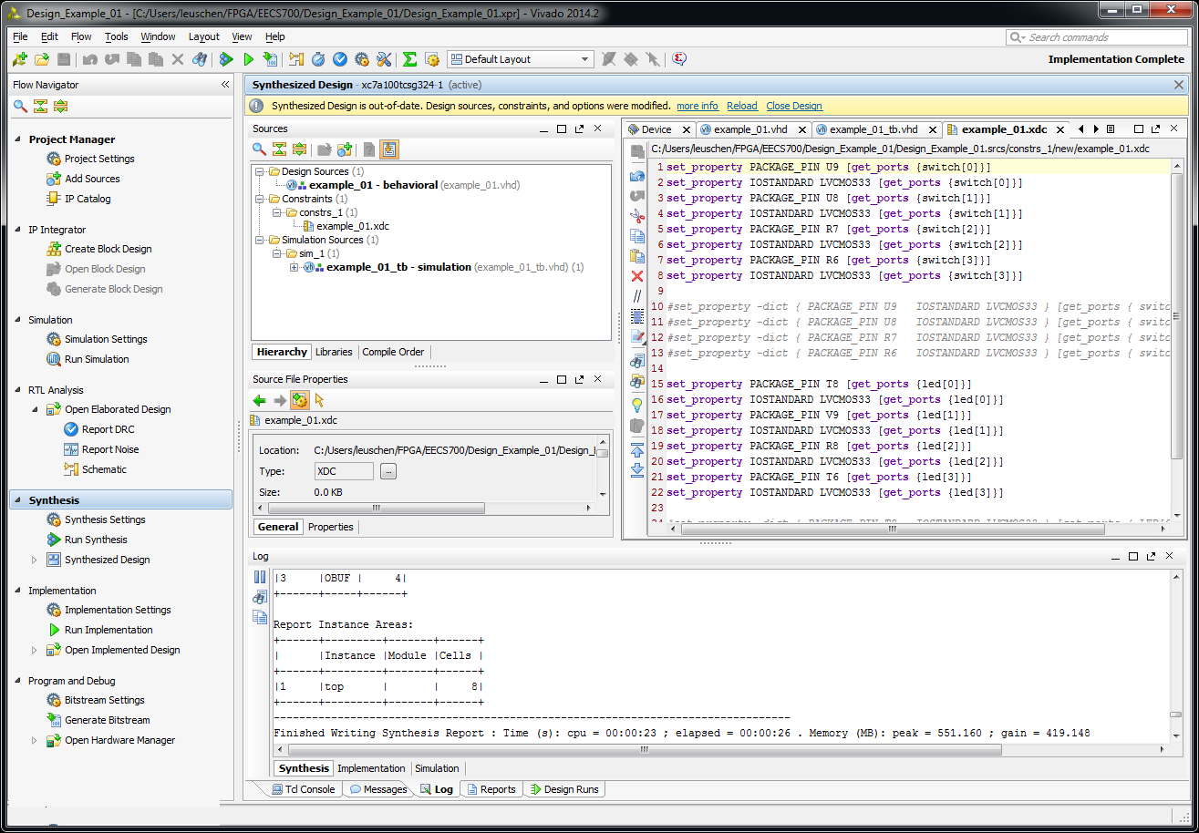
Implement Design

Slide 21
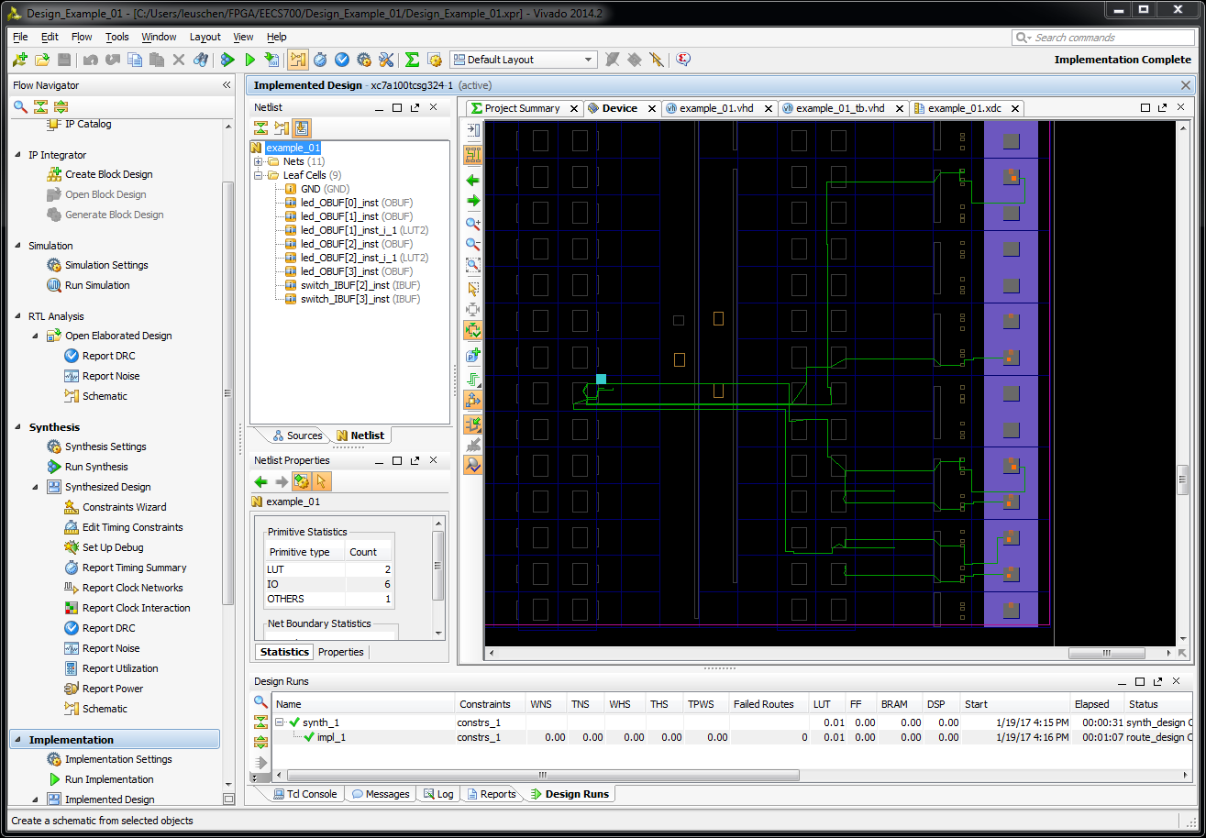

Slide 22
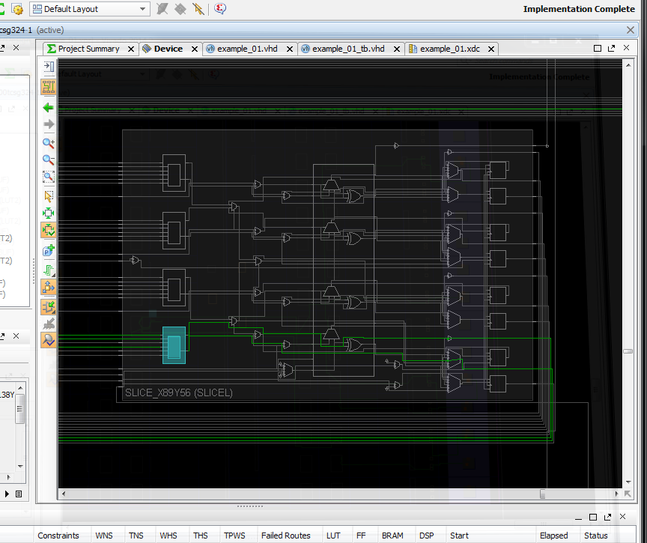
INIT = 4’h8?????

Slide 23
FPGA Development Process
High level block diagram and design
Describes how parts are connected (Structural)
Describes how parts work (Functional)
Develop the code (Verilog, VHDL, Schematic)
Synthesize and Simulate (device independent)
Schematics (RTL and Synthesized)
Write a test-bench to simulate (first level of debug)
Place and Route (device specific)
Constraints (pin locations, clock speeds, timing req.)
Simulate (second level of debug)
Generate a programming file (.bit)
Program the device.
Chipscope logic analyzer (third level of debug)

Slide 24
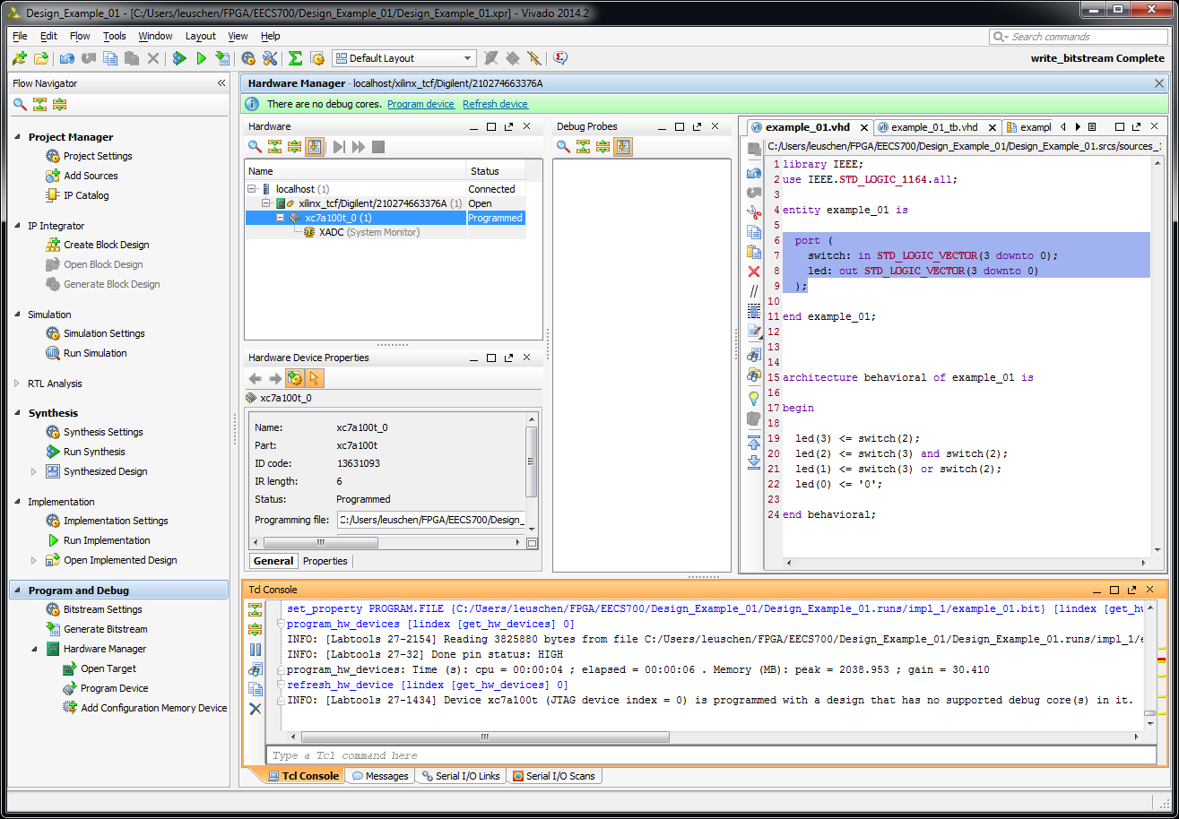
Programming File & Programming

