Slide 1
Basic Logic Architecture
CARRY CONNECTS
CARRY CONNECTS
switch matrix
CLB
switch matrix
CLB
SLICE M
SLICE X
X1Y1
SLICE L
SLICE X
X3Y1
X0Y1
X2Y1
INTERCONNECTS
switch matrix
CLB
switch matrix
CLB
SLICE M
SLICE X
X1Y0
SLICE L
SLICE X
X3Y0
X0Y0
X2Y0

Slide 2
Signal Routing
●
Carry: connects SLICEL or SLICEM components vertically. Interconnects (horizontal and vertical)
●
●
Connect components of the FPGA. 3 types of connections.
●
–
–
–
Single connection: connects neighboring components. Double connection: connects every other component. Quad connection: connects every fourth component.
●
Hard-wired, switch matrix connects to appropriate type and direction.
●
Switch Matrix
●
Connects CLB to interconnects.
Route signal back to same CLB (fast connection).
●
–
Implement more complex logic.
●
Programmable during configuration using pass through transistors and latches.
●
Total of five connections: carry, fast, single, double, and quad.

Slide 3
FPGA Logic
●
Logic components of the FPGA are located in Configurable Logic Blocks (CLB).
Arranged in a two-dimensional grid. Each CLB has two slices
●
●
–
–
One SLICEX in the right half (Spartan-6).
One SLICEL or SLICEM in the left half (right half for 7s).
●
Slices are identified by their x and y locations. The lower, left-hand corner is X0Y0.
●

Slide 4
Basic Logic Architecture
CARRY CONNECTS
CARRY CONNECTS
switch matrix
CLB
switch matrix
CLB
SLICE M
SLICE X
X1Y1
SLICE L
SLICE X
X3Y1
X0Y1
X2Y1
INTERCONNECTS
switch matrix
CLB
switch matrix
CLB
SLICE M
SLICE X
X1Y0
SLICE L
SLICE X
X3Y0
X0Y0
X2Y0

Slide 5
SLICEX
CHAIN D
CHAIN C
CHAIN B
CHAIN A
A0
LUT6
A
A1
A2
A3
LUT6
FLIP FLOP
MUX
AMUX
A4
ADDITIONAL LOGIC FOR SLICEL/SLICEM
A5
AX
MUX
AQ
FLIP
FLOP
CLK EN
CLK/CLKB
RESET

Slide 6
SLICEX and L/M
●
Four identical chains:
Single 6-input 2-output LUT (4 total) for combinational logic.
Two Flip Flops with clock enable and reset (8 total) for sequential logic.
Two static MUXs (8 total) for signal routing.
●
LUT configuration and MUX routing are programmable during configuration.
Chains are independent, no interconnections (SLICEX).
SLICEL includes same as SLICEX plus additional carry logic and multiplexers.
●
●
Carry logic provides vertical interconnects between chains and slices.
Additional multiplexers can implement wide multiplexers (up to 16:1), LUT7, or LUT8.
●
SLICEM includes same as SLICEL plus additional shift registers and distributed RAM.
–
See Configurable Logic Block User Guide for additional information.

Slide 7
6-Input 2-output LUT
Two 5-input LUT.
Single 2-input MUX.
64 bit INIT parameter.
● O5(0:31) = O6(0:31) = INIT(0:31).
● O5(32:63) = O5(0:31) = INIT(0:31).
O6(32:63) = INIT(32:63).
Instantiation Template
LUT6_2 # (
.INIT(64'h0000000000000000))
LUT6_2_inst (
.O6(O6),
.O5(O5),
.I0(I0),
.I1(I1),
.I2(I2),
.I3(I3),
.I4(I4),
.I5(I5));
Location/Routing Constraints
INST “LUT6_2_inst” LOC=SLICE_XmYn | BEL=[A:B:C:D]6LUT | LOCK_PINS=ALL or O6:O6...
LUT6
A0
A1
A2
LUT5
A3
O6
●
A4
LUT5
O5
A5

Slide 8
Storage Elements
●
8 storage elements in each slice.
–
–
–
–
4 can be either flip flops (registers) or latches. 4 can only be flip flops (registers).
If 4 are latches, the other 4 are inaccessible.
All elements use the same clock, clock enable, and set/reset signals.
●
Instantiation Example: FDRE
–
–
D Flip Flop with clock enable and sync reset.
There is an INIT parameter, typically set to 0 for reset, and 1 for set.
FDRE FDRE_inst (
.Q(Q),
.C(C),
.CE(CE),
.R(R),
.D(D));

Slide 9
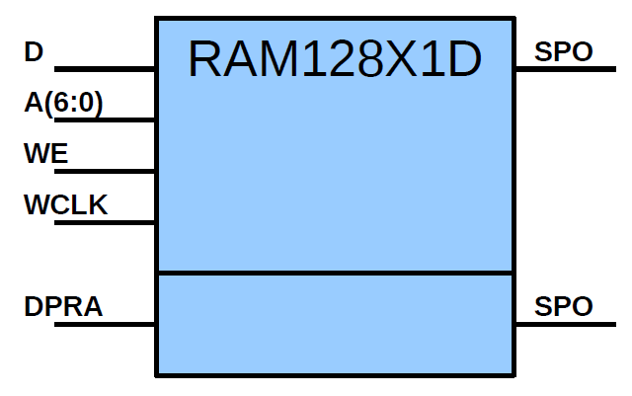
Other Components
●
Distributed RAM (SLICEM Only)
– Single Port, Dual Port, and Quad Port.
– Up to 256 bits.
– 64, 128, 256-bit ROM also.
Implemented in the LUT6.
Example: RAM128X1D
128 by 1 bit dual port RAM
RAM128X1D # (
.INIT(128'h00000000000000000000000000000000))
RAM128X1D_inst (
.DPO(DPO),
.SPO(SPO),
.A(A),
.D(D),
.DPRA(DPRA),
.WCLK(WCLK),
.WE(WE));
●

Slide 10
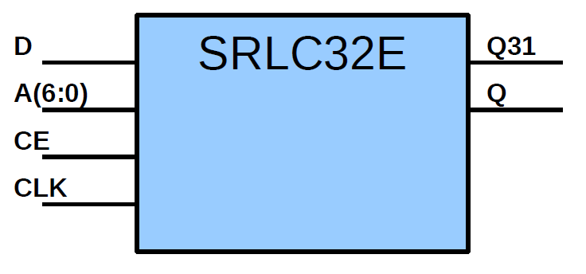
Other Components
●
32-bit Shift Register (SLICEM Only)
–
–
–
Implemented in LUT6.
Cascade for up to 128-bit per slice. Delayed output and addressable output.
●
Example: SRLC32E
SRLC32E # (
.INIT(32'h00000000))
SRLC32E_inst (
.Q(Q),
.Q31(Q31),
.A(A),
.CE(CE),
.CLK(CLK),
.D(D));

Slide 11
Other Components
●
Wide Multiplexer
–
Four 4:1 MUX. (All)
●
Each LUT6 can be used as a 4:1 MUX (SLICEX also). 2 inputs used as SELECT[1:0].
4 inputs used as INPUT[3:0].
●
●
–
Two 8:1 MUX. (SLICEL/M Only)
●
F7AMUX and F7BMUX.
combine [A,B]6LUT and [C,D]6LUT. using AX and CX signals as SELECT.
●
●
–
One 16:1 MUX. (SLICEL/M Only)
●
F8MUX.
combine F7AMUX and F7BMUX. using BX signal as SELECT.
●
●

Slide 12
Other Components
●
Fast Carry Logic (SLICEL/M Only)
–
–
–
MUX and XOR connecting LUT outputs vertically.
Used for addition or subtraction. Inputs
CO
S
S: Sum of a individual bit stage.
0
1
–
–
–
DI
DI: Carry value of an individual bit stage.
O
CI: Carry input
●
Initial value of 0 for add Initial value of 1 for subtract
CI
●
–
–
O: Add/Sum output value. CO: Carry output.
–
Connect slices vertically to create large adders.
●
CI of bottom LUT can MUX 0, 1, AX, or CO of the Slice below.

Slide 13
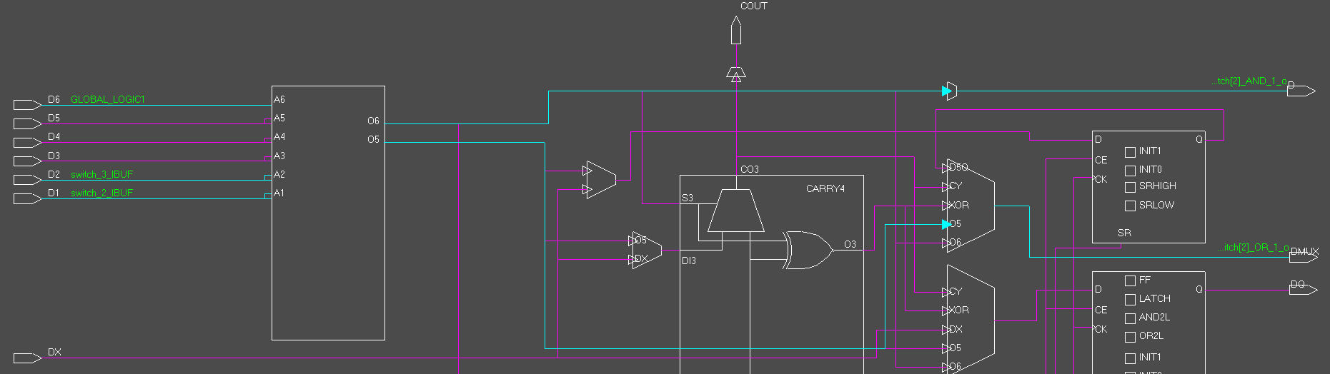
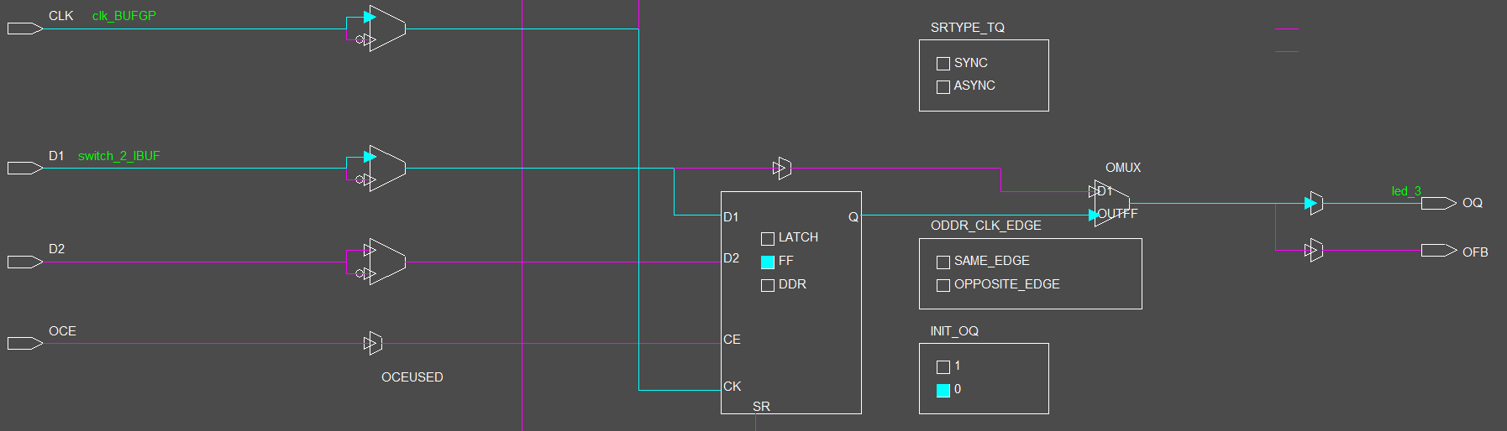
library IEEE;
use IEEE.STD_LOGIC_1164.all;
entity example_01 is
port (
clk: in STD_LOGIC;
switch: in STD_LOGIC_VECTOR(3 downto 0);
led: out STD_LOGIC_VECTOR(3 downto 0)
);
end example_01;
architecture behavioral of example_01 is
begin
process (clk)
begin
if (clk'event and clk='1') then
led(3) <= switch(2);
led(2) <= switch(3) and switch(2);
led(1) <= switch(3) or switch(2);
led(0) <= '0';
end if;
end process;
end behavioral;

Slide 14
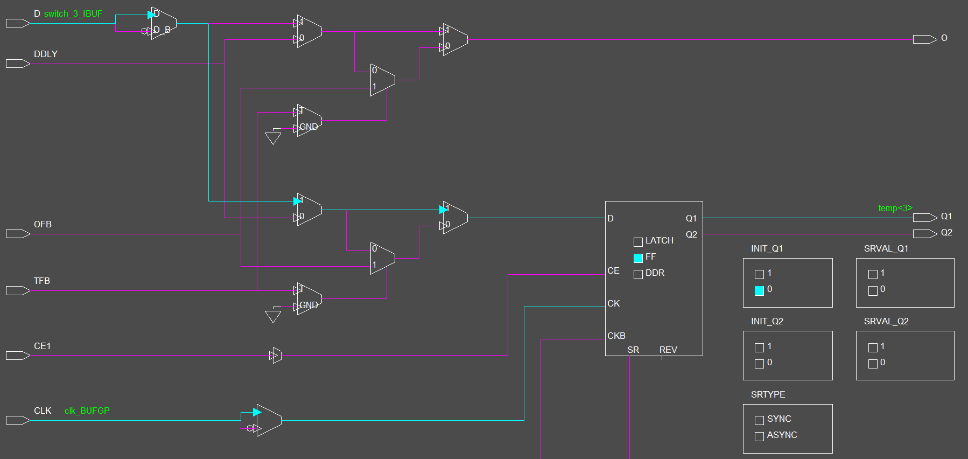
library IEEE;
use IEEE.STD_LOGIC_1164.all;
entity example_01 is
port (
clk: in STD_LOGIC;
switch: in STD_LOGIC_VECTOR(3 downto 0);
led: out STD_LOGIC_VECTOR(3 downto 0)
);
end example_01;
architecture behavioral of example_01 is
signal temp : STD_LOGIC_VECTOR(3 downto 0);
begin
process (clk)
begin
if (clk'event and clk='1') then
temp <= switch;
end if;
end process;
led(3) <= temp(2);
led(2) <= temp(3) and temp(2);
led(1) <= temp(3) or temp(2);
led(0) <= '0';
end behavioral;

Slide 15
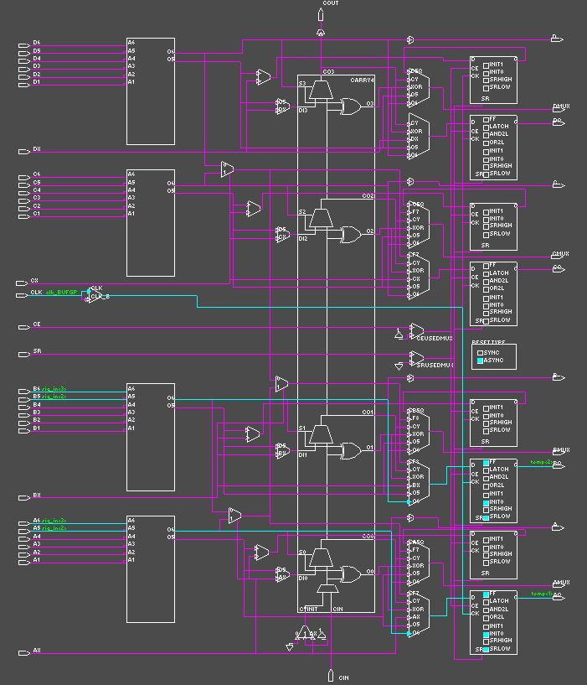
library IEEE;
use IEEE.STD_LOGIC_1164.all;
entity example_01 is
port (
clk: in STD_LOGIC;
switch: in STD_LOGIC_VECTOR(3 downto 0);
led: out STD_LOGIC_VECTOR(3 downto 0)
);
end example_01;
architecture behavioral of example_01 is
signal sig_in : STD_LOGIC_VECTOR(3 downto 0);
signal temp : STD_LOGIC_VECTOR(3 downto 0);
signal sig_out : STD_LOGIC_VECTOR(3 downto 0);
begin
process (clk)
begin
if (clk'event and clk='1') then
sig_in <= switch;
temp(3) <= sig_in(2);
temp(2) <= sig_in(3) and sig_in(2);
temp(1) <= sig_in(3) or sig_in(2);
temp(0) <= '0';
sig_out <= temp;
end if;
end process;
led <= sig_out;
end behavioral;

Slide 16
FPGA Architecture Design
●
What does the schematic
do below?
+1
_{Z}-1
out
in
_{Z}-1
_{Z}-1
How could
you map this into (SLICEX).
basic CLBs (4bit
bus)?

Slide 17
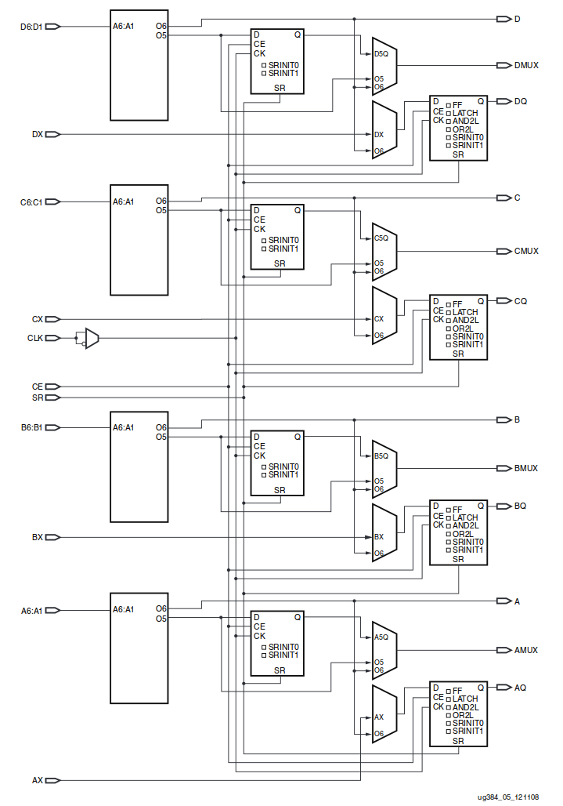
FPGA Architecture Design
Diagram from Xilinx UG384

Slide 18
FPGA Architecture Design
_{Z}-1
_{Z}-1

Slide 19
FPGA Architecture Design
+1
_{Z}-1

Slide 20
FPGA Architecture Design
+1
_{Z}-1
enable

Slide 21
FPGA Architecture Design
Homework #3: Due
Monday counter.
Design an 4­bit
Label inputs/outputs: clock
enable
count [3:0] Route path
Muxes Feedback
Define INIT values

