Slide 1
Signal Processing using FPGAs
Instructor: Office Hours:
Carl Leuschen
2052 Eaton, 11-12 AM MW*
Location/Time: 3152 Learned, 10-11 AM MWF
Webpage: email:
people.eecs.ku.edu/~leuschen/ leuschen@ku.edu
*By appointment as well as other arranged times. Just let me know...
*I am typically at Nichols Hall other times during the week. Tuesdays and Thursdays

Slide 2
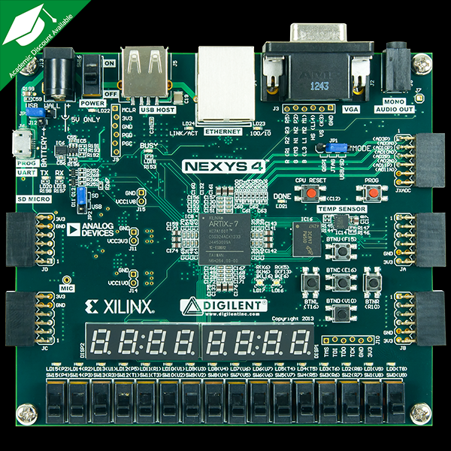
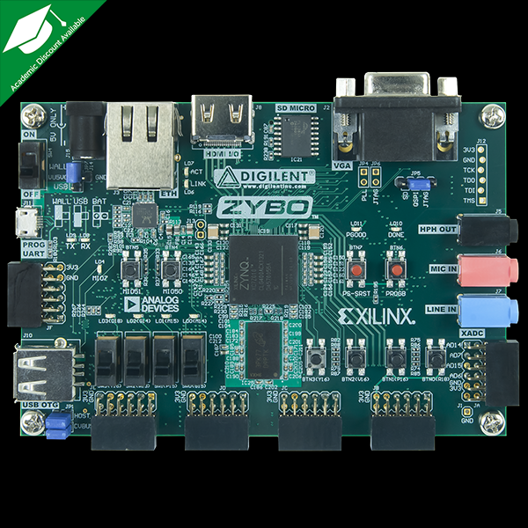
Signal Processing using FPGAs
Text:
Assorted Datasheets, User Guides, and Application Notes.
Nexys-4 (Zybo?)
http://store.digilentinc.com/nexys-4-artix-7-fpga-trainer-board-limited-time-see-nexys4-ddr/
http://store.digilentinc.com/zybo-zynq-7000-arm-fpga-soc-trainer-board/
Dev. Board:

Slide 3
Signal Processing using FPGAs
Backgound Concepts: Suggested Prerequisites
Digital Logic Design 140/443
Combinational
Sequential
Timing (Set-up and Hold)
Digital Signal Processing 360/x44
Signals and Systems
Linearity
Impulse Response
z-Transform
Convolution
FIR and IIR Filters
Fourier Transforms
System Controller (MCU): Programming 168/388

Slide 4



Signal Processing using FPGAs
Implementation of Designs
Design Entry
Intellectual Property Integration
Design Constraints
Placement
Input/Output Timing
Clocking
Compile Tools
Simulation Tools
Real-time Probing Tools

Slide 5
Signal Processing using FPGAs
Core Course Topics (Applying Implementation of Designs to Basic Concepts)
Number Representation
Waveform Generation
Basic FPGA/DSP Resources
Filter Implementation (FIR/IIR)
Coding and Modulation
Spanning Clock Domains (Parallel DSP)
Multi-Rate Designs
Fourier Transforms
Adaptive Processing
Soft MCUs
FPGA Structure
Matlab SysGen

Slide 6
Signal Processing using FPGAs
Grading Elements
Attendance/Quiz 10
Homeworks 10
Designs 25
Projects 30
Exam 25

Slide 7
Signal Processing using FPGAs
Example Design/Project Topics
Hello World
Audio Codec IP integration
Pulse Width/Density Modulation
Serial RS-232 integration
Waveform Generation (DDS, AWG)
Filtering, Decimation, Demodulation
Fourier Transforms
Soft Core Processors

Slide 8
EECS 700: Applied FPGA Design
●
Reading Assignment
●
Digilent Nexys-4 User Guide
7-Series Family Overview
●
●
Homework #0 (Due ASAP) – nothing to turn in
●
Gain access to Xilinx ISE (personal computer or 2002 Eaton)

Slide 9
Field Programmable Gate Arrays
Digital Logic Integrated Circuits
Logic Gates and Memories (EECS312)
Micro-Processor
System-on-Chip (SoC)
Application Specific Integrated Circuit (ASIC)
Field Programmable Gate Array (FPGA)
Complex Programmable Logic Device (CPLD)
Why (or Why Not) use an FPGA vs other?
Application Complexity
Performance (Speed)
Re-configurability
Quantity
Price

Slide 10
Basic Components of an FPGA
Input and Output
Need to get electrical signal in and out of the device
Pad: physical connection
Buffers
Conditions the signal
Isolates inputs and outputs
Routing
Connects components to each other
Switches
Logic Elements
Where the function is implemented (LUTs, FF)

Slide 11
Spartan-6 LX9 CSG324
Input Output Pads & Logic
Buffers, Delays, (De)Serializers
Interconnects & Switches
Configurable Logic Elements (CLE)
Clock Regions
Clock Distribution
Clock Management Tiles (CMT)
Digital Clock Managers (DCM)
Phase-Locked Loops (PLL)
Block RAM (BRAM)
Digital Signal Processor (DSP)
Memory Controllers (MCB)

Slide 12
Tools
Synthesis & Placement: ISE and Vivado
Simulator: ISim
Schematic Viewers: RTL and Hardware
Layout Viewers: FPGA Editor and PlanAhead
Logic Analyzer: Chipscope
Programming: Impact
Intellectual Property: Core Generator
Embedded Processor: XPS and SDK
Constraints Editor
Timing Analyzer
Power Analyzer

Slide 13
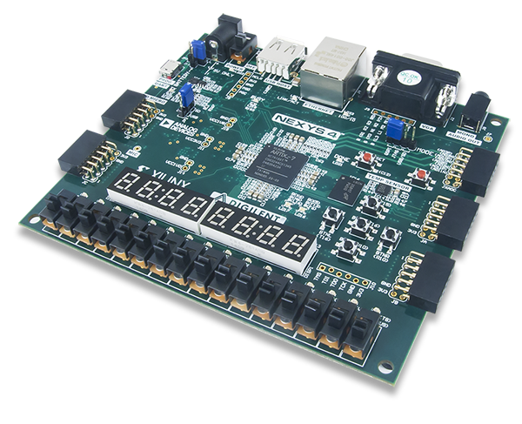
Nexys-4 Artix-7 Board

Slide 14
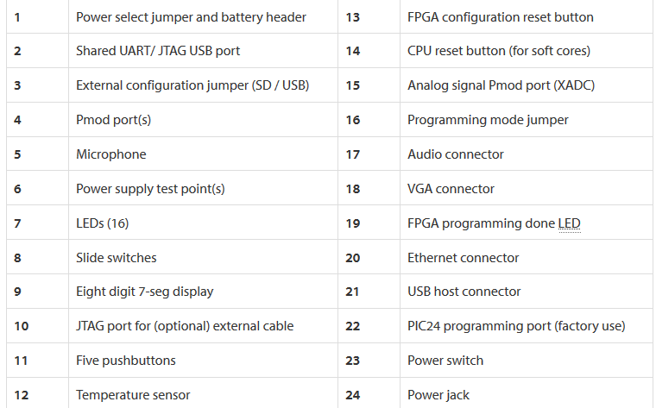
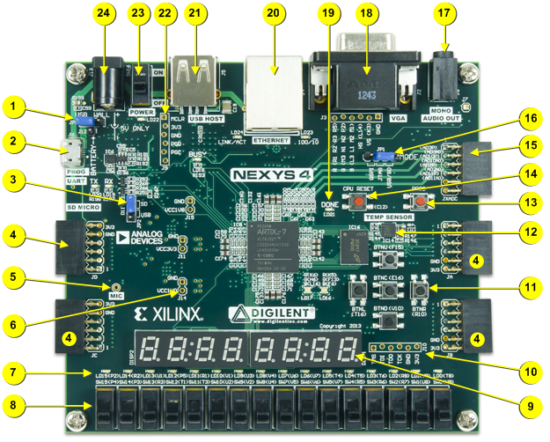
Components

Slide 15
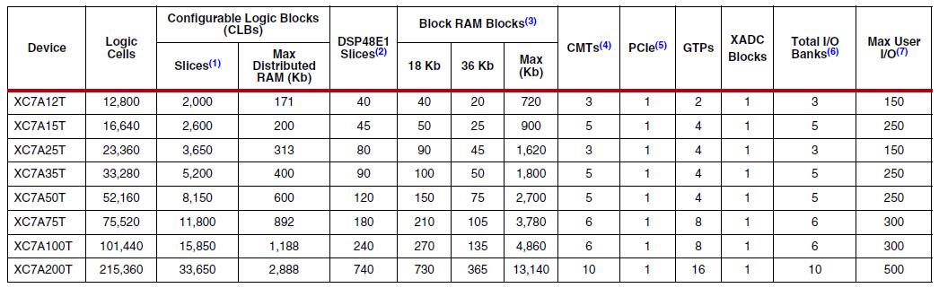
Artix-7 Features

Slide 16
Xilinx Design Decisions
ISE vs. Vivado vs. ???
VHDL vs. Verilog vs. Schematic
Functional vs. Structural
Direct vs. Inferred vs. Core Generator

