Slide 1
ATM
SIMULATION
A simple menu-driven banking simulation built in C.
C Programming Mini Hackathon
Check Balance
Deposit
Withdraw
Exit
Team Vikings
Batch 53
Starting balance
Assumed for the demonstration account
₹ 5,000
Manjit • Raunak Rai • Saksham
Notes:
[Sources]
User-provided Mini Hackathon guidelines, ATM Simulation requirements, pp. 4–5.
[/Sources]

Slide 2
Problem Statement
What the project is expected to do
01
Check balance
Build a basic ATM simulation for a single demonstration account.
02
Deposit money
The program should let a user check balance, deposit money, withdraw money and exit through a simple menu.
03
Withdraw money
It must also reject invalid amounts and withdrawals that exceed the available balance.
04
Exit
Notes:
[Sources]
User-provided Mini Hackathon guidelines, ATM Simulation requirements, lines 181–196.
[/Sources]

Slide 3
Objectives & Features
Kept intentionally simple for a first-year C lab project
Balance
Deposit
Withdraw
View the current account balance.
Add a valid positive amount.
Subtract money only when funds are sufficient.
Validation
Loop
Exit
Reject zero/negative amounts and invalid menu choices.
Return to the menu after every transaction.
Close the program with a clear message.
C concepts used: variables • input/output • operators • if/else • switch • do-while • functions
Notes:
[Sources]
User-provided project README content and ATM requirements.
[/Sources]

Slide 4
Program Logic
The menu repeats until the user chooses Exit
1
Start with ₹5000
2
Display ATM menu
3
Read user choice
4
Perform selected operation
5
Update / show balance
6
Repeat or exit
Decision rules
Deposit > 0 • Withdraw > 0 • Withdraw ≤ balance • Other menu choices → Invalid choice
Notes:
[Sources]
User-provided project algorithm/README.
[/Sources]

Slide 5
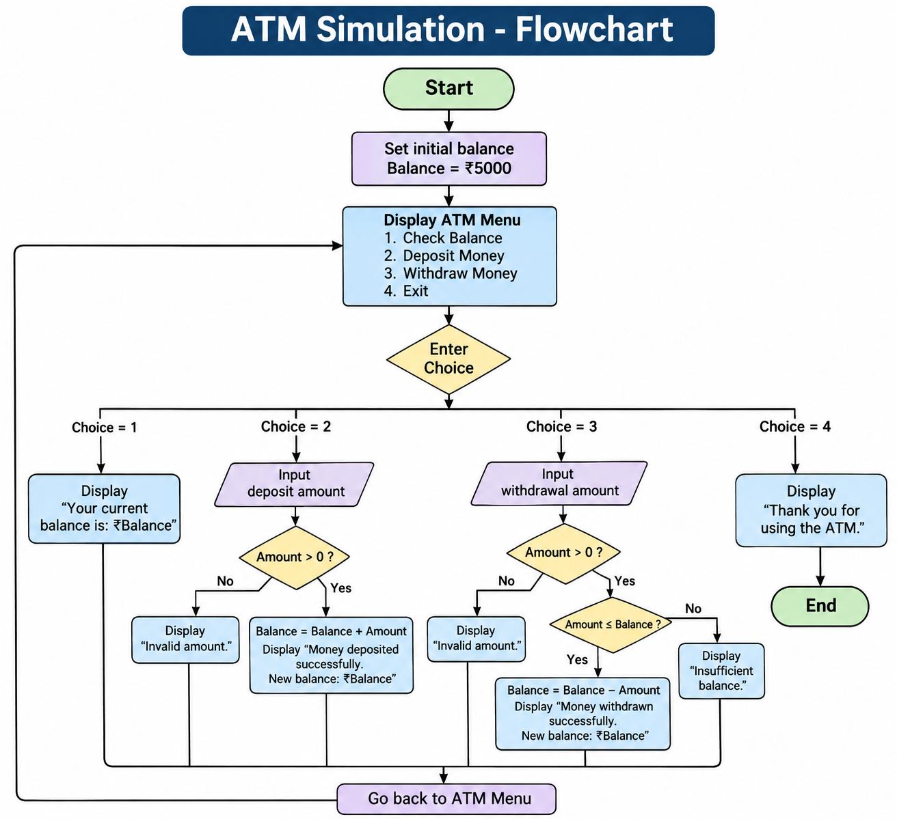
Flowchart
Visual path of the ATM menu and validation
Notes:
[Sources]
Flowchart generated earlier in this conversation from the user-approved ATM logic.
[/Sources]

Slide 6
Implementation
Simple C structure with separate operations
checkBalance()
Displays current balance
1 int main()
2 {
3 int choice;
4 float balance = 5000.0;
5
6 do
7 {
8 printf("1. Check Balance\n");
9 printf("2. Deposit Money\n");
10 printf("3. Withdraw Money\n");
11 printf("4. Exit\n");
12 scanf("%d", &choice);
13
14 switch (choice) { /* operations */ }
15 } while (choice != 4);
16 }
deposit()
Validates and adds amount
withdraw()
Checks funds and subtracts amount
do-while
Keeps the menu running
switch
Routes the selected menu option
Notes:
[Sources]
Code excerpt based on the user-approved atm.c created in this conversation.
[/Sources]

Slide 7
Testing & Sample Output
Normal and invalid inputs were checked
Test
Input
Result
===== ATM MENU =====
1. Check Balance
2. Deposit Money
3. Withdraw Money
4. Exit
Enter your choice: 2
Enter amount to deposit: 1000
Money deposited successfully.
New balance: Rs. 6000.00
Check balance
1
₹5000.00
Deposit
2 + 1000
₹6000.00
Withdraw
3 + 500
Successful
Excess withdrawal
3 + 10000
Insufficient balance
Invalid amount
2 + -100
Invalid amount
Exit
4
Program ends
Sample console run
Notes:
[Sources]
User-tested program behavior and sample test cases from project README.
[/Sources]

Slide 8
Conclusion
A small project that demonstrates core C programming concepts
What we achieved
THANK YOU
Created a working menu-driven ATM simulation.
Handled deposits, withdrawals and balance checks.
Added validation for invalid amounts and insufficient funds.
Used functions, conditionals, switch-case and a do-while loop.
Prepared code, README, flowchart and GitHub repository.
Questions?
Vikings
Manjit • Raunak Rai • Saksham
Notes:
[Sources]
User-provided project details and completed project artifacts.
[/Sources]

