Slide 1







Technology Trends & Analysis Pattern
Manjit Prasad
26th March, 2024

Slide 2



OUTLINE
Executive Summary
Introduction
Methodology
Results
Visualization – Charts
Dashboard
Discussion
Findings & Implications
Conclusion
Appendix

Slide 3

EXECUTIVE SUMMARY
Trends in programming languages and databases.
Demographics survey.
Technological gap in countries.
Gender gap in job.

Slide 4

INTRODUCTION
About :
Analyzing the trends in software development
Purpose :
Identify skill requirements for future.
What are the top programming languages in demand?
What are the top database skills in demand?
What are the popular IDEs
Audience : HR and IT Head

Slide 5

METHODOLOGY
Data Collection Sources
Stack Overflow Developer 2019 Survey.
GitHub job postings.
Programming Languages Annual Salary
Data Exploration
Data Cleaning
Data Visualization
Presentation

Slide 6
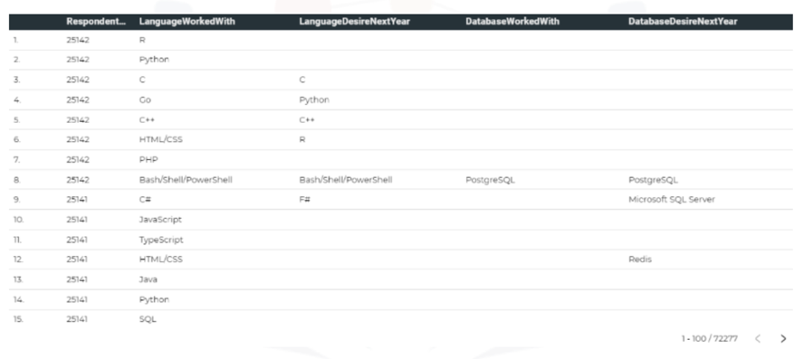
RESULTS

Slide 7
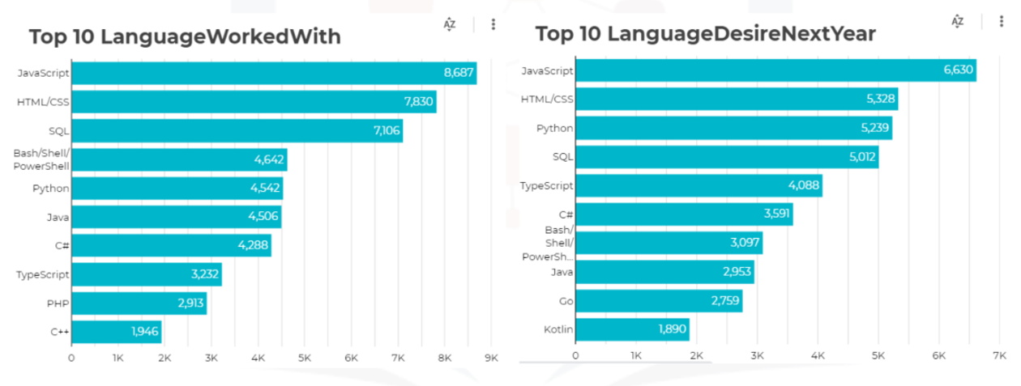
PROGRAMMING LANGUAGE TRENDS

Slide 8
PROGRAMMING LANGUAGE TRENDS - FINDINGS & IMPLICATIONS
Findings
Javascript, HTML/CSS, SQL are top 3 this year.
Python and Typescript becoming popular next year.
PowerShell edge out in next year.
Implications
Web Development are still in high demand.
Big Data Technology in companies still requires SQL.
With AI and ML in rising demand, Python is the best choice.

Slide 9
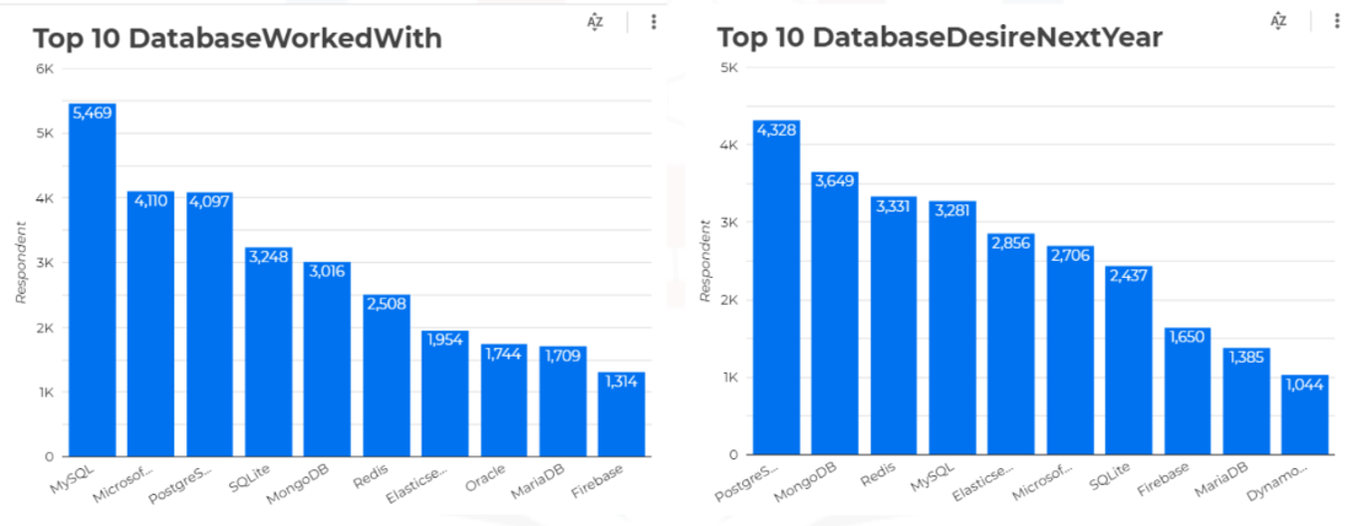
DATABASE TRENDS

Slide 10
DATABASE TRENDS - FINDINGS & IMPLICATIONS
Findings
MySQL is the most popular.
Behind is MS SQL Server.
MongoDB and Redis are upcoming favorites.
New kid on the block : Elasticsearch
Implications
Open source databases are still preferable in companies.
NoSQL databases will make an impact for storing non relational data.
Redis supports abstract data types.
Pre tuned search to website, app, or ecommerce store

Slide 11

DASHBOARD
https://github.com/manjit8387/Dashboards/blob/main/Final-capstone-story-template.pptx
Or
https://github.com/manjit8387/Final-Project/blob/main/Final-capstone-story-template.pptx
github.com > manjit8387 > Dashboards > Final-capstone-story-template.pptx
Or
github.com > manjit8387 > Final-Project > Final-capstone-story-template.pptx

Slide 12
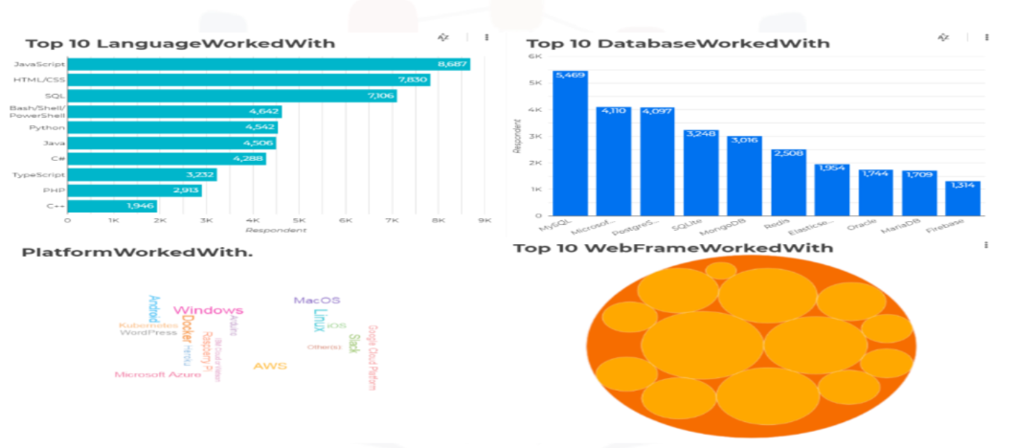
DASHBOARD TAB 1

Slide 13
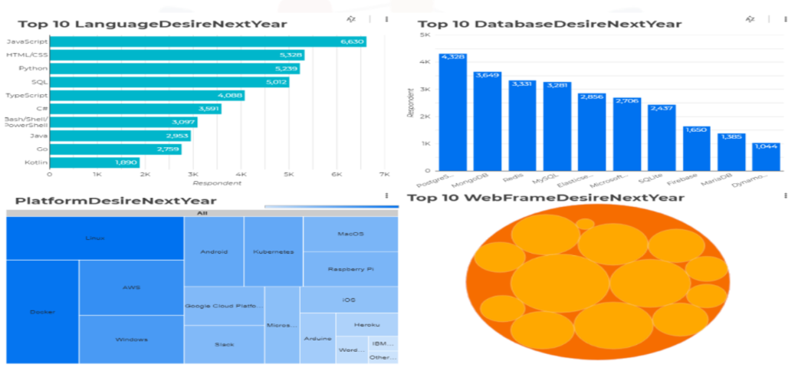
DASHBOARD TAB 2

Slide 14
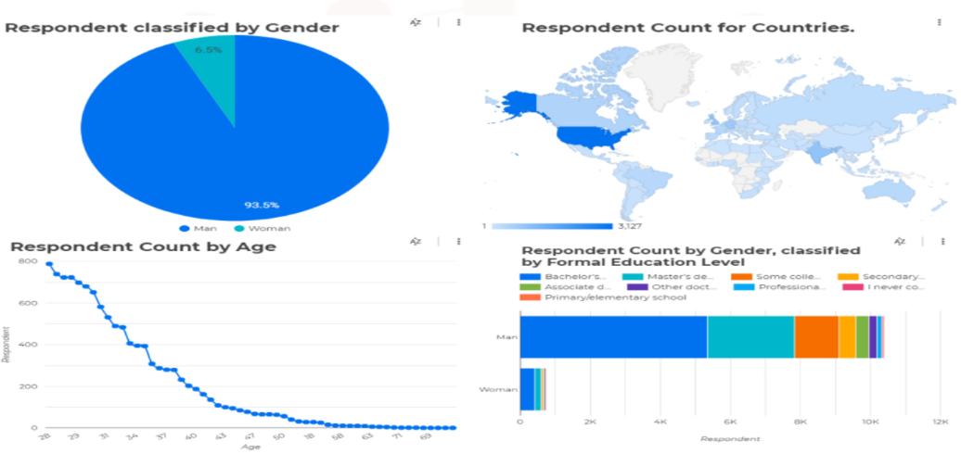
DASHBOARD TAB 3

Slide 15
DISCUSSION
Technology trends now and future.
Training and Reskilling workers.
Females partition in technology field.
Bridge divide of Technology gaps among developing countries.
Eliminate age and education discrimination in employment.

Slide 16
OVERALL FINDINGS & IMPLICATIONS
Findings
Fast changing technology every year.
Concentration on several countries like USA and India.
Gender gaps in technical jobs.
Platforms like Docker and AWS are growing.
Implications
Companies need to be flexible and adjust to rapid changes.
Need to spread technology out to lagging countries.
Impact of job hiring’s.
Shift to faster app deployments and cloud services in future.

Slide 17

CONCLUSION
Technology trends for current and next year.
Programming languages, databases and platform overview.
Demographics overview.
Actions to be taken.
In future, incorporate Machine Learning to predict trends and salaries.

Slide 18
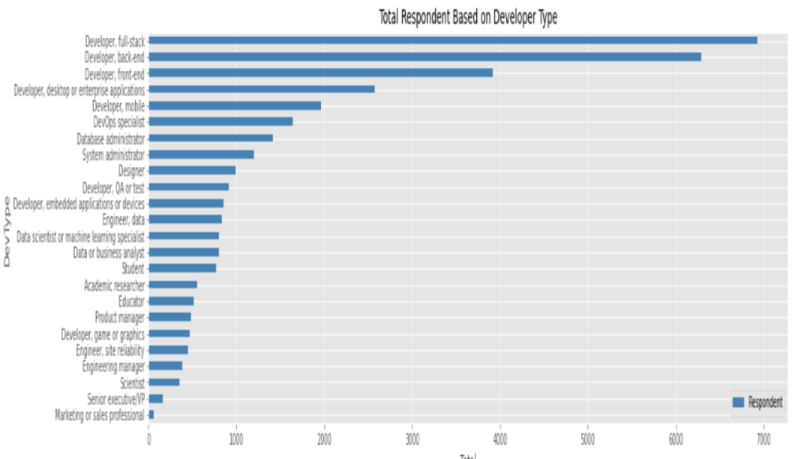

APPENDIX

Slide 19
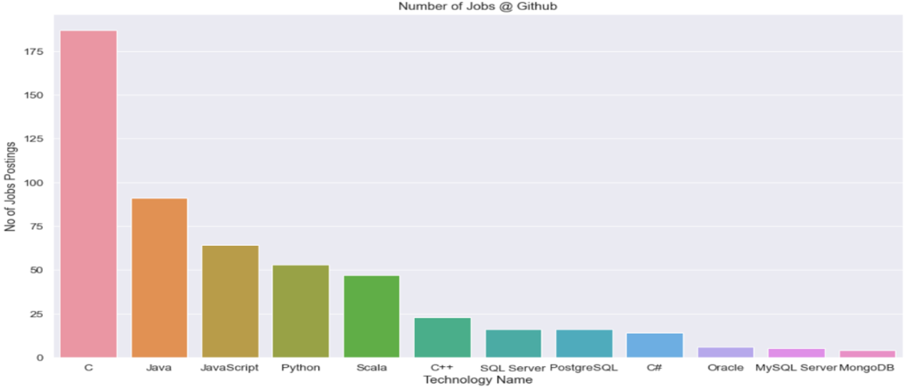
JOB POSTINGS

Slide 20
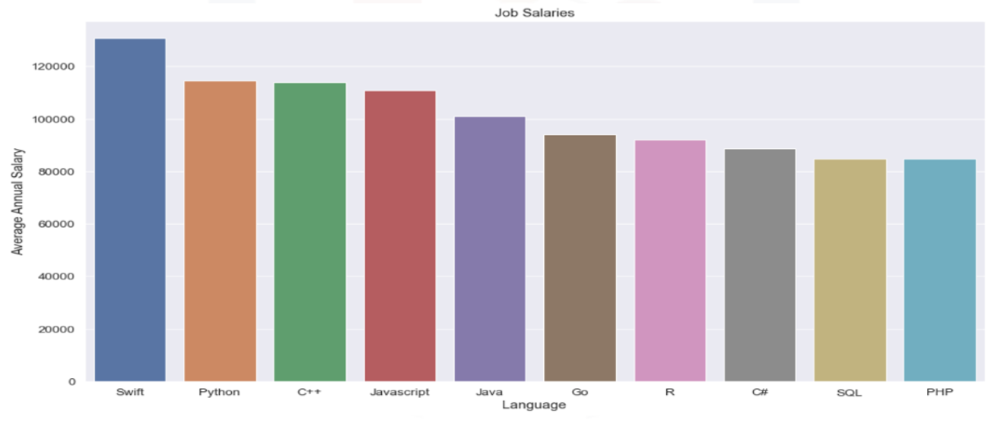
POPULAR LANGUAGES

