Slide 1
AmNow
Reliable emergency services
Developed by AlphaQ

Slide 2
Introduction
AmNow is an app that provides fast and reliable ambulance services at your doorstep
We follow strict quality standards to ensure the best ambulance services are provided

Slide 3
Technologies Used
React-Native
NodeJs
Firebase for real time tracking
Google Maps API
Shell Scripting
Naive Bayes model for self help
Web Sockets

Slide 4
Need
Acute shortage of ambulances
Ambulances that are available are not upto standards
Drivers/Attendants are underpaid and overworked
Drivers/Attendants do not have required certifications
Often ambulances are delayed due to traffic
This platform will help standardise the quality of ambulances, drivers and assistants
Provide better pay and working conditions to drivers and attendants

Slide 5
Standards
We will enforce the standards prescribed by Automotive Research Association of India for ambulances
Drivers and attendants should have the following certifications
12th pass or Diploma
Driver’s License
CPR and BLS Certification preferably from Red Cross
Emergency Medical Training
Emergency Vehicle Operator certification by National Highway Traffic Safety Administration
Clean record
Years of service > 2 and good knowledge of locality

Slide 6
Driver and attendant registration
Drivers/attendants signs up and requests verification
Agent goes to driver’s requested location to verify standards of ambulance
Certifications verified via respective database
Years of stay can be verified using rent agreement / property papers

Slide 7
Patient App
The patient app has a SOS button.
After pressing the button the app fetches the user location and locates ambulances nearby.
The nearest ambulance is pinged. After an ambulance accepts, the app shows the driver details and the path of the ambulance on the map.
The user is notified once the ambulance arrives.
The user can cancel the ambulance request until an ambulance is accepts the request.
Any fraudulent activity will be dealt with the full force of the law.

Slide 8
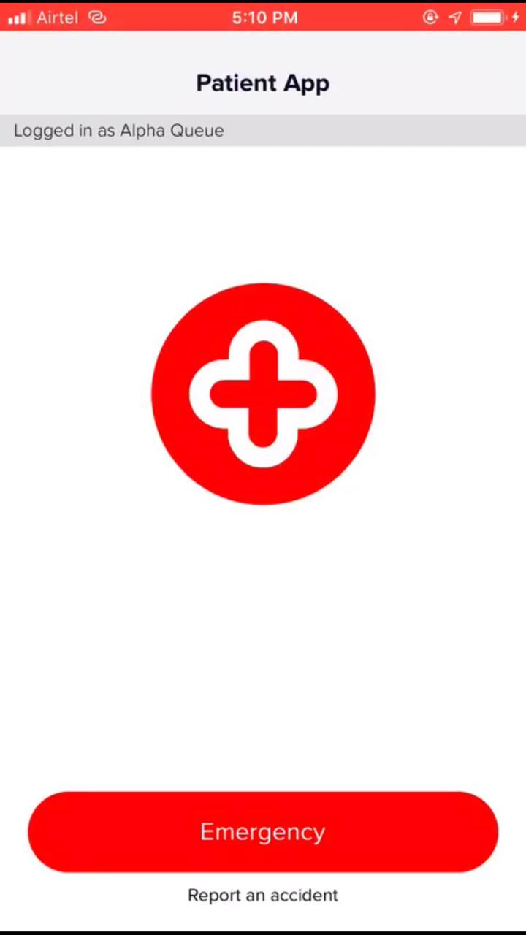
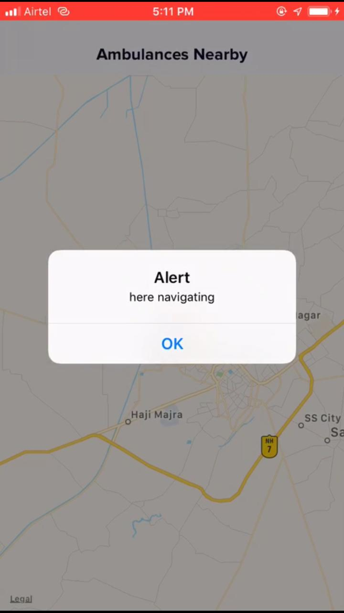
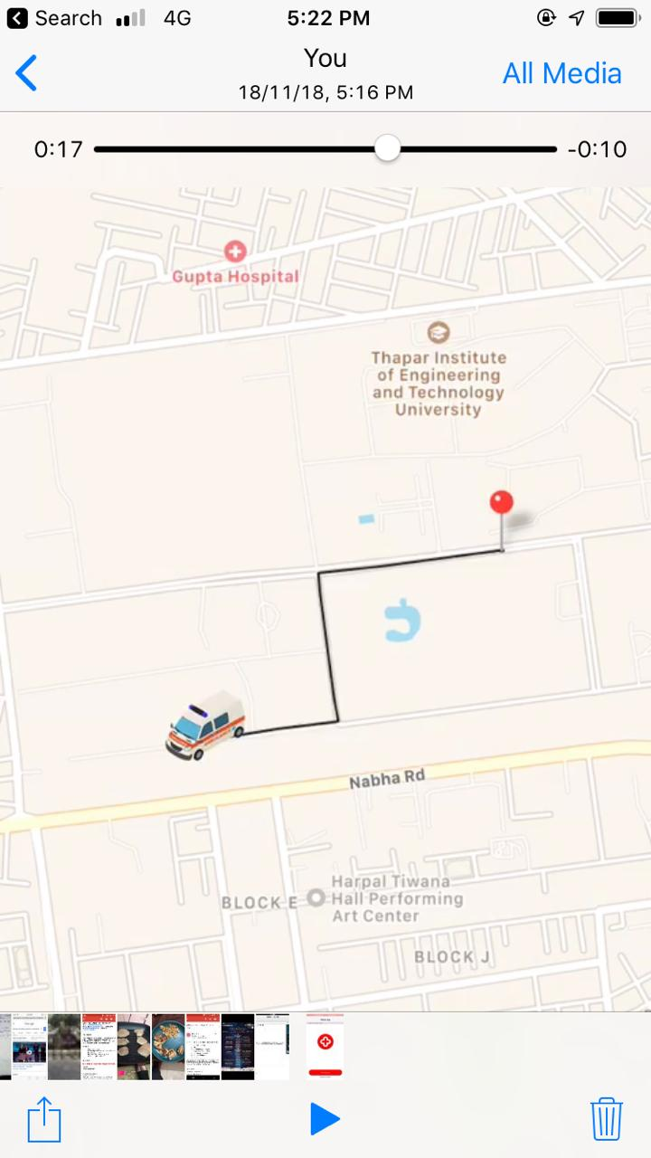

Slide 9
Driver App
The driver app has the following features
Button to accept the request for ambulance
Button for taking a break
Button to requeue the ambulance in case machine learning model removes it from active queue.
A pop up notification will be displayed when a request comes in giving the driver the option to accept or reject the request
The app will show the most optimal path the ambulance can take to reach the destination
Option to report fraudulent request

Slide 10
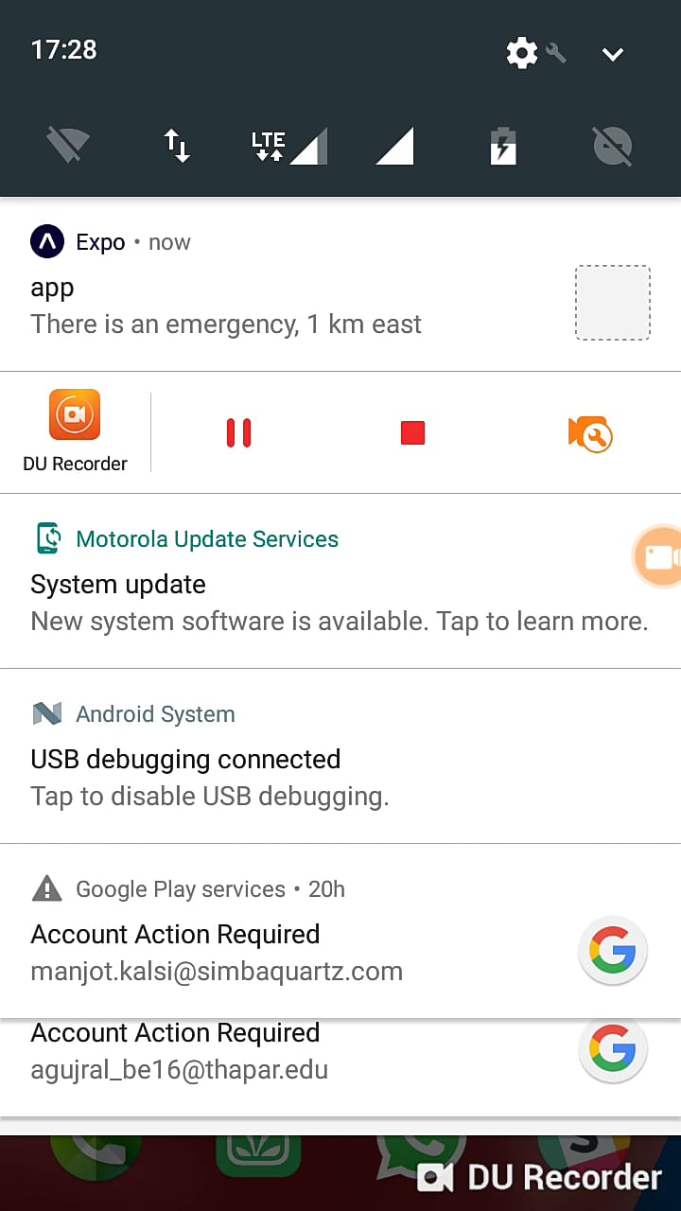
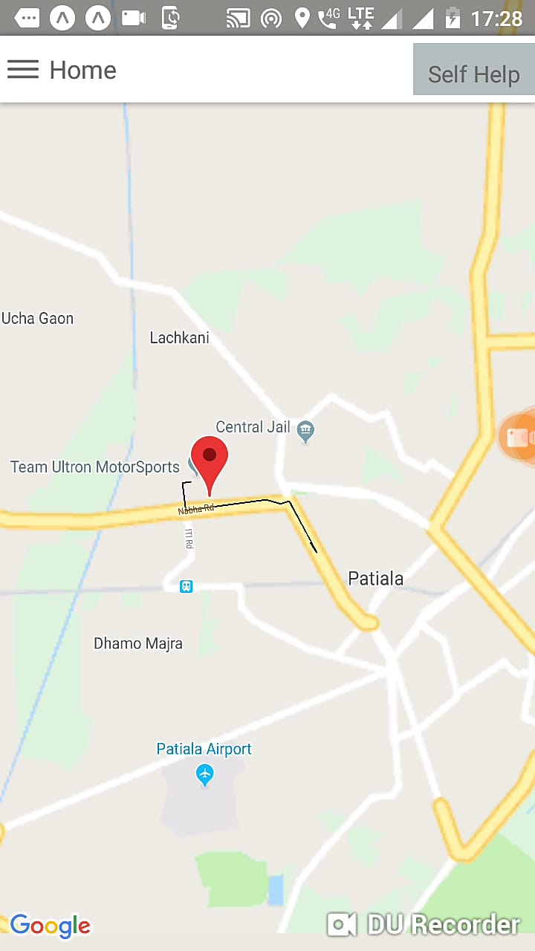
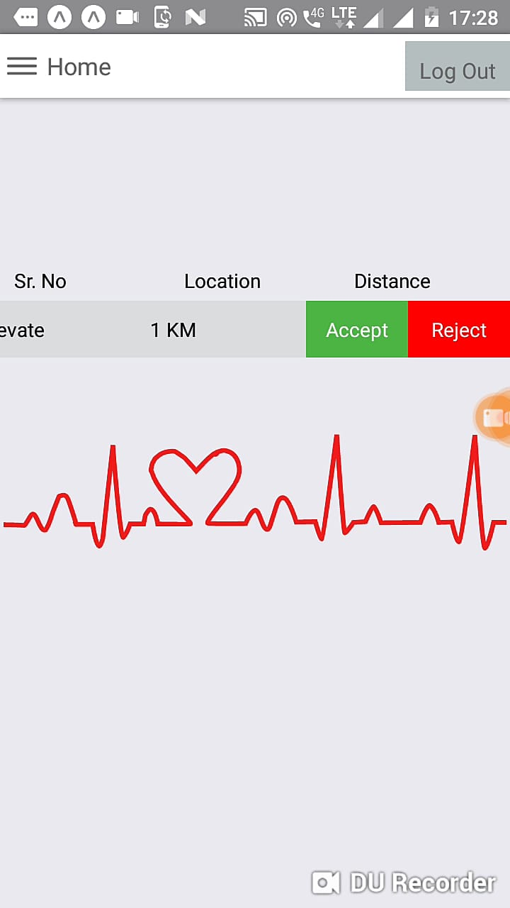

Slide 11
Security Measures
Using machine learning we can detect the presence of attendant and driver.
If found absent the driver and attendant will be notified after 5 minutes of absence and the ambulance will be taken out of active queue
After the driver and attendant return, they will manually requeue the ambulance and the model will verify their presence.
If the ambulance driver reaches the destination and the request turns out to be false, the driver will report the request and an agent will be dispatched to look into it.

Slide 12
Machine Learning Model
We will be using one-shot learning as it requires extremely few data samples for classification.
Siamese networks used in OpenFace are perfect for this application
A video of the driver/attendant’s face will be recorded capturing every angle and fed frame by frame to the network for training
2 IoT devices with camera and sufficient computational resources will be fitted in the ambulance, one in the driver’s cabinet and one in the patient’s compartment for the attendant

Slide 13
Expansion Prospect and Self Help
Another dimension to the platform can be requesting a doctor
This is made viable simply due to the fact that rural areas and government hospitals have shortage of doctors
This part of the platform can be integrated into the mandatory 2 year service of every MBBS graduate at a government hospital in a rural area
Using machine learning we can help the patient diagnose self by using symptoms, x-rays and other medical documents

Slide 14
Demo Time

