Slide 1


ADITYA ENGINEERING COLLEGE(A)
Department of Computer Science And Engineering
Internship from EXCELR
Movie Recommendation System
- using Machine Learning
by
K. Devi Sri Manju (21A91A05C6)

Slide 2


Slide 3
Problem Statement
With an overwhelming number of movies available, users struggle to find movies that match their tastes.
Traditional methods of finding movies (e.g., browsing genres or top
charts) are inefficient and time-consuming.

Slide 4
Types of recommendation systems in machine learning:
Collaborative Filtering
Uses user behavior and interactions to recommend items.
Content based filtering
Analyzes item features and user profiles to recommend similar items.
Hybrid approach
Combines both collaborative and content-based filtering to improve recommendations.

Slide 5
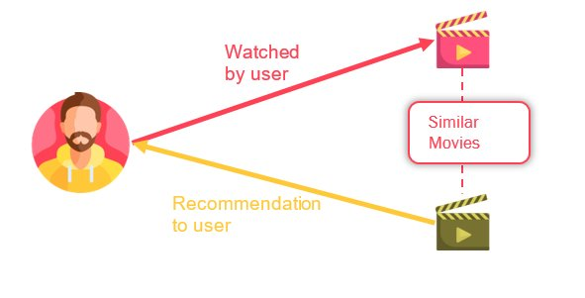
Content-Based Filtering
Content-based filtering uses machine learning algorithms to analyze a user's profile and the featured items in a database.
Provides personalized recommendations for items that closely match the user's demonstrated preferences through viewing or liking.

Slide 6
Data Collection
Data Source:
Data is collected from the TMDB (The Movie Database) website.
Datasets:
tmdb_5000_movies: Contains records like budget, genres, homepage, id, keywords, original language, original title, overview, popularity, release date, revenue, status, tagline, title, vote count, etc.
tmdb_5000_credits: Contains movie_id, title, cast, crew, etc.

Slide 7
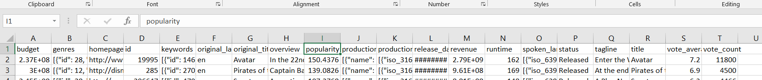
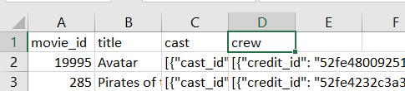
Data(before cleaning)
A brief look at the raw data before preprocessing steps are applied.

Slide 8
Data Preprocessing
Merging Datasets: Merged both datasets and stored them based on movie title.
Filtering Columns: Removed unimportant columns and handled null values.
Data Conversion: Converted unreadable data to a readable format.
Text Processing: Removed spaces and found the most frequent words using CountVectorizer to identify frequently repeated words.
Tools:
Pandas and NumPy for data manipulation.
CountVectorizer from Scikit-learn for text processing.

Slide 9
Model Building
Scikit-learn:
The Scikit-learn module is used for building the model. It provides a variety of tools for building, evaluating, and improving recommendation systems.
NLP Processing:
The NLTK library in Python is used for natural language processing (NLP). One of its features is the Porter Stemmer, which reduces words to their root form, known as a stem.
Pickle:
Pickle is used to flexibly convert the data types from list to dictionary and vice versa. This allows for efficient storage and retrieval of data structures.
Cosine Similarity:
Cosine similarity is used for finding the nearest similarity between movies to identify similar movies. It measures the cosine of the angle between two vectors in a multi-dimensional space, providing a metric of similarity.

Slide 10
Model Deployment
Used VScode for Deployment and execution of the Movie Recommendation System
Features of VScode:
1. Versatile Development Environment: VSCode offers extensive support for Python, Jupyter Notebooks, integrated terminal, and debugging tools, enhancing productivity and code quality in ML projects.
2. Streamlined Version Control: Built-in Git support and customizable features make VSCode an efficient platform for managing and developing machine learning projects.

Slide 11
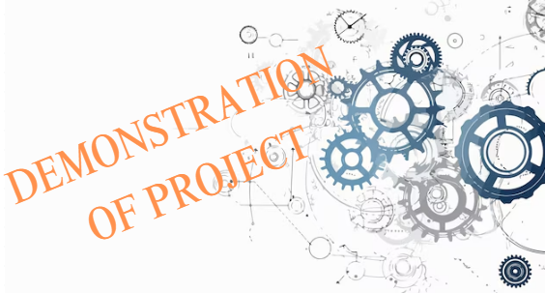
Demonstration
User Experience:
Simple and intuitive interface.
Quick and relevant movie suggestions.

Slide 12
Challenges
Data Sparsity:
Many users rate only a few movies, leading to sparse datasets that make it difficult to find common preferences and generate reliable recommendations.
Cold Start Problem:
New users and items with no prior interaction data pose a significant challenge, as the system lacks enough information to provide accurate recommendations.
Data Quality:
Incomplete, inconsistent, or noisy data can affect the accuracy of recommendations. Ensuring high-quality data is crucial for effective model training and prediction.
Computational Resources:
Training machine learning models, especially with large datasets, requires substantial computational power and resources, which can be a limitation.

Slide 13
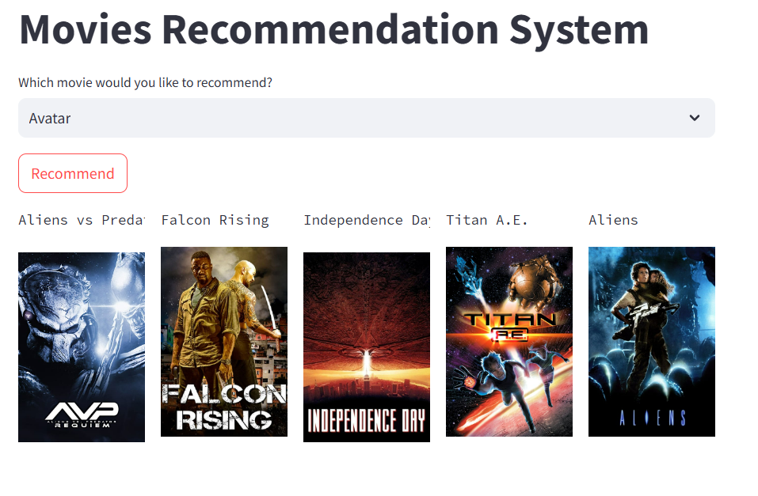
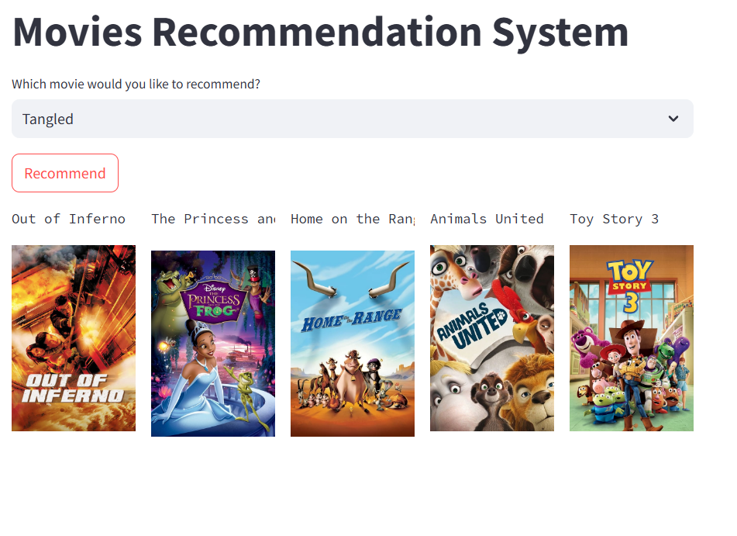
Output:

Slide 14


