Slide 1

Practical AI/ML for Computational Biology and Chemistry
(Day 1)
Chuming Chen
chenc@udel.edu
Research Associate Professor
Computer and Information Sciences
Center for Bioinformatics and Computational Biology
Data Science Institute
Slides and notebooks: https://github.com/udel-cbcb/al_ml_workshop
June 13, 2022

Slide 2
Introduction to Workshop

Slide 3
Welcome and Roundtable Introduction
Instructors
Chuming Chen
Hongzhan Huang
Cecilia Arighi
TAs
Qinghua Wang
Julie Cowart
Manju Anandakrish
Participants

Slide 4
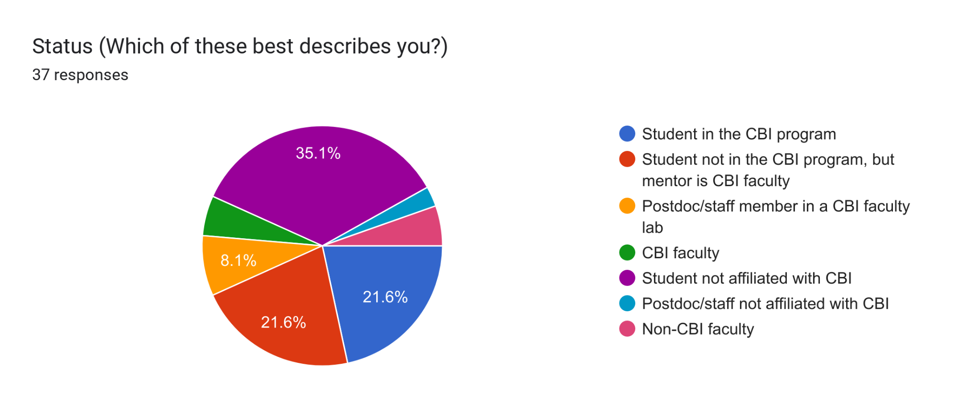
Participants

Slide 5
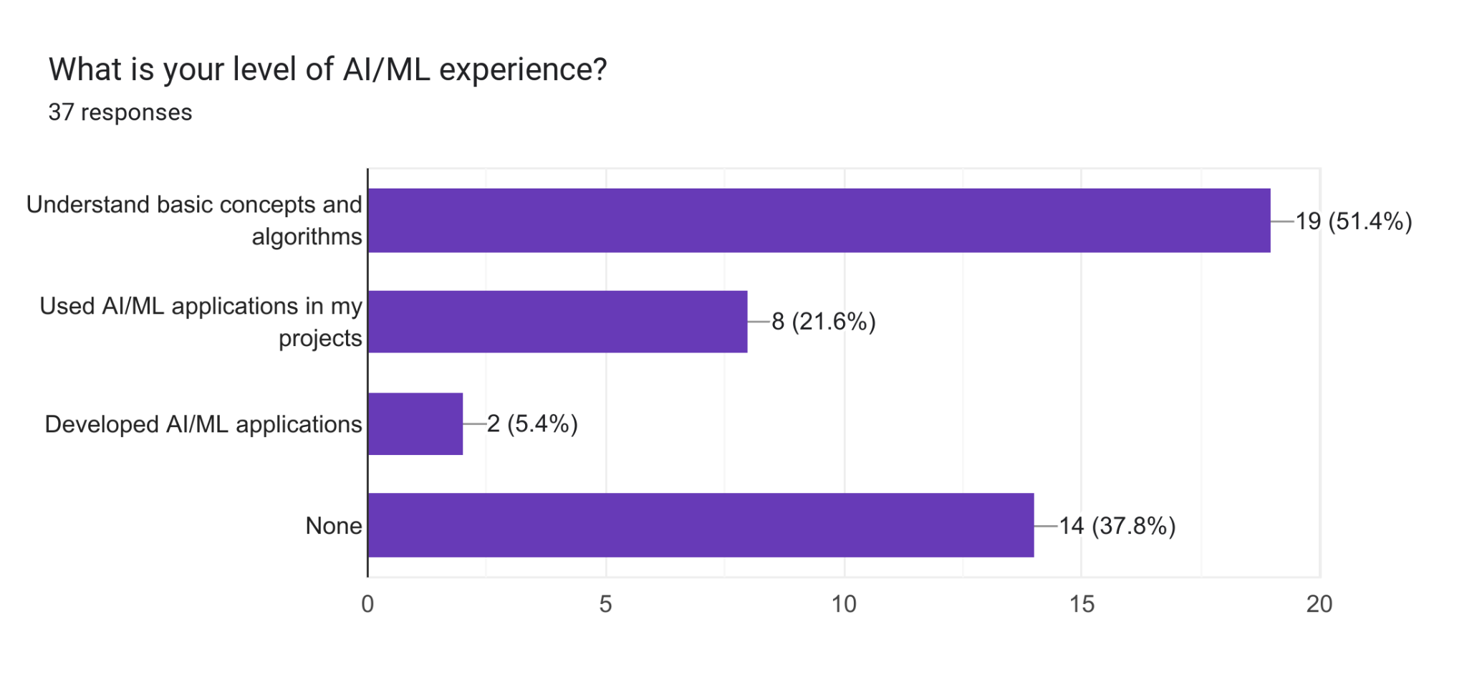
AI/ML Experience

Slide 6
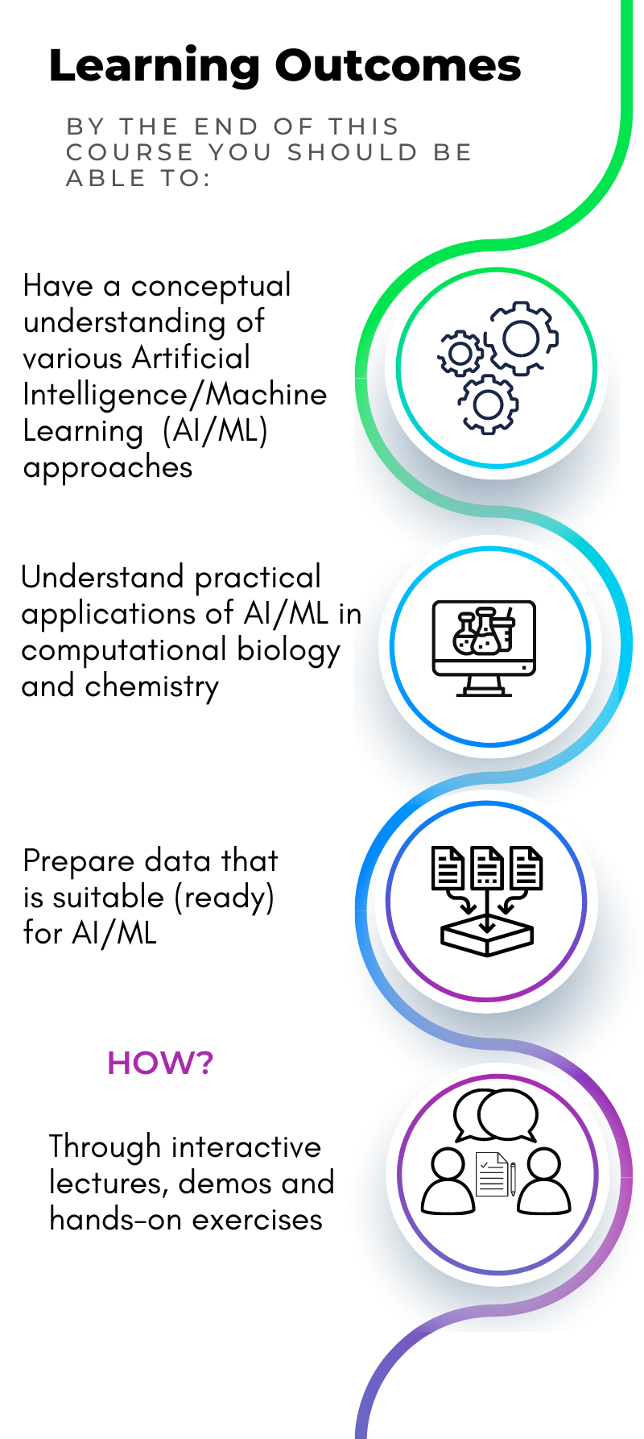
Workshop Outcome and agenda
Day 1: Introduction to AI/ML and Python ML ecosystem, AI/ML applications in computational biology and chemistry
Day 2: Data collection and data preparation, data readiness for AI/ML checklist
Day 3: Feature selection, feature engineering and feature scaling
Day 4: ML models, from its selection to its training, evaluation and tuning
Day 5: Introduction to deep learning
Notes:
This is alternative slide combining slide 4 and 6

Slide 7
Workshop Logistics
June 13 - 17, 2022, 1:00pm – 5:00pm
Ammon Pinizzotto Biopharmaceutical Innovation Center conference room 140
Slack Channel (https://ud-cbcbcore-workshops.slack.com/archives/C03G09R43SA)
Daily Activities:
Lectures
Live demos (Google Colaboratory)
Hands-on exercises (Google Colaboratory)

Slide 8
General Information
Parking/Transportation:
UD permit parking is available. Gray Permit: Lot 207 (some spaces) and on street parking on Discovery Blvd and Avenue 1743; Red Permit: Lot 209. Those without UD parking permits may use on street parking and pay at kiosks or using the PassPort app. Parking map available at: https://sites.udel.edu/parking/. UD Bus: North/South College Route use the Star Tower stop.
COVID Considerations:
Face mask requirements remain in place for all indoor spaces in accordance with CDC guidance pertaining to the local Delaware community.
Please Be Kind:
The organizers of the workshop and the University of Delaware are dedicated to fostering a safe and inclusive learning environment that does not discriminate against any person on the basis of race, color, national origin, sex, gender identity or expression, sexual orientation, disability, religion, age, or any other characteristic. All participants are asked to also please abide by these values in your interactions with others throughout this workshop.

Slide 9
Acknowledgements
Cathy Wu
Shawn Polson
Amelia Harrison
Rita Hayford
Yuqi Wang
This workshop is offered free of charge with support from the NIH National Institute for General Medical Sciences (T32GM133395-03S1) granted to UD Chemistry-Biology Interface Program.

