Slide 1
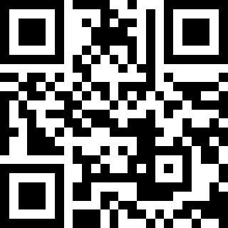
Practical AI/ML for Computational Biology and Chemistry
(Day 4)
Chuming Chen
chenc@udel.edu
Research Associate Professor
Computer and Information Sciences
Center for Bioinformatics and Computational Biology
Data Science Institute
Slides and notebooks: https://github.com/udel-cbcb/al_ml_workshop
June 16, 2022

Slide 2
Model Tuning, Interpretation and Deployment

Slide 3

Lecture Outline
Model Tuning
Model Interpretation
Model Deployment

Slide 4
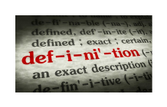
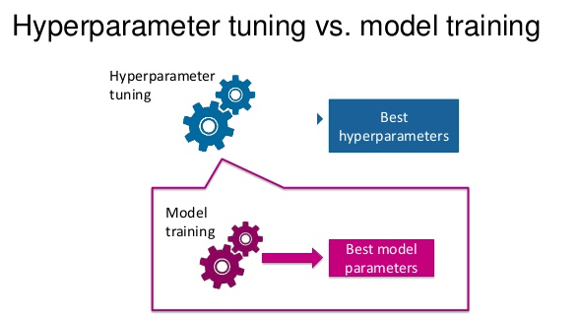
What are hyperparameters?
Hyperparameters are meta parameters that are associated with any ML algorithm and are usually set before the model training and building process.
Hyperparameters are different from model parameters since they do not have dependency on the data.
Hyperparameters represent some high-level concepts or knobs that a data scientist can tweak and tune during the model training and building process to improve performance.
(source: Prabhu, 2018)

Slide 5
Example hyperparameters in ML algorithms
Logistic regression
Regularization penalty
Optimization algorithm
Max_Iter
Support Vector Machine
Different Kernels
Neural networks
Number of hidden layers and units
Learning rate
Dropout rate
Number of epochs
Batch size

Slide 6
What is Bias?
The error that arises due to the model making wrong assumptions on the parameters in the underlying data.
The bias error is the difference between the expected or predicted value of the model estimator and the true or actual value which we are trying to predict.
Linear model (assume linearity between dependent and independent variables) has high bias than a decision tree model (no assumptions on the structure of data)
High bias makes a model miss relevant relationships between features and output variables.

Slide 7
What is Variance?
This error arises due to model sensitivity to fluctuations in the dataset such as new data points, randomness, noise etc.
Decision tree model has high variance than linear model based on data and underlying noise/randomness.
High variance makes a model too sensitive to outliers or random noise and lead to bad generalization.

Slide 8
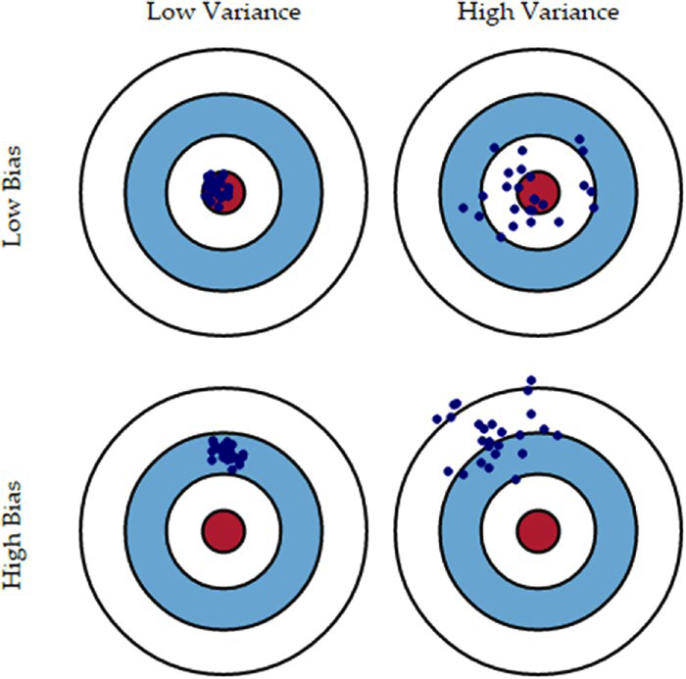
Visual Interpretation of Bias-Variance Tradeoff
Good general structure of data patterns and relationships
Generalize to some extent and perform well on average but sensitive to data
Make consistent predictions irrespective of datasets.
Not learn necessary relationships and sensitive to data, outliers and noise.
(source: Sarkar et al. 2018)

Slide 9
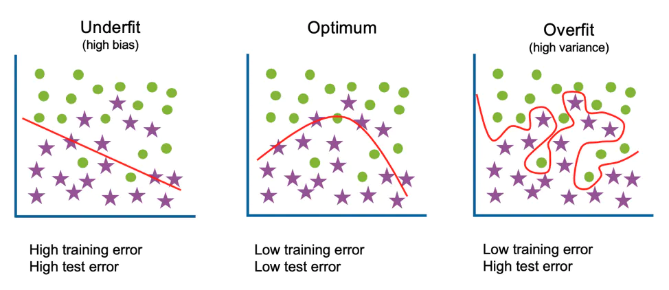
Extreme Cases of Bias-Variance
Underfitting
Consider a linear model always predicts a constant value.
The model will have extremely low variance (not dependent on which subset of data it gets) and extremely high bias (not learning anything from data).
The model will fail to learn anything about the data, underlying patterns and relationships.
(source: IBM)

Slide 10
Extreme Cases of Bias-Variance
Overfitting
Consider a model tries to fit every data points (n^{th} polynomial curve for n observations).
The model will have very low bias (no assumption to the structure of data), but very high variance (focusing too much on training data)
The model is so specific to the training data and fails to do any generalization over new data.
(source: IBM)

Slide 11
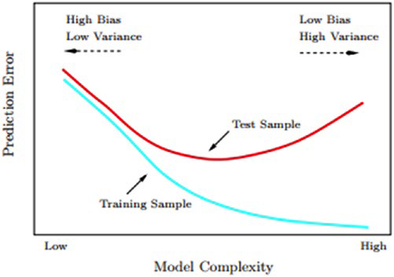
The Bias-Variance Tradeoff
Irreducible error is the error gets introduced due to noise in the training data itself and not much we can do about.
Every model needs to do a tradeoff:
Making assumptions about the structure of data
Fitting itself too closely to the data at hand.
The idea is to focus on balancing the model complexity by doing an optimal tradeoff between bias and variance.
(source: Sarkar et al. 2018)

Slide 12
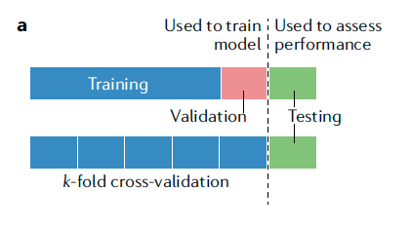
Cross Validation
Most prevalent practices for tuning ML models.
Uses the same data to build different models and also tune their hyperparameters using a simple data partitioning strategy.
Useful when we have less data observations and cannot segregate a specific partition of data as validation set.
(source: Greener et al. 2022)

Slide 13
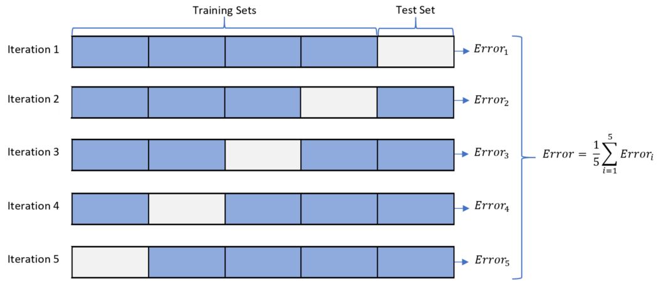
Cross-Validation Strategies
Leave One Out Cross-Validation:
We have a single data point only in our validation set and the rest n-1 observations become the training set. Mostly suitable for small datasets.
K-Fold Cross Validation:
To split the training dataset into k equal subsets.
Out of these k subsets we train the model on k-1 subsets and keep one subset as a validation set.
This process is repeated k times and the error is averaged over the k models.
For each iteration, the model is trained on a different subset.
(source: Patro, 2021)

Slide 14
Hyperparameter tuning strategies
Grid Search
We specify the grid of values (of hyperparameters) we want to try out and optimize to get the best parameter combinations
We then build models on each of those values using cross-validation and report the best parameters’ combination in the whole grid.
The output will be the model using the best combination from the grid.
Drawback: user needs to manually provide the actual parameters, that may not be the most optimal parameters.
Randomized Search
A modification to the grid search. It takes input for grid elements as in normal grid search but it can also take distributions as input.
We get the parameter values from certain distribution and control the number of iterations.

Slide 15
Lecture Outline
Model Tuning
Model Interpretation
Model Deployment

Slide 16
Model Interpretation
Some ML models use interpretable algorithms, for example a decision tree will give you importance of all the variables as an output.
Some ML models are interpretable in nature by default - e.g. generative model such as Bayesian Rule List.
Many ML models are black box and hard to interpret.
Model interpretation can help data scientists understand the interactions among features that can lead to better feature engineering and enhanced performance.
It can also help in model comparisons and explaining the results better to the stakeholders.

Slide 17
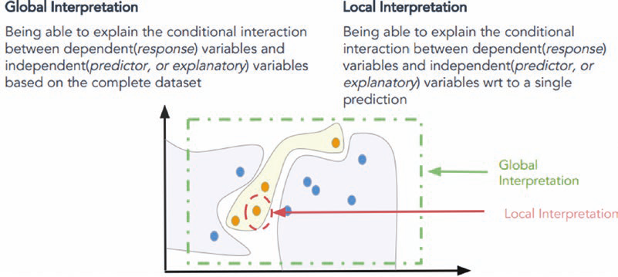
Skater
Open source Python framework to provide model agnostic interpretation of predictive models.
The idea of Skater is to understand black box ML models by querying them and interpreting their learned decision policies.
Skater enables us to do both global and local interpretations.
(source: Sarkar et al. 2018)
Notes:
The philosophy of Skater is that all models should be evaluated as black boxes and decision criteria of the models are inferred and interpreted based on input perturbations and observing the corresponding output predictions.

Slide 18
Lecture Outline
Model Tuning
Model Interpretation
Model Deployment

Slide 19
Model persistence
The simplest way to deploy a model is to persist the final model on permanent media like hard drive and use it for making predictions in the future.
This deployment scheme performs the necessary data transformations on the raw data and then reads the model from the permanent data store.
Once we have the data and model, we then can make a prediction.
FAIR (Findable, Accessible, Interoperable, and Reusable) data practices.

Slide 20
Custom Development
Another option to deploy a model is by developing the implementation of model prediction method separately.
The output of most ML algorithms is the values of parameters that were learned.
We can extract these parameter values and use them for prediction by doing mathematical operation on new data using the extracted parameters.

Slide 21
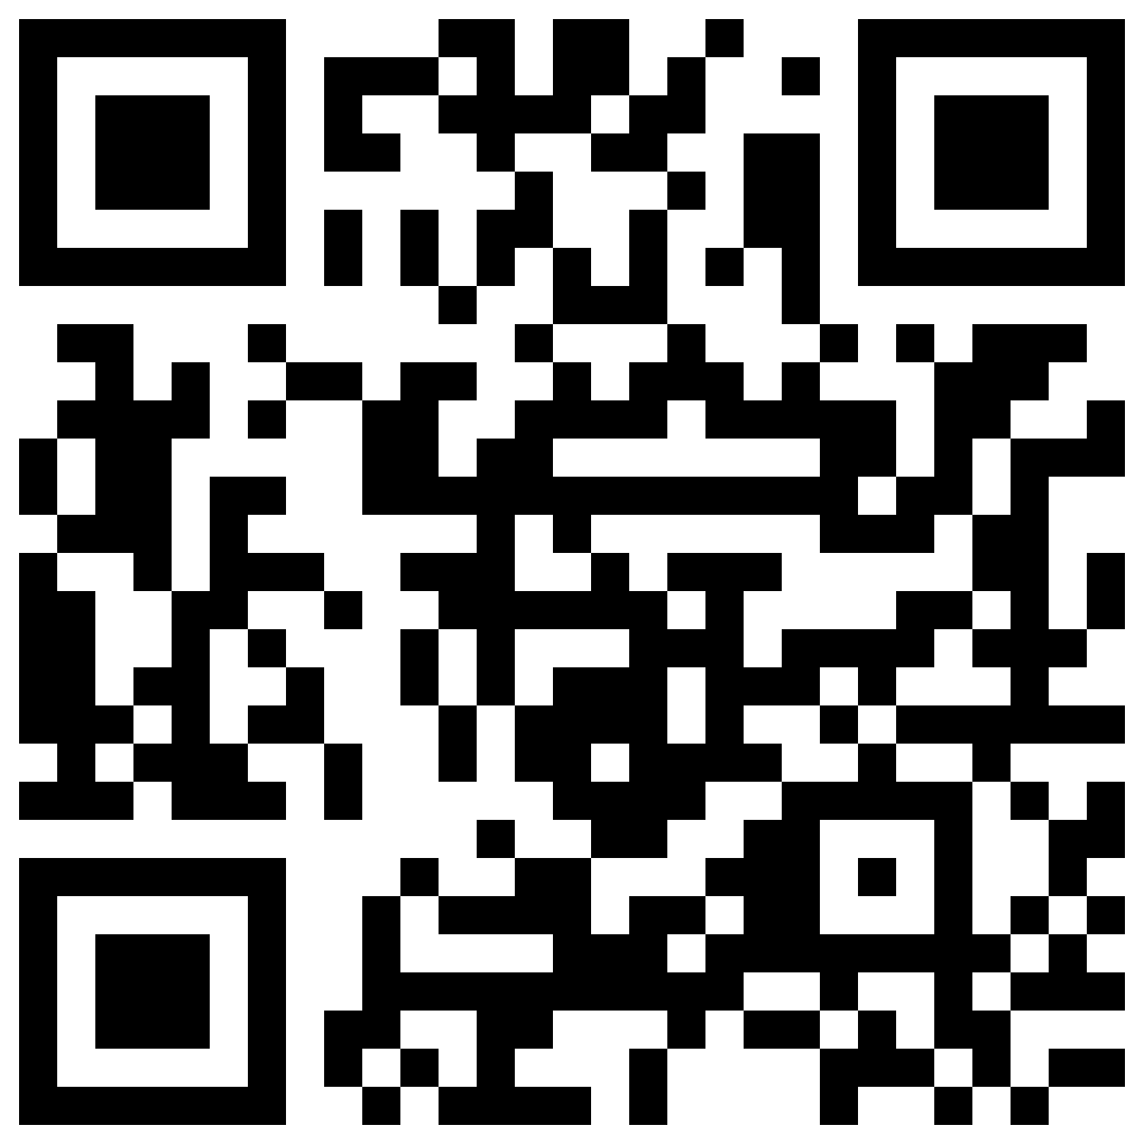
Quiz
What data is used to optimize the parameter settings of a learning algorithm?
Testing data
Training data
Validation data
None of the above
✔
Which of the followings are hyperparameters?
Regularization penalty
Learning rate
Different kernels
All of the above
✔
Which of the following model is the best model we are looking for?
High bias, high variance
High bias, low variance
Low bias. high variance
Low bias, low variance
✔
https://forms.gle/4pYqDEqpw4orJ4Vz6

Slide 22

References
Dipanjan Sarkar, Raghav Bali and Tushar Sharma. 2018. Practical Machine Learning with Python. A Problem-Solver's Guide to Building Real-World Intelligent Systems. Apress. (https://doi.org/10.1007/978-1-4842-3207-1), Chapter 5
Rebecca Patro. Jan 25, 2021. Cross-Validation: K Fold vs Monte Carlo. (https://towardsdatascience.com/cross-validation-k-fold-vs-monte-carlo-e54df2fc179b)
IBM. Underfitting vs Overfitting. (https://www.ibm.com/cloud/learn/underfitting#toc-underfitti-FKaOZyJR)

