Slide 1

Practical AI/ML for Computational Biology and Chemistry
(Day 3)
Chuming Chen
chenc@udel.edu
Research Associate Professor
Computer and Information Sciences
Center for Bioinformatics and Computational Biology
Data Science Institute
Slides and notebooks: https://github.com/udel-cbcb/al_ml_workshop
June 15, 2022

Slide 2
Feature Engineering, Scaling, and Selection

Slide 3

Lecture Outline
Review of Day 2
Features
Feature Engineering
Feature Scaling
Feature Selection

Slide 4
Review of Day 2
Data Collection
Data formats (e.g., CSV/TSV, XML, JSON, HTML, SQL)
Data Preparation for ML
Data cleaning
Feature selection
Data transformation
Dimensionality reduction
Data Readiness for AI/ML Checklist
Essential checks, Additional checks
Live Demos
Basic data cleaning
Marking and removal of missing data
Outlier identification and removal
Missing data imputation
Exercise

Slide 5
Supplementary Topics
FAIR Principles
Imbalanced Classification
Uncertainty in Machine Learning

Slide 6
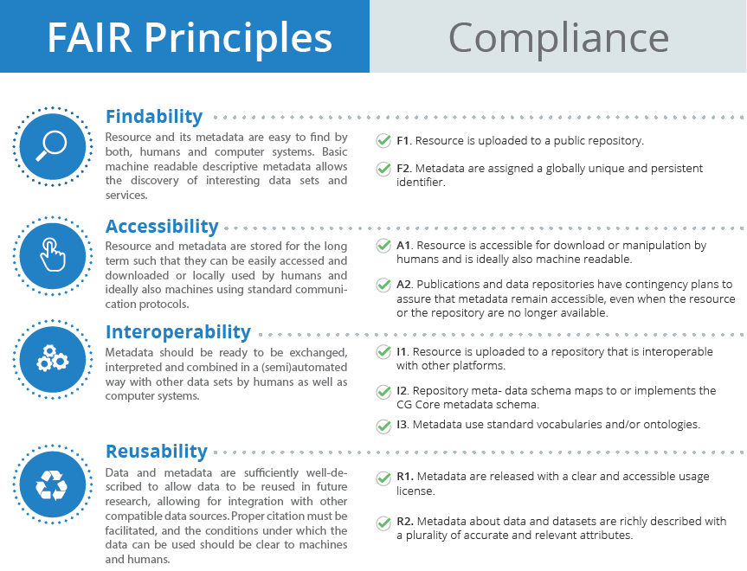
FAIR Principles for scientific data management and stewardship
(source: CGIAR)

Slide 7
Imbalance Classification Problems
A classification predictive modeling problem where the number of examples in the training dataset for each class label is not balanced. That is, the class distribution is not equal or close to equal, and is biased or skewed.
Imbalanced classifications pose a challenge for predictive modeling as most of the machine learning algorithms used for classification were designed around the assumption of an equal number of examples for each class.
Causes of class imbalance:
Data sampling
Biased sampling (corrected by improved sampling methods)
Measurement errors (corrected by improved measurement methods)
Properties of the domain
The process generates observations in one class is more expensive in time, cost, computation or other resources.
It is often infeasible or intractable to simply collect more samples from the domain to improve the class distribution.
Instead, a model is required to learn the difference between the classes.

Slide 8
Techniques to Handle Imbalanced Data
Use the right evaluation metrics
Accuracy, Precision/Specificity, Recall/Sensitivity, F1 Score, AUC
Resample the training set
Under-sampling: reducing the size of abundant class.
Oversampling: increasing the size of rare samples.
Use K-fold cross validation in the right way
Cross validation should always be done before over-sampling the data.
Ensemble different resample datasets
ML models tend to generalize by discarding the rare class.
One easy best practice is to building n models that use all the samples of the rare class and n-differing samples of the abundant class.
Resample with different ratios
Instead of training all the models with the same ratio in the ensemble, it is worth trying to ensemble different ratios.
Cluster the abundant class
Clustering the abundant class in R groups and only keep the medoid for each group.
The model is then trained with the rare class and the medoids only.

Slide 9
Uncertainty in Machine Learning
Uncertainty
means working with imperfect or incomplete information.
It is fundamental to the field of machine learning.
Is the biggest source of difficulty for beginners, especially developers.
Sources of uncertainty:
Observations from the domain are not crisp; instead, they contain noise.
Observations from a domain used to train a model are a sample and incomplete by definition.
A machine learning model will always have some error, which means imperfect predictions.
How to manage uncertainty:
noisy observations, probability and statistics help us to understand and quantify the expected value, variability, of variables in our observations from the domain.
the incomplete coverage of the domain, probability helps to understand and quantify the expected distribution and density of observations in the domain.
model error, probability helps to understand and quantify the expected capability and variance in performance of our predictive models when applied to new data.

Slide 10
Lecture Outline
Review of Day 2
Features
Feature Engineering
Feature Scaling
Feature Selection

Slide 11
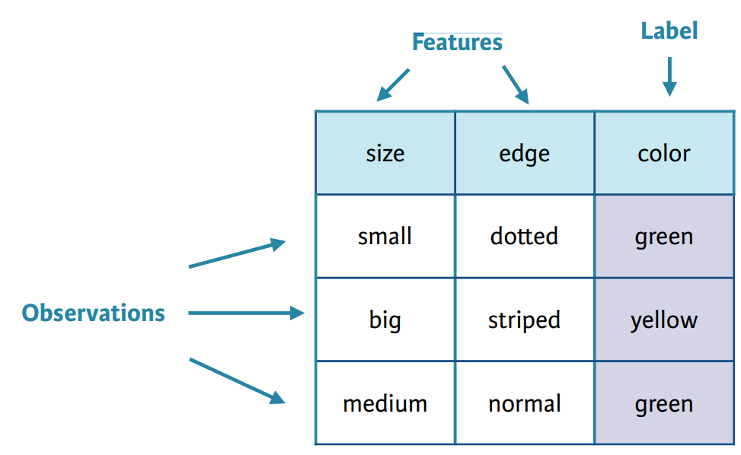
What are features?
The features are the input variables describing the data
Each observation is a row and each feature is a column that will have a specific value for an observation
A label is the target that we’ve trying to predict
Features in a row typically form a feature vector and the entire set of features across all the observations (rows) is called a feature set.
Inherent raw features | Derived features
Obtained directly from the dataset without data manipulation | Usually obtained from feature engineering of existing data attributes
(source: https://zinayouhan33.medium.com/machine-learning-can-be-divided-into-3-categorizations-supervised-unsupervised-and-reinforcement-9a1b47460f5d)
Notes:
Each feature is an individual measurable attribute, depicted as a column in a table
Each observation is a row and each feature will have a specific value for an observation
Each row typically indicates a feature vector and entire set of features across all the observations is called a feature set.
Inherent raw features are obtained directly from the dataset without data manipulation or engineering.
Derived features are usually obtained from feature engineering from existing data attributes.

Slide 12
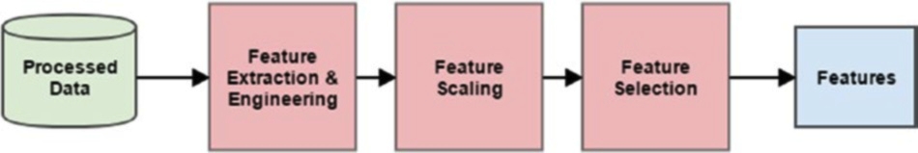
How to handle data features?
Major essential steps:
Feature extraction and engineering
Feature scaling
Feature selection
(source: Sarkar et al. 2018)

Slide 13
Lecture Outline
Review of Day 2
Features
Feature Engineering
Feature Scaling
Feature Selection

Slide 14
What is feature engineering?
“Feature engineering is the process of transforming raw data into features that better represent the underlying problem to the predictive models, resulting in improved model accuracy on unseen data.” - Dr. Jason Brownlee
Raw data: data in its native form after being retrieved from the source. Typically, some data processing and wrangling have been done on it.
Features: specific representations of raw data after the process of feature engineering.
The underlying problem:The problem we want to solve or the ML task we want to perform.
The predictive models: the ML models that learn about the data.
Model accuracy: model performance metrics that are used to evaluate the model.
Unseen data: new data not used previously to build or train the model. The model is expected to learn from training data and generalize well from unseen data using good quality features.

Slide 15
Why do we need to do feature engineering?
Raw data cannot be used to build ML models directly
Essential for model building and evaluation as it provides better representation of data such that the data can be better understood by the ML algorithms.
Helps us build models on diverse data types therefore enables us to work on complex unstructured data.
Enables data scientists to take a step back and try to understand the domain problem better by taking inputs from the domain experts.
Notes:
Better representation of data can be better understood by the ML algorithms.
In general if you have the right feature set, even a simple model will perform well.
Raw data cannot be used to build ML models directly. Feature engineering is essential for model building and evaluation.
Feature engineering helps us build models on diverse data types therefore enables us to work on complex unstructured data.
Feature engineering enables data scientists to take a step back and try to understand the domain and the business problem better by taking inputs from domain experts.

Slide 16

How to engineer features
It involves using a combination of domain knowledge and constraints, hand-crafted transformations and mathematical transformations to transform the raw data into desired features.
Different data types need different techniques for feature extraction
Numeric, Categorical, Text, Temporal, Audio/Video/Image data
Auto feature generation is currently popular. It uses Deep Learning to make the machine detect patterns and extract useful data representations from the raw data directly and use them as features.
Convolutional neural networks (CNNs)
Recurrent neural networks (RNNs)
Long Short Term Memory networks (LSTMs)
(source: Koehrsen, 2018)

Slide 17
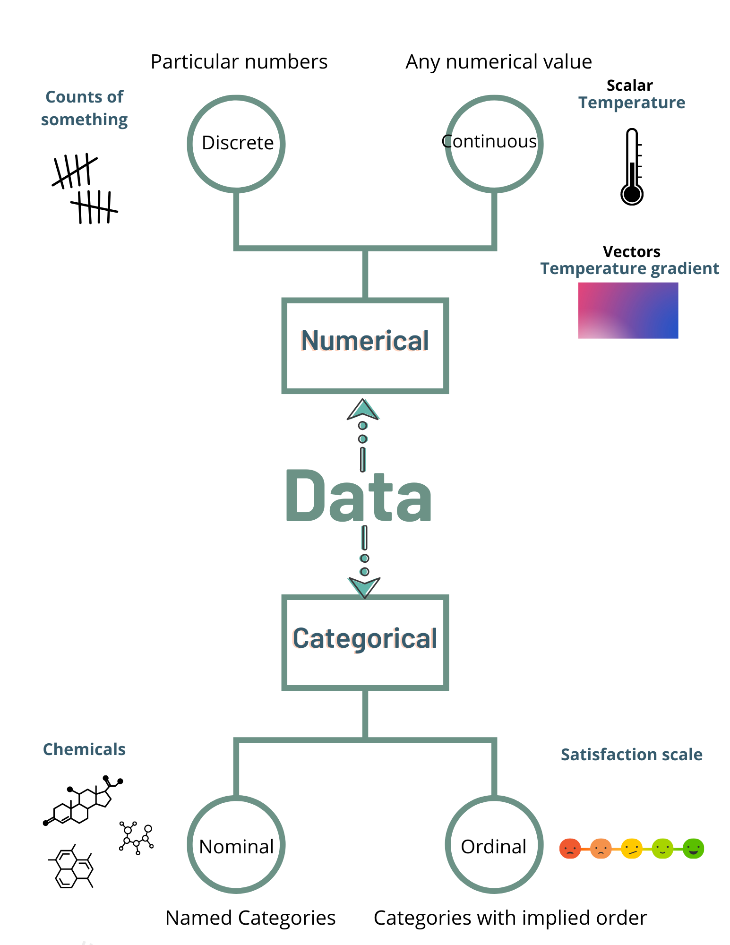
Feature engineering on numeric data
Raw measurement
Values: e.g. average, standard deviation, quartiles
Counts: e.g. frequencies and occurrences of specific attributes
Binarization: sometime, we prefer binary feature as opposed to a count base measure.
Rounding: round off high precision percentages into numeric integers
Created in Canva by C. Arighi
Interactions: capture the interactions between feature variables as a part of the input feature set
Binning: also called quantization, which transform continuous numeric values into discrete ones.
Statistical or Mathematical Transformation

Slide 18
Binning
Binning, also known as quantization, can be used for transforming continuous numeric values into discrete ones.
In many cases, the distributions of data values are skewed in the sense that some sets of values will occur a lot and some will be very rare. Besides that, the range of these values is also varied.
We can group raw values into discrete numbers (bins). Each bin represents a specific degree of intensity and has a specific range of values.
Fixed-Width Binning:
Each bin has a pre-fixed range of values which should be assigned to that bin on the basis of some business or custom logic, rules, or necessary transformations.
Adaptive Binning:
Use data distribution itself (Quantile) to decide the appropriate bins.

Slide 19
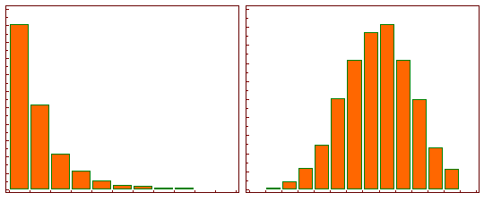
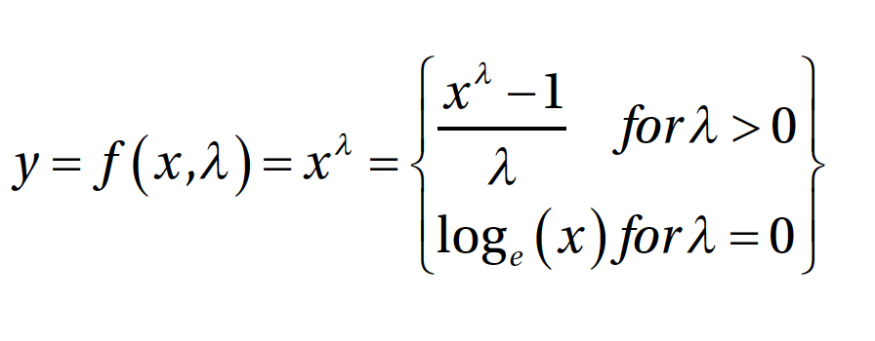
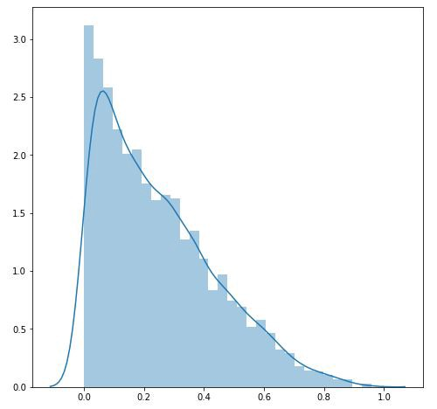
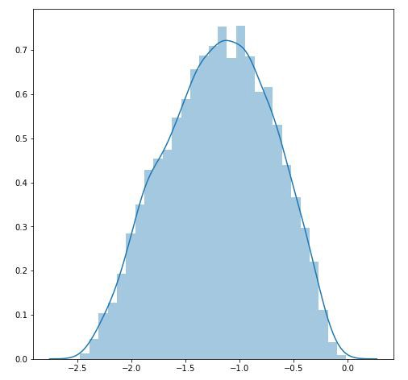
Statistical or Mathematical Transformation
Belonging to the power transform family of functions:
Log Transformation: y = log_{b}(x)
This tends to make the skewed distribution as normal-like as possible.
Box-Cox Transformation:
It transforms non-normal dependent variables into a normal shape.
This function has a prerequisite that the numeric values to be transformed must be positive (similar to what log transform expects).
(Source: https://www.medcalc.org/manual/log-transformation.php)
(Source: https://towardsdatascience.com/box-cox-transformation-explained-51d745e34203)
Notes:
Link to nice article
https://medium.com/@kyawsawhtoon/log-transformation-purpose-and-interpretation-9444b4b049c9
Link to nice video to short intro to box-cox
https://youtu.be/pjwDpF_Igkw

Slide 20
Transforming Nominal Features
Nominal features or attributes are categorical variables that usually have a finite set of distinct discrete values.
Often these values are in string or text format and ML algorithms cannot understand them directly.
Hence usually you might need to transform these features into a more representative numeric format.
The LabelEncoder class from scikit-learn can be used to generate a mapping scheme where each nominal feature is mapped to a number.
Nominal
Created in Canva by C. Arighi

Slide 21
Transforming Ordinal Features
Ordinal features are similar to nominal features except that order matters and is an inherent property with which we can interpret the values of these features.
Like nominal features, even ordinal features might be present in text format and you need to map and transform them into their numeric representation.
it is really easy to build your own transformation mapping scheme with the help of Python dictionaries and use the map(...) function from pandas to transform the ordinal feature.
Ordinal
Created in Canva by C. Arighi

Slide 22
Why do we need encoding categorical features?
If we directly fed these transformed numeric representations of categorical features into any ML algorithm, the model will essentially try to interpret these as raw numeric features and hence the notion of magnitude will be wrongly introduced in the system.

Slide 23
Methods for Encoding Categorical Features
One Hot Encoding
Encode a feature with m distinct labels into m binary features. Each observation is converted into a vector of size m with only one of the values of 1.
Dummy Encoding
Encode a feature with m distinct labels into m-1 binary features, such that each value gets converted into a vector of size m-1. 0th or m-1th feature will be all 0s.
Bin-Counting
Useful for dealing with categorical variables with many categories.
It converts a categorical variable into statistics about the value.
It turns a large, sparse, binary representation of the categorical variable, such as that produced by one-hot encoding, into a very small, dense, real-valued numeric representation.
Feature Hashing
Another useful feature engineering scheme for dealing with large scale categorical features.
A hash function is typically used such that the hashed values of the features are used as indices in this predefined feature vector and values are updated accordingly.

Slide 24
Feature engineering on text data
The challenges
It is challenge to extract useful information from text for building models. Because we are dealing with the unpredictable nature of the syntax, format, and content of the documents.
Transforming these textual representations into numeric representations will make it easy for ML algorithms to understood.
Two aspects to execute feature engineering on text data
Pre-processing and normalizing text
Feature extraction and engineering

Slide 25
Natural Language Processing and Text Analytics
Text Pre-Processing
Text tokenization, special characters removal, contraction expansion, stopwords removal, spelling correction, stemming, lemmatization
Bag of Words Model
Simple and effective scheme of vectorizing features from unstructured text.
Bag of N-Grams Model
Help us take into account phrases or collection of words which occur in a sequence
TF-IDF Model
Some terms may occur frequently across all documents.
Uses a combination of term frequency (tf) and inverse document frequency (idf) can help us scaling or normalizing on frequently occurring terms

Slide 26
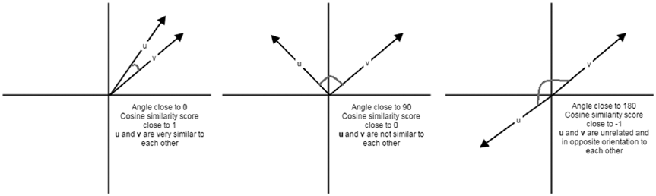
Document Similarity
Useful in domains like search engines, document clustering, and information retrieval.
The process of using a distance or similarity based metric that can be used to identify how similar a text document is with another document based on features extracted from the documents like bag of words or tf-idf.
Example similarity and distance metrics:
cosine distance/similarity
BM25 distance
Hellinger-Bhattacharya distance
jaccard distance
(source: Sarkar et al. 2018)

Slide 27
Topic Modeling
Besides document terms, phrases and similarities, we can also use some summarization techniques to extract topic or concept based features from text documents.
The process of extracting key themes or concepts from a corpus of documents which are represented as topics.Each topic can be represented as a bag or collection of words/terms from the document corpus.
Together, these terms signify a specific topic, theme or a concept and each topic can be easily distinguished from other topics by virtue of the semantic meaning conveyed by these terms.
Topic modeling techniques:
Latent Semantic Indexing (LSI) uses matrix decomposition like SVD
Latent Dirichlet Allocation (LDA) uses generative probabilistic models

Slide 28
Feature engineering on temporal data
Datasets where most attributes are time based and changed over time
Date-Based Features:
Each temporal value has a date component that can be used to extract useful information and features related to the date.
Time-Based Features:
Each temporal value has a time component that can be used to extract useful information and features related to the time.

Slide 29
Feature engineering on Image data
It is not possible to directly use images for training models.
If you are given a raw image, you might have a hard time trying to think of ways to represent it so that any Machine Learning algorithm can utilize it for model training.
However, there are various strategies and techniques that can be used in this case to engineer the right features from images.
Image Metadata Features (EXIF)
Raw Image and Channel Pixels
Grayscale Image Pixels
Binning Image Intensity Distribution
Image Aggregation Statistics
Edge Detection
Object Detection
Localized Feature Extraction
Visual Bag of Words Model
Automated Feature Engineering with Deep Learning

Slide 30
Lecture Outline
Review of Day 2
Data, Dataset, Features
Feature Engineering
Feature Scaling
Feature Selection

Slide 31
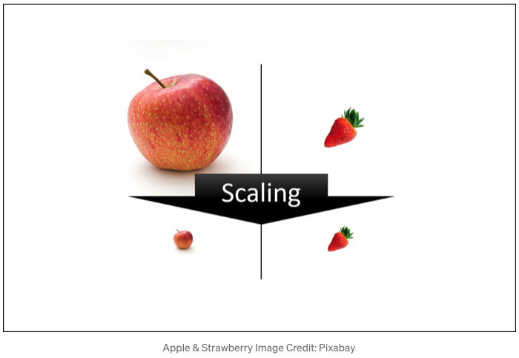
Feature Scaling
Technique to standardize the independent features present in the data into a fixed range
Using the raw values as input features might make models biased toward features having really high magnitude of values.
Machine learning model just sees number — if there is a vast difference in the range of values, it makes the underlying assumption that higher ranging numbers have superiority of some sort.
Scaling is performed during the data pre-processing to handle highly varying magnitudes or values or units
https://towardsdatascience.com/all-about-feature-scaling-bcc0ad75cb35
Notes:
When dealing with numeric features, we have specific attributes which may be completely unbounded in nature, like view counts of a video or web page hits.
Using the raw values as input features might make models biased toward features having really high magnitude of values.
Models such linear or logistic regression are typically sensitive to the magnitude or scale of features. Tree based models can still work without feature scaling. However it is still recommended to normalize and scale down the features with feature scaling, especially if you want to try out multiple Machine Learning algorithms on input features.

Slide 32
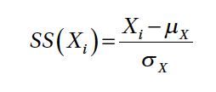
Standardized Scaling (Z-score scaling)
Standard scaler tries to standardize each value in a feature column by making the mean 0 and scaling the variance to be 1 from the values.This is also known as centering and can be denoted mathematically as
where each value in feature X is subtracted by the mean μ_{X} and the resultant is divided by the standard deviation σ_{X}.
You can also divide the resultant by the variance instead of the standard deviation if needed.

Slide 33
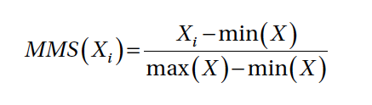
Min-Max Scaling
Scales all the data between 0 and 1
However, the MinMaxScaler class in scikit-learn also allows you to specify your own upper and lower bound in the scaled value range using the feature_range variable. Mathematically we can represent this scaler as
where we scale each value in the feature X by subtracting it from the minimum value in the feature min(X) and dividing the resultant by the difference between the maximum and minimum values in the feature max(X) - min (X).

Slide 34

Robust Scaling
The disadvantage of min-max scaling is that often the presence of outliers affects the scaled values for any feature. Robust scaling tries to use specific statistical measures to scale features without being affected by outliers. Mathematically this scaler can be represented as
where we scale each value of feature X by subtracting the median of X and dividing the resultant by the IQR also known as the Inter-Quartile Range of X which is the range (difference) between the first quartile (25th %ile) and the third quartile (75th %ile).

Slide 35
Lecture Outline
Review of Day 2
Data, Dataset, Features
Feature Engineering
Feature Scaling
Feature Selection

Slide 36
Why do we want to do Feature Selection?
Objective is to select an optimal number of features to train and build models that generalize very well on the data and prevent overfitting
Dealing with a large number of features bring us to the issue of the curse of dimensionality, which means more features tend to make models more complex and difficult to interpret.
Besides this, it can often lead to models over-fitting on the training data.

Slide 37
Feature Selection Strategies
Filter methods:
These techniques select features purely based on metrics like correlation, mutual information etc.
These methods do not depend on results obtained from any model and usually check the relationship of each feature with the response variable to be predicted.
Popular methods include threshold based methods and statistical tests.
Wrapper methods:
These techniques try to capture interaction between multiple features by using a recursive approach to build multiple models using feature subsets and select the best subset of features giving us the best performing model.
Methods like backward selecting and forward elimination are popular wrapper based methods.
Embedded methods:
These techniques try to combine the benefits of the other two methods by leveraging Machine Learning models themselves to rank and score feature variables based on their importance.
Tree based methods like decision trees and ensemble methods like random forests are popular examples of embedded methods.

Slide 38

Quiz
Which of the following is not feature scaling method?
Standardized
Min-Max
Robust
Binning
✔
Which of the following is not feature engineering method?
Rounding
Dummy encoding
Quantization
Feature hashing
✔
Which of the following are feature selection strategies?
Filter method
Wrapper method
Embedded method
All of the above
✔
https://forms.gle/JcNcoXCAsnGawBxa6

Slide 39

References
Dipanjan Sarkar, Raghav Bali and Tushar Sharma. 2018. Practical Machine Learning with Python. A Problem-Solver's Guide to Building Real-World Intelligent Systems. Apress. (https://doi.org/10.1007/978-1-4842-3207-1), Chapter 4.
Jason Brownlee. 2019. A Gentle Introduction to Imbalanced Classification (https://machinelearningmastery.com/what-is-imbalanced-classification/)
Jason Brownlee. 2019. A Gentle Introduction to Uncertainty in Machine Learning (https://machinelearningmastery.com/uncertainty-in-machine-learning/)

