Slide 1

Practical AI/ML for Computational Biology and Chemistry
(Day 2)
Chuming Chen
chenc@udel.edu
Research Associate Professor
Computer and Information Sciences
Center for Bioinformatics and Computational Biology
Data Science Institute
Slides and notebooks: https://github.com/udel-cbcb/al_ml_workshop
June 14, 2022

Slide 2

Lecture outline
Review of Day 1
Data Collection
Data Preparation
Data Readiness for AI/ML Checklist

Slide 3
Review of Day 1
Introduction to AI/ML
Overview of Artificial Intelligence and Machine Learning
Key concepts in AI/ML
Python AI/ML Ecosystem
AI/ML Applications in Biology and Chemistry
Comparison of different AI/ML algorithms
Recommendations for the use of AI/ML strategies for different data types
Multi-omics Data Analysis
Protein structure prediction with AlphaFold
Live Demo
Introduction to Google Colab, NumPy and Pandas, Gene family prediction
Exercise

Slide 4
Lecture outline
Review of Day 1
Data Collection
Data Preparation
Data Readiness for AI/ML Checklist

Slide 5
Data Collection and Data Preparation

Slide 6
Common Steps of Machine Learning Process
Define the problem
Learning enough about the project to select the model or models for the prediction task.
Prepare the data
Transforming the raw data into a form that can be used in modeling
Evaluate the models
Evaluating machine learning models on your dataset.
Finalize the model
Selecting and deploying the final model

Slide 7
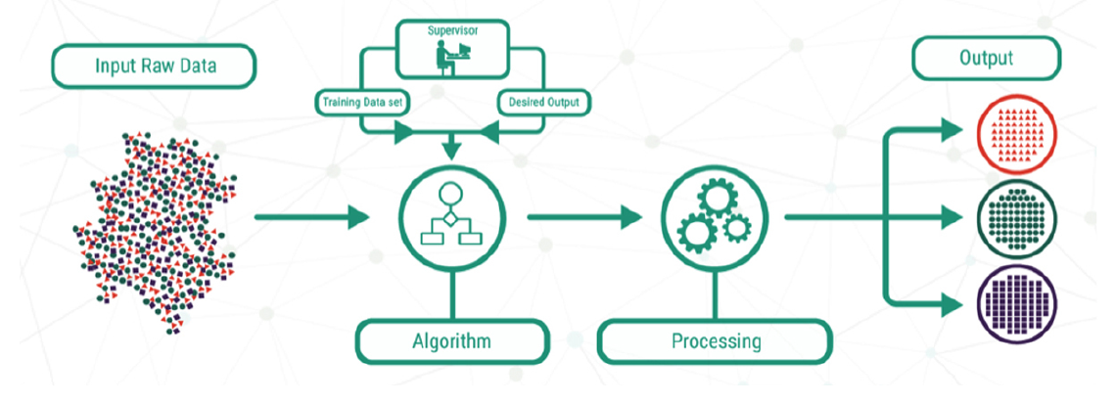
What is data?
Examples or cases from a given domain that characterize the problem we want to solve
Source: Lucidchart
Input data:
tabular (spreadsheet, database table, CSV, TSV)
structured data (XML, JSON, HTML)
Output data:
labels (classification)
numbers (regression)
Notes:
In supervised learning, data consists of examples where each example has an input that will be provided to the model and an output or target that the model is going to predict.
Output data: a label (classification), a number (regression)
Input data: usually is tabular or structured data (spreadsheet, database table, CSV, TSV)
Row: a single example from the domain, also called an instance, an example or a case.
Column: a single property observed about that example, also called a variable, a predictor or feature.
Input variables: columns in the dataset provided to the model to make a prediction
Output variables: column in the dataset to be predicted by the model

Slide 8
Data Collection
Data collection is where everything begins. Data collection often happens in parallel to the problem definition and it is later formalized once the problem statement is defined and the project gets underway.
Data can be present in different formats, shapes, and sizes and exists in systems such as legacy machines (say mainframes), web (say web sites and web applications), databases, flat files, sensors, mobile devices, and so on.
Notes:
Data collection is where everything begins. Though listed as a step that comes post business understanding and problem definition, data collection often happens in parallel.
Of course, data collection takes a formal and better form once the problem statement is defined and the project gets underway.
We should also realize that data can be present in different formats, shapes, and sizes and exists in systems such as legacy machines (say mainframes), web (say web sites and web applications), databases, flat files, sensors, mobile devices, and so on.

Slide 9
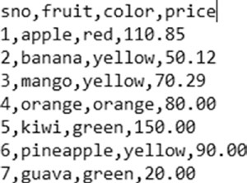
Format: Comma Separated Values (CSV)
A CSV data file is one of the most widely available formats of data. It is also one of the oldest formats still used and preferred by different systems across domains.
Comma Separated Values (CSV) are data files that contain data with each of its attributes delimited by a “,” (a comma).
A CSV may contain an optional header row (as shown in the example below).
CSVs may optionally enclose each of the attributes in single or double quotes.
CSVs are usually used to store tabular data, i.e., data in the form of rows and columns.
CSVs come in different variations and just changing the delimiter to a tab makes one a TSV (or a tab separated values) file.

Slide 10
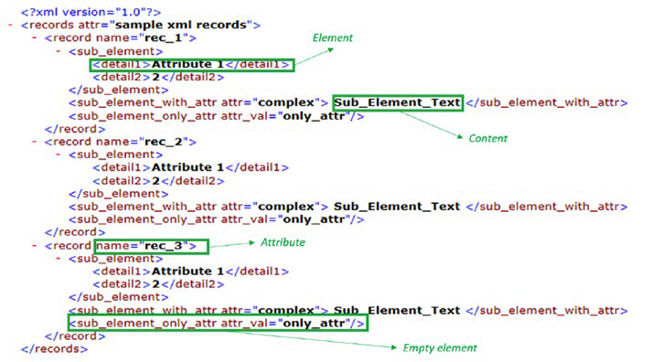
Format: eXtensible Markup Language (XML)
https://www.w3schools.com/xml/
Markup language that defines rules for encoding data/documents to be shared across the Internet.
XML is a text format that is human readable. Its design goals involved strong support for various human languages (via Unicode), platform independence, and simplicity.
Example in UniProt: https://rest.uniprot.org/uniprotkb/P31749.xml

Slide 11
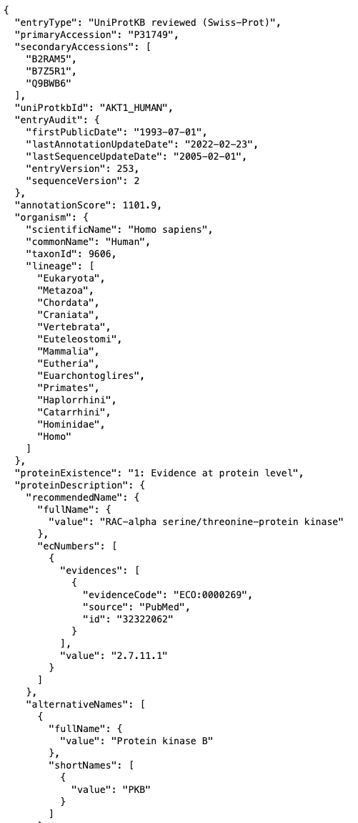
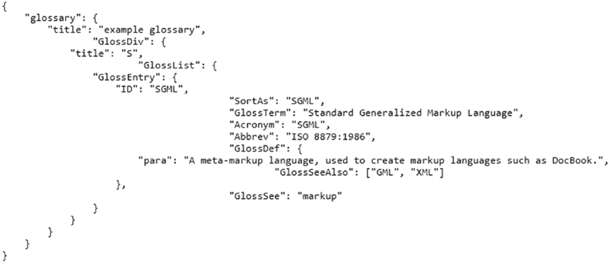
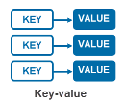
Format: Java Script Object Notation
(JSON)
http://www.json.org/
One of the most widely used data interchange formats across the digital realm.
A text format that is language independent with certain defined conventions.
A human-readable format
Easy to parse in most programming/scripting languages.
A JSON file/object is simply a collection of name(key)-value pairs.
https://rest.uniprot.org/uniprotkb/P31749.json
Notes:
Such key-value pair structures have corresponding data structures available in programming languages in the form of dictionaries (Python dict), struct, object, record, keyed lists, and so on. More details are available at http://www.json.org/.

Slide 12
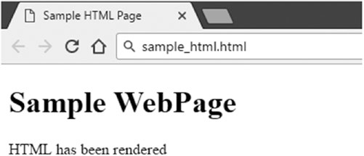
Format: Hyper Text Markup Language (HTML)
A markup language similar to XML. Mainly used by web browsers and similar applications to render web pages for consumption.
Defines rules and structure to describe web pages using markup.
Browsers use markup tags to understand special instructions like text formatting, positioning,
hyperlinks, and so on but only renders the content for the end user to see.
<!DOCTYPE html>
<html>
<head>
<title>Sample HTML Page</title>
</head>
<body>
<h1>Sample WebPage</h1>
<p>HTML has been rendered</p>
</body>
</html>

Slide 13
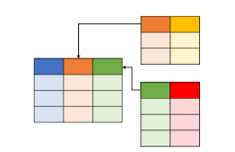
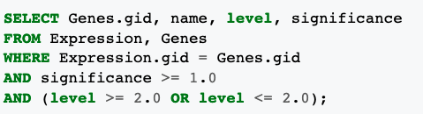
Format: Structured Query Language (SQL)
Data available in the form of tables in databases, or to be more specific, relational databases, comprise of another format of structured data that we encounter when working on different use cases, most of them conforming to the SQL standard.
The most common way used while working on data science and related use cases is to access data using SQL queries directly.
The second way of interacting with databases is the ORM or the Object Relational Mapper method.
Powerful libraries like sqlalchemy and pyodbc from Python Ecosystem support both methods.

Slide 14
Lecture outline
Review of Day 1
Data Collection
Data Preparation
Data Readiness for AI/ML Checklist

Slide 15
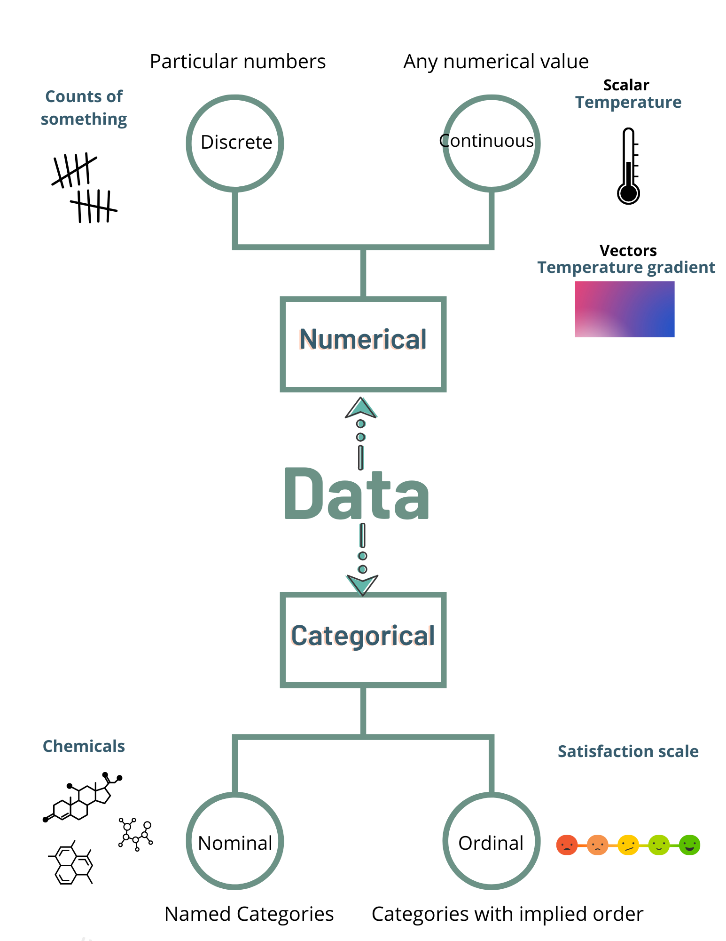
Data Description (Types)
Numeric
This is simplest of the data types available. Directly usable and understood by most AI/ML algorithms.
Scalars and vectors
Categorical
Categorical variables are descriptive
Nominal: named categories, no order.
Ordinal: categories of data with implied order
Created in Canva by C. Arighi
Notes:
Numeric
This is simplest of the data types available. It is also the type that is directly usable and understood by most algorithms.
Numeric data represents scalar information about entities being observed.
Numeric values also form the basis of vector features, where each dimension is represented by a scalar value. The scale, range, and distribution of numeric data has an implicit effect on the algorithm and/or the overall workflow.
Categorical
Categorical variables are used to represent categories of entities being observed.
Nominal: define the category of the data point without any ordering possible. e.g., hair color can be black, brown, blonde, etc.
Ordinal: define the categories of data but can also be ordered based on rules on the context. e.g., people categorized by economic status of low, medium, or high.

Slide 16

What is data preparation?
A step in predictive modeling project where the raw data must be pre-processed before being used to fit and evaluate a machine learning model.
The goal is to discover how to best expose the underlying structure of the data to the learning algorithms.
ML is mostly about data preparation!
Most ML algorithms are well understood and well parameterized and there are standard definitions and implementations
Each ML project is empirically rather than theoretical and require systematic experimentation on data
One thing that changes from project to project is the specific data used in the project

Slide 17
Why raw data needs to be prepared?
Data in the form provided from the domain of interest are usually not ready for AI/ML
Machine Learning algorithms expect numbers
Statistical noise and errors in the data need to be corrected
Model performance also depends on the quality of data

Slide 18

Steps in data preparation
Data preparation involves:
Data cleaning: identifying and correcting
mistakes or errors in the data
Data transformation: changing the scale
or distribution of the input variables
Feature selection: identifying those input variables that are most relevant
Feature engineering: deriving new variables from available data
Dimensionality reduction: creating compact representations of the data
Source: https://www.thecads.com/

Slide 19
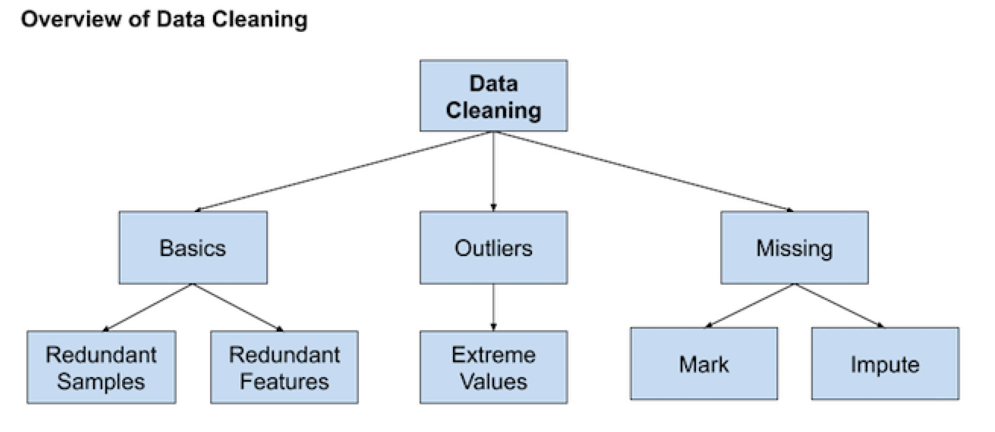
Data Cleaning
The goal is to identify and address specific observations that may be incorrect.
Involves fixing systematic problems or errors in messy data.
Involves deep domain expertise.
(source: Brownlee, 2020)

Slide 20
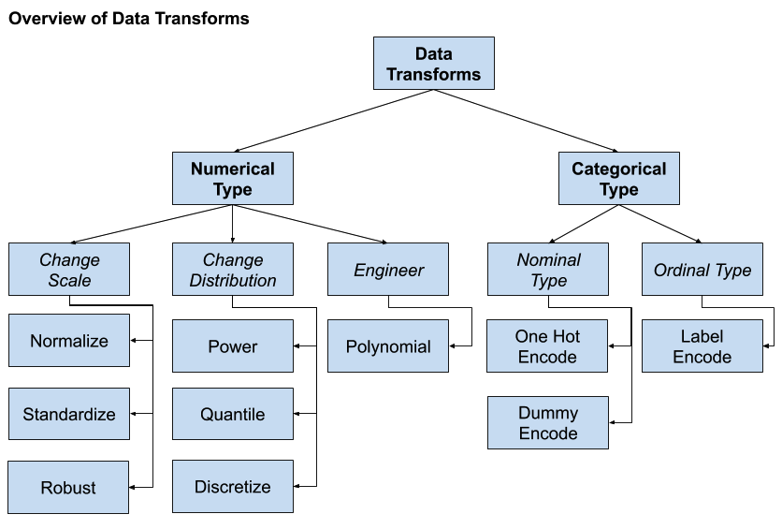
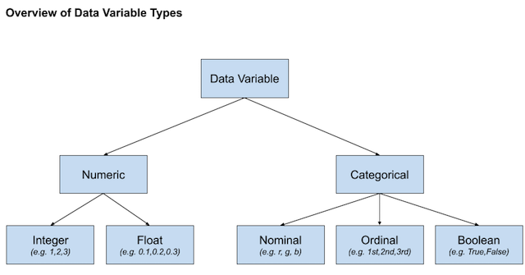
Data Transformation
Change the type or distribution of data variables.
Operations are generally performed separately for each variable.
(source: Brownlee, 2020)

Slide 21
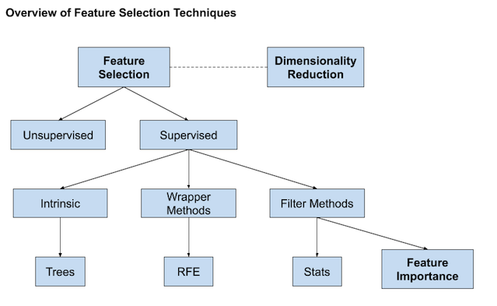
Feature Selection
Techniques for selecting a subset of input features that are most relevant to the target variable that is being predicted
Irrelevant and redundant input variables can distract or mislead learning algorithms possibly resulting in lower predictive performance.
The goal is to favor the simplest possible well performing model.
(source: Brownlee, 2020)
Notes:
Feature selection techniques may generally grouped into those that use the target variable
(supervised) and those that do not (unsupervised). Additionally, the supervised techniques
can be further divided into models that automatically select features as part of fitting the
model (intrinsic), those that explicitly choose features that result in the best performing model
(wrapper) and those that score each input feature and allow a subset to be selected (filter).

Slide 22
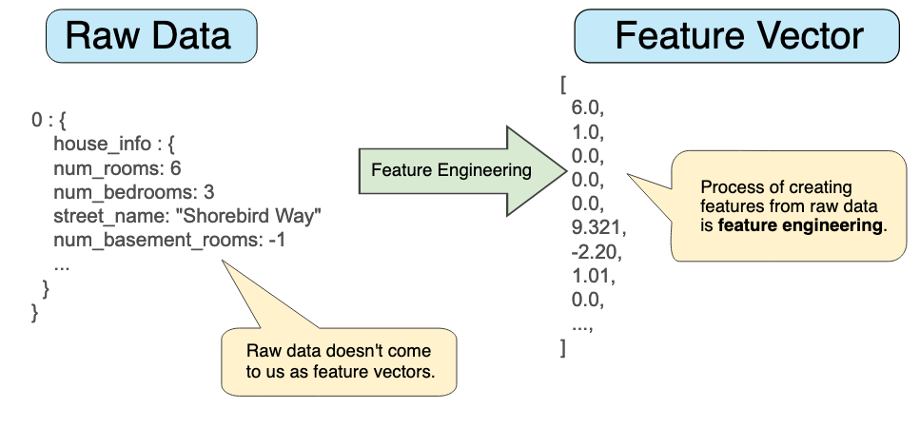
Feature Engineering
The art and science of transforming raw data into features that better represent a pattern to the learning algorithms
Popular techniques:
Adding a boolean flag variable for some state.
Adding a group or global summary statistic, such as mean.
Adding new variables for each component of a compound variable, such as a date-time.
Creating copies of numerical input variables that have been changed with a simple mathematical operation.
Notes:
The process of creating new input variables from the available data.
Usually require the collaboration of a subject matter expert to help identify new features.
To add broader context to a single observation or decompose a complex variable in order to provide more straightforward perspectives on the input data.
Popular techniques:
Adding a boolean flag variable for some state.
Adding a group or global summary statistic, such as mean.
Adding new variables for each component of a compound variable, such as a date-time.
Creating copies of numerical input variables that have been changed with a simple mathematical operation.

Slide 23
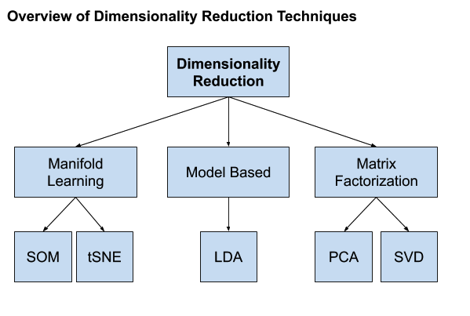
Dimensionality Reduction
The curse of dimensionality: The problem is, the more dimensions (e.g. the more input variables) the dataset has, the more likely it is that the dataset represents a very sparse and likely unrepresentative sampling space.
This motivates creating a projection of the data into a lower-dimensional space that still preserves the most important properties of the original data.
(source: Brownlee, 2020)

Slide 24

Quiz
How can we handle missing or corrupted dataset?
Drop missing rows or columns
Assign a unique category to missing values
Replace missing values with mean/median/mode
All of the above
✔
Which of the following is not a data transformation method?
Normalization
Imputation
Quantization
One-hot encoding
✔
Which of the following is considered data preparation for AI/ML?
Data cleansing and transformation
Feature engineering and selection
Dimension reduction
All of the above
✔
https://forms.gle/xPj1A9WvEzXQHoEa7

Slide 25

References
Will Koehrsen. Feature Engineering: What Powers Machine Learning. Nov 12, 2018.
(https://towardsdatascience.com/feature-engineering-what-powers-machine-learning-93ab191bcc2d)
Jason Brownlee. 2020. Data Preparation for Machine Learning. (https://machinelearningmastery.com/data-preparation-for-machine-learning/)
Chirag Goyal. Data Leakage And Its Effect On The Performance of An ML Model. July 23, 2021 (https://www.analyticsvidhya.com/blog/2021/07/data-leakage-and-its-effect-on-the-performance-of-an-ml-model/)

Slide 26
Lecture outline
Review of Day 1
Data Collection
Data Preparation
Data Readiness for AI/ML Checklist

