Slide 1

Practical AI/ML for Computational Biology and Chemistry
(Day 2)
Chuming Chen
chenc@udel.edu
Research Associate Professor
Computer and Information Sciences
Center for Bioinformatics and Computational Biology
Data Science Institute
Slides and notebooks: https://github.com/udel-cbcb/al_ml_workshop
June 14, 2022

Slide 2
Data Readiness for AI/ML CheckList

Slide 3

Lecture outline
Essential checks
Additional checks

Slide 4
Essential Checks
The minimum requirements for ML
The answers should all be “yes.”
A “no” wouldn’t automatically disqualify your data, but you would most likely need to discuss it with a data scientist to explore the solutions and evaluate the limitations.
Your ML data
ML essential check questions
No
Review data
Yes
Data ML ready
Notes:
Use the following questions to determine whether your data meets the minimum requirements for ML.
The answers should all be “yes.”
A “no” wouldn’t automatically disqualify your data, but you would most likely need to discuss it with a data scientist to explore the solutions and evaluate the limitations.

Slide 5
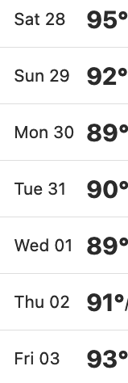
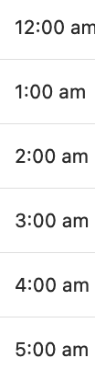
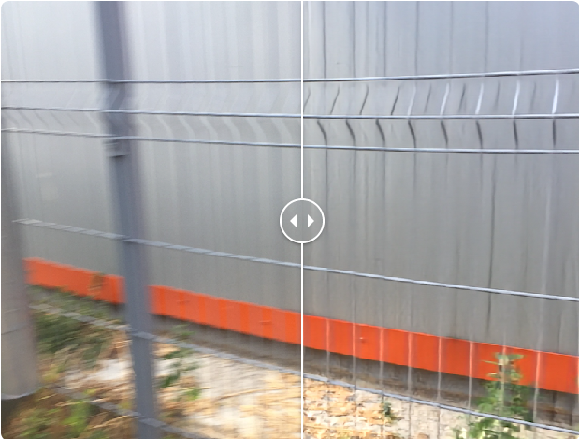





Does the data include information that can predict the target?
ML essential check questions
Different granularity
If you want to predict hourly temperature using daily temperature data, your data will not have enough signal.
You cannot predict a very granular characteristic based on aggregates.
You can build a model to convert blurry images to sharp images, but you first need to give it some sharp images as training data to learn from.
Training data:
daily average temperature (F)
Prediction:
hourly temperature
Training both sharp and blurry images

Slide 6
Do you already have labeled data?
ML essential check questions
For supervised or semi-supervised learning
If you have a categorical target, you’ll need some labeled data for each of the categories.
For example, in a cancer tumor classification problem, you’ll need some examples of both correctly identified Benign tumors and Malignant tumors.
If you have a numerical target, you’ll need some labeled data for different ranges of Values.
For example, if you want to predict the height of a person from her photo, you’ll need some photos of tall persons, of average-height persons, and of short persons, all with the correct heights assigned to them.
Notes:
Unless you are planning to do unsupervised learning, you will need labeled data.
If you have a categorical target, you’ll need some labeled data for each of the categories.
For example, in a spam email classification problem, you’ll need some examples both of correctly identified spam emails and of correctly identified non-spam emails.
You cannot build the model if you have examples for only one of the categories but not all.
If you have a numerical target, you’ll need some labeled data for different ranges of Values.
For example, if you want to predict the height of a person from her photo, you’ll need some photos of tall persons, of average-height persons, and of short persons, all with the correct heights assigned to them.

Slide 7
Is your data correct/accurate?
ML essential check questions
You cannot expect great performance from a model trained on data when the labels and/or features of that data are incorrect or inaccurate.
If you have erroneous values in your data, for example, due to software or hardware failure, you should try to identify and impute the correct values as much as possible.
When you correct the values, do not delete the errors or replace them. Instead, create a new field to store the corrected values.
Keep in mind, in some problems (for example, a failure forecast), data errors can be an important predictor field.

Slide 8
Solution 1 - Identify and impute missing values
Make sure you don’t lose any information during the imputation.
For example, for a given feature that contains both None and NA, create two new features named feature_is_None and feature_is_NA and record whether the feature is None or NA, respectively.
This way, you capture hidden information in missing values.
If None means no feature present and NA means information was not recorded, the ML model learns the difference.

Slide 9
Solution 2 - Remove noise from your data
Treat noise similarly to errors. Identify and remove them as much as possible.
For example, you can reduce periodic noise from images before doing image classification using some filters.
When you do NLP on scanned documents, you should first remove any scanning artifacts and irrelevant material (for example, a copier cover page) that is not useful for the ML model.

Slide 10
Solution 3 - Identify and remove sources of data leakage
Data leakage happens if you train your model using predictive information that won’t be available at serving time (that is, prediction time).
For example, suppose you’d like to use the electronic health records (hundreds of fields of data) to predict whether someone would need surgery.
Drop the field surgery_room_number . Otherwise, the model can learn that whoever had a valid value for this field also had surgery.

Slide 11
The goal of data quality checks
There are no missing values.
There are no erroneous values.
There are no duplicate values.
The distribution of features and label are as expected. If you expect a specific feature to have a mean of zero, it is alarming if the mean of the values are three standard deviations away from zero.
There is consistency between testing and training, including no data leakage.

Slide 12

Do you have enough data?
ML essential check questions
If you are predicting a category, the number of examples you’ll need for each category is 10 ✕ number of features.
For example, suppose you want to categorize 100 ✕ 100 COVID X-ray images. Each image has 10,000 pixels (that is, features) and there are 10 categories. Following the rule of thumb you’ll need 100,000 images.
If you are predicting a number, you’ll need 50 ✕ number of features.
This statement is assuming samples are distributed evenly across the range of target values. Sample imbalance requires more data.
If the acquisition of sufficient labeled data is difficult, semi-supervised learning can be of great practical value.
In semi-supervised learning, you use a small amount of labeled data in combination with a large amount of unlabeled data to improve learning performance.

Slide 13
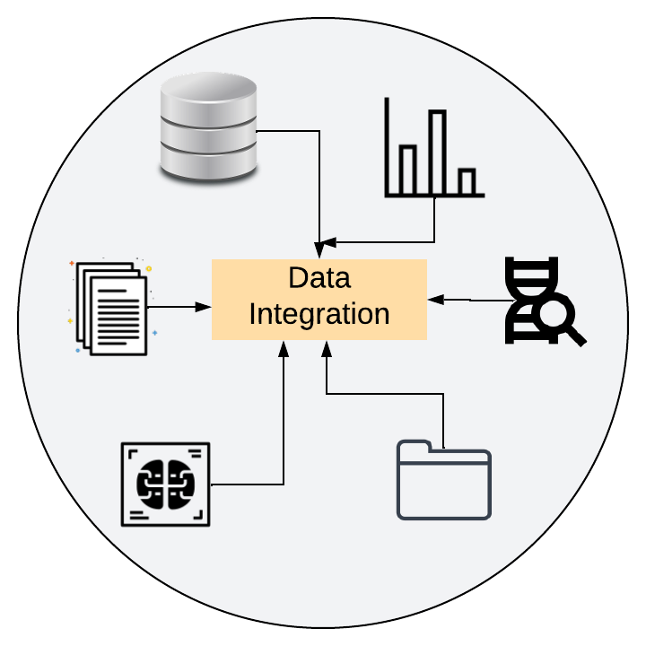
Solution 1 - Integrate data from diverse input sources
For example, paper documents, text files, image files, data warehouses, and slides can all contain useful information that you should integrate together.
Created in Lucidchart by C. Arighi

Slide 14

Solution 2 - If your data is scattered, identify and consolidate it
Consolidating your data can ease handling of the data and interpretability of the model
For example, if the gene identifiers as part of your data is stored under gene_id and the rest under accession_gene, you should identify this fact and, if possible, consolidate the two into one feature.
If redundant values stored in two different places do not match, do not arbitrarily drop one.
Notes:
For example, if the shipping address of some of your customers is stored under mailing_address and the rest under shipping_address, identify this fact and, if possible, consolidate the two into one feature.
Consolidating your data can ease handling of the data and interpretability of the model.
However, if the redundant values stored in two different places do not match, do not arbitrarily drop one.

Slide 15
Solution 3 - Integrate all the features of an instance into one object
For example, suppose your data is stored in a relational database across multiple tables such as chromosome, gene, variant and so on.
Integrate (that is, denormalize) those tables into one single table in which each row contains one instance with all the relevant information.

Slide 16

Is the data easily accessible by the team and machines performing the ML?
ML essential check questions
If there are strict restrictions that prevent easy access, you should address them before the ML tasks start.

Slide 17
Can the data be read fast enough?
ML essential check questions
You don’t want to wait days to generate your features and/or labels each time you make a change to your data preparation pipeline.
For example, suppose you have a massive database of sensor readings that can be accessed using an API. If you want to generate a new feature that is the sum of all sensor readings, you’ll want to be able to do so within a reasonable amount of time.

Slide 18
Do you have documentation for each field of data?
ML essential check questions
Can you provide a brief description for each field that includes its name and type, what it represents, how its value is measured, when the data is collected, whether the original values can get updated, and what its applicability to the use case?
Do you have records of any changes in the method of collection or in the measurement of a field? (For example, switching from grams to milligrams)
FAIR (Findable, Accessible, Interoperable, and Reusable) data practices

Slide 19
Are the missing values a small percentage of the fields of interest?
ML essential check questions
Note that missing values can be represented in different forms even for the same field: " " , None , NULL , NaN , 0 , -1 , 9999 , and so on. The more missing values, the less useful the data.
As a check, do you have enough useful data left if you consider only data with no missing values?

Slide 20
If you want to forecast n periods in advance, do you have n + 2 periods of data?
ML essential check questions
To build an ML model to forecast n periods in advance, you would need at least n+2 periods of data to train and evaluate the model properly
For example, if you want to build an ML model to forecast COVID spread in the next three years, you would need at least five years of data
You’ll need three years labelled data, one more year for the model to learn the general trend (that is, increasing, decreasing, or unchanging) for COVID, and one more year to evaluate the model.

Slide 21
Lecture outline
Essential checks
Additional checks

Slide 22
Additional Checks
To better understand your data and set expectations
The answers to the following questions should all be “yes.”
Most “no” answers are manageable problems, but it is important to know beforehand about the limitations to find an appropriate solution.
Your ML data
ML additional check questions
No
Review data
Yes
Data ML ready
Notes:
Use the following items to better understand your data and set expectations appropriately.
The answers to the following questions should all be “yes.”
Please discuss any “no” answers with a data scientist.
Most “no” answers are manageable problems, but it is important that you know beforehand about the limitations to find an appropriate solution.

Slide 23
Is your data unbiased?
ML additionalcheck questions
If you are considering building a model on a subset of your data, make sure that subset does not introduce bias.
For example, if you want to predict variant-gene-disease association in regions across the world, but have data only for population of European descent, your model may not work well for other regions.
If you use a subset of data for training, make sure it is unbiased.
If you have to use a subset of your data (for example, due to regulations, privacy, data size, or limited resources) to train the model, make sure it has the same statistical distribution as the original data.
When you have too much data files, sample all the files. If you cannot sample them with the same probability, account for that by using weights in the training.
Notes:
If you have to use a subset of your data (for example, due to regulations, privacy, data size, or limited resources) to train the model, make sure it has the same statistical distribution as the original data.
When you have too much data, there can be the temptation to randomly drop what feels like unnecessary excess, taking files 1-15, for example, and ignoring files 15-100. This is a mistake.
Try to sample all the files. If you cannot sample them with the same probability, account for that by using weights in the training.

Slide 24
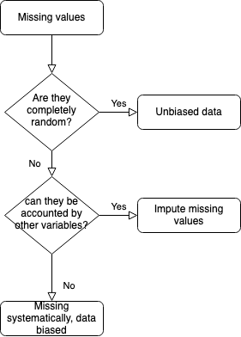
If there are missing values, do you know the causes?
Do missing values occur at random?
ML additionalcheck questions
Handling missing data is possible, but if the cause of the missing data is not well understood, ML may not be as successful.
Notes:
Handling missing data is possible, but if the cause of the missing data is not well understood, ML may not be as successful.
Missing values are common. If the values are missing completely at random (MCAR) — that is, if there is nothing systematic happening that makes some data more likely to be missing than other data — then the available data is unbiased.
For values not MCAR, there are two cases. If the missing values can be fully accounted for by other variables, this group is called missing at random (MAR). In this case, you should impute the missing values properly using the available data to build a model that is reasonably unbiased.
But if the values are missing systematically, that is, missing not at random (MNAR), the model built on this data may be biased and so may underperform at deployment.

Slide 25
For each field (input or target), does the data have the same unit?
ML additionalcheck questions
For example, a data field called volume has values that can be in different units (ml, cubic centimeters, ounces).
All the values should be converted to one standard.
Is the meaning of the data consistent?
For example, the data is inconsistent in a field molecular_surface where some values record the solvent-accessible surface and some values instead record the solvent-excluded surface.
Try to make all the values consistent. If that is not possible, create a new feature that identifies the meaning (for example, solvent-accessible or solvent-excluded).
Notes:
For example, a data field called item_cost has prices that can be in different currencies.
All the values should be converted to one currency.
Is the meaning of the data consistent?
For example, the data is inconsistent in a field item_price where some values record the wholesale price and some values instead record the retail price.
If it is not possible to determine the meaning of each value, the data field may not be useful for ML. Try to make all the values consistent.
If that is not possible, create a new feature that identifies the meaning (for example, wholesale price or retail price).

Slide 26
Is the same value recorded in the same way everywhere?
ML additionalcheck questions
For example, in a field amino_acid_type , if “Arg” is recorded in multiple ways such as arginine, R , and arg , then the same value is not represented consistently.
To improve the ML outcome, any such inconsistency should be identified and made consistent.

Slide 27
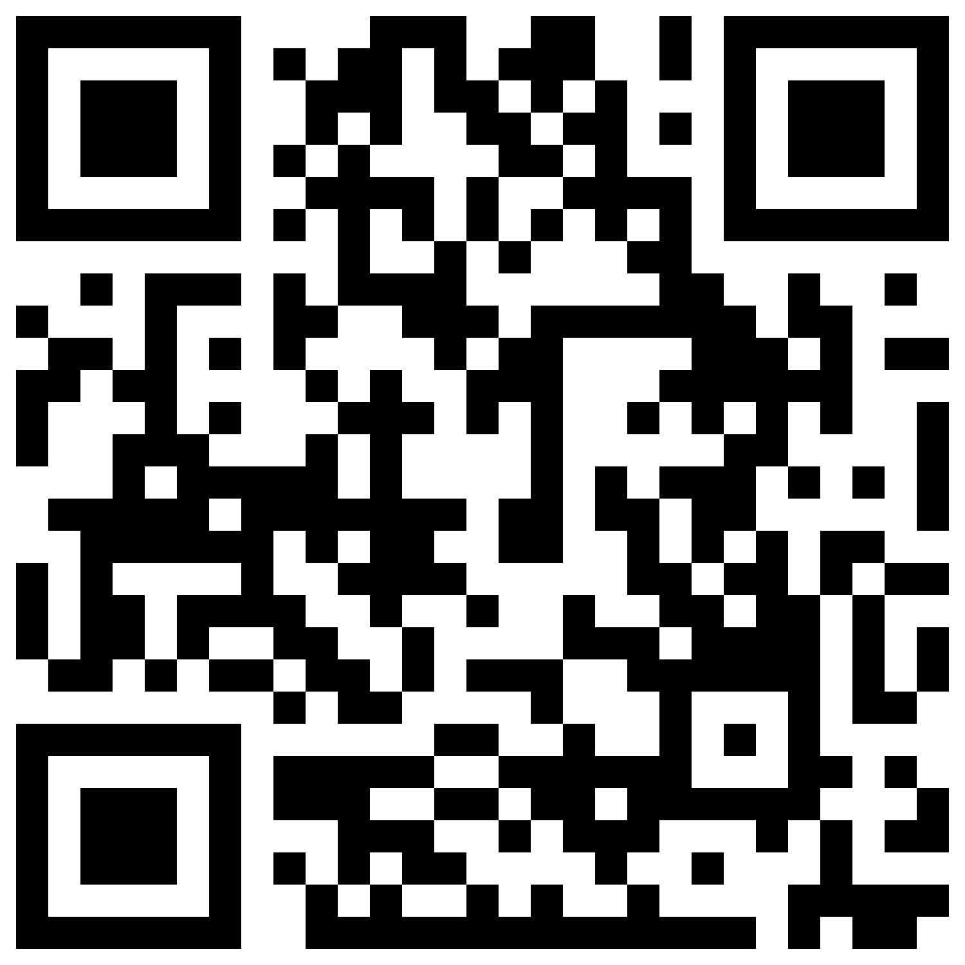
Quiz
Which is not an essential question for checking AI/ML readiness ?
Do you already have labeled data?
Is your data correct/accurate?
Is your data unbiased?
Do you have enough data?
✔
What questions should you ask for your data to make it AI/ML ready?
Does the data have the same unit?
Is the meaning of the data consistent?
Is the same value recorded in the same way everywhere?
All of the above
✔
What kind of data quality checks should you use for your data?
Check if there are missing values.
Check if there are erroneous values.
Check if there are duplicate values.
All of the above
✔
https://forms.gle/uGbp2tXo5J8BYu979

Slide 28

References
Google. Is My Data Any Good? A Pre-ML Checklist (https://services.google.com/fh/files/blogs/data-prep-checklist-ml-bd-wp-v2.pdf)

