Slide 1


Crowdfund Projects App
Presenter
Manjunath Asundi

Slide 2

Content
z
Assumptions on craft problem
Architecture Diagram
Database ER Diagram
Live demo
Sequence Diagram

Slide 3
Assumptions on craft problem
Written in VS code

Slide 4
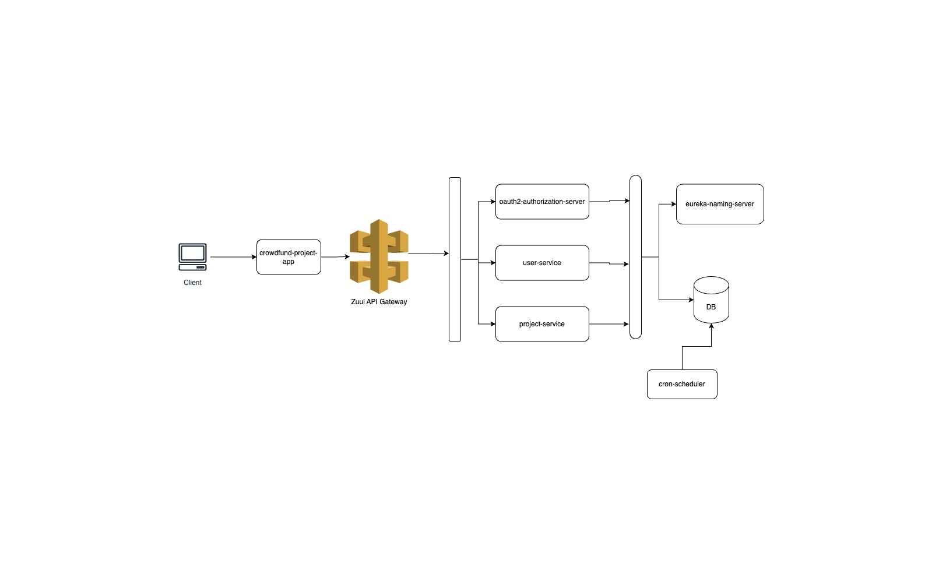
Architecture Diagram

Slide 5
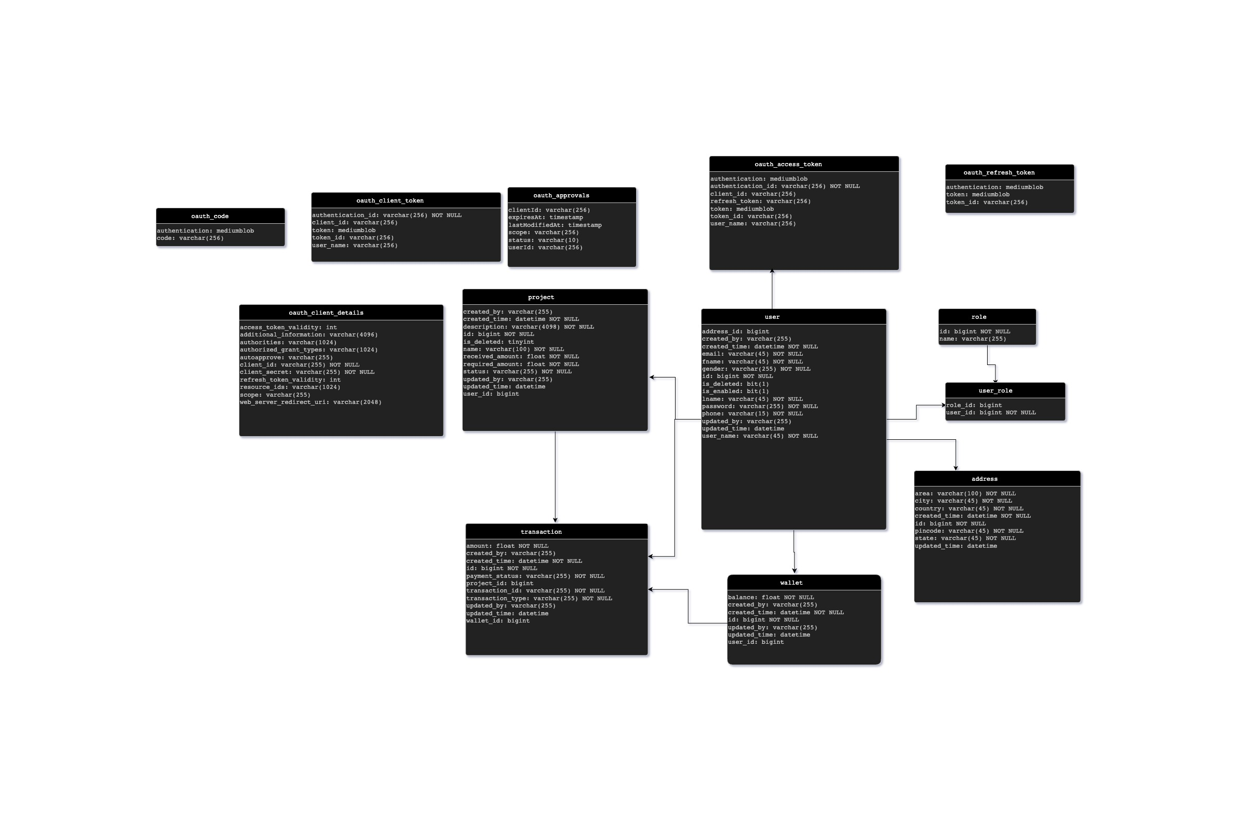
Database ER Diagram

Slide 6
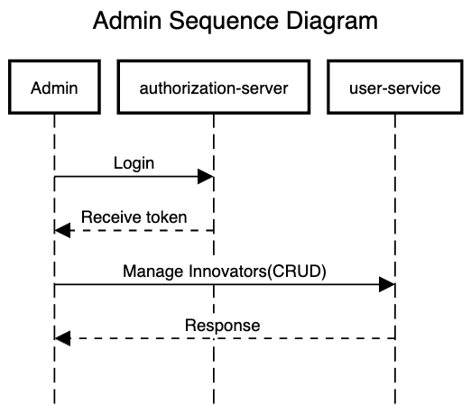
C

Slide 7
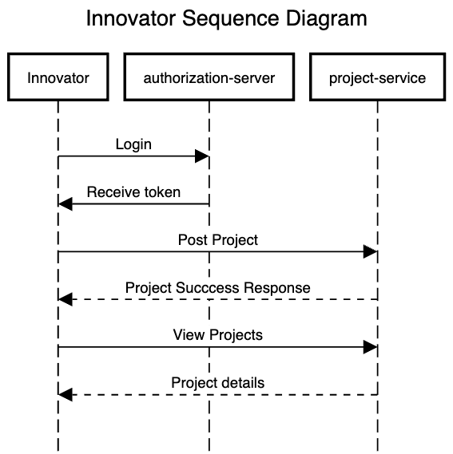

Slide 8
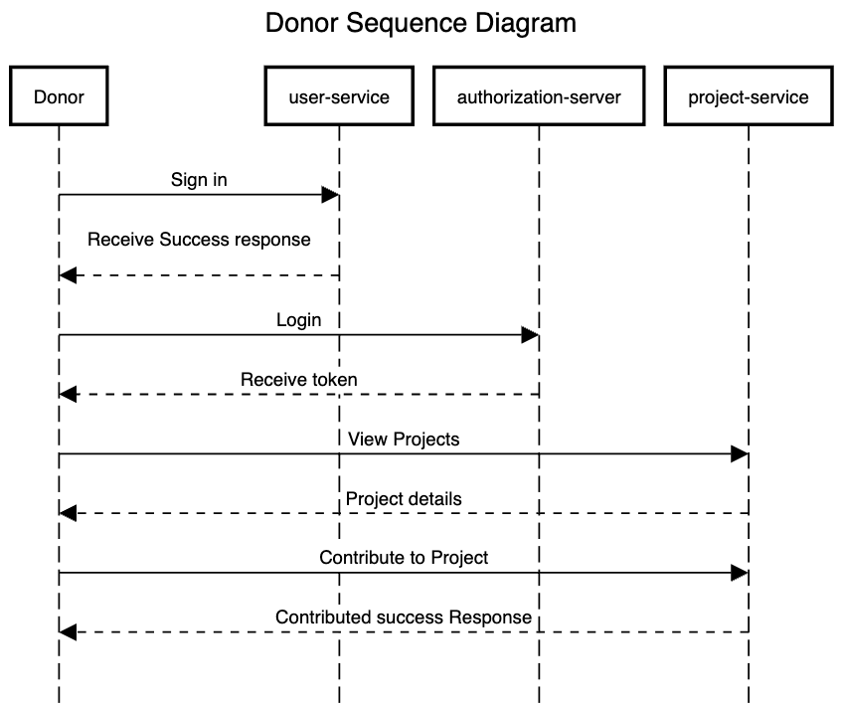

Slide 9

Live Demo
z

Slide 10

End
z

