Slide 1
Keylogger project
CAPSTONE PROJECT
Presented By:
1. Student Name-M.Manju College Name-Priyadarshini Engineering college Department-CSE

Slide 2
OUTLINE
Problem Statement (Should not include solution)
Proposed System/Solution
System Development Approach (Technology Used)
Algorithm & Deployment
Result (Output Image)
Conclusion
Future Scope
References

Slide 3
Problem Statement
In today's digital age, where cybersecurity threats loom large, one of the significant concerns is the proliferation of keyloggers, stealthy software tools designed to monitor and record keystrokes on a user's computer without their knowledge. Keyloggers pose a severe threat to individuals and organizations as they can capture sensitive information such as passwords, credit card details, and other personal data, leading to identity theft, financial loss, and privacy breaches.

Slide 4
Proposed Solution
The proposed solution involves developing a robust and stealthy keylogger application capable of recording keystrokes on various operating systems while prioritizing data security and ethical considerations.
1. Stealth Operation:
Utilize low-level system hooks to intercept keyboard input discreetly, avoiding detection by antivirus software and system monitoring tools.
2. Keystroke Logging:
Capture keystrokes from the keyboard input buffer, ensuring accurate recording of all user inputs.
3. Data Encryption:
Employ strong encryption algorithms (e.g., AES) to encrypt logged keystrokes before storing them in a secure format.
4. Persistence:
Configure the keylogger to start automatically upon system boot, ensuring continuous operation across system reboots.
5. Remote Reporting:
Develop a communication module to transmit encrypted keystroke logs to a remote server or designated storage location.:
Result: This solution addresses the technical challenges of keylogger development while promoting responsible usage and ethical considerations.

Slide 5
System Approach
The "System Approach" section outlines the overall strategy and methodology for developing and implementing the rental bike prediction system. Here's a suggested structure for this section:
System requirements- Python
Library required to build the model

Slide 6
Algorithm & Deployment
Algorithm:
Capture Keystrokes: The keylogger needs to capture keystrokes made by the user. This can be achieved using platform-specific APIs or libraries that allow monitoring keyboard events.
Store Keystrokes: Store the captured keystrokes securely, either in memory or in a file on the system. Ensure that the storage mechanism is efficient and secure to prevent unauthorized access to the logged data.
Optional Features: Depending on the requirements, you might implement additional features such as logging timestamps, capturing screenshots, or filtering out sensitive information.
Deployment:
Packaging: Package your keylogger software for deployment. This may involve creating an installer for ease of installation on target systems.
Disguising: Consider disguising the keylogger to avoid detection by antivirus software or users. However, be mindful of ethical considerations and legal implications.
Installation: Install the keylogger on the target system. Depending on your access to the system, this could be done manually or remotely.
Monitoring: Monitor the logged keystrokes either by accessing the log file on the target system or by implementing remote monitoring functionality that sends the logged data to a central server.

Slide 7
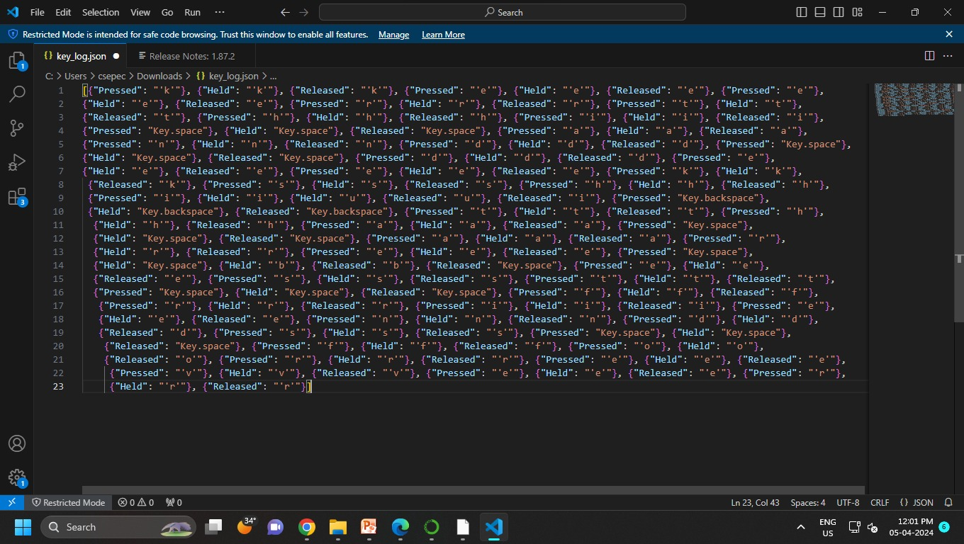
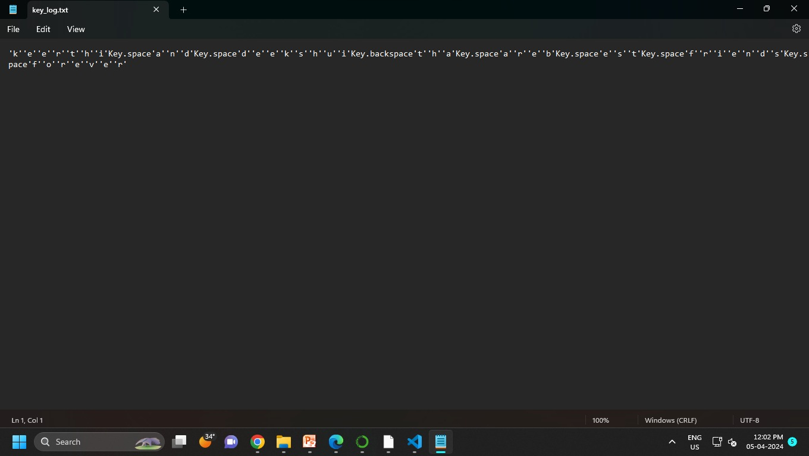
Result

Slide 8
Conclusion
As we can see from the above implementation that we have created a keylogger in java language after implementing a python keylogger for windows. The table below gives more information regarding the similarity and differences between the two keylogger

Slide 9
Future scope
The future scope for keylogger projects encompasses both technological advancements and evolving societal needs. While keyloggers have traditionally been associated with surveillance and security purposes, their future applications may extend beyond these domains.

Slide 10
References
Santripti Bhujel, Mrs. N. Priya,"Keylogger for Windows using Python",International Journal of Trend in Scientific Research and Development(IJTSRD), ISSN: 2456-6470, Volume 5Issue 1, page 566-568, 2020.
[2]Manan Kalpesh Shah, Devashree Kataria, S. Bharath Raj, PriyaG, "RealTime Working of Keylogger Malware Analysis", International Journal ofEngineering Research & Technology (IJERT), ISSN: 2278-0181,Volume , Issue 10, page 569-573, 2020
[3] Chien-Wei Hung, Fu-Hau Hsu, Chuan-Sheng Wang, Chia-HaoLee"Keyloggers Prevention with Time-SensitiveObfuscation", WorldAcademy of Science, Engineering and Technology International Journalof Computer and Information Engineering, I.

Slide 11
THANK YOU

