Slide 1
ELECTRA: Pre-training Text Encoders as Discriminators Rather Than Generators Clark et al., 2020(Google AI Language)
Manju Yadav
CS662: Natural Language Processing
University of Alabama at Birmingham

Slide 2
ELECTRA: “Efficiently Learning an Encoder that Classifies Token Replacements Accurately.”
Main ideas
To improve the efficiency of training for state-of-the-art Transformer networks.
Electra targets to reduce computation time and resources while maintaining high-quality performance.
The trick is introducing the generator for Masked Language Model (MLM) prediction, and forwarding the generator result to the discriminator.

Slide 3
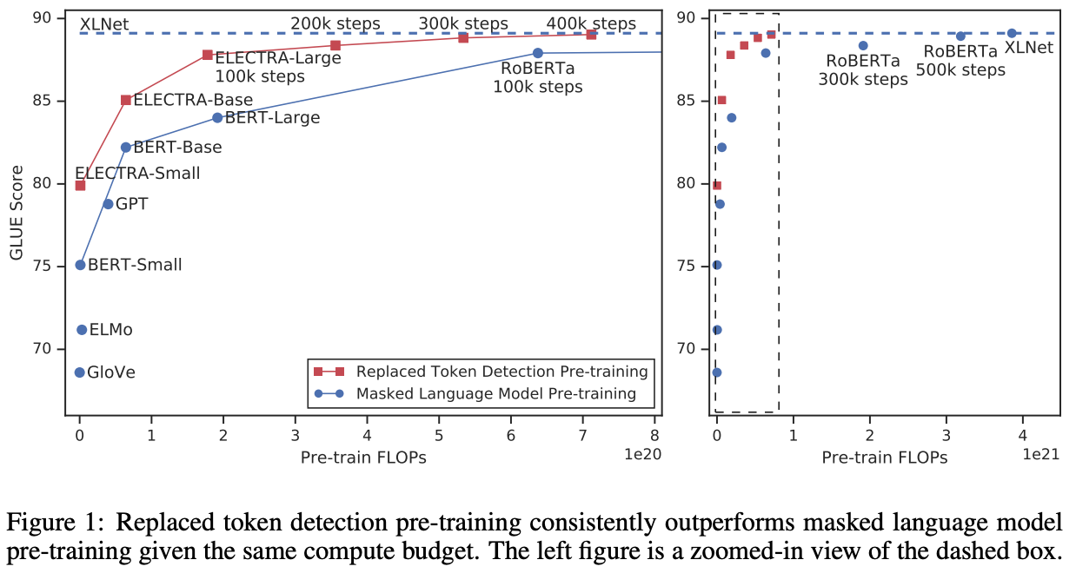
Performance Comparison
Source: ELECTRA: Pre-training Text Encoders as Discriminators Rather Than Generators, Clark et al., 2020(Google AI Language)

Slide 4
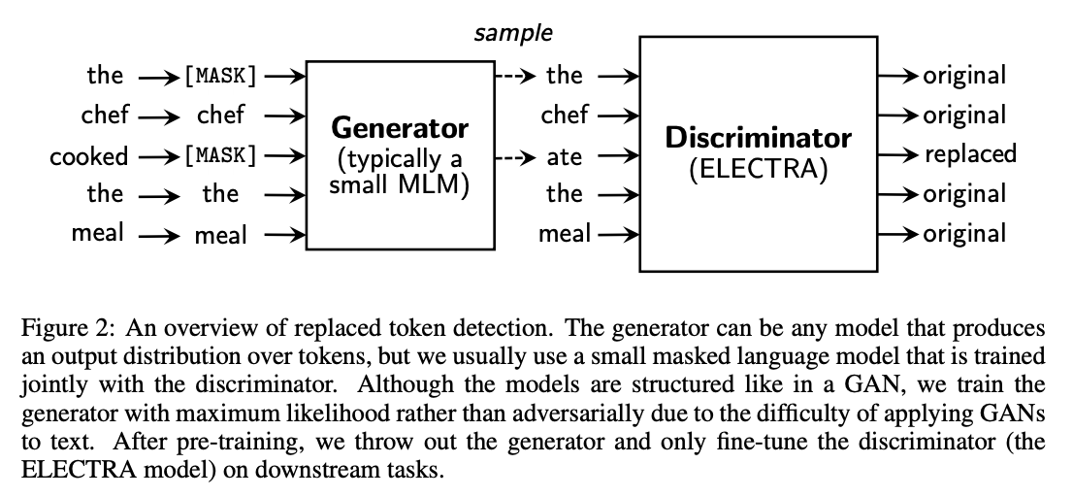
Method
Replaced Token Detection
The approach trains two neural networks, a generator G and a discriminator D.
Note: After the training phase, the generator will be thrown away while we only keep the discriminator for fine-tuning and inference
Source: ELECTRA: Pre-training Text Encoders as Discriminators Rather Than Generators Clark et al., 2020(Google AI Language)
More Efficient NLP Model Pre-training with ELECTRA by Kevin Clark, Google AI Blog

Slide 5

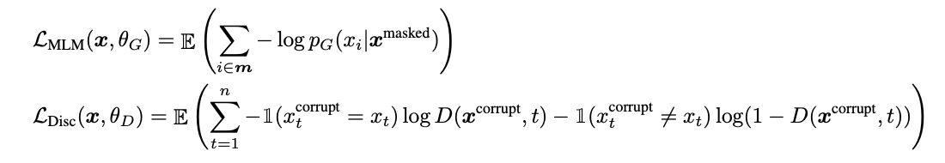

Training Details
Generator/Discriminator output
probability for generating a particular token xt with a softmax layer:
Here:
x is a sequence on input tokens
h is a sequence of contextualized vector representations
e denotes token embedding
minimizing the combined loss over a large corpus X of raw text
Loss Functions
Combined Minimum Loss
Source: ELECTRA: Pre-training Text Encoders as Discriminators Rather Than Generators Clark et al., 2020(Google AI Language)

Slide 6
Experimental Setup
Evaluated on the GLUE benchmark and Stanford Question Answering (SQuAD) dataset
Mostly pre-trained on the same data as BERT, However, for the Large model pre-trained on the data used for XLNet.
Most hyperparameters are the same as BERT’s.
For fine-tuning on GLUE, added simple linear classifiers on top of ELECTRA. For SQuAD, added the QA module from XLNet on top of ELECTRA

Slide 7
Model Extensions
Weight Sharing: only share the embeddings (both the token and positional embeddings) of the generator and discriminator.
(GLUE scores are 83.6 for no weight tying, 84.3 for tying token embeddings, and 84.4 for tying all weights.)
Smaller Generators: to reduce the factor of compute per step. Model work best with generators 1/4-1/2 the size of the discriminator
Training Algorithms: explored other training algorithms for ELECTRA, although these did not end up improving results

Slide 8
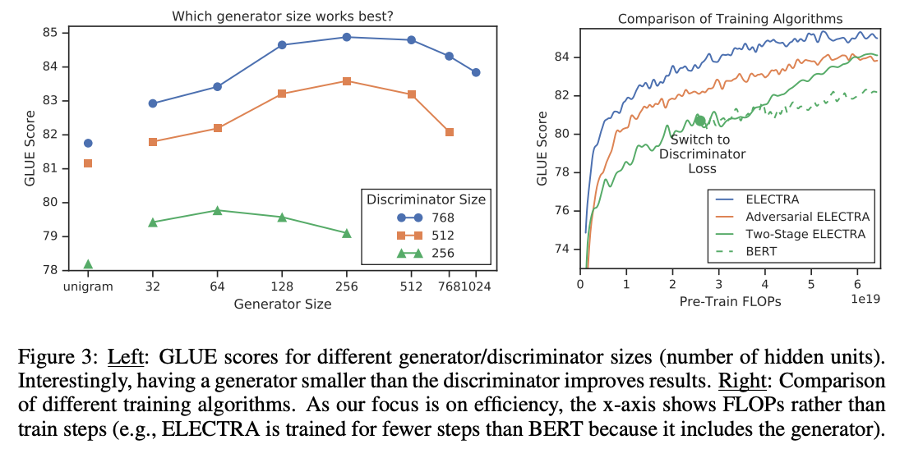
Performance Comparison
Performance of different generator size and discriminator size (Clark et al., 2020)
Source: ELECTRA: Pre-training Text Encoders as Discriminators Rather Than Generators Clark et al., 2020(Google AI Language)

Slide 9
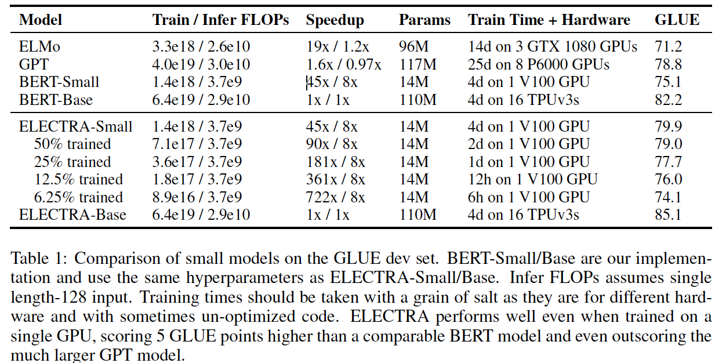
Experimental Results
ELECTRA-Small gets a GLUE score of 79.9 and outperforms a comparably small BERT model with a score of 75.1 and a much larger GPT model with a score of 78.8.
An ELECTRA model that performs comparably to XLNet and RoBERTa uses only 25% of their pre-training compute.
Trained a model on one GPU for 4 days that outperforms GPT (trained using 30x more compute) on the GLUE.
Source: ELECTRA: Pre-training Text Encoders as Discriminators Rather Than Generators Clark et al., 2020(Google AI Language)

Slide 10
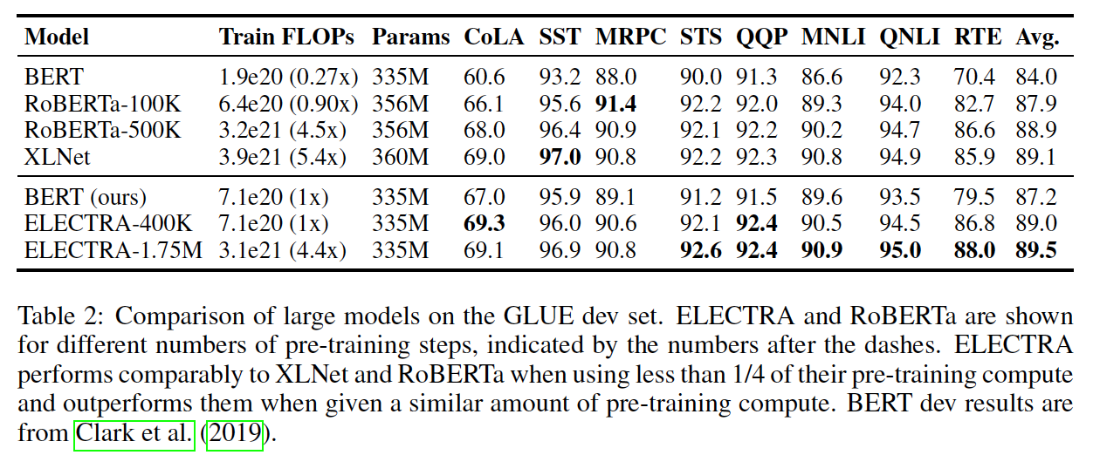
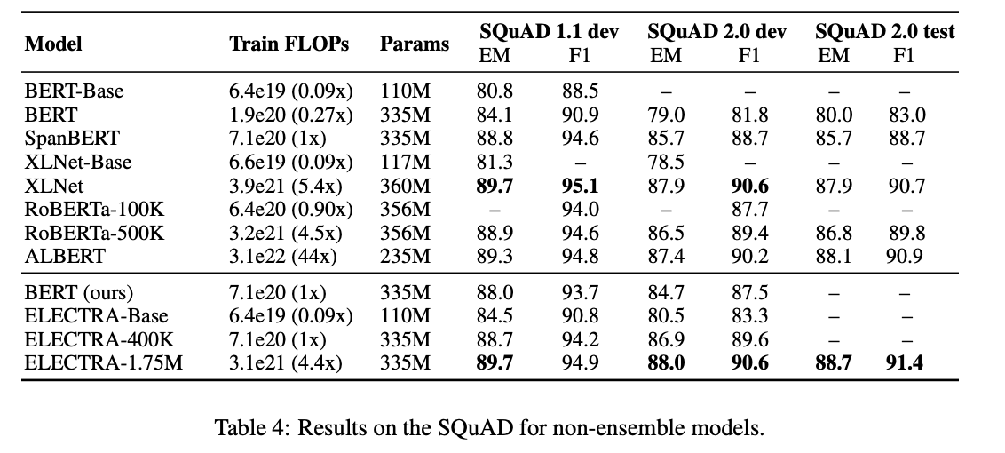
Experimental Results
ELECTRA-Large outscores the alternative state-of-the-art models on the GLUE and SQuAD benchmarks while still requiring less pre-training compute.
Model Squad 2.0 test set
ELECTRA-Large. 88.7
ALBERT-xxlarge 88.1
XLNet-Large 87.9
RoBERTa-Large 86.8
BERT-Large. 80.0
Source: ELECTRA: Pre-training Text Encoders as Discriminators Rather Than Generators Clark et al., 2020(Google AI Language)

Slide 11
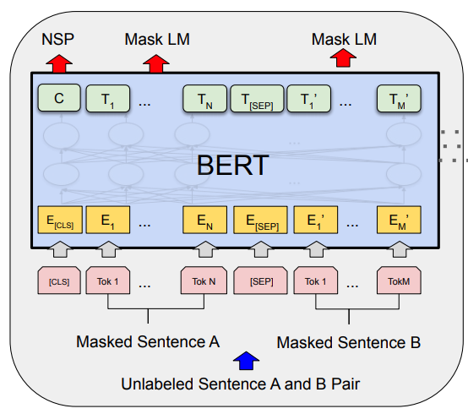
Efficiency Gains
MLM leans from 15% of tokens per example.
Task is defined over all input tokens, no mask token:
pre-train fine-tune mismatch
Source: BERT: Pre-training of Deep Bidirectional Transformers for Language Understanding

Slide 12
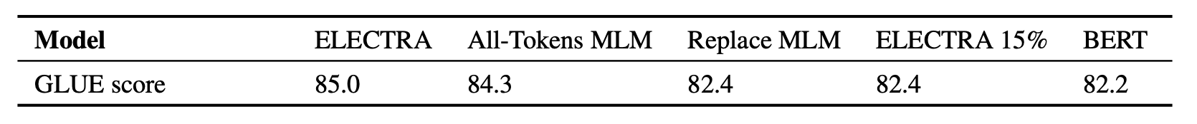
Efficiency Analysis Experiments
• ELECTRA 15%: sum in the discriminator loss LDisc is over i ∈ m instead of from 1 to n.
• Replace MLM: instead of replacing masked-out tokens with [MASK], they are replaced with tokens from a generator model (to solve discrepancy between training and fine tuning)
• All-Tokens MLM: the model predicts the identity of all tokens in the input, not just ones that were replaced.
Source: ELECTRA: Pre-training Text Encoders as Discriminators Rather Than Generators Clark et al., 2020(Google AI Language)

Slide 13
Tuning Hyperparameters
Pre Training Hyperparameters
Source: ELECTRA: Pre-training Text Encoders as Discriminators Rather Than Generators Clark et al., 2020(Google AI Language)

Slide 14
Conclusion
Simple but novel self-supervised task, strong results.
More Compute and parameter efficient. Now it’s possible to train our own language models on a single GPU
Learns from all input is the key
Approach is Similar to GAN
Large amount of ELECTRA’s improvement can be attributed to learning from all tokens and a smaller amount can be attributed to alleviating the pre-train fine-tune mismatch.

Slide 15
Thank You
Questions
⁉️

