Slide 1
PERSONALIZED PARTY DRINK GUIDE
Sipwise
AI-Powered Drink & Party Planning Assistant
Built with Next.js · TypeScript · OpenAI · 5,000+ Drink Catalog

Slide 2
THE PROBLEM
🎉
Planning a party with alcohol is complicated
🌍
Which brands are even available in my city?
🤧
Guests have allergies, dislikes, and different budgets
🍹
Too little or too much — no safe pacing plan
😕
Generic internet suggestions aren't personalized
2

Slide 3
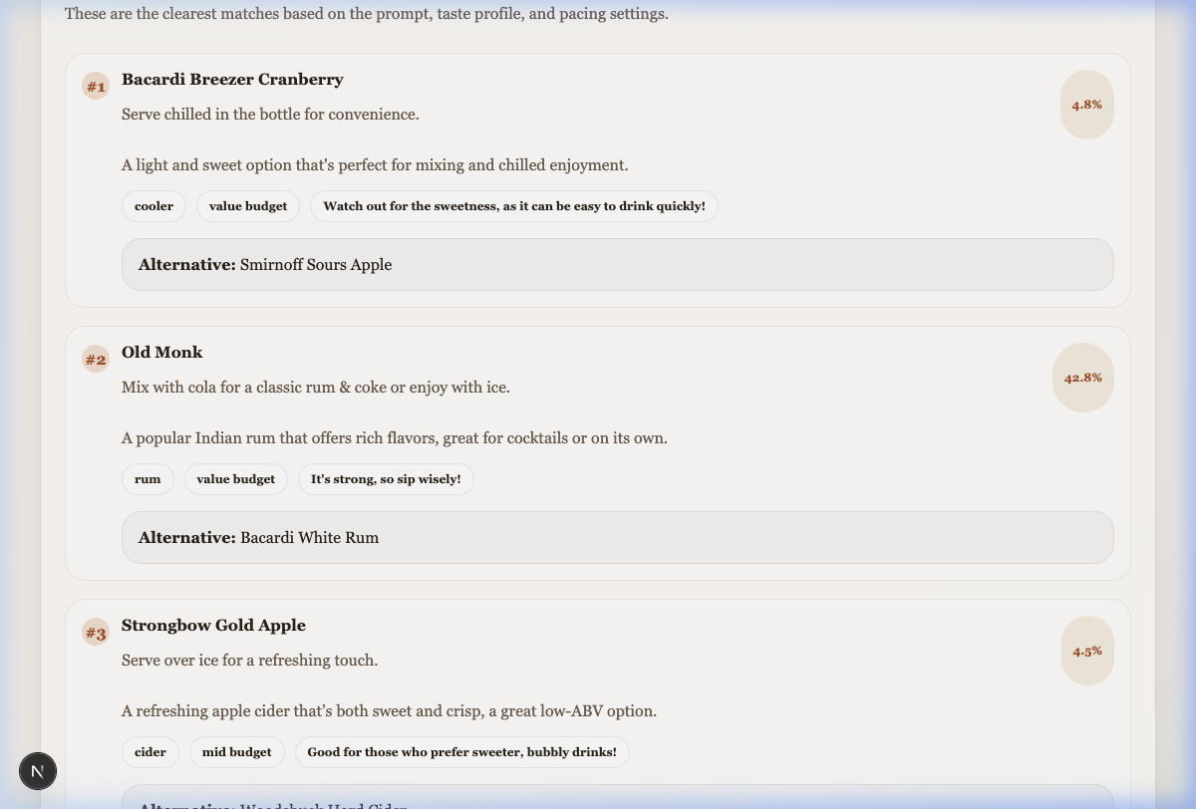
WHAT IS SIPWISE?
One Prompt → Full Party Plan
You describe your party in plain English. Sipwise responds with curated drink picks, a safe pacing timeline, and regionally-available alternatives — all personalised for every guest.
🍸 3 Curated Drink Picks
Matched to group tastes, budget & region
⏱️ Safe Pacing Timeline
Water breaks, low-ABV transitions, wind-down
🌏 Regional Alternatives
Locally-available fallback for every pick
3

Slide 4
APPLICATION OVERVIEW
🏠
👤
🎪
📅
🔑
Start Here
My Taste
Party Setup
Party Plan
Local Picks
/
/contacts
/drafts
/itinerary
/settings
Type your party prompt and get AI suggestions
Manage your profile and unlimited guest profiles
Set event name, date, city, people count
View AI-generated drink timeline for the night
Enter your OpenAI API key
4

Slide 5
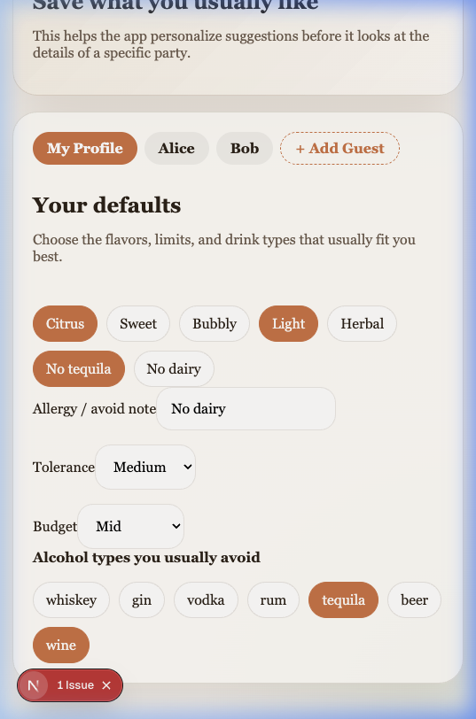
FEATURE: MULTI-PROFILE GUEST MANAGEMENT
Every guest. Every preference. All balanced.
Per-profile settings:
• Name (e.g. Alice, Bob, Charlie)
• Taste Preferences (Citrus, Sweet, Bubbly, Light, Herbal…)
• Allergy Notes (gluten, dairy, nuts…)
• Alcohol Tolerance (Low / Medium / High)
• Budget Tier (Value / Mid / Premium)
• Categories to Avoid (Whiskey, Gin, Tequila…)
✅ Profiles persist in localStorage — no login required.
5

Slide 6
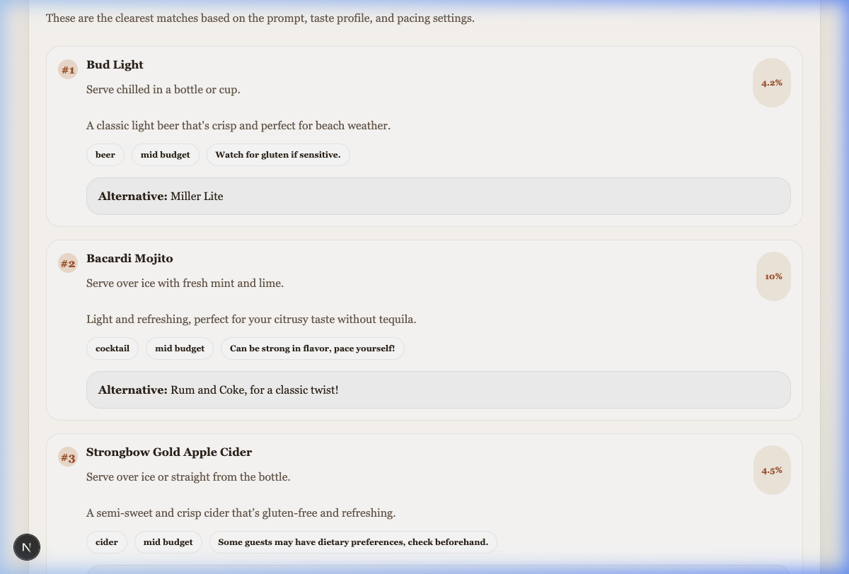
FEATURE: STRICT REGIONAL INTELLIGENCE
The right drink for the right city.
🇮🇳
Mumbai / India
Royal Stag · Sula · Old Monk · Bira 91
🇺🇸
Miami / USA
Tito's Vodka · Bud Light · Jack Daniel's
🇧🇷
Brazil
Cachaça · Brahma · local beach staples
🌍
Global Fallback
Well-known international brands only
❌ Completely blocks out-of-region brands from appearing in results.
6

Slide 7
DATA: 5,000+ DRINK CATALOG
5,000+
CSV → JSON Pipeline
1. Load alcohol_5000_taste_node.csv
Curated Alcohol Entries
2. Normalize ABV, country, brand
3. Parse tasteNotes from comma list
Catalog Fields:
Name
Bacardi Breezer
4. Map priceTier (Budget→Value, etc.)
Category
Rum / Cooler
5. Set lowAbv flag (ABV ≤ 12.5%)
ABV
4.8%
6. Merge into alcohol-catalog.json
Price Tier
Value
Country
Global
Taste Notes
Fruity, Sweet, Tropical
Allergen Notes
Contains gluten
Low ABV flag
true
7

Slide 8
AI ARCHITECTURE: RANKING ENGINE
Smart pre-ranking. Then AI narration.
User Prompt + All Profiles
↓
Scoring Factors
Score 5,000+ catalog drinks
Taste match (user + all guests)
+2 – 5 pts
↓
Both user AND a guest prefer it
+4 pts
Pick top 12 candidates
Regional origin match
+10 pts
↓
Allergy conflict
−100 pts
Send to GPT-4o-mini
Disliked category
−50 pts
↓
Low ABV (if low-abv mode on)
+3 pts
Returns 3 Suggestions +
Budget match
+1 – 2 pts
Summary + Timeline + Tips
8

Slide 9
TECH STACK
Built for performance & simplicity.
🔲 Framework
🎨 Styling
Next.js 14 (App Router)
Vanilla CSS (Glassmorphism)
🔵 Language
✅ Validation
TypeScript
Zod
⚛️ State
🍸 Drink Data
React Context + localStorage
Custom JSON (CSV → 5,000+)
🤖 AI
OpenAI GPT-4o-mini
9

Slide 10
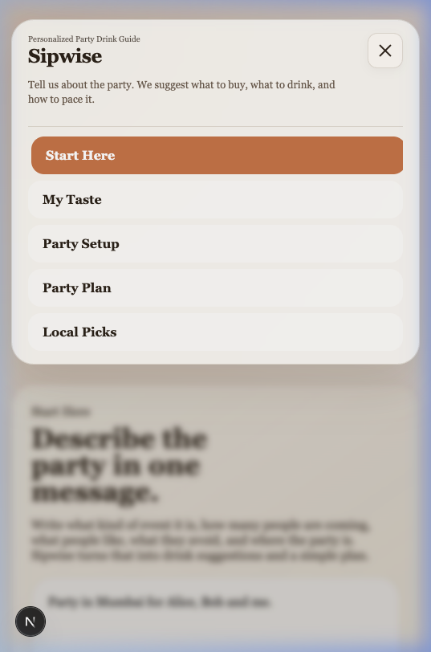
FEATURE: MOBILE-FIRST NAVIGATION
App-like. Smooth. Always on top.
☰
Hamburger Toggle
Animated icon transforms into ✕ when open
🌫️
Glassmorphism Card
Blurred overlay, soft backdrop — premium look
🔗
Auto-Close on Nav
Menu closes the moment a link is clicked
📌
Sticky Positioning
Always visible at top as you scroll
✨
Page Highlight
Active page is clearly highlighted in the menu
10

Slide 11
WHAT MAKES SIPWISE UNIQUE?
🧠
Not just a chatbot
The AI works WITH a pre-built scoring engine, not in isolation.
👥
Multi-person intelligence
Most apps are single-user. Sipwise balances constraints for an entire group simultaneously.
🌏
Regional-first
Suggestions respect local availability — Miami ≠ Mumbai ≠ Brazil.
🛡️
Safe hosting built-in
Water cadence, low-ABV mode, and quantity guidance make it a responsible host tool.
📵
Offline persistence
All profiles & settings saved locally. No login, no server dependency.
11

Slide 12
FUTURE ROADMAP
Where Sipwise can go next.
🔍
Vector Database
📤
Shareable Party Plan
Semantic drink search for smarter, fuzzy recommendations
Export as a PDF or send a party-plan link to guests
📱
QR Code for Guests
🧃
Mocktail Mode
Guests scan a QR to submit their own preferences
Fully non-alcoholic recommendation flow
💸
Budget Calculator
🌐
Multi-language Support
Estimate total spend for the entire party
Serve global markets with translated suggestions
12

Slide 13
Thank You
Questions & Demo
Sipwise · Next.js · TypeScript · OpenAI · 5,000+ Drinks

