Slide 1

Apache Hive

Slide 2

Topics to be covered
Introduction to Hive
Manipulating Data with Hive
Partitioning and Bucketing
Hive Best Practices
Notes:
No transcript required

Slide 3
Introduction to Hive
Notes:
No transcript required

Slide 4
Introduction to Hive
What Is Hive?
Benefits of Hive
Getting Data into Hive
The Hive Architecture
Creating Hive Tables
Loading Data into Hive
Storing Query Results in HDFS
Notes:
No transcript required

Slide 5
What is Hive?
Hive is an open-source data warehousing solution built on top of Hadoop.
Hive is a way to allow non-Java programmers access to the data stored in Hadoop clusters.
Used by Data analysts, Statisticians, Scientists etc
Hive supports queries expressed in a SQL-like declarative language - HiveQL, which are compiled into MapReduce jobs that are executed using Hadoop.
HiveQL includes a type system with support for tables.
HiveQL contains primitive types, collections like arrays & maps and nested compositions of the same.

Slide 6
What is Hive? (cont'd)
In addition, HiveQL enables users to plug in custom map-reduce scripts into queries.
Hive also includes a system catalog - Metastore – that contains schemas and statistics, which are useful in data exploration, query optimization and query compilation.
The Hive implementation at Facebook contains tens of thousands of tables and stores over 700TB of data. It is being used extensively for both reporting and ad-hoc analyses by more than 200 users per month.

Slide 7
Benefits of Hive
Hive is much easier to learn and use as its based on standard SQL.
Writing HiveQL queries is much faster than writing the equivalent Java code.
Many people already know SQL.
Can rapidly start using Hive to query and manipulate data in the cluster.

Slide 8
Getting Data Into Hive
To get data into Hive, first access Hive through the Hive Shell.
Invoke the Hive shell from the command line by typing
The shell responds with its own command prompt
A file containing HiveQL code can be executed using the -f option
$ hive>
$ hive
hive>
$ hive -f myfile.hql
Notes:
$ hive -e 'select * from users‘ ;

Slide 9
Getting Data Into Hive (cont’d)
HiveQL can be used directly from the command line using the -e option
As with most similar shells, HiveQL queries must be terminated with a Semicolon (;).
$ hive -e 'select * from users`;

Slide 10
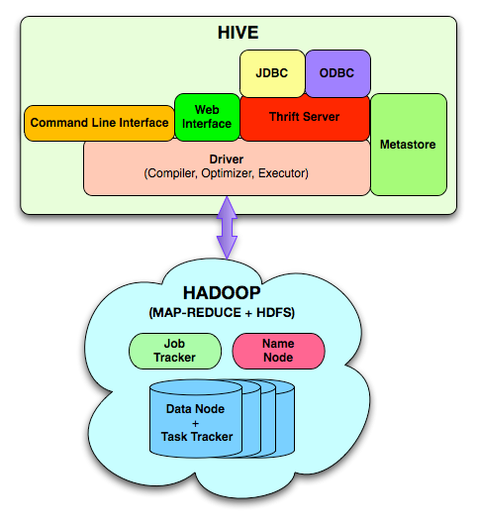
The Hive Architecture
Notes:
Metastore – that contains schemas , table definition and statistics, which are useful in data exploration, query optimization and query compilation.

Slide 11
The Hive Architecture (cont'd)
Metastore: stores system catalog.
Driver: manages the life cycle of HiveQL query as it moves thru’ HIVE, also manages session handle and session statistics.
Query compiler: Compiles HiveQL into a directed acyclic graph of map/reduce tasks.
Execution engines: The component executes the tasks in proper dependency order; interacts with Hadoop.
HiveServer: provides Thrift interface and JDBC/ODBC for integrating other applications.
Client components: include - CLI, web interface, JDBC/ODBC interface, Extensibility interface include SerDe, User Defined Functions and User Defined Aggregate Function.

Slide 12
Creating a Table in Hive
Example table definition:
ROW FORMAT DELIMITED
Tells Hive to expect one record per line.
FIELDS TERMINATED BY . . .
Columns will be separated by the specified character.
Default separator is ‘Ctrl-A’.
CREATE TABLE movies (id INT, name STRING, year INT)
ROW FORMAT DELIMITED
FIELDS TERMINATED BY ','
STORED AS TEXTFILE
Notes:
Notes:
In this example we are going to create a table which will store in HDFS as Text file containing line as a per record in table and in each line columns will be separated by ,(comma) .
Table will store as a subdirectory in default directory /user/hive/warehouse/movies .
And in this directory(/user/hive/warehouse/movies ) a text file will be creating which contains table’s contents.

Slide 13
Hive’s Column Types
Hive supports a number of different column types.
Each type maps to a native data type in Java.
Type | Description
TINYINT | 1 byte
SMALLINT | 2 bytes
INT | 4 bytes
BIGINT | 8 bytes
FLOAT | Single precision
DOUBLE | Double precision
STRING | Sequence of characters
BOOLEAN | True/false
TIMESTAMP | YYYY/MM/DD HH:MM:SS.fffffffff

Slide 14
Hive’s Column Types (cont'd.)
Hive has no binary column types like BLOB data type available in RDBMSs.
Hive is designed to deal with textual data.
Complex Column Types
Maps
Key, Value Pairs
Lists of Elements
Struct
Arrays
User defined Structures

Slide 15
How Hive Stores Data
By default, tables are stored in Hive’s Warehouse HDFS directory
The contents of the files in this directory are considered to be the contents of the table.
hive> CREATE TABLE employees (name string, age int);
Now check if this table is stored as a directory in hive’s warehouse in HDFS:
$ hadoop fs -ls /user/hive/warehouse/employees
drwxr-xr-r . . . /user/hive/warehouse/employees/data1.txt

Slide 16
How Hive Stores Data (cont’d)
Accessing table using hive shell:
hive> SELECT * FROM employees;
OK
Steve 32
John 28
Brian 35
Check the contents of table in HDFS using cat command :
$ hadoop fs -cat /user/hive/warehouse/employees/data1.txt
Steve 32
John 28
Brian 35

Slide 17
How Hive interprets Data?
Hive layers a table definition onto a directory.
Doesn’t verify the data when it is loaded, but rather when a query is issued. This is called schema on read.
The table definition describes the layout of the data files
Typically they are delimited files (using commas, tabs, or other characters).
Hive’s default delimiter is the Control-A character.
This does not have to be the case if you use a custom Serializer/Deserializer.
This table definition is saved in Hive’s Metastore.

Slide 18
Hive’s Metastore
The Hive Metastore is held in a set of tables stored in an RDBMS.
Typically either Derby (the default) or MySQL.
The data held in the Metastore includes:
Table definitions.
Table name, column names, column data types, etc.
Information on where the table data is stored in HDFS.
Row format of files in the table.
Storage format of the files in the table.
Determines which Input Format and Output Format the MapReduce jobs will use.

Slide 19
Submitting a Hive Query
When a HiveQL query is submitted, the Hive interpreter on the client machine converts it into one or more MapReduce jobs.
The MapReduce jobs are then submitted to the cluster by the interpreter.

Slide 20
External Table
It is possible to create a table which points to an existing directory rather than having the directory automatically created under /user/hive/warehouse.
This is known as an external table.
CREATE EXTERNAL TABLE movies (id INT, name STRING, year INT)
ROW FORMAT DELIMITED
FIELDS TERMINATED BY ','
STORED AS TEXTFILE
LOCATION ‘ /user/ian/movieFileDirectory ’
Notes:
Notes:
Specifies the format of data rows. If ROW FORMAT SERDE is not specified, ROW FORMAT defaults are the ROW FORMAT DELIMITED options that are not explicitly specified. Do not use with the STORED AS SEQUENCEFILE option.DELIMITEDSpecifies a delimiter at the table level for structured fields:
EXTERNAL is keyword used in table definition specifies that table is created as external table.
and will be remain in the directory('/user/ian/movieFileDirectory) mention by user not in the default directory(/user/hive/warehouse)

Slide 21
External Table (cont’d)
External Tables
Creates a table and points to a specified directory in HDFS.
Hive does not use a default location for this table.
Very useful for existing data.
DROPing an External Table only removes metadata.
Notes:
Notes : Dropping a regular table deletes the table’s directory .
Dropping an external table simply removes the table’s definition from the
Hive Metastore,The directory is not deleted.

Slide 22
Table operations
VIEW Table Definitions
DESCRIBE t (to see the columns of the table).
DESCRIBE EXTENDED t (to see detailed description of the table).
DELETE the Table
DROP TABLE t (to delete the table).
ALTER structure of existing tables
Add and remove partitions.
Rename a table/modify properties.
Modify Columns.
Change a table’s location.

Slide 23
Table operations (cont’d)
Examples
ALTER TABLE t ADD PARTITION (part_col='val')
ALTER TABLE t DROP PARTITION (part_col='val')
ALTER TABLE t RENAME TO x
ALTER TABLE t CHANGE old_name new_name new_type
ALTER TABLE t ADD COLUMNS (col_name, type, ...)
ALTER TABLE t SET LOCATION new_location (change location for external table)
Notes:
Notes : Dropping a regular table deletes the table’s directory .
Dropping an external table simply removes the table’s definition from the
Hive Metastore,The directory is not deleted.

Slide 24
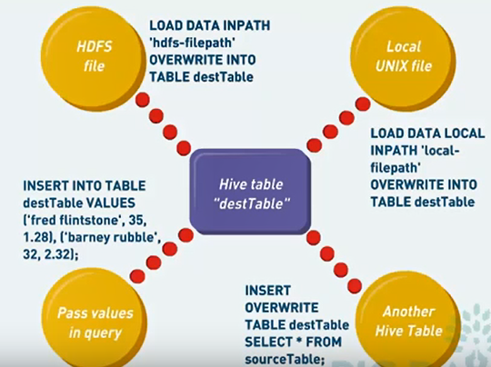
Loading data into Hive

Slide 25
Loading data into Hive
Loading data into a Hive table involves moving the data files into the Hive table warehouse directory in HDFS
This can be done by two ways
Can be done directly using hadoop fs command.
Alternatively, use Hive’s LOAD DATA INPATH command:
$ hadoop fs –mv /depts/finance/salesdata /user/hive/warehouse/sales/
hive> LOAD DATA INPATH '/depts/finance/salesdata'
INTO TABLE sales ;

Slide 26
Loading Data From Files (cont’d)
Add the LOCAL keyword to load data from the local disk
hive> LOAD DATA LOCAL INPATH '/home/bob/salesdata'
INTO TABLE sales;
Or Alternatively Hadoop fs put command
$ hadoop fs -put /home/bob/salesdata /user/hive/warehouse/sales

Slide 27
Loading Data From Files (cont’d)
OVERWRITE
Direct update in hive tables is not possible in which case, load thenew updated file with updated records using OVERWRITE command
hive> LOAD DATA INPATH '/depts/finance/salesdata'
OVERWRITE INTO TABLE sales;

Slide 28
Loading Data from a file to External Table
Example
Define the External Table and point it to a directory within HDFS.
Copy a local file into the specified HDFS directory.
CREATE EXTERNAL TABLE p_view_stagq (hitTime INT, userid STRING, page_url STRING, comment STRING)
ROW FORMAT DELIMITED FIELDS TERMINATED BY '\t‘
STORED AS TEXTFILE
LOCATION '/user/data/staging/p_views';
$ hadoop fs -put /tmp/pv_data.txt /user/data/staging/p_views

Slide 29
Hive Complex types

Slide 30
Complex types
Hive suppots 3 complex types
Array
Map
Struct

Slide 31
Array type
An array is a collection of individual atoms
Each value in array has to be separated by a delimiter
Elements are extracted using 0 based index
Syntax:
CREATE TABLE <tablename>(
column_definitions,
columnname ARRAY<DATA TYPE>
)
ROW FORMAT DELIMITED
FIELDS TERMINATED BY ‘symbol’
COLLCTION ITEMS TERMINIATED BY ‘symbol’
STORED AS file_type;

Slide 32
Array type example
CREATE TABLE array_tab(
id INT,
name STRING,
phone ARRAY<STRING>,
)
ROW FORMAT DELIMITED
FIELDS TERMINATED BY ‘,’
COLLECTION ITEMS TERMINATED BY ‘|’
STORED AS TEXTFILE;
Sample Text file
1,ramakumar,8544283421|8877727733
2,rajesh,3333333222|1122334455
3,latha,8822112233|9988776655

Slide 33
Data retrieval : Array type
Data can be retrieved using below syntax
SELECT <columns>,array_column_name[index] FROM tablename
Index starts from 0
Example:
SELECT id,name,phone FROM array_tab;
SELECT id,name,phone[1] FROM array_tab;

Slide 34
Map type
Map is a combination of (key,value) pair
Value can be retrieved using key
Syntax
CREATE TABLE <table_name>)
column_definitions,
award MAP<key_data_type,value_data_type)
)
ROW FORMAT DELIMITED
FIELDS TERMINATED BY ‘symbol’
COLLECTION ITEMS TERMINATED BY ‘symbol’
MAP KEYS TERMINATED BY ‘symbol’
STORED AS file_type;

Slide 35
MAP Example
CREATE TABLE rewards(
id INT,
name STRING,
award MAP<STRING,INT>
)
ROW FORMAT DELIMITED
FIELDS TERMINATED BY ‘,’
COLLECTION ITEMS TERMINATED BY ‘|’
MAP KEYS TERMINATED BY ‘#’
STORED AS TEXTFILE;
Sample Text file
1,rajesh,AOM#2002|POB#2002
2,radha,POB#2001|BRAVO#2009
3,rakesh,ACE#2013

Slide 36
Data retrival : MAP type
Data can be retrieved using below syntax
SELECT <columns>,column_name[“key”] FROM tablename
Example:
SELECT * FROM rewards;
SELECT id,name,award[“AOM”] FROM rewards;

Slide 37
STRUCT type
A Structure is a collection of 2 or more elements placed in one column
Each value in the structure is delimited
Syntax
CREATE TABLE <table_name>(
column_definitions,
column_name STRUCT<elementname:data_type, elementname:data_type>
)
ROW FORMAT DELIMITED
FIELDS TERMINATED BY ‘symbol’
COLLECTION ITEMS TERMINATED BY ‘symbol’
STORED AS file_type;

Slide 38
Example Struct
CREATE TABLE employee(
id INT,
name STRUCT<fname:STRING,mname:STRING,lname:STRING>
)
ROW FORMAT DELIMITED
FIELDS TERMINATED BY ‘,’
COLLECTION ITEMS TERMINATED BY ‘|’
STORED AS TEXTFILE;
Sample Text file
1,rama|kumar|prabhala
2,rajesh||maddali

Slide 39
Data retrieval : Struct type
Data is retrieved using . (dot) operator
Examples
SELECT * FROM employee;
SELECT id,name.fname FROM employee;

Slide 40
DML Operations in Hive

Slide 41
Hive DML Operations
Understanding ACID and Transactions in Hive
Hive support Transactional operations on Hive tables just like traditional RDBMS Systems
Hive Supports DML Operations
Insert
Update
Delete

Slide 42
Configuration for Hive DML
Configure below options in hive configuration file and restart hive server or issue below commands from hive prompt.
set hive.support.concurrency=true; set hive.enforce.bucketing=true; set hive.exec.dynamic.partition.mode=nonstrict; set hive.txn.manager=org.apache.hadoop.hive.ql.lockmgr.DbTxnManager; set hive.compactor.initiator.on=true; set hive.compactor.worker.threads=2;

Slide 43
Create a table with ACID Properties
Table updation is allowed only on tables that are created with transactional facility along with bucketing feature
CREATE TABLE <table_name>(
Column list,
)
CLUSTERED BY (column_name)
INTO <number> BUCKETS
STORED AS ORCFILE
TBLPROPERTIES(‘transactional’=‘true’);

Slide 44
Insert Operation on Hive Table
Inserting Single Record into Hive Table
INSERT INTO <table_name> VALUES(…)
Example
INSERT INTO employee VALUES(1,’RAMA’,’10-JUN-1996’,’MALE’)
Inserting Multiple Records into Hive Table
INSERT INTO <table_name> VALUES (…),(…),…
Example
INSERT INTO employee VALUES
(1,’RAMA’,’10-JUN-1996’,’MALE’),
(2,’RADHA’,’12-MAY-1992,’FEMALE’)

Slide 45
Update operation on Hive Table
UPDATE <table_name> SET colname=value[,…] [WHERE <condition>

Slide 46
Delete operation on Hive Table
DELETE FROM <table_name> [WHERE <condition>;

Slide 47
Sqoop – Import Data
A frequent requirement is to load data from a table in an existing RDBMS.
Sqoop, an open-source tool from Cloudera, helps to automate this process.
MySQL
Hadoop
Custom
MapReduce
programs
reinterpret data
Sqoop
Via auto - generated datatype definitions

Slide 48
Sqoop Concepts
The Sqoop program launches a Map-only MapReduce job to import the data.
Makes multiple simultaneous connections to the RDBMS.
Default is four
Each connection imports a portion of the table
Sqoop uses JDBC to connect to RDBMSs.
Inspects the table and creates a mapping from the database column types to the corresponding Java data types.
Can be configured to automatically create a Hive table from the imported data.

Slide 49
Sqoop Custom Connectors
Connectors allow data transfer at much higher speeds than the standard JDBC interface.
These connectors are not open-source but are provided free-of-charge by their respective OEMs (Original Equipment Manufacturers) like Netezza, Teradata, Oracle (via Quest software).

Slide 50
Sqoop Syntax
Basic Sqoop syntax to import table t1 from database db, store as tab- separated files, and create a Hive table
sqoop import \
--username user \
--password pass \
--connect jdbc:mysql://dbserver.example.com/db \
--hive-import \
--fields-terminated-by '\t' \
--table t1

Slide 51
Storing Query Results in HDFS
Writing Output into Local Filesystem or HDFS.
INSERT OVERWRITE DIRECTORY
Writing Output to an existing Hive Table.
INSERT OVERWRITE
INSERT INTO

Slide 52
Writing Output an Existing Hive Table
INSERT OVERWRITE
Copies data from one Hive table into another table
Overwrites contents of second table
INSERT INTO
Like INSERT OVERWRITE, it copies data from one table into another
However, it appends to (rather than overwrite) the contents of the second table
INSERT INTO is only supported in Hive versions 0.8 and later
INSERT OVERWRITE TABLE t2 SELECT * FROM t;
INSERT INTO TABLE t2 SELECT * FROM t;

Slide 53
Writing Output - Local file system or HDFS
INSERT OVERWRITE DIRECTORY
Writes query results into HDFS
Can specify LOCAL to write to the local file system
Data written to the file system is serialized as text
Columns are separated by Ctrl-A characters
Rows are separated by newlines
Appropriate for extracting large amounts of data from Hive
Example
Write out the entire contents of table ‘t’ to the local file system.
INSERT OVERWRITE LOCAL DIRECTORY '/path/file.dat'
SELECT * FROM t;

Slide 54
Multiple Databases in Hive
Earlier versions of Hive placed all tables in the same namespace.
This is still the default.
Recent versions support the creation of multiple databases.
Useful on clusters with multiple users
Default database is named default.

Slide 55
Hands-On Exercise
Notes:
No transcript required

Slide 56
Manipulating Data with Hive
Notes:
No transcript required

Slide 57
Data retrieval in Hive
An Introduction to HiveQL
Retrieving Data using the Select statement
Joining Tables
Basic Hive Functions
More Advanced HiveQL Queries
Statistics and Data Mining
Notes:
No transcript required

Slide 58
An Introduction to HiveQL
HiveQL is Hive’s query language, a dialectic of SQL
Has many elements that are in SQL-92
Has some additional elements that are not in SQL-92
Supports JOINS, AGGREGATES,SUBQUERIES etc.
Does not support UPDATE or DELETE
Includes Hive-specific extensions
Partitioning
Sampling
Complex data structures (Structs, Maps, Arrays)
User-defined functions
Multi-table inserts

Slide 59
Retrieving Data using select Statement
Hive uses the SELECT statement to retrieve data.
Expressions can be column names, function calls etc.
FROM clause is required.
Hive keywords are not case-sensitive.
SELECT expr, expr, … FROM tablename
Notes:
→ Hive keywords are not case-sensitive: Standard convention is to capitalize keywords, but this is not required.

Slide 60
Basic SELECT Syntax
Tables can be aliased in Hive.
However, Hive only accepts the following syntax
Useful to get around a bug that won’t allow a SELECT from a column that has the same name as the table name
Also note that the alternative AS syntax used by some RDBMSs is not supported in Hive
SELECT expr, expr, … FROM tablename alias
SELECT alias.t FROM t alias
SELECT expr, expr, … FROM tablename AS alias
Notes:
Note that the alternative AS syntax used by some RDBMSs is not supported.
For ex:
SELECT expr, expr, … FROM tablename AS alias

Slide 61
Limiting the rows returned
Limit the rows returned from the query with the WHERE clause.
Conditions can be any Boolean expression. Examples:
countryCode = 'USA‘
id > 100000
url LIKE '%.example.com’
col1 IS NULL
Conditions can be combined using AND/OR.
SELECT expr, expr, … FROM tablename WHERE condition

Slide 62
Sorting the Rows returned
HiveQL supports the ORDER BY expression.
Can sort in descending order with ORDER BY expr DESC.
Often used with a LIMIT clause.
Limits the output to the first n rows
SELECT expr, expr, … FROM tablename
WHERE condition
ORDER BY expr;
SELECT expr, expr, … FROM tablename
WHERE condition
ORDER BY expr
LIMIT n;
Notes:
The ORDER BY keyword is used to sort the result-set by one or more columns.
The ORDER BY keyword sorts the records in ascending order by default. To sort the records in a descending order, you can use the DESC keyword.

Slide 63
Sorting the Rows returned(Cont’d)
HiveQL also supports the SORT BY expression
Sorts the rows before feeding to a reducer
Sort order is dependent upon the column type
i.e. if numeric then numeric order, if string then lexicographical (alphabetical) order.
SELECT expr, expr, … FROM tablename
WHERE condition
SORT BY expr;

Slide 64
SORT BY and ORDER BY
SORT BY
May use multiple reducers for final output
Sorts the data per reducer
Only guarantees ordering of rows within reducers
May give partially ordered final results
ORDER BY
Uses a single reducer to guarantee total order in output
Single reducer will take long to sort very large outputs
One reducer writes to one file in HDFS, this could fill the disk on a particular node
Use the LIMIT clause to minimize sort time

Slide 65
DISTRIBUTE BY
DISTRIBUTE BY
Distributes the rows among reducers
Does not guarantee clustering or sorting properties
Useful if there is a need to partition and sort the output of the query for subsequent queries

Slide 66
DISTRIBUTE BY (cont’d)
EXAMPLES
SELECT pets FROM t1 DISTRIBUTE BY pets;
Reducer 1
Cat
Fish
Cat
Table t1
Final output
Cat, Fish, Cat
Cat
Fish
Dog
Cat
Dog
Bird
Cat
Fish
Cat
Dog
Dog
Bird
Reducer 2
Dog
Dog
Bird
Dog, Dog, Bird

Slide 67
CLUSTER BY
CLUSTER BY
Combination of DISTRIBUTE BY and SORT BY
Rows with the same keys are distributed to the same reducer
Clustered in adjacent position and sorted per reducer

Slide 68
CLUSTER BY
EXAMPLE
SELECT pets FROM t1 CLUSTER BY pets;
Reducer 1
Cat
Fish
Cat
Final output
Table t1
Cat, Cat, Fish
Cat
Cat
Fish
Bird
Dog
Dog
Cat
Fish
Dog
Cat
Dog
Bird
Reducer 2
Dog
Dog
Bird
Bird, Dog, Dog

Slide 69
Grouping the rows returned
The GROUP BY aggregate function is used to group the retrieved data by one or more columns
Also used with multiple aggregations
SELECT gender, count (DISTINCT userid )
FROM users
GROUP BY gender;
SELECT gender, count (DISTINCT userid ), count(*)
FROM users
GROUP BY gender;

Slide 70
Hands-On Exercise
Notes:
No transcript required

Slide 71
Joining Tables
Notes:
No transcript required

Slide 72
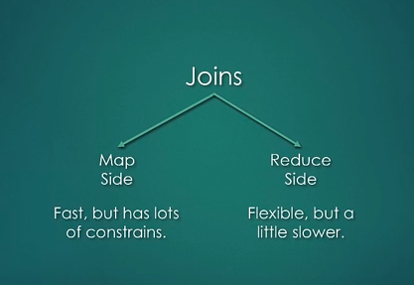
Joining Tables

Slide 73
Joining Tables
A frequent requirement is to join two or more tables together.
Hive supports
Inner joins
Left Outer joins
Right Outer joins
Full Outer joins
Left semi joins
Returns rows from the first table when one or more matches are found
in the second table (e.g. list the departments in a table that have at least one employee)
Notes:
Note that only equality joins are supported
→a.id = b.id is supported
→a.id <> b.id not supported
Inner joins:-The INNER JOIN keyword selects all rows from both tables as long as there is a match between the columns in both tables.
→LEFT, RIGHT, and FULL OUTER joins exist in order to provide more control over ON clauses for which there is no match.
*Left Outer joins:-The LEFT JOIN keyword returns all rows from the left table, with the matching rows in the right table. The result is NULL in the right side when there is no match.
*Right Outer joins:- The RIGHT JOIN keyword returns all rows from the right table, with the matching rows in the left table. The result is NULL in the left side when there is no match.
*Full Outer joins:- The FULL OUTER JOIN keyword returns all rows from the left table and from the right table.
The FULL OUTER JOIN keyword combines the result of both LEFT and RIGHT joins.
*LEFT SEMI JOIN:- implements the uncorrelated IN/EXISTS subquery semantics in an efficient way. Since Hive currently does not support IN/EXISTS subqueries, you can rewrite your queries using LEFT SEMI JOIN. The restrictions of using LEFT SEMI JOIN is that the right-hand-side table should only be referenced in the join condition (ON-clause), but not in WHERE- or SELECT-clauses etc.

Slide 74

Default Join Behavior
Reduce side join
Mapper reads the tables and emits the join key and join value
Reducer performs the actual join
SELECT * FROM A JOIN B ON A.Value=B.value
Map Reduce Task
Table A
Mapper
Mapper
Mapper
Mapper
Mapper
Mapper
Table B
Shuffle and Sort
Reducer

Slide 75
Join Optimization
Map-side join
Reads the smaller table to an in-memory hash table
Each mapper gets its own copy of the hash table
The join is performed in the mapper
No reducer or sort and shuffle phases are required
SELECT /*+mapjoin(B)*/ * FROM A JOIN B ON
A.Value = B.Value;
Notes:
→As of 0.7.0 Hive no longer needs the hint and can perform this automatically.

Slide 76
Map-side v/s Reduce-side Joins
There are two fundamental ways to join dataset in MapReduce
Map-side join
Reducer-side join
Map-side Joins
Function similar to an RDBMS joins
Scans the smaller table in memory for each record found in the larger table
Smaller table is shipped with the job, replicated and loaded into memory
Larger table can be filtered in the mapper
i.e. if there is no row match the row isn’t sent across the network to the reducer

Slide 77
Map- side v/s Reduce- side Joins (cont’d)
Pros
More efficient, but requires one dataset to be small enough to be held in the memory
Cons
All data is shipped over the network to the reducers
Wasteful for inner joins where there are few matches between tables
Previous versions of Hive needed to be told if they could use Map-side join via a ‘hint’
An extra clause in the HiveQL query
Largest version of Hive can work this out for themselves, based on the side of the input data
To enable this, set hive.auto.convert.join = true

Slide 78
Joining Tables: Syntax
Hive uses the following syntax to join tables.
JOIN can be replaced with LEFT OUTER JOIN,RIGHT OUTER JOIN,FULL OUTER JOIN or LEFT SEMI JOIN.
SELECT cols FROM t1 JOIN t2 ON (condition) JOIN
t3 ON (condition)
Notes:
→Note that alternative syntax often used by popular RDBMSs is not supported:
SELECT cols FROM t1,t2 WHERE …….

Slide 79
Join Examples
Consider two tables:
Customer Table
custid | firstname | surname
1 | Jane | Doe
2 | Tom | Smith
3 | Doug | Jones
Purchases Table
custid | order_date | cost
1 | 2010-01-15 | 42.99
2 | 2010-03-21 | 19.65
2 | 2010-04-01 | 1.00
1 | 2010-04-18 | 170.16

Slide 80
Inner Join
An inner join returns all rows where the condition is satisfied.
SELECT * FROM Customer JOIN Purchases
ON (customer.custid = purchases.custid)
custid | firstname | surname | custid | order_date | cost
1 | Jane | Doe | 1 | 2010-01-15 | 42.99
1 | Jane | Doe | 1 | 2010-04-18 | 170.16
2 | Tom | Smith | 2 | 2010-03-21 | 19.65
2 | Tom | Smith | 2 | 2010-04-01 | 1.00

Slide 81
Outer join
A left outer join returns all the rows in the first table even if there are no matches.
SELECT C.custid, firstname, surname, order_date
FROM Customer C LEFT OUTER JOIN Purchases P
ON (C.custid = P.custid)
custid | firstname | surname | order_date
1 | Jane | Doe | 2010-01-15
1 | Jane | Doe | 2010-04-18
2 | Tom | Smith | 2010-03-21
2 | Tom | Smith | 2010-04-01
3 | Doug | Jones | NULL

Slide 82
Left Semi Joins
A left semi join is an optimized IN/EXISTS sub-query.
Performs a map-side group by to reduce data flowing to reducers
Allows for an early exit if match in join
Equivalent IN/EXISTS subquery
SELECT A.*
FROM A LEFT SEMI JOIN B
ON (A.KEY = B.KEY AND B.VALUE >100);
SELECT A.*
FROM A WHERE A.KEY IN
( SELECT A.KEY = B.KEY AND B.VALUE >100);

Slide 83
Identifying Unmatched Records
Outer joins are useful for finding unmatched records.
Example: Find customers who have not made purchases.
SELECT C.custid, firstname, surname
FROM Customer C LEFT SEMI JOIN Purchases P
ON (C.custid = P.custid) WHERE P.custid IS NULL;
custid | firstname | surname
3 | Doug | Jones

Slide 84
Joining Multiple tables
Syntax for joining multiple tables
SELECT cols FROM
t1 JOIN t2 ON (condition)
JOIN t3 ON (condition)

Slide 85
Basic Hive Functions
Notes:
No transcript required

Slide 86
Hive Functions
Hive provides many built-in functions
Mathematical
Date
Conditional
String
Aggregate functions
Hive also supports user-defined functions.

Slide 87
Numeric Functions
Numeric functions include
round()
floor()
ceil()
rand()
exp()
log()
sqrt()
abs()
sin()
cos()
etc.
Notes:
*round():-The round function returns the value rounded to n integer places
*floor():-The floor function returns the largest integer less than or equal to the given value
*ceil():-The ceil function returns the smallest integer greater than or equal to the decimal value n.
*rand ( [int seed] ):- The rand function returns a random number. If you specify the seed value, the generated random number will become deterministic.
*exp():-The exp function returns e to the power of n. Where e is the base of natural logarithm and its value is 2.718.
*log():-The log function returns the base logarithm of the number
*sqrt():-The sqrt function returns the square root of the number *abs():-The abs function returns the absolute value of a number
*sin():-The sin function returns the sin of a number.
*cos( double n ):- The cos function returns the cosine of the value n. Here n should be specified in radians. Example: COS(180*3.1415926/180)

Slide 88
String Functions
String functions include
length()
concat()
substr()
upper()
lower()
trim()
regexp_replace()
etc.
Notes:
*length()-The length function returns the number of characters in a string.
*concat()-The CONCAT function concatenates all the strings.
*substr()-The substr or SUBSTRING function returns a part of the source string from the start position with the specified length of characters. If the length is not given, then it returns from the start position to the end of the string.
*upper()-Returns the string resulting from converting all characters of given string to upper case.
*lower()-Returns the string resulting from converting all characters of given string to lower case.
*trim()-The trim function removes both the trailing and leading spaces from the string.
*regexp_replace()-Returns the string resulting from replacing all substrings in INITIAL_STRING that match the regular expression syntax defined in PATTERN with instances of REPLACEMENT.

Slide 89
Date Functions
Date functions include
unix_timestamp()
from_unixtime()
to_date()
year()
month()
day()
date_add()
date_sub()
datediff()
etc.
Notes:
*unix_timestamp()-This function returns the number of seconds from the Unix epoch (1970-01-01 00:00:00 UTC) using the default time zone.
*from_unixtime()-The from_unixtime function converts the specified number of seconds from Unix epoch and returns the date in the format 'yyyy-MM-dd HH:mm:ss'.
*to_date()-The to_date function returns the date part of the timestamp in the format 'yyyy-MM-dd'.
*year()-The year function returns the year part of the date.
*month()-The month function returns the month part of the date.
*day()-The day function returns the day part of the date.
*date_add()-The date_add function adds the number of days to the specified date
*date_sub()-The date_sub function subtracts the number of days to the specified date
*datediff()-The datediff function returns the number of days between the two given dates

Slide 90
Aggregate Functions
Aggregate functions include
sum()
avg()
min()
max()
stddev_pop()
stddev_sample()
percentile()
etc.
Notes:
→stddev_pop()-Returns the standard deviation of a numeric column in the group.
→stddev_sample()-Returns the unbiased sample standard deviation of a numeric column in the group.
→percentile()-Returns the exact p^{th} percentile of a column in the group (does not work with floating point types). p must be between 0 and 1. NOTE: A true percentile can only be computed for integer values. Use PERCENTILE_APPROX if your input is non-integral.

Slide 91
Multi-table insert
Hive SELECT queries can take a long time.
We sometime need to extract data to a multiple tables based on the same query.
Hive provides an extension to SQL to do this
‘Multi-table insert’
Only requires the query to be run once
FROM (SELECT ...) alias
INSERT OVERWRITE TABLE t1 ...
INSERT OVERWRITE TABLE t2 ...
...

Slide 92
Multi-table insert: Example
Multi-table insert syntax
FROM (SELECT * FROM movies WHERE documentary = 1 ) docs
INSERT OVERWRITE DIRECTORY 'docs_names'
SELECT movie_name
INSERT OVERWRITE DIRECTORY 'docs_count'
SELECT count(1);

Slide 93
Partitioning and Bucketing
Notes:
No transcript required

Slide 94
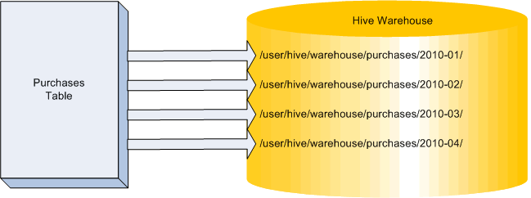
What is Partitioning?
Partitioning a dataset means splitting it into smaller portions based on the value in a column.
This is some times known as ‘horizontal partitioning’.
Hive partitions are stored in subdirectories of the table directory.

Slide 95
Why Partitioning?
Partitioning allows hive to filter at the input path level.
Non-matching data is never read
Splitting a table into partitions is useful if many queries refer to a specific column.
For e.g. - A table containing log entries
Much of the analysis looks at individual days
By partitioning the data based on the date column, only a subset of the data needs to be scanned while executing the query
Since each partition is stored in a different directory, only the data in the relevant directories needs to be read
Any queries which do not specify the date will still work, however in such cases, the entire data set will have to be scanned

Slide 96
Creating a Partitioned table in Hive
To create a partitioned table specify a column like this
Example
CREATE TABLE t (column_spec)
PARTITIONED BY (column_name datatype)
ROW FORMAT ...
CREATE TABLE logs (uid INT, action STRING)
PARTITIONED BY (dt STRING)
ROW FORMAT DELIMITED
FIELDS TERMINATED BY '\t'

Slide 97
Creating a Partitioned table in Hive
The partitioned column is displayed if you DESCRIBE the table
However, the partition is a ‘virtual column’
The data does not exist in your incoming data
Instead, the partition is specified when loading the data
hive> DESCRIBE logs;
OK
uid INT
action STRING
dt STRING

Slide 98
Loading Data into Partitions
To load data into a partition in the table, use
Example:
LOAD DATA INPATH '/path/to/table'
INTO TABLE t
PARTITION (col=val)
LOAD DATA INPATH '/user/ian/mylogs'
INTO TABLE logs
PARTITION (dt='2012-01-15')
Notes:
→Files will be placed in a directory named
/user/hive/warehouse/logs/dt=2012-01-15

Slide 99
Querying a Partitioned Table
When queries include the partition column in the WHERE clause, Hive only needs to process the relevant subdirectories not the entire data set.
The filtering is done by the Hive interpreter, using data from Hive’s Metastore.
Supports =, !=, <, <=, >, >=, and LIKE for strings
Conditions can be chained together with AND and OR

Slide 100
Dynamic Partition Inserts
If your data already exists in a table, recent versions of Hive can dynamically insert the data into specific partitions for you.
Syntax:
Partitions are automatically created based on the value of the last column.
If the partition does not already exist, it will be created
If the partition does exist, it will be overwritten
FROM employees
INSERT OVERWRITE TABLE emps_by_dept PARTITION(dept)
SELECT first_name, last_name, address, phone, dept;
Notes:
→To enable dynamic partitioning, set
hive.exec.dynamic.partition=true
hive.exec.dynamic.partition.mode=nonstrict

Slide 101
Dynamic Partition Inserts
Three Hive configuration properties exist to limit this:
hive.exec.max.dynamic.partitions.pernode
Maximum number of dynamic partitions that can be created by any given Mapper or Reducer
Default 100
hive.exec.max.dynamic.partitions
Total number of dynamic partitions that can be created by one.
HiveQL statement
Default 1000
hive.exec.max.created.files
Maximum total files created by Mappers and Reducers
Default 100000
Notes:
→Caution:if the partition column has many different values, many
partitions will be created

Slide 102
Sub-Partitions
A table can have sub-partitions.
Example
Second partition will be a subdirectory of the first partition’s directory.
E.g. create a partition year, a sub-partition month and another sub-partition for date
Multiple partitions can be used during a multi-partition insert.
The dynamically defined partition must be the last partition in the list
CREATE TABLE t (col_spec)
PARTITION(dt STRING, country STRING)

Slide 103
Dropping/Adding Partitions
Hive’s ALTER TABLE statement provides the ability to drop or add a partition.
Adding multiple partitions example
Removing partition example
ALTER TABLE page_view ADD PARTITION (dt='2008-08-08',
country='us') location '/path/to/us/part080808’;
ALTER TABLE page_view ADD PARTITION (dt='2008-08-09',
country='us') location '/path/to/us/part080809';
ALTER TABLE page_view DROP PARTITION
(dt='2008-08-08', country='us');

Slide 104
What is Bucketing?
Bucketing data is similar to partitioning data.
Data is split into buckets based on the hash value of the column of the incoming data.
Intended to produce an even distribution of rows across n buckets.
Useful for jobs which need to ‘sample’ data from the table.
Jobs which just work on a ‘random’ portion of the data

Slide 105
Creating a bucketed table
Syntax to create a bucketed table
CREATE TABLE t (col_spec)
CLUSTERED BY (col) INTO n BUCKETS
Notes:
Since a hash will be taken of the col column value for each row to determine the destination bucket, the column should contain well-distributed values.

Slide 106
Inserting data into the bucketed table
To insert data into the bucketed column, first insert it into a ‘helper’ table (with no bucketing) and then fire the following commands
hive>SET mapred.reduce.tasks=( number-of-buckets)
hive>SET hive.enforce.bucketing=true;
hive>INSERT OVERWRITE TABLE target_bucketed_table
SELECT * FROM helper_table;

Slide 107
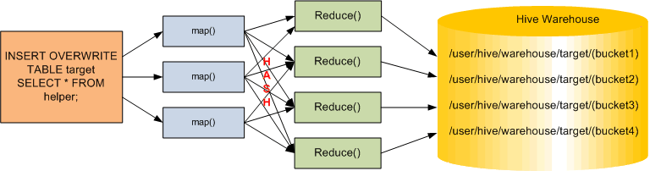
Inserting data into the bucketed table
Hive implements bucketing by running mapReduce job on the data in the helper table.

Slide 108
Sampling data from a bucketed table
To use the bucketed table, use the following syntax:
If the table was bucketed into the 4 buckets on col, this would choose just the rows in bucket 1
If the table was bucketed into the 16 buckets on col, this would choose the rows in bucket 1, 5, 9, 13
SELECT * FROM bucketed_table
TABLESAMPLE (bucket 1 OUT OF 4 ON col)
Notes:
You can use TIMESTAMP on the non-bucketed table. However, this requires a full scan of the entire table.

Slide 110
Various File Formats

Slide 111
File formats supported by Hive
Avro Files
ORC Files
Parquet
Compressed Data Storage
LZO Compression
Depending on requirement, one can use any format as required by the application

Slide 112
AVRO integration with Hive

Slide 113
AVRO files
AVRO is a Remote Procedure Call and Data serialization system
It used JSON to define data types and protocols
Serializes data in compact binary format
it provides serialization format for persistent data, and a wire format for communication between Hadoop nodes, and from client programs to the Hadoop services

Slide 114
AVRO files
Advantages:
Data is fully typed.
A compact, fast, binary data format.
Data is stored in files along with their Schema
This makes serialization and Deserialization faster as well as any application can process AVRO data files
AVRO Schemas are defined using JSON
Data can read across any language
Schema ca evolve over time, in a safe manner
Disadvantages:
Avro support for some languages may be lacking
Can’t “print” the data without using the Avro tools(because it’s compressed and serialized )
Notes:
Dynamic typing: Avro does not require that code be generated. Data is always accompanied by a schema that permits full processing of that data without code generation, static datatypes, etc. This facilitates construction of generic data-processing systems and languages.
Untagged data: Since the schema is present when data is read, considerably less type information need be encoded with data, resulting in smaller serialization size.
No manually-assigned field IDs: When a schema changes, both the old and new schema are always present when processing data, so differences may be resolved symbolically, using field names.

Slide 115
Processing AVRO files from Hive
The AvroSerde allows users to read or write Avro data as Hive tables
Infers the schema of the Hive table from the Avro schema
Reads all Avro files within a table against a specified schema, taking advantage of Avro's backwards compatibility abilities
Supports arbitrarily nested schemas.
Translates all Avro data types into equivalent Hive types. Most types map exactly, but some Avro types don't exist in Hive and are automatically converted by the AvroSerde.
Understands compressed Avro files.
Transparently converts the Avro idiom of handling nullable types as Union[T, null] into just T and returns null when appropriate.
Writes any Hive table to Avro files.
Has worked reliably against our most convoluted Avro schemas in our ETL process.

Slide 116
Avro to Hive type conversion
Avro type | Becomes Hive type | Note
union | union | Unions of [T, null] transparently convert to nullable T, other types translate directly to Hive's unions of those types. However, unions were introduced in Hive 7 and are not currently able to be used in where/group-by statements. They are essentially look-at-only. Because the AvroSerde transparently converts [T,null], to nullable T, this limitation only applies to unions of multiple types or unions not of a single type and null.
string | string
record | struct
null | void
map | map
long | bigint
list | array
int | int
float | float
fixed | binary | Fixeds are converted to Array[smallint] prior to Hive 0.12.0.
enum | string | Hive has no concept of enums.
double | double
bytes | binary | Bytes are converted to Array[smallint] prior to Hive 0.12.0.
boolean | boolean

Slide 117
Creating AVRO files from HIVE
Below model is available from Hive 0.14 and above only
CREATE TABLE avro_test_table(
id INT,
Name STRING,
dob DATE,
dept INT)
PARTITIONED BY (gender STRING)
STORED AS AVRO;

Slide 118
Check AVRO table schema
Hive> Desc avro_test_file
Ok
id int
name string
dob date
gender string
# Partition information
# col_name data_type comment
gender string
Time taken: 16.008 Seconds, Fetched: 9 row(s)

Slide 119
Prior to Hive 0.14
Below method is applicable to all Hive versions
CREATE TABLE kst
PARTITIONED BY (ds string)
ROW FORMAT SERDE
'org.apache.hadoop.hive.serde2.avro.AvroSerDe'
STORED AS INPUTFORMAT
‘org.apache.hadoop.hive.ql.io.avro.AvroContainerInputFormat'
OUTPUTFORMAT
'org.apache.hadoop.hive.ql.io.avro.AvroContainerOutputFormat'
TBLPROPERTIES
('avro.schema.url'='http://schema_provider/kst.avsc');

Slide 120
Load data into AVRO format file
Create an intermediate file into which actual data is loaded.
Use the below command to load data into AVRO file.
INSERT OVERWRITE TABLE as_avrotest SELECT * FROM intermediate_table;

Slide 121
Specifying Schema for table in AVRO
Schema can be specified in 3 different ways
Use avro.schema.url (already used)
Use schema.literal and embed the schema in the create statement
CREATE TABLE embedded
COMMENT "just drop the schema right into the HQL"
ROW FORMAT SERDE
'org.apache.hadoop.hive.serde2.avro.AvroSerDe'
STORED AS INPUTFORMAT
'org.apache.hadoop.hive.ql.io.avro.AvroContainerInputFormat'
OUTPUTFORMAT
'org.apache.hadoop.hive.ql.io.avro.AvroContainerOutputFormat'
TBLPROPERTIES (
'avro.schema.literal'='{
"namespace": "com.howdy",
"name": "some_schema",
"type": "record",
"fields": [ { "name":"string1","type":"string"}]
}');

Slide 122
Specifying Schema for table in AVRO
Use avro.schema.literal and pass the schema into the script
set hiveconf:schema;
DROP TABLE example;
CREATE TABLE example
ROW FORMAT SERDE
'org.apache.hadoop.hive.serde2.avro.AvroSerDe'
STORED AS INPUTFORMAT
'org.apache.hadoop.hive.ql.io.avro.AvroContainerInputFormat'
OUTPUTFORMAT
'org.apache.hadoop.hive.ql.io.avro.AvroContainerOutputFormat'
TBLPROPERTIES (
'avro.schema.literal'='${hiveconf:schema}');
Run the script using below command
hive --hiveconf schema="${SCHEMA}" -f your_script_file.sql

Slide 123
ORC integration with Hive

Slide 124
ORC Files
ORC stands for Optimized Row Columnar file format
Very efficient to store Hive data
This helps improving Hive performance during storage, retrieval and processing data
Advantages
a single file as the output of each task, which reduces the NameNode's load
Hive type support including datetime, decimal, and the complex types (struct, list, map, and union)
light-weight indexes stored within the file
skip row groups that don't pass predicate filtering
seek to a given row
block-mode compression based on data type
run-length encoding for integer columns
dictionary encoding for string columns
concurrent reads of the same file using separate RecordReaders
ability to split files without scanning for markers
bound the amount of memory needed for reading or writing

Slide 125
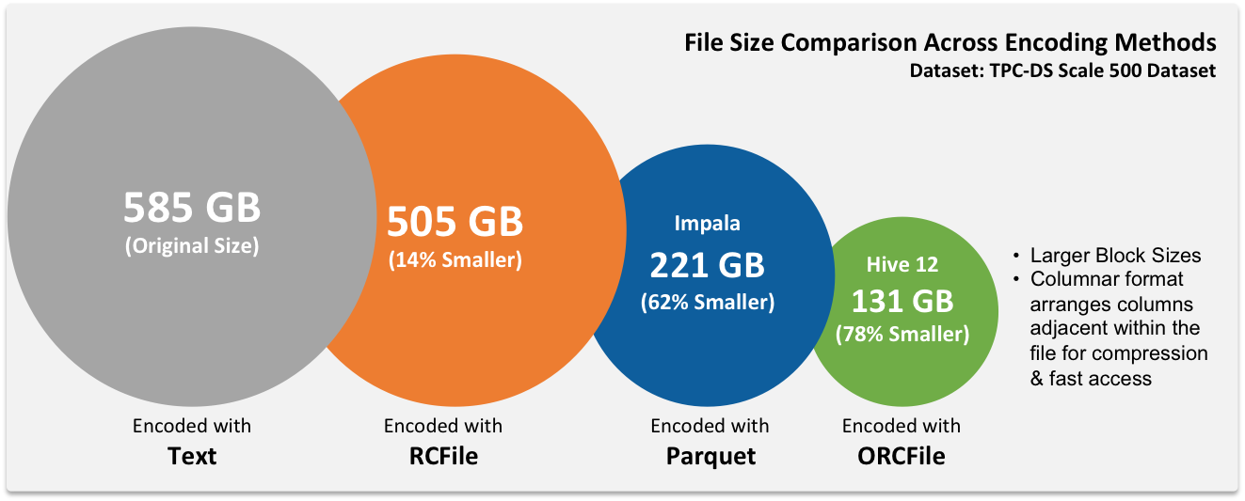
ORC Files capability
Source: http://datametica.com/rcorc-file-format/

Slide 126
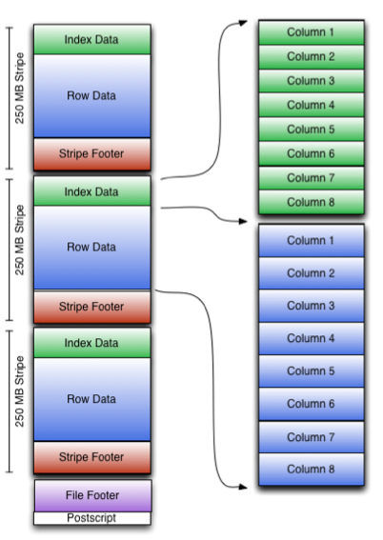
ORC file format
Postscript : provides the necessary information to interpret the rest of the file including the length of the file's Footer and Metadata sections, the version of the file, and the kind of general compression used (eg. none, zlib, or snappy)
Footer: contains the layout of the body of the file, the type schema information, the number of rows, and the statistics about each of the columns
Stripe Information: Body of file is divided into stripes. Stripes have three sections: a set of indexes for the rows within the stripe, the data itself, and a stripe footer. Both the indexes and the data sections are divided by columns so that only the data for the required columns needs to be read.

Slide 127
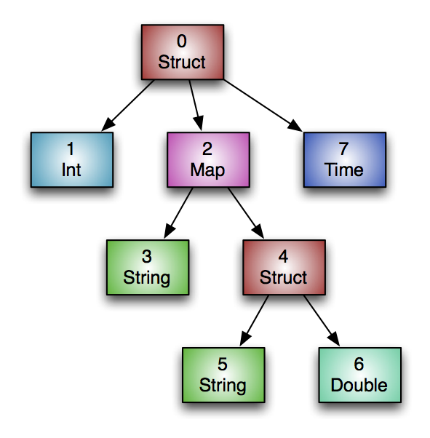
Type Information
All of the rows in an ORC file must have the same schema. Logically the schema is expressed as a tree as in the figure below, where the compound types have subcolumns under them
create table Foobar ( myInt int, myMap map<string, struct<myString : string, myDouble: double>>, myTime timestamp );

Slide 128
Parquet files

Slide 129
Parquet files
It is a ecosystem wide columnar format for Hadoop
Paraquet has support for various engines
Apache Hive
Apache Drill
Cloudera Impala
Apache Crunch
Apache Pig
Cascading
Apache Spark

