Slide 1
Spring Security
Confidential © Tech Mahindra 2012

Slide 2
Objective
At the end of the training participants will be able to:
    Introduction to Security
    Introduction to Spring Security
    Describe the Spring security for authentication and authorization
        HTTP Security
        Method Security
        Annotation-Based Security
        Domain Object Instance Security

Slide 3
Agenda
Security overview
Spring Security
Authentication and Authorization
HTTP Security
Method Security
Annotation-Based Security
Domain Object Security

Slide 4
Security
Confidential © Tech Mahindra 2012

Slide 5
Security terminologies
Authentication - It is the process of verifying a principal’s identity
against what it claims to be.
principal - It can be a user, a device, or a system, but most typically, it’s a user.
Credential - A principal has to provide evidence of identity to be authenticated. usually a password when the target principal is a user.
Authorization - It is the process of granting (roles) authorities to an authenticated user. It must be performed after the authentication process.

Slide 6
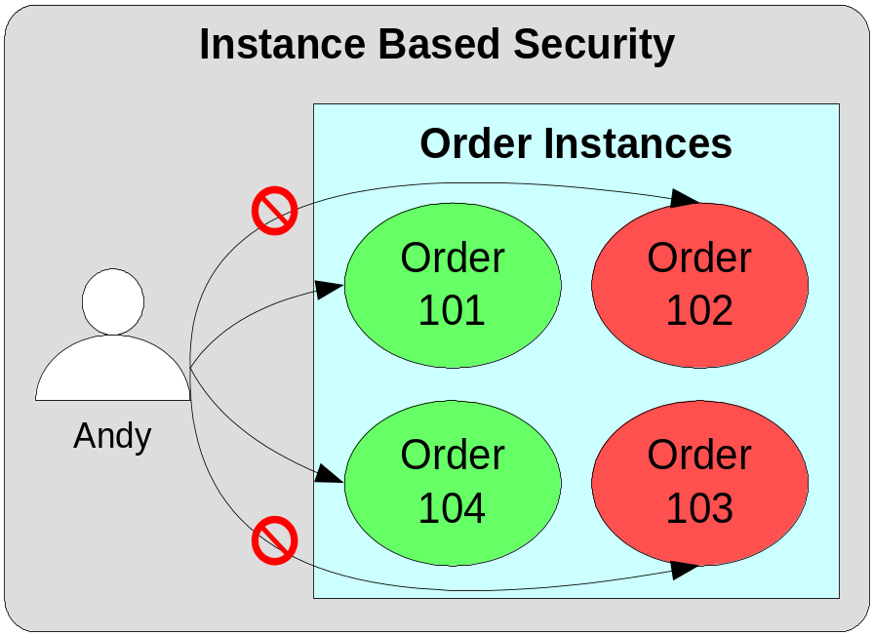
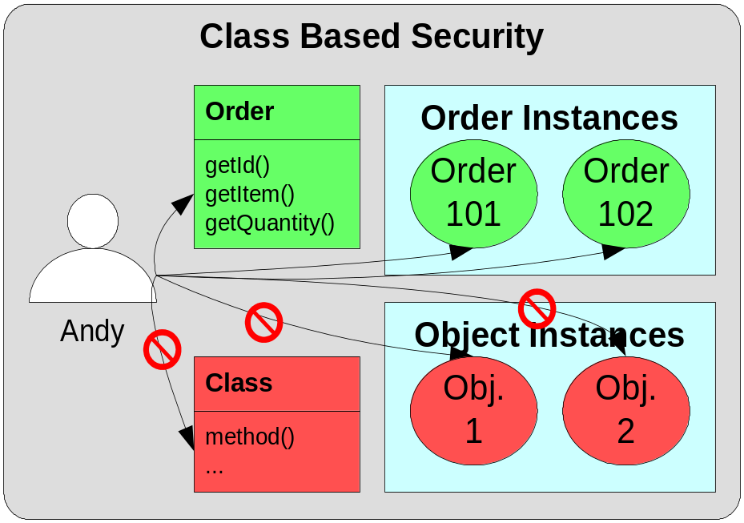
What is Instance-Based Security?
Instance-based security is an authorization mechanism for protecting access to resources based on the identity of the resource.
Class-based security protects access to resources based on the class of the resource.

Slide 7
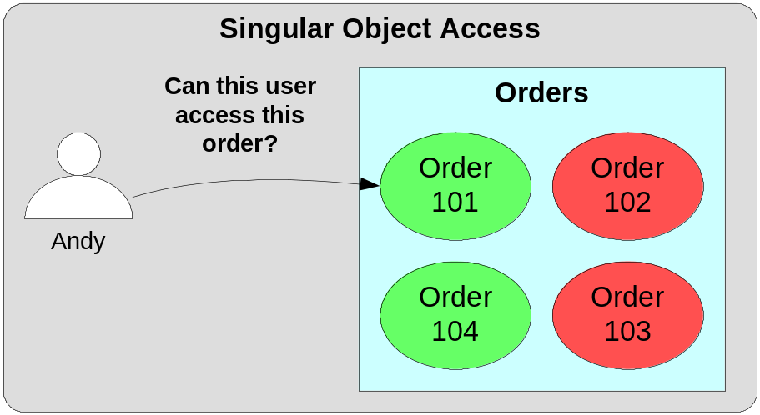
Singular Object Access
Applications need to determine whether a User has permission to a specified object instance.
Singular access:
  Can User A access Object O

Slide 8
Why is Instance-Based Security Important?
Why is Instance-Based Security Important?
  Most real-world applications require instance-based security instead of class-based security.
  Some industries are mandated by law to implement instance-based security – Healthcare industry.
Why is Instance-Based Security Difficult?
  Volume of data problem – compared to the number of classes within a system, the number of instances of those classes can be huge.
  Administration requires knowledge of runtime state of system.
  Some link with business logic is typically required.

Slide 9
Spring Securiry
Spring Security was initially known as Acegi Security, but its name
has been changed.
Spring Security framework, a subproject of the Spring framework.
Some security features changed in Spring3.0 ex –
  Annotations support
  OpenID support
  and includes class name changes and package partitioning
Spring Security is a powerful and highly customizable authentication and access-control framework.
It is the de-facto standard for securing Spring-based applications
Spring Security is one of the most mature and widely used Spring projects.

Slide 10
Spring Security (Cont…)
It is used to secure numerous demanding environments including government agencies, military applications and central banks.
It comprises of a set of interfaces and classes that are configured through the Spring IOC container.
All the security requirements can be implemented via declarative configuration settings in the IOC container.

Slide 11
Why Spring security
Spring-based dependency injection makes easy to configure and implement in a completely nonintrusive way.
Spring security is an open source security framework that allows you to keep your business logic free from security code.
Excellent unit test coverage.
With JAAS, porting container-managed security realms is not easy.
Spring security will allow you to easily reuse and port your "Remember Me," "I forgot my password," and log-in/log-out security functions to different servlet and EJB containers.

Slide 12
Spring security – URL Access
It handles security by applying servlet filters to HTTP requests.
Configure servlet filter DelegatingFilterProxy in the web.xml
Spring Security allows you to configure web application security through the <http> element.
To use basic security services, set <http> is true.
It includes the following:
  Form-based login service: This provides a default page that contains a login form for users to log into this application.
  Logout service: This provides a handler mapped with a URL for users to log out of this application.
  HTTP Basic authentication: This can process the Basic authentication credentials presented in HTTP request headers.
  Anonymous login: It assigns principle to an anonymous user so that you can handle an anonymous user like a normal user.
  Remember-me support: It remember a user’s identity across multiple browser sessions.
  Servlet API integration: Standard Servlet APIs, such as HttpServletRequest.isUserInRole() and HttpServletRequest.getUserPrincipal().

Slide 13
Security in Spring
Confidential © Tech Mahindra 2012

Slide 14
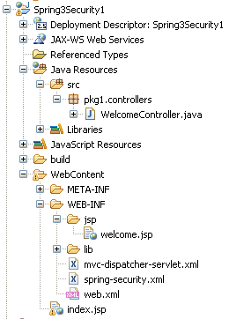
Spring Security – URL access
Create Dynamic Web Project “Spring3Security1”.
Copy the required jar files in WEB-INF\lib [see foot note]
Edit web.xml
Create mvc-dispatcher-servlet.xml and spring-security.xml
Notes:
commons-logging-1.0.4.jar
jstl.jar
lib.txt
org.springframework.aop-3.1.2.RELEASE.jar
org.springframework.asm-3.1.2.RELEASE.jar
org.springframework.beans-3.1.2.RELEASE.jar
org.springframework.context-3.1.2.RELEASE.jar
org.springframework.context.support-3.1.2.RELEASE.jar
org.springframework.core-3.1.2.RELEASE.jar
org.springframework.expression-3.1.2.RELEASE.jar
org.springframework.transaction-3.1.2.RELEASE.jar
org.springframework.web-3.1.2.RELEASE.jar
org.springframework.web.portlet-3.1.2.RELEASE.jar
org.springframework.web.servlet-3.1.2.RELEASE.jar
spring-security-config-3.1.2.RELEASE-javadoc.jar
spring-security-config-3.1.2.RELEASE-sources.jar
spring-security-config-3.1.2.RELEASE.jar
spring-security-core-3.1.2.RELEASE-javadoc.jar
spring-security-core-3.1.2.RELEASE-sources.jar
spring-security-core-3.1.2.RELEASE.jar
spring-security-taglibs-3.1.2.RELEASE-javadoc.jar
spring-security-taglibs-3.1.2.RELEASE-sources.jar
spring-security-taglibs-3.1.2.RELEASE.jar
spring-security-web-3.1.2.RELEASE-javadoc.jar
spring-security-web-3.1.2.RELEASE-sources.jar
spring-security-web-3.1.2.RELEASE.jar
standard.jar

Slide 15
Edit web.xml
<?xml version="1.0" encoding="UTF-8"?>
<web-app....>
<context-param>
<param-name>contextConfigLocation</param-name>
  <param-value>
    /WEB-INF/mvc-dispatcher-servlet.xml,
    /WEB-INF/spring-security.xml
  </param-value>
</context-param>
<listener>
<listener-class>org.springframework.web.context.ContextLoaderListener</listener-class>
</listener>
<!-- Spring Security -->
<filter>
  <filter-name>springSecurityFilterChain</filter-name>
  <filter-class>org.springframework.web.filter.DelegatingFilterProxy</filter-class>
</filter>

Slide 16
Edit web.xml (Cont…)
<filter-mapping>
  <filter-name>springSecurityFilterChain</filter-name>
  <url-pattern>/*</url-pattern>
</filter-mapping>
<servlet>
<servlet-name>mvc-dispatcher</servlet-name>
  <servlet-class>org.springframework.web.servlet.DispatcherServlet</servlet-class>
  <load-on-startup>1</load-on-startup>
</servlet>
<servlet-mapping>
  <servlet-name>mvc-dispatcher</servlet-name>
  <url-pattern>/</url-pattern>
</servlet-mapping>
<welcome-file-list>
<welcome-file>index.jsp</welcome-file>
</welcome-file-list>
</web-app>

Slide 17
Create mvc-dispatcher-servlet.xml
<beans xmlns="http://www.springframework.org/schema/beans"
xmlns:context="http://www.springframework.org/schema/context"
xmlns:xsi="http://www.w3.org/2001/XMLSchema-instance"
xsi:schemaLocation="
http://www.springframework.org/schema/beans
http://www.springframework.org/schema/beans/spring-beans-3.0.xsd
http://www.springframework.org/schema/context
http://www.springframework.org/schema/context/spring-context-3.0.xsd">
<context:component-scan base-package="pkg1.controllers" />
<bean class="org.springframework.web.servlet.view.InternalResourceViewResolver">
<property name="prefix" value="/WEB-INF/jsp/"/>
<property name="suffix" value=".jsp"/>
</bean>
</beans>

Slide 18
Create spring-security.xml
<beans:beans ...>
<http auto-config="true">
<!-- <form-login /> -->
<intercept-url pattern="/welcome*" access="ROLE_USER" />
<logout />
</http>
<authentication-manager>
<authentication-provider>
<user-service>
<user name="admin" password="admin" authorities="ROLE_USER,ROLE_ADMIN" />
<user name="user1" password="user1" authorities="ROLE_USER" />
<user name="user2" password="user2" authorities="ROLE_USER" />
</user-service>
</authentication-provider>
</authentication-manager>
</beans:beans>

Slide 19
Create controller
package pkg1.controllers;
// all imports
@Controller
@RequestMapping("/welcome")
public class WelcomeController
{
@RequestMapping(method = RequestMethod.GET)
public String printWelcome(ModelMap model)
{
model.addAttribute("msg", "Welcome to Spring Security example");
return "welcome";
}
}

Slide 20
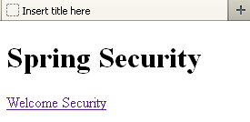
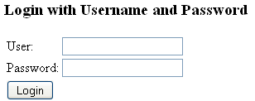
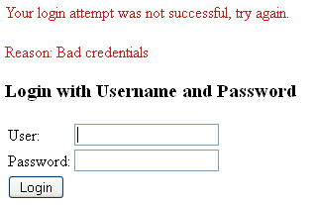
Create view page
index.jsp
<html>
<body>
<h1> Spring Security</h1>
<a href="welcome">Welcome Security</a>
</body>
</html>
Spring based login page
1
2
3
Spring based error message

Slide 21
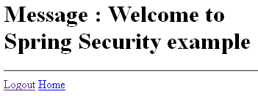
Create view page
WEB-INF\jsp\welcome.jsp
<%@taglib uri="http://java.sun.com/jsp/jstl/core" prefix="c"%>
<html>
<body>
<h1>Message : ${msg}</h1> <hr>
<a href="<c:url value="/j_spring_security_logout"/>">Logout</a>
<a href="index.jsp"> Home</a>
</body>
</html>

Slide 22
Custom Login page
Edit spring-security.xml as below –
<http auto-config="true">
<form-login login-page="/login.jsp"/>
<intercept-url pattern="/welcome*" access="ROLE_USER" />
<logout />
</http>

Slide 23
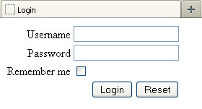
Create login.jsp page
Create login.jsp as below –
<html>
<head>
<body>
<form method="POST" action="<c:url value="/j_spring_security_check" />">
Username - <input type="text" name="j_username" /><br>
Password - <td><input type="password" name="j_password" /><br>
Remember me - <input type="checkbox" name="_spring_security_remember_me" /><br
<input type="submit" value="Login" />
<input type="reset" value="Reset" />
</form>
</body>
</html>

Slide 24
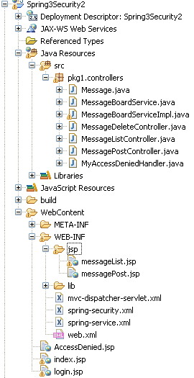
Develop App using Spring security
Create Dynamic Web Project “Spring3Security2”.
Copy the required jar files in WEB-INF\lib [see foot note]
Edit web.xml [Same as previous project]
Create mvc-dispatcher-servlet.xml [Same as previous project]
And spring-security.xml
Create spring-service.xml
Create view page –
  index.jsp
  AccessDenied.jsp
  jsp\messageList.jsp
  jsp\messagePost.jsp
Notes:
commons-logging-1.0.4.jar
jstl.jar
lib.txt
org.springframework.aop-3.1.2.RELEASE.jar
org.springframework.asm-3.1.2.RELEASE.jar
org.springframework.beans-3.1.2.RELEASE.jar
org.springframework.context-3.1.2.RELEASE.jar
org.springframework.context.support-3.1.2.RELEASE.jar
org.springframework.core-3.1.2.RELEASE.jar
org.springframework.expression-3.1.2.RELEASE.jar
org.springframework.transaction-3.1.2.RELEASE.jar
org.springframework.web-3.1.2.RELEASE.jar
org.springframework.web.portlet-3.1.2.RELEASE.jar
org.springframework.web.servlet-3.1.2.RELEASE.jar
spring-security-config-3.1.2.RELEASE-javadoc.jar
spring-security-config-3.1.2.RELEASE-sources.jar
spring-security-config-3.1.2.RELEASE.jar
spring-security-core-3.1.2.RELEASE-javadoc.jar
spring-security-core-3.1.2.RELEASE-sources.jar
spring-security-core-3.1.2.RELEASE.jar
spring-security-taglibs-3.1.2.RELEASE-javadoc.jar
spring-security-taglibs-3.1.2.RELEASE-sources.jar
spring-security-taglibs-3.1.2.RELEASE.jar
spring-security-web-3.1.2.RELEASE-javadoc.jar
spring-security-web-3.1.2.RELEASE-sources.jar
spring-security-web-3.1.2.RELEASE.jar
standard.jar

Slide 25
spring-security.xml
<beans:beans xmlns="http://www.springframework.org/schema/security"
xmlns:beans......>
<http auto-config="true">
<form-login login-page="/login.jsp" default-target-url="/messageList" />
<intercept-url pattern="/messageList*" access="ROLE_USER,ROLE_ANONYMOUS" />
<intercept-url pattern="/messagePost*" access="ROLE_USER" />
<intercept-url pattern="/messageDelete*" access="ROLE_ADMIN" />
<access-denied-handler ref="accessDeniedHandler"/>
<logout />
</http>
<authentication-manager>
<authentication-provider>
<user-service>
<user name="admin" password="admin" authorities="ROLE_USER,ROLE_ADMIN" />
<user name="user1" password="user1" authorities="ROLE_USER" />
<user name="user2" password="user2" authorities="ROLE_USER" />
</user-service>
</authentication-provider>
</authentication-manager>
</beans:beans>

Slide 26
spring-service.xml
<?xml version="1.0" encoding="UTF-8"?>
<beans ....>
<bean id="messageBordService" class="pkg1.controllers.MessageBoardServiceImpl" />
<bean id="accessDeniedHandler" class="pkg1.controllers.MyAccessDeniedHandler">
<property name="accessDeniedUrl" value="AccessDenied.jsp" />
</bean>
</beans>

Slide 27
Create view page – index.jsp
<%@ taglib prefix="c" uri="http://java.sun.com/jsp/jstl/core"%>
<%@ page language="java" contentType="text/html; charset=ISO-8859-1"
pageEncoding="ISO-8859-1"%>
<!DOCTYPE html PUBLIC "-//W3C//DTD HTML 4.01 Transitional//EN" "http://www.w3.org/TR/html4/loose.dtd">
<html>
<head>
<meta http-equiv="Content-Type" content="text/html; charset=ISO-8859-1">
<title>Spring Security Example</title>
</head>
<body>
<h1> Spring Securiry Example<br>
1. <a href="messageList">List Message</a><br>
2. <a href="messagePost">Post Message</a><br>
3. <a href="messageDelete">Delete Message</a><br>
</h1>
</body>
</html>

Slide 28
Create view page – AccessDenied.jsp
<html>
<body>
<h1>HTTP Status - Access is denied</h1>
<h3>Message : ${message}</h3>
<a href="login.jsp">Login</a>
</body>
</html>

Slide 29
Create view page – messageList.jsp
<%@ taglib prefix="c" uri="http://java.sun.com/jsp/jstl/core" %>
<%@ taglib prefix="security" uri="http://www.springframework.org/security/tags" %>
<html>
<head>
<title>Message List <security:authentication property="name" />
</title> </head>
<body>
<h2>Welcome! <security:authentication property="name" /></h2>
<security:authentication property="authorities" var="authorities" />
<ul>
<c:forEach items="${authorities}" var="authority">
<li>${authority.authority}</li>
</c:forEach>
</ul><hr />
<a href="<c:url value="/login.jsp" />">Login</a> |
<a href="<c:url value="/j_spring_security_logout" />">Logout</a>
<c:forEach items="${messages}" var="message">
Author - ${message.author} <br>
Title - ${message.title} <br>
Body - ${message.body} <br>
<a href="messageDelete?messageId=${message.id}">Delete</a> <br>
<hr />
</c:forEach>
<a href="messagePost">Post</a>
</body> </html>

Slide 30
Create view page – messagePost.jsp
<%@ taglib prefix="form" uri="http://www.springframework.org/tags/form" %>
<html>
<head>
<title>Message Post</title>
</head>
<body>
<form:form method="POST" modelAttribute="message">
<table>
<tr>
<td>Title</td>
<td><form:input path="title" /></td>
</tr>
<tr>
<td>Body</td>
<td><form:textarea path="body" /></td>
</tr>
<tr>
<td colspan="2"><input type="submit" value="Post" /></td>
</tr>
</table>
</form:form>
</body>
</html>

Slide 31
Create message model - Message.java
package pkg1.controllers;
public class Message {
private Long id;
private String author;
private String title;
private String body;
// getter/setter
}

Slide 32
Create message service - MessageBoardService .java
package pkg1.controllers;
import java.util.List;
public interface MessageBoardService
{
public List<Message> listMessages();
public void postMessage(Message message);
public void deleteMessage(Message message);
public Message findMessageById(Long messageId);
}

Slide 33
Create service implementation - MessageBoardServiceImpl.java
package pkg1.controllers;
// all imports
public class MessageBoardServiceImpl implements MessageBoardService {
private Map<Long, Message> messages = new LinkedHashMap<Long, Message>();
public List<Message> listMessages() {
return new ArrayList<Message>(messages.values());
}
public synchronized void postMessage(Message message) {
message.setId(System.currentTimeMillis());
messages.put(message.getId(), message);
}
public synchronized void deleteMessage(Message message) {
messages.remove(message.getId());
}
public Message findMessageById(Long messageId) {
return messages.get(messageId);
} }

Slide 34
Create message delete controller – MessageDeleteController.java
package pkg1.controllers;
// all imports
@Controller
@RequestMapping("/messageDelete*")
public class MessageDeleteController {
private MessageBoardService messageBoardService;
@Autowired
public MessageDeleteController(MessageBoardService messageBoardService) {
this.messageBoardService = messageBoardService;
}
@RequestMapping(method = RequestMethod.GET)
public String messageDelete(@RequestParam(required = true, value = "messageId")
Long messageId, Model model) {
Message message = messageBoardService.findMessageById(messageId);
messageBoardService.deleteMessage(message);
model.addAttribute("messages", messageBoardService.listMessages());
return "redirect:messageList";
}
}

Slide 35
Create message list controller – MessageListController.java
package pkg1.controllers;
// all imports
@Controller
@RequestMapping("/messageList*")
public class MessageListController {
private MessageBoardService messageBoardService;
@Autowired
public MessageListController(MessageBoardService messageBoardService) {
this.messageBoardService = messageBoardService;
}
@RequestMapping(method = RequestMethod.GET)
public String generateList(Model model) {
List<Message> messages = java.util.Collections.emptyList();
messages = messageBoardService.listMessages();
model.addAttribute("messages", messages);
return "messageList";
}
}

Slide 36
Create message post controller – MessagePostController.java
package pkg1.controllers;
// all imports
@Controller
@RequestMapping("/messagePost*")
public class MessagePostController {
private MessageBoardService messageBoardService;
@Autowired
public MessagePostController(MessageBoardService messageBoardService) {
this.messageBoardService = messageBoardService;
}
@RequestMapping(method = RequestMethod.GET)
public String setupForm(Model model) {
Message message = new Message();
model.addAttribute("message", message);
return "messagePost";
}
@RequestMapping(method = RequestMethod.POST)
public String onSubmit(@ModelAttribute("message") Message message, BindingResult result) { //, SessionStatus status) {
if (result.hasErrors()) {
return "messagePost";
} else {
messageBoardService.postMessage(message);
return "redirect:messageList";
}}}

Slide 37
Create access denied handler
package pkg1.controllers;
// all imports
public class MyAccessDeniedHandler implements AccessDeniedHandler {
private String accessDeniedUrl;
public MyAccessDeniedHandler() {
}
public MyAccessDeniedHandler(String accessDeniedUrl) {
this.accessDeniedUrl = accessDeniedUrl;
}
@Override
public void handle(HttpServletRequest request,
HttpServletResponse response,
AccessDeniedException accessDeniedException) throws IOException,
ServletException {
response.sendRedirect(accessDeniedUrl);
request.getSession().setAttribute("message",
"You do not have permission to access this page!");
}
public String getAccessDeniedUrl() {
return accessDeniedUrl;
}
public void setAccessDeniedUrl(String accessDeniedUrl) {
this.accessDeniedUrl = accessDeniedUrl;
} }

Slide 38
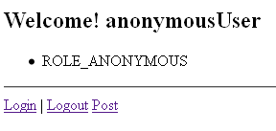
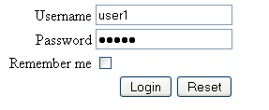
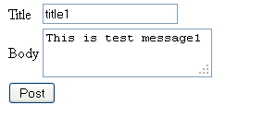
Run the application

Slide 39
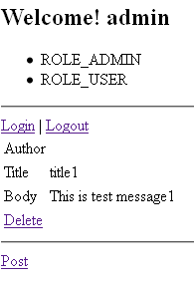
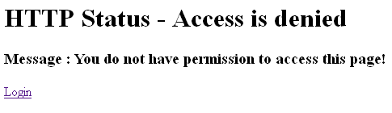
Run the application (Cont…)

Slide 40
Summary
    Introduction to Security
    Introduction to Spring Security
    Describe the Spring security for authentication and authorization
        HTTP Security
        Method Security
        Annotation-Based Security
        Domain Object Instance Security

Slide 41

Confidential © Tech Mahindra 2012

