Slide 1
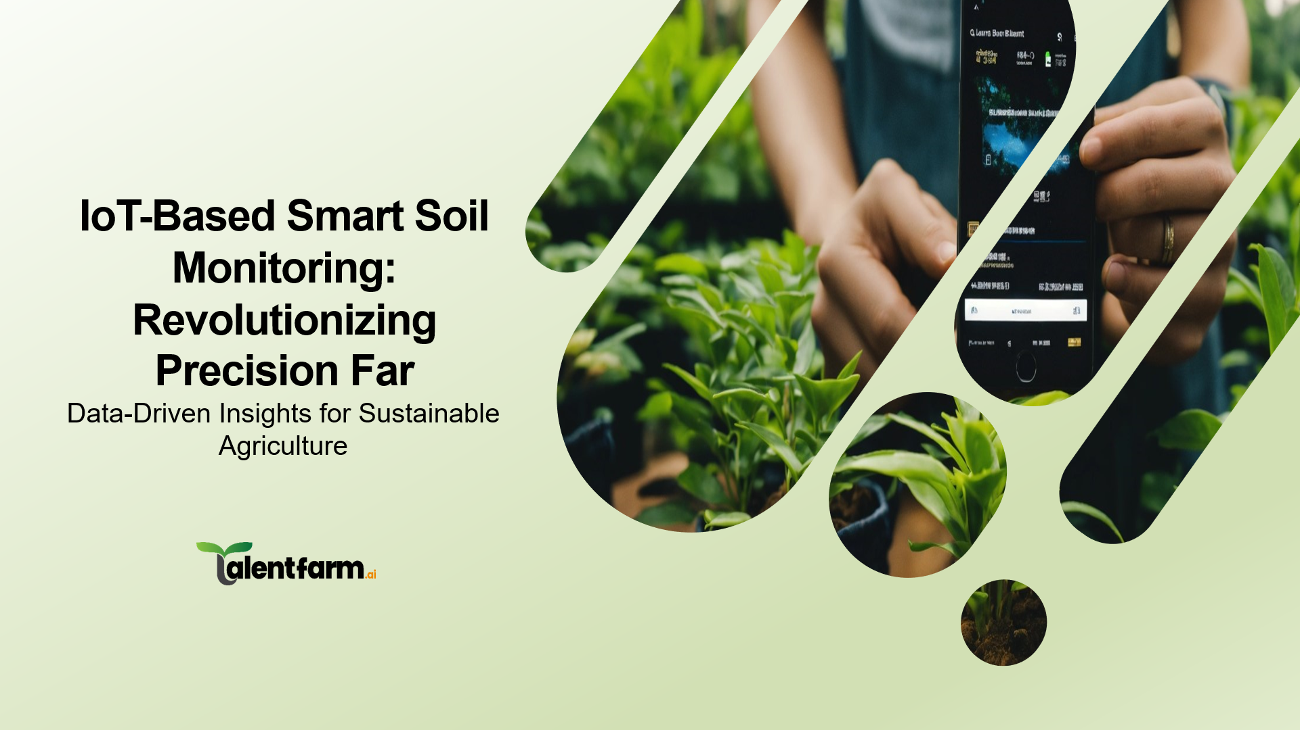

Slide 2
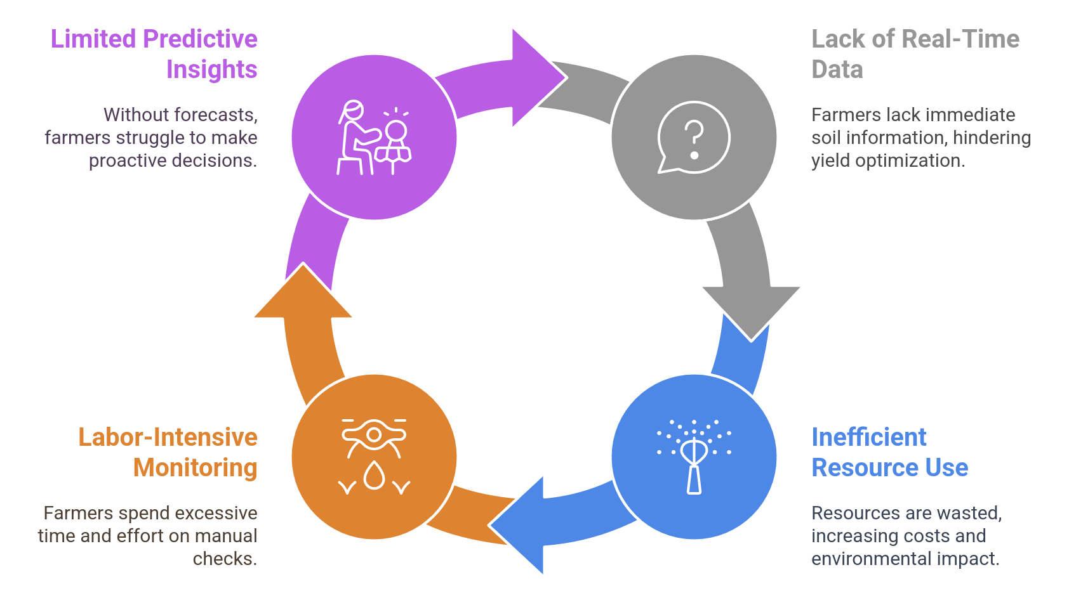

Problem Statement
The Challenge: Traditional Farming Inefficiencies
Farmers face challenges in optimizing crop yields due to lack of real-time soil data.
Inefficient use of resources (water, fertilizers) leads to increased costs and environmental impact.
Manual monitoring is labour-intensive, time-consuming, and prone to errors.
Lack of predictive insights limits proactive decision-making for crop management.

Slide 3
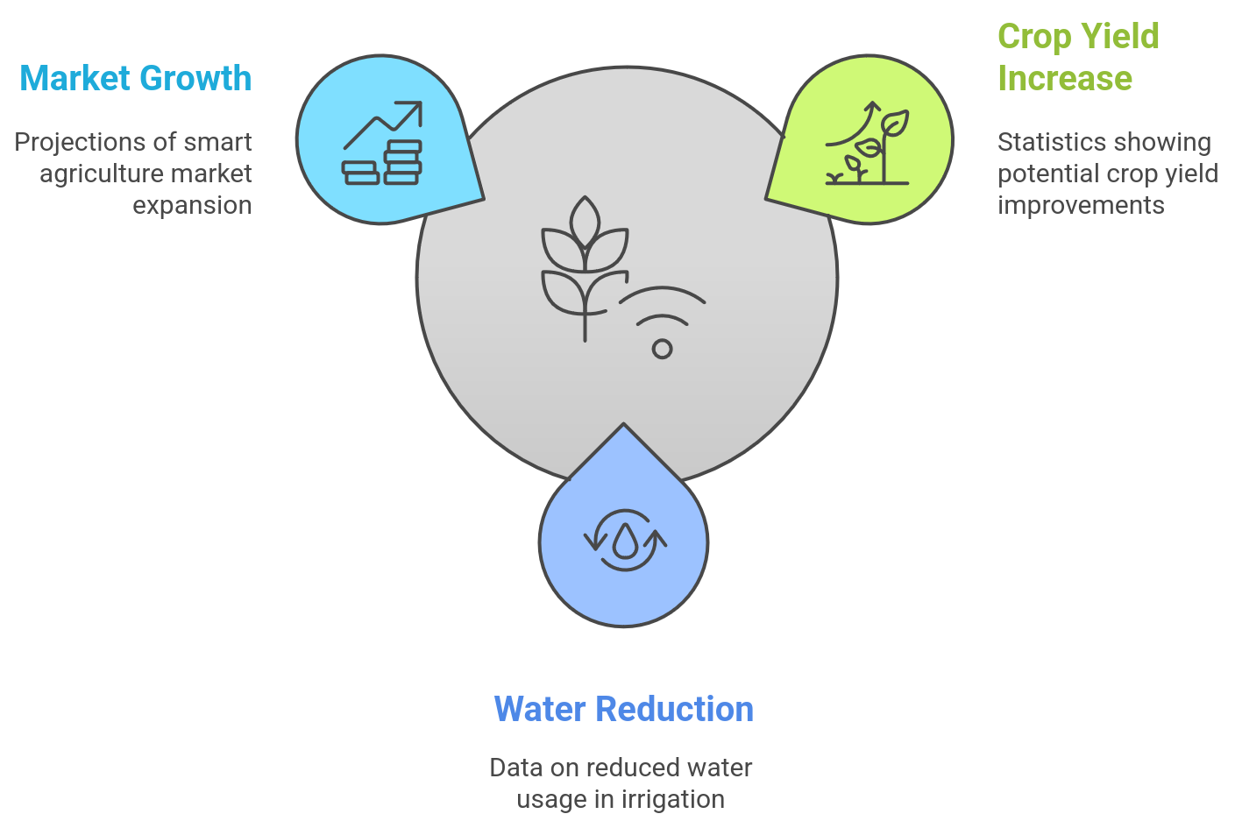
Statistics
The Opportunity: Embracing Smart Farming
Water Waste: Agriculture accounts for 70% of global freshwater withdrawals, with inefficient irrigation practices leading to 60% water loss due to runoff and evaporation. (https://www.fao.org)
Fertilizer Overuse: Up to 50% of nitrogen fertilizers applied in traditional farming methods are lost to the environment, contributing to soil degradation and water pollution. (https://www.mdpi.com)
Manual Monitoring Issues: Traditional soil monitoring methods require 25–50% more labor hours, making them inefficient and prone to 15-20% human error in data collection. (https://link.springer.com)

Slide 4
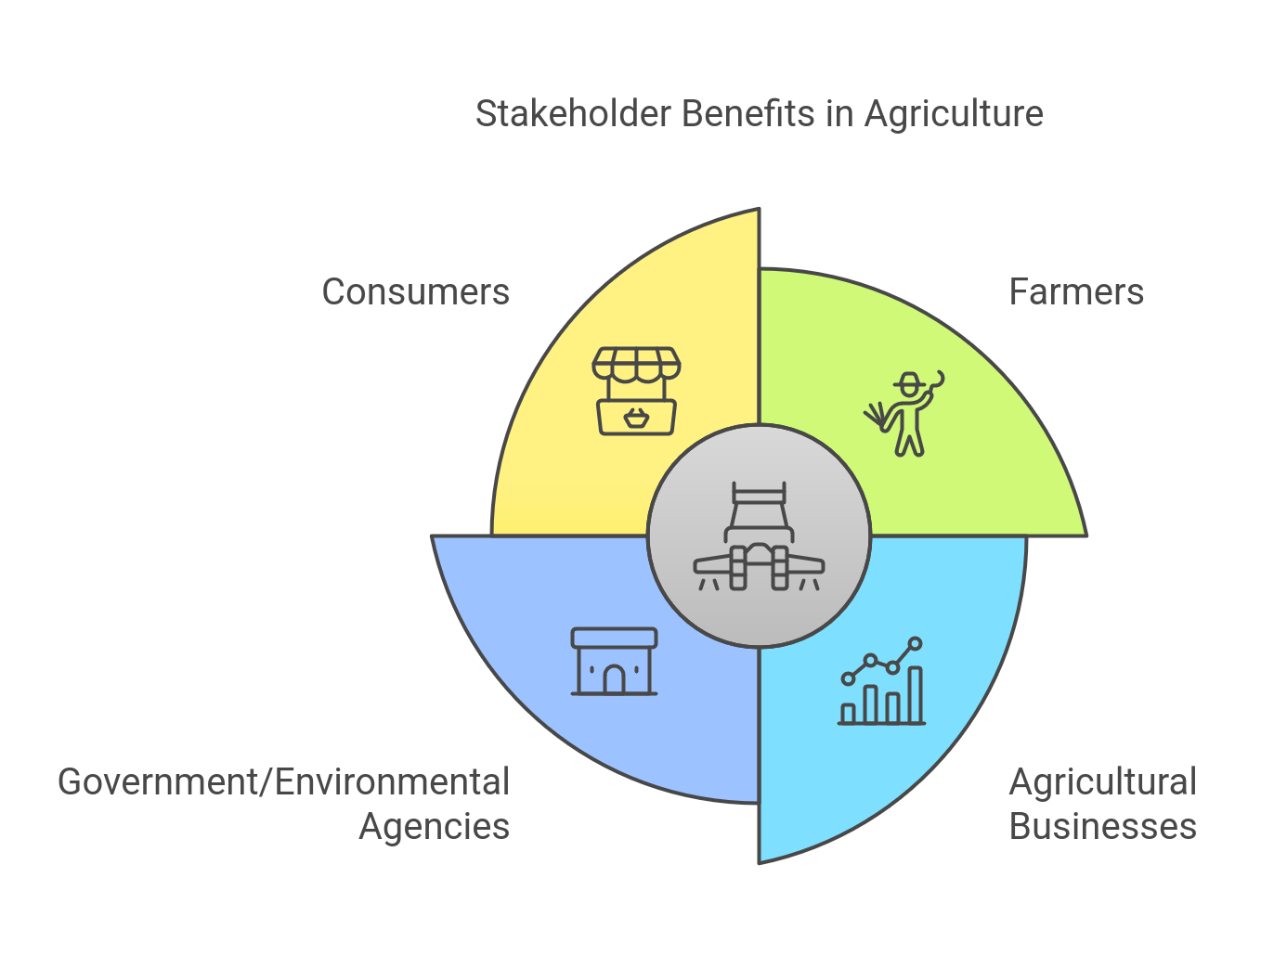
Stakeholders
Farmers: Benefit from increased yields, reduced costs, and improved sustainability.
Agricultural Businesses: Access real-time data and predictive insights to enhance decision-making and optimize resource allocation.
Government/Environmental Agencies: Promote sustainable farming practices and reduce environmental impact.
Consumers: Benefit from a stable food supply and access to high-quality produce.

Slide 5
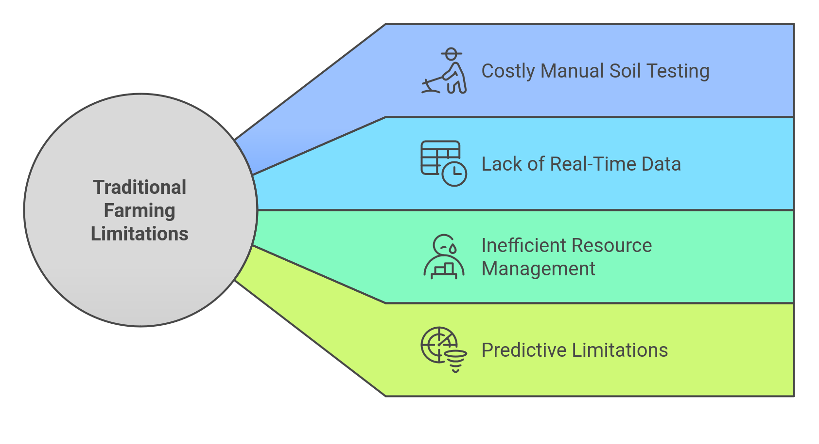
Present Scenario
Traditional Farming Limitations
Reliance on manual soil testing is infrequent and costly.
Lack of real-time data hinders timely interventions for crop health.
Inefficient resource management leads to increased costs and environmental
degradation.
Inability to predict crop performance limits proactive decision-making.

Slide 6
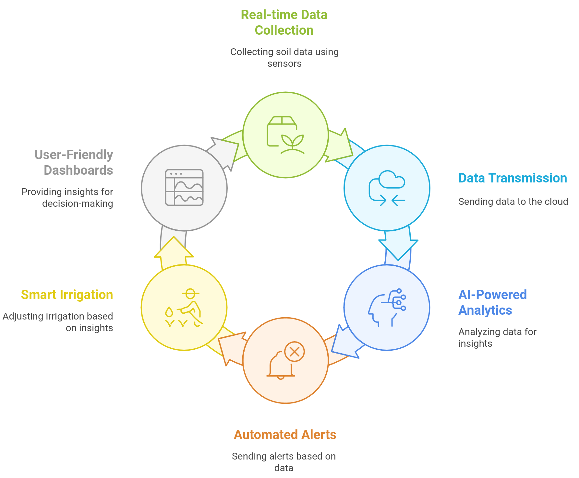
Proposed Solution - Predictive/ Preventive Maintenance
Our Solution: IoT-Based Smart Soil Monitoring
Real-time data collection using a network of soil sensors.
Data transmission to the cloud for processing and analysis.
AI-powered analytics provide actionable insights and predictive recommendations.
Automated alerts and smart irrigation based on predefined conditions.
User-friendly dashboards for monitoring and decision-making.

Slide 7
Features
Benefits
Real Time Data Capturing and Visualization
Deployment of soil sensors (pH, moisture, temperature, NPK).
Wireless communication (MQTT, HTTP) for real-time data transmission.
Secure data storage in a scalable cloud database.
AI-Powered Personalized Chabot
AI algorithms for predictive modelling of soil conditions and crop performance.
Automated alerts for critical parameters (e.g., low moisture levels).
Smart irrigation control for optimized water usage.
User-friendly UI
User-friendly dashboards with real-time data visualization.
Mobile app for remote monitoring and control.
Integration with weather data for context-aware recommendations.
Crop Yield Increase
Increased crop yields and quality.
Reduced water consumption and fertilizer usage.
Improved soil health and sustainability.
Proactive decision-making based on real-time insights.
Real Time Monitoring
Reduced operational costs through automation and optimization.
Early detection of potential crop issues, minimizing yield losses.
Improved resource efficiency, leading to long-term cost savings.
More accurate forecasting of crop performance, enabling better planning.

Slide 8
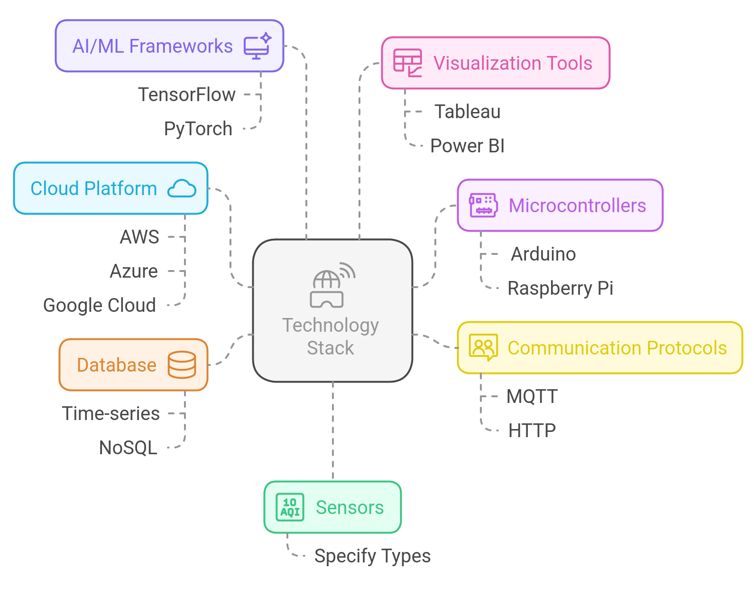
Technology Stack
Sensors: (Specify types used)
Microcontrollers: (e.g., Arduino, Raspberry Pi)
Communication Protocols: (MQTT, HTTP)Cloud Platform: (AWS, Azure, Google Cloud)
Database: (Time-series, NoSQL)
AI/ML Frameworks: (TensorFlow, PyTorch)
Visualization Tools: (Tableau, Power BI)

Slide 9
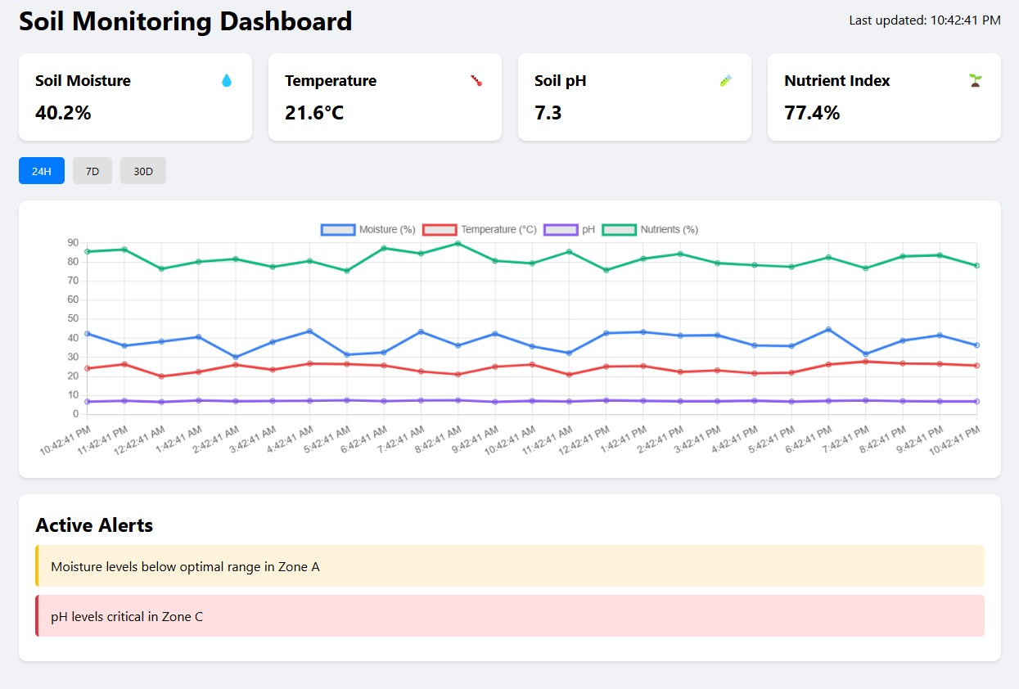

Slide 10

Thank You!
☺

