Slide 1
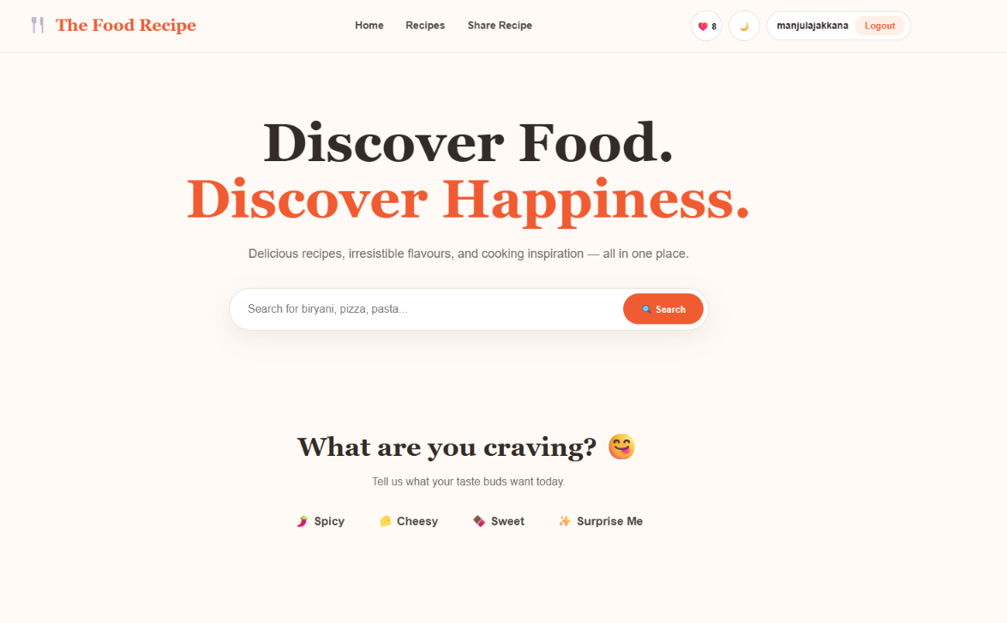
THE FOOD
RECIPE
Discover Food. Discover Happiness.
An interactive recipe discovery and sharing website built with HTML, CSS and JavaScript.
TEAM MEMBERS
ID: 2500030862 Name: P. Keerthana
ID: 2500031665 Name: T.Lashwanthi
ID: 2500032222 Name: J. D. Manjula
THE FOOD RECIPE • Project Review

Slide 2
2. Project Theme
2
A simple idea: make discovering and sharing recipes easy, visual and interactive.
Discover Food. Discover Happiness.
CORE TECHNOLOGIES
The Food Recipe is a client-side web application that helps people discover recipes, search by ingredients or categories, view step-by-step preparation, save favourites and share their own recipes.
HTML
Page structure
Problem addressed
Our solution
CSS
Finding a suitable recipe can take time when recipes are scattered across different sources.
One organized interface with search, categories, craving filters, ingredient matching and recipe details.
Design + responsive layout
JavaScript
Community idea
Personalization
Interaction + logic
Users can submit recipes, rate existing recipes and leave reviews.
Favourites and user access make the experience more personal.
Local Storage
Browser-side persistence
THE FOOD RECIPE • Project Review

Slide 3
3. User / Customer Role
3
The customer is the person who uses the website to discover and enjoy recipes.
What the user can do
Typical customer flow
• Login to access protected website features.
• Search recipes by recipe name, category or available ingredients.
• Use craving buttons such as Spicy, Cheesy, Sweet and Surprise Me.
• Browse cuisine/category collections such as Indian, Italian, Fast Food, Desserts and Healthy.
• Open a recipe to see ingredients, preparation time and step-by-step instructions.
• Add recipes to Favourites and view the saved collection.
• Give ratings and write reviews.
• Submit/share a new recipe with an image and instructions.
1
Login
2
Search / Filter
3
View Recipe
4
Favourite / Review
5
Share
In one sentence
User = consumes, searches, saves, reviews and contributes recipes.
THE FOOD RECIPE • Project Review

Slide 4
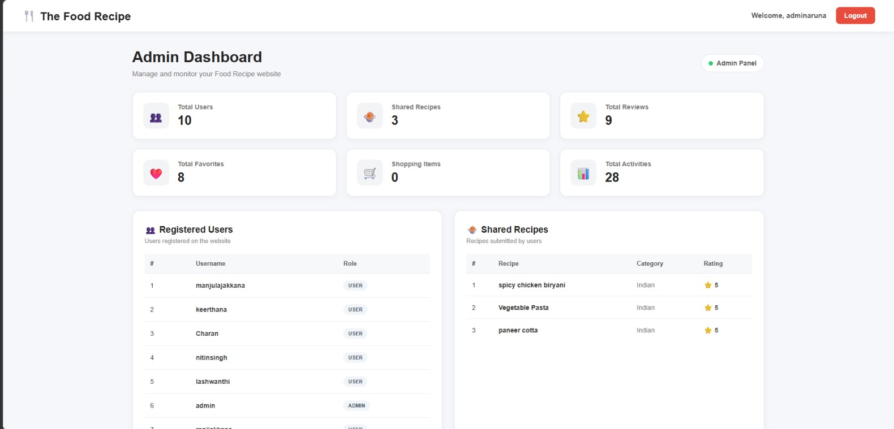
4. Admin Role
4
Management-side responsibility for controlling the recipe platform.
What an admin would manage
ADMIN DASHBOARD
• Monitor registered users and contributors.
• View submitted recipes and check their content.
• Approve, reject, edit or remove recipes when moderation is required.
• Monitor ratings, reviews and reported content.
• Remove inappropriate or duplicate content.
• View overall recipe and user activity through an Admin Dashboard.
• Maintain website rules and keep the recipe collection organized.
USERS
RECIPES
25
56
REVIEWS
SUBMISSIONS
32
8
THE FOOD RECIPE • Project Review

Slide 5
5. Technology Stack & Application Structure
5
How the three files work together.
HTML — Structure
CSS — Presentation
JavaScript — Behaviour
Navbar, hero section, search forms, recipe sections, share form, modals and footer.
Colours, typography, Grid/Flexbox, cards, buttons, responsive layout, modals and dark mode.
Search, filters, favourites, ratings, reviews, login, recipe submission, DOM updates and storage.
Supporting browser features used
DOM Manipulation
Event Listeners
JavaScript reads and updates HTML elements dynamically.
Clicks and form submissions trigger functions.
Array Methods
FileReader
Recipe data is searched and filtered using array operations.
Local recipe images can be read and displayed in the browser.
Local Storage
Login state and other client-side data can persist in the browser.
THE FOOD RECIPE • Project Review

Slide 6
6. HTML & CSS Used in the Project
6
The frontend structure and visual design.
HTML example — navigation + login
CSS example — responsive Grid + hover
<nav>
<a href="#home">Home</a>
<a href="#recipes">Recipes</a>
<a href="#share">Share Recipe</a>
<button id="loginBtn">🔐 Login</button>
</nav>
.recipe-grid {
display: grid;
grid-template-columns:
repeat(auto-fit, minmax(280px, 1fr));
gap: 28px;
}
.recipe-card:hover {
transform: translateY(-7px);
}
Important HTML sections
Important CSS techniques
• Navigation bar and page links
• Hero / welcome section
• Search and ingredient forms
• Craving and category filters
• Recipe cards and recipe modal
• Share recipe form, favourites and footer
• CSS Grid for recipe cards
• Flexbox for aligned controls
• Rounded cards, shadows and hover effects
• Responsive layout using auto-fit
• Modal styling and dark-mode styles
• Consistent food-themed visual language
THE FOOD RECIPE • Project Review

Slide 7
7. JavaScript, Login & Data Handling
7
JavaScript connects the interface to the application's features.
JavaScript example — search + access control
Local Storage — login state
function searchRecipes() {
if (!requireLogin("Please login first...")) return;
const search =
document.getElementById("searchInput")
.value.toLowerCase().trim();
const filtered = recipes.filter(recipe =>
recipe.name.toLowerCase().includes(search) ||
recipe.category.toLowerCase().includes(search)
);
}
localStorage.setItem(
"foodRecipeLoggedIn", "true"
);
localStorage.setItem(
"foodRecipeUsername", username
);
Main JavaScript responsibilities
Client-side image handling
• Store recipe data in JavaScript arrays/objects
• Filter and search recipes dynamically
• Open recipe details and update the DOM
• Handle favourites, ratings and reviews
• Handle login/logout and protected actions
• FileReader reads a selected local image
• Image data can be previewed before/after submission
• No external image URL is required for the share form
• Production version: server/cloud storage would be preferable
THE FOOD RECIPE • Project Review

Slide 8
8. Features Added to the Food Recipe App
8
The project combines discovery, personalization and community features.
🔎 Smart Search
🥕 Ingredient Finder
Search recipes using names, categories and ingredients.
Enter available ingredients and find matching recipes.
😋 Craving Filters
🍽️ Categories
Spicy, Cheesy, Sweet and Surprise Me options.
Indian, Italian, Fast Food, Desserts and Healthy.
❤️ Favourites
⭐ Ratings & Reviews
Save recipes and view the favourite collection.
Rate recipes and write feedback.
📤 Share Recipe
🔐 Login Access
Submit a recipe with ingredients, instructions and image.
Login controls access to protected website actions.
🌙 Dark Mode
🧑‍🍳 Community Recipes
Switch the interface to a darker theme.
User-submitted recipes appear as community content.
THE FOOD RECIPE • Project Review

Slide 9
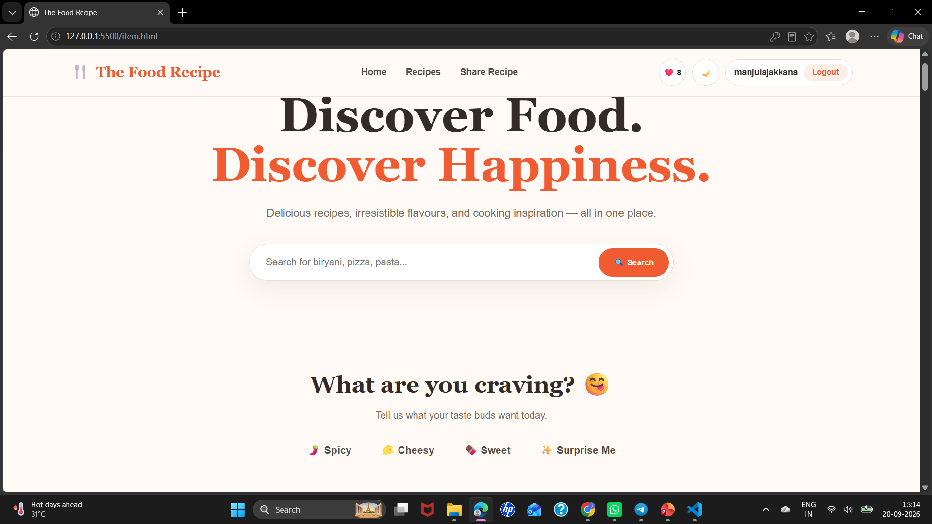
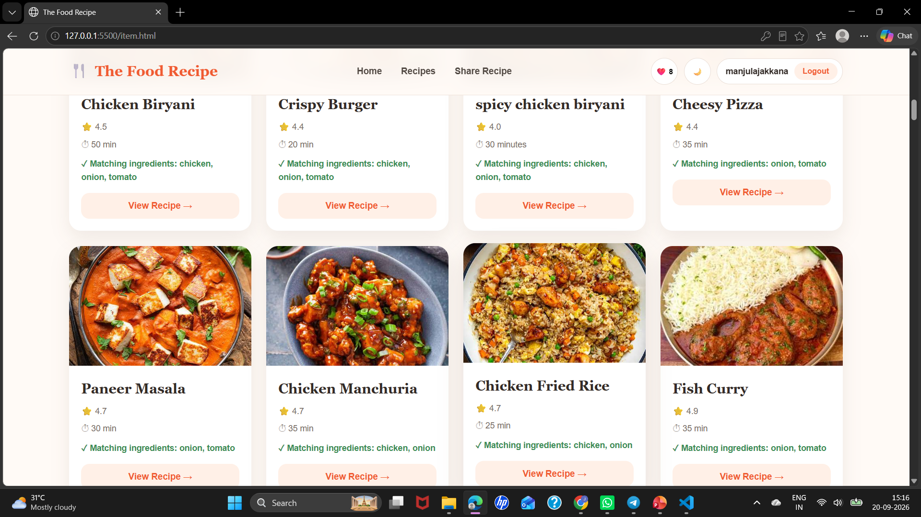
9. Website Output & User Experience
9
Screenshots from the Food Recipe project.
Home page • search • craving • categories
Recipe details • ingredients • preparation • review
Ingredient finder • matching recipes
The screenshots show the actual project interface: recipe cards, interactive recipe details, ratings/reviews and ingredient-based discovery.
THE FOOD RECIPE • Project Review

Slide 10
10. Impact, Limitations & Future Scope
10
What the project achieves and how it can grow into a full application.
How it helps
Current technical scope
Future enhancements
• Saves time while finding recipes
• Makes recipe discovery visual and organized
• Supports ingredient-based cooking
• Encourages sharing and community feedback
• Client-side HTML/CSS/JavaScript
• Browser-side Local Storage
• Dynamic DOM updates
• Local image preview/handling
• Frontend login/access control
• Backend + database
• Centralized Admin Dashboard
• Secure authentication
• Cloud image storage
• Multi-device user activity
• Analytics and notifications
Final project flow
User Login
Discover / Search
View Recipe
Favourite / Review
Share Recipe
Conclusion: The Food Recipe project is a user-friendly frontend application that combines recipe discovery, personalization, community contribution and interactive JavaScript functionality in one website.
Thank You
THE FOOD RECIPE • Project Review

