Slide 1
Investment Tracker and Risk Manager

Slide 2
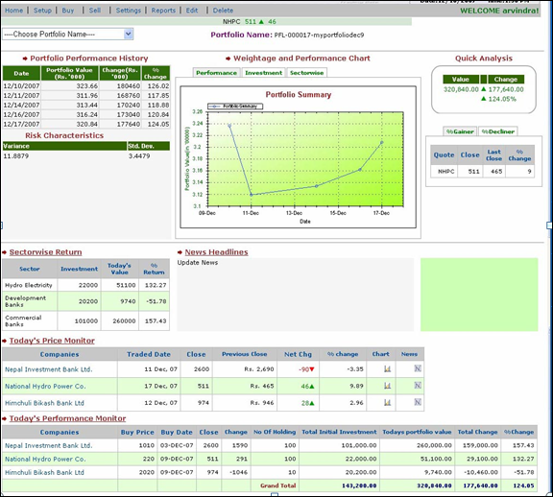
Now you are at your portfolio homepage.
You will see following menus Home
Setup
Buy
Sell
Settings
Reports
Edit and
Delete.
Click on setup to have new portfolio.

Slide 3
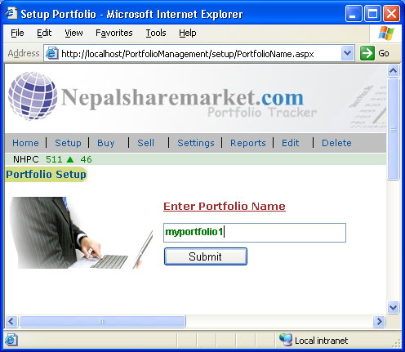
Type your new portfolio name e.g. myportfolio1
Click on submit button.

Slide 4
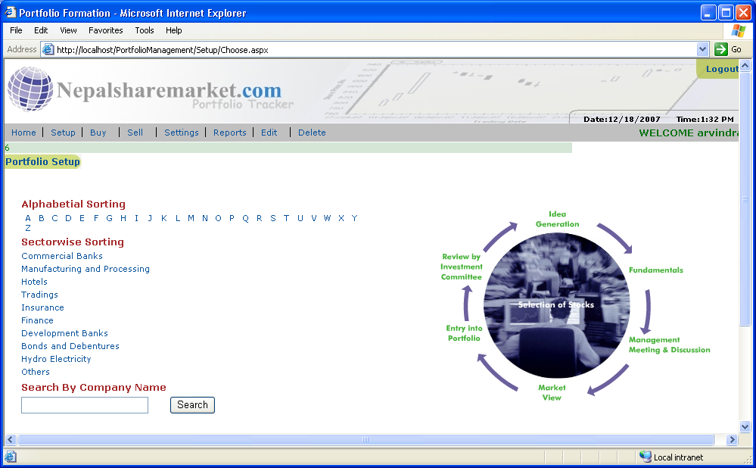
You will have company selection window.
(You have a option to see your companies with alphabetical and sector wise listing or can also search by typing company name.)
For example click on commercial banks

Slide 5
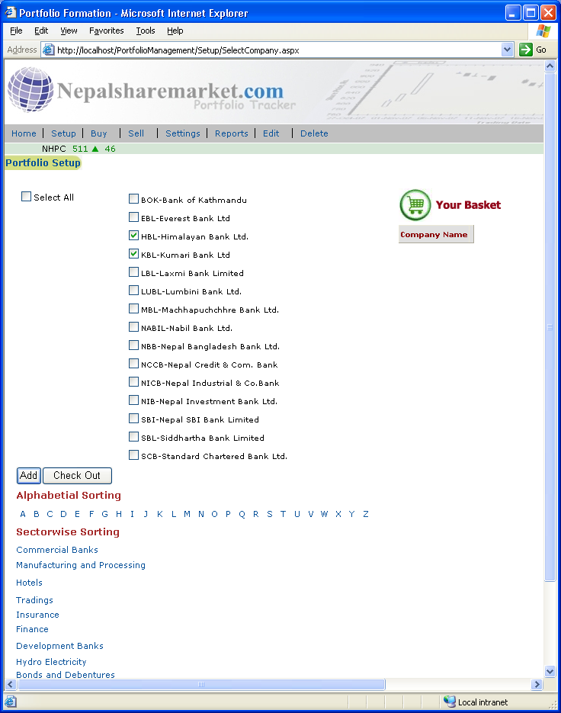
Now select the companies as below. For example I am selecting Kumari Bank and Himalayan Bank.
Click on Add button.

Slide 6
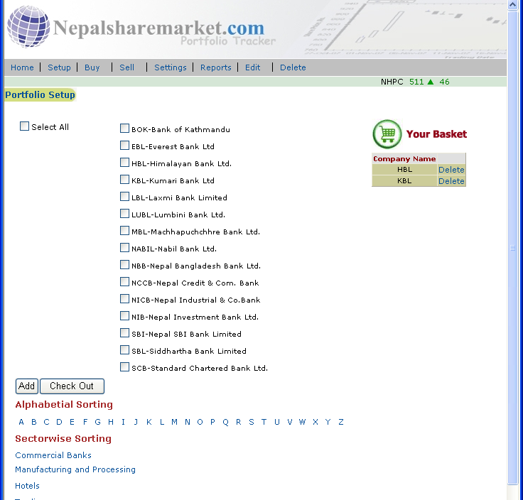
Now you will see the list of selected companies at right side.
If you want to add more companies go to another sectors. For example
I am adding from Development banks.
Click on Development banks.

Slide 7
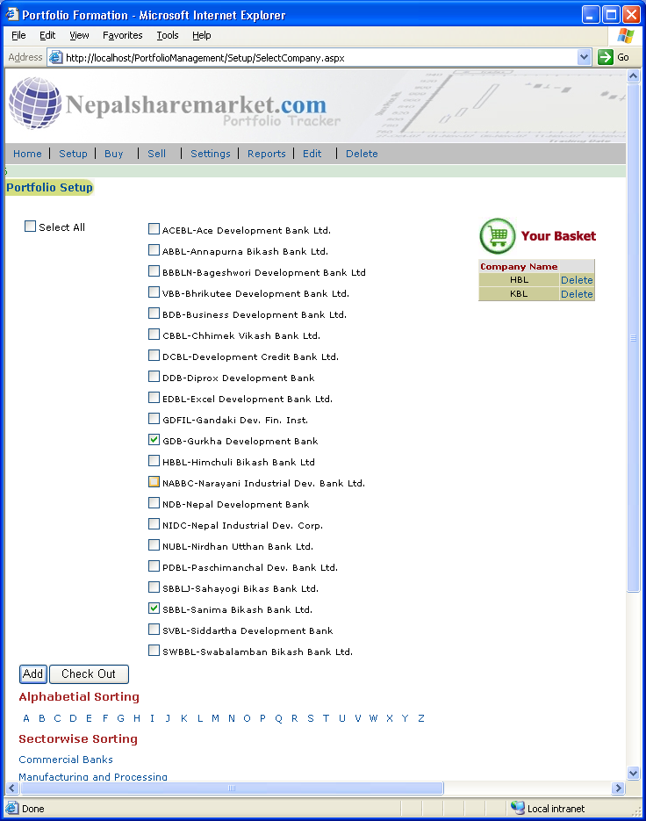
For example I am selecting Sanima Bikash Bank and Gurkha Development Bank.
Click on Add again.

Slide 8
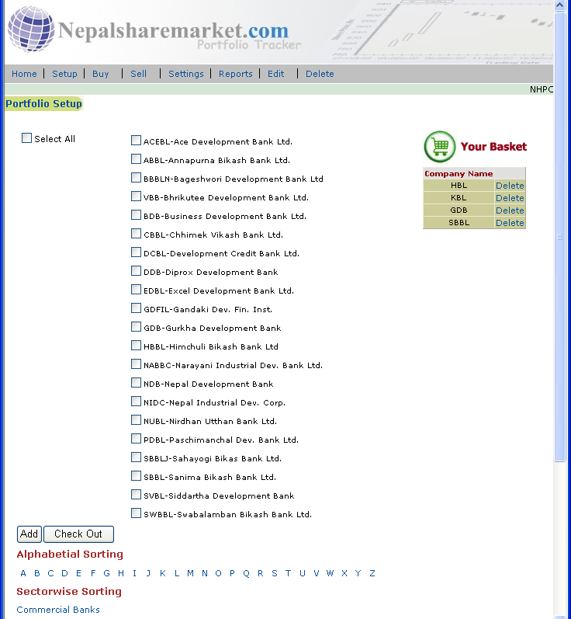
Now you have 4 companies selected for your portfolio.
Now Click on Check out button for next step.

Slide 9
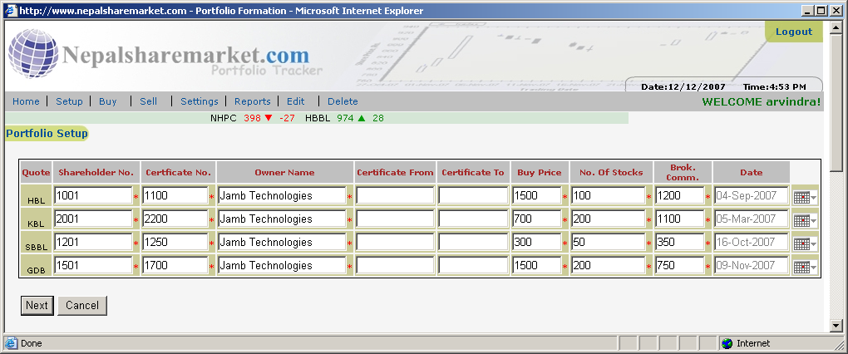
Now Enter all the Data for your selected companies.
(* indicates necessary fields.)
Enter the Brokerage Commission in Total as in Bill software automatically divides it by number of stock and adds in Buy Price.
Click on Next button.

Slide 10
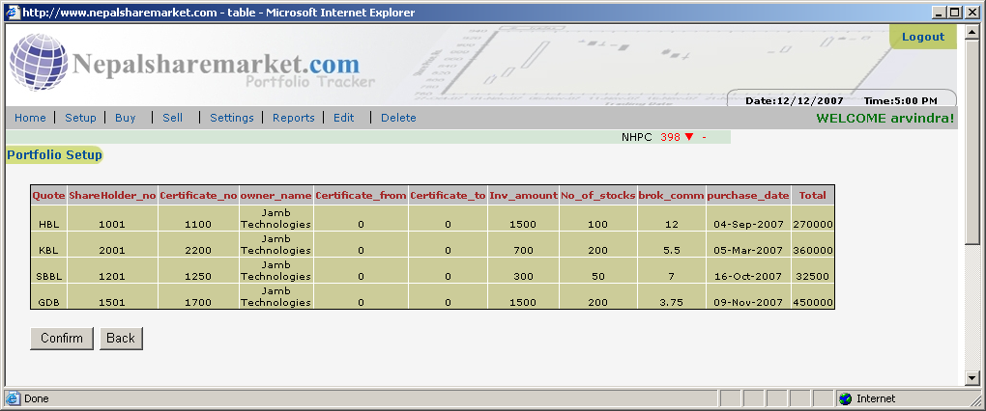
Review your entered data and Click confirm button to finalize your data entry.

Slide 11
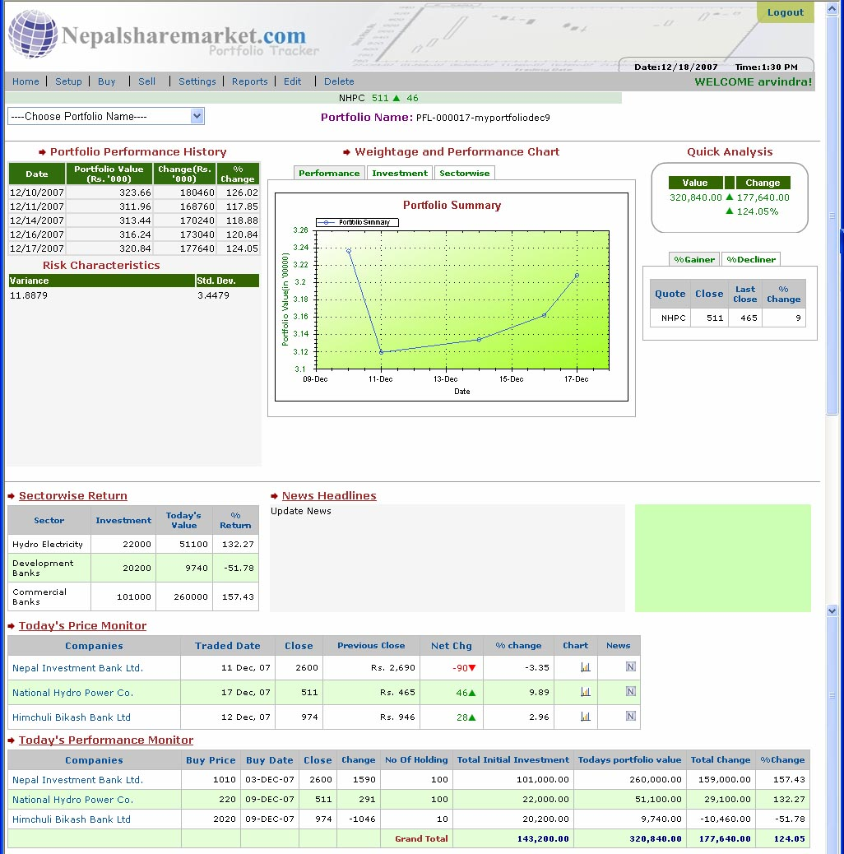
The above Picture is your portfolio page where u can see.
Today's Quick analysis
(Today's Portfolio Value, +/-Profit or Loss Value and Profit/Loss percentage)
Portfolio Performance History
Performance Line Chart
Investment Pie Chart
Sector Wise Investment Chart
Sector wise Return
Updated News
Today's Daily price monitor of your selected companies
Today's Performance Monitor
Today's Gainer (Profit) List
Today's Decliner (Loss) List

Slide 12
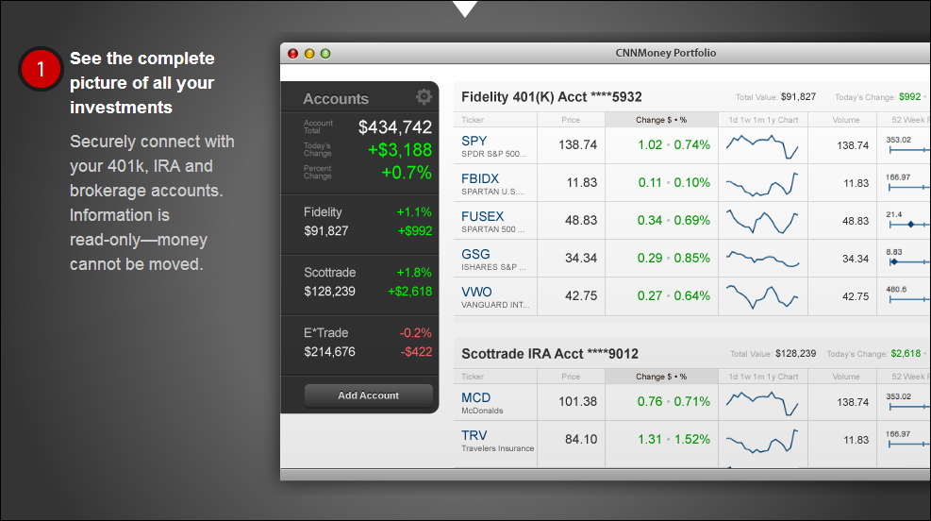
Detailed View of Companies in Portfolio

Slide 13
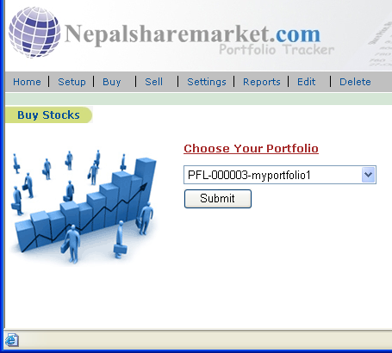
Buy Module
Click on Buy button at menu.
Select your portfolio name in which u want to add a new stock and click on Submit.

Slide 14
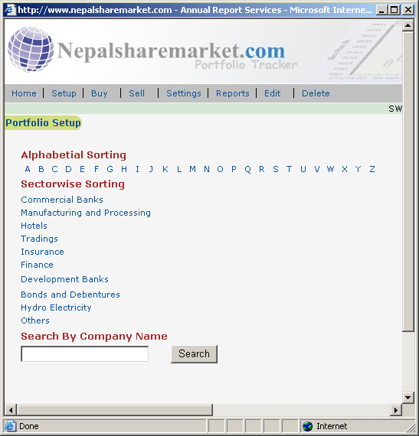
You will have the same window and in Setup.
So Go thru the same process as in setup.

Slide 15
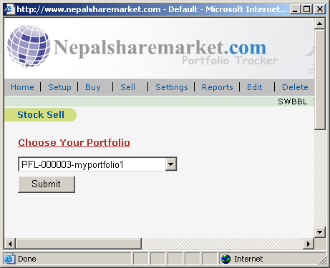
Sell Module
Click on Sell button at menu.
Select your portfolio from which you are selling stock and click on Submit.

Slide 16
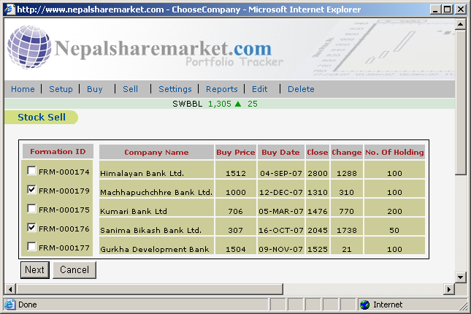
Select the company names of which you are selling shares and Click on Next.

Slide 17
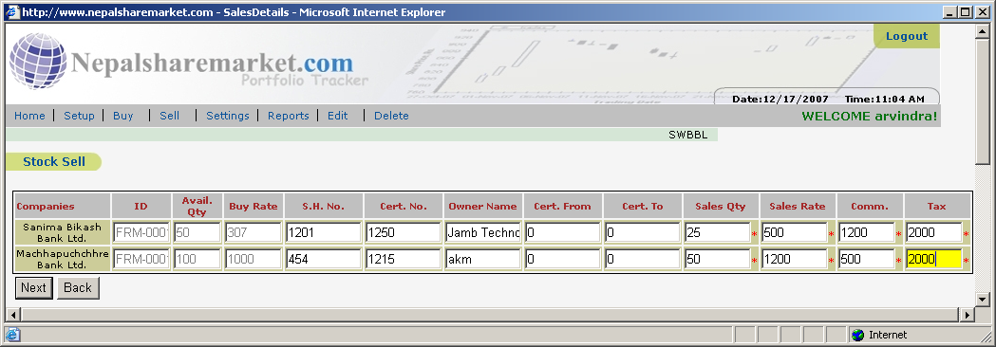
Sell Stock Entry
Enter the Sales Qty.
Sales Rate
Total Commission as in your Bill.
Total Tax as in your Bill.
Click on Next

Slide 18
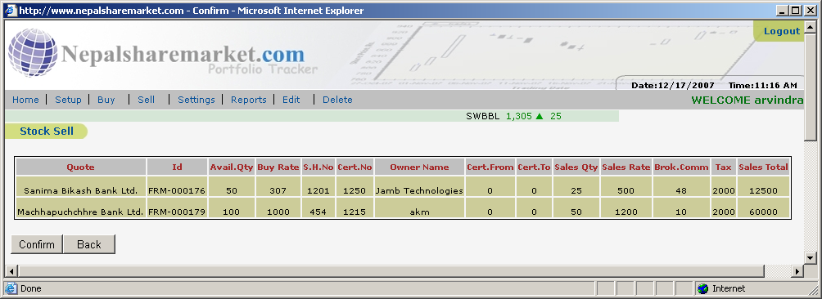
Preview your entry
Click on Confirm to finalize or
Back to Modify your entry.

Slide 19
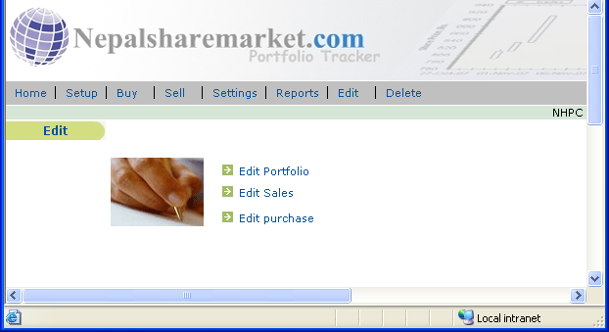
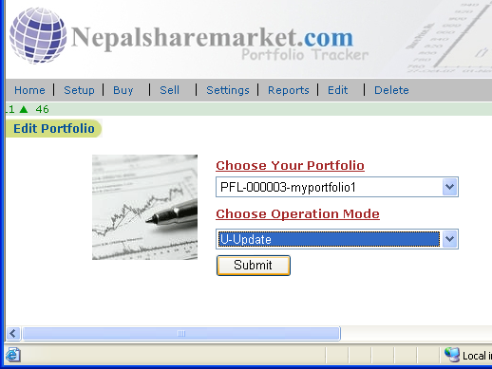
Edit Existing Portfolio

Slide 20
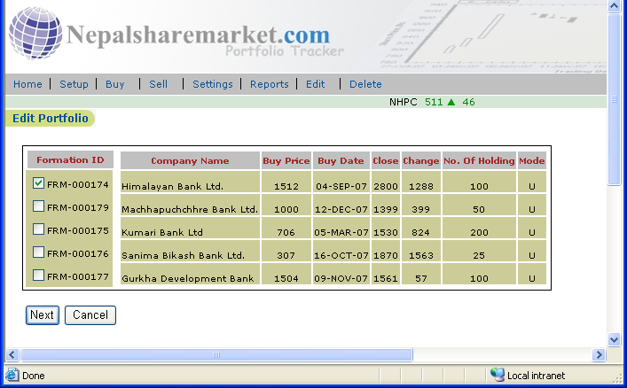
Select the Companies to modify.

Slide 21
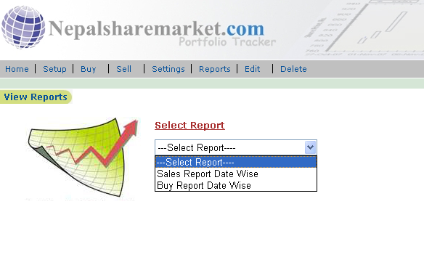
Reports I
Can View and Print your Report with different criteria (Buy and Sell History).

Slide 22
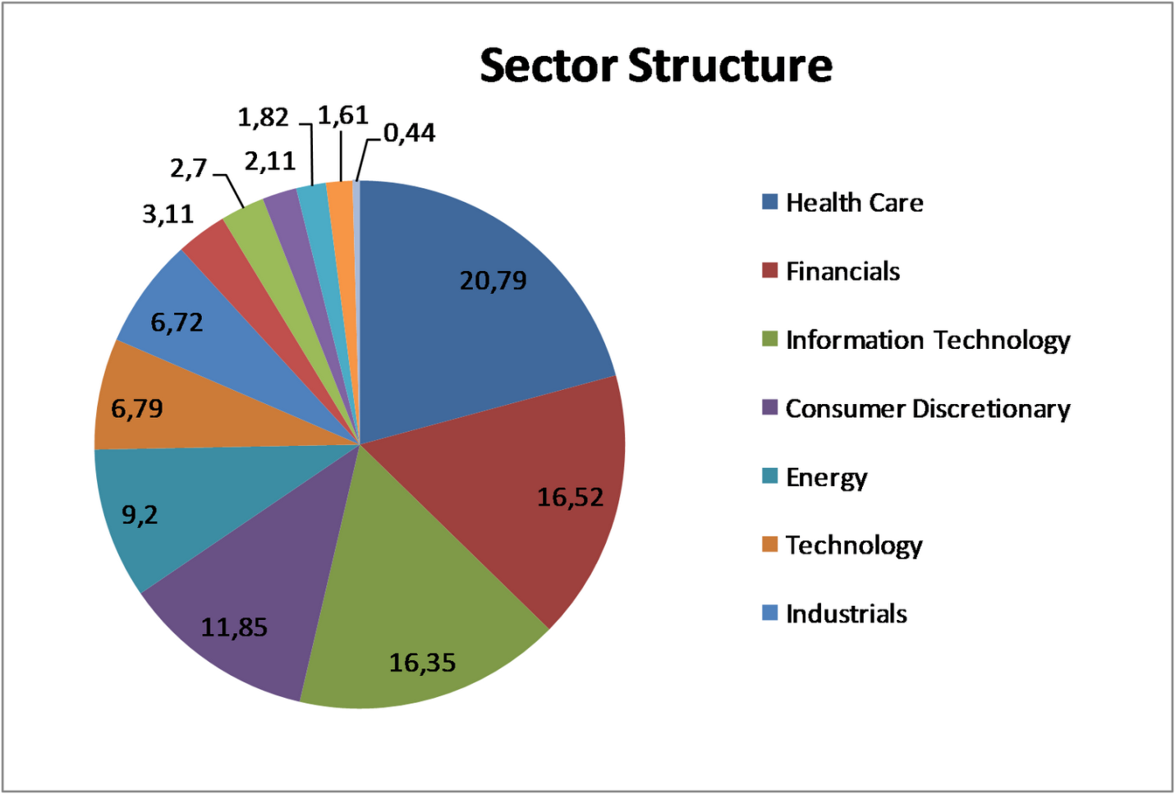
Reports I
Reports on Sectorial allocation (Banking, Hydro, Hotels, Insurance)

Slide 23
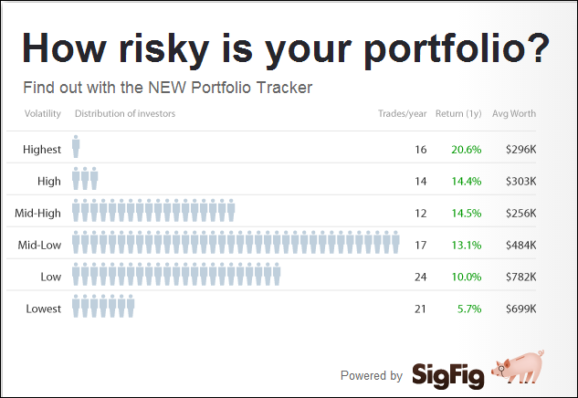
Reports III
Reports on riskiness of portfolio

Slide 24
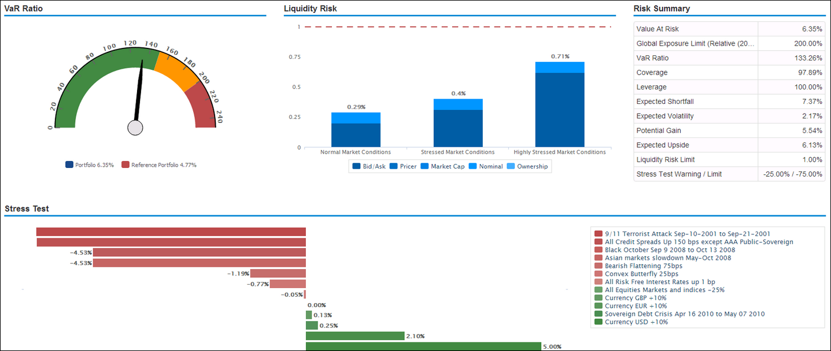
Reports IV
Complex Reports. Data saved from Nepes in Database. Needs to be able to do complex calculation based on mathematical modellings and produce graphs

Slide 25
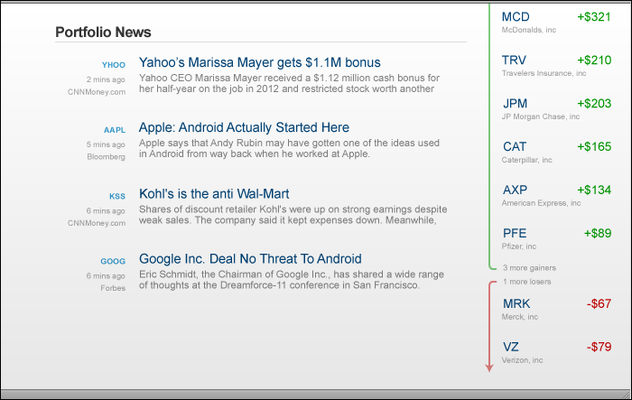
Portfolio News
News from around the internet related to the companies in the portfolio

Slide 26
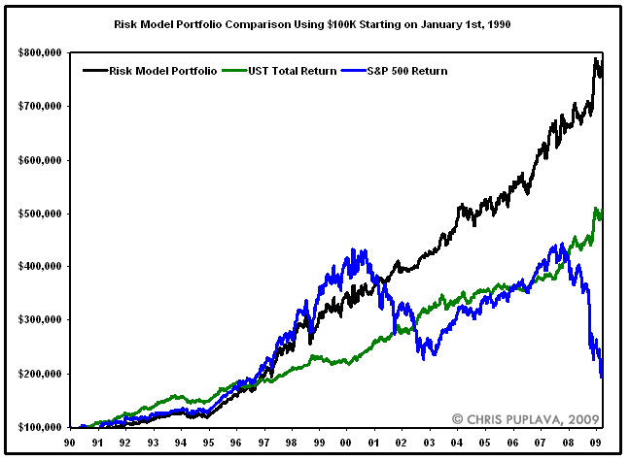
Portfolio Comparison to Market
Comparison of the performance of the portfolio to other the benchmark indices (data will be provided).

Slide 27
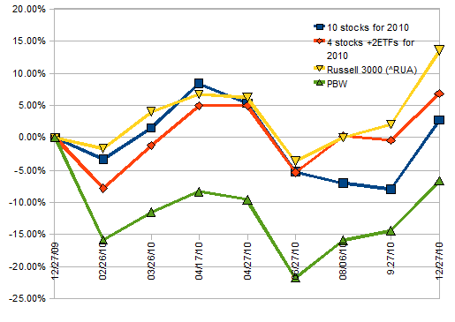
Portfolio Comparison to Other Portfolios
Comparison of the performance of the portfolio to other portfolios (data to be extracted from Nepse web).

Slide 28
The End

