Slide 1
AIDL + Ansible on Good Shepherd
Discover
Using AI-assisted delivery with Ansible as the execution layer for repeatable Azure releases.
Design
Build
Deploy
Verify
Learn
AI proposes. Ansible applies. Tests prove. Humans approve. Operations observe.
Good Shepherd Azure delivery path
1
Notes:
Open by positioning AIDL as the lifecycle and Ansible as the control point.
Emphasize that the GS project already contains the pieces for an auditable release path.
[Sources]
- README.md, 'AI-DLC Workflow with Ansible at the Centre', lines 1-42.
- README.md, 'Simple narrative', lines 75-82.
- README.md, 'GS POV Harness Agent Azure Deployment', lines 85-91.

Slide 2
AIDL turns intent into controlled delivery work
AIDL contribution
GS project expression
Converts business change into acceptance criteria and target state.
A single deployment playbook handles preflight, source staging, Azure auth, deploy, and verify.
Drafts task breakdowns, playbook structure, and environment variables.
Dev and staging JSON files make environment promotion explicit.
Surfaces review points for risky changes, secrets, and production promotion.
The console lets teams choose a bastion and watch live Ansible stages.
2
Notes:
Use this slide to connect the AI-DLC concept to concrete GS repository assets.
The key message is that AIDL is useful when its output becomes versioned, reviewable automation.
[Sources]
- README.md, 'What the flow does', lines 5-24.
- README.md, 'Deployment Console', lines 229-259.
- config/environments/dev.json and config/environments/staging.json.

Slide 3
Ansible makes the GS release path repeatable
The same playbook runs from a Linux bastion, stages code, authenticates to Azure, deploys, and verifies the live app.
Preflight
Source
Azure auth
Deploy
Verify
Validate settings and bootstrap bastion packages.
Use copy, git, or existing checkout strategy.
Use existing login, managed identity, or service principal.
Run app-only update or Terraform-backed stack flow.
Check Container App revision and application endpoints.
Delivery benefit: one automation contract can be run by a person, the UI console, or a CI/CD runner.
3
Notes:
Walk left to right as the operational delivery path.
Call out that source staging was intentionally designed to avoid requiring GitHub keys on the bastion.
[Sources]
- README.md, GS deployment prerequisites and source strategies, lines 100-137.
- playbooks/deploy_gs_pov_harness_agent.yml task sequence: preflight, source sync, Azure login, deploy, verify.
- README.md, Terraform failure skip behavior, lines 197-204.

Slide 4
Workflow architecture keeps control close to delivery
AIDL shapes the work; CI chooses the gate; Ansible executes from the bastion; Azure returns verification evidence.
AIDL + Git
CI/CD runner
Linux bastion
Azure platform
Intent
Acceptance criteria
Playbook changes
Environment vars
Syntax and lint
Env selection
Trigger playbook
Store evidence
Ansible controller
Source sync
Azure CLI auth
Deployment logs
ACR image build
Container App
PostgreSQL
Health endpoints
Feedback loop: deployment output, failed stages, endpoint checks, and review decisions feed the next AIDL iteration.
4
Notes:
Use this as the architecture slide: it shows where AIDL, CI, Ansible, the bastion, and Azure each own part of delivery.
The important design choice is that Ansible remains the execution contract, whether triggered by a person, the UI, or CI.
[Sources]
- README.md, 'Core components', lines 30-42.
- README.md, 'Deployment Console', lines 229-259.
- README.md, 'Dev Bastion Infrastructure', lines 264-300.
- playbooks/deploy_gs_pov_harness_agent.yml task sequence and Azure verification tasks.

Slide 5
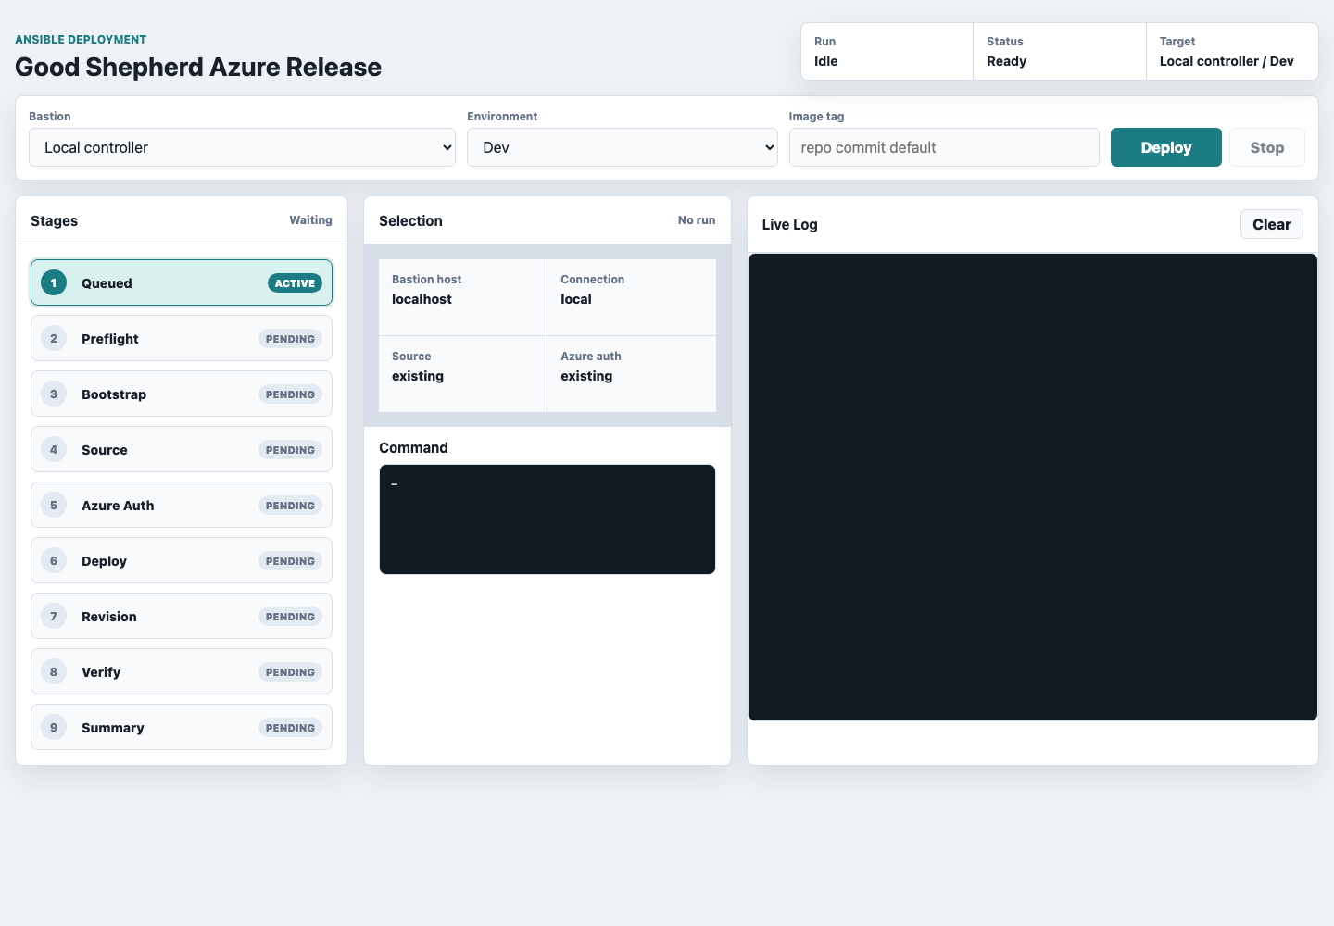
The deployment console makes Ansible delivery visible
Teams can choose the bastion and environment, trigger the playbook, and watch stages and logs in one place.
What the UI adds
Bastion dropdown for local, dev, or staging control points.
Environment files become selectable release inputs.
Stage status and live logs expose deployment progress.
This turns a command-line playbook into a delivery cockpit without changing the underlying Ansible contract.
5
Notes:
Use the screenshot to make the delivery model tangible.
The UI does not replace Ansible; it wraps the same playbook in a safer operator experience.
[Sources]
- Screenshot captured locally from deployment_console/server.py at http://127.0.0.1:8766/.
- deployment_console/static/index.html and deployment_console/static/app.js.
- deployment_console/server.py API routes for bastions, environments, deployments, logs, and events.

Slide 6
In CI, Ansible becomes the promotion contract
AIDL improves the work entering the pipeline; Ansible standardizes what the pipeline actually does.
CI moment
AIDL contribution
Ansible control
Delivery outcome
Pull request
Generate criteria, risks, and test ideas.
Run syntax, lint, and idempotency checks.
Automatable review gate.
Dev deploy
Translate change intent into vars and runbook updates.
Run playbook against dev bastion and dev env file.
Fast, repeatable validation.
Stage promote
Summarize changes and unresolved risks.
Reuse same playbook with staging variables.
Same logic, new target.
Release gate
Explain failure signals and next fixes.
Verify endpoints and Container App revision health.
Evidence-backed approval.
6
Notes:
This slide is the CI/CD operating answer: let AIDL shape the inputs and Ansible enforce the delivery contract.
Emphasize that dev/staging config files make promotion explicit without changing the playbook logic.
[Sources]
- README.md, 'Core components', lines 30-42.
- README.md, validation and CI/CD flow, lines 15-23 and 38-41.
- config/environments/dev.json and config/environments/staging.json.

Slide 7
Use the pattern as a delivery operating model
Standardize
Govern
Learn
Keep one playbook path across environments.
Approve RBAC, secrets, and risky infra.
Feed deployment logs back into AIDL prompts.
Treat env files and inventory as release inputs.
Let CI run validation before promotion.
Convert recurring fixes into playbook updates.
Make bastion source strategy explicit.
Keep identity paths clear.
Use verification as delivery evidence.
Practical next step: wire CI to run syntax/lint on PRs, deploy to dev on merge, and promote with the same Ansible playbook plus environment-specific vars.
7
Notes:
Close by making the recommendation practical: keep AI-assisted planning, Ansible execution, and CI evidence connected.
This is not a separate process; it is a disciplined way to use the assets already in the GS automation repo.
[Sources]
- README.md, 'Suggested lifecycle', lines 44-72.
- README.md, 'Example control points', lines 67-73.
- README.md, deployment console and bastion infrastructure sections, lines 229-300.

