Slide 1
FACULTY ADVISORY SYSTEM OF NITC
Prepared by:
V Rohith
P B V Krishna
R Prathap Reddy
V Manjunath

Slide 2
INTRODUCTION
This System is designed to computerize the current existing paper based system.
It provides tools for retrieving the personal data and data regarding the grades of individual students and also to get list of students with some filters.

Slide 3
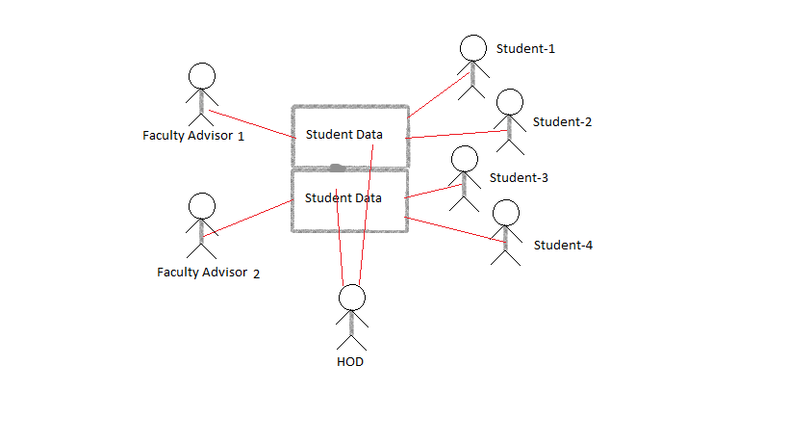
DESCRIPTION

Slide 4
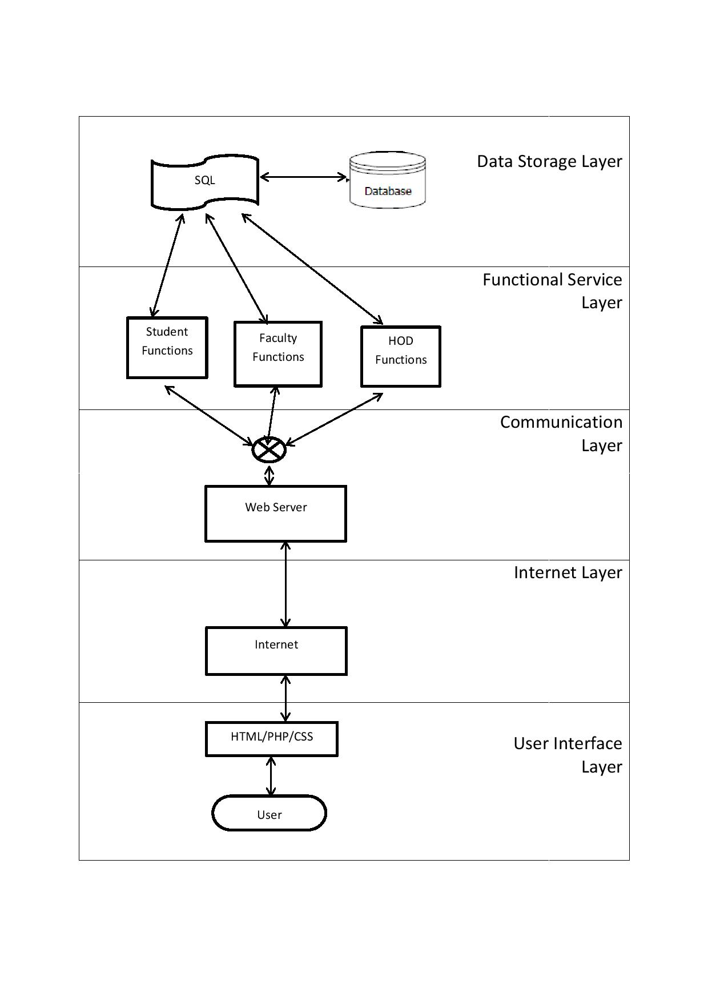
ARCHITECTURAL DESIGN

Slide 5
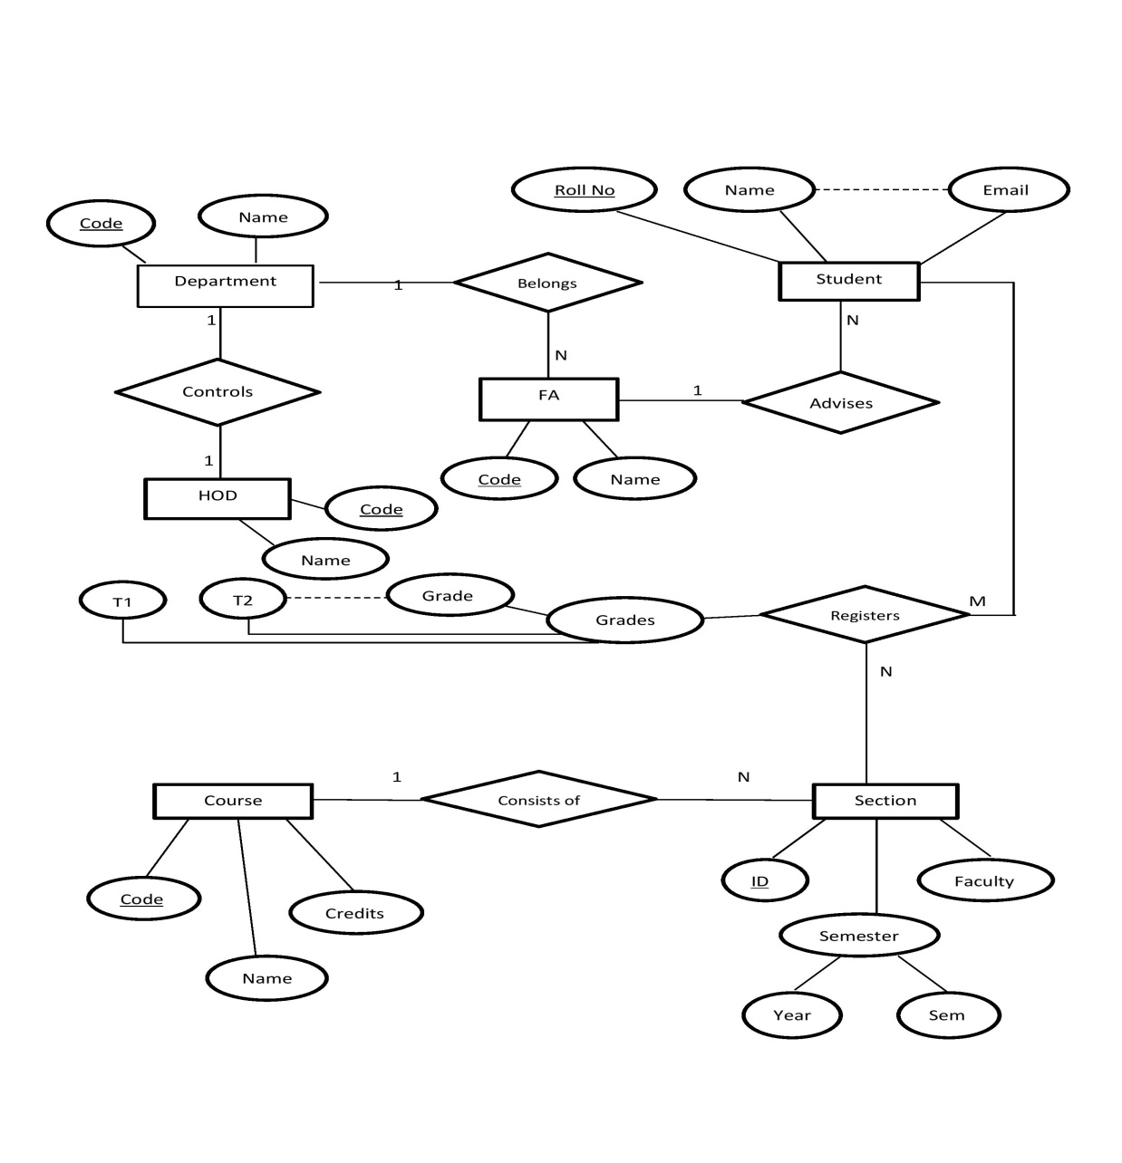
ER DIAGRAM

Slide 6
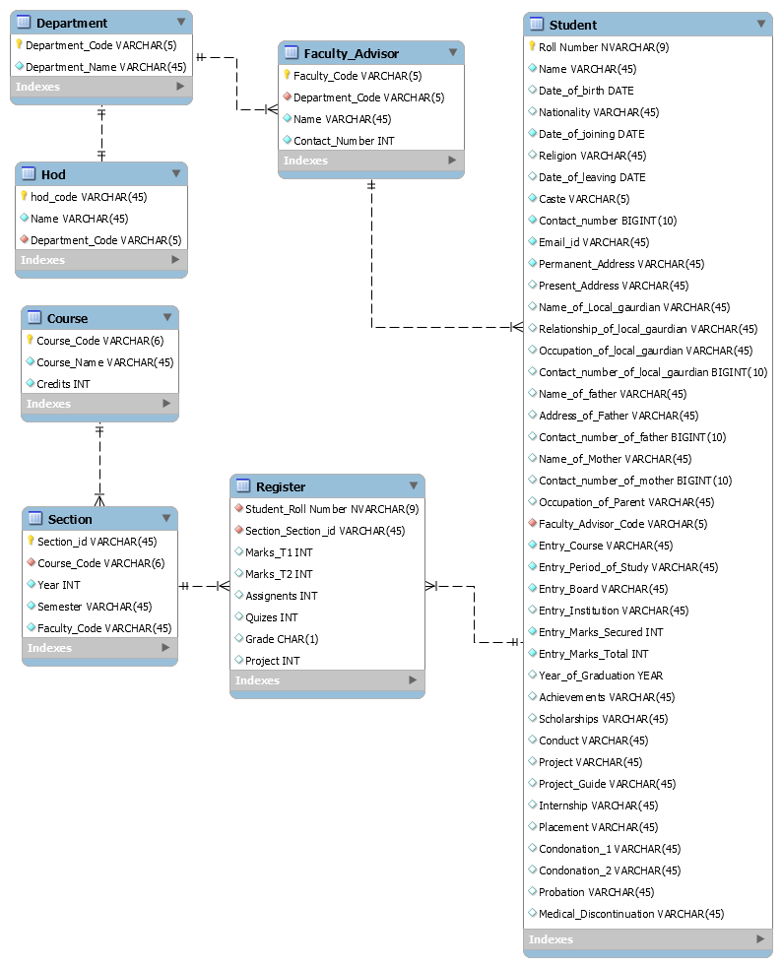
RELATIONAL SCHEMA
List of tables used:
Student
Faculty Advisor
HOD
Department
Course
Section
Register
In addition to those mentioned above the following tables are also used:
Login
Messages

Slide 7
NORMALIZATION
Wondering why we need an additional table for Course? (i.e., Why can’t we embed Course information into Section table itself?)
Well, The answer turns out to be Normalization
Which Normal form our Relational Schema is in?

Slide 8
NORMALIZATION(2)
1NF?
Yes, By definition, It doesn’t have any composite attributes or nested relations.
2NF?
Yes, All our relations except ‘Registers’ and ‘Section’ consists of a single attribute in primary key and in the above two relations all other attributes fully depend on the primary key.

Slide 9
NORMALIZATION(3)
3NF?
Yes, Our design is in 3NF since there are no transitive dependencies.
Note: If we had combined ‘Section’ and ‘Course’ tables as a single table that schema would not have been in 3NF.

Slide 10
NORMALIZATION(3)
BCNF?
Yes, Our design is in BCNF since no prime attributes are dependent on non prime attributes.
Hence our Relational Schema is in BCNF

Slide 11
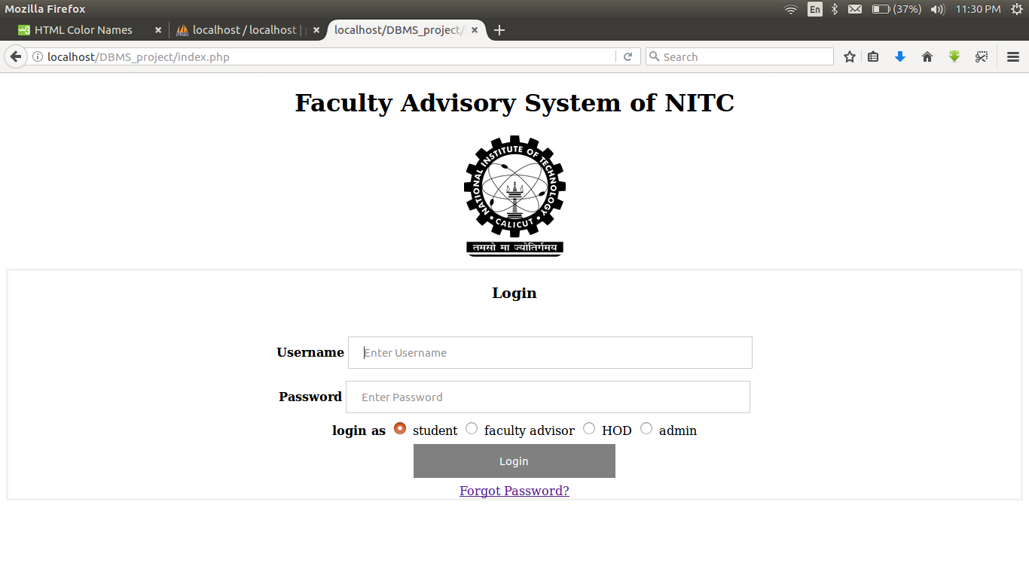
LOGIN
A user can login with username and password provided.
Four types of logins are available one each for Student, FA, HOD and Admin

Slide 12
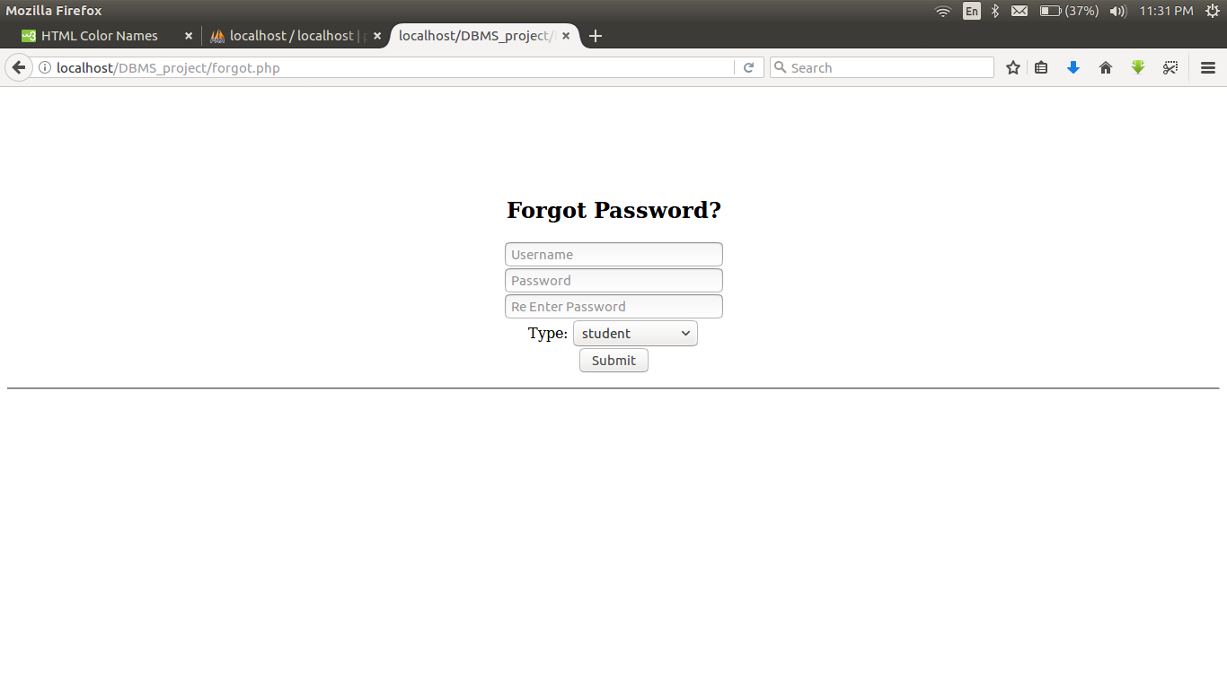
FORGOT PASSWORD
User can change his password by entering his username and new password

Slide 13
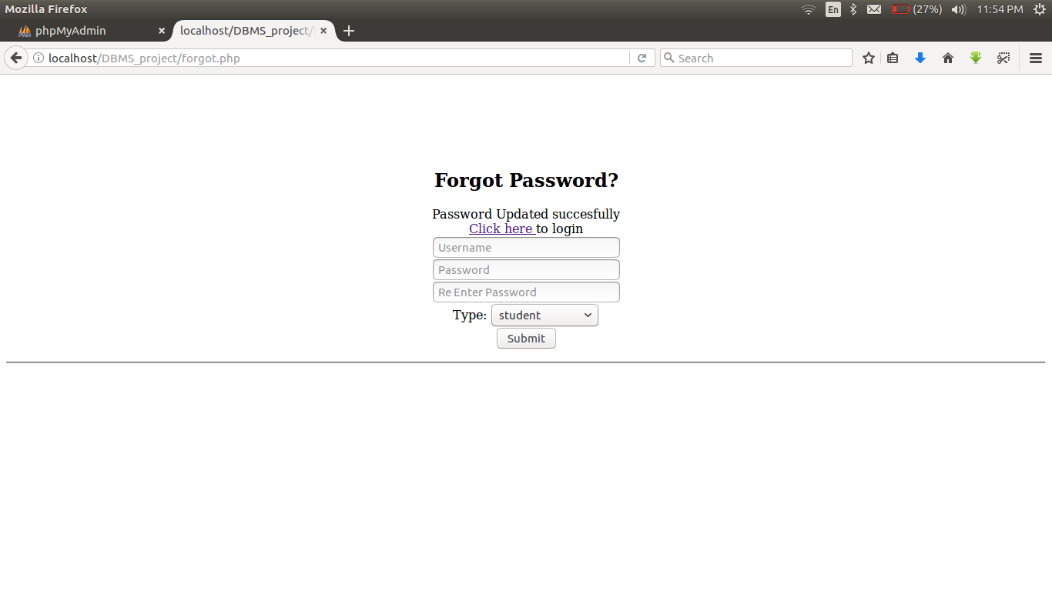
FORGOT PASSWORD(2)
Upon successful updation the user can login again through the link provided

Slide 14
WHO IS ADMIN?
Admin is someone who can execute privileged operations on the database.
Those include
Adding/Deleting Users
Adding Courses
Adding Sections at the beginning of each semester

Slide 15
WHAT IS A SECTION
In our context section is something which uniquely differentiates all courses that are being offered in same/different semesters by same/different faculty members.
We used a section id which will be uniquely generated for every section being added by Adimin.

Slide 16
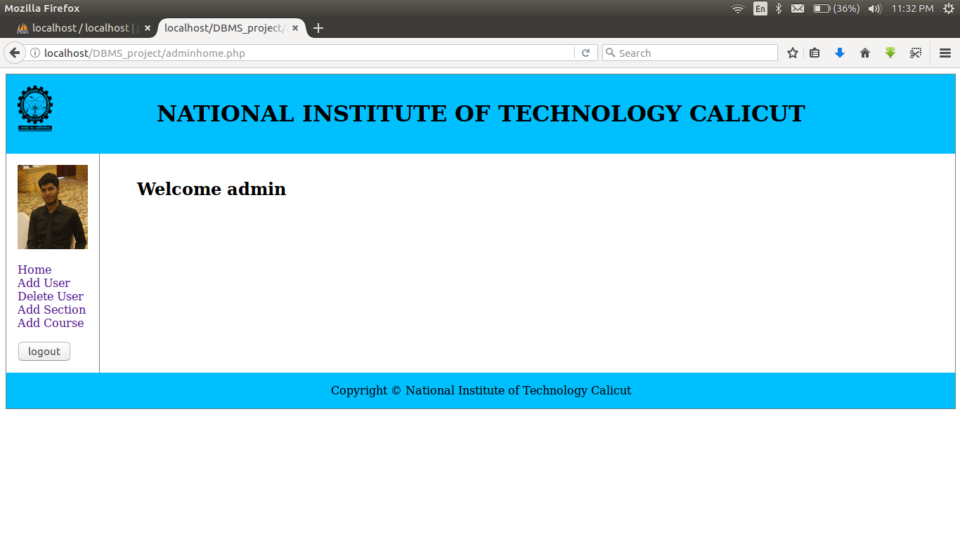
ADMIN HOME
When an admin logs in he will be redirected to his home page
Admin accesses his functionalities through the menu at the left hand side

Slide 17
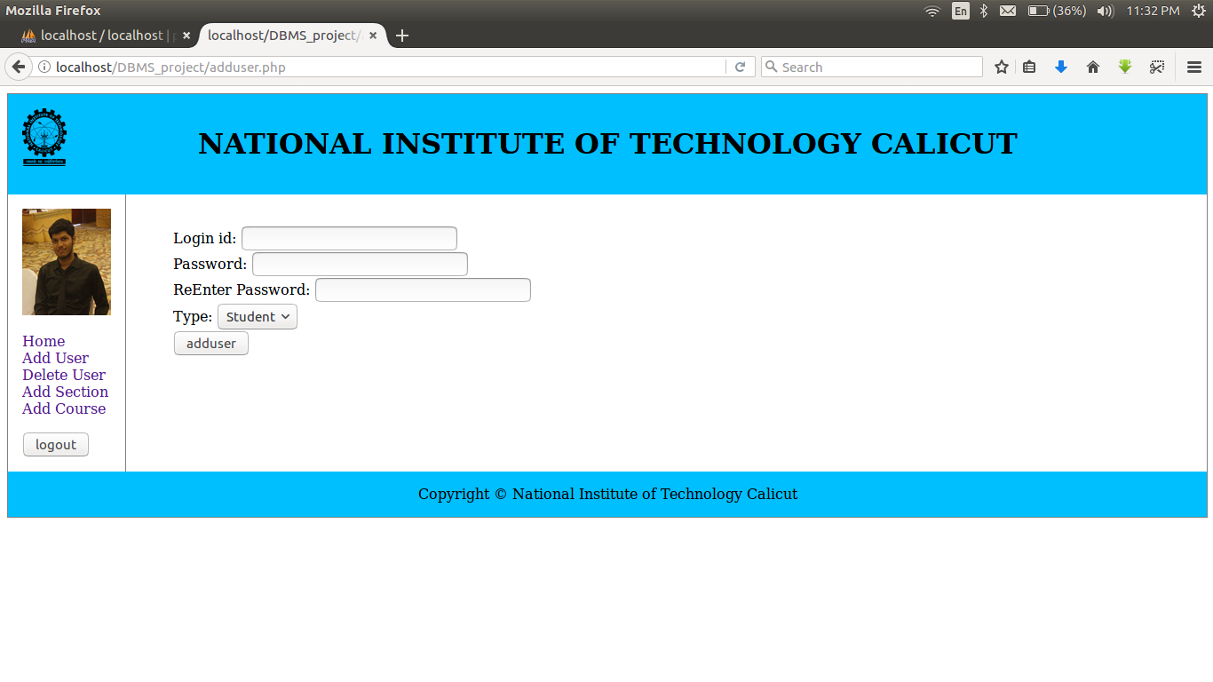
ADD USER
Admin can add any type of user by mentioning login id and a password

Slide 18
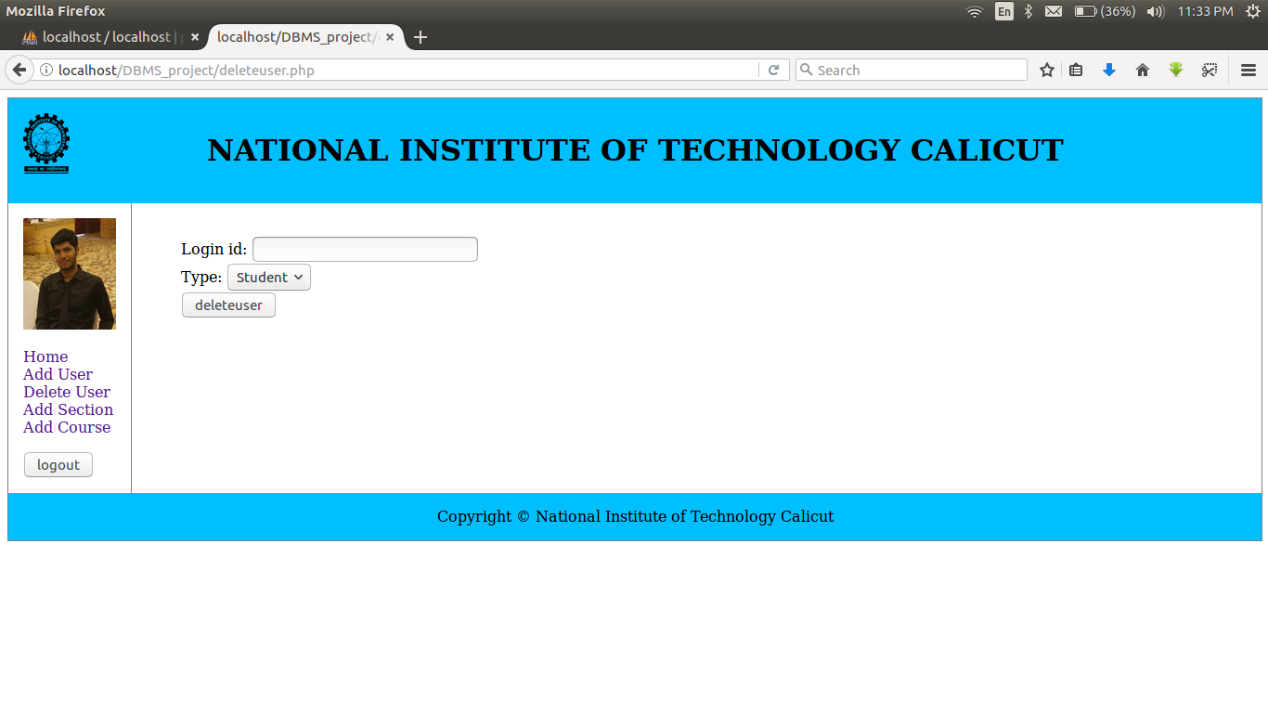
DELETE USER
Admin can delete any type of user by mentioning login id and type

Slide 19
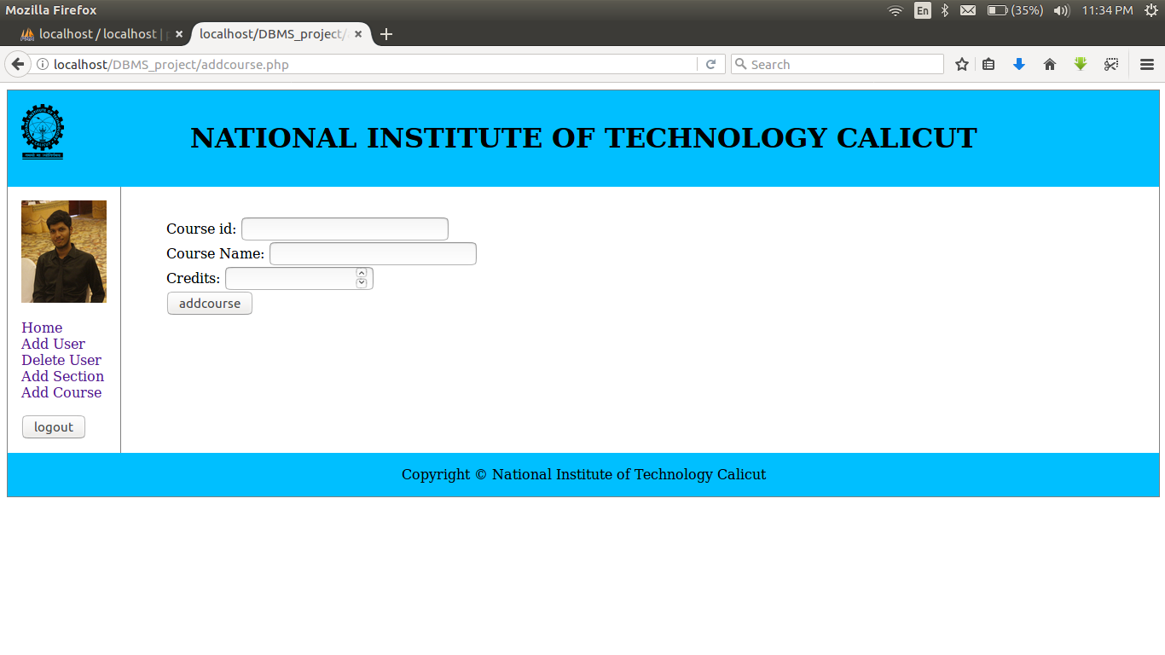
ADD COURSE
Admin can add new courses whenever they are getting added into the curriculum.
He cannot remove a course because: If an old course is removed because of change in curriculum, those section entries’ referential integrity constraint will not be satisfied.

Slide 20
ASSUMPTION
Student will have the timetable he/she is registering for beforehand so that he/she knows the course code and faculty offering that course in that particular semester.
Hence admin adds a bunch of Sections at the beginning of every semester for which a student can register.

Slide 21

ADD SECTION

Slide 22
STUDENT
Student gets a login id and password from the admin.
Every Student at least knows the following details before accessing this portal
Department he/she is currently studying and its code.
Name and Code of his/her Faculty Advisor.

Slide 23
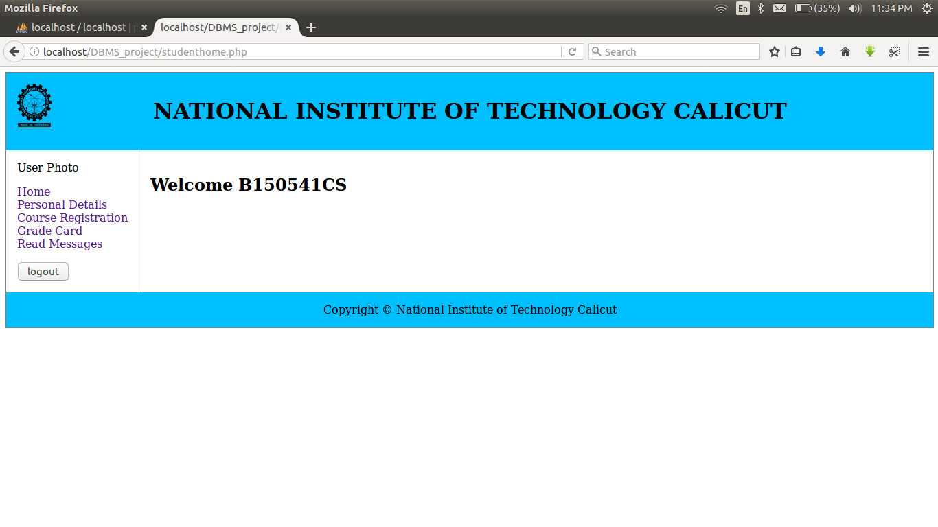
STUDENT HOME
As soon as the student logs in a welcome message is displayed with his roll number.

Slide 24
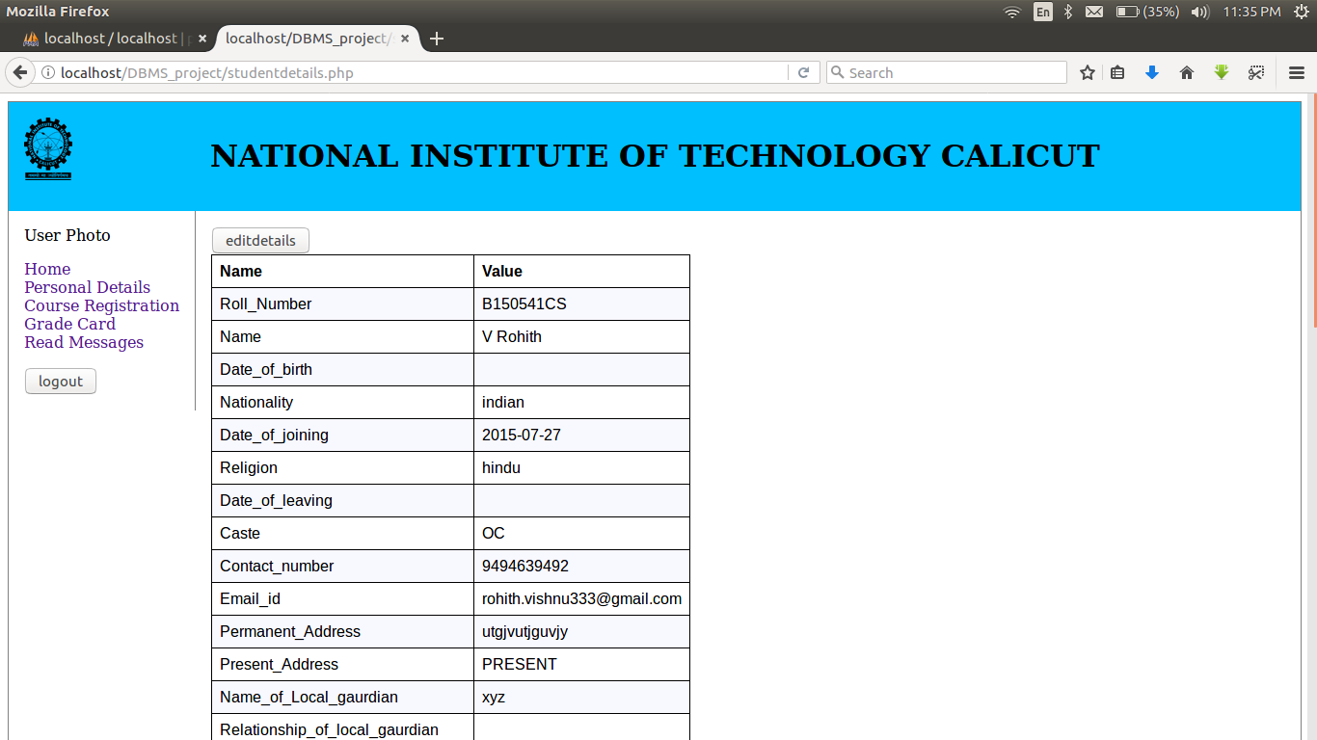
STUDENT PERSONAL DETAILS

Slide 25
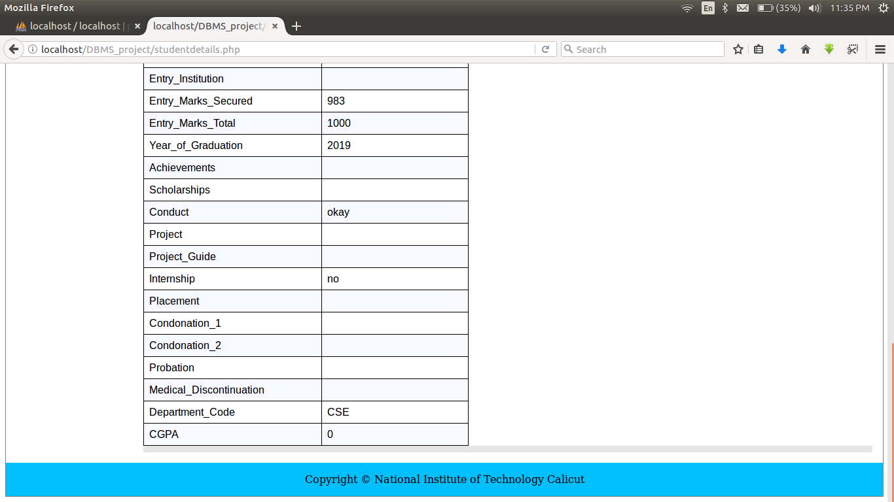
STUDENT PERSONAL DETAILS(2)

Slide 26
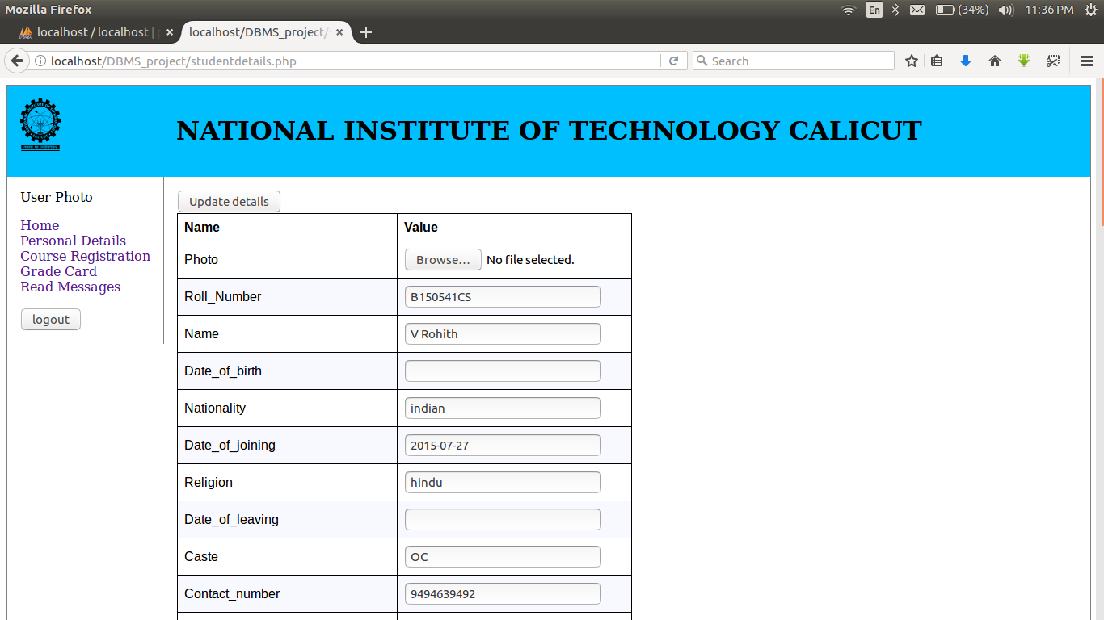
EDIT PERSONAL DETAILS
After updating all the details he can click on update details button.

Slide 27
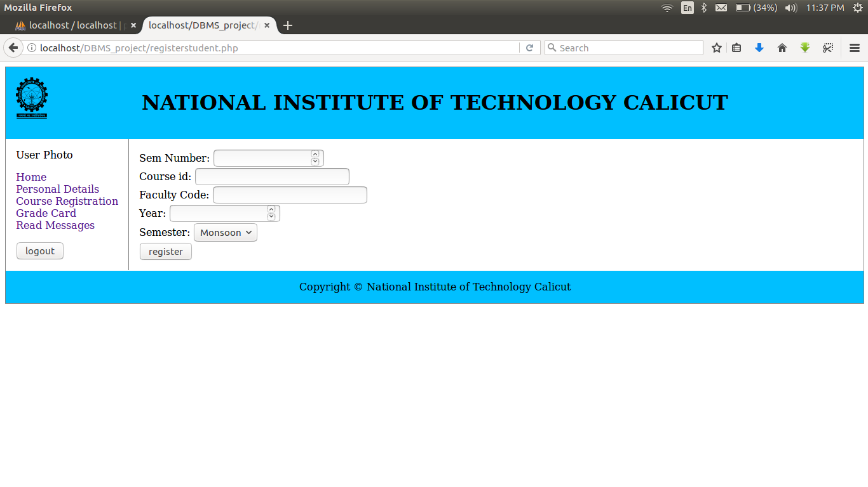
COURSE REGISTRATION
At the beginning of every semester student registers for some courses.

Slide 28
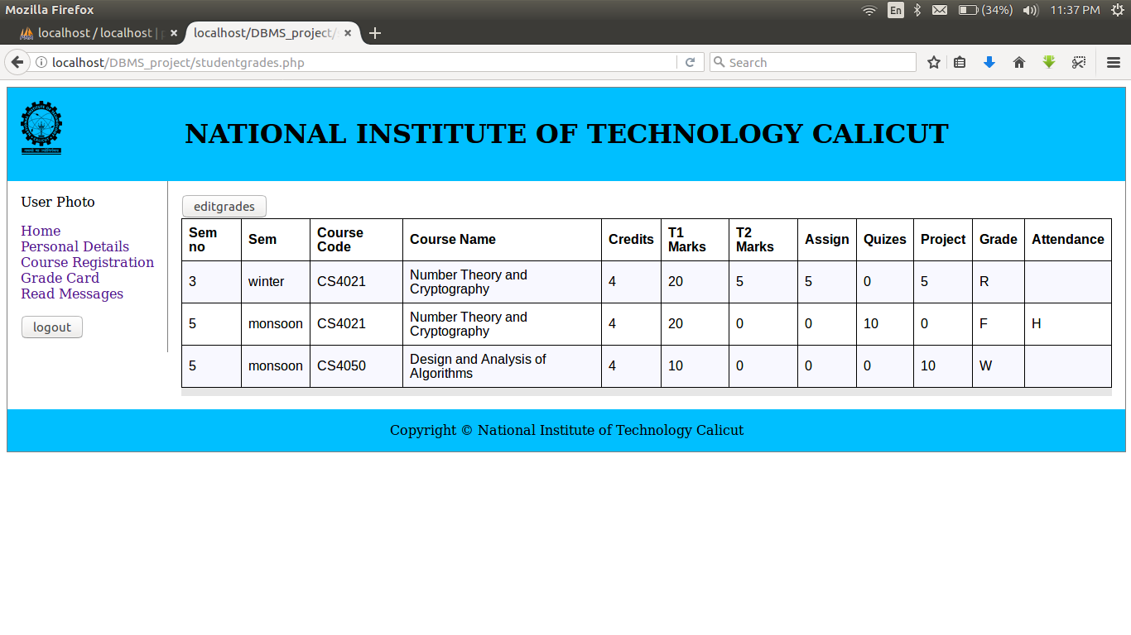
GRADE CARD
Students can view and edit their grades at any point of time.
The Grades are ordered by the semester number in which he studied the course.

Slide 29
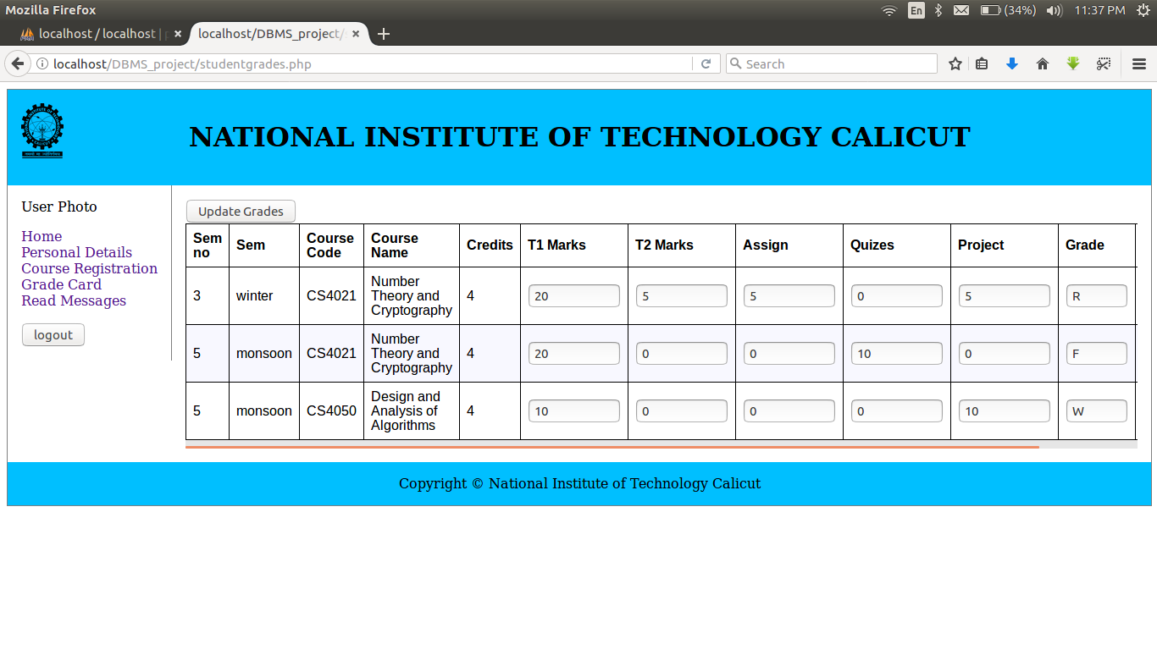
EDIT GRADES(MARKS)
Students can enter their marks & grades including Attendance details and click on Update Details after updation.

Slide 30
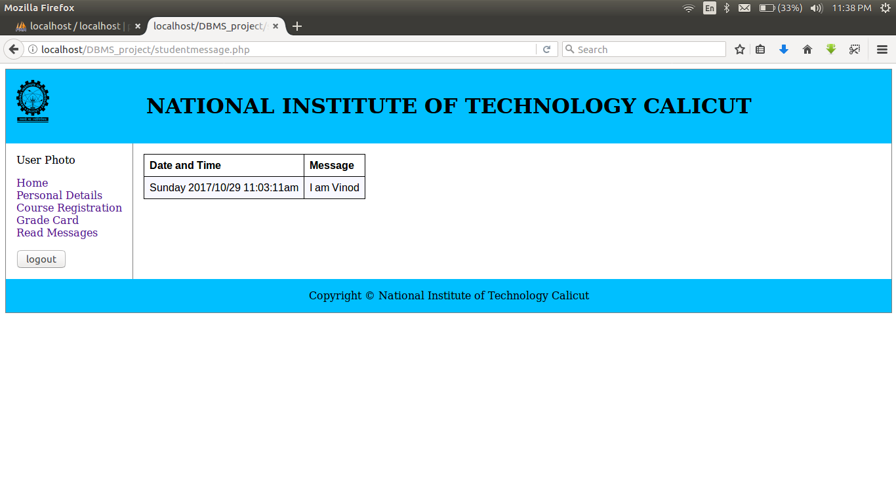
READ MESSAGES
Students can read the messages sent by their respective Faculty Advisors along with the timestamp

Slide 31
FACULTY ADVISOR

Slide 32
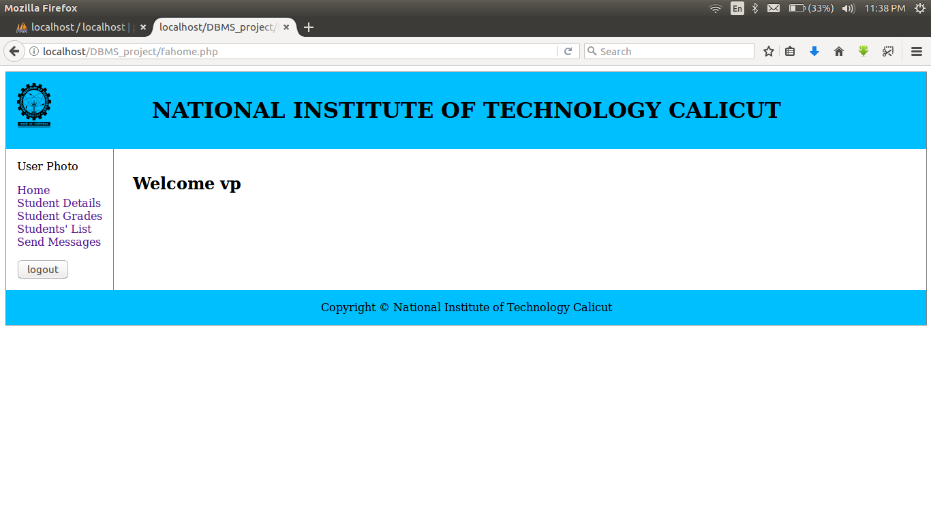
FACULTY ADVISOR HOME
A Welcome message is displayed with the name/code of the Faculty Advisor

Slide 33
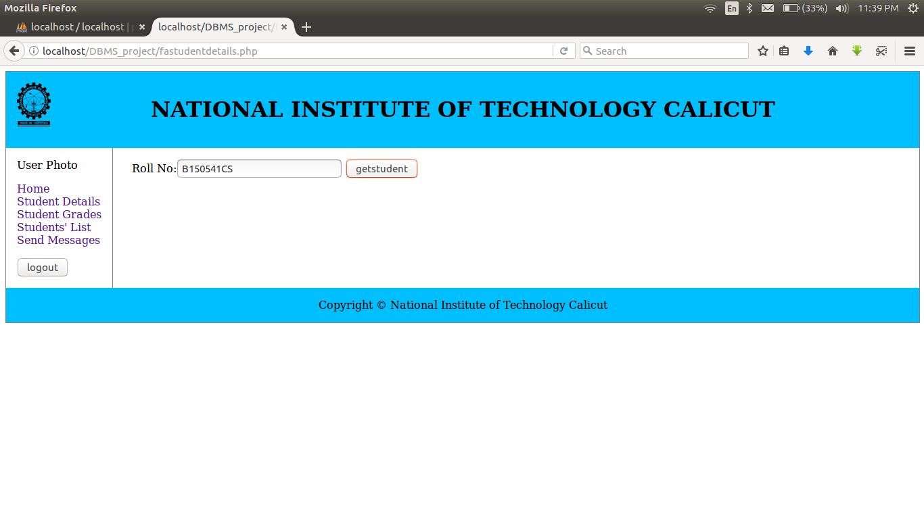
FA-STUDENT DETAILS
FA can access the details of any student under his advisoryship.

Slide 34
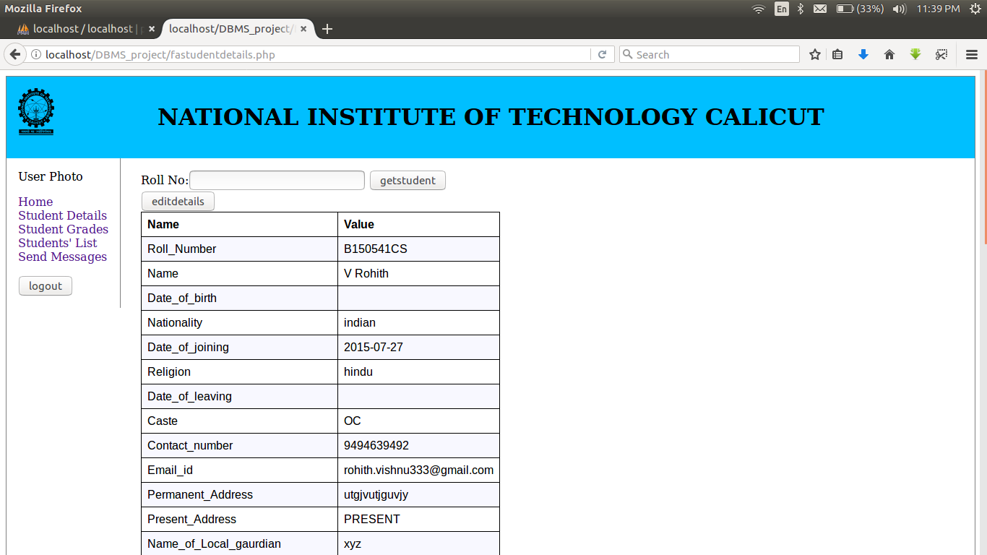
FA-STUDENT DETAILS(2)
FA can also edit student details

Slide 35
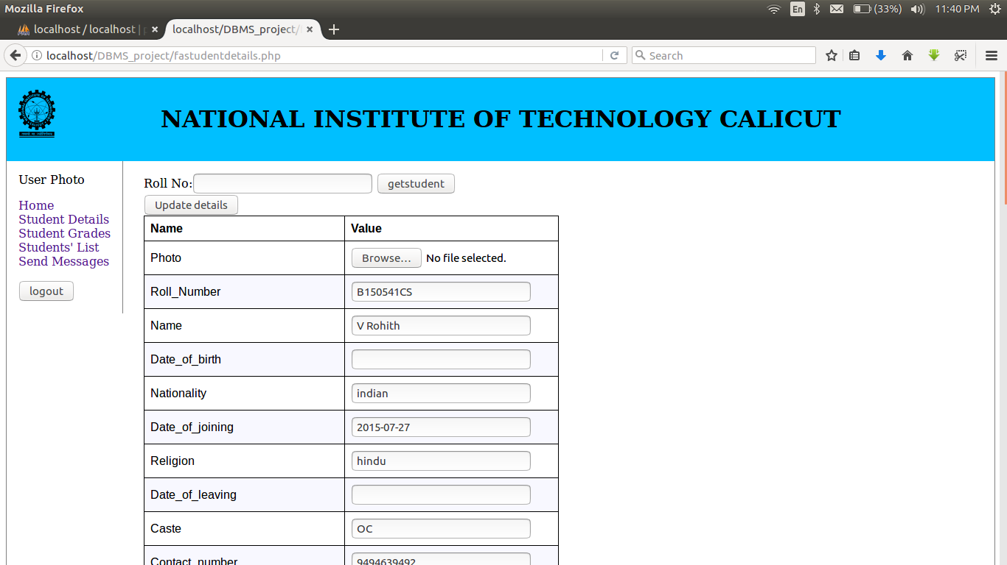
FA-STUDENT DETAILS(3)

Slide 36
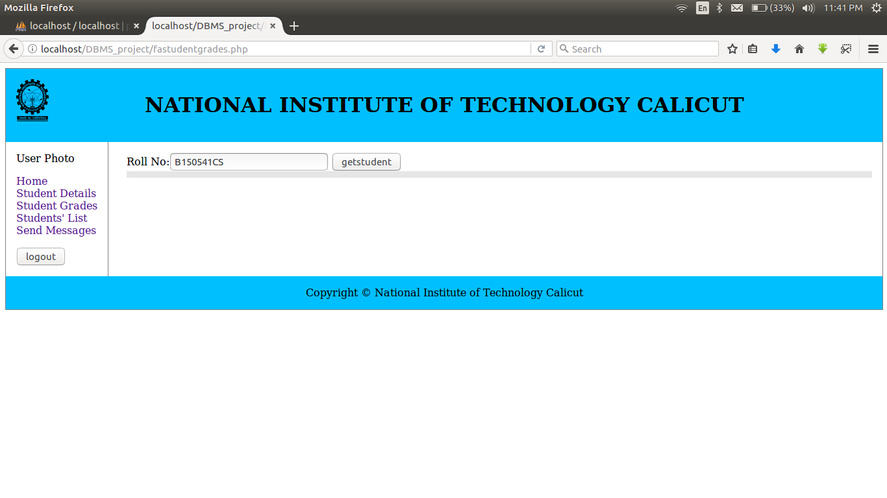
FA-STUDENT GRADES
A Faculty Advisor can access grades of individual students

Slide 37
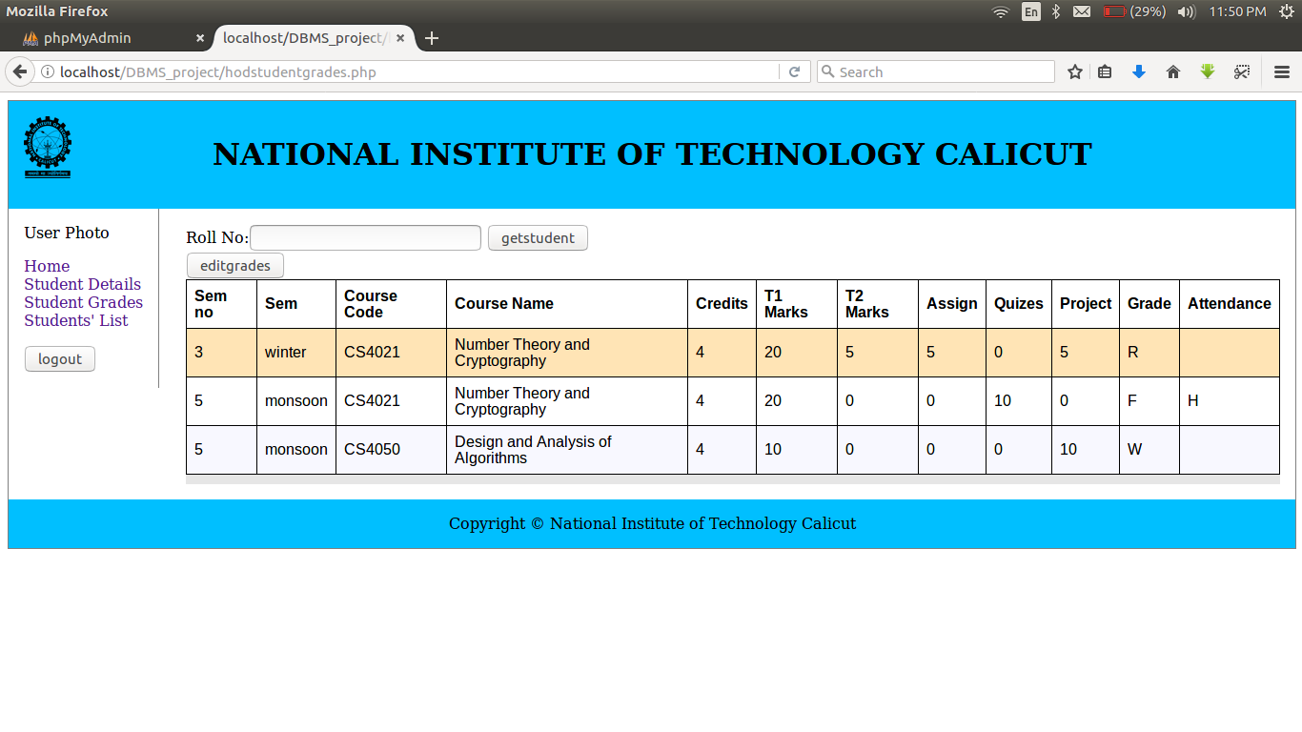
FA-STUDENT GRADES(2)
FA can also edit grades of students under his advisoryship.

Slide 38
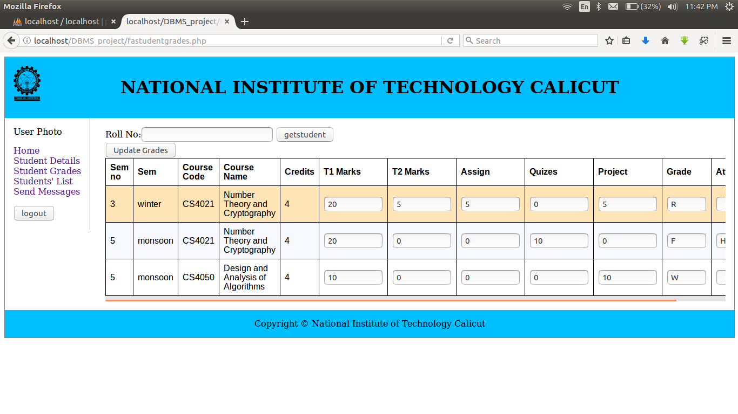
FA-STUDENT GRADES(3)

Slide 39
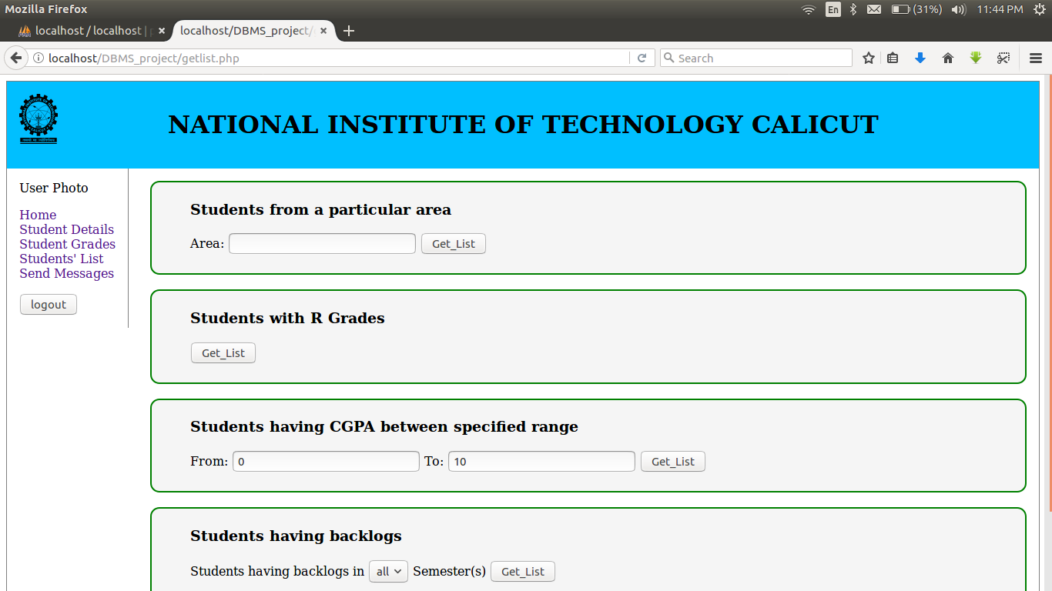
GET LIST OF STUDENTS

Slide 40
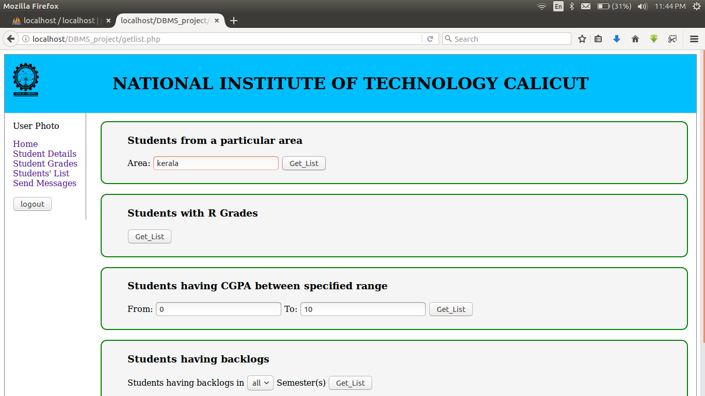
LIST OF STUDENTS FROM A SPECIFIED LOCATION
Students from Kerala

Slide 41
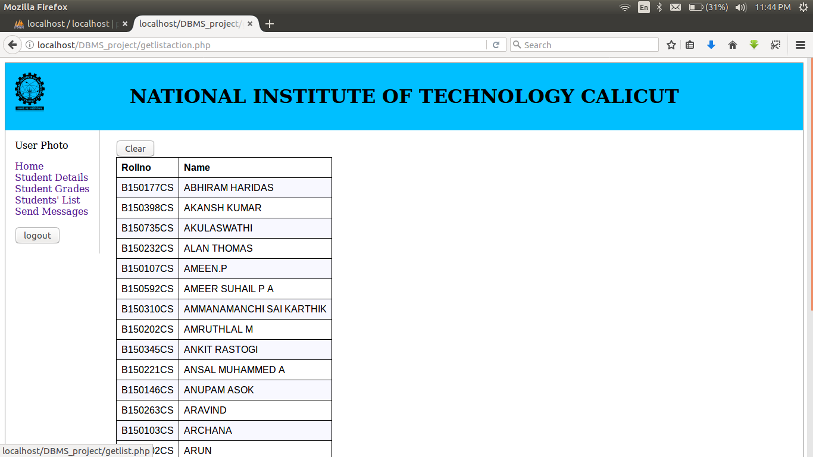
LIST OF STUDENTS FROM KERALA
On clicking ‘clear’ FA can go to the main ‘get list’ page.

Slide 42
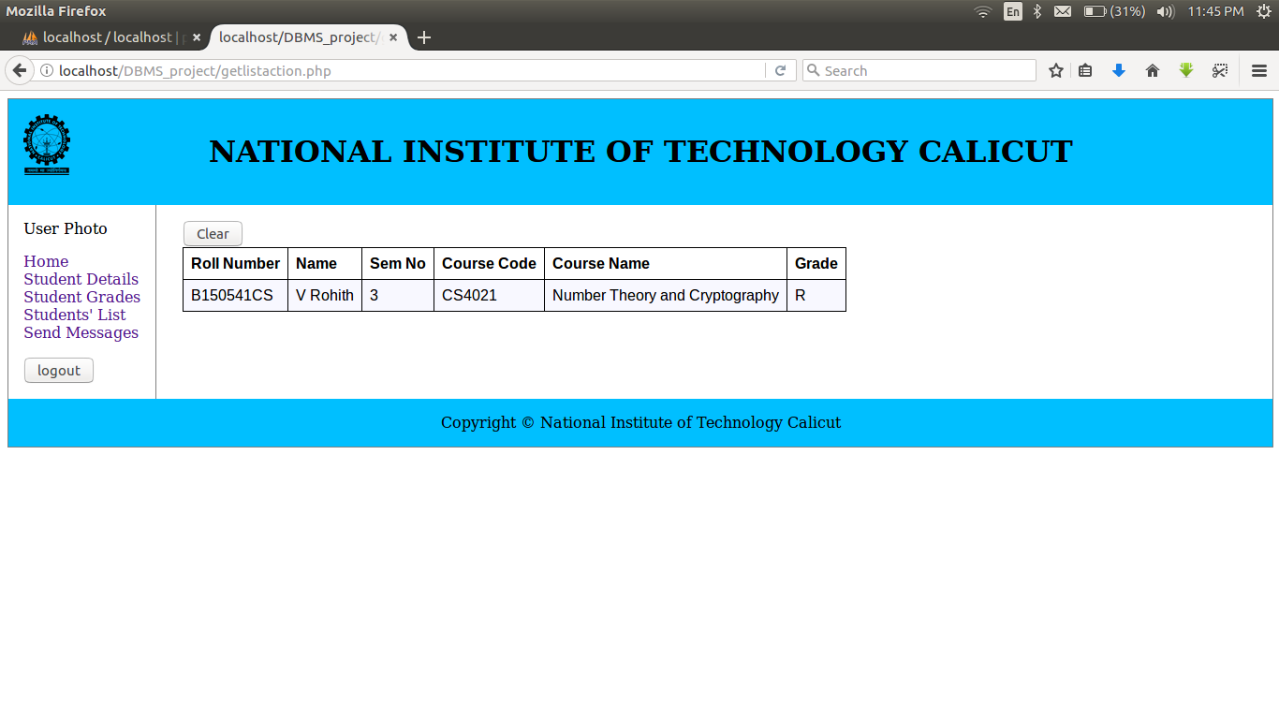
STUDENTS WITH ‘R’ GRADES

Slide 43
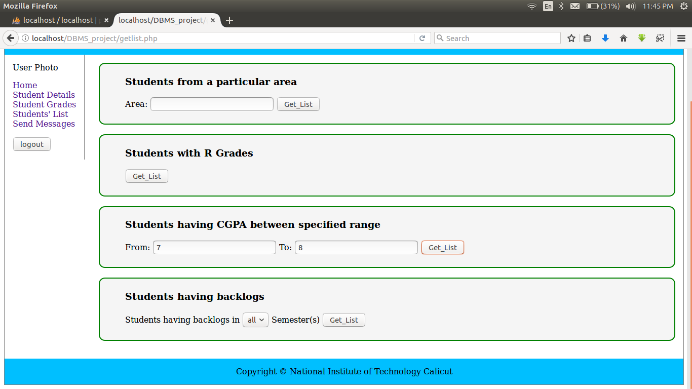
CGPA FILTER

Slide 44
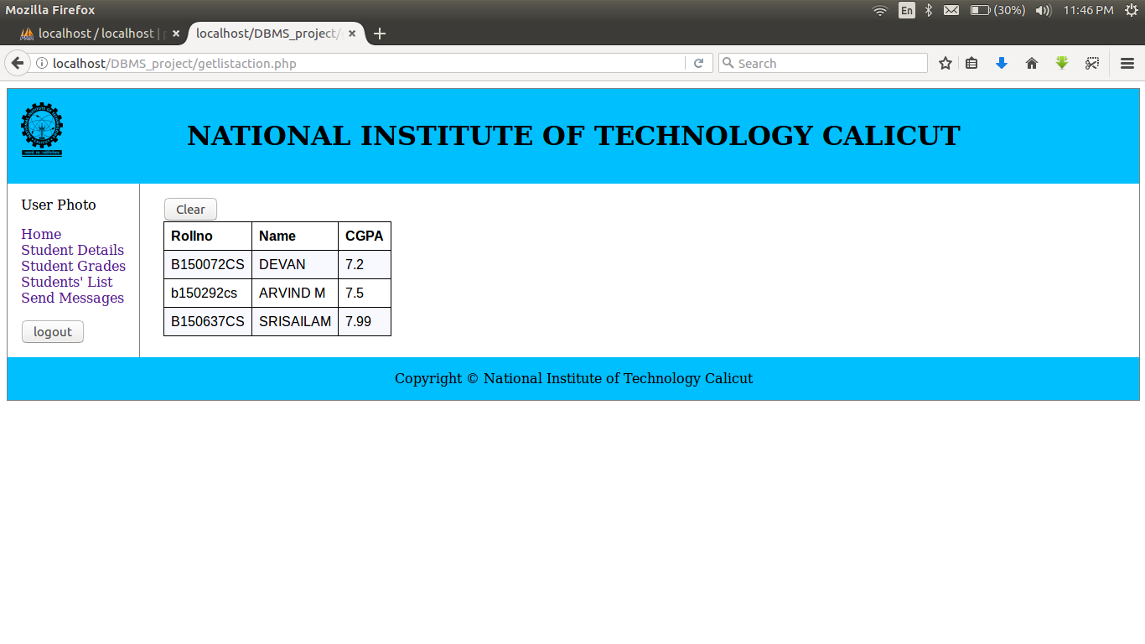
LIST OF STUDENTS BETWEEN CGPA 7 AND 8

Slide 45
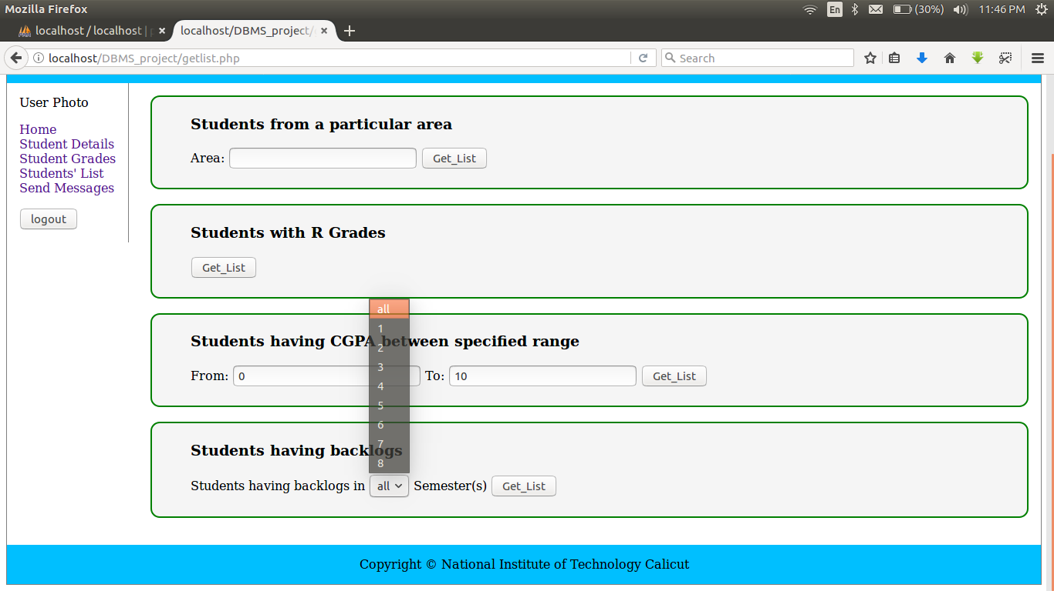
STUDENTS HAVING BACKLOGS
FA can retrieve list of students having backlogs in all semesters / a particular semester (especially for those who have backlogs in first year)

Slide 46
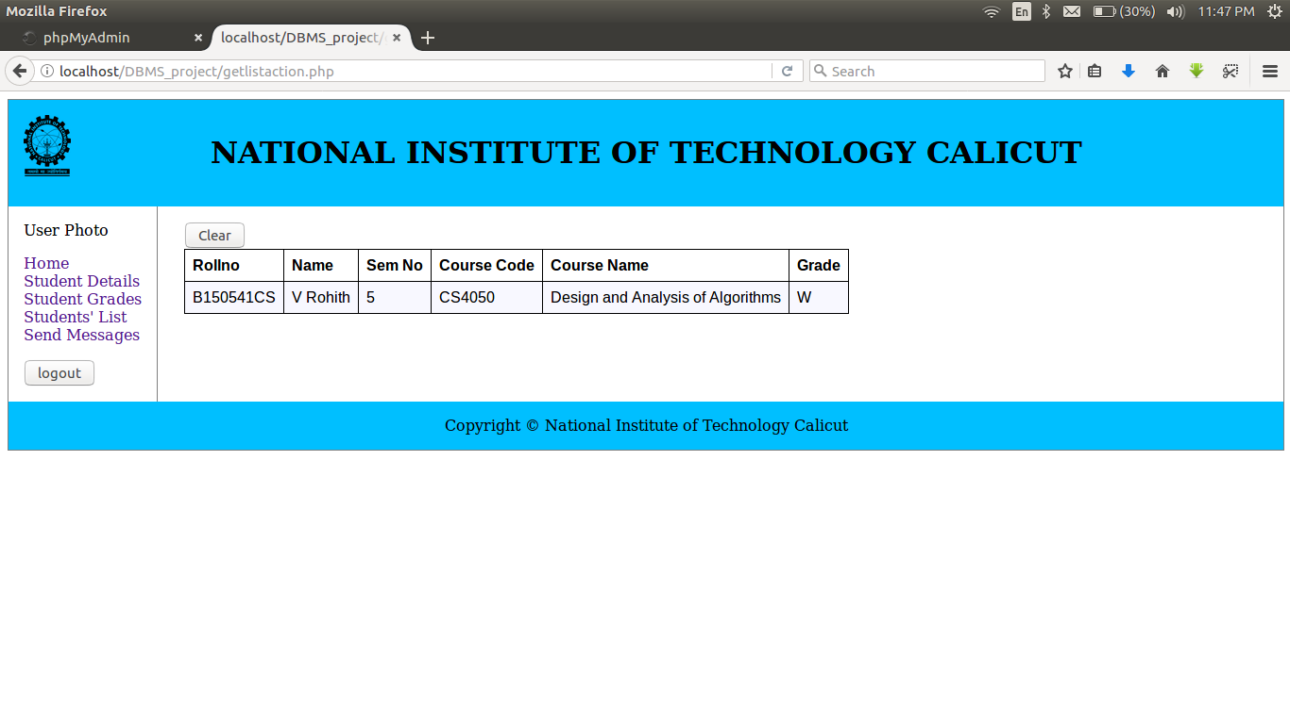
LIST OF STUDENTS HAVING BACKLOGS IN ANY OF THEIR SEMESTERS

Slide 47
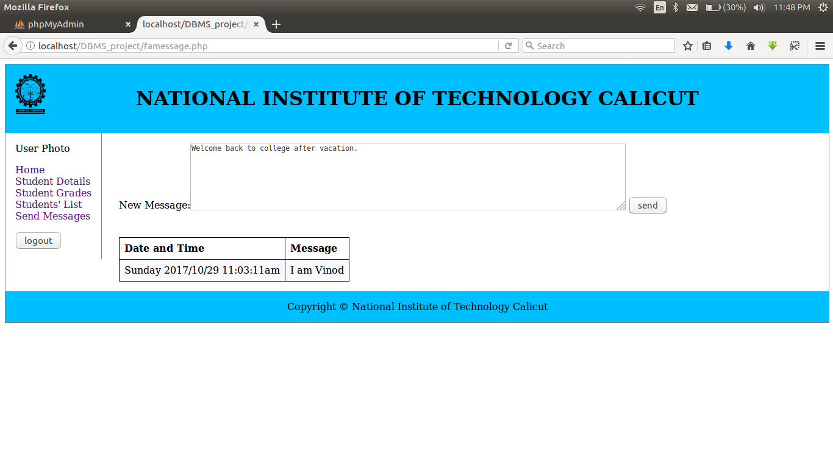
SEND MESSAGES
FA can send instant messages to all students simply by typing the message and clicking on send button.

Slide 48
HOD
HoD has functionalities that are similar to those a Faculty Advisor have but they differ in the domain of execution in the sense that HoD can access details of all students in his department where as a Faculty Advisor can access details of students under his advisoryship only.

Slide 49
IMPLEMENTATION DETAILS

Slide 50
CREATE SCHEMA
CREATE SCHEMA IF NOT EXISTS `FA_System`

Slide 51
CREATE TABLES
CREATE TABLE IF NOT EXISTS `FA_System`.`Department` (
`Department_Code` VARCHAR(5) NOT NULL,
`Department_Name` VARCHAR(45) NOT NULL,
PRIMARY KEY (`Department_Code`)
)
CREATE TABLE IF NOT EXISTS `FA_System`.`Faculty_Advisor` (
`Faculty_Code` VARCHAR(5) NOT NULL,
`Department_Code` VARCHAR(5) NOT NULL,
`Name` VARCHAR(45) NOT NULL,
`Contact_Number` INT NOT NULL,
PRIMARY KEY (`Faculty_Code`),
CONSTRAINT `belongs_to`
FOREIGN KEY (`Department_Code`)
REFERENCES `FA_System`.`Department` (`Department_Code`)
ON DELETE NO ACTION
ON UPDATE NO ACTION)

Slide 52
CREATE TABLES(2a)
CREATE TABLE IF NOT EXISTS `FA_System`.`Student` (
`Roll Number` NVARCHAR(9) NOT NULL,
`Name` VARCHAR(45) NOT NULL,
`Date_of_birth` DATE NULL,
`Nationality` VARCHAR(45) NULL,
`Date_of_joining` DATE NOT NULL,
`Religion` VARCHAR(45) NULL,
`Date_of_leaving` DATE NULL,
`Caste` VARCHAR(5) NOT NULL,
`Contact_number` BIGINT(10) NOT NULL,
`Email_id` VARCHAR(45) NOT NULL,
`Permanent_Address` VARCHAR(45) NOT NULL,
`Present_Address` VARCHAR(45) NULL,
`Name_of_Local_gaurdian` VARCHAR(45) NULL,
`Relationship_of_local_gaurdian` VARCHAR(45) NULL,
`Occupation_of_local_gaurdian` VARCHAR(45) NULL,
`Contact_number_of_local_gaurdian` BIGINT(10) NULL,
`Name_of_father` VARCHAR(45) NULL,
`Address_of_Father` VARCHAR(45) NULL,
`Contact_number_of_father` BIGINT(10) NULL,

Slide 53
CREATE TABLES(2b)
`Name_of_Mother` VARCHAR(45) NULL,
`Contact_number_of_mother` BIGINT(10) NULL,
`Occupation_of_Parent` VARCHAR(45) NULL,
`Faculty_Advisor_Code` VARCHAR(5) NOT NULL,
`Entry_Course` VARCHAR(45) NOT NULL,
`Entry_Period_of_Study` VARCHAR(45) NOT NULL,
`Entry_Board` VARCHAR(45) NOT NULL,
`Entry_Institution` VARCHAR(45) NULL COMMENT 'Name of Institution he studied +2',
`Entry_Marks_Secured` INT NOT NULL,
`Entry_Marks_Total` INT NOT NULL,
`Year_of_Graduation` YEAR NULL,
`Achievements` VARCHAR(45) NULL,
`Scholarships` VARCHAR(45) NULL,
`Conduct` VARCHAR(45) NULL,
`Project` VARCHAR(45) NULL,
`Project_Guide` VARCHAR(45) NULL,
`Internship` VARCHAR(45) NULL,
`Placement` VARCHAR(45) NULL,
`Condonation_1` VARCHAR(45) NULL,
`Condonation_2` VARCHAR(45) NULL,

Slide 54
CREATE TABLES(2c)
`Probation` VARCHAR(45) NULL,
`Medical_Discontinuation` VARCHAR(45) NULL,
`Department_Code` VARCHAR(45) NOT NULL,
PRIMARY KEY (`Roll Number`),
CONSTRAINT `under`
FOREIGN KEY (`Faculty_Advisor_Code`)
REFERENCES `FA_System`.`Faculty_Advisor` (`Faculty_Code`),
CONSTRAINT `department`
FOREIGN KEY (`Department_Code`)
REFERENCES `FA_System`.`Department` (`Department_Code`)
)

Slide 55
CREATE TABLES(3)
CREATE TABLE IF NOT EXISTS `FA_System`.`Course` (
`Course_Code` VARCHAR(6) NOT NULL,
`Course_Name` VARCHAR(45) NOT NULL,
`Credits` INT NOT NULL,
PRIMARY KEY (`Course_Code`),
)
CREATE TABLE IF NOT EXISTS `FA_System`.`Section` (
`Section_id` VARCHAR(45) GENERATED ALWAYS AS () VIRTUAL,
`Course_Code` VARCHAR(6) NOT NULL,
`Year` INT NOT NULL,
`Semester` VARCHAR(45) NOT NULL,
`Faculty_Code` VARCHAR(45) NOT NULL,
PRIMARY KEY (`Section_id`),
CONSTRAINT `has_course`
FOREIGN KEY (`Course_Code`)
REFERENCES `FA_System`.`Course` (`Course_Code`)
)

Slide 56
CREATE TABLES(4)
CREATE TABLE IF NOT EXISTS `FA_System`.`Hod` (
`hod_code` VARCHAR(45) NOT NULL,
`Name` VARCHAR(45) NOT NULL,
`Department_Code` VARCHAR(5) NOT NULL,
PRIMARY KEY (`hod_code`),
CONSTRAINT `controls`
FOREIGN KEY (`Department_Code`)
REFERENCES `FA_System`.`Department` (`Department_Code`))
CREATE TABLE IF NOT EXISTS `FA_System`.`Login` (
`id` VARCHAR(15) NOT NULL,
`type` VARCHAR(10) NOT NULL,
`password` VARCHAR(45) NOT NULL,
PRIMARY KEY (`id`, `type`))

Slide 57
CREATE TABLES(5)
CREATE TABLE IF NOT EXISTS `FA_System`.`Register` (
`Roll Number` NVARCHAR(9) NOT NULL,
`Section_Section_id` VARCHAR(45) NOT NULL,
`Marks_T1` INT NULL DEFAULT 0,
`Marks_T2` INT NULL DEFAULT 0,
`Assignents` INT NULL DEFAULT 0,
`Quizes` INT NULL DEFAULT 0,
`Grade` CHAR(1) NULL,
`Project` INT NULL DEFAULT 0,
CONSTRAINT `enrols`
FOREIGN KEY (`Roll Number`)
REFERENCES `FA_System`.`Student` (`Roll Number`),
CONSTRAINT `registers`
FOREIGN KEY (`Section_Section_id`)
REFERENCES `FA_System`.`Section` (`Section_id`)
)

Slide 58
STUDENTS HAVING BACKLOGS
Challenges:
If a student fails in a course in 3rd Semester and he clears the course again by taking the same course in 5th Semester then name of the student should not be listed but the failure information is still in the database.

Slide 59
SECURITY
Sessions were used in the login mechanism to ensure that after a user logs out he cannot access the database by pressing the back button.
Passwords are stored in the database in encrypted form using ‘sha256’ function which ensures confidentiality of the users’ password

Slide 60
THANK YOU

