Slide 1
Bphys/Biol-E 101 = HST 508 = GEN224
Instructor: George Church
Teaching fellows: Lan Zhang (head), Chih Liu, Mike Jones, J. Singh,
Faisal Reza, Tom Patterson, Woodie Zhao, Xiaoxia Lin, Griffin Weber
Lectures Tue 12:00 to 2:00 PM Cannon Room (Boston)
Tue 5:30 to 7:30 PM Science Center A (Cambridge)
Your grade is based on five problem sets and a course project,
with emphasis on collaboration across disciplines.
Open to: upper level undergraduates, and all graduate students.
The prerequisites are basic knowledge of molecular biology,
statistics, & computing.
Please hand in your questionnaire after this class.
First problem set is due Tue Sep 30 before lecture
via email or paper depending on your section TF.

Slide 2
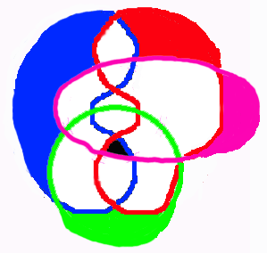
Intersection (not union) of:
Computer-Science
& Math
Chemistry &
Technology
Genomics
& Systems
Biology, Ecology, Society, & Evolution

Slide 3
Bio 101: Genomics &
Computational Biology
Tue Sep 16 Integrate 1: Minimal “Systems”, Statistics, Computing
Tue Sep 23 Integrate 2: Biology, comparative genomics, models & evidence, applications
Tue Sep 30 DNA 1: Polymorphisms, populations, statistics, pharmacogenomics, databases
Tue Oct 06 DNA 2: Dynamic programming, Blast, multi-alignment, HiddenMarkovModels
Tue Oct 14 RNA 1: 3D-structure, microarrays, library sequencing & quantitation concepts
Tue Oct 21 RNA 2: Clustering by gene or condition, DNA/RNA motifs.
Tue Oct 28 Protein 1: 3D structural genomics, homology, dynamics, function & drug design
Tue Nov 04 Protein 2: Mass spectrometry, modifications, quantitation of interactions
Tue Nov 11 Network 1: Metabolic kinetic & flux balance optimization methods
Tue Nov 18 Network 2: Molecular computing, self-assembly, genetic algorithms, neural-nets
Tue Nov 25 Network 3: Cellular, developmental, social, ecological & commercial models
Tue Dec 02 Project presentations
Tue Dec 09 Project Presentations
Tue Dec 16 Project Presentations

Slide 4
Integrate 1: Today's story, logic & goals
Life & computers : Self-assembly required
Discrete & continuous models
Minimal life & programs
Catalysis & Replication
Differential equations
Directed graphs & pedigrees
Mutation & the Single Molecules models
Bell curve statistics
Selection & optimality

Slide 5
acgt
00=a
01=c
10=g
11=t
1
0
1
1
0
1
1
0
1
1
0
1
1
0
1
1
0
1
5

Slide 6
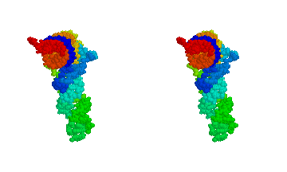
Post- 300 genomes & 3D structures
gggatttagctcagttgggagagcgccagactgaa gat
ttg gag
gtcctgtgttcgatccacagaattcgcacca
6

Slide 7
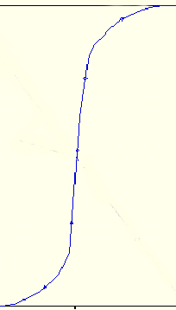
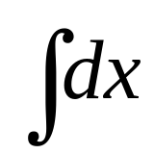
Discrete Continuous
a sequence a weight matrix of sequences
lattice molecular coordinates
digital analog (16 bit A2D converters)
Σ Δx
neural/regulatory on/off gradients & graded responses
sum of black & white gray
essential/neutral conditional mutation
alive/not probability of replication

Slide 8
Bits (discrete)
bit = binary digit
1 base >= 2 bits
1 byte = 8 bits
+ Kilo Mega Giga Tera Peta Exa Zetta Yotta +
3 6 9 12 15 18 21 24
- milli micro nano pico femto atto zepto yocto -
Kibi Mebi Gibi Tebi Pebi Exbi
1024 = 2¹⁰ 2²⁰ 2³⁰ 2⁴⁰ 2⁵⁰ 2⁶⁰
http://physics.nist.gov/cuu/Units/prefixes.html

Slide 9
Quantitative measure definitions unify/clarify/prepare conceptual breakthroughs
Seven basic (Système International) SI units:
s, m, kg, mol, K, cd, A
(some measures at precision of 14 significant figures)
Quantal: Planck time, length: 10⁻⁴³ seconds, 10⁻³⁵ meters,
mol=6.0225 10²³ entities.
casa.colorado.edu/~ajsh/sr/postulate.html
physics.nist.gov/cuu/Uncertainty/
scienceworld.wolfram.com/physics/SI.html

Slide 10
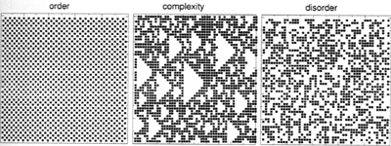
Do we need a “Biocomplexity” definition distinct from “Entropy”?
1. Computational Complexity = speed/memory scaling P, NP
2. Algorithmic Randomness (Chaitin-Kolmogorov)
3. Entropy/information
4. Physical complexity
(Bernoulli-Turing Machine)
Sole & Goodwin, Signs of Life 2000
Crutchfield & Young in Complexity, Entropy, & the Physics of Information 1990 pp.223-269
www.santafe.edu/~jpc/JPCPapers.html

Slide 11
Quantitative definition of life?
Historical/Terrestrial Biology extends to "General Biology"
Probability of replication … simple in, complex out
(in a specific environment)
Robustness/Evolvability
(in a variety of environments)
Challenging cases:
Physics: nucleate-crystals, mold-replica, geological layers, fires
Biology: pollinated flowers, viruses, predators, sterile mules,
Engineering: molecular ligation, self-assembling machines.

Slide 12
Why Model?
To understand biological/chemical data.
(& design useful modifications)
To share data we need to be able to
search, merge, & check data via models.
Integrating diverse data types can reduce random & systematic errors.

Slide 13
Which models will we search, merge & check in this course?
Sequence: Dynamic programming, assembly, translation & trees.
3D structure: motifs, catalysis, complementary surfaces – energy and kinetic optima
Functional genomics: clustering
Systems: qualitative & boolean networks
Systems: differential equations & stochastic
Network optimization: Linear programming

Slide 14
Intro 1: Today's story, logic & goals
Life & computers : Self-assembly required
Discrete & continuous models
Minimal life & programs
Catalysis & Replication
Differential equations
Directed graphs & pedigrees
Mutation & the Single Molecules models
Bell curve statistics
Selection & optimality

Slide 15
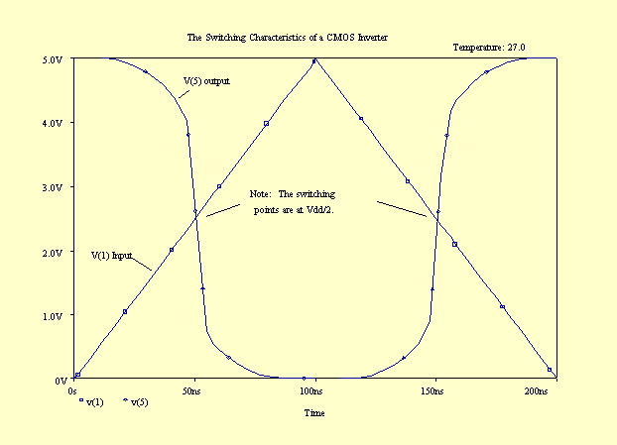
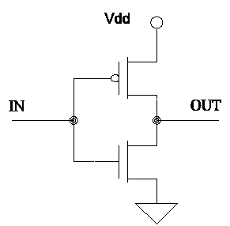
Transistors > inverters > registers > binary adders > compilers > application programs
Spice simulation of a CMOS inverter (figures)

Slide 16
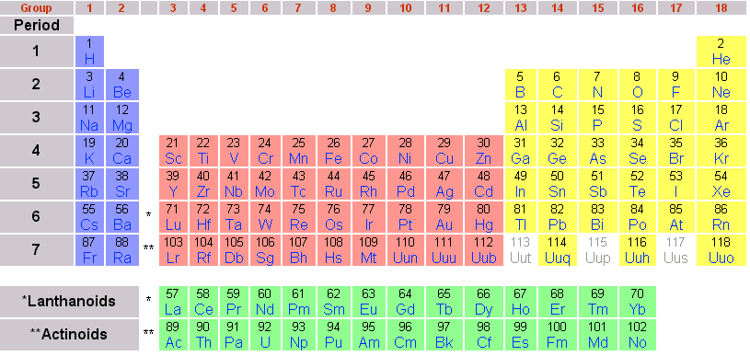
Elements
of RNA-based life: C,H,N,O,P
Useful for many species:
Na, K, Fe, Cl, Ca, Mg, Mo, Mn, S, Se, Cu, Ni, Co, B, Si

Slide 17
Minimal self-replicating units
Minimal theoretical composition: 5 elements: C,H,N,O,P
Environment = water, NH₄⁺, 4 NTP⁻s, lipids
Johnston et al. Science 2001 292:1319-1325 RNA-catalyzed RNA polymerization:
accurate and general RNA-templated primer extension.
Minimal programs
perl -e "print exp(1);" 2.71828182845905
excel: = EXP(1) 2.71828182845905000000000
f77: print*, exp(1.q0) 2.71828182845904523536028747135266
Mathematica: N[ Exp[1],100] 2.71828182845904523536028747135266249775
7247093699959574966967627724076630353547594571382178525166427
Underlying these are algorithms for arctangent and hardware for RAM and printing.
Beware of approximations & boundaries.
Time & memory limitations. E.g. first two above 64 bit floating point:
52 bits for mantissa (= 15 decimal digits), 10 for exponent, 1 for +/- signs.

Slide 18
Self-replication of complementary nucleotide-based oligomers
5’ccg + ccg => 5’ccgccg
5’CGGCGG
CGG + CGG => CGGCGG
ccgccg
Sievers & Kiedrowski 1994 Nature 369:221
Zielinski & Orgel 1987 Nature 327:347

Slide 19
Why Perl & Excel?
In the hierarchy of languages, Perl is a "high level" language,
optimized for easy coding of string searching & string manipulation.
It is well suited to web applications and is "open source"
(so that it is inexpensive and easily extended).
It has a very easy learning curve relative to C/C++
but is similar in a few way to C in syntax.
Excel is widely used with intuitive stepwise addition of
columns and graphics.

Slide 20
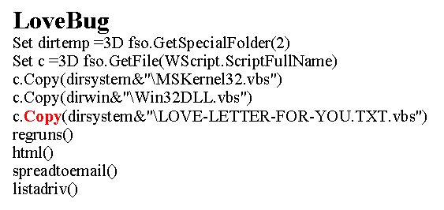
Facts of Life 101
Where do parasites come from?
(computer & biological viral codes)
AIDS - HIV-1
26 M dead (worse than black plague & 1918 Flu)
www.apheda.org.au/campaigns/images/hiv_stats.pdf
www.ncbi.nlm.nih.gov/Taxonomy/Browser/wwwtax.cgi?id=11676
Polymerase drug resistance mutations
M41L, D67N, T69D, L210W, T215Y, H208Y
PISPIETVPVKLKPGMDGPK VKQWPLTEEK
IKALIEICAE LEKDGKISKI
GPVNPYDTPV FAIKKKNSDK
WRKLVDFREL NKRTQDFCEV
Computer viruses & hacks :
over $3 trillion/year
www.ecommercetimes.com/perl/story/4460.htm

Slide 21
Conceptual connections
Concept Computers Organisms
Instructions Program Genome
Bits 0,1 a,c,g,t
Stable memory Disk,tape DNA
Active memory RAM RNA
Environment Sockets,people Water,salts
I/O AD/DA proteins
Monomer Minerals Nucleotide
Polymer chip DNA,RNA,protein
Replication Factories 1e-15 liter cell sap
Sensor/In Keys,scanner Chem/photo receptor
Actuator/Out Printer,motor Actomyosin
Communicate Internet,IR Pheromones, song

Slide 22
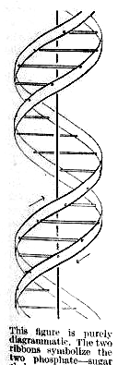
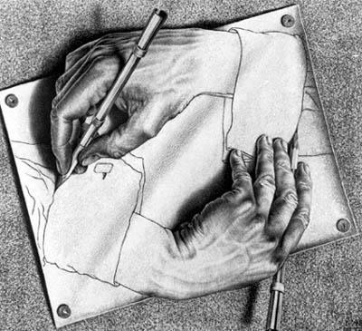
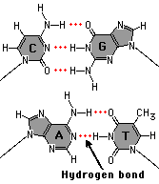
Self-compiling & self-assembling
Complementary surfaces
Watson-Crick base pair
(Nature April 25, 1953)
MC. Escher

Slide 23
Minimal Life:
Self-assembly, Catalysis, Replication, Mutation, Selection
Cell boundary
Monomers
RNA

Slide 24
Replicator diversity
Self-assembly, Catalysis, Replication, Mutation, Selection Polymerization & folding (Revised Central Dogma)
Monomers
DNA
RNA
Protein
Growth rate
Polymers: Initiate, Elongate, Terminate, Fold, Modify, Localize, Degrade

Slide 25
Maximal Life:
Self-assembly, Catalysis, Replication, Mutation, Selection Regulatory & Metabolic Networks
Interactions
Metabolites
DNA
RNA
Protein
Growth rate
Expression
Polymers: Initiate, Elongate, Terminate, Fold, Modify, Localize, Degrade

Slide 26


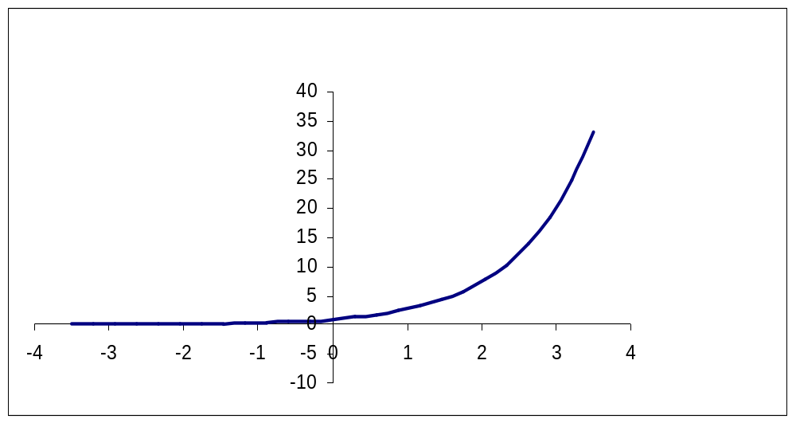
Rorschach Test

Slide 27
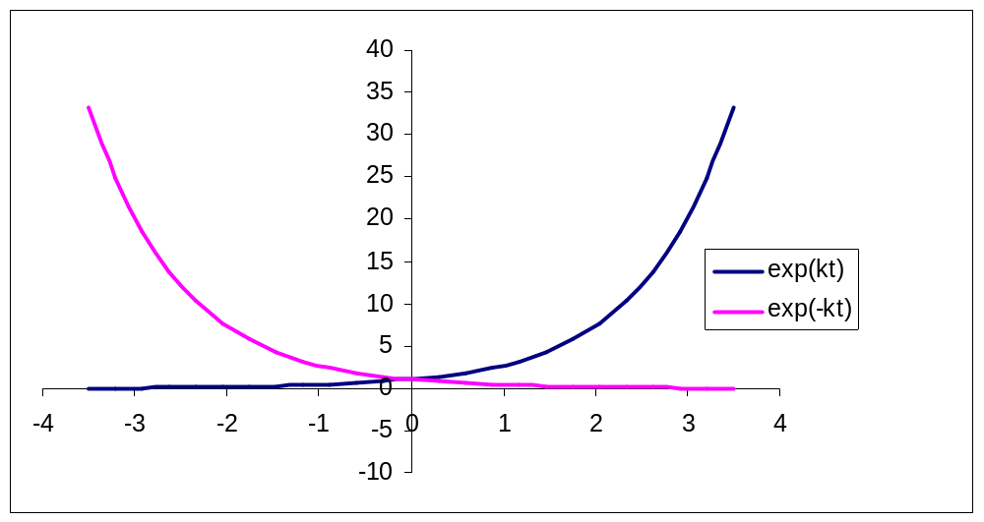
Growth & decay
dy/dt = ky
y = Ae^{kt} ; e = 2.71828...
k=rate constant; half-life=log_{e}(2)/k
y
t

Slide 28
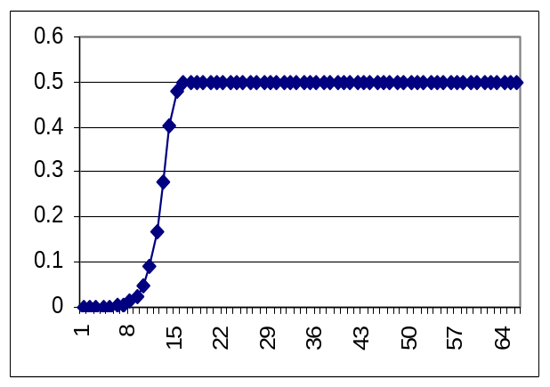
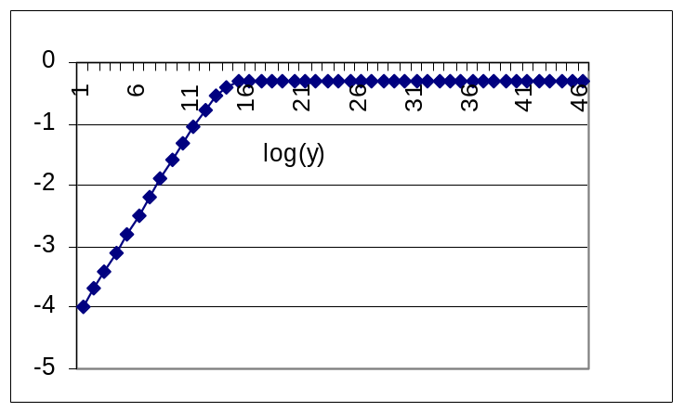
What limits exponential growth?
Exhaustion of resources
Accumulation of waste products
What limits exponential decay?
Finite particles, stochastic (quantal) limits
Log(y)
y
t
t

Slide 29
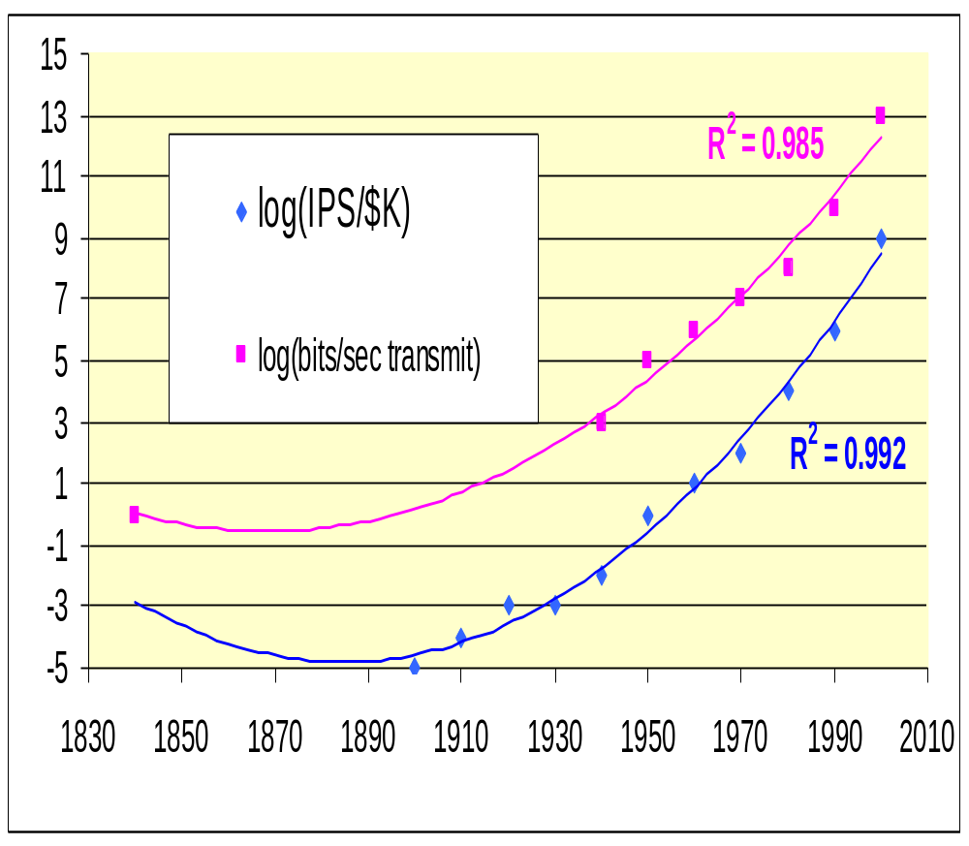
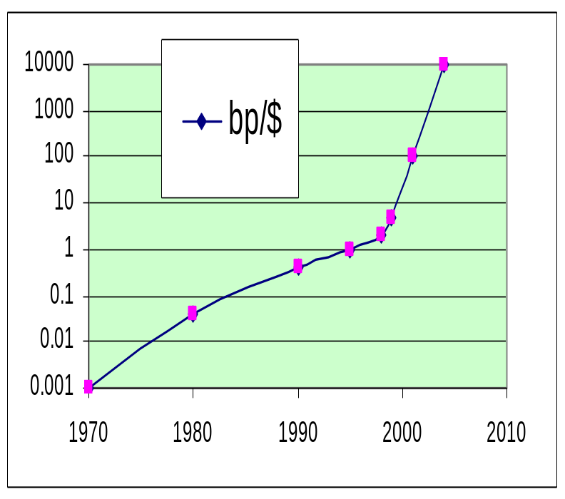
Steeper than exponential growth
Instructions Per Second
1965 Moore's law
of integrated circuits
1999 Kurzweil’s law
http://www.faughnan.com/poverty.html
http://www.kurzweilai.net/meme/frame.html?main=/articles/art0184.html

Slide 30
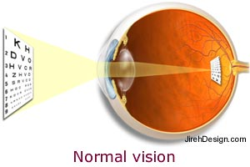
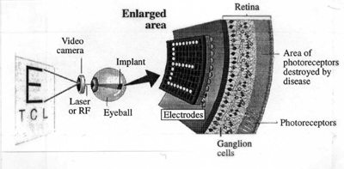
Comparison of Si & neural nets
fig
“The retina's 10 million detections per second
[.02 g] ... extrapolation ...
10¹⁴ instructions per second to emulate the 1,500 gram human brain. ... thirty more years at the present pace would close the millionfold gap.” (Morovec1999)
Edge & motion detection (examples)
2003: the ESC is already 35 Tflops & 10Tbytes. http://www.top500.org/
http://www.ai.mit.edu/people/brooks/papers/nature.pdf

Slide 31
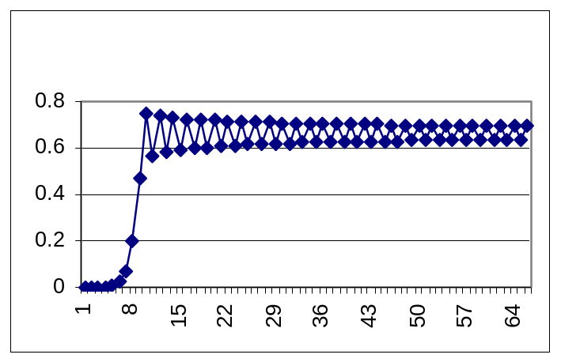

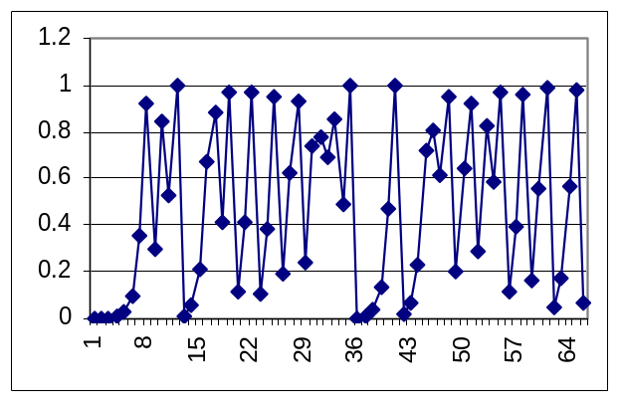
Post-exponential growth & chaos
Excel:
A3=k*A2*(1-A2)
A4=k*A3*(1-A3)
…
k = growth rate
A= population size (min=0, max=1)
k=3
Pop[3], 0.0001, 50]
oscillation
k=2
k=4
Smooth approach to plateau
chaos
“Logistic equation ”

Slide 32
Intro 1: Today's story, logic & goals
Life & computers : Self-assembly required
Discrete & continuous models
Minimal life & programs
Catalysis & Replication
Differential equations
Directed graphs & pedigrees
Mutation & the Single Molecules models
Bell curve statistics
Selection & optimality

Slide 33
Inherited Mutations & Graphs
Directed Acyclic Graph (DAG)
Example: a mutation pedigree
Nodes = an organism, edges = replication with mutation
time
hissa.nist.gov/dads/HTML/directAcycGraph.html

Slide 34
Directed Graphs
Directed Acyclic Graph:
Biopolymer backbone
Phylogeny
Pedigree
Cyclic:
Polymer contact maps
Metabolic &
Regulatory Nets
Time independent or implicit
Time

Slide 35
System models Feature attractions
E. coli chemotaxis Adaptive, spatial effects
Red blood cell metabolism Enzyme kinetics
Cell division cycle Checkpoints
Circadian rhythm Long time delays
Plasmid DNA replication Single molecule precision
Phage λ switch Stochastic expression
also, all have large genetic & kinetic datsets.

Slide 36
Intro 1: Today's story, logic & goals
Life & computers : Self-assembly required
Discrete & continuous models
Minimal life & programs
Catalysis & Replication
Differential equations
Directed graphs & pedigrees
Mutation & the Single Molecules models
Bell curve statistics
Selection & optimality

Slide 37
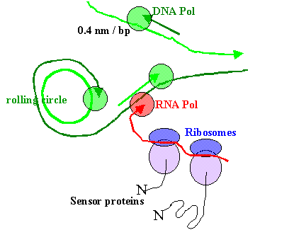
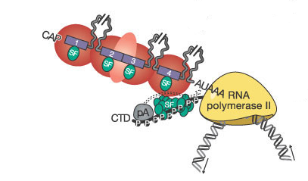
Bionano-machines
Types of biomodels.
Discrete, e.g. conversion stoichiometry
Rates/probabilities of interactions
Modules vs
“extensively coupled networks”
Maniatis & Reed Nature 416, 499 - 506 (2002)

Slide 38
Types of Systems Interaction Models
Quantum Electrodynamics subatomic
Quantum mechanics electron clouds
Molecular mechanics spherical atoms nm-fs
Master equations stochastic single molecules
Fokker-Planck approx. stochastic
Macroscopic rates ODE Concentration & time (C,t)
Flux Balance Optima dC_{ik}/dt optimal steady state
Thermodynamic models dC_{ik}/dt = 0 k reversible reactions
Steady State ΣdC_{ik}/dt = 0 (sum k reactions)
Metabolic Control Analysis d(dC_{ik}/dt)/dC_{j} (i = chem.species) Spatially inhomogenous dCi/dx
Population dynamics as above km-yr
Increasing scope, decreasing resolution

Slide 39
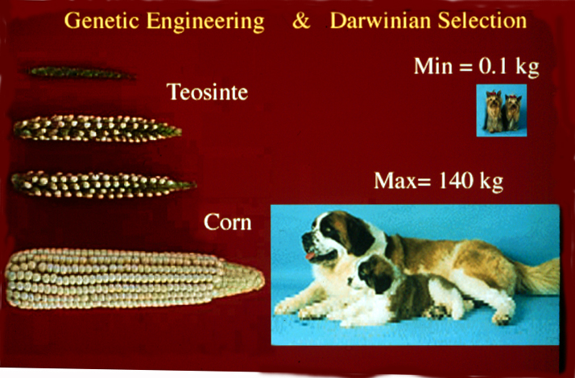
How to do single DNA molecule manipulations?
Yorkshire Terrier
English Mastiff

Slide 40
One DNA molecule per cell
Replicate to two DNAs.
Now segregate to two daughter cells
If totally random, half of the cells will have too many or too few.
What about human cells with 46 chromosomes (DNA molecules)?
Dosage & loss of heterozygosity & major sources of mutation
in human populations and cancer.
For example, trisomy 21, a 1.5-fold dosage with enormous impact.

Slide 41
Mean, variance, & linear correlation coefficient
Expectation E (rth moment) of random variables X for any distribution f(X)
First moment= Mean μ ; variance σ² and standard deviation σ
E(X^{r}) = ∑ X^{r} f(X) μ = E(X) σ² = E[(X-μ)²]
Pearson correlation coefficient C= cov(X,Y) = Ε[(X-μ_{X} )(Y-μ_{Y})]/(σ_{X} σ_{Y})
Independent X,Y implies C = 0,
but C =0 does not imply independent X,Y. (e.g. Y=X²)
P = TDIST(C*sqrt((N-2)/(1-C²)) with dof= N-2 and two tails.
where N is the sample size.
www.stat.unipg.it/IASC/Misc-stat-soft.html

Slide 42
Binomial frequency distribution as a function of X ∈ {int 0 ... n}
p and q 0 ≤ p ≤ q ≤ 1 q = 1 – p two types of object or event.
Factorials 0! = 1 n! = n(n-1)!
Combinatorics (C= # subsets of size X are possible from a set of total size of n)
n!
X!(n-X)! ^{= C(n,X)}
B(X) = C(n, X) p^{X} q^{n-X} μ = np σ² = npq
(p+q)^{n} = ∑ B(X) = 1
B(X: 350, n: 700, p: 0.1) = 1.53148×10⁻¹⁵⁷
=PDF[ BinomialDistribution[700, 0.1], 350] Mathematica
~= 0.00 =BINOMDIST(350,700,0.1,0) Excel

Slide 43
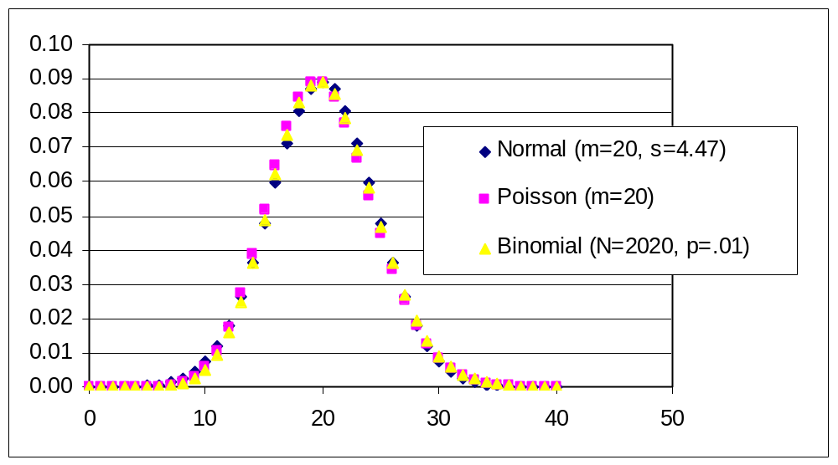
Mutations happen

Slide 44
Poisson frequency distribution as a function of X ∈ {int 0 ...∞}
P(X) = P(X-1) μ/X = μ^{x} e^{-μ}/ X! σ² = μ
n large & p small → P(X) ≅ B(X) μ = np
For example, estimating the expected number of positives
in a given sized library of cDNAs, genomic clones,
combinatorial chemistry, etc. X= # of hits.
Zero hit term = e^{-μ}

Slide 45
Normal frequency distribution as a function of X ∈ {-∞... ∞}
Z= (X-μ)/σ
Normalized (standardized) variables
N(X) = exp(-Ζ²/2) / (2πσ)^{1/2}
probability density function
npq large → N(X) ≅ B(X)

Slide 46
One DNA molecule per cell
Replicate to two DNAs.
Now segregate to two daughter cells
If totally random, half of the cells will have too many or too few.
What about human cells with 46 chromosomes (DNA molecules)?
Exactly 46 chromosomes (but any 46):
B(X) = C(n,x) p^{x} q^{n-x}
n=46*2; x=46; p=0.5
B(X)= 0.083
P(X) = μ^{x} e^{-μ}/ X!
μ=X=np=46, P(X)=0.058
But what about exactly
the correct 46?
0.5⁴⁶ = 1.4 x 10⁻¹⁴
Might this select for non random segregation?

Slide 47
What are random numbers good for?
Simulations.
Permutation statistics.
Notes:
24

Slide 48
Where do random numbers come from?
X ∈ {0,1}
perl -e "print rand(1);" 0.116790771484375
0.8798828125 0.692291259765625 0.1729736328125
excel: = RAND() 0.4854394999892640 0.6391685278993980
0.1009497853098360
f77: write(*,'(f29.15)') rand(1) 0.513854980468750
0.175720214843750 0.308624267578125
Mathematica: Random[Real, {0,1}] 0.7474293274369694
0.5081794113149011 0.02423389638451016

Slide 49
Where do random numbers come from really?
Monte Carlo.
Uniformly distributed random variates X_{i} = remainder(aX_{i-1} / m)
For example, a= 7⁵ m= 2³¹ -1
Given two X_{j} X_{k} such uniform random variates,
Normally distributed random variates can be made
(with μ_{X} = 0 σ_{X} = 1)
X_{i} = sqrt(-2log(X_{j})) cos(2πX_{k}) (NR, Press et al. p. 279-89)
Notes:
24

Slide 50
Mutations happen

Slide 51
Intro 1: Summary
Life & computers : Self-assembly required
Discrete & continuous models
Minimal life & programs
Catalysis & Replication
Differential equations
Directed graphs & pedigrees
Mutation & the Single Molecules models
Bell curve statistics
Selection & optimality
Notes:
Computation and Biology share a common obsession with strings of letters, which are translated into complex 3D and 4D structures. Evolution (biological, technical, and cultural) will probably continue to act via manipulation of symbols (A, C, G, T, 0 & 1 , A-Z) plus "selection" at the highest "systems" levels. The power of these systems lies in complexity.
Simple representations of them (fractals, surgery, and drugs) may not be as fruitful as detailed programming of the symbols aided by hierarchical models and highly-parallel testing. Local decisions no longer stay local.Examples are the Internet, computer viruses, genetically modified organisms (GMOs), replicating nanotechnology, bioterrorism, global warming, and biological species transport. Information (& education) is becoming increasingly easy to spread (and hard to control). We are on the verge of begin able to collect data on almost any system at costs of
terabytes-per-dollar.
The world is manipulating increasingly complex systems, many at steeper-than-exponential rates. Much of this is happening without much modeling. Some people predict a "singularity" in our lifetime or at least the creation of systems more intelligent (and/or more proliferative) than we are (possibly as little as 100 Teraflops/terabytes). We need to not only teach our students how to cope with this, but start thinking about how to teach these "intelligent" systems as if they were students. As integrated circuits reach their limit soon, the next generation of computers may be based on quantum computing and/or biologically inspired. We need to be able to teach our students about this revolution, and via the Internet teach anyone else listening

