Slide 1
DNA1: (Last week)
Types of mutants
Mutation, drift, selection
Binomial for each
Association studies χ² statistic
Linked & causative alleles
Alleles, Haplotypes, genotypes
Computing the first genome,
the second ...
New technologies
Random and systematic errors

Slide 2
DNA2: Aligning ancient diversity
Comparing types of alignments & algorithms
Dynamic programming
Multi-sequence alignment
Space-time-accuracy tradeoffs
Finding genes -- motif profiles
Hidden Markov Model for CpG Islands

Slide 3
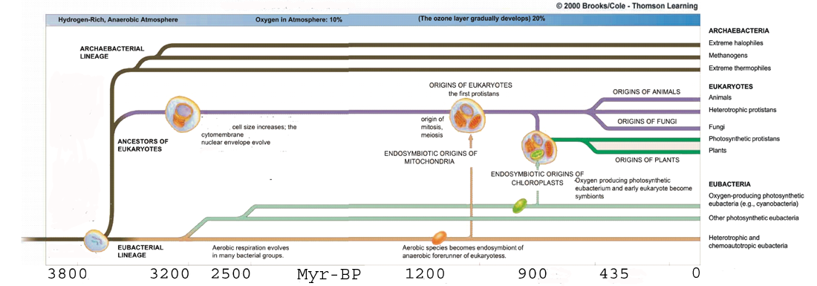
DNA2: diversity & continuity
DNA1: the last 5000 human generations
Integrate1&2: ancient genetic code
http://www.colorado.edu/epob/epob1030cornwall/fall_2001/Evolution_of_Life.gif

Slide 4
Applications of Dynamic Programming
To sequence analysis
  Shotgun sequence assembly
  Multiple alignments
  Dispersed & tandem repeats
  Bird song alignments
  Gene Expression time-warping
3D-structure alignment
Through HMMs
  RNA gene search & structure prediction
  Distant protein homologies
  Speech recognition

Slide 5
Alignments & Scores
Global (e.g. haplotype)
ACCACACA
::xx::x:
ACACCATA
Score= 5(+1) + 3(-1) = 2
Local (motif)
ACCACACA
::::
ACACCATA
Score= 4(+1) = 4
Suffix (shotgun assembly)
ACCACACA
:::
ACACCATA
Score= 3(+1) =3

Slide 6

Increasingly complex (accurate) searches
Exact (StringSearch) CGCG
Regular expression (PrositeSearch) CGN{0-9}CG = CGAACG
Substitution matrix (BlastN) CGCG ~= CACG
Profile matrix (PSI-blast) CGc(g/a) ~ = CACG
Gaps (Gap-Blast) CGCG ~= CGAACG
Dynamic Programming (NW, SM) CGCG ~= CAGACG
Hidden Markov Models (HMMER)
WU

Slide 7
"Hardness" of
(multi-) sequence alignment
Align 2 sequences of length N allowing gaps.
ACCAC-ACA ACCACACA
::x::x:x: :xxxxxx:
AC-ACCATA , A-----CACCATA , etc.
2N gap positions, gap lengths of 0 to N each:
A naïve algorithm might scale by O(N^{2N}).
For N= 3x10⁹ this is rather large.
Now, what about k>2 sequences?
or rearrangements other than gaps?

Slide 8
Testing search & classification algorithms
Separate Training set and Testing sets
Need databases of non-redundant sets.
Need evaluation criteria (programs)
Sensistivity and Specificity (false negatives & positives)
sensitivity (true_predicted/true)
specificity (true_predicted/all_predicted)
Where do training sets come from?
More expensive experiments: crystallography, genetics, biochemistry

Slide 9
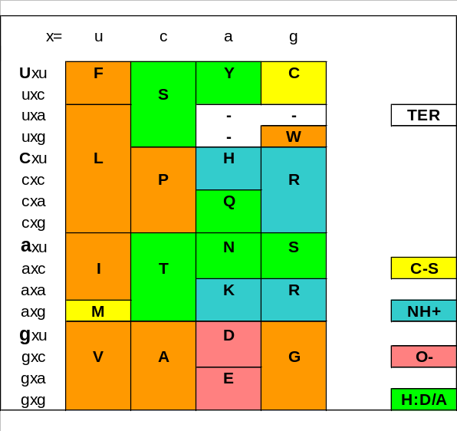
Comparisons of homology scores
Pearson WR Protein Sci 1995 Jun;4(6):1145-60
Comparison of methods for searching protein
sequence databases. Methods Enzymol 1996;266:227-58
Effective protein sequence comparison.
Algorithm: FASTA, Blastp, Blitz
Substitution matrix:PAM120, PAM250, BLOSUM50, BLOSUM62
Database: PIR, SWISS-PROT, GenPept
Switch to protein searches when possible

Slide 10
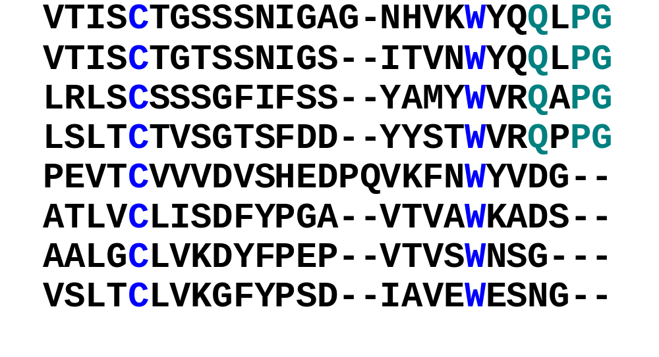
A Multiple Alignment of Immunoglobulins

Slide 11
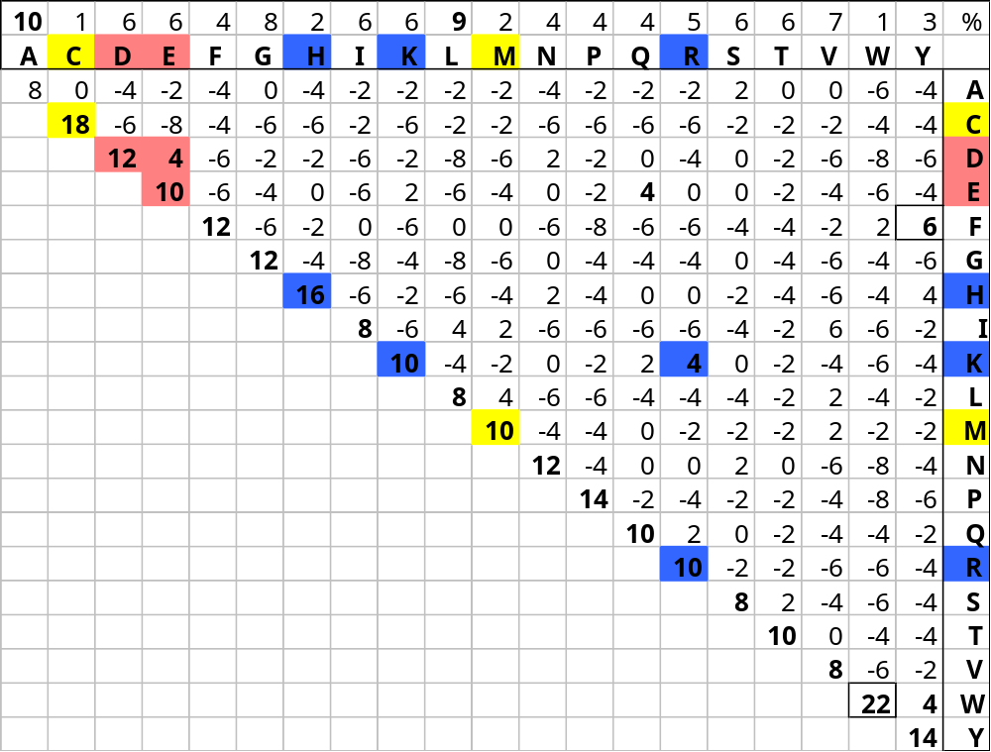
Scoring matrix based on large set of distantly related blocks: Blosum62

Slide 12
Scoring Functions and Alignments
Scoring function:
  ω(match) = +1;
  ω(mismatch) = -1;
  ω(indel) = -2;
  ω(other) = 0.
Alignment score: sum of columns.
Optimal alignment: maximum score.
} ^{substitution matrix}

Slide 13
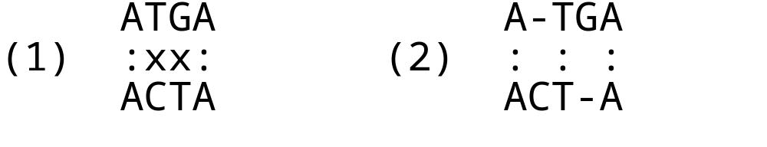
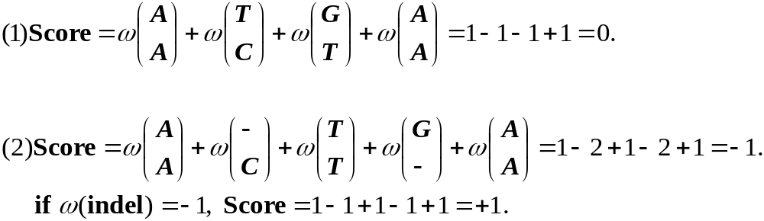
Calculating Alignment Scores

Slide 14
DNA2: Aligning ancient diversity
Comparing types of alignments & algorithms
Dynamic programming
Multi-sequence alignment
Space-time-accuracy tradeoffs
Finding genes -- motif profiles
Hidden Markov Model for CpG Islands

Slide 15
What is dynamic programming?
A dynamic programming algorithm solves every subsubproblem just once and then saves its answer in a table, avoiding the work of recomputing the answer every time the subsubproblem is encountered.
-- Cormen et al. "Introduction to Algorithms",
The MIT Press.

Slide 16
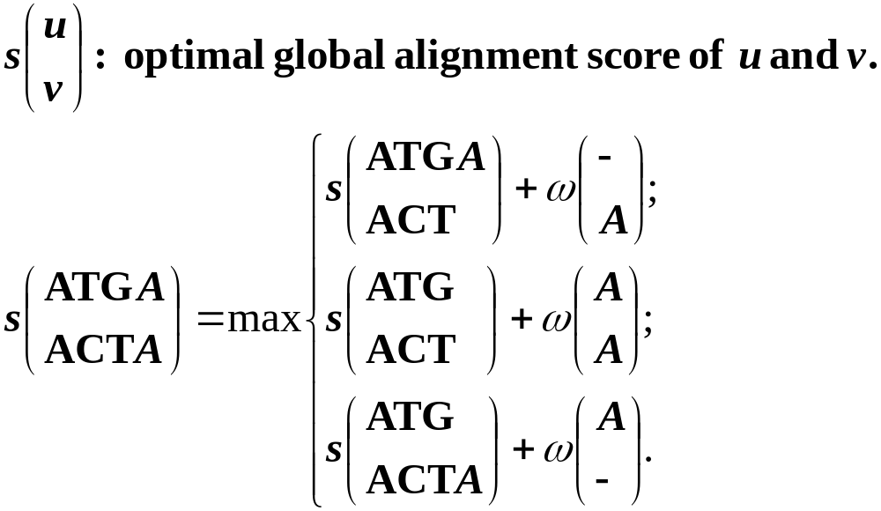
Recursion of Optimal Global Alignments

Slide 17
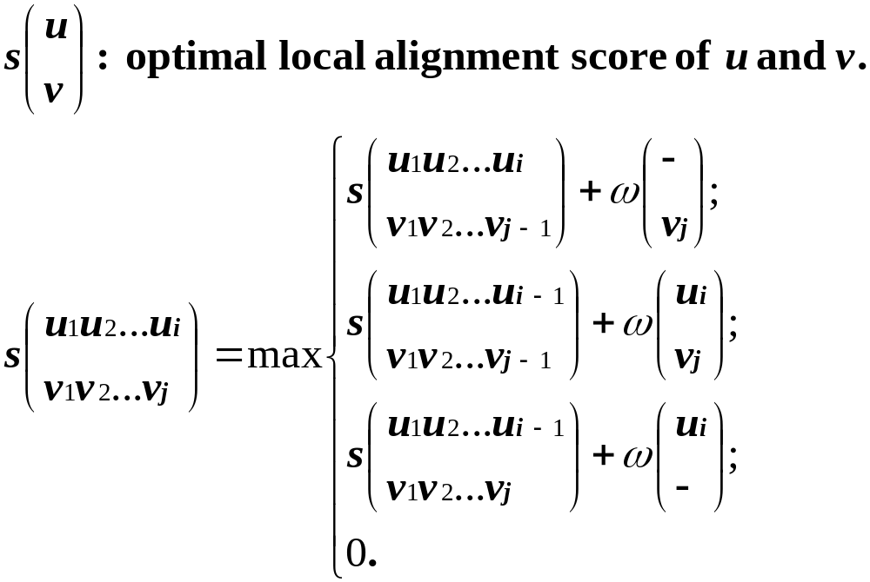
Recursion of Optimal
Local Alignments

Slide 18
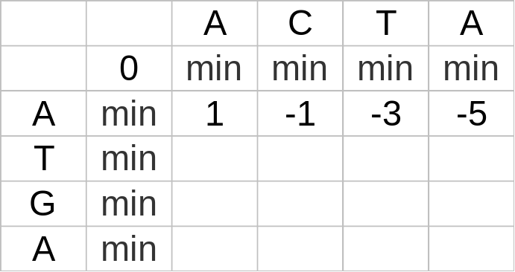
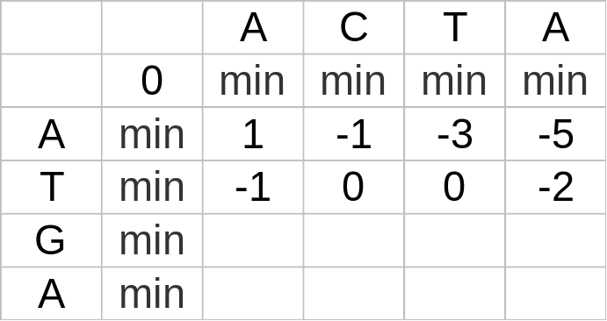
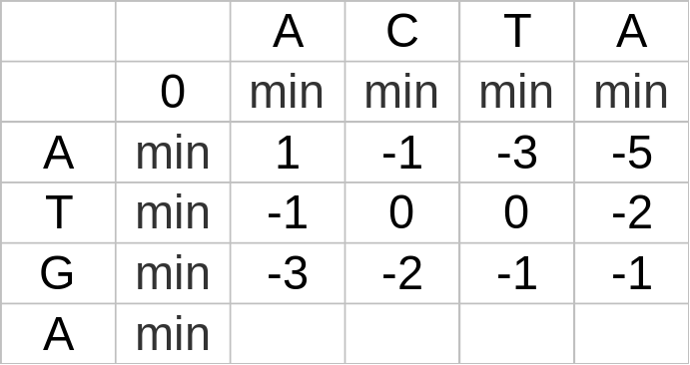
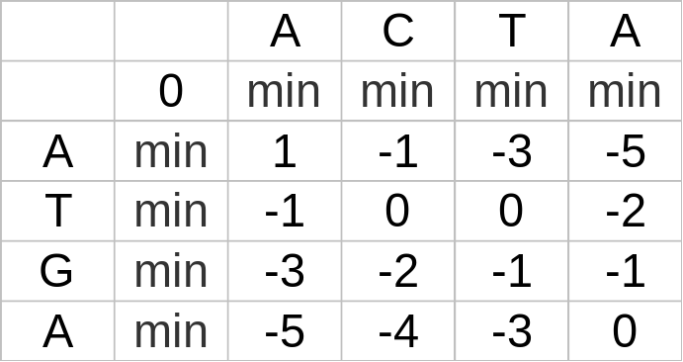
Computing Row-by-Row
min = -10⁹⁹

Slide 19
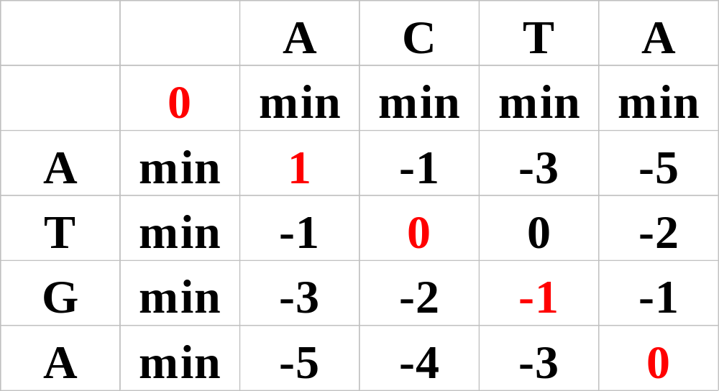
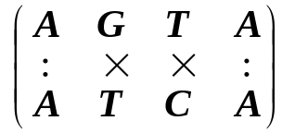
Traceback Optimal Global Alignment

Slide 20
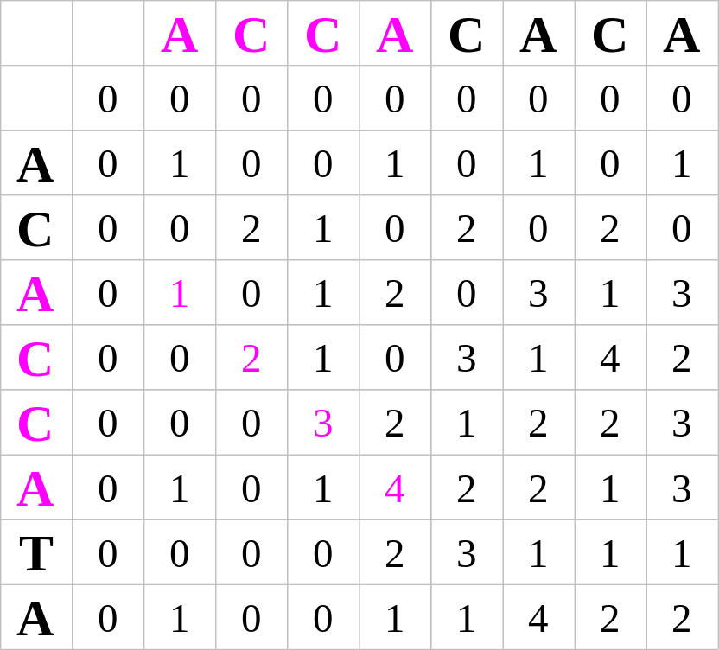
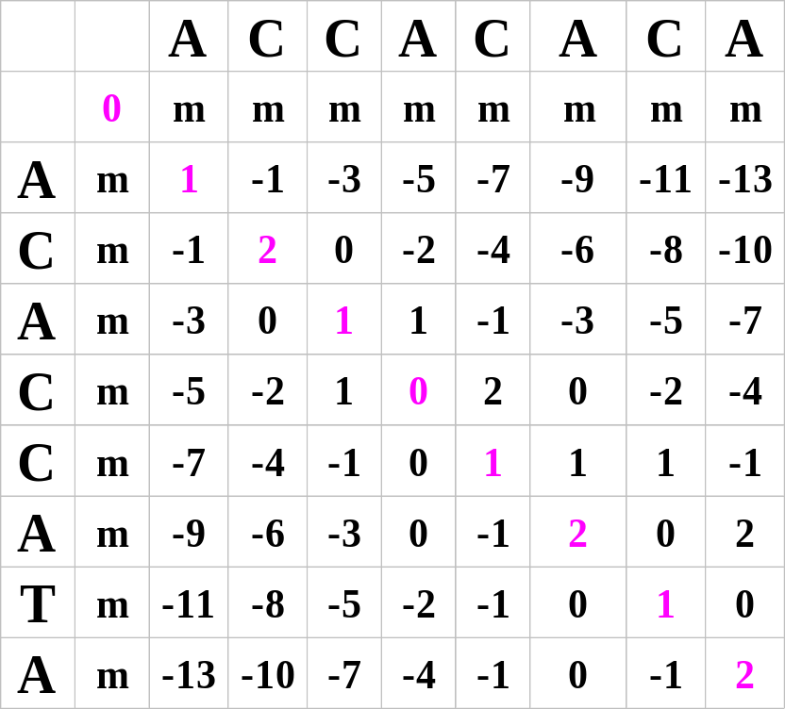
Local and Global Alignments

Slide 21
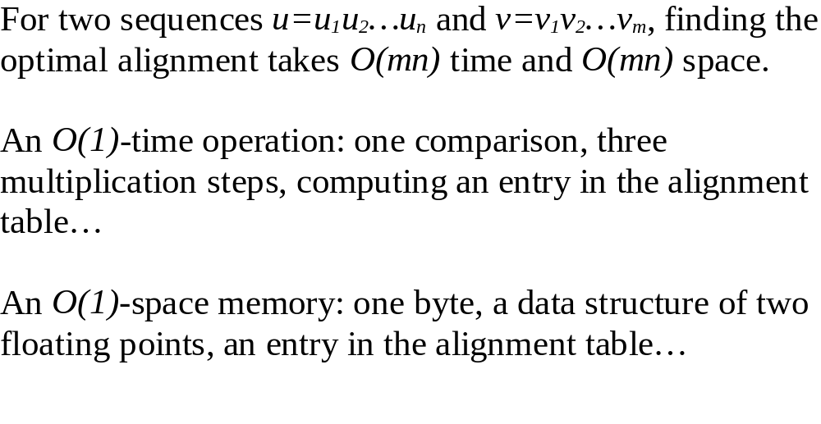
Time and Space Complexity of Computing Alignments

Slide 22
Time and Space Problems
Comparing two one-megabase genomes.
Space:
  An entry: 4 bytes;
  Table: 4 * 10^6 * 10^6 = 4 G bytes memory.
Time:
  1000 MHz CPU: 1M entries/second;
  10^12 entries: 1M seconds = 10 days.

Slide 23
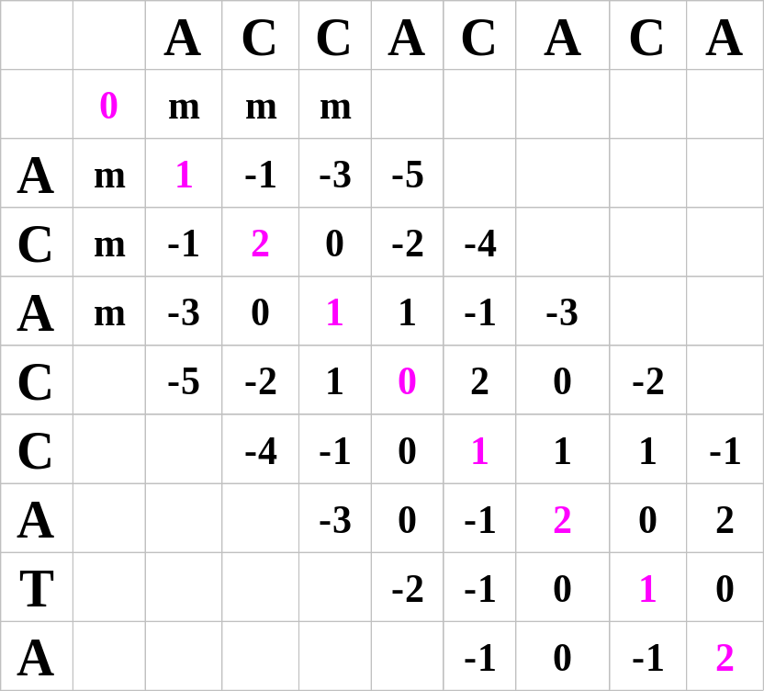
Time & Space Improvement for w-band Global Alignments
Two sequences differ by at most w bps (w<<n).
w-band algorithm: O(wn) time and space.
Example: w=3.

Slide 24
Summary
Dynamic programming
Statistical interpretation of alignments
Computing optimal global alignment
Computing optimal local alignment
Time and space complexity
Improvement of time and space
Scoring functions

Slide 25
DNA2: Aligning ancient diversity
Comparing types of alignments & algorithms
Dynamic programming
Multi-sequence alignment
Space-time-accuracy tradeoffs
Finding genes -- motif profiles
Hidden Markov Model for CpG Islands

Slide 26
A Multiple Alignment of Immunoglobulins

Slide 27
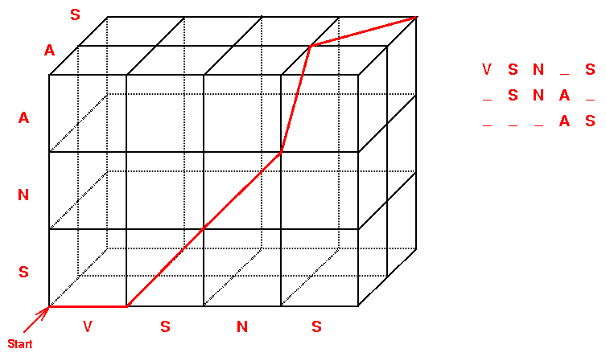
A multiple alignment <=> Dynamic programming on a hyperlattice
From G. Fullen, 1996.

Slide 28
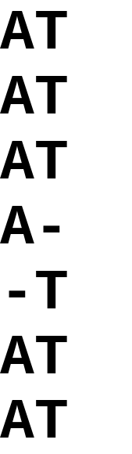
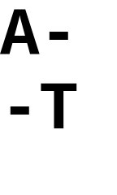
Multiple Alignment vs
Pairwise Alignment
Optimal Multiple Alignment
Non-Optimal Pairwise Alignment

Slide 29
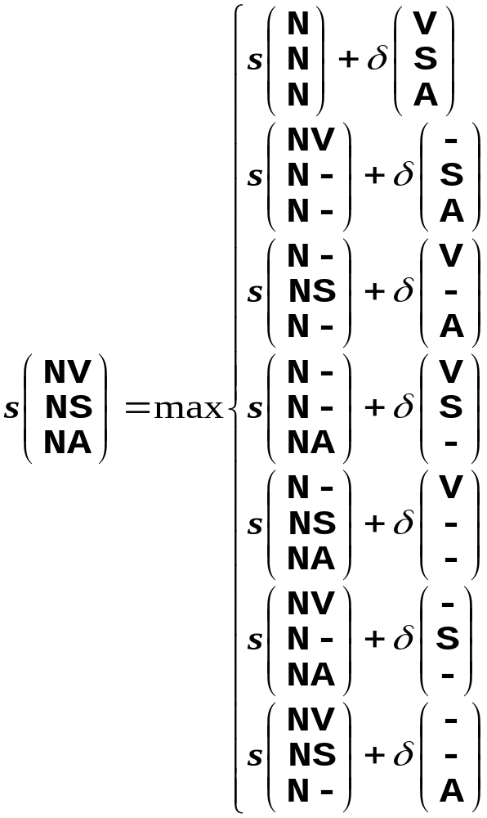
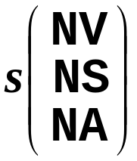
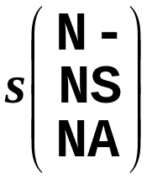
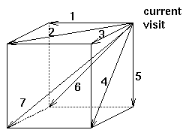
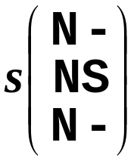
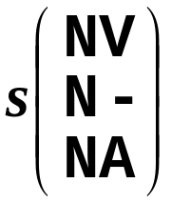
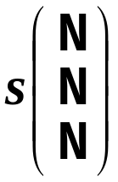
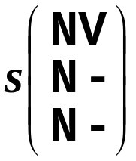
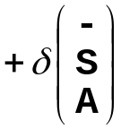
Computing a Node on Hyperlattice
k=3 2^{k} –1=7
A
S
V

Slide 30
Challenges of Optimal Multiple Alignments
Space complexity (hyperlattice size): O(n^{k}) for k sequences each n long.
Computing a hyperlattice node: O(2^{k}).
Time complexity: O(2^{k}n^{k}).
Find the optimal solution is exponential in k (non-polynomial, NP-hard).

Slide 31
Methods and Heuristics for Optimal Multiple Alignments
Optimal: dynamic programming
  Pruning the hyperlattice (MSA)
Heuristics:
  tree alignments(ClustalW)
  star alignments
  sampling (Gibbs) (discussed in RNA2)
  local profiling with iteration (PSI-Blast, ...)

Slide 32
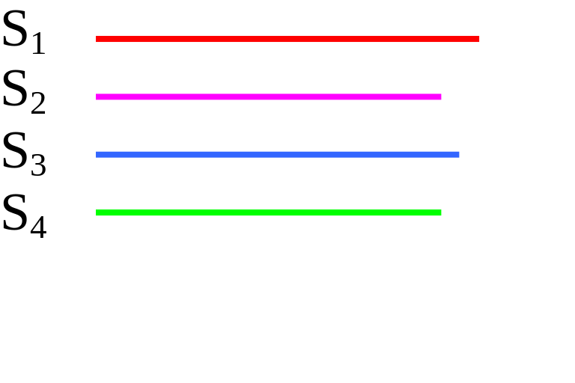
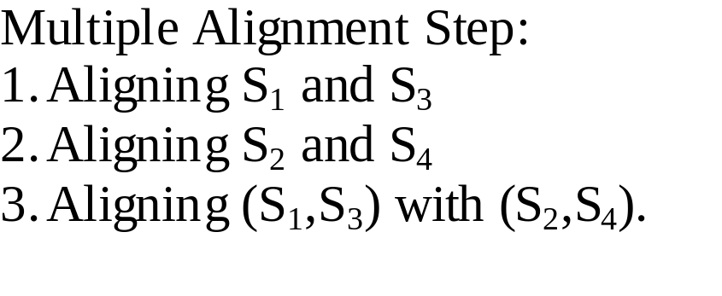
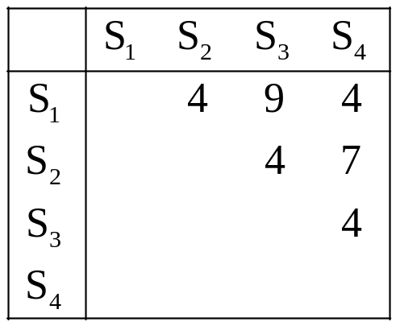
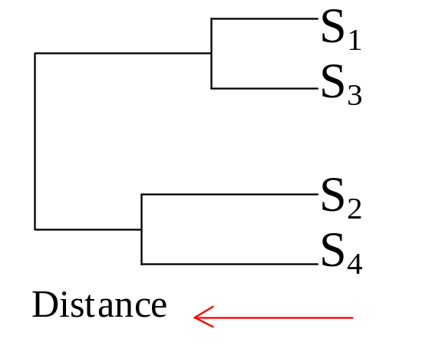
ClustalW: Progressive Multiple Alignment
All Pairwise
Alignments
Similarity Matrix
Dendrogram
Cluster Analysis
From Higgins(1991) and Thompson(1994).

Slide 33
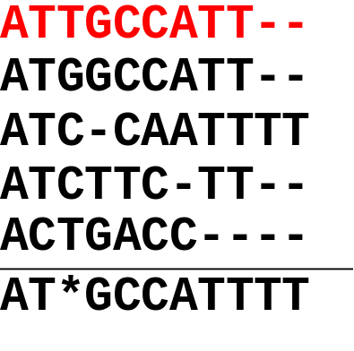
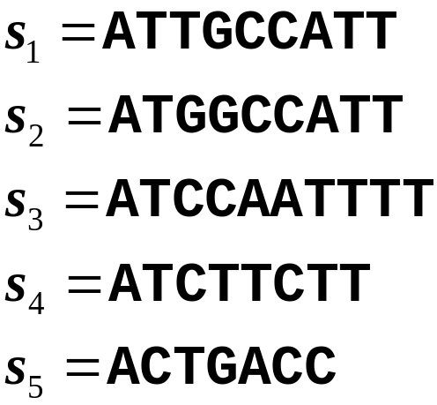
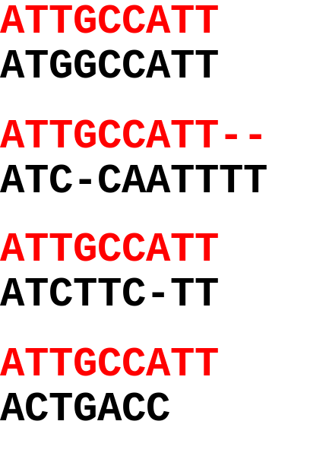
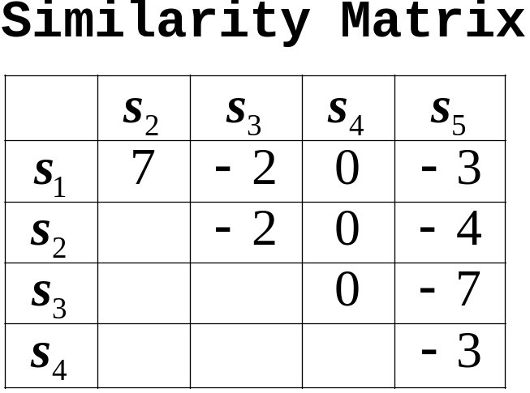
Star Alignments
Multiple Alignment
Combine into
Multiple Alignment
Pairwise Alignment
Pairwise Alignment
Find the Central
Sequence s₁

Slide 34
DNA2: Aligning ancient diversity
Comparing types of alignments & algorithms
Dynamic programming
Multi-sequence alignment
Space-time-accuracy tradeoffs
Finding genes -- motif profiles
Hidden Markov Model for CpG Islands

Slide 35
Accurately finding genes
& their edges
What is distinctive ? Failure to find edges?
0. Promoters & CGs islands Variety & combinations
1. Preferred codons Tiny proteins (& RNAs)
2. RNA splice signals Alternatives & weak motifs
3. Frame across splices Alternatives
4. Inter-species conservation Gene too close or distant
5. cDNA for splice edges Rare transcript

Slide 36
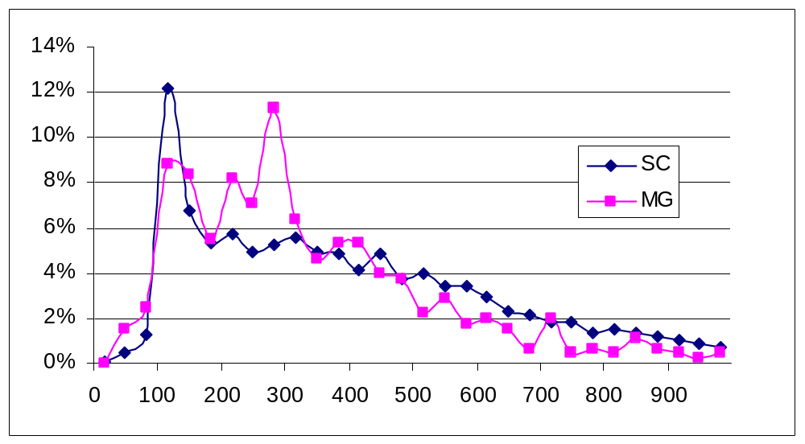
Annotated "Protein" Sizes
Yeast & Mycoplasma
Largest proteins:
Mycoplasma Gli521 4727
Yeast Midasin 4910
Human Titin 34,350
Yeast
% of proteins at length x
smallest proteins:
Mycoplasma L36 37
Yeast yjr151wa 16
x = "Protein" size in #aa
http://www.ncbi.nlm.nih.gov/entrez/
2:20[Sequence Length] AND cerevisiae

Slide 37
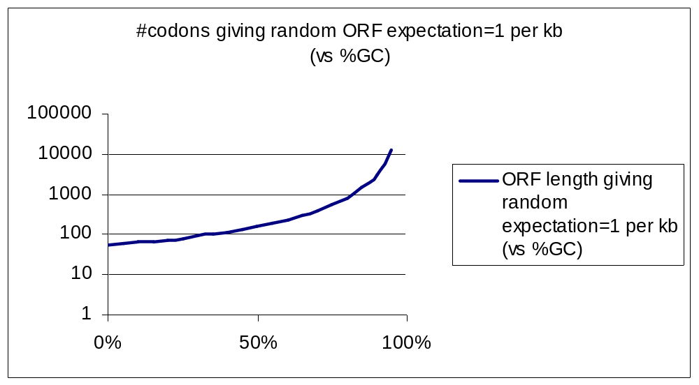
Predicting small proteins (ORFs)
min
max
Yeast

Slide 38
Small coding regions
Mutations in domain II of 23 S rRNA facilitate
translation of a 23 S rRNA-encoded pentapeptide conferring
erythromycin resistance. Dam et al. 1996 J Mol Biol 259:1-6
Trp (W) leader peptide, 14 codons:
MKAIFVLKGWWRTS
Phe (F) leader peptide, 15 codons:
MKHIPFFFAFFFTFP
His (H) leader peptide, 16 codons:
MTRVQFKHHHHHHHPD
STOP
STOP
STOP
http://www.andrew.cmu.edu/~berget/Education/attenuation/atten.html
Other examples in proteomics lectures

Slide 39
Motif Matrices
a a t g
c a t g
g a t g
t g t g
a 1 3 0 0
c 1 0 0 0
g 1 1 0 4
t 1 0 4 0
Align and calculate frequencies.
Note: Higher order correlations lost.

Slide 40
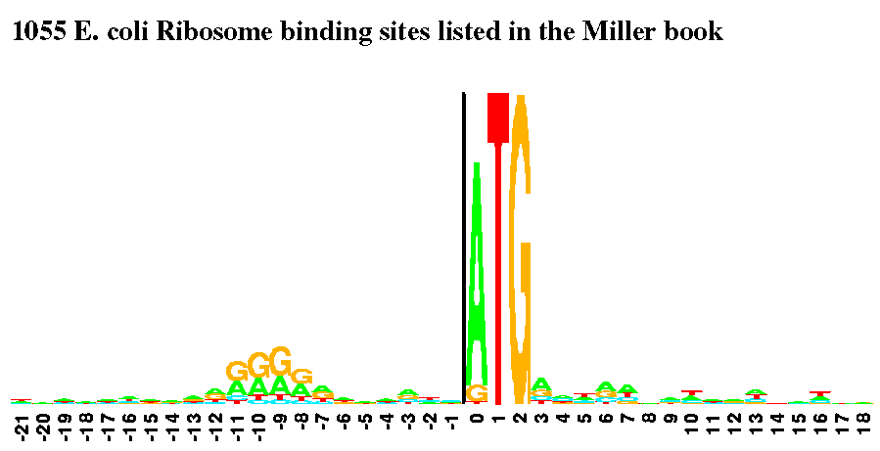
Protein starts
GeneMark

Slide 41
Motif Matrices
a a t g 1+3+4+4 = 12
c a t g 1+3+4+4 = 12
g a t g 1+3+4+4 = 12
t g t g 1+1+4+4 = 10
a 1 3 0 0
c 1 0 0 0
g 1 1 0 4
t 1 0 4 0
Align and calculate frequencies.
Note: Higher order correlations lost.
Score test sets:
a c c c 1+0+0+0 = 1

Slide 42
DNA2: Aligning ancient diversity
Comparing types of alignments & algorithms
Dynamic programming
Multi-sequence alignment
Space-time-accuracy tradeoffs
Finding genes -- motif profiles
Hidden Markov Model for CpG Islands

Slide 43
Why probabilistic models in sequence analysis?
Recognition - Is this sequence a protein start?
Discrimination - Is this protein more like a hemoglobin or a myoglobin?
Database search - What are all of sequences in SwissProt that look like a serine protease?

Slide 44
A Basic idea
Assign a number to every possible sequence such that
∑_{s}P(s|M) = 1
P(s|M) is a probability of sequence s given a model M.

Slide 45
Sequence recognition
Recognition question - What is the probability that the sequence s is from the start site model M ?
P(M|s) = P(M)* P(s|M) / P(s)
(Bayes' theorem)
P(M) and P(s) are prior probabilities and P(M|s) is posterior probability.

Slide 46
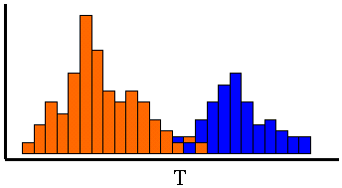
Database search
N = null model (random bases or AAs)
Report all sequences with
logP(s|M) - logP(s|N) > logP(N) - logP(M)
Example, say α/β hydrolase fold is rare in the database, about 10 in 10,000,000. The threshold is 20 bits. If considering 0.05 as a significant level, then the threshold is 20+4.4 = 24.4 bits.

Slide 47
Plausible sources of mono, di, tri, & tetra- nucleotide biases
C rare due to lack of uracil glycosylase (cytidine deamination)
TT rare due to lack of UV repair enzymes.
CG rare due to 5methylCG to TG transitions (cytidine deamination)
AGG rare due to low abundance of the corresponding Arg-tRNA.
CTAG rare in bacteria due to error-prone "repair" of CTAGG to C*CAGG.
AAAA excess due to polyA pseudogenes and/or polymerase slippage.
AmAcid Codon Number /1000 Fraction
Arg AGG 3363.00 1.93 0.03
Arg AGA 5345.00 3.07 0.06
Arg CGG 10558.00 6.06 0.11
Arg CGA 6853.00 3.94 0.07
Arg CGT 34601.00 19.87 0.36
Arg CGC 36362.00 20.88 0.37
ftp://sanger.otago.ac.nz/pub/Transterm/Data/codons/bct/Esccol.cod

Slide 48
CpG Island + in a ocean of -
First order Markov Model
Hidden
MM=16, HMM= 64 transition probabilities (adjacent bp)
P(A+|A+)
A+
T+
A-
T-
P(C-|A+)>
C+
G+
C-
G-
P(G+|C+) >

Slide 49
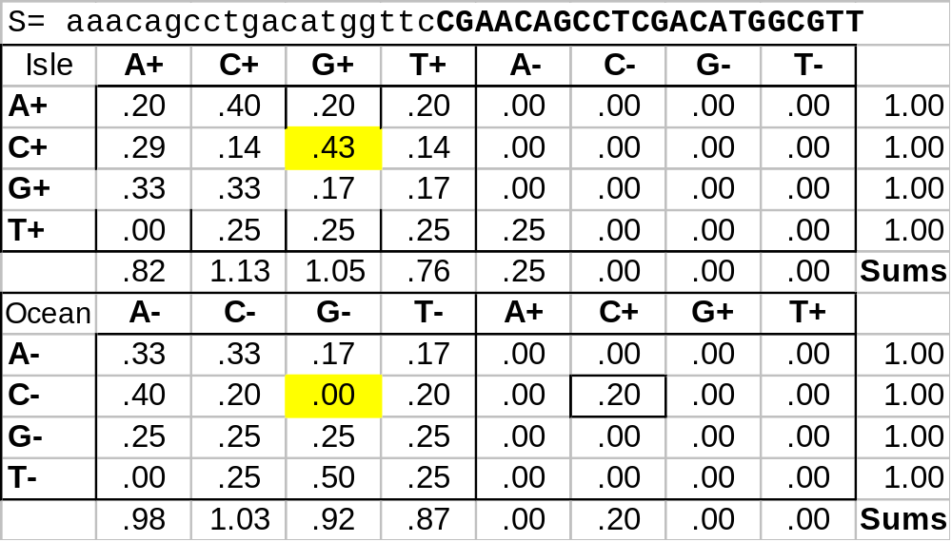
Estimate transistion probabilities -- an example
Training set
P(G|C) = 3/7 =
#(CG) / ∑_{N} #(CN)
Laplace pseudocount: Add +1 count to each observed. (p.9,108,321 Dirichlet)

Slide 50
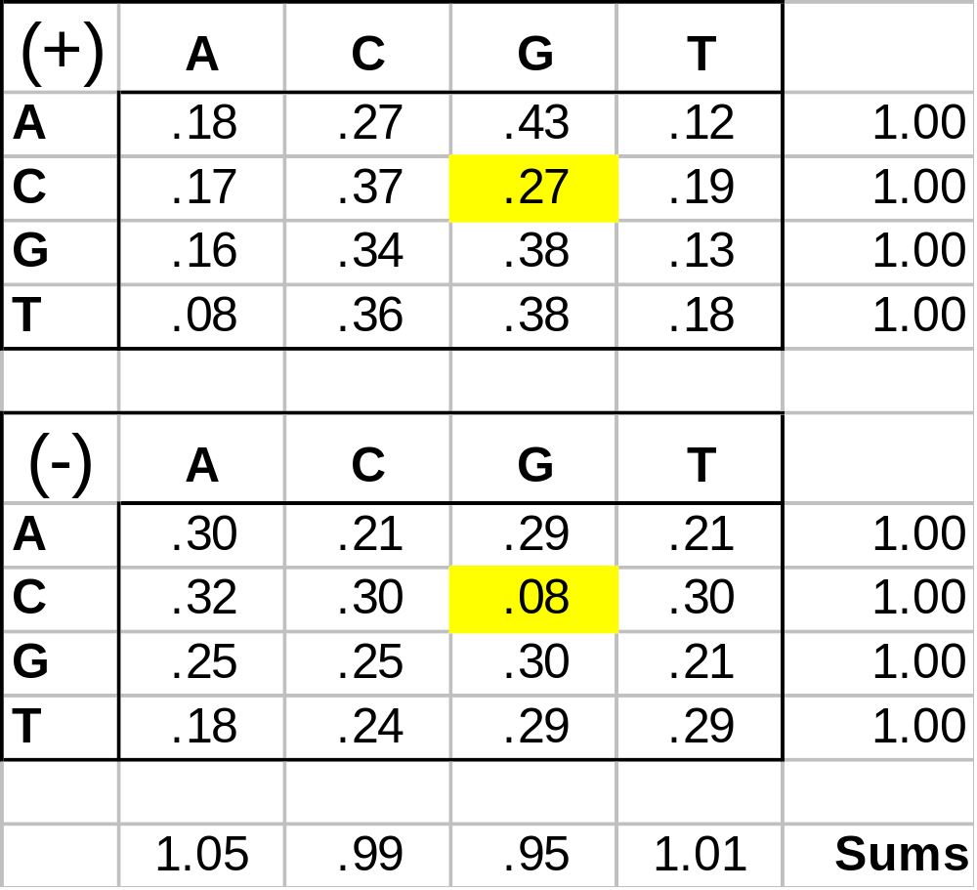
Estimated transistion probabilities from 48 "known" islands
Training set
P(G|C) =
#(CG) / ∑_{N} #(CN)

Slide 51
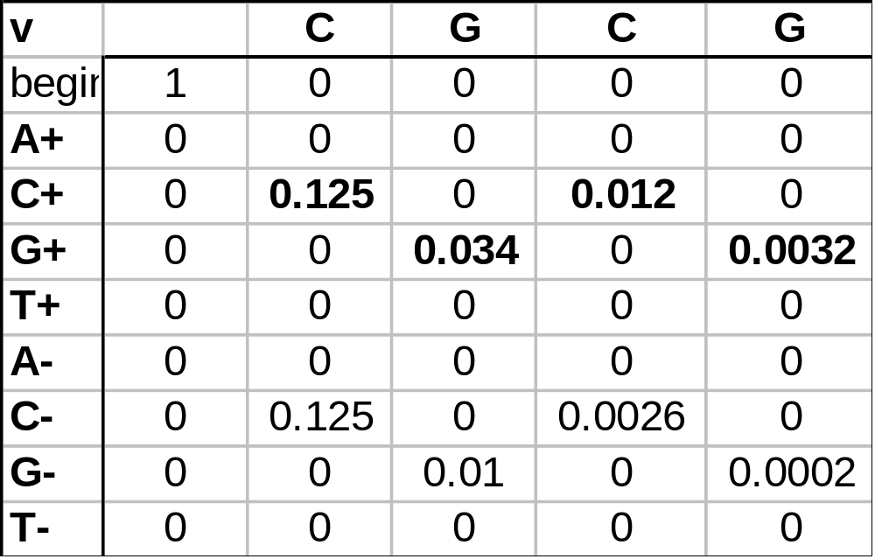
Viterbi: dynamic programming for HMM
1/8*.27
s_{i} =
Most probable path
l,k=2
states
Recursion:
v_{l}(i+1) =
e_{l}(x_{i}+1) max(v_{k}(i)a_{kl})
a= table in slide 50
e= emit s_{i} in state l (Durbin p.56)

Slide 52
DNA2: Aligning ancient diversity
Comparing types of alignments & algorithms
Dynamic programming
Multi-sequence alignment
Space-time-accuracy tradeoffs
Finding genes -- motif profiles
Hidden Markov Model for CpG Islands

