Slide 1
RNA1: Structure & Quantitation (Last week)
Integration with previous topics (HMM for RNA structure)
Goals of molecular quantitation (maximal fold-changes, clustering & classification of genes & conditions/cell types, causality)
Genomics-grade measures of RNA and protein and how we choose (SAGE, oligo-arrays, gene-arrays)
Sources of random and systematic errors (reproducibility of RNA source(s), biases in labeling, non-polyA RNAs, effects of array geometry, cross-talk).
Interpretation issues (splicing, 5' & 3' ends, editing, gene families, small RNAs, antisense, apparent absence of RNA).
Time series data: causality, mRNA decay, time-warping

Slide 2
RNA2: Clusters & Motifs
Clustering by gene and/or condition
Distance and similarity measures
Clustering & classification
Applications
DNA & RNA motif discovery & search

Slide 3
Gene Expression Clustering Decision Tree
Data Normalization | Distance Metric | Linkage | Clustering Method
Data
- Ratios
- Log Ratios
- Absolute Measurement
- Euclidean Dist.
- Manhattan Dist.
- Sup. Dist.
- Correlation Coeff.
- Single
- Complete
- Average
- Centroid
Unsupervised | Supervised
How to normalize
- Variance normalize
- Mean center normalize
- Median center normalize
- SVM
- Relevance Networks
Hierarchical | Non-hierarchical
- Minimal Spanning Tree
- K-means
- SOM
What to normalize
- genes
- conditions

Slide 4
(Whole genome) RNA quantitation objectives
RNAs showing maximum change
minimum change detectable/meaningful
RNA absolute levels (compare protein levels)
minimum amount detectable/meaningful
Classification: drugs & cancers
Network -- direct causality-- motifs

Slide 5
Clustering vs. supervised learning
Discovery:
K-means clustering
SOM = Self Organizing Maps
SVD = Singular Value Decomposition
PCA = Principal Component Analysis
Classification:
SVM = Support Vector Machine classification
& Relevance networks
Brown et al. PNAS 97:262 Butte et al PNAS 97:12182

Slide 6
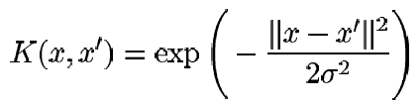
Non-linear SVM
The Kernel trick
Imagine a function φ that maps the data into another space:
X_{j}
=-1
=+1
X_{i}
φ
=-1
=+1
The function to optimize: Ld = ∑α_{i} – ½∑α_{i}α_{j}x_{i}•x_{j},
x_{i} and x_{j} as a dot product. We have φ(x_{i}) • φ(x_{j}) in the non-linear case.
If there is a ”kernel function” K(xi,xj) = φ(xi) • φ(xj), we
do not need to know φ explicitly.
(Ref)

Slide 7
Cluster analysis of mRNA expression data
By gene (rat spinal cord development, yeast cell cycle):
Wen et al., 1998; Tavazoie et al., 1999; Eisen et al., 1998; Tamayo et al., 1999
By condition or cell-type or by gene&cell-type (human cancer):
Golub, et al. 1999; Alon, et al. 1999; Perou, et al. 1999; Weinstein, et al 1997
Cheng, ISMB 2000.
.
Rana.lbl.gov/EisenSoftware.htm

Slide 8
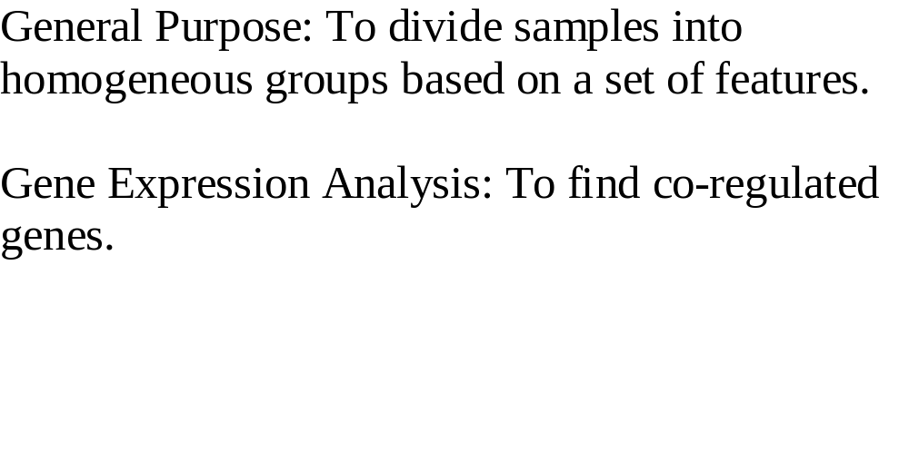
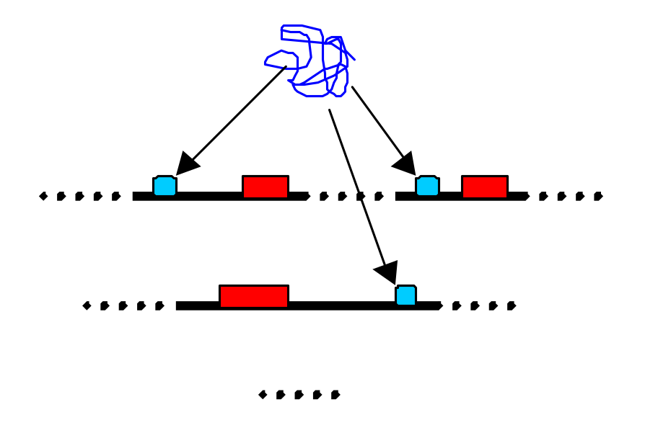
Cluster Analysis
Protein/protein complex
Genes
DNA regulatory elements

Slide 9

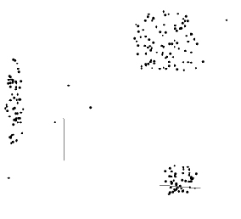
Clustering hierarchical & non-
Hierarchical: a series of successive fusions of data until a final number of clusters is obtained; e.g. Minimal Spanning Tree: each component of the population to be a cluster. Next, the two clusters with the minimum distance between them are fused to form a single cluster. Repeated until all components are grouped.
Non-: e.g. K-mean: K clusters chosen such that the points are mutually farthest apart. Each component in the population assigned to one cluster by minimum distance. The centroid's position is recalculated and repeat until all the components are grouped. The criterion minimized, is the within-clusters sum of the variance.

Slide 10
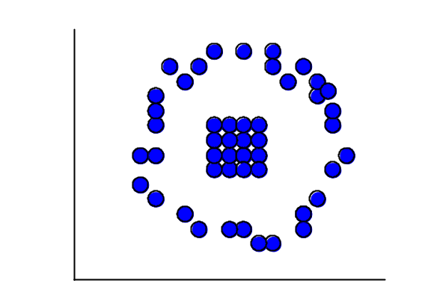
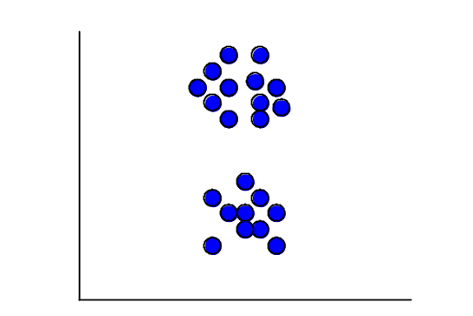
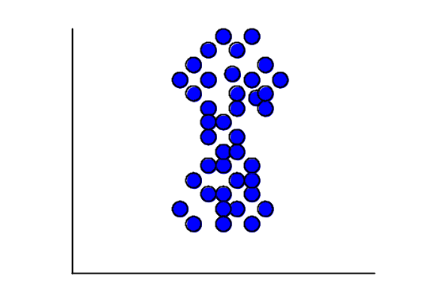
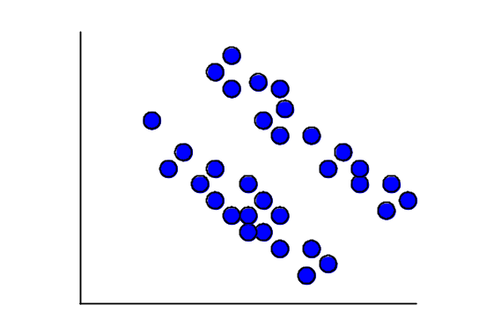
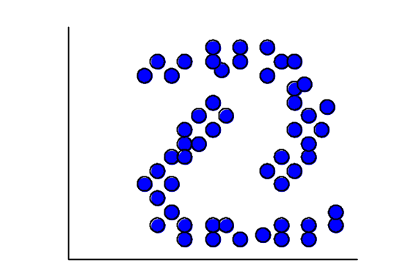
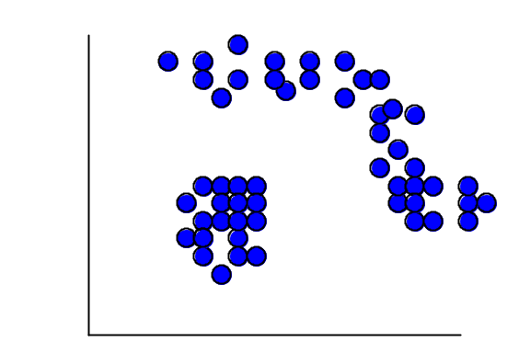
Clusters of Two-Dimensional Data

Slide 11
Key Terms in Cluster Analysis
Distance measures
Similarity measures
Hierarchical and non-hierarchical
Single/complete/average linkage
Dendrogram

Slide 12
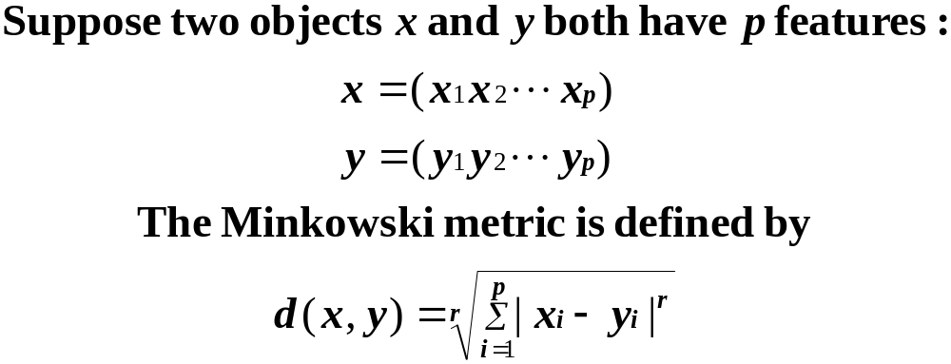
Distance Measures: Minkowski Metric

Slide 13
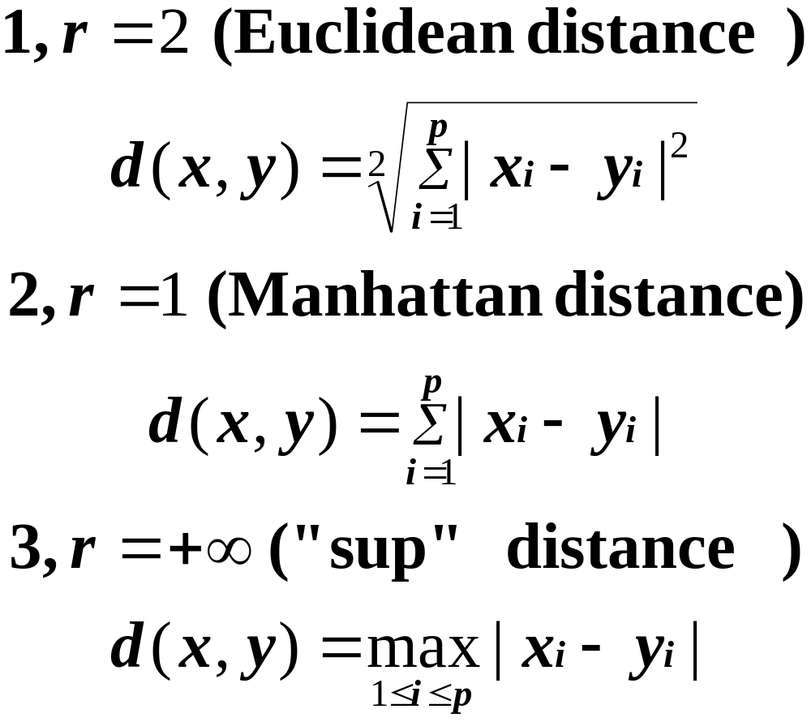
Most Common Minkowski Metrics

Slide 14
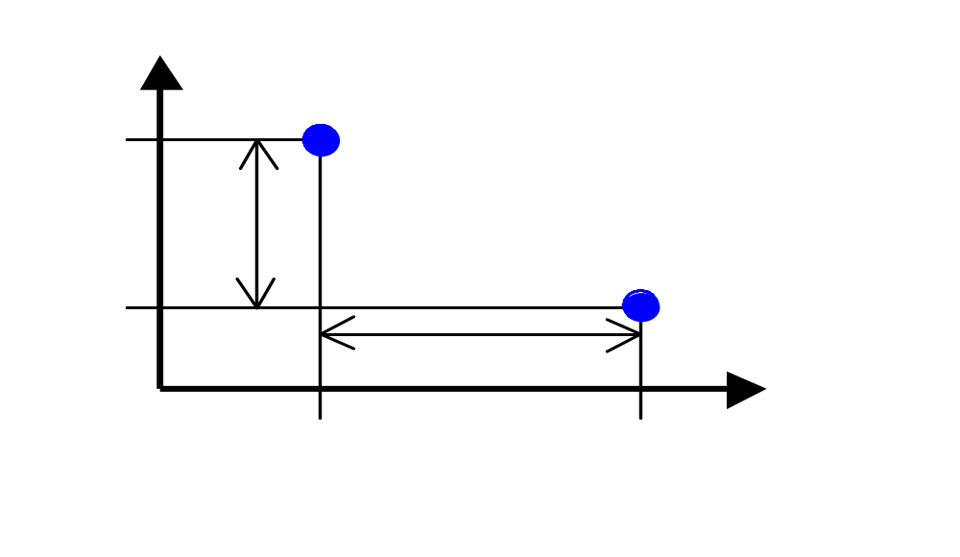
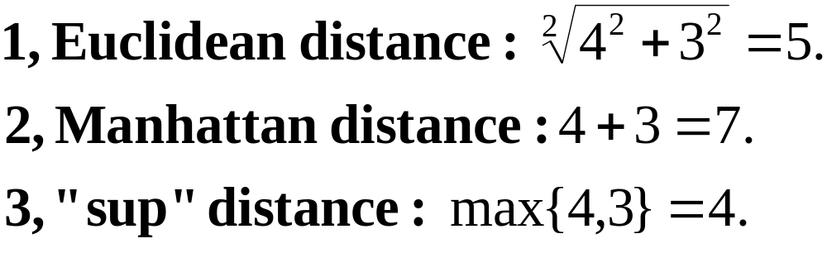
An Example
x
3
y
4

Slide 15
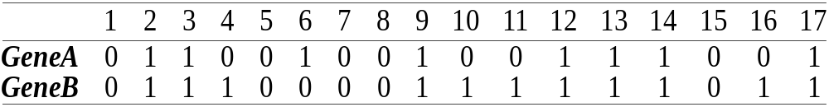
Manhattan distance is called Hamming distance when all features are binary.
Gene Expression Levels Under 17 Conditions (1-High,0-Low)

Slide 16
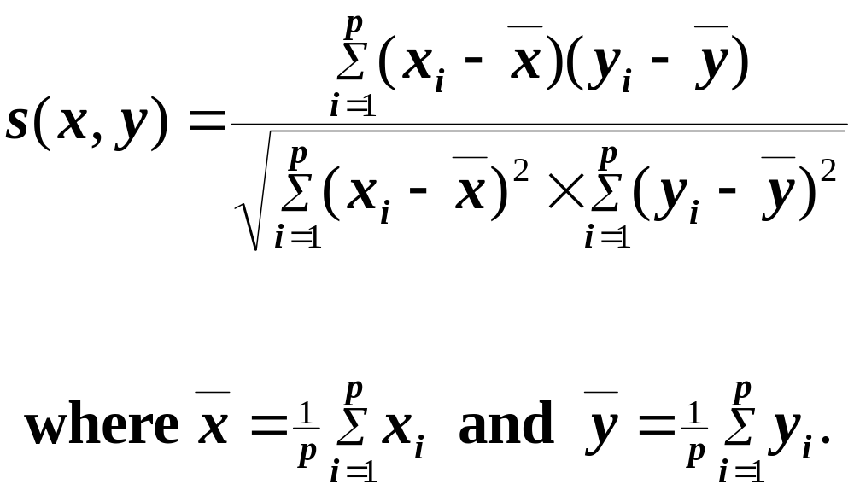
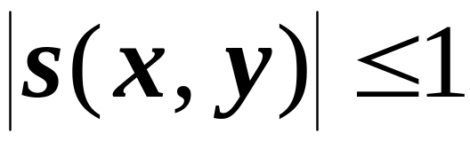
Similarity Measures: Correlation Coefficient

Slide 17
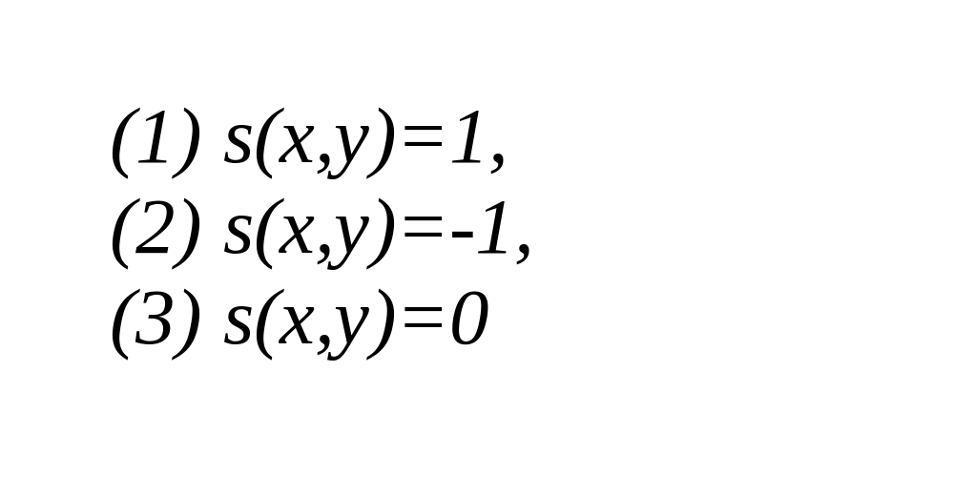
What kind of x and y give linear CC
?

Slide 18
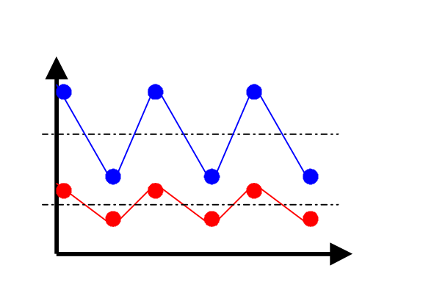
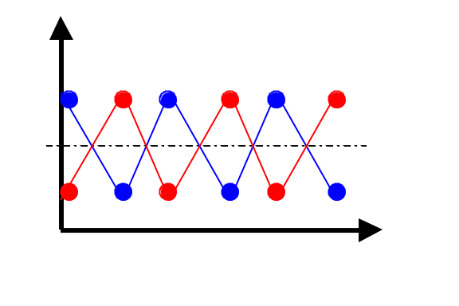
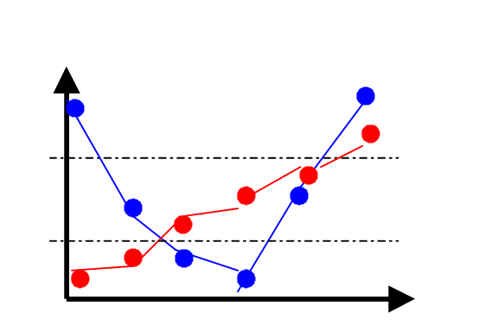
Similarity Measures: Correlation Coefficient
Expression Level
Expression Level
Gene A
Gene B
Gene B
Gene A
Time
Time
Expression Level
Gene B
Gene A
Time

Slide 19
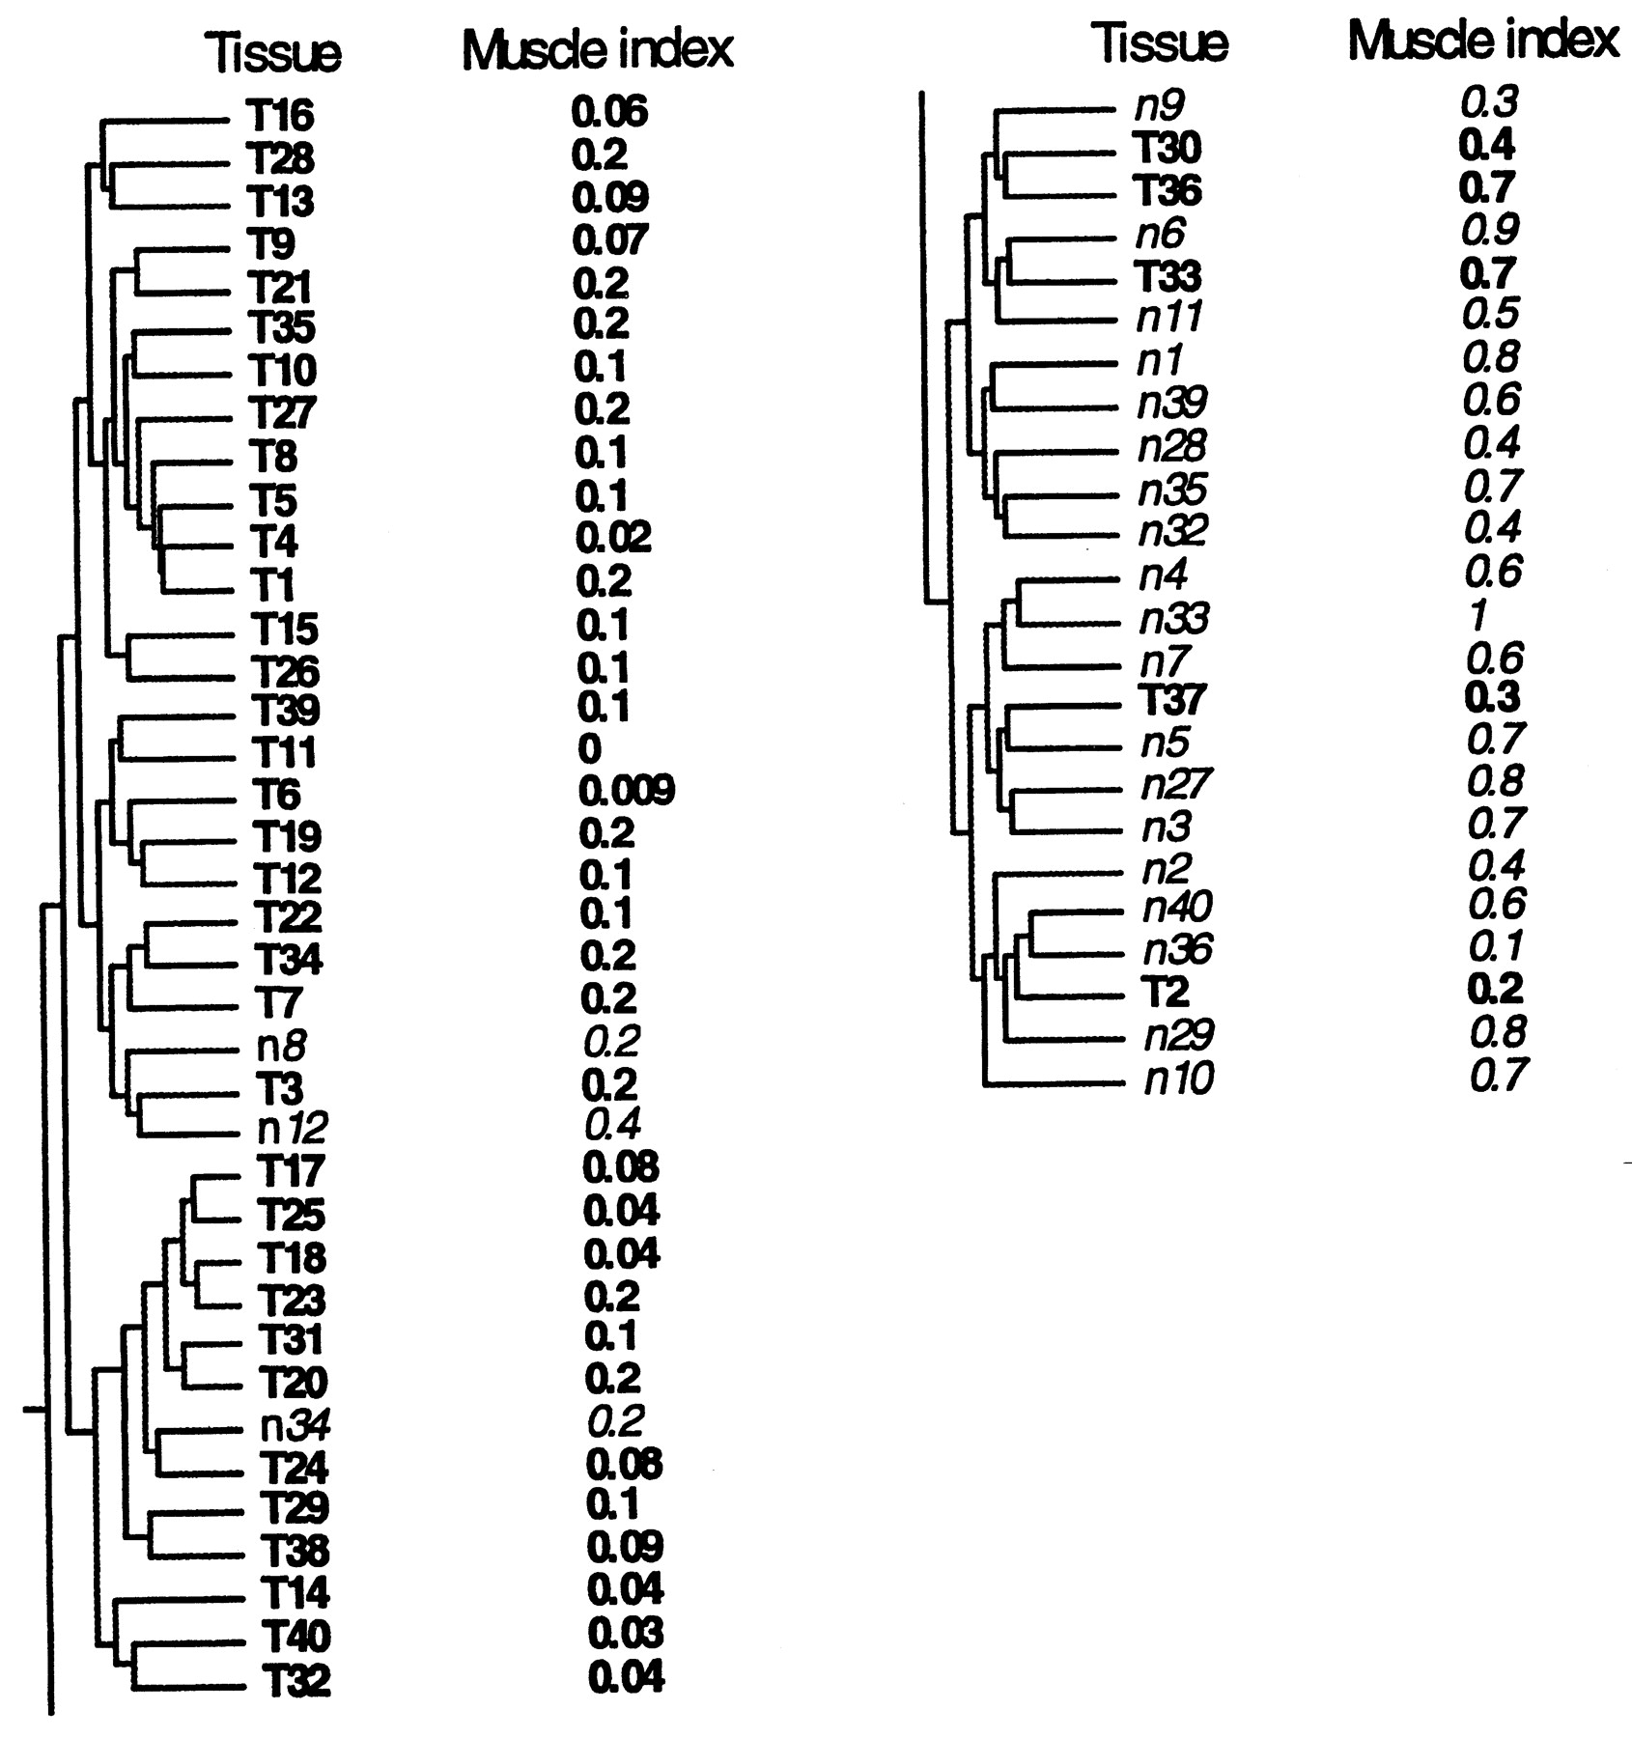
Hierarchical Clustering Dendrograms
Clustering tree for the tissue samples
Tumors(T) and normal tissue(n).
Alon et al. 1999

Slide 20
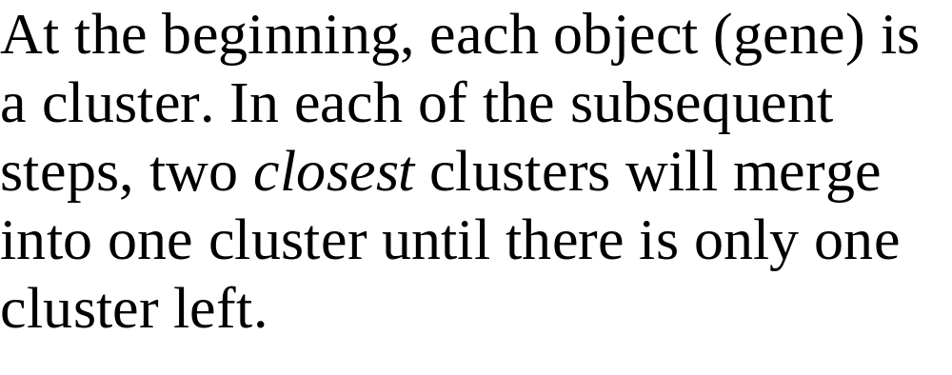
Hierarchical Clustering Techniques

Slide 21
The distance between two clusters is defined as the distance between
Single-Link Method / Nearest Neighbor: their closest members.
Complete-Link Method / Furthest Neighbor: their furthest members.
Centroid: their centroids.
Average: average of all cross-cluster pairs.

Slide 22
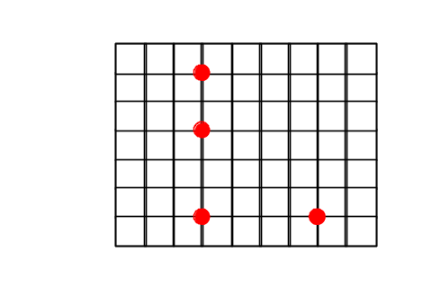
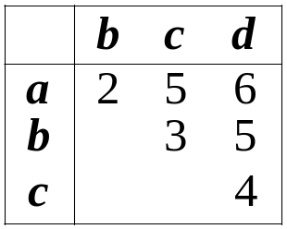
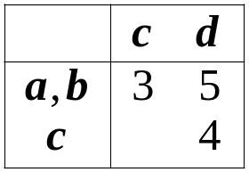
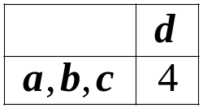
Single-Link Method
Euclidean Distance
a
a,b
b
a,b,c
a,b,c,d
c
d
c
d
d
(1)
(2)
(3)
Distance Matrix

Slide 23
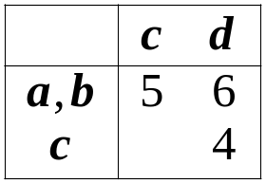
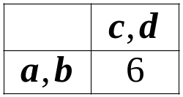
Complete-Link Method
Euclidean Distance
a
a,b
a,b
b
a,b,c,d
c,d
c
d
c
d
(1)
(2)
(3)
Distance Matrix

Slide 24
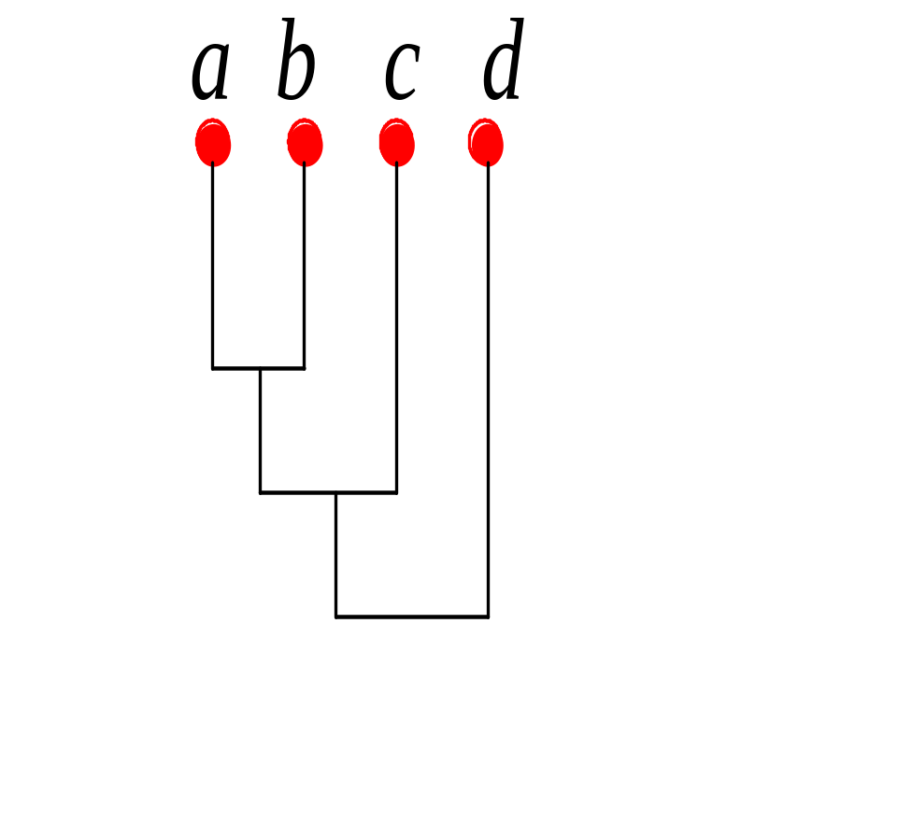
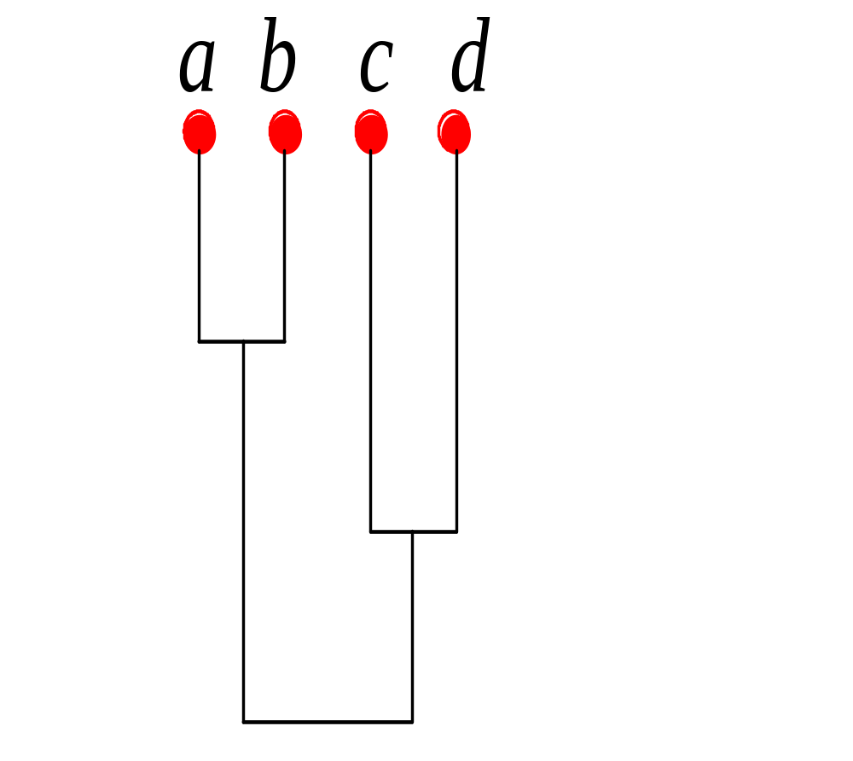
Dendrograms
Single-Link
Complete-Link
0
2
4
6

Slide 25
Which clustering methods do you suggest for the following two-dimensional data?

Slide 26
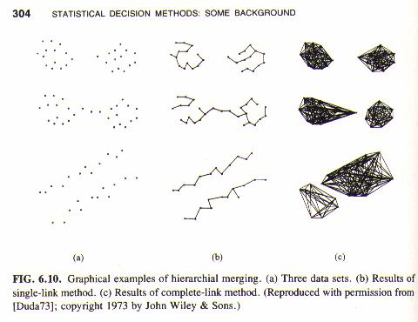
Nadler and Smith, Pattern Recognition Engineering, 1993

Slide 27
Gene Expression Clustering Decision Tree
Data Normalization | Distance Metric | Linkage | Clustering Method
Data
- Ratios
- Log Ratios
- Absolute Measurement
- Euclidean Dist.
- Manhattan Dist.
- Sup. Dist.
- Correlation Coeff.
- Single
- Complete
- Average
- Centroid
Unsupervised | Supervised
How to normalize
- Variance normalize
- Mean center normalize
- Median center normalize
- SVM
- Relevance Networks
Hierarchical | Non-hierarchical
- Minimal Spanning Tree
- K-means
- SOM
What to normalize
- genes
- conditions

Slide 28
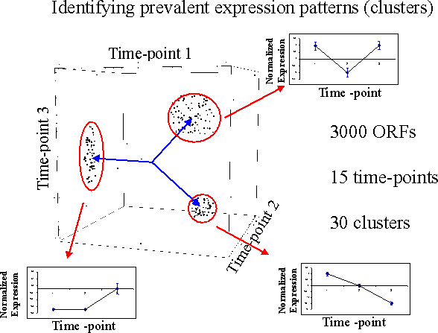

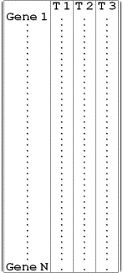
Normalized Expression Data
Tavazoie et al. 1999 (http://arep.med.harvard.edu)

Slide 29
Representation of expression data
T1
T2
T3
Gene 1
Time-point 1
Time-point 3
d_{ij}
Gene N
.
Time-point 2
Normalized Expression Data from microarrays
Gene 1
Gene 2

Slide 30
Identifying prevalent expression patterns (gene clusters)
Time-point 1
1.5
Normalized
Expression
0.5
1
-0.5
0
1
2
3
-1.5
-1
Time-point 3
Time -point
Time-point 2
1.2
1.5
Normalized
Expression
0.7
1
Normalized
Expression
0.5
0.2
0
-0.3
1
2
3
-0.5
1
2
3
-0.8
-1
-1.3
-1.5
-1.8
Time -point
-2
Time -point

Slide 31
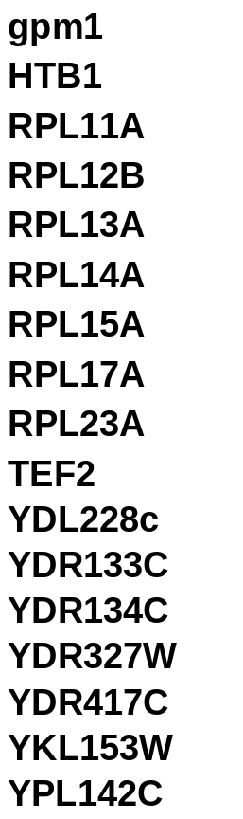
Cluster contents
Genes
MIPS functional category
Glycolysis
Nuclear Organization
Ribosome
Translation
Unknown

Slide 32
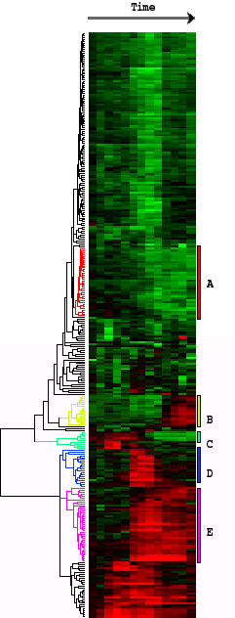
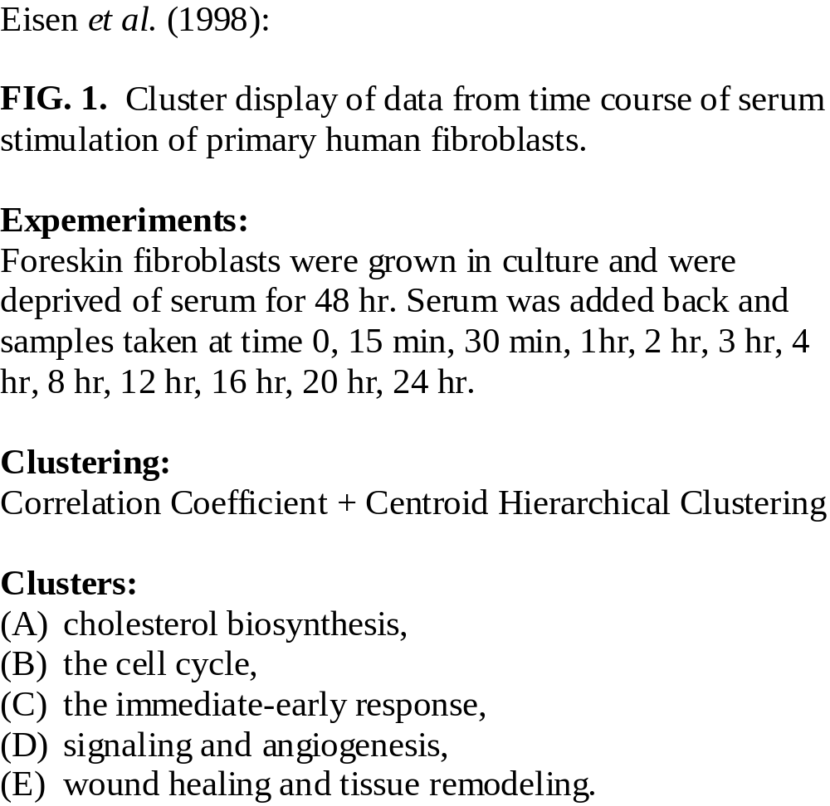

Slide 33
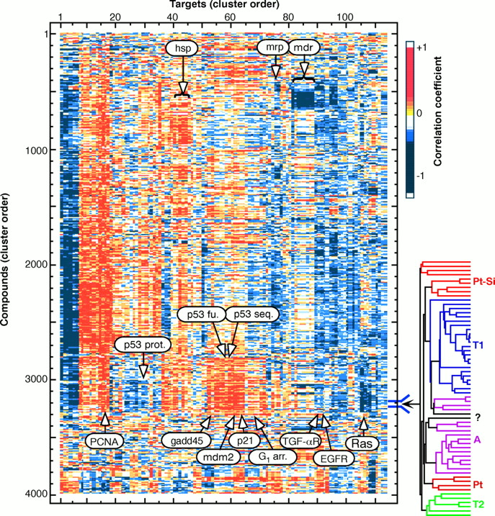
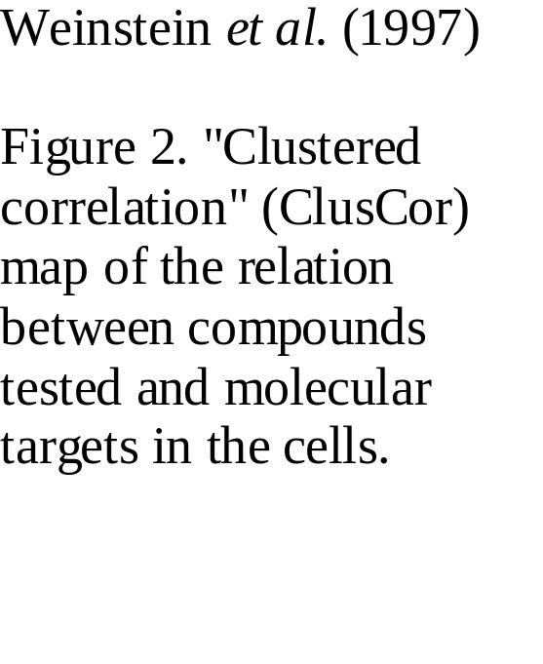

Slide 34
RNA2: Clusters & Motifs
Clustering by gene and/or condition
Distance and similarity measures
Clustering & classification
Applications
DNA & RNA motif discovery & search

Slide 35
Motif-finding algorithms
oligonucleotide frequencies
Gibbs sampling (e.g. AlignACE)
MEME (Motif Expectation Maximum for motif Elicitation)
ClustalW
MACAW

Slide 36

Feasibility of a whole-genome motif search?
Genome:
(12 Mb)
Transcription control sites
(~7 bases of information)
7 bases of information (14 bits) ~ 1 match every 16000 sites.
1500 such matches in a 12 Mb genome (24 * 10⁶ sites).
The distribution of numbers of sites for different motifs is Poisson with mean 1500, which can be approximated as normal with a mean of 1500 and a standard deviation of ~40 sites.
Therefore, ~100 sites are needed to achieve a detectable signal above background.

Slide 37
Sequence Search Space Reduction
Whole-genome mRNA expression data: two-way comparisons between different conditions or mutants, clustering/grouping over many conditions/timepoints.
Shared phenotype (functional category).
Conservation among different species.
Details of the sequence selection: eliminate protein-coding regions, repetitive regions, and any other sequences not likely to contain control sites.

Slide 38
Sequence Search Space Reduction
Whole-genome mRNA expression data: two-way comparisons between different conditions or mutants, clustering/grouping over many conditions/timepoints.
Shared phenotype (functional category).
Conservation among different species.
Details of the sequence selection: eliminate protein-coding regions, repetitive regions, and any other sequences not likely to contain control sites.

Slide 39
Motif Finding
AlignACE
(Aligns nucleic Acid Conserved Elements)
Modification of Gibbs Motif Sampling (GMS), a routine for motif finding in protein sequences (Lawrence, et al. Science 262:208-214, 1993).
Advantages of GMS/AlignACE:
  stochastic sampling
  variable number of sites per input sequence
  distributed information content per motif
  considers both strands of DNA simultaneously
  efficiently returns multiple distinct motifs

Slide 40
AlignACE Example
Input Data Set
5’- TCTCTCTCCACGGCTAATTAGGTGATCATGAAAAAATGAAAAATTCATGAGAAAAGAGTCAGACATCGAAACATACAT
…HIS7
5’- ATGGCAGAATCACTTTAAAACGTGGCCCCACCCGCTGCACCCTGTGCATTTTGTACGTTACTGCGAAATGACTCAACG
…ARO4
5’- CACATCCAACGAATCACCTCACCGTTATCGTGACTCACTTTCTTTCGCATCGCCGAAGTGCCATAAAAAATATTTTTT
…ILV6
5’- TGCGAACAAAAGAGTCATTACAACGAGGAAATAGAAGAAAATGAAAAATTTTCGACAAAATGTATAGTCATTTCTATC
…THR4
5’- ACAAAGGTACCTTCCTGGCCAATCTCACAGATTTAATATAGTAAATTGTCATGCATATGACTCATCCCGAACATGAAA
…ARO1
5’- ATTGATTGACTCATTTTCCTCTGACTACTACCAGTTCAAAATGTTAGAGAAAAATAGAAAAGCAGAAAAAATAAATAA
…HOM2
5’- GGCGCCACAGTCCGCGTTTGGTTATCCGGCTGACTCATTCTGACTCTTTTTTGGAAAGTGTGGCATGTGCTTCACACA
…PRO3
300-600 bp of upstream sequence per gene are searched in Saccharomyces cerevisiae.

Slide 41
AlignACE Example
The Target Motif
5’- TCTCTCTCCACGGCTAATTAGGTGATCATGAAAAAATGAAAAATTCATGAGAAAAGAGTCAGACATCGAAACATACAT
…HIS7
5’- ATGGCAGAATCACTTTAAAACGTGGCCCCACCCGCTGCACCCTGTGCATTTTGTACGTTACTGCGAAATGACTCAACG
…ARO4
5’- CACATCCAACGAATCACCTCACCGTTATCGTGACTCACTTTCTTTCGCATCGCCGAAGTGCCATAAAAAATATTTTTT
…ILV6
5’- TGCGAACAAAAGAGTCATTACAACGAGGAAATAGAAGAAAATGAAAAATTTTCGACAAAATGTATAGTCATTTCTATC
…THR4
5’- ACAAAGGTACCTTCCTGGCCAATCTCACAGATTTAATATAGTAAATTGTCATGCATATGACTCATCCCGAACATGAAA
…ARO1
5’- ATTGATTGACTCATTTTCCTCTGACTACTACCAGTTCAAAATGTTAGAGAAAAATAGAAAAGCAGAAAAAATAAATAA
…HOM2
5’- GGCGCCACAGTCCGCGTTTGGTTATCCGGCTGACTCATTCTGACTCTTTTTTGGAAAGTGTGGCATGTGCTTCACACA
…PRO3
AAAAGAGTCA
AAATGACTCA
AAGTGAGTCA
AAAAGAGTCA
GGATGAGTCA
AAATGAGTCA
GAATGAGTCA
AAAAGAGTCA
MAP score = 20.37 (maximum)
**********

Slide 42
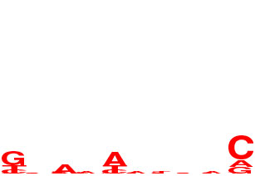
AlignACE Example
Initial Seeding
5’- TCTCTCTCCACGGCTAATTAGGTGATCATGAAAAAATGAAAAATTCATGAGAAAAGAGTCAGACATCGAAACATACAT
5’- TCTCTCTCCACGGCTAATTAGGTGATCATGAAAAAATGAAAAATTCATGAGAAAAGAGTCAGACATCGAAACATACAT
…HIS7
5’- ATGGCAGAATCACTTTAAAACGTGGCCCCACCCGCTGCACCCTGTGCATTTTGTACGTTACTGCGAAATGACTCAACG
…ARO4
5’- ATGGCAGAATCACTTTAAAACGTGGCCCCACCCGCTGCACCCTGTGCATTTTGTACGTTACTGCGAAATGACTCAACG
5’- CACATCCAACGAATCACCTCACCGTTATCGTGACTCACTTTCTTTCGCATCGCCGAAGTGCCATAAAAAATATTTTTT
…ILV6
5’- CACATCCAACGAATCACCTCACCGTTATCGTGACTCACTTTCTTTCGCATCGCCGAAGTGCCATAAAAAATATTTTTT
5’- TGCGAACAAAAGAGTCATTACAACGAGGAAATAGAAGAAAATGAAAAATTTTCGACAAAATGTATAGTCATTTCTATC
5’- TGCGAACAAAAGAGTCATTACAACGAGGAAATAGAAGAAAATGAAAAATTTTCGACAAAATGTATAGTCATTTCTATC
…THR4
5’- ACAAAGGTACCTTCCTGGCCAATCTCACAGATTTAATATAGTAAATTGTCATGCATATGACTCATCCCGAACATGAAA
…ARO1
5’- ATTGATTGACTCATTTTCCTCTGACTACTACCAGTTCAAAATGTTAGAGAAAAATAGAAAAGCAGAAAAAATAAATAA
…HOM2
5’- GGCGCCACAGTCCGCGTTTGGTTATCCGGCTGACTCATTCTGACTCTTTTTTGGAAAGTGTGGCATGTGCTTCACACA
…PRO3
TGAAAAATTC
TGAAAAATTC
GACATCGAAA
GACATCGAAA
GCACTTCGGC
GCACTTCGGC
GAGTCATTAC
GAGTCATTAC
GTAAATTGTC
GTAAATTGTC
CCACAGTCCG
CCACAGTCCG
TGTGAAGCAC
TGTGAAGCAC
MAP score = -10.0
**********
**********

Slide 43
AlignACE Example
Sampling
Add?
5’- TCTCTCTCCACGGCTAATTAGGTGATCATGAAAAAATGAAAAATTCATGAGAAAAGAGTCAGACATCGAAACATACAT
…HIS7
5’- ATGGCAGAATCACTTTAAAACGTGGCCCCACCCGCTGCACCCTGTGCATTTTGTACGTTACTGCGAAATGACTCAACG
…ARO4
5’- CACATCCAACGAATCACCTCACCGTTATCGTGACTCACTTTCTTTCGCATCGCCGAAGTGCCATAAAAAATATTTTTT
…ILV6
5’- TGCGAACAAAAGAGTCATTACAACGAGGAAATAGAAGAAAATGAAAAATTTTCGACAAAATGTATAGTCATTTCTATC
…THR4
5’- ACAAAGGTACCTTCCTGGCCAATCTCACAGATTTAATATAGTAAATTGTCATGCATATGACTCATCCCGAACATGAAA
…ARO1
5’- ATTGATTGACTCATTTTCCTCTGACTACTACCAGTTCAAAATGTTAGAGAAAAATAGAAAAGCAGAAAAAATAAATAA
…HOM2
5’- GGCGCCACAGTCCGCGTTTGGTTATCCGGCTGACTCATTCTGACTCTTTTTTGGAAAGTGTGGCATGTGCTTCACACA
…PRO3
TCTCTCTCCA
TGAAAAATTC
How much better is the alignment with this site as opposed to without?
TGAAAAATTC
GACATCGAAA
GACATCGAAA
GCACTTCGGC
GCACTTCGGC
GAGTCATTAC
GAGTCATTAC
GTAAATTGTC
GTAAATTGTC
CCACAGTCCG
CCACAGTCCG
TGTGAAGCAC
TGTGAAGCAC
**********
**********

Slide 44
AlignACE Example
Continued Sampling
Add?
Remove.
5’- TCTCTCTCCACGGCTAATTAGGTGATCATGAAAAAATGAAAAATTCATGAGAAAAGAGTCAGACATCGAAACATACAT
…HIS7
5’- ATGGCAGAATCACTTTAAAACGTGGCCCCACCCGCTGCACCCTGTGCATTTTGTACGTTACTGCGAAATGACTCAACG
…ARO4
5’- CACATCCAACGAATCACCTCACCGTTATCGTGACTCACTTTCTTTCGCATCGCCGAAGTGCCATAAAAAATATTTTTT
…ILV6
5’- TGCGAACAAAAGAGTCATTACAACGAGGAAATAGAAGAAAATGAAAAATTTTCGACAAAATGTATAGTCATTTCTATC
…THR4
5’- ACAAAGGTACCTTCCTGGCCAATCTCACAGATTTAATATAGTAAATTGTCATGCATATGACTCATCCCGAACATGAAA
…ARO1
5’- ATTGATTGACTCATTTTCCTCTGACTACTACCAGTTCAAAATGTTAGAGAAAAATAGAAAAGCAGAAAAAATAAATAA
…HOM2
5’- GGCGCCACAGTCCGCGTTTGGTTATCCGGCTGACTCATTCTGACTCTTTTTTGGAAAGTGTGGCATGTGCTTCACACA
…PRO3
ATGAAAAAAT
TGAAAAATTC
How much better is the alignment with this site as opposed to without?
TGAAAAATTC
GACATCGAAA
GACATCGAAA
GCACTTCGGC
GCACTTCGGC
GAGTCATTAC
GAGTCATTAC
GTAAATTGTC
GTAAATTGTC
CCACAGTCCG
CCACAGTCCG
TGTGAAGCAC
TGTGAAGCAC
**********
**********

Slide 45
AlignACE Example
Column Sampling
5’- TCTCTCTCCACGGCTAATTAGGTGATCATGAAAAAATGAAAAATTCATGAGAAAAGAGTCAGACATCGAAACATACAT
…HIS7
5’- ATGGCAGAATCACTTTAAAACGTGGCCCCACCCGCTGCACCCTGTGCATTTTGTACGTTACTGCGAAATGACTCAACG
…ARO4
5’- CACATCCAACGAATCACCTCACCGTTATCGTGACTCACTTTCTTTCGCATCGCCGAAGTGCCATAAAAAATATTTTTT
…ILV6
5’- TGCGAACAAAAGAGTCATTACAACGAGGAAATAGAAGAAAATGAAAAATTTTCGACAAAATGTATAGTCATTTCTATC
…THR4
5’- ACAAAGGTACCTTCCTGGCCAATCTCACAGATTTAATATAGTAAATTGTCATGCATATGACTCATCCCGAACATGAAA
…ARO1
5’- ATTGATTGACTCATTTTCCTCTGACTACTACCAGTTCAAAATGTTAGAGAAAAATAGAAAAGCAGAAAAAATAAATAA
…HOM2
5’- GGCGCCACAGTCCGCGTTTGGTTATCCGGCTGACTCATTCTGACTCTTTTTTGGAAAGTGTGGCATGTGCTTCACACA
…PRO3
How much better is the alignment with this new column structure?
GACATCGAAA
GACATCGAAAC
GCACTTCGGC
GCACTTCGGCG
GAGTCATTAC
GAGTCATTACA
GTAAATTGTC
GTAAATTGTCA
CCACAGTCCG
CCACAGTCCGC
TGTGAAGCAC
TGTGAAGCACA
**********
********* *

Slide 46
AlignACE Example
The Best Motif
5’- TCTCTCTCCACGGCTAATTAGGTGATCATGAAAAAATGAAAAATTCATGAGAAAAGAGTCAGACATCGAAACATACAT
…HIS7
5’- ATGGCAGAATCACTTTAAAACGTGGCCCCACCCGCTGCACCCTGTGCATTTTGTACGTTACTGCGAAATGACTCAACG
…ARO4
5’- CACATCCAACGAATCACCTCACCGTTATCGTGACTCACTTTCTTTCGCATCGCCGAAGTGCCATAAAAAATATTTTTT
…ILV6
5’- TGCGAACAAAAGAGTCATTACAACGAGGAAATAGAAGAAAATGAAAAATTTTCGACAAAATGTATAGTCATTTCTATC
…THR4
5’- ACAAAGGTACCTTCCTGGCCAATCTCACAGATTTAATATAGTAAATTGTCATGCATATGACTCATCCCGAACATGAAA
…ARO1
5’- ATTGATTGACTCATTTTCCTCTGACTACTACCAGTTCAAAATGTTAGAGAAAAATAGAAAAGCAGAAAAAATAAATAA
…HOM2
5’- GGCGCCACAGTCCGCGTTTGGTTATCCGGCTGACTCATTCTGACTCTTTTTTGGAAAGTGTGGCATGTGCTTCACACA
…PRO3
AAAAGAGTCA
AAATGACTCA
AAGTGAGTCA
AAAAGAGTCA
GGATGAGTCA
AAATGAGTCA
GAATGAGTCA
AAAAGAGTCA
MAP score = 20.37
**********

Slide 47
AlignACE Example
Masking (old way)
5’- TCTCTCTCCACGGCTAATTAGGTGATCATGAAAAAATGAAAAATTCATGAGAAAAXAGTCAGACATCGAAACATACAT
…HIS7
5’- ATGGCAGAATCACTTTAAAACGTGGCCCCACCCGCTGCACCCTGTGCATTTTGTACGTTACTGCGAAATXACTCAACG
…ARO4
5’- CACATCCAACGAATCACCTCACCGTTATCGTGACTXACTTTCTTTCGCATCGCCGAAGTGCCATAAAAAATATTTTTT
…ILV6
5’- TGCGAACAAAAXAGTCATTACAACGAGGAAATAGAAGAAAATGAAAAATTTTCGACAAAATGTATAGTCATTTCTATC
…THR4
5’- ACAAAGGTACCTTCCTGGCCAATCTCACAGATTTAATATAGTAAATTGTCATGCATATGACTXATCCCGAACATGAAA
…ARO1
5’- ATTGATTGACTXATTTTCCTCTGACTACTACCAGTTCAAAATGTTAGAGAAAAATAGAAAAGCAGAAAAAATAAATAA
…HOM2
5’- GGCGCCACAGTCCGCGTTTGGTTATCCGGCTGACTXATTCTGACTXTTTTTTGGAAAGTGTGGCATGTGCTTCACACA
…PRO3
AAAAGAGTCA
Take the best motif found after a prescribed number of random seedings.
Select the strongest position of the motif.
Mark these sites in the input sequence, and do not allow future motifs to sample those sites.
Continue sampling.
AAATGACTCA
AAGTGAGTCA
AAAAGAGTCA
GGATGAGTCA
AAATGAGTCA
GAATGAGTCA
AAAAGAGTCA
**********

Slide 48
AlignACE Example
Masking (new way)
5’- TCTCTCTCCACGGCTAATTAGGTGATCATGAAAAAATGAAAAATTCATGAGAAAAGAGTCAGACATCGAAACATACAT
…HIS7
5’- ATGGCAGAATCACTTTAAAACGTGGCCCCACCCGCTGCACCCTGTGCATTTTGTACGTTACTGCGAAATGACTCAACG
…ARO4
5’- CACATCCAACGAATCACCTCACCGTTATCGTGACTCACTTTCTTTCGCATCGCCGAAGTGCCATAAAAAATATTTTTT
…ILV6
5’- TGCGAACAAAAGAGTCATTACAACGAGGAAATAGAAGAAAATGAAAAATTTTCGACAAAATGTATAGTCATTTCTATC
…THR4
5’- ACAAAGGTACCTTCCTGGCCAATCTCACAGATTTAATATAGTAAATTGTCATGCATATGACTCATCCCGAACATGAAA
…ARO1
5’- ATTGATTGACTCATTTTCCTCTGACTACTACCAGTTCAAAATGTTAGAGAAAAATAGAAAAGCAGAAAAAATAAATAA
…HOM2
5’- GGCGCCACAGTCCGCGTTTGGTTATCCGGCTGACTCATTCTGACTCTTTTTTGGAAAGTGTGGCATGTGCTTCACACA
…PRO3
AAAAGAGTCA
Maintain a list of all distinct motifs found.
Use CompareACE to compare subsequent motifs to those already found.
Quickly reject weaker, but similar motifs.
AAATGACTCA
AAGTGAGTCA
AAAAGAGTCA
GGATGAGTCA
AAATGAGTCA
GAATGAGTCA
AAAAGAGTCA
**********

Slide 49
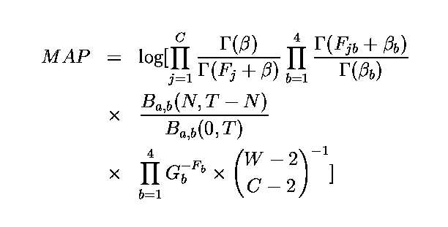
MAP Score
Β,Γ = standard Beta & Gamma functions
N = number of aligned sites; T = number of total possible sites
F_{jb} = number of occurrences of base b at position j (F = sum)
G_{b} = background genomic frequency for base b
β_{b} = n x G_{b} for n pseudocounts (β = sum)
W = width of motif; C = number of columns in motif (W>=C)

Slide 50
MAP Score
MAP ~= N log R
N = number of aligned sites
R = overrepresentation of those sites.

Slide 51












AlignACE Example:
Final Results
(alignment of upstream regions from 116 amino
acid biosynthetic genes in S. cerevisiae)
MAP score Motif
188.3
117.5
89.4
78.1
73.4
55.0
31.1
GCN4
28.1
19.3
20.6
8.2
2.7

Slide 52
Indices used to evaluate motif significance
Group specificity
Functional enrichment
Positional bias
Palindromicity
Known motifs (CompareACE)

Slide 53
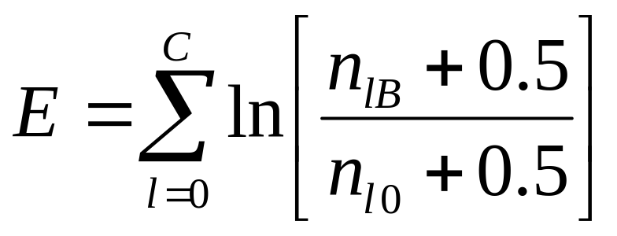
Searching for additional motif instances in the entire genome sequence
Searches over the entire genome for additional high-scoring instances
of the motif are done using the ScanACE program, which uses the Berg
& von Hippel weight matrix (1987).
C = length of binding site motif (# Columns)
B = base at position l within the motif
n_{lB}= number of occurrences of base B at position l in the input alignment
n_{lO}= number of occurrences of the most common base at position l in the
input alignment

Slide 54

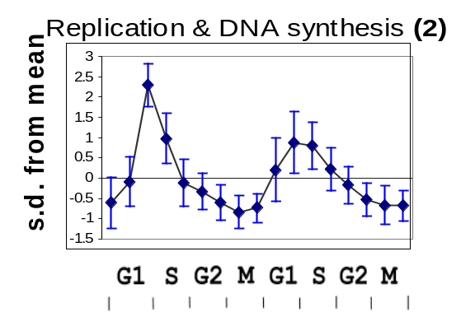
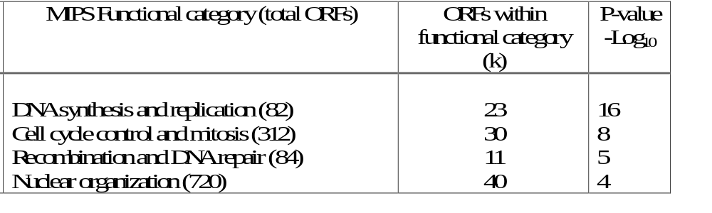
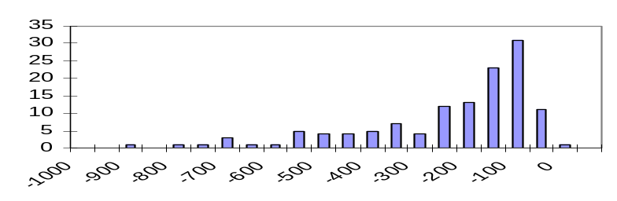
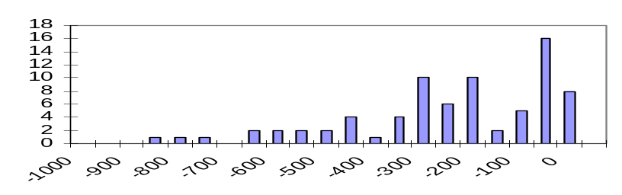
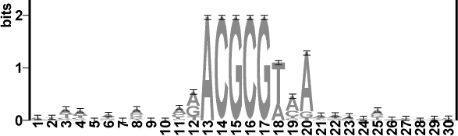
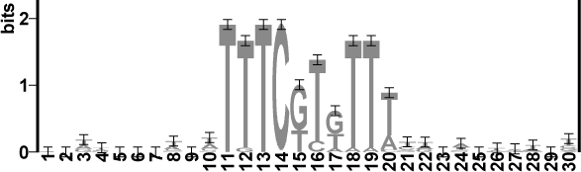
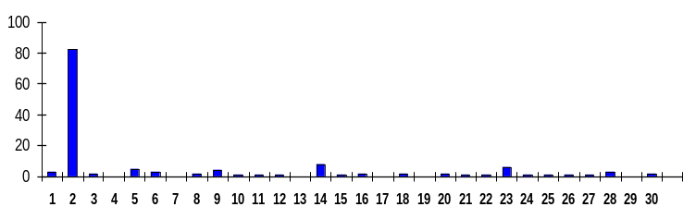
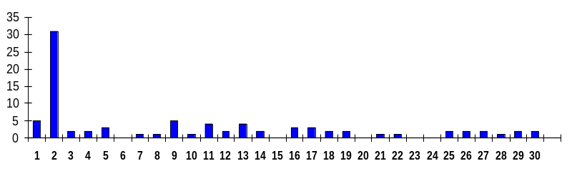
N = 186
Number of sites
Number of sites
Distance from ATG (b.p.)
Distance from ATG (b.p.)
MCB
SCB
Number of ORFs
Number of ORFs
CLUSTER
CLUSTER

Slide 55








N = 164
Number of sites
Number of sites
Distance from ATG (b.p.)
Distance from ATG (b.p.)
Rap1
M1a
Number of ORFs
Number of ORFs
CLUSTER
CLUSTER

Slide 56
Metrics of motif significance
Separate, Tag, Quantitate
RNAs or interactions
Previous
Functional
Assignments
Periodicity
Clustering
Group specificity
Positional bias
Palindromicity
CompareACE
Interaction
Motifs
Interaction
partners

Slide 57


Functional category enrichment odds
N genes total; s1 = # genes in a cluster; s2= # genes in a particular functional category (“success”); p = s2/N; N=s1+s2-x
Which odds of exactly x in that category in s1 trials?
Binomial: sampling with replacement.
or Hypergeometric: sampling without replacement:
Odds of getting exactly x = intersection of sets s1 & s2:
(Wrong!)
ref

Slide 58

Functional category enrichment
N = 6226
(S. cerevisiae)
s1
x
s2
N = Total # of genes (or ORFs) in the genome
s1 = # genes in the cluster
s2 = # genes found in a functional category
x = # ORFs in the intersection of these groups
(hypergeometric probability distribution)

Slide 59

Group Specificity Score (S_{group})
N = 6226
(S. cerevisiae)
s1
x
s2
N = Total # of genes (ORFs) in the genome
s1 = # genes whose upstream sequences were used to align the motif (cluster)
s2 = # genes in the target list (~ 100 genes in the genome with the best sites for the motif near their translational starts)
x = # genes in the intersection of these groups

Slide 60

Positional Bias
(Binomial)
t = number of sites within 600 bp of translational start from among the best 200 being considered
m = number of sites in the most enriched 50-bp window
s = 600 bp
w = 50 bp
Start
-600 bp
50 bp

Slide 61
Comparisons of motifs
The CompareACE program finds best alignment between two motifs and calculates the correlation between the two position-specific scoring matrices
Similar motifs: CompareACE score > 0.7

Slide 62
Clustering motifs by similarity
Cluster motifs using a similarity matrix
consisting of all pairwise CompareACE scores
A B C D
A 1.0 0.9 0.1 0.0
B 1.0 0.2 0.1
C 1.0 0.4
D 1.0
motif A
motif B
motif C
motif D
CompareACE
Hierarchical
Clustering
cluster 1: A, B
cluster 2: C, D

Slide 63




Palindromicity
CompareACE score of a motif versus its reverse complement
Palindromes: CompareACE > 0.7
Selected palindromicity values:
PurR
ArgR
0.97
0.92
Crp
CpxR
0.92
0.39

Slide 64

S. cerevisiae AlignACE test set

Slide 65

Most specific motifs
(ranked by S_{group})

Slide 66

Most positionally biased motifs

Slide 67
Negative Controls
250 AlignACE runs on 50 groups each of 20, 40, 60, 80,and 100 orfs, resulting in 3692 motifs.
Allows calibration of an expected false positive rate for a set of hypotheses resulting from any chosen cutoffs.
Example:
MAP > 10.0
Spec. < 1e-5
Functional Categories
82 motifs (24 known)
Random Runs
41 motifs
Computational identification of cis-regulatory elements associated with groups of functionally related genes in S. cerevisiae Hughes, et al JMB, 1999.

Slide 68
Positive Controls
29 transcription factors listed on the CSH web site have five or more known binding sites. AlignACE was run on the upstream regions of the corresponding genes.
An appropriate motif was found in 21/29 cases.
5/8 false negatives were found in appropriate functional category AlignACE runs.
False negative rate = ~ 10-30 %

Slide 69
Establishing regulatory connections
Generalizing & reducing assumptions:
Motif Interactions: (Pilpel et al 2001 Nat Gen )
Which protein(s): in vivo crosslinking
Interdependence of column in weight matrices: array binding (Bulyk et al 2001PNAS 98: 7158)

Slide 70
RNA2: Clusters & Motifs
Clustering by gene and/or condition
Distance and similarity measures
Clustering & classification
Applications
DNA & RNA motif discovery & search

