Slide 1
Protein2: Properties & Quantitation
(Last week)
Separation of proteins & peptides
Protein localization & complexes
Peptide identification (MS/MS)
  Database searching & sequencing.
Protein quantitation
  Absolute & relative
Protein modifications & crosslinking
Protein - metabolite quantitation

Slide 2
Net1: Simulation & optimization
Macroscopic continuous concentration rates
  Cooperativity & Hill coefficients
  Bistability
Mesoscopic discrete molecular numbers
  Approximate & exact stochastic
Chromosome Copy Number Control
Flux balance optimization
  Universal stoichiometric matrix
  Genomic sequence comparisons

Slide 3
Networks Why model?
Red blood cell metabolism Enzyme kinetics (Pro2)
Cell division cycle Checkpoints (RNA2)
Plasmid Copy No. Control Single molecules
Phage λ switch Stochastic bistability
Comparative metabolism Genomic connections
Circadian rhythm Long time delays
E. coli chemotaxis Adaptive, spatial effects
also, all have large genetic & kinetic datasets.

Slide 4
Types of interaction models
Quantum Electrodynamics subatomic
Quantum mechanics electron clouds
Molecular mechanics spherical atoms (101Pro1)
Master equations stochastic single molecules (Net1)
Phenomenological rates ODE Concentration & time (C,t)
Flux Balance dC_{ik}/dt optima steady state (Net1)
Thermodynamic models dC_{ik}/dt = 0 k reversible reactions
Steady State ΣdC_{ik}/dt = 0 (sum k reactions)
Metabolic Control Analysis d(dC_{ik}/dt)/dC_{j} (i = chem.species) Spatially inhomogenous models dCi/dx
Increasing scope, decreasing resolution

Slide 5
In vivo & (classical) in vitro
1) "Most measurements in enzyme kinetics are based on initial rate measurements, where only the substrate is present… enzymes in cells operate in the presence of their products" Fell p.54 (Pub)
2) Enzymes & substrates are closer to equimolar than in classical in vitro experiments.
3) Proteins close to crystalline densities so some reactions occur faster while some normally spontaneous reactions become undetectably slow.
e.g. Bouffard, et al., Dependence of lactose metabolism upon mutarotase encoded in the gal operon in E.coli.
J Mol Biol. 1994; 244:269-78. (Pub)

Slide 6
Human
Red Blood Cell
ODE model
ADP
ATP
NADH
1,3 DPG
3PG
NAD
GA3P
2,3 DPG
2PG
FDP
ADP
DHAP
PEP
ATP
ADP
F6P
ATP
R5P
GA3P
F6P
PYR
G6P
GL6P
GO6P
RU5P
NADH
NAD
ADP
NADP
NADP
X5P
S7P
E4P
LAC_{i}
LAC_{e}
ATP
NADPH
NADPH
GLC_{e}
GLC_{i}
ADP
2 GSH
GSSG
GA3P
F6P
Cl⁻
K⁺
NADPH
NADP
pH
Na⁺
ATP
ADP
ADO
AMP
ADE
HCO₃⁻
ATP
ADP
INO
IMP
ATP
PRPP
ADO_{e}
AMP
ODE model
Jamshidi et al.
2000 (Pub)
PRPP
INO_{e}
ATP
HYPX
R1P
R5P
ADE_{e}

Slide 7
Factors Constraining Metabolic Function
Physicochemical factors
  Mass, energy, and redox balance:
    Systemic stoichiometry
  osmotic pressure, electroneutrality, solvent capacity, molecular diffusion, thermodynamics
  Non-adjustable constraints
System specific factors
  Capacity:
    Maximum fluxes
  Rates:
    Enzyme kinetics
  Gene Regulation
  Adjustable constraints
Notes:
This slide summarizes the factors that constrain cellular functions.
Metabolic functions are constrained by the mass, energy, and redox balances, and these constraints are defined by the stoichiometry of the reactions.
Capacity constraints define the allowable flux values for each metabolic reaction or transport process.
Reaction rates also constrain metabolic function, which are influenced by the enzyme properties and enzyme kinetics.
Additionally, there are physicochemical factors that constrain the operation of the metabolic network. These include osmotic pressure, electroneutrality, solvent capacity, molecular diffusion, and thermodynamics.
In the limiting case, where all the constraints are known, the operation of the metabolic network is completely defined. Today, I will discuss the analysis of metabolic systems with an incomplete set of constraints.

Slide 8
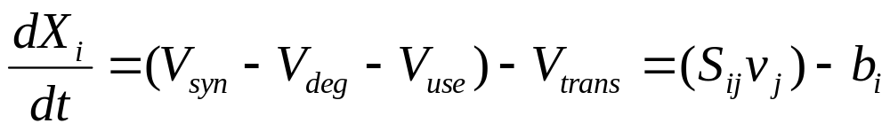
Dynamic mass balances on each metabolite
V_{trans}
V_{syn}
V_{deg}
V_{use}
Time derivatives of metabolite concentrations are linear combination of the reaction rates.
The reaction rates are non-linear functions of the metabolite concentrations (typically from in vitro kinetics).
  v_{j} is the jth reaction rate, b is the transport rate vector,
S_{ij} is the “Stoichiometric matrix” = moles of metabolite i produced in reaction j

Slide 9
RBC model integration
Reference Glyc- PPP ANM Na⁺/K⁺ Osmot. Trans- Hb-5 Gpx Shape
olysis Pump port ligands Hb Ca
Rapoport ’74-6 + - - - - - - - - -
Heinrich ’77 + - - - - - - - - -
Ataullakhanov’81 + + - - - - - - - -
Schauer ’81 + - + - - - - - - -
Brumen ’84 + - - + + - - - - -
Werner ’85 + - - + + + - - - -
Joshi ’90 + + + + + + - - - -
Yoshida ’90 - - - - - - + - - -
Lee ’92 + + + + + + (+) - - -
Gimsa ’98 - - - - - - - - - +
Destro-Bisol ‘99 - - - - - - - (-) - -
Jamshidi ’00 + + + + + + - - - -

Slide 10
Scopes & Assumptions
Mechanism of ATP utilization other than nucleotide metabolism and the Na⁺/K⁺ pump (75%) is not specifically defined
Ca²⁺ transport not included
Guanine nucleotide metabolism neglected
  little information, minor importance
Cl⁻, HCO₃⁻, LAC, etc. are in “pseudo” equilibrium
No intracellular concentration gradients
Rate constants represent a “typical cell”
Surface area of the membrane is constant
Environment is treated as a sink

Slide 11
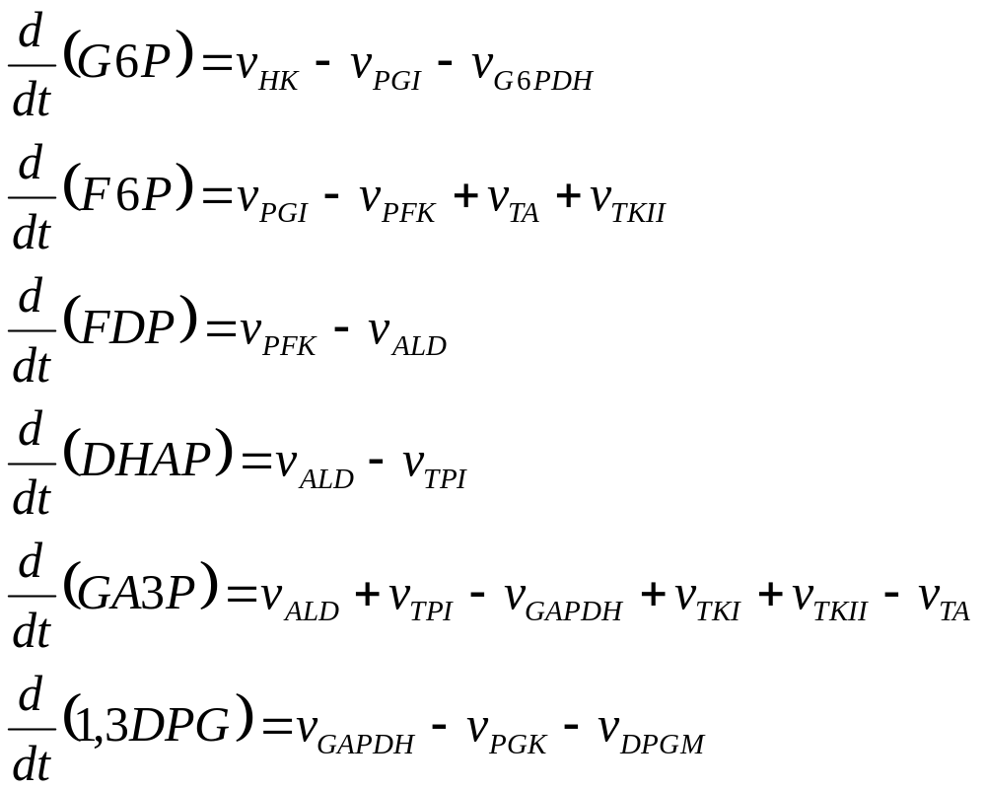
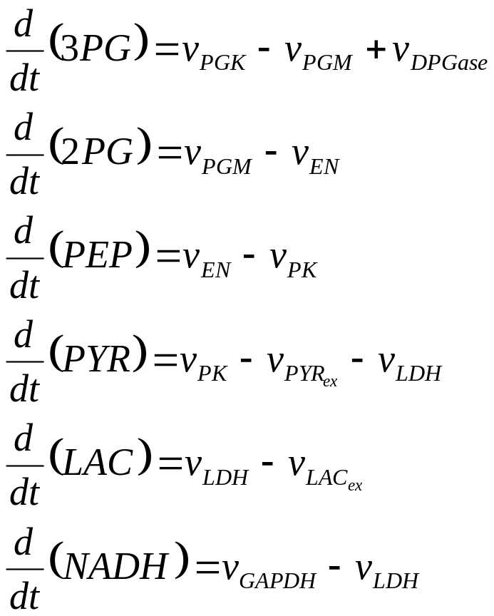
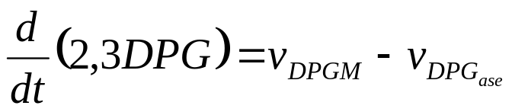
Glycolysis Dynamic Mass Balances

Slide 12
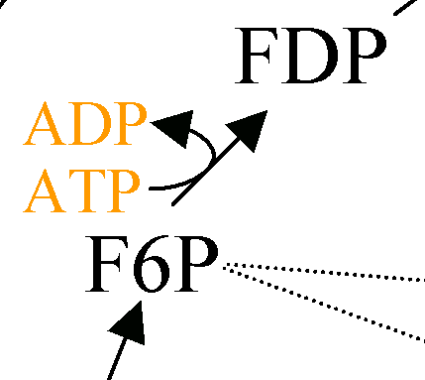
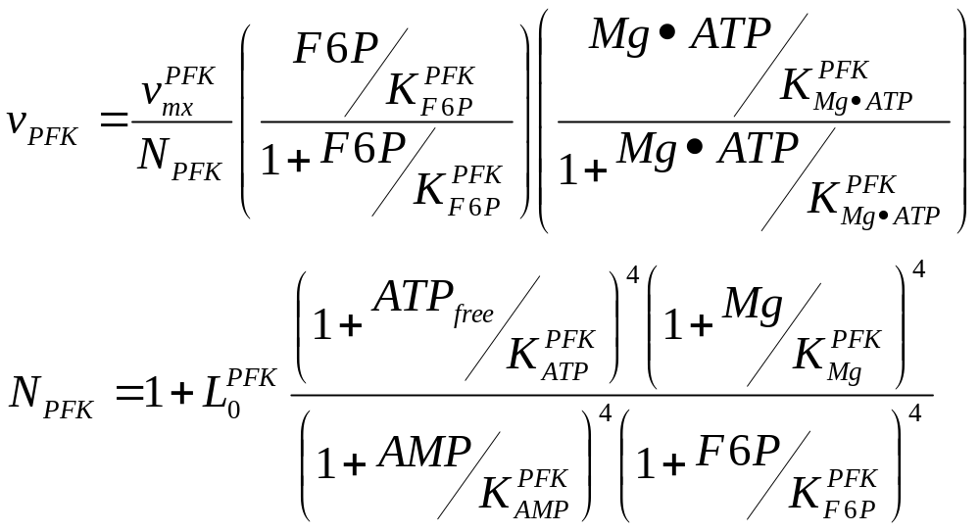
Enzyme Kinetic Expressions
Phosphofructokinase
v
AMP
F6P

Slide 13
Kinetic Expressions
All rate expressions are similar to the previously shown rate expression for phosphofructokinase.
Model has 44 rate expressions with ~ 5 constants each → ~ 200 parameters
What are the assumptions associated with using these expressions?

Slide 14
Kinetic parameter assumptions
in vitro values represent the in vivo parameters
  protein concentration in vitro much lower than in vivo
    enzyme interactions (enzymes, cytoskeleton, membrane, …)
  samples used to measure kinetics may contain unknown conc. of effectors (i.e. fructose 2,6-bisphosphate)
  enzyme catalyzed enzyme modifications
all possible concentrations of interacting molecules been considered (interpolating)
  e.g. glutamine synthase (unusually large # of known effectors)
    3 substrates, 3 products, 9 significant effectors
    4¹⁵ (~10⁹) measurements: 4 different conc. of 15 molecules (Savageau, 1976)
      in vivo probably even more complex, but approximations are effective.
have all interacting molecules been discovered?
and so on …

Slide 15
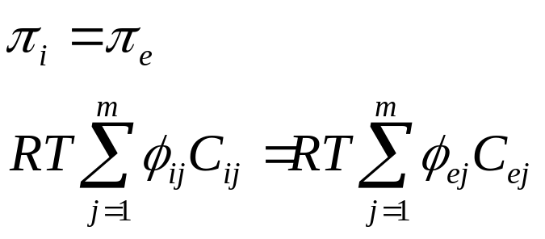
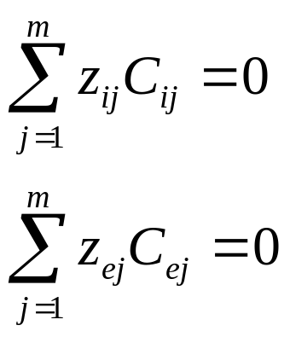
Additional constraints:
Physicochemical constrains
Osmotic Pressure Equilibrium (interior & exterior, m chem. species)
Electroneutrality (z = charge, Concentration)

Slide 16
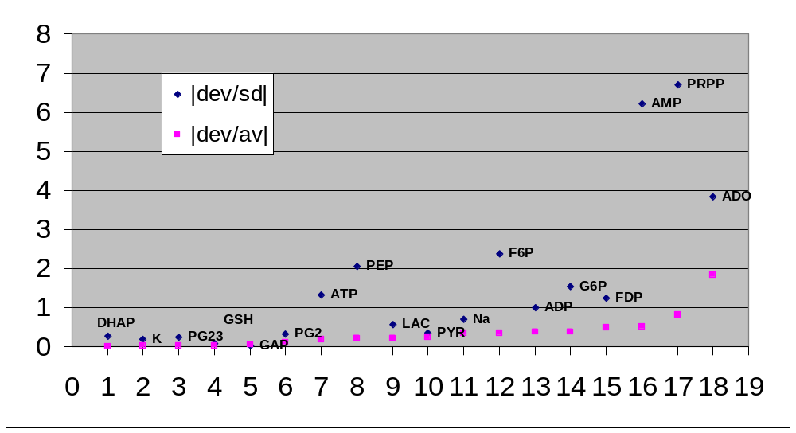
RBC steady-state in vivo vs calculated
|obs-calc| = Y
^{sd(obs)}
X= metabolites (ordered by Y)

Slide 17
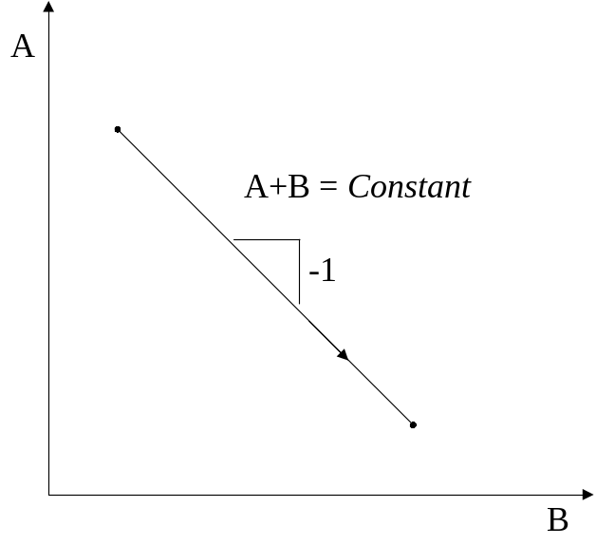
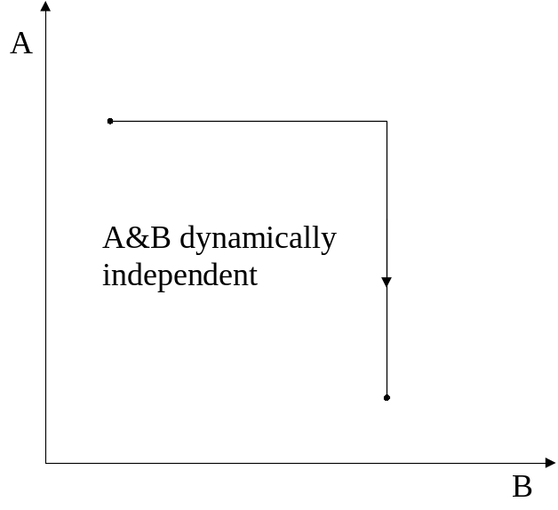
Phase plane diagrams: concentration of metabolite A vs B over a specific time course
1 2
3 4
A
1: conservation relationship.
2: a pair of concentrations in equilibrium
3: two dynamically independent metabolites
4: a closed loop trace
K
ΔA
= K
ΔB
= K
B
A
Circular motion
Return to
steady state
B

Slide 18
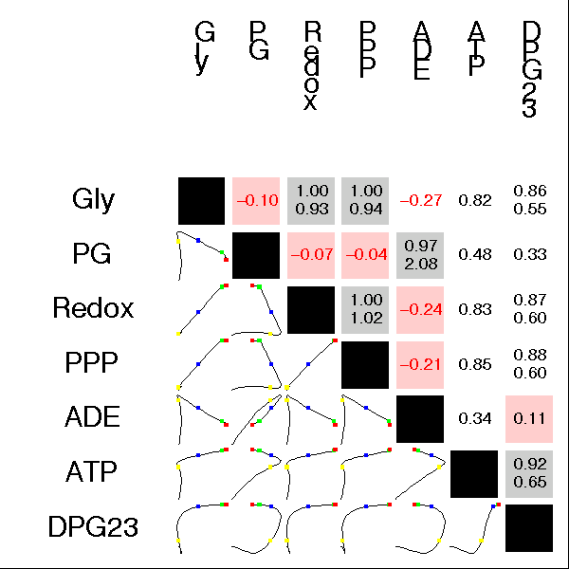
ATP load
Red 0 hours
Green 0.1
Blue 1.0
Yellow 10
End 300

Slide 19
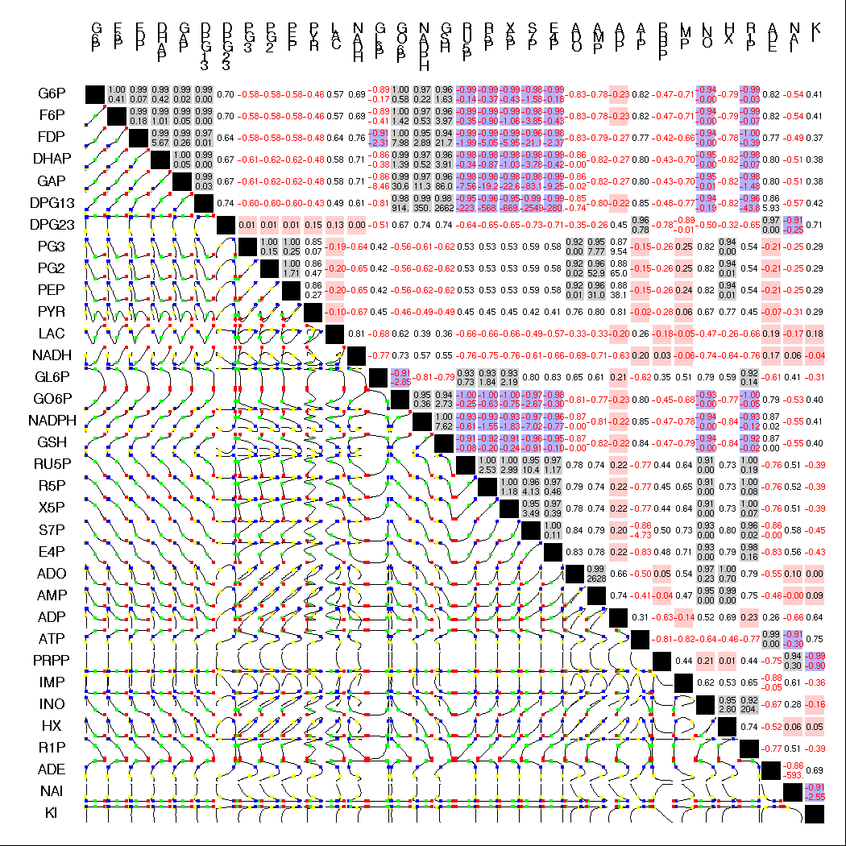
Redox
Load
0 to 300
hour
dynamics
34 metabolites
calculated
ODE model Jamshidi et al. 2000 (Pub)

Slide 20
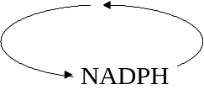
RBC Metabolic “Machinery”
Glucose
Transmembrane
Pumps
ATP
Nucleotide
Metabolism
Maintenance
& Repair
Glycolysis
PPP
Oxidants
Hb ⬄ Met Hb
NADH
2,3 DPG
HbO₂
2,3 DPG
Pyruvate Lactate
O₂

Slide 21
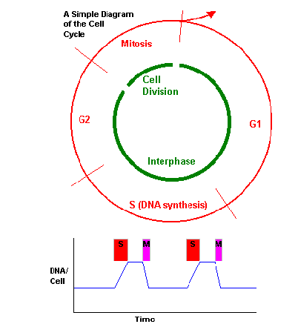
Cell
Division
Cycle
G2 arrest to M arrest switch
.

Slide 22
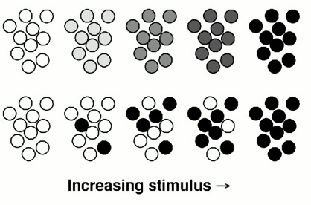

Hill coefficients
Response
_{R} ₌ 1
1+(K/S)^{H}
H simple hyperbolic = 1
H (R=HbO₂, S=O₂) sigmoidal = 2.8
H (R=Mapk-P, S=Mos) = 3
H (R=Mapk-P, S=Progesterone in vivo) = 42
.

Slide 23
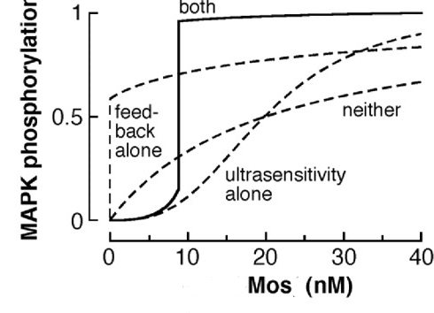
“The biochemical basis of an all-or-none cell fate switch in Xenopus oocytes.”
Progesterone
AA Mos Mos-P
Mek Mek-P
Mapk Mapk-P
k₁ k₂
k₋₁ k₋₂
positive
(a chain of enzyme modifiers close to saturation generate higher sensitivity to signals than one enzyme can)
Science 1998;280:895-8 Ferrell & Machleder, (Pub)

Slide 24
Net1: Simulation & optimization
Macroscopic continuous concentration rates
  Cooperativity & Hill coefficients
  Bistability
Mesoscopic discrete molecular numbers
  Approximate & exact stochastic
Chromosome Copy Number Control
Flux balance optimization
  Universal stoichiometric matrix
  Genomic sequence comparisons

Slide 25
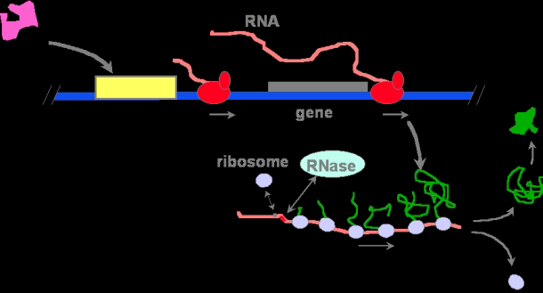
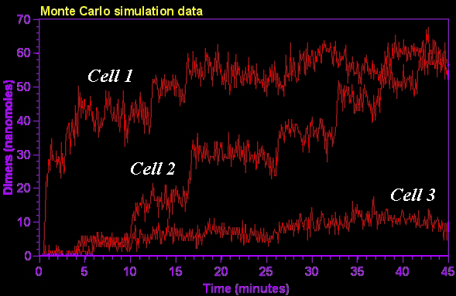
Stochastic kinetic analysis of developmental pathway bifurcation in phage lambda-infected E. coli cells.
Arkin A, Ross J, McAdams HH Genetics 1998 149(4):1633.
Variation in level, time & whole cell effect

Slide 26
Efficient exact stochastic simulation of chemical systems with many species & many channels
"the Next Reaction Method, an exact algorithm ...time proportional to the logarithm of the number of reactions, not to the number of reactions itself". Gibson & Bruck, 1999; J. Physical Chemistry. (Pub)
Gillespie J.Phys Chem 81:2340-61. 1977. Exact stochastic simulation of coupled chemical reactions

Slide 27
Utilizing Noise
Hasty, et al. PNAS 2000; 97:2075-2080, Noise-based switches and amplifiers for gene expression (Pub)
“Bistability ... arises naturally... Additive external noise [allows] construction of a protein switch... using short noise pulses. In the multiplicative case, ... small deviations in the transcription rate can lead to large fluctuations in the production of protein”.
Paulsson, et al. PNAS 2000; 97:7148-53. Stochastic focusing: fluctuation-enhanced sensitivity of intracellular regulation. (Pub) (exact master equations)

Slide 28
Net1: Simulation & optimization
Macroscopic continuous concentration rates
  Cooperativity & Hill coefficients
  Bistability
Mesoscopic discrete molecular numbers
  Approximate & exact stochastic
Chromosome Copy Number Control
Flux balance optimization
  Universal stoichiometric matrix
  Genomic sequence comparisons

Slide 29
Copy Number Control Models
Replication of ColE1 & R1 Plasmids
Determine the factors that govern the plasmid copy number
  cellular growth rate
  One way to address this question is via the use of a kinetic analysis of the replication process, and relate copy number to overall cellular growth.
Why? the copy number can be an important determinant of cloned protein production in recombinant microorganisms

Slide 30
ColE1 CNC mechanism
DNA
Polymerase
RNA II
Rnase H cleaved RNAII forms a primer for DNA replication
RNase H
Rom protein
RNA I
RNA
Polymerase
RNA II
RNA I "antisense" binds RNA II, blocks RNaseH

Slide 31
Assumptions?
DNA
Polymerase
Where do we start?
  Dynamic mass balance
What are the important parameters?
  Plasmid, RNA I, RNA II, Rom, μ
  All the constants
    degradation, initiation, inhibition
  RNaseH rate is very fast ➔ instantaneous
  DNA polymerization is very rapid
  Simplify by subsuming [RNA II] ➔ model RNA I inhibition
  RNA I and RNA II transcription is independent (neglect convergent transcription)
  Rom protein effects constant
  Consider 2 species: RNA I and plasmid
  Many more assumptions...
RNA II
RNase H
Rom protein
RNA I
RNA
Polymerase
RNA II

Slide 32
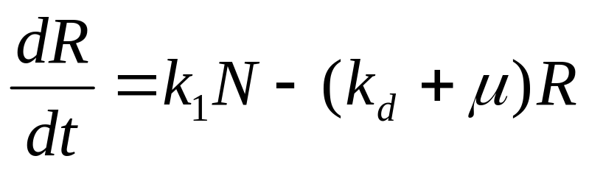
Dynamic Mass Balance: ColE1 RNAI
[concentration in moles/liter]
Rate of change
of [RNA I]
Synthesis of
RNA I
Degradation
of RNA I
Dilution due
to cell growth
=
-
-
R = [RNA I]
k₁ = rate of RNA I initiation
N = [plasmid]
k_{d} = rate of degradation
μ = growth rate
Keasling,& Palsson (1989) J theor Biol 136, 487-492; 141, 447-61.

Slide 33
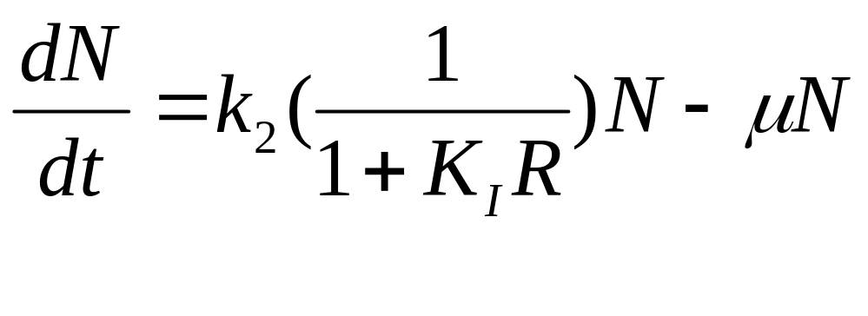
Dynamic Mass Balance: ColE1 Plasmid
Rate of change
of [N]
Plasmid
Replication
Dilution due
to cell growth
=
-
R = [RNA I]
k₂ = rate of RNA II initiation
N = [plasmid]
K_{I} = RNA I/RNA II binding constant
(an inhibition constant)
μ = growth rate
Solve for N(t).

Slide 34
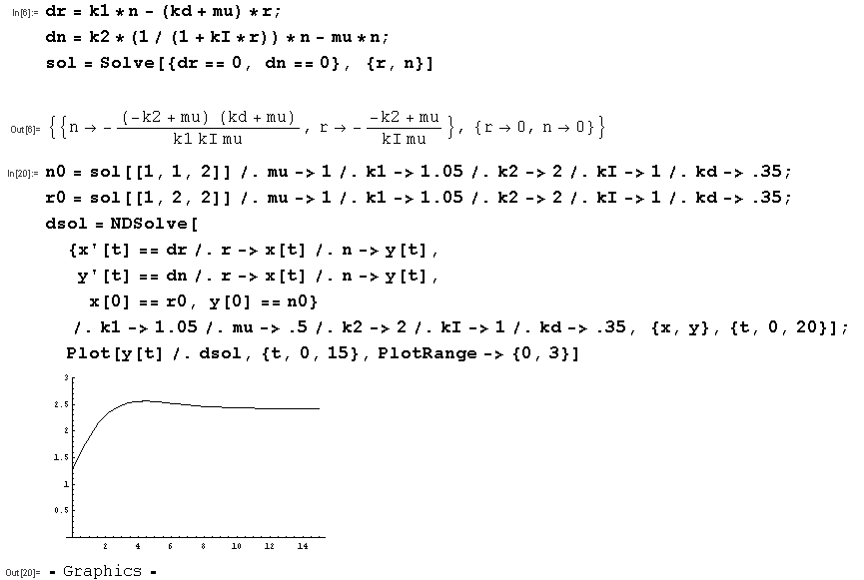
Mathematica ODE program
Formulae for steady state
start at mu=1 shift to mu=.5
and then solve for plasmid concentration N as a function of time.

Slide 35
Stochastic models for CNC
Paulsson & Ehrenberg, J Mol Biol 1998;279:73-88. Trade-off between segregational stability and metabolic burden: a mathematical model of plasmid ColE1 replication control. (Pub),
J Mol Biol 2000;297:179-92. Molecular clocks reduce plasmid loss rates: the R1 case. (Pub)
While copy number control for ColE1 efficiently corrects for fluctuations that have already occurred, R1 copy number control prevents their emergence in cells that by chance start their cycle with only one plasmid copy. Regular, clock-like, behaviour of single plasmid copies becomes hidden in experiments probing collective properties of a population of plasmid copies ... The model is formulated using master equations, taking a stochastic approach to regulation”

Slide 36
From RBC & CNC to models for whole cell replication?
e.g. E. coli ?
What are the difficulties?
  The number of parameters
  Measuring the parameters
  Are parameters measured in vitro representative to the parameters in vivo

Slide 37
Factors Constraining Metabolic Function
Physicochemical factors:
  Mass, energy, and redox balance:
    Systemic stoichiometry
  osmotic pressure, electroneutrality, solvent capacity, molecular diffusion, thermodynamics
  Non-adjustable constraints
System specific factors:
  Capacity:
    Maximum fluxes
  Rates:
    Enzyme kinetics
  Gene Regulation
  Adjustable constraints
Notes:
This slide summarizes the factors that constrain cellular functions.
Metabolic functions are constrained by the mass, energy, and redox balances, and these constraints are defined by the stoichiometry of the reactions.
Capacity constraints define the allowable flux values for each metabolic reaction or transport process.
Reaction rates also constrain metabolic function, which are influenced by the enzyme properties and enzyme kinetics.
Additionally, there are physicochemical factors that constrain the operation of the metabolic network. These include osmotic pressure, electroneutrality, solvent capacity, molecular diffusion, and thermodynamics.
In the limiting case, where all the constraints are known, the operation of the metabolic network is completely defined. Today, I will discuss the analysis of metabolic systems with an incomplete set of constraints.

Slide 38
Net1: Simulation & optimization
Macroscopic continuous concentration rates
  Cooperativity & Hill coefficients
  Bistability
Mesoscopic discrete molecular numbers
  Approximate & exact stochastic
Chromosome Copy Number Control
Flux balance optimization
  Universal stoichiometric matrix
  Genomic sequence comparisons

Slide 39
Dynamic mass balances on each metabolite
V_{trans}
V_{syn}
V_{deg}
V_{use}
Time derivatives of metabolite concentrations are linear combination of the reaction rates. The reaction rates are non-linear functions of the metabolite concentrations (typically from in vitro kinetics).
Where v_{j} is the jth reaction rate, b is the transport rate vector,
S_{ij} is the “Stoichiometric matrix” = moles of metabolite i produced in reaction j

Slide 40
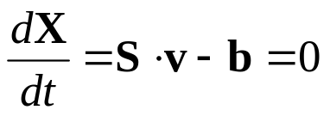
Flux-Balance Analysis
Make simplifications based on the properties of the system.
  Time constants for metabolic reactions are very fast (sec - min) compared to cell growth and culture fermentations (hrs)
  There is not a net accumulation of metabolites in the cell over time.
One may thus consider the steady-state approximation.

Slide 41

Flux-Balance Analysis
Removes the metabolite concentrations as a variable in the equation.
Time is also not present in the equation.
We are left with a simple matrix equation that contains:
  Stoichiometry: known
  Uptake rates, secretion rates, and requirements: known
  Metabolic fluxes: Can be solved for!
  In the ODE cases before we already had fluxes (rate equations, but lacked C(t).

Slide 42

Additional Constraints
Fluxes >= 0 (reversible = forward - reverse)
The flux level through certain reactions is known
Specific measurement – typically for uptake rxns
maximal values
uptake limitations due to diffusion constraints
maximal internal flux

Slide 43

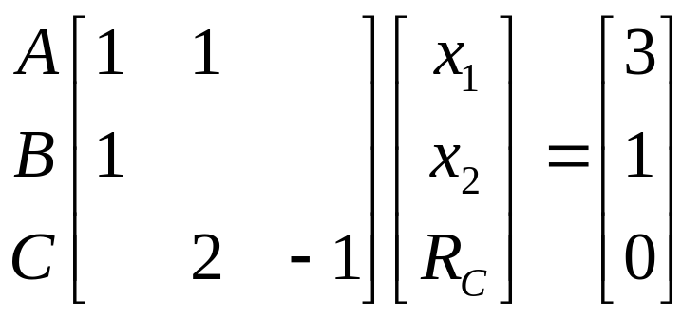
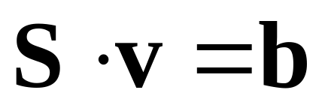
Flux Balance Example
Flux Balances:
A: R_{A} – x₁ – x₂ = 0
B: x₁ – R_{B} = 0
C: 2 x₂ – R_{C} = 0
Supply/load constraints:
R_{A} = 3
R_{B} = 1
R_{B}
x₁
B
R_{A}
A
x₂
R_{C}
2C
Equations:
A: x₁+x₂ = 3
B: x₁ = 1
C: 2 x₂ – R_{C} = 0

Slide 44
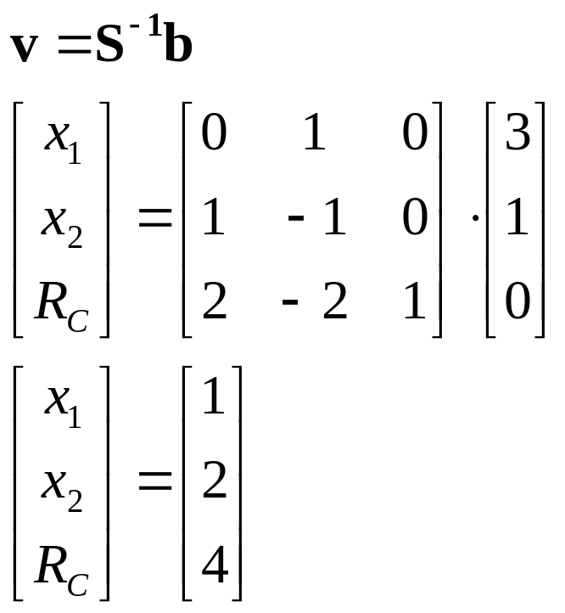
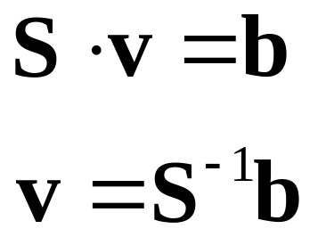
FBA Example
1
1
B
3
A
4
2
2C

Slide 45
FBA
Often, enough measurements of the metabolic fluxes cannot be made so that the remaining metabolic fluxes can be calculated.
Now we have an underdetermined system
  more fluxes to determine than mass balance constraints on the system
  what can we do?

Slide 46
Incomplete Set of Metabolic Constraints
Identify a specific point within the feasible set under any given condition
Linear programming - Determine the optimal utilization of the metabolic network, subject to the physicochemical constraints, to maximize the growth of the cell
Assumption:
The cell has found the optimal solution by adjusting the system specific constraints (enzyme kinetics and gene regulation) through evolution and natural selection.
Find the optimal solution by linear programming
Flux_{C}
Flux_{B}
Flux_{A}

Slide 47
Under-Determined System
All real metabolic systems fall into this category, so far.
Systems are moved into the other categories by measurement of fluxes and additional assumptions.
Infinite feasible flux distributions, however, they fall into a solution space defined by the convex polyhedral cone.
The actual flux distribution is determined by the cell's regulatory mechanisms.
It absence of kinetic information, we can estimate the metabolic flux distribution by postulating objective functions(Z) that underlie the cell’s behavior.
Within this framework, one can address questions related to the capabilities of metabolic networks to perform functions while constrained by stoichiometry, limited thermodynamic information (reversibility), and physicochemical constraints (ie. uptake rates)

Slide 48
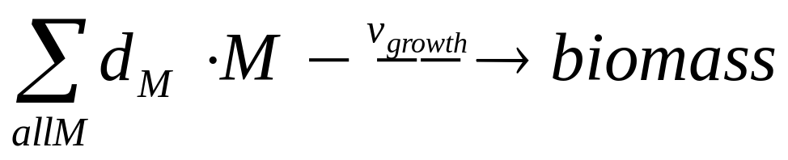
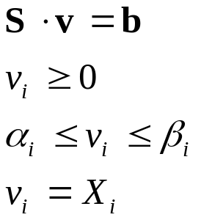
FBA - Linear Program
For growth, define a growth flux where a linear combination of monomer (M) fluxes reflects the known ratios (d) of the monomers in the final cell polymers.
A linear programming finds a solution to the equations below, while minimizing an objective function (Z). Typically Z= ν_{growth} (or production of a key compound).
i reactions

Slide 49
Very simple LP solution
R_{C}
Flux Balance
Constraints:
R_{A} = R_{B}
R_{A} < 1
x₁ + x₂ < 1
x₁ >0
x₂ > 0
C
x₁
R_{A}
R_{B}
A
B
x₂
D
Max Z = Max R_{D}
Production
R_{D}
x₂
Feasible flux
distributions
Max Z = R_{C}
Production
x₁

Slide 50
Applicability of LP & FBA
Stoichiometry is well-known
Limited thermodynamic information is required
  reversibility vs. irreversibility
Experimental knowledge can be incorporated in to the problem formulation
Linear optimization allows the identification of the reaction pathways used to fulfil the goals of the cell if it is operating in an optimal manner.
The relative value of the metabolites can be determined
Flux distribution for the production of a commercial metabolite can be identified. Genetic Engineering candidates

Slide 51
Precursors to cell growth
How to define the growth function.
  The biomass composition has been determined for several cells, E. coli and B. subtilis.
    This can be included in a complete metabolic network
  When only the catabolic network is modeled, the biomass composition can be described as the 12 biosynthetic precursors and the energy and redox cofactors

Slide 52
in silico cells
E. coli H. influenzae H. pylori
Genes 695 362 268
Reactions 720 488 444
Metabolites 436 343 340
(of total genes 4300 1700 1800)
Edwards, et al 2002. Genome-scale metabolic model of Helicobacter pylori 26695. J Bacteriol. 184(16):4582-93.
Segre, et al, 2002 Analysis of optimality in natural and perturbed metabolic networks. PNAS 99: 15112-7. (Minimization Of Metabolic Adjustment ) http://arep.med.harvard.edu/moma/

Slide 53
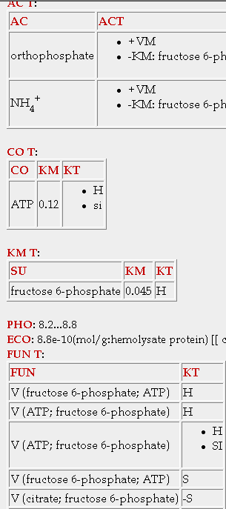
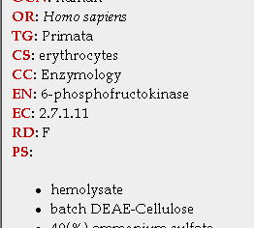
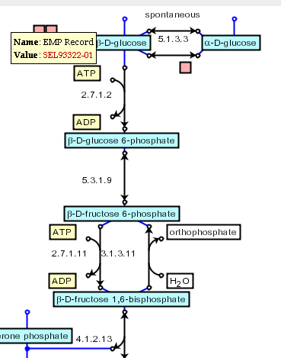
Where do the Stochiometric matrices (& kinetic parameters) come from?
EMP RBC, E.coli
KEGG, Ecocyc

Slide 54
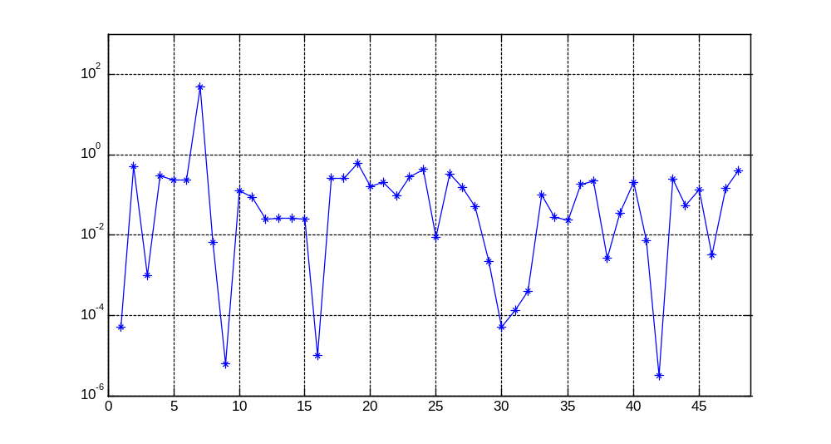
Biomass Composition
ATP
GLY
LEU
coeff. in growth reaction
ACCOA
NADH
FAD
SUCCOA
COA
metabolites

Slide 55
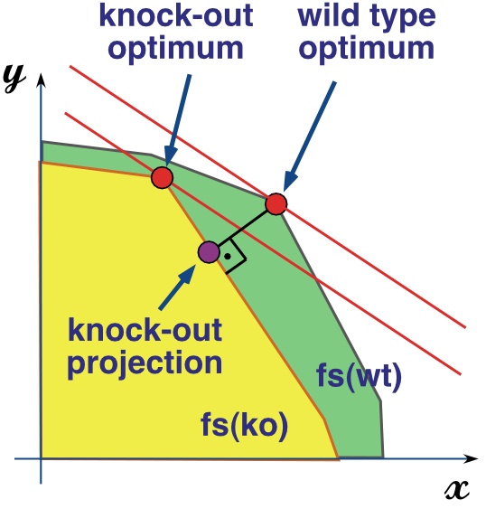
Flux ratios at each branch point yields optimal polymer composition for replication
x,y are two of the 100s of flux dimensions

Slide 56
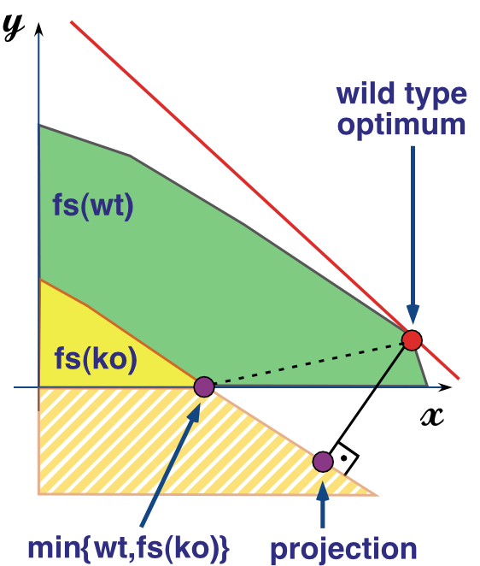
Minimization of Metabolic Adjustment (MoMA)

Slide 57
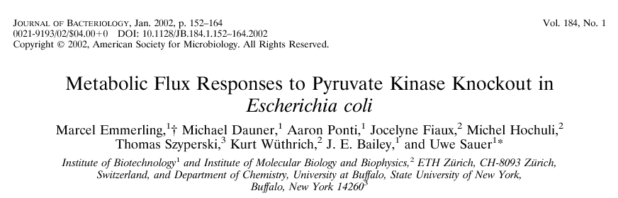
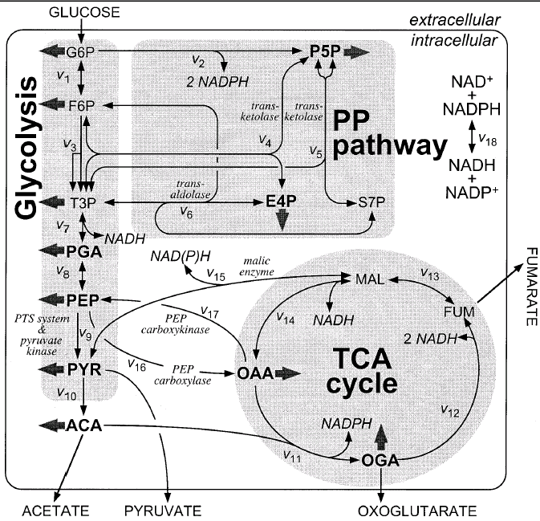
Flux Data

Slide 58
C009-limited
200
180
WT (LP)
7
160
8
140
9
120
10
Predicted Fluxes
ρ=0.91
p=8e-8
100
14
13
11
80
1
3
12
60
40
20
2
16
5
15
6
0
4
17
18
0
50
100
150
200
Experimental Fluxes
250
Δpyk (LP)
250
Δpyk (QP)
200
18
200
7
ρ=0.56
P=7e-3
150
7
ρ=-0.06
p=6e-1
150
8
Predicted Fluxes
2
8
Predicted Fluxes
100
9
100
9
13
10
11
3
12
10
14
1
14
13
11
50
5
3
12
50
6
4
16
16
2
15
5
0
15
17
0
6
18
17
4
1
-50
-50
0
50
100
150
200
250
-50
-50
0
50
100
150
200
250
Experimental Fluxes
Experimental Fluxes

Slide 59
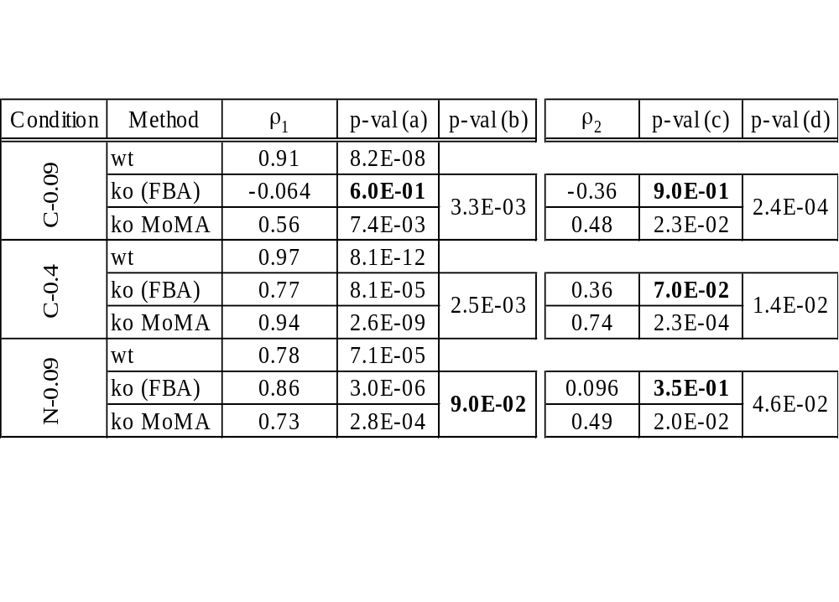
Flux data (MOMA & FBA)

Slide 60
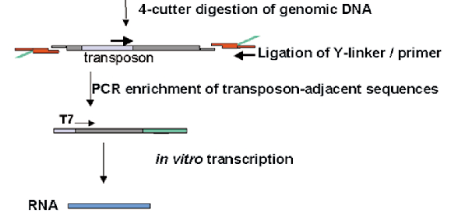
Replication rate of a whole-genome set of mutants
Badarinarayana, et al. (2001) Nature Biotech.19: 1060

Slide 61
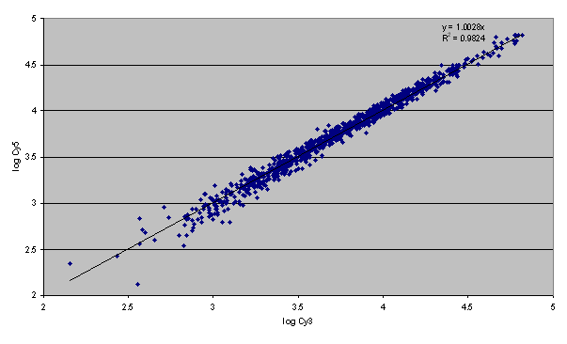
Reproducible selection?
Correlation between two selection experiments
Badarinarayana, et al. (2001) Nature Biotech.19: 1060

Slide 62
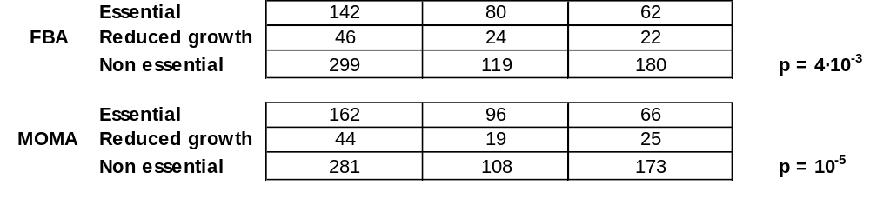
Competitive growth data
487 mutants multiplexed & modeled on minimal media
negative small
selection effect
Χ ² p-values
4x10⁻³
1x10⁻⁵
Novel position effects
Novel redundancies
Badarinarayana, et al. Nature Biotech 19: 1060-5

Slide 63
Replication rate challenge met: multiple homologous domains
thrA
1
2
3
1.1 6.7
lysC
1
2
10.4
metL
1
2
3
1.8 1.8
Selective disadvantage in minimal media
probes

Slide 64
Net1: Simulation & optimization
Macroscopic continuous concentration rates
  Cooperativity & Hill coefficients
  Bistability
Mesoscopic discrete molecular numbers
  Approximate & exact stochastic
Chromosome Copy Number Control
Flux balance optimization
  Universal stoichiometric matrix
  Genomic sequence comparisons

