Slide 1
Section3 Biology
Biophysics 101 October 7 2003
Answers to this weeks e-mail questions
Chromosomes
Behavior
Structure
Composition

Slide 2
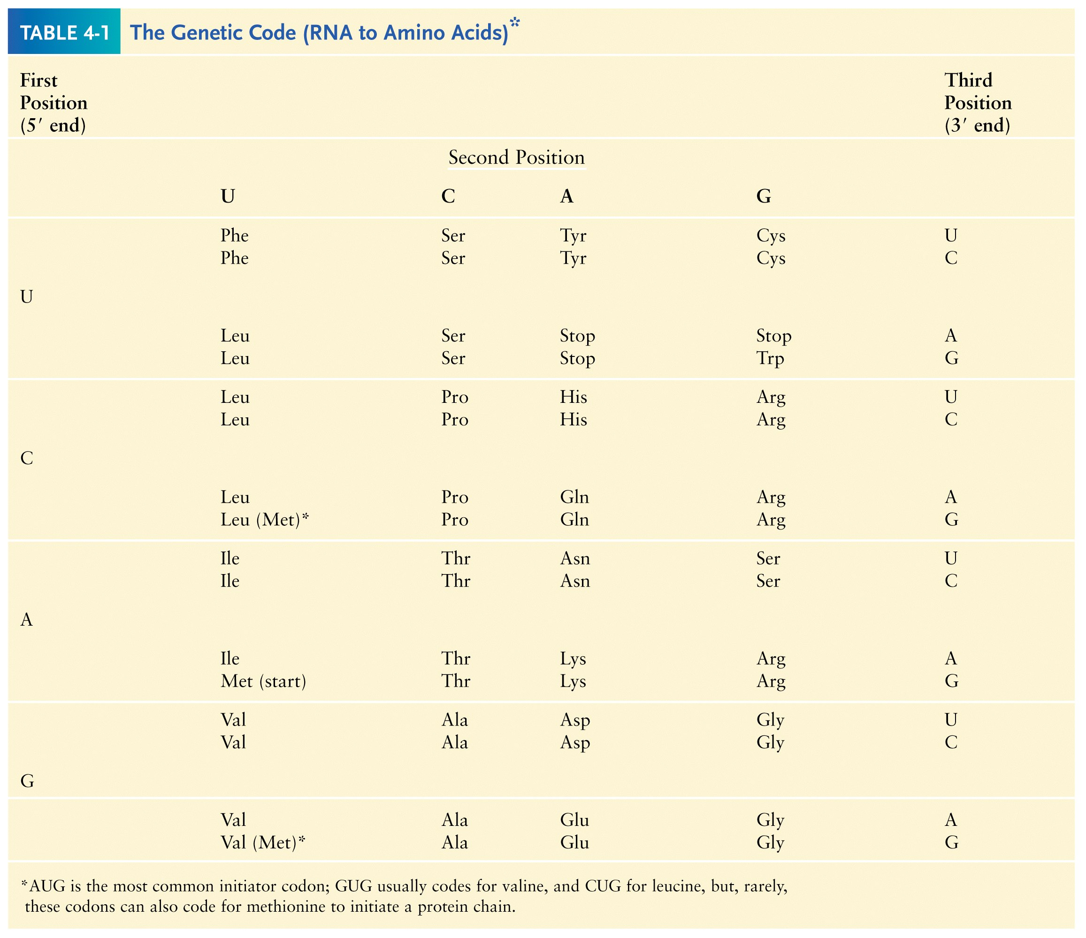
Synonymous and non-synonymous codons

Slide 3
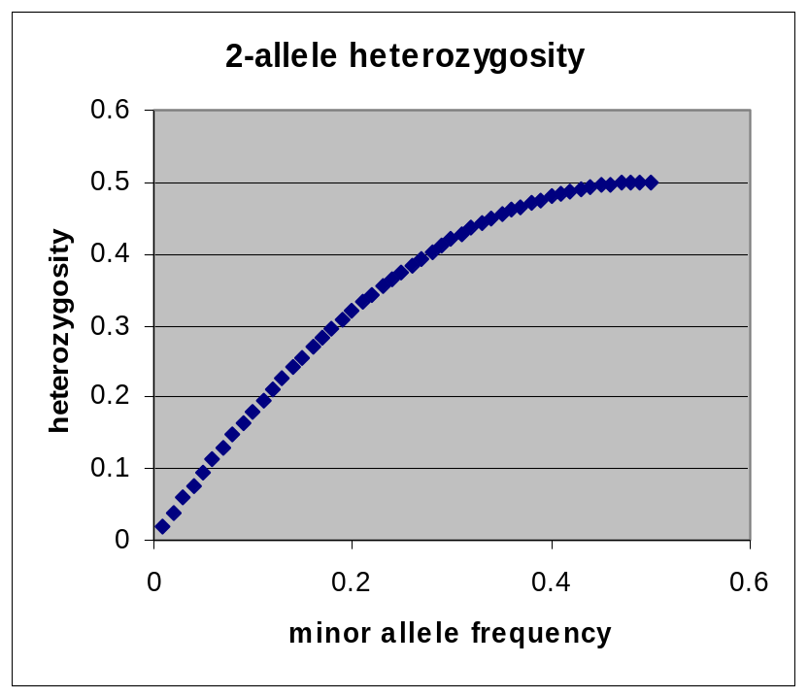
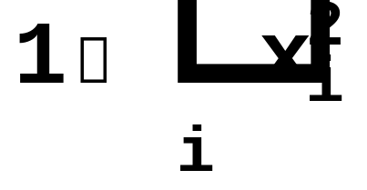
The heterozygosity measure.
Heterozygosity formula for i alleles.
Heterozygosity = 0 when i=1, and approaches 0 as the genetic diversity at a marker increases.

Slide 4
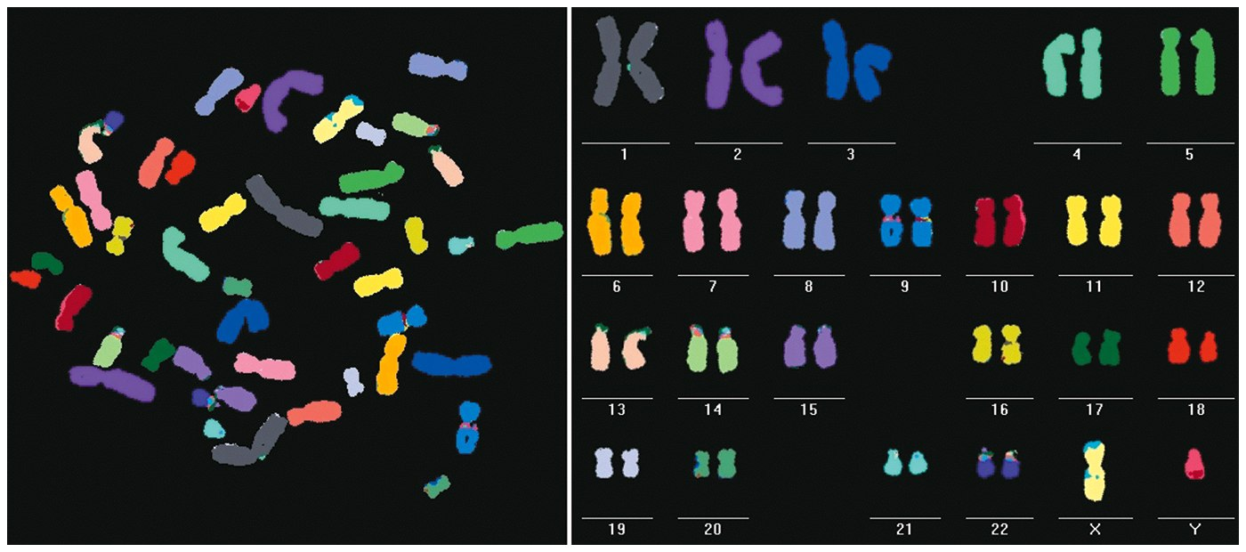
Chromosomes ⬄ Eukaryote
Humans typically have 23 pairs in each cell.
(Mostly) numbered from biggest to smallest.
Help organize, protect, and regulate the expression of DNA.
Are only this compact during cell division.
Do not come in 23 colors.

Slide 5
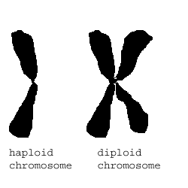
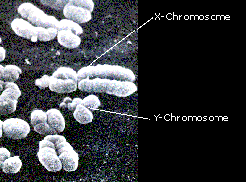
Haploid, Diploid, X and Y
Condensed chromosomes, shown in all of these slides, as well as diploid chromosomes, are only present during cell division.

Slide 6
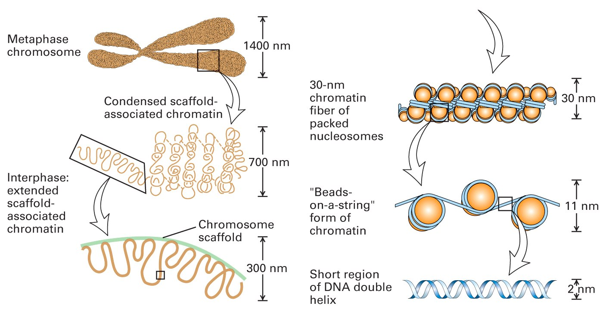
Chromosome Structure

Slide 7
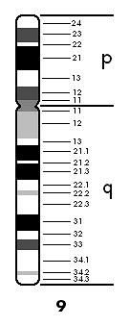
Chromosome regions
p = (short arm)
q = (long arm);
<"region" number>. <band number>
Bands are created by reactions with dyes, some of which show differences in A+T/G+C content
Centromeres and telomeres are sparse with genes and rich with repetitive sequence.
telomere
centromere
telomere

Slide 8

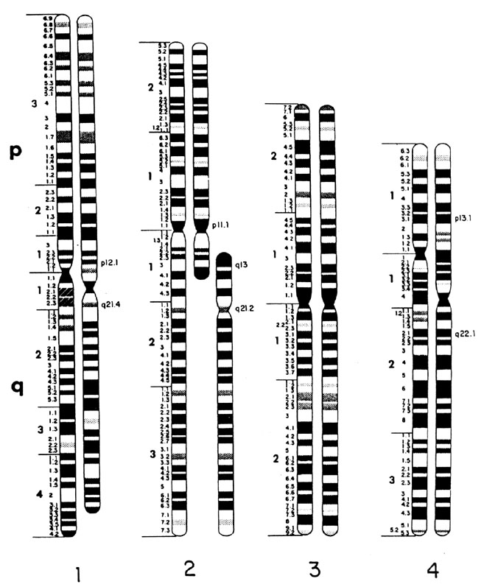
Chromosomes: Human vs. Chimpanzee
23 pairs
24 pairs
Major differences:
Fusion of Chimp chromosomes “2p” and “2q” into Human chromosome 2, and small inversions in chromosomes 1 and 18.
1 Chimp/Human SNiP every 100 bp’s.
1 Human/Human SNiP every 1500 bp’s

Slide 9
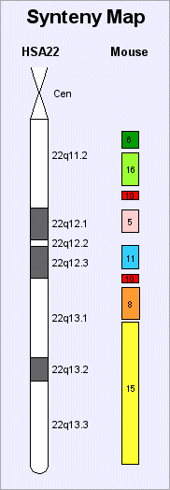
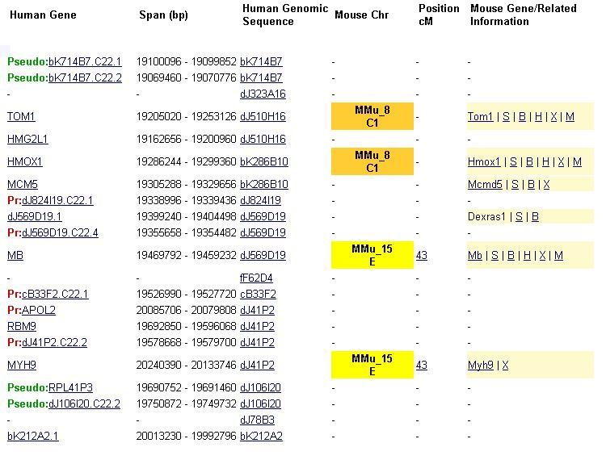
Human/Mouse synteny
Does synteny give evidence for orthologs or paralogs?
http://www.sanger.ac.uk/HGP/Chr22/Mouse

Slide 10
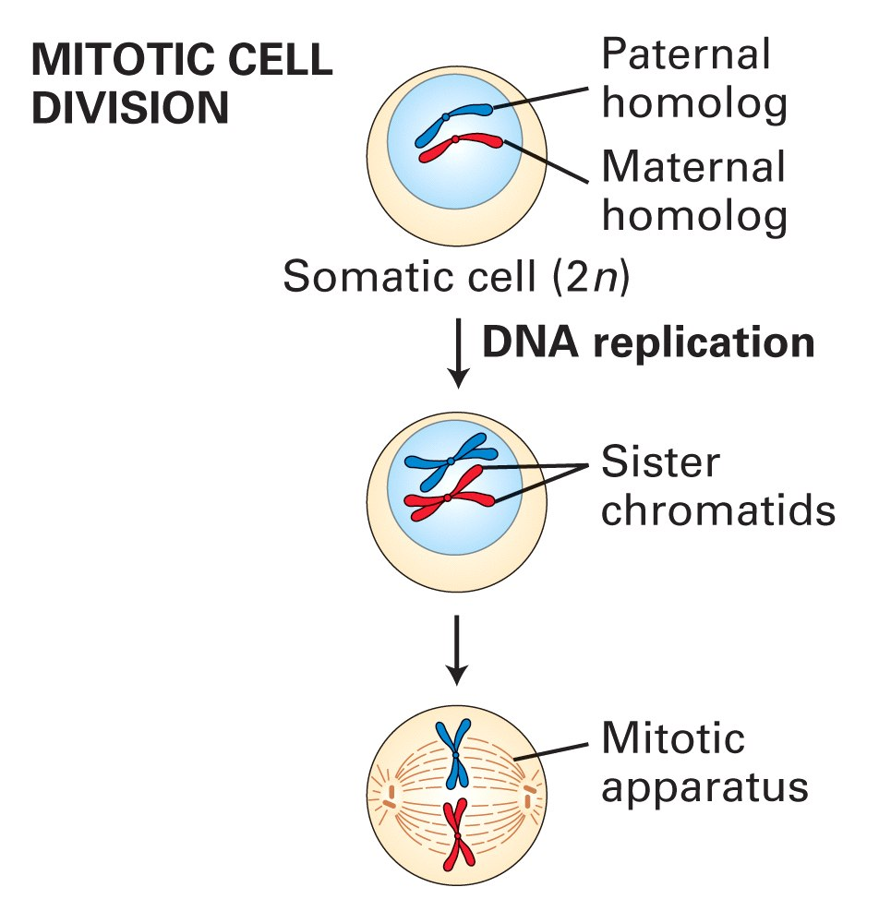
Mitosis

Slide 11
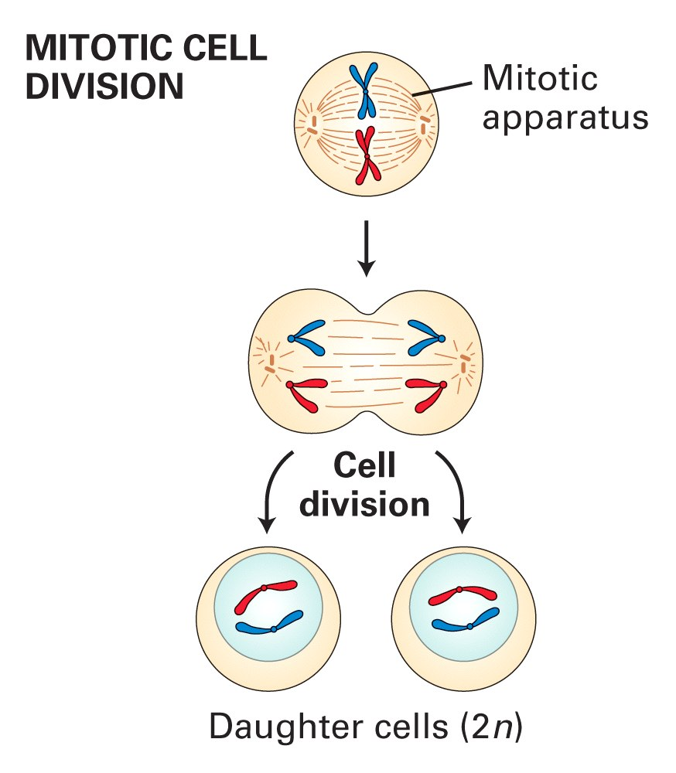
Mitosis (continued)

Slide 12
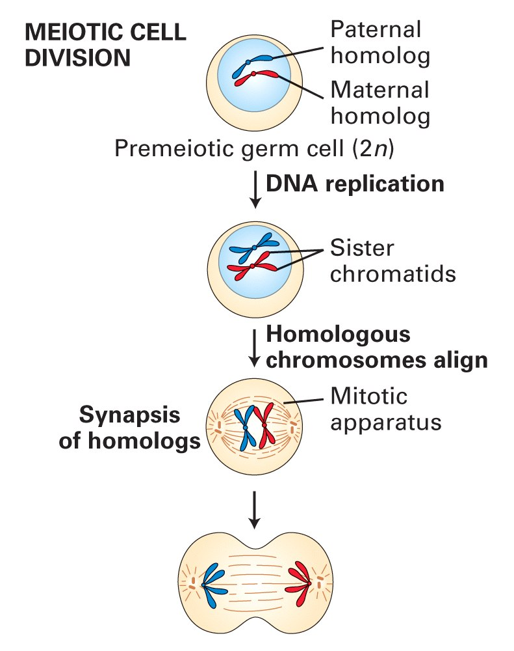
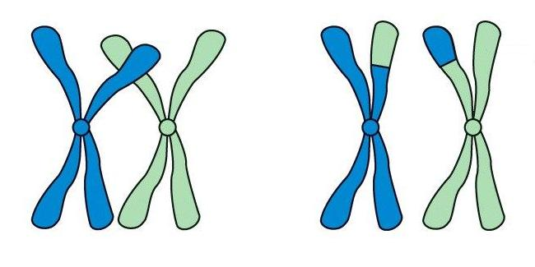
Meiosis

Slide 13
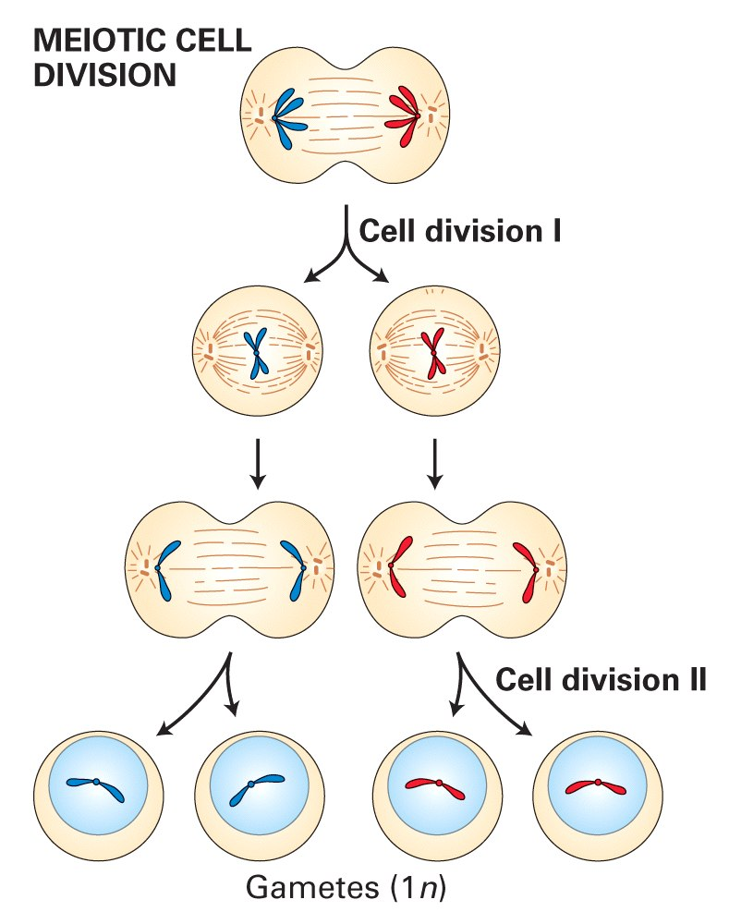
Meiosis (continued)

Slide 14
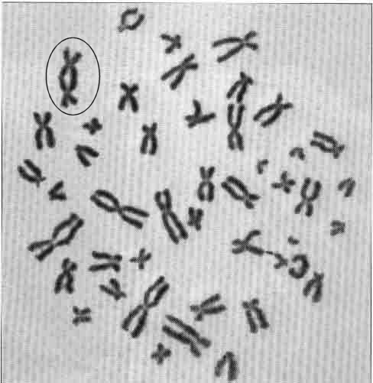
Chromosome Errors: negative in the short run
Downs Syndrome
1 in 1500
1 in 300 after age 45
Trisomy
(three copies) of chromosome 21
Mental Retardation,
Defective internal organs
Klinefelter Syndrome
1 in 2000
47 chromosomes.
XXY, male
Small penis, testicles, sterile.
Turner's Syndrome
1 in 2000
45 chromosomes.
X0 female
Sterile, no ovarian tissues
Other gamete chromosome errors.
Perhaps 2 out of 3 human pregnancies fail, many for this reason.
Trisomy 18 (90%, 1yr.)
Trisomy 13 (72%, 1yr.)
Mosaic Trisomy 9p
Many are fatal to the fetus. Most healthy people may have minor irregularities
Somatic chromosome errors.
Many types of cancer have been linked to specific chromosome errors.
“Good risk” AML: inversion (16), t(8;21), t(15;17).
Expression analysis can optimize chemotherapy treatments.

Slide 15
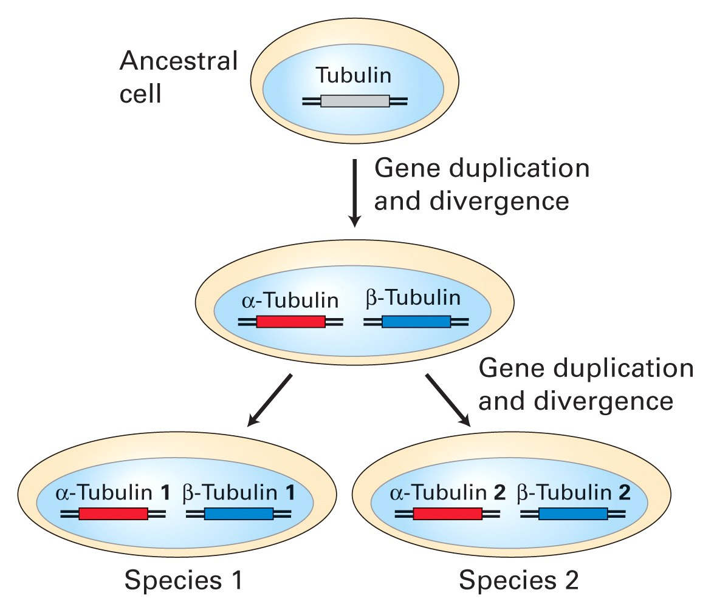
Chromosome errors: positive in the long run

Slide 16
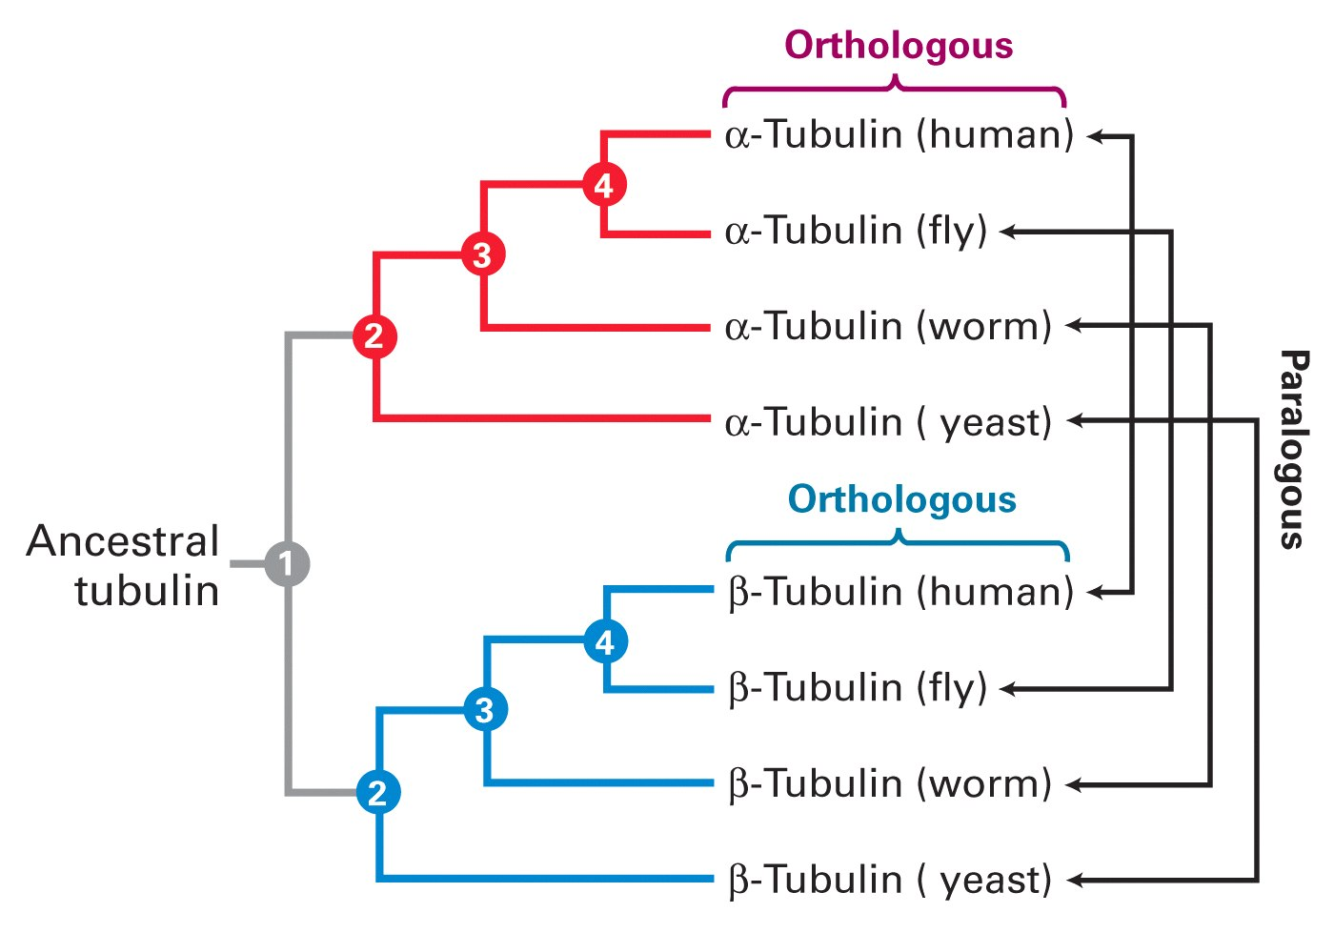
Homologous genes: Orthologs and Paralogs

Slide 17
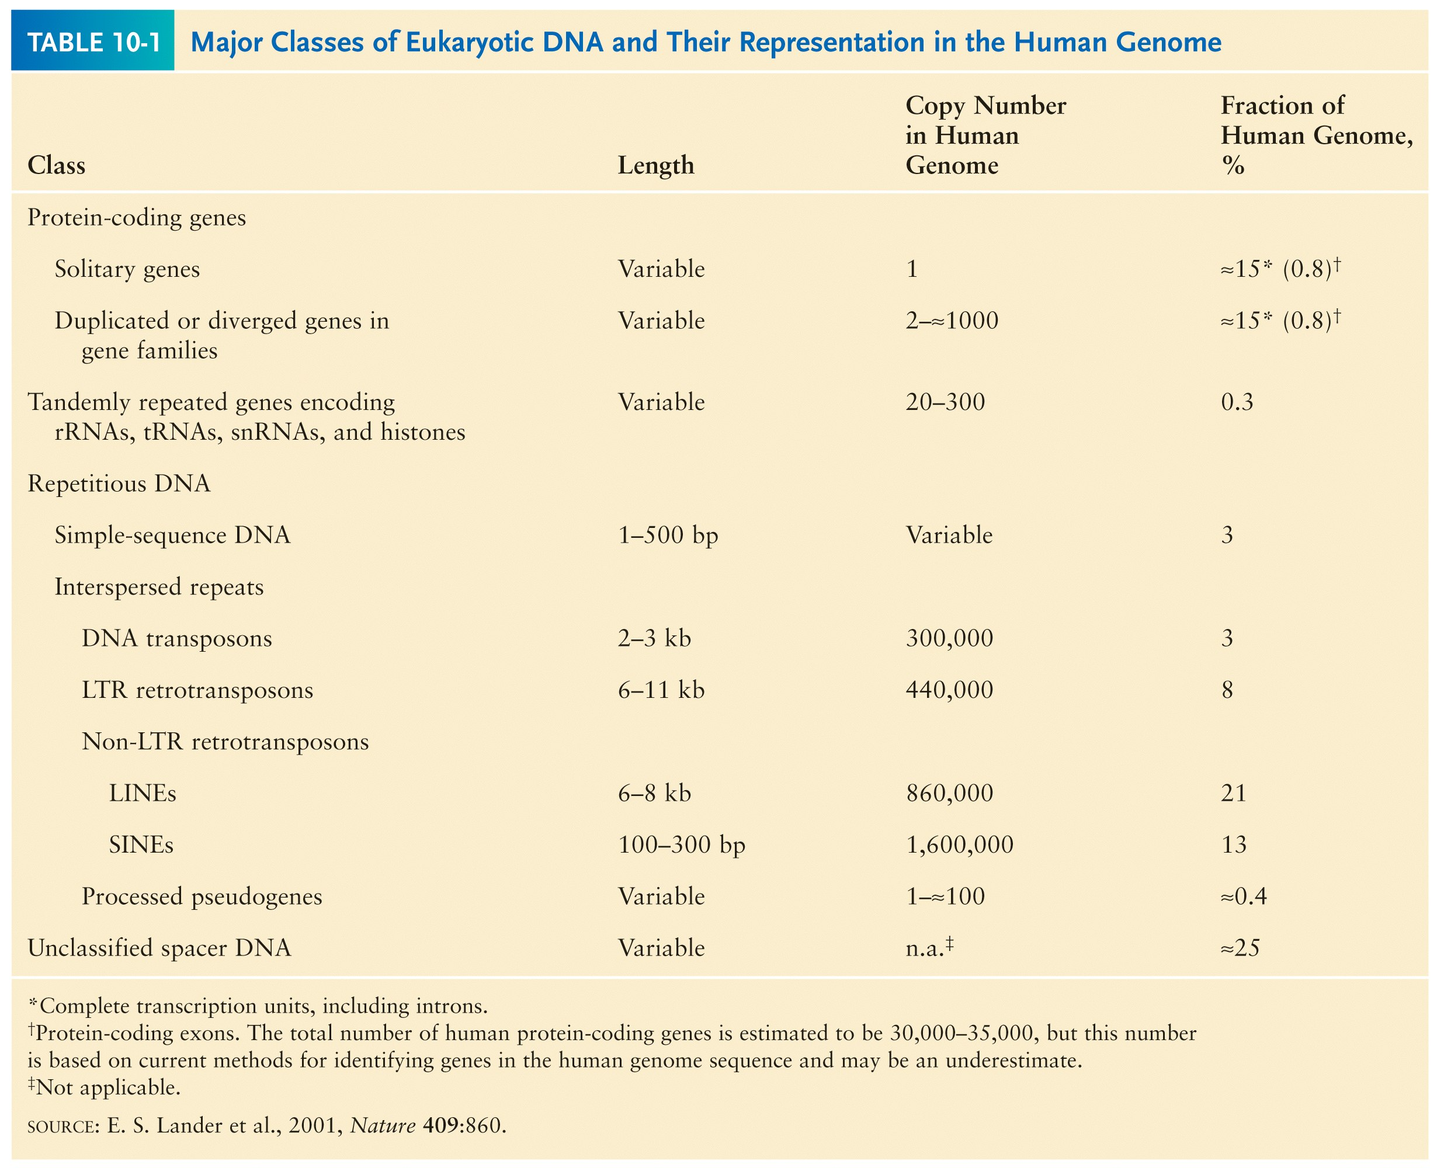
Chromosome Inventory

Slide 18
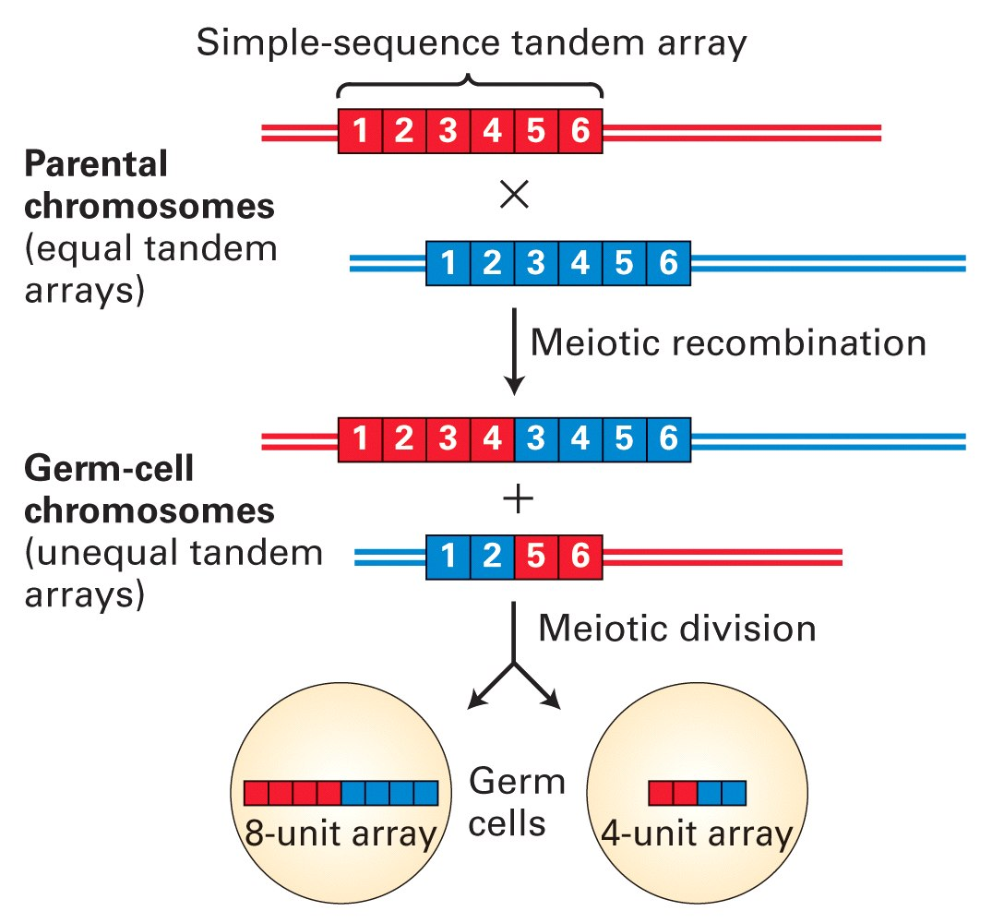
Repetitive DNA regions are agents of diversity.
Example:
Microsatellites are ~100 fold di-, tri-, and tetra-nucleotide repeats:
AGCAGCAGCAGC…
GCGCGCGCGCGC…
Microsatellite alleles are typically variations in repeat length, and their mutation rate is ~10⁴ per generation, ~10⁴ fold higher than typical alleles.

Slide 19
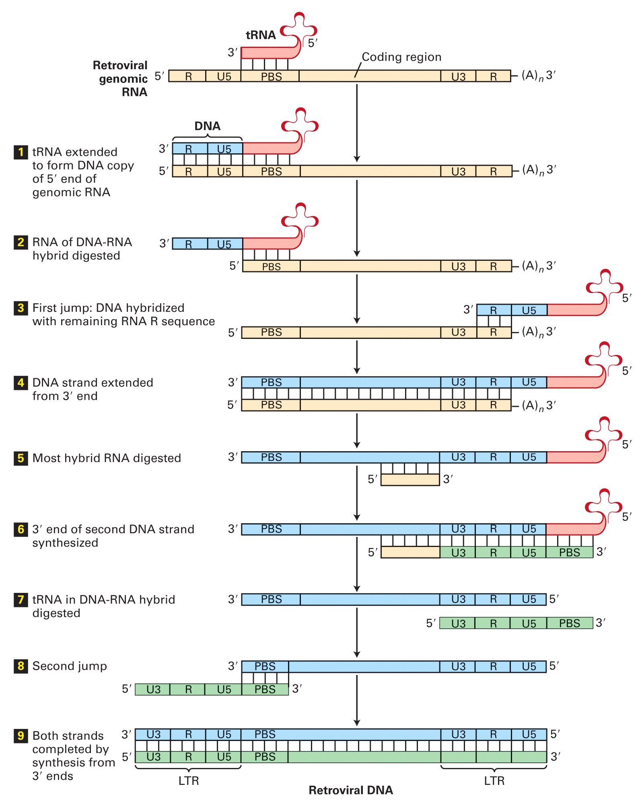
Retroviruses: agents of misery, evolution, and superb genetic engineers.
Damaged retroviruses and fragments of retroviruses litter the human genome.

Slide 20
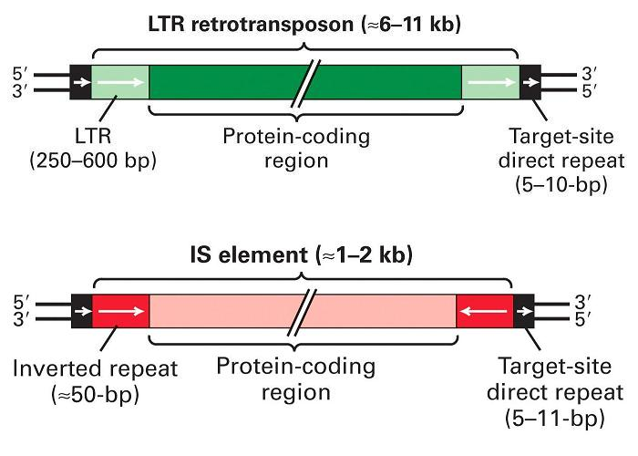
“Jumping Genes”: a more primitive parasite than the viruses.

Slide 21
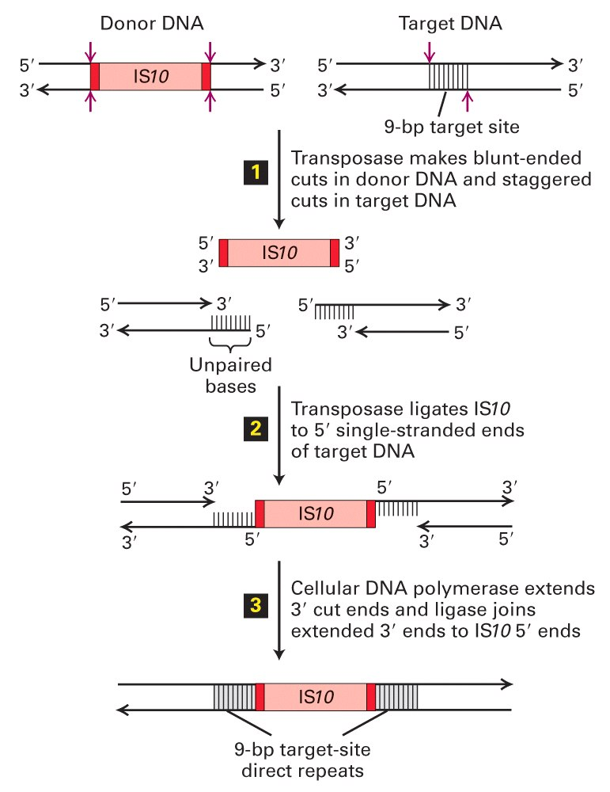
Insertion element propagation

Slide 22
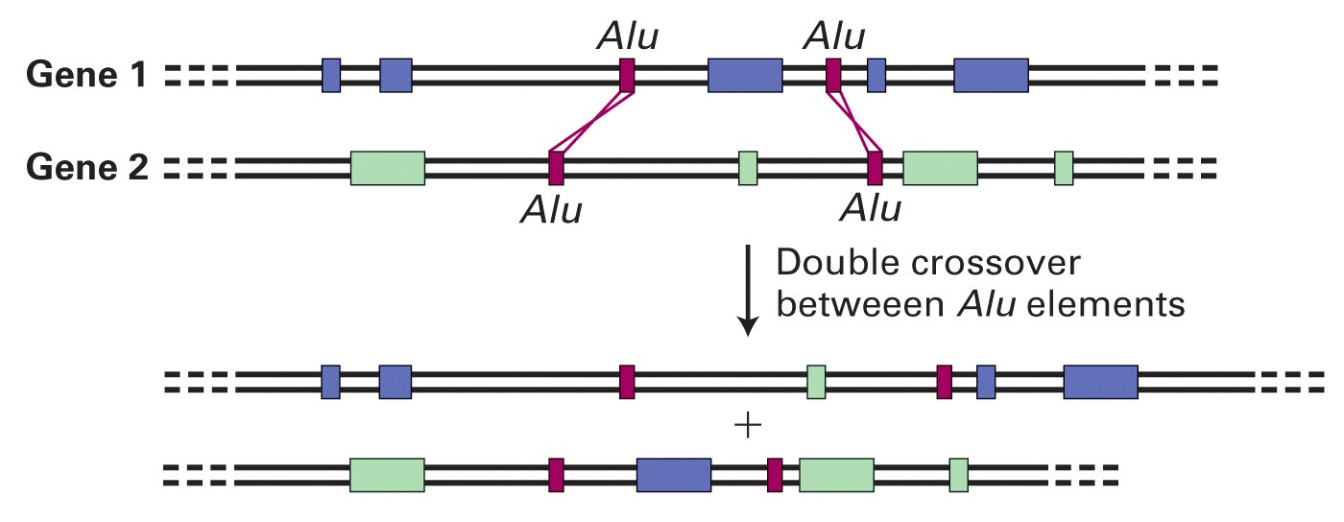
Parasitic DNA’s impact on evolution

Slide 23
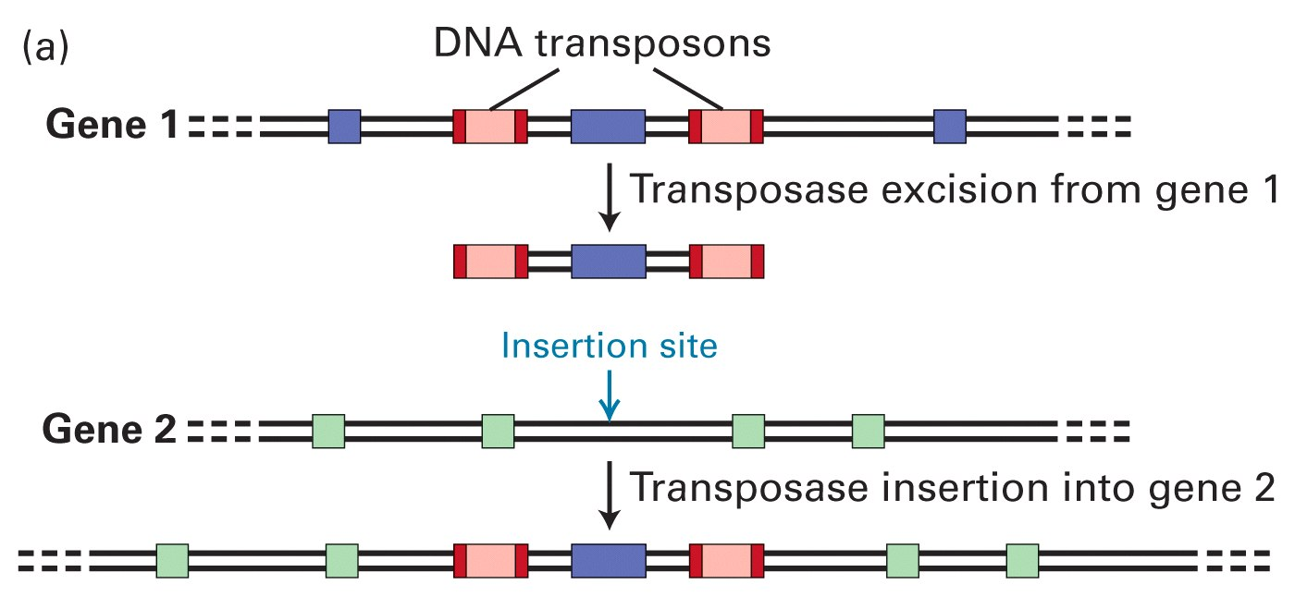
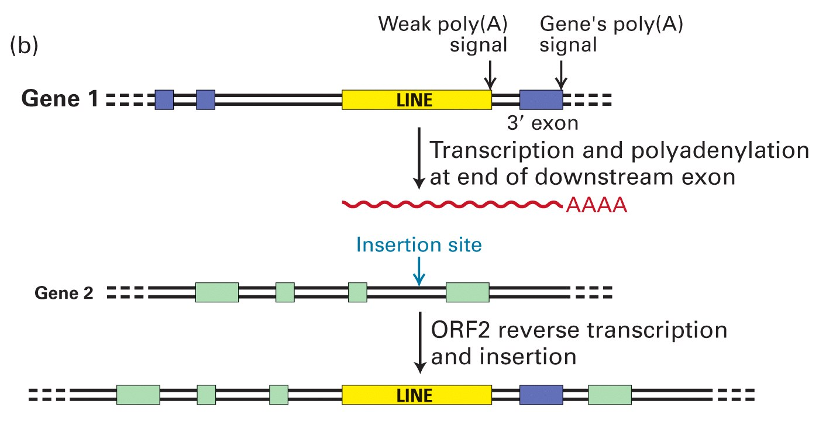
Parasitic DNA’s impact on evolution II, III

Slide 24
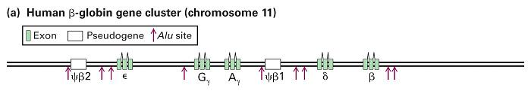
Globin gene insertion elements
Peudogenes are found using sequence alignment software.

