Slide 1
15.082J and 6.855J and ESD.78J
November 2, 2010
Network Flow Duality and
Applications of Network Flows

Slide 2
Overview of Lecture
Applications of network flows
  shortest paths
  maximum flow
  the assignment problem
  minimum cost flows
Linear programming duality in network flows and applications of dual network flow problems

Slide 3
Applications of network flows
  shortest paths
  maximum flow
  the assignment problem
  minimum cost flows

Slide 4
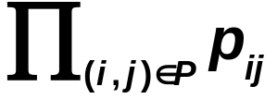
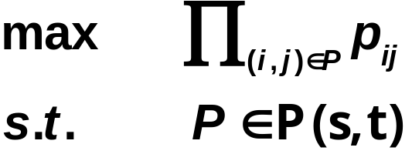
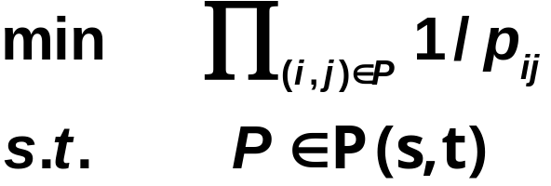
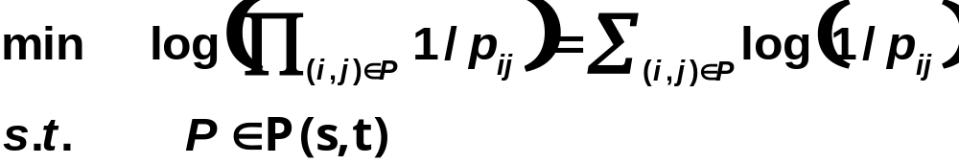
Most reliable paths
Let p_{ij} be the probability that an arc is working, and that all arcs are independent.
The probability that a path P is working is
What is the most reliable path from s to t, that is the one that maximizes the probability of working?
Let c_{ij} = log 1/p_{ij}

Slide 5
Dynamic Shortest Paths
Suppose that the time it takes to travel in arc (i, j) depends on when one starts. (e.g., rush hour vs. other hours in road networks.)
Let c_{ij}(t) be the time it takes to travel in (i, j) starting at time t. What is the minimum time it takes to travel from node 1 to node n starting at 7 AM?
Start time
 | 7 | 7:10 | 7:20 | 7:30 | 7:40 | 7:50 | …
(1,2) | 20 | 30 | 30 | 20 | … | … | …
(1,3) | 10 | 10 | 10 | 10 | … | … | …
(2,3) | 20 | 20 | 20 | 20 | … | … | …
(3,4) | 10 | 20 | 20 | 10 | … | … | …
…
arc
travel time in minutes

Slide 6
The time expanded network
(1,2) | 20 | 30 | 30 | 20 | … | …
(1,3) | 10 | 10 | 10 | 10 | … | …
(2,3) | 20 | 20 | 20 | 20 | … | …
(3,4) | 10 | 20 | 20 | 10 | … | …
 | 7 | 7:10 | 7:20 | 7:30 | 7:40 | 7:50
1
1
1
1
…
What is the minimum time T such that there is a path from node 1 at 7 AM to node n at time T?
2
2
2
2
2
2
…
3
3
3
3
3
3
…
Time T
4
4
4
4
4
…
n

Slide 7
Applications of network flows
  shortest paths
  maximum flows
  the assignment problem
  minimum cost flows

Slide 8
App. 6.4 Scheduling on Uniform Parallel Machines
Job(j)
1
2
3
4
Processing
1.5
3
4.5
5
Time
Release
2
0
2
4
Time
Due Date
5
4
7
9
Suppose there are 2 parallel machines. Is there a feasible schedule?
2
1
4
3
The best (infeasible) schedule without preemption.

Slide 9
A feasible schedule with preemption
Job(j)
1
2
3
4
Processing
1.5
3
4.5
5
Time
Release
2
0
2
4
Time
Due Date
5
4
7
9
Preemption permits a job to be split into two or more parts and scheduled on the same or different machines, but not two machines at the same time. How can one find a feasible schedule when preemption is allowed?
2
1
4
3
4
3

Slide 10
Transformation into a maximum flow problem
Time allocation is the thing that is flowing.
Job j must have p(j) units of time allocated to it.
0,1
2
1,2
2
1
2
1.5
2,3
Job j can be scheduled for at most one time unit in any period.
3
2
2
3,4
s
4.5
2
3
t
4,5
5
2
If there are m machines, then at most m different jobs may be scheduled in any period.
4
5,6
2
6,7
2
7,8
2
u_{ij} = 1 for arcs from green to yellow
8,9

Slide 11
The optimal allocation and flow
0,1
1,2
1
1.5
2,3
3
2
3,4
s
4.5
3
t
4,5
5
4
5,6
6,7
2
1
4
7,8
3
4
3
8,9

Slide 12
A more efficient transformation
0,1
0-2
2
1
4
1,2
1.5
1
2-4
4
2,3
3
2
s
4.5
2
2
1
t
3,4
5
3
4-5
4
3
4,5
4
4
5-7
4
5,6
2
7-9
6,7
Merge two adjacent period nodes if the same set of tasks can be scheduled in both periods. The number of nodes after merging is less than 2 |J|, where J = set of jobs.
7,8
8,9

Slide 13
Sports Writer Problem
Games
Won
Games
Left
Bos
NY
Balt
Tor
Tamp
Bos
--
1
4
1
2
Bos
82
8
NY
1
--
0
3
4
NY
77
8
Balt
4
0
--
1
0
Balt
80
8
Tor
1
3
1
0
3
Tor
79
8
Tamp
2
4
0
3
0
Tamp
74
9
Games remaining
Has Tampa already been eliminated from winning in this hypothetical season finale?
Notes:
In professional sports, one likes to know when a team is guaranteed to win regardless of the outcomes of the remaining games and when a team is guaranteed to be eliminating from winning regardless of the outcome of the remaining games.
It is relatively easy to determine whether a team T is guaranteed to win regardless of subsequent games. All one needs to do is to hypothesize that the team T loses all remaining games and its closest competitor wins all remaining games. If T wins under these totally adverse circumstances, then T is guaranteed to win under all circumstances.
Surprisingly, it is not so easy to determine if a team T is guaranteed to be eliminated from winning. One starts in the same manner and presumes that T wins all of their games. But now suppose that T has 2 or more close competitors. One cannot assume that each of these competitors loses all of their games because some of the games may be against each other. So, in order to determine whether T has a chance of winning the division, one needs to determine how many games each of its closest competitors wins against each other. One can determine this as a max flow problem. But the transformation into a max flow problem is pretty tricky. It’s much easier to see that it is a special case of a min cost flow problem. We will show this transformation next.

Slide 14
Data assuming that Tampa wins all its remaining games.
Games
Won
Games
Won
Games
Left
Games
Left
Bos
NY
Balt
Tor
Bos
--
1
4
1
Bos
Bos
82
82
11
6
NY
1
--
0
3
NY
NY
77
77
8
4
Balt
4
0
--
1
Balt
Balt
80
80
8
6
Tor
1
3
1
--
Tor
Tor
79
79
8
5
Tamp
Tamp
74
83
9
0
Games remaining
Question: can the remaining games be played so that no team wins more than 83 games?
http://riot.ieor.berkeley.edu/~baseball/

Slide 15
Flow on (i,j) is interpreted as games won.
Red Sox
vs. Yankees
1
Red Sox
1
Red Sox
vs. Orioles
4
Yankees
6
Red Sox
vs. Blue Jays
1
t
s
3
Orioles
3
Yankees
vs. Blue Jays
4
1
max wins permitted
Orioles
vs. Blue Jays
Blue Jays
Notes:
The capacities on the arcs from the source represent the maximum number of games that each of the teams can win while still having Tampa as the division winner. The supplies of each of the nodes on the right represent the number of games that must be played between pairs of teams.
The flows from the team nodes to the yellow boxes on the left represent the number of wins for a team in matchups. For example, the flow from the Red Sox node to the “Red Sox vs Orioles” node is the number of games that the Red Sox beat the Orioles. This is a decision variable because we are trying to determine whether we can allocate victories in all remaining games so that Tampa wins the division.

Slide 16
A Maximum Flow
Red Sox
vs. Yankees
1
Red Sox
1
1
1
1
Red Sox
vs. Orioles
4
2
Yankees
1
6
Red Sox
vs. Blue Jays
1
t
s
3
3
3
Orioles
3
Yankees
vs. Blue Jays
4
1
4
2
1
1
Orioles
vs. Blue Jays
Blue Jays

Slide 17
Applications of network flows
  shortest paths
  maximum flows
  the assignment problem
  minimum cost flows

Slide 18
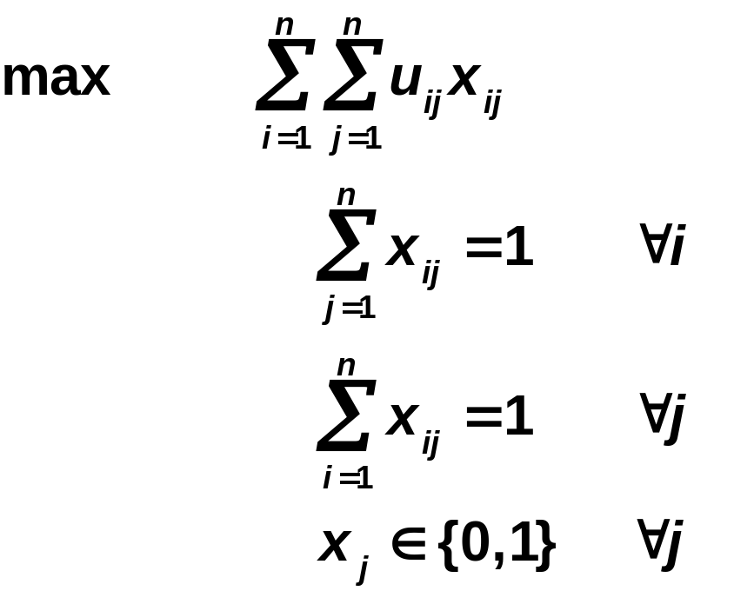
The Assignment Problem
n persons
n tasks
u_{ij} = utility of assigning person i to task j
Maximize the sum of the utilities
Each person gets assigned to a task
Each task has one person assigned to it.
P
T
u₁₄
1
1
1
u₁₅
4
1
1
2
5
1
1
3
6

Slide 19
Identifying Moving Targets in Space
Suppose that there are moving targets in space.
You can identify each target as a pixel on a radar screen.
Given two successive pictures, identify how the targets have moved.
This is an efficient way of tracking items.

Slide 20
Applications of network flows
  shortest paths
  maximum flows
  the assignment problem
  minimum cost flows

Slide 21
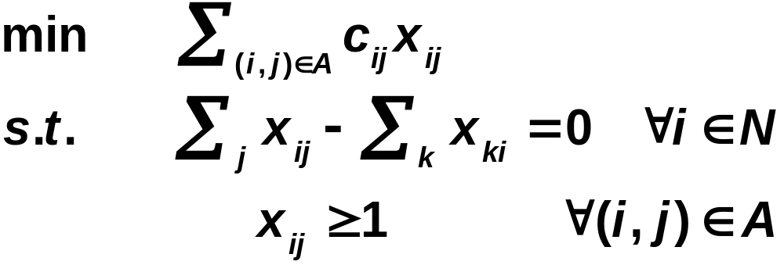
Chinese Postman Problem (directed version)
A postman (using a postal truck) wants to visit every city street at least once while minimizing the total travel time.
x_{ij} = number of times
that the postman
traverses arc (i, j)
c_{ij} = length of (i, j)

Slide 22
Chinese Postman Problem (undirected)
odd degree
even degree
d_{ij} = minimum length
of a path from
node i to node j.
Compute d_{ij} for all
nodes i, j of odd
degree.
Add paths joining nodes of odd degree so as to minimize the total d-length. (This is a nonbipartite matching problem.)

Slide 23
Duality for Network Flow Problems
Each network flow problem has a corresponding problem called the “dual”.
Rest of lecture:
  Review of max flow min cut theorem
  Weak Duality in linear programming
  Strong Duality in linear programming
  Duality for shortest paths plus applications
  Duality for min cost flow plus applications

Slide 24
Duality for the max flow problem
Theorem. (Weak duality). If x is any s-t flow and if (S, T) is any s-t cut, then the flow out of s is at most the capacity of the cut (S,T).
1
1
6
6
In this example, the capacities of all arcs is 1.
The max flow consists of the thick arcs.
If S = red nodes, then min cut (S, N\S).
2
7
s
3
8
t
s
3
8
4
4
9
5
10
Theorem. (Max-flow Min-Cut). The maximum flow value is the minimum capacity of a cut.

Slide 25
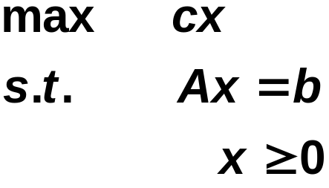
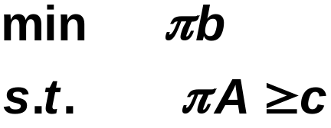
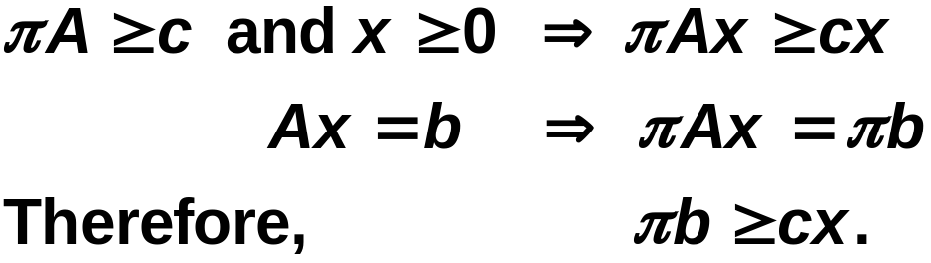
Weak Duality in Linear Programming
Weak Duality Theorem. Suppose that x is feasible for the primal problem and that π is feasible for the dual problem. Then cx ≤ πb.
Primal Problem
Proof
Dual Problem

Slide 26
Strong Duality in Linear Programming
Strong Duality Theorem.
Suppose that the primal problem has an optimal solution x*.
Then the dual problem also has an optimal solution, say π*, and the two optimum objective values are the same. That is, cx* = π*b.
Primal Problem
Dual Problem
Note: it is not obvious that max-flow min-cut is a special case of LP duality.

Slide 27
Duality for the shortest path problem
Let G = (N, A) be a network, and let c_{ij} be the length or cost of arc (i, j). The shortest path problem is to find the path of shortest length from node 1 to node n.
We say that a distance vector d( ) is dual feasible for the shortest path problem if
  d(1) = 0
  d(j) ≤ d(i) + c_{ij} for all (i, j) ∈ A.
The dual shortest path problem is to maximize d(n) subject to the vector d( ) being dual feasible.

Slide 28
Duality Theorem for Shortest Path Problem
Let G = (N, A) be a network, and let c_{ij} be the length or cost of arc (i, j). If there is no negative cost cycle, then the minimum length of a path from node 1 to node n is the maximum value of d(n) subject to d( ) being dual feasible.
1
2
4
2
1
3
2
5
4
2
4
2
2
4
2
3
3
1
1
2
6
4
2
3
4
6
3
2
3
5

Slide 29
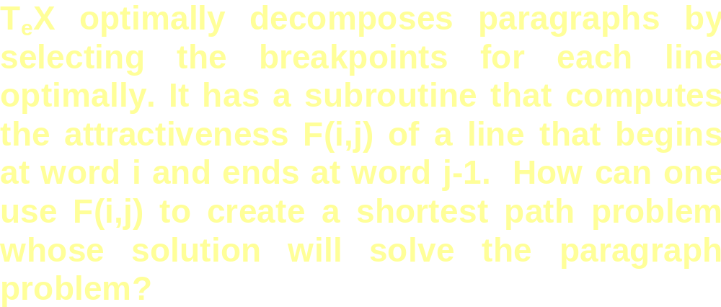
Application: Optimum Paragraph Layout
The paragraph layout problem can be modeled as a shortest path problem or the dual of a shortest path problem.

Slide 30
Application: Optimum Paragraph Layout
Let d*(j) be the value of laying out words 1 to j-1 most attractively. d* can be computed as follows.
min d(n+1)
s.t d(j) ≥ d(i) + F(i, j) ∀ (i,j) ∈ A d(i) ≤ d(j) – F(i, j)
d(1) = 0
For any feasible vector d, d(j) is an upper bound on the beauty of laying out words 1 to j – 1.
The most accurate upper bound gives the optimum beauty.
There is a close connection to dynamic programming.

Slide 31
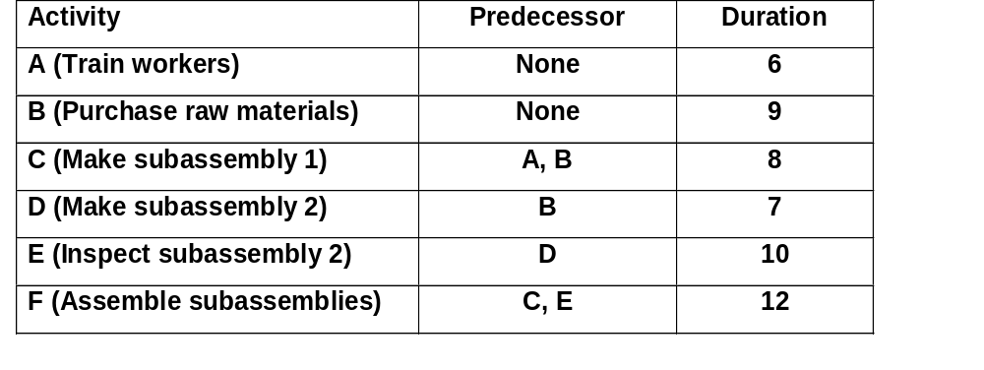
Application: project scheduling
A
C
F
0
n
B
D
E

Slide 32
Application: project scheduling
Let s(i) be the start time of task i.
Let f(i) be the finish time of task i.
Let p(i) be the processing time of task i.
minimize f(n)
subject to s(0) = 0
f(j) = s(j) + p(j) for all j ≠ 0 or n
s(j) ≥ f(i) if i precedes j.
Corresponds to a longest path problem. We can make it a shortest path problem by letting g(j) = - f(j) for all j.

Slide 33
Project scheduling with just-in-time delivery
Suppose that for some tasks i and j, task j must be started within h(i, j) time units of task i finishing.
Let s(i) be the start time of task i.
Let f(i) be the finish time of task i.
Let p(i) be the processing time of task i.
minimize f(n)
subject to s(0) = 0
f(j) = s(j) + p(j) for all j ≠ 0 or n
s(j) ≥ f(i) if i precedes j
s(j) ≤ f(i) + h(i, j) or f(i) ≥ s(j) - h(i, j)

Slide 34
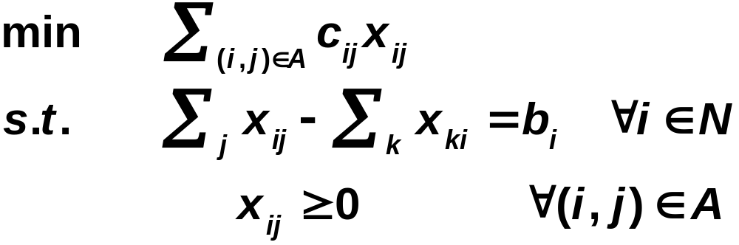
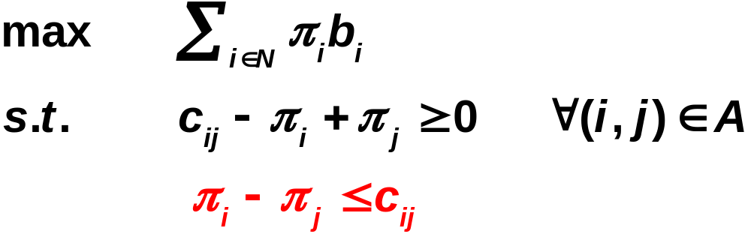
Duality for minimum cost flows
Theorem. Suppose that x is feasible for the uncapacitated MCF problem, and π is feasible for the dual problem. Then cx ≥ πb.
If one of the problems has a finite optimum, then so does the other, and the two values are the same.
Uncapacitated min cost flow problem
Dual of the uncapacitated MCF problem.

Slide 35
More on Duality
One can solve the dual problem using an algorithm for solving the uncapacitated MCF problem.
Any linear programming problem in which every constraint is either a lower bound on a variable or an upper bound on a variable or of the form “y_{i} – y_{j} ≤ c_{ij}” is the dual of a minimum cost flow problem.

Slide 36
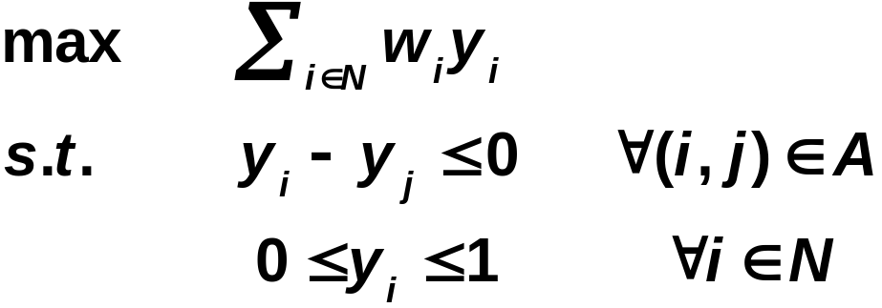
Maximum Weight Closure of a Graph
Let G = (N, A). Let w_{i} be the weight of node i.
A subset S ⊆ N is called a closure if there are no arcs leaving the subset. That is, if i ∈ S and if (i, j) ∈ A, then j ∈ S.
i
j
The maximum weight closure problem is to find a closure of maximum weight. It is the dual of a minimum cost flow problem.

Slide 37
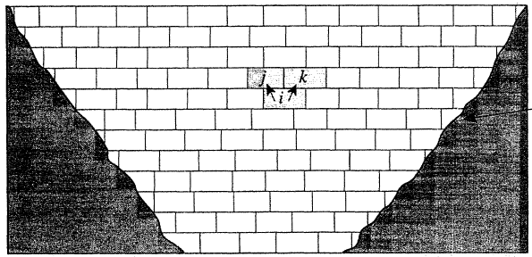
Open Pit Mining
Suppose an open pit mine is subdivided into blocks. We create a graph G = (N, A) as follows:
  There is a node for each block
  If block j must be removed before block i, then (i, j) ∈ A.
  The net revenue from block i is w_{i.}
Special case of the closure problem.
j
k
i
(i, j) ∈ A
(i, k)∈ A

Slide 38
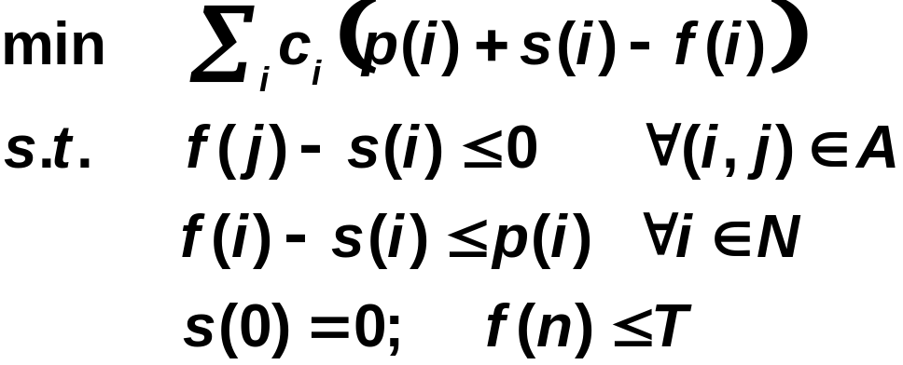
Project management with “crashing”
Suppose that one can reduce the time at which task j is completed for each j. The cost of reducing the time for task i is c_{i} per unit of time.
What is the least cost schedule that completes all tasks by time T?
Let s(i) be the start time of task i.
Let f(i) be the finish time of task i.
Let p(i) be the original
processing time of task i.
The above LP is the dual of a minimum cost flow problem.

Slide 39
Summary
There are hundreds of direct applications of the minimum cost flow problem or its dual.
Even more common, min cost flow problems arise as subproblems of a larger and more complex problem. We will see more of this in a few lectures from now.
Next Lecture: the simplex algorithm for the min cost flow problem.

Slide 40
MITOpenCourseWare
http://ocw.mit.edu
15.082J / 6.855J / ESD.78J Network Optimization
Fall 2010
For information about citing these materials or our Terms of Use, visit: http://ocw.mit.edu/terms.

