Slide 1
15.082 and 6.855J
Lagrangian Relaxation
    I never missed the opportunity to remove obstacles in the way of unity.
      —Mohandas Gandhi

Slide 2
On bounding in optimization
In solving network flow problems, we not only solve the problem, but we provide a guarantee that we solved the problem.
Guarantees are one of the major contributions of an optimization approach.
But what can we do if a minimization problem is too hard to solve to optimality?
Sometimes, the best we can do is to offer a lower bound on the best objective value. If the bound is close to the best solution found, it is almost as good as optimizing.

Slide 3
Overview
Decomposition based approach.
Start with
  Easy constraints
  Complicating Constraints.
Put the complicating constraints into the objective and delete them from the constraints.
We will obtain a lower bound on the optimal solution for minimization problems.
In many situations, this bound is close to the optimal solution value.

Slide 4
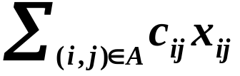
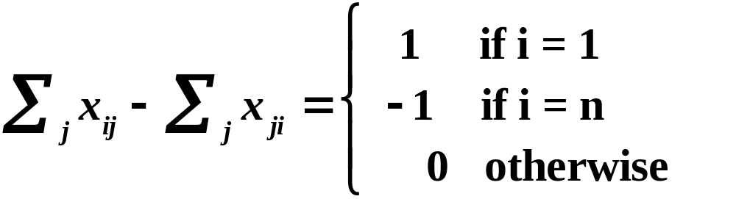
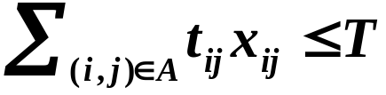

An Example: Constrained Shortest Paths
Given: a network G = (N,A)
c_{ij} cost for arc (i,j)
t_{ij} traversal time for arc (i,j)
z* = Min
s. t.
Complicating constraint

Slide 5
Example
Find the shortest path from node 1 to node 6 with a transit time at most 10
$c_{ij}, t_{ij}
i
j
2
$1,1
4
$1,10
$2,3
$1,7
1
$1,2
$10,1
6
$5,7
$10,3
$2,2
3
5
$12,3

Slide 6
Shortest Paths with Transit Time Restrictions
Shortest path problems are easy.
Shortest path problems with transit time restrictions are NP-hard.
We say that constrained optimization problem Y is a relaxation of problem X if Y is obtained from X by eliminating one or more constraints.
We will “relax” the complicating constraint, and then use a “heuristic” of penalizing too much transit time. We will then connect it to the theory of Lagrangian relaxations.

Slide 7
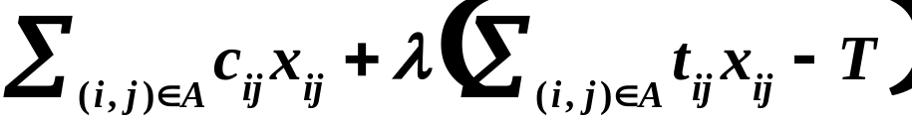

Shortest Paths with Transit Time Restrictions
Step 1. (A Lagrangian relaxation approach). Penalize violation of the constraint in the objective function.
z(λ) = Min
Complicating constraint
Note: z*(λ) ≤ z* ∀λ ≥ 0

Slide 8
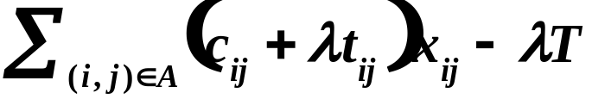
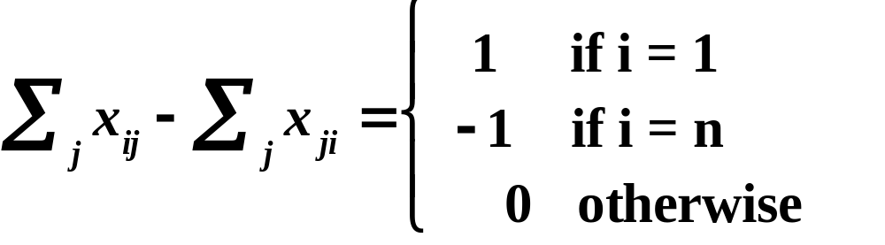
Shortest Paths with Transit Time Restrictions
Step 2. Delete the complicating constraint(s) from the problem. The resulting problem is called the Lagrangian relaxation.
L(λ) = Min
Complicating constraint
Note: L(λ) ≤ z(λ) ≤ z* ∀λ ≥ 0

Slide 9
What is the effect of varying λ?
Case 1: λ = 0
2
$1,1
4
$1,10
$2,3
$1,7
1
$1,2
$10,1
6
$5,7
2
1
4
$10,3
$2,2
1
3
5
1
2
$12,3
1
1
10
6
5
c_{ij} + λ t_{ij}
i
j
10
2
3
5
12
P = 1-2-4-6
P =
c(P) = 3
c(P) =
t(P) = 18
t(P) =

Slide 10
Question to class
If λ = 0, the min cost path is found.
What happens to the (real) cost of the path as λ increases from 0?
What path is determined as λ gets VERY large?
What happens to the (real) transit time of the path as λ increases from 0?
c_{ij} + λ t_{ij}
i
j

Slide 11
Let λ = 1
Case 2: λ = 1
2
$1,1
4
$1,10
$2,3
$1,7
1
$1,2
$10,1
6
$5,7
2
2
4
$10,3
$2,2
8
3
5
11
5
$12,3
1
11
6
3
12
13
4
3
5
15
P = 1-2-5-6
P =
c(P) = 5
c(P) =
t(P) = 15
t(P) =

Slide 12
Let λ = 2
Case 3: λ = 2
2
$1,1
4
$1,10
$2,3
$1,7
1
$1,2
$10,1
6
$5,7
2
3
4
$10,3
$2,2
15
3
5
21
8
$12,3
1
12
6
5
19
16
6
3
5
18
P = 1-2-5-6
P =
c(P) = 5
c(P) =
t(P) = 15
t(P) =

Slide 13
And alternative shortest path when λ = 2
2
$1,1
4
$1,10
$2,3
$1,7
1
$1,2
$10,1
6
$5,7
2
3
4
$10,3
$2,2
15
3
5
21
8
$12,3
1
12
6
5
19
16
6
3
5
18
P = 1-3-2-5-6
P =
c(P) = 15
c(P) =
t(P) = 10
t(P) =

Slide 14
Let λ = 5
Case 4: λ = 5
2
$1,1
4
$1,10
$2,3
$1,7
1
$1,2
$10,1
6
$5,7
2
3
4
$10,3
$2,2
15
3
5
21
8
$12,3
1
12
6
5
19
16
6
3
5
18
P = 1-3-2-4-5-6
P =
c(P) = 24
c(P) =
t(P) = 8
t(P) =

Slide 15
A parametric analysis
Toll | modified cost | Cost | Transit Time | Modified cost -10λ
0 ≤ λ ≤ ⅔ | 3 + 18λ | 3 | 18 | 3 + 8λ
⅔ ≤ λ ≤ 2 | 5 + 15λ | 5 | 15 | 5 + 3λ
2 ≤ λ ≤ 4.5 | 15 + 10λ | 15 | 10 | 15
4.5 ≤ λ < ∞ | 24 + 8λ | 24 | 8 | 24 - 2λ
A lower bound on z*
The best value of λ is the one that maximizes the lower bound.

Slide 16
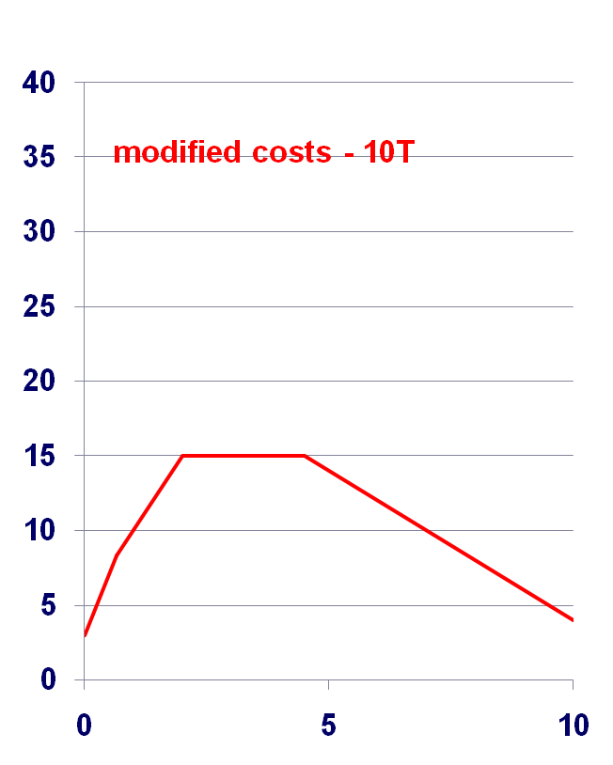
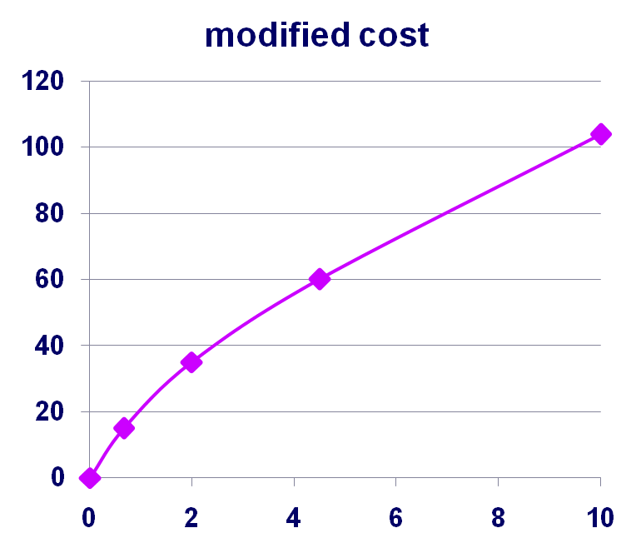
Costs
Modified Cost – 10λ
Transit Times
λ
λ

Slide 17
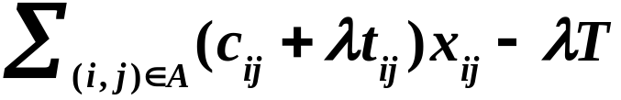
The Lagrangian Multiplier Problem
L(λ) = min
s.t.
L* = max {L(λ) : λ ≥ 0}.
Lagrangian Multiplier Problem
Theorem. L(λ) ≤ L* ≤ z*.

Slide 18
Application to constrained shortest path
L(λ) = min
Let c(P) be the cost of path P that satisfies the transit time constraint.
Corollary. For all λ, L(λ) ≤ L* ≤ z* ≤ c(P).
If L(λ’) = c(P), then L(λ’) = L* = z* = c(P). In this case, P is an optimal path and λ’ optimizes the Lagrangian Multiplier Problem.

Slide 19
More on Lagrangian relaxations
Great technique for obtaining bounds.
Questions?
How can one generalize the previous ideas?
How good are the bounds? Are there any interesting connections between Lagrangian relaxation bounds and other bounds?
What are some other interesting examples?

Slide 20
Mental Break
In 1784, there was a US state that was later merged into another state. Where was this state?
The state was called Franklin. Four years later it was merged into Tennessee.
In the US, it is called Spanish rice. What is it called in Spain?
Spanish rice is unknown in Spain. It is called “rice” in Mexico.
Why does Saudi Arabia import sand from other countries?
Their desert sand is not suitable for construction.

Slide 21
Mental Break
In Tokyo it is expensive to place classified ads in their newspaper. How much does a 3-line ad cost per day?
More than $3,500.
Where is the largest Gothic cathedral in the world?
New York City. It is the Cathedral of Saint John the Divine.
The Tyburn Convent is partially located in London’s smallest house. How wide is the house?
Approximately 3.5 feet, or a little over 1 meter.

Slide 22



The Lagrangian Relaxation Technique
(Case 1: equality constraints)
s.t.
P
P(μ)
s.t.
Lemma 16.1. For all vectors μ, L(μ) ≤ z*.

Slide 23

The Lagrangian Multiplier Problem
(obtaining better bounds)
s.t.
P(μ)
A bound for a minimization problem is better if it is higher. The problem of finding the best bound is called the Lagrangian multiplier problem.
Lemma 16.2. For all vectors μ, L(μ) ≤ L* ≤ z*.
Corollary. If x is feasible for the original problem and if L(μ) = cx, then L(μ) = L* = z* = cx. In this case x is optimal for the original problem and μ optimizes the Lagrangian multiplier problem.

Slide 24
Lagrangian Relaxation and Inequality Constraints
z* = Min cx
subject to Ax ≤ b, (P*)
x ∈ X.
L(μ) = Min cx + μ(Ax - b) (P*(μ))
subject to x ∈ X,
Lemma. L(μ) ≤ z* for μ ≥ 0.
The Lagrange Multiplier Problem: maximize (L(μ) : μ ≥ 0).
Suppose L* denotes the optimal objective value, and suppose x is feasible for P* and μ ≥ 0. Then L(μ) ≤ L* ≤ z* ≤ cx.

Slide 25
A connection between Lagrangian Relaxations and LPs
Consider the constrained shortest path problem, but with T = 13.
2
$1,1
4
$1,10
$2,3
$1,7
1
$1,2
$10,1
6
$5,7
$10,3
$2,2
3
5
$12,3
What is the min cost path with transit time at most 13?

Slide 26
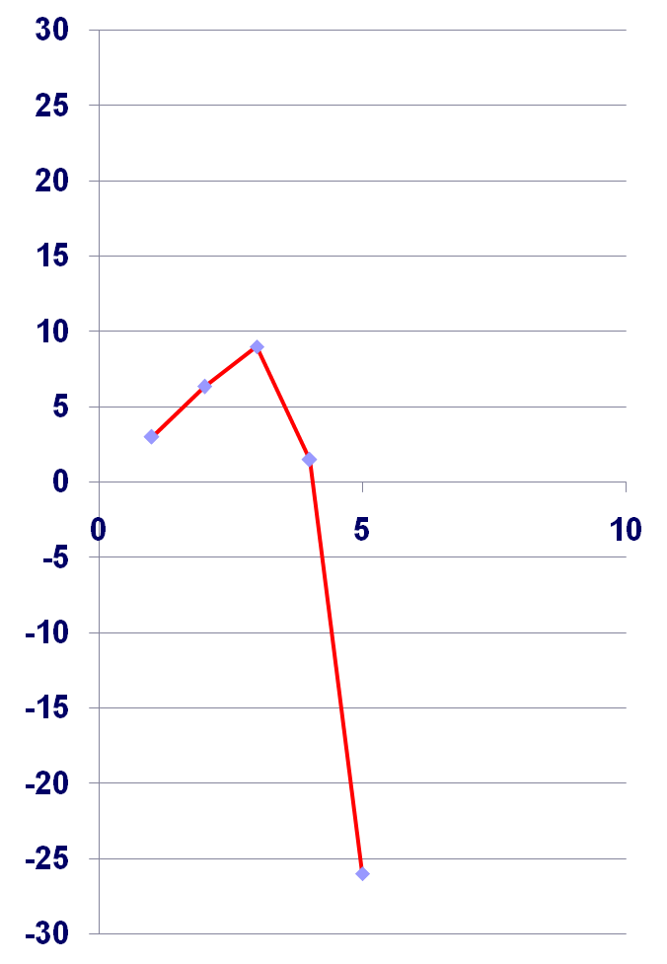
Sometimes the Lagrangian bound isn’t tight.
Consider the constrained shortest path problem, but with T = 13.
2
$1,1
4
$1,10
$2,3
$1,7
1
$1,2
$10,1
6
$5,7
$10,3
$2,2
3
5
$12,3
What is L*, the optimum solution for the lagrangian dual?

Slide 27
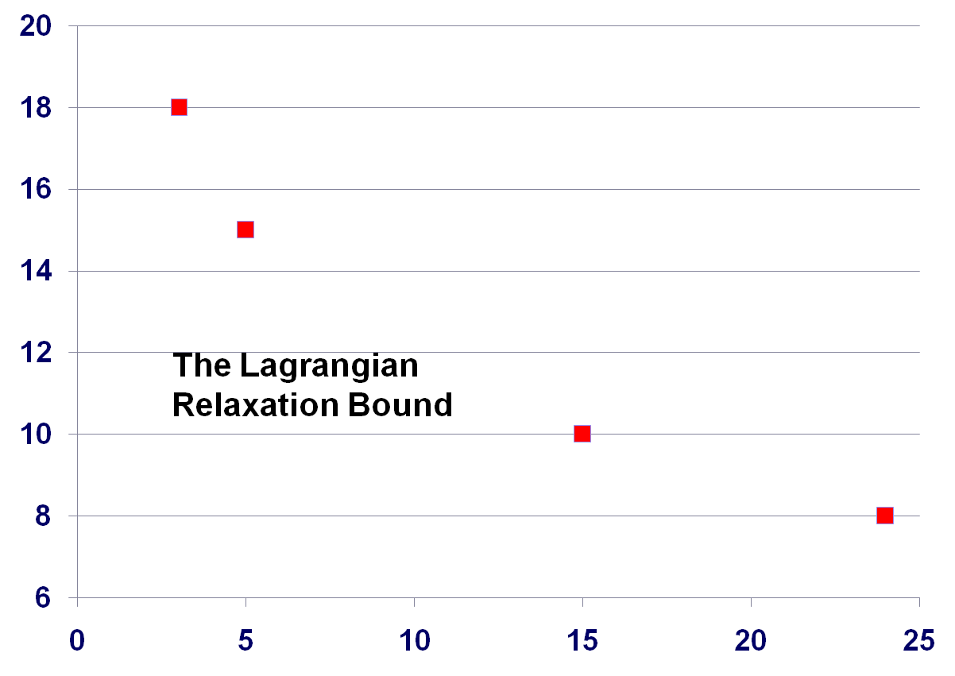
Paths obtained by parametric analysis
1-2-4-6
1-2-5-6
Transit time
13
1-3-2-4-6
1-3-2-5-6
1-3-2-4-5-6
Cost

Slide 28
Application 2 of Lagrangian Relaxation.
Traveling Salesman Problem (TSP)
INPUT: n cities, denoted as 1, . . . , n
c_{ij} = travel distance from city i to city j
OUTPUT: A minimum distance tour.

Slide 29
Representing the TSP problem
A collection of arcs is a tour if
There are two arcs incident to each node
The red arcs (those not incident to node 1) form a spanning tree in G\1.
1

Slide 30

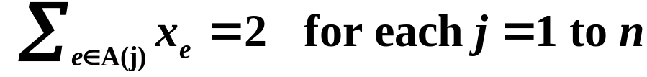

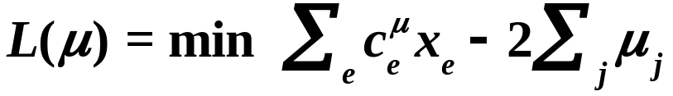

A Lagrangian Relaxation for the TSP
Let A(j) be the arcs incident to node j.
Let X denote all 1-trees, that is, there are two arcs incident to node 1, and deleting these arcs leaves a tree.
P
c_{ij} + μ_{i} + μ_{j}
i
j
P(μ)
where for e = (i,j),

Slide 31
More on the TSP
This Lagrangian Relaxation was formulated by Held and Karp [1970 and 1971].
Seminal paper showing how useful Lagrangian Relaxation is in integer programming.
The solution to the Lagrange Multiplier Problem gives an excellent solution, and it tends to be “close” to a tour.

Slide 32
An optimal spanning tree for the Lagrangian problem L(μ*) for optimal μ* usually has few leaf nodes.
1

Slide 33
Towards a different Lagrangian Relaxation
1
S
In a tour, the number of arcs with both endpoints in S is at most |S| - 1 for |S| < n

Slide 34

Another Lagrangian Relaxation for the TSP
where for e = (i,j),
A surprising fact: this relaxation gives exactly the same bound as the 1-tree relaxation for each μ.

Slide 35
Summary
Constrained shortest path problem
Lagrangian relaxations
Lagrangian multiplier problem
Application to TSP
Next lecture: a little more theory. Some more applications.

Slide 36
Generalized assignment problem ex. 16.8
Ross and Soland [1975]
1
a_{ij} = the amount of
processing time of
job i on machine j
1
2
2
x_{ij} = 1 if job i is processed
on machine j
= 0 otherwise
3
3
4
4
Job i gets processed.
5
Machine j has at most d_{j} units of processing
Set I of jobs
Set J of machines

Slide 37
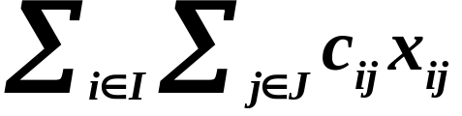
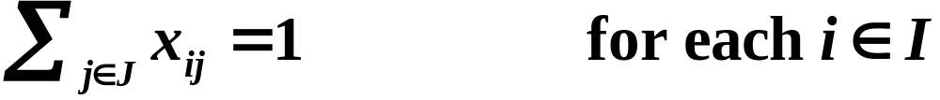
Generalized assignment problem ex. 16.8
Ross and Soland [1975]
Minimize
(16.10a)
(16.10b)
(16.10c)
(16.10d)
Generalized flow with integer constraints.
Class exercise: write two different Lagrangian relaxations.

Slide 38
Facility Location Problem ex. 16.9
Erlenkotter 1978
Consider a set J of potential facilities
Opening facility j ∈ J incurs a cost F_{j}.
The capacity of facility j is K_{j}.
Consider a set I of customers that must be served
The total demand of customer i is d_{i}.
Serving one unit of customer i’s from location j
costs c_{ij}.
customer
potential facility

Slide 39
A pictorial representation

Slide 40
A possible solution

Slide 41
Class Exercise
Formulate the facility location problem as an integer program. Assume that a customer can be served by more than one facility.
Suggest a way that Lagrangian Relaxation can be used to help solve this problem.
Let x_{ij} be the amount of demand of customer i served by facility j.
Let y_{j} be 1 if facility j is opened, and 0 otherwise.

Slide 42
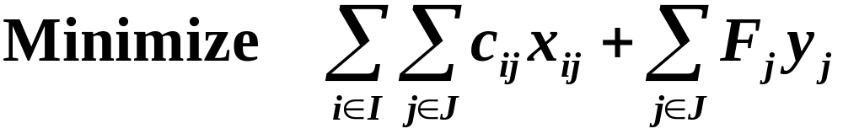
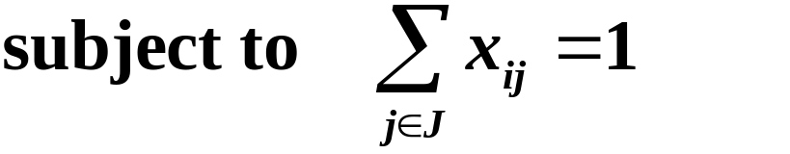

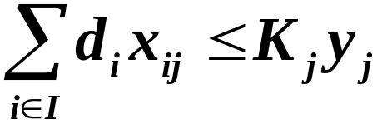

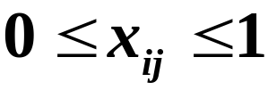

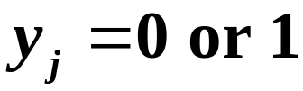
The facility location model

Slide 43
Summary of the Lecture
Lagrangian Relaxation
  Illustration using constrained shortest path
  Bounding principle
  Lagrangian Relaxation in a more general form
  The Lagrangian Multiplier Problem
  Lagrangian Relaxation and inequality constraints
  Very popular approach when relaxing some constraints makes the problem easy
Applications
  TSP
  Generalized assignment
  Facility Location

Slide 44
Next Lecture
Review of Lagrangian Relaxation
Lagrangian Relaxation for Linear Programs
Solving the Lagrangian Multiplier Problem
  Dantzig-Wolfe decomposition

Slide 45
MITOpenCourseWare
http://ocw.mit.edu
15.082J / 6.855J / ESD.78J Network Optimization
Fall 2010
For information about citing these materials or our Terms of Use, visit: http://ocw.mit.edu/terms.

