Slide 1
15.082J and 6.855J and ESD.78J
Lagrangian Relaxation 2
  Applications
  Algorithms
  Theory

Slide 2
Lagrangian Relaxation and Inequality Constraints
z* = Min cx
subject to Ax ≤ b, (P*)
x ∈ X.
L(μ) = Min cx + μ(Ax - b) (P*(μ))
subject to x ∈ X,
Lemma. L(μ) ≤ z* for μ ≥ 0.
The Lagrange Multiplier Problem: maximize (L(μ) : μ ≥ 0).
Suppose L* denotes the optimal objective value, and suppose x is feasible for P* and μ ≥ 0. Then L(μ) ≤ L* ≤ z* ≤ cx.

Slide 3
Lagrangian Relaxation and Equality Constraints
z* = Min cx
subject to Ax = b, (P*)
x ∈ X.
L(μ) = Min cx + μ(Ax - b) (P*(μ))
subject to x ∈ X,
Lemma. L(μ) ≤ z* for all μ ∈ R^{n}
The Lagrange Multiplier Problem: maximize (L(μ) : μ ∈ R^{n} ).
Suppose L* denotes the optimal objective value, and suppose x is feasible for P* and μ ≥ 0. Then L(μ) ≤ L* ≤ z* ≤ cx.

Slide 4
Generalized assignment problem ex. 16.8
Ross and Soland [1975]
1
a_{ij} = the amount of
processing time of
job i on machine j
1
2
2
x_{ij} = 1 if job i is processed
on machine j
= 0 otherwise
3
3
4
4
Job i gets processed.
5
Machine j has at most d_{j} units of processing
Set I of jobs
Set J of machines

Slide 5
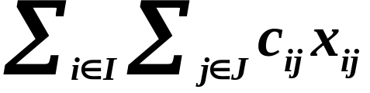
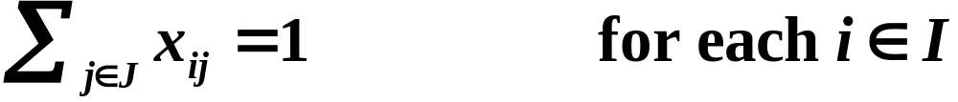
Generalized assignment problem ex. 16.8
Ross and Soland [1975]
Minimize
(16.10a)
(16.10b)
(16.10c)
(16.10d)
Generalized flow with integer constraints.
Class exercise: write two different Lagrangian relaxations.

Slide 6
Facility Location Problem ex. 16.9
Erlenkotter 1978
Consider a set J of potential facilities
Opening facility j ∈ J incurs a cost F_{j}.
The capacity of facility j is K_{j}.
Consider a set I of customers that must be served
The total demand of customer i is d_{i}.
Serving one unit of customer i’s from location j
costs c_{ij}.
customer
potential facility

Slide 7
A pictorial representation

Slide 8
A possible solution

Slide 9
Class Exercise
Formulate the facility location problem as an integer program. Assume that a customer can be served by more than one facility.
Suggest a way that Lagrangian Relaxation can be used to help solve this problem.
Let x_{ij} be the amount of demand of customer i served by facility j.
Let y_{j} be 1 if facility j is opened, and 0 otherwise.

Slide 10
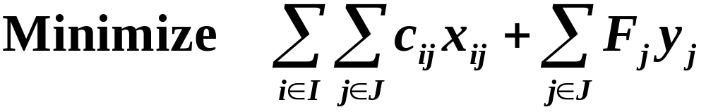


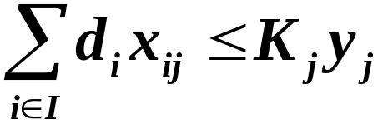

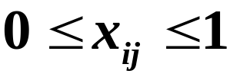

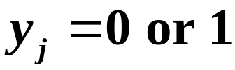
The facility location model

Slide 11
Solving the Lagrangian Multiplier Problem
Approach 1: represent the LP feasible region as the convex combination of corner points. Then use a constraint generation approach.
Approach 2: subgradient optimization

Slide 12
The Constrained Shortest Path Problem
2
(1,1)
4
(1,10)
(2,3)
(1,7)
1
(1,2)
(10,1)
6
(5,7)
(10,3)
(2,2)
3
5
(12,3)
Find the shortest path from node 1 to node 6 with a transit time at most 14.

Slide 13
Constrained Shortest Paths: Path Formulation
Given: a network G = (N,A)
c_{ij} cost for arc (i,j)
c(P) cost of path P
t_{ij} traversal time for arc (i,j)
T upper bound on transit times.
t(P) traversal time for path P
P set of paths from node 1 to node n
Min c(P)
s.t. t(P) ≤ T
P ∈ P
L(μ) = Min c(P) + μ t(P) - μT
s.t. P ∈ P
Lagrangian
Constrained Problem

Slide 14
The Lagrangian Multiplier Problem
Step 0. Formulate the Lagrangian Problem.
L(μ) = Min c(P) + μ t(P) - μT
s.t. P ∈ P
L(μ) = Max w
s.t w ≤ c(P) + μ t(P) – μT
for all P ∈ P
Step 1. Rewrite as a maximization problem
L* = max {L(μ): μ ≥ 0} =
= Max w
s.t w ≤ c(P) + μ t(P) – μT
for all P ∈ P
μ ≥ 0
Step 2. Write the Lagrangian multiplier problem

Slide 15
Max { w: w ≤ c(P) + μ t(P) – μT ∀P ∈ P,
and μ ≥ 0}
Paths
30
1-3-4-6
1-2-4-6
20
1-3-4-5-6
1-2-4-5-6
10
1-2-5-6
Composite Cost
1-3-2-4-6
0
1-3-2-4-5-6
L* = max (L(μ): μ ≥ 0)
1-3-2-5-6
1-3-5-6
-10
0
1
2
3
4
5
Lagrange Multiplier μ
Figure 16.3 The Lagrangian function for T = 14.

Slide 16
The Restricted Lagrangian
P : the set of paths from node 1 to node n
S ⊆ P : a subset of paths
L* = max w
s.t w ≤ c(P) + μ t(P) –T
for all P ∈ P
μ ≥ 0
L*_{S} = max w
s.t w ≤ c(P) + μ t(P) – μT
for all P ∈ S
μ ≥ 0
Lagrangian Multiplier Problem
Restricted Lagrangian
Multiplier Problem
L(μ) ≤ L* ≤ L*_{S}
If L(μ) = L*_{S} then L(μ) = L*.
Optimality Conditions

Slide 17
Constraint Generation for Finding L*
Let Path(μ) be the path that optimizes the Lagrangian.
Let Multiplier(S) be the value of μ that optimizes L_{S}(μ).
M is some large number
Initialize:
S := {Path(0), Path(M)}
μ := Multiplier(S),
Yes
Is L(μ) = L*_{S}?
Quit. L(μ) = L*
No
S := S ∪ Path(μ)

Slide 18
We start with the paths 1-2-4-6, and 1-3-5-6
which are optimal for L(0) and L(∞).
Paths
30
1-2-4-6
3 + 18 μ
20
(2.1, 40.8)
10
Composite Cost
0
1-3-5-6
24 + 8 μ
-10
0
1
2
3
4
5
Lagrange Multiplier μ

Slide 19
Set μ = 2.1 and solve the constrained shortest path problem
The optimum path is 1-3-2-5-6
2
3.2
15 + 10 μ
4
22
8.3
15.7
1
5.2
12.1
6
19.7
16.3
6.2
3
5
18.3

Slide 20
Path(2.1) = 1-3-2-5-6. Add it to S and reoptimize.
Paths
30
1-2-4-6
3 + 4 μ
20
10
Composite Cost
1.5, 9
0
15 - 4 μ
1-3-2-5-6
1-3-5-6
24 - 6 μ
-10
0
1
2
3
4
5
Lagrange Multiplier μ

Slide 21
Set μ = 1.5 and solve the constrained shortest path problem
The optimum path is 1-2-5-6.
2
2.5
4
16
6.5
11.5
1
4
11.5
6
15.5
14.5
5
3
5
16.5

Slide 22
Add Path 1-2-5-6 and reoptimize
Paths
30
1-2-4-6
3 + 4 μ
20
1-2-5-6
5 + μ
10
Composite Cost
2, 7
0
15 - 4 μ
1-3-2-5-6
1-3-5-6
24 - 6 μ
-10
0
1
2
3
4
5
Lagrange Multiplier μ

Slide 23
Set μ = 2 and solve the constrained shortest path problem
The optimum paths are
1-2-5-6 and
1-3-2-5-6
2
3
4
21
8
15
1
5
12
6
19
16
6
3
5
18

Slide 24
There are no new paths to add.
μ* is optimal for the multiplier problem
Paths
30
1-2-4-6
3 + 4 μ
20
1-2-5-6
5 + μ
10
Composite Cost
2, 7
0
15 - 4 μ
1-3-2-5-6
1-3-5-6
24 - 6 μ
-10
0
1
2
3
4
5
Lagrange Multiplier μ

Slide 25
Mental Break
Where did the name Gatorade come from?
The drink was developed in 1965 for the Florida Gators football team. The team credits in 1967 Orange Bowl victory to Gatorade.
What percentage of people in the world have never made or received a phone call?
50%
What causes the odor of natural gas?
Natural gas has no odor. They add the smell artificially to make leaks easy to detect.

Slide 26
Mental Break
What is the most abundant metal in the earth’s crust?
Aluminum
How fast are the fastest shooting stars?
Around 150,000 miles per hour.
The Malaysian government banned car commercials starring Brad Pit. What was their reason for doing so?
Brad Pitt was not sufficiently Asian looking. Using a Caucasian such as Brad was considered “an insult to Asians.”

Slide 27
Towards a general theory
Next: a way of generalizing Lagrangian Relaxation for the time constrained shortest path problem to LPs in general.
Key fact: bounded LPs are optimized at extreme points.

Slide 28
Extreme Points and Optimization
Paths ⇔ Extreme Points
Optimizing over paths ⇔ Optimizing over extreme points
If an LP region is bounded, then there is a minimum cost solution that occurs at an extreme (corner) point)

Slide 29
Convex Hulls and Optimization:
The convex hull of a set X of points is the smallest LP feasible region that contains all points of X. The convex hull will be denoted as H(X) .
Min cx
s.t x ∈ X
Min cx
s.t. x ∈ H(X)
`

Slide 30
Convex Hulls and Optimization:
Let S = {x : Ax = b, x ≥ 0}.
Suppose that S has a bounded feasible region.
Let Extreme(S) be the set of extreme points of S.
Min cx
s.t Ax = b
x ≥ 0
Min cx
s.t. x ∈ Extreme(S)
`

Slide 31
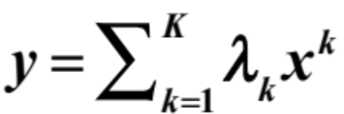
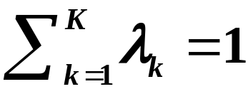

Convex Hulls
Suppose that X = {x¹, x², …, x^{K}} is a finite set.
Vector y is a convex combination of X = {x¹, x², …, x^{K}} if there is a feasible solution to
The convex hull of X is H(X) = { x : x can be expressed as a convex combination of points in X.}

Slide 32
Lagrangian Relaxation and
Inequality Constraints
z* = min cx
subject to Ax ≤ b, (P)
x ∈ X.
L(μ) = min cx + μ(Ax - b) (P(μ))
subject to x ∈ X.
L* = max (L(μ) : μ ≥ 0).
So we want to maximize over μ, while we are minimizing over x.

Slide 33
An alternative representation
Suppose that X = {x¹, x², x³, …, x^{K}}. Possibly K is exponentially large; e.g., X is the set of paths from node s to node t.
L(μ) = min cx + μ(Ax - b) = (c + μA)x - μb
subject to x ∈ X.
L(μ) = min {(c + μA)x^{k} - μb : k = 1 to K}
L(μ) = max w
s.t. w ≤ (c + μA)x^{k} - μb for all k

Slide 34
The Lagrange Multiplier Problem
L* = max w
s.t. w ≤ (c + A)x^{k} - μb for all k ∈ [1,K]
μ ∈ R^{n}
Suppose that S ⊆ [1,K]
For a fixed value μ
L*_{S}(μ) = max w
s.t. w ≤ (c + μA)x^{k} - μb for all k ∈ S
L*_{S} = max w
s.t. w ≤ (c + μA)x^{k} - μb for all k ∈ S
μ ∈ R^{n}

Slide 35
Constraint Generation for Finding L*
Suppose that Extreme(μ) optimizes the Lagrangian.
Let Multiplier(S) be the value of μ that optimizes L_{S}(μ).
Initialize with a set S of extreme points of X.
μ := Multiplier(S),
Yes
Is L(μ) = L*_{S}?
Quit. L(μ) = L*
No
S := S ∪ Extreme(μ)

Slide 36
Paths
30
1-3-4-6
1-2-4-6
20
1-3-4-5-6
1-2-4-5-6
10
1-2-5-6
Composite Cost
1-3-2-4-6
0
1-3-2-4-5-6
L* = max (L(μ): μ ≥ 0)
1-3-2-5-6
1-3-5-6
-10
0
1
2
3
4
5
Lagrange Multiplier μ
Figure 16.3 The Lagrangian function for T = 14.

Slide 37
We start with the paths 1-2-4-6, and 1-3-5-6
which are optimal for L(0) and L(μ).
Paths
30
1-2-4-6
3 + 18 μ
20
2.1, 40.8
10
Composite Cost
0
1-3-5-6
24 + 8 μ
-10
0
1
2
3
4
5
Lagrange Multiplier μ

Slide 38
Add Path 1-3-2-5-6 and reoptimize
Paths
30
1-2-4-6
3 + 4 μ
20
10
Composite Cost
1.5, 9
0
15 - 4 μ
1-3-2-5-6
1-3-5-6
24 - 6 μ
-10
0
1
2
3
4
5
Lagrange Multiplier μ

Slide 39
Add Path 1-2-5-6 and reoptimize
Paths
30
1-2-4-6
3 + 4 μ
20
1-2-5-6
5 + μ
10
Composite Cost
2, 7
0
15 - 4 μ
1-3-2-5-6
1-3-5-6
24 - 6 μ
-10
0
1
2
3
4
5
Lagrange Multiplier μ

Slide 40
There are no new paths to add.
μ* is optimal for the multiplier problem
Paths
30
1-2-4-6
3 + 4 μ
20
1-2-5-6
5 + μ
10
Composite Cost
2, 7
0
15 - 4 μ
1-3-2-5-6
1-3-5-6
24 - 6 μ
-10
0
1
2
3
4
5
Lagrange Multiplier μ

Slide 41
Subgradient optimization
Another major solution technique for solving the Lagrange Multiplier Problem is subgradient optimization.
Based on ideas from non-linear programming.
It converges (often slowly) to the optimum.
See the textbook for more information.

Slide 42

Networks with side
constraints
minimum cost flows
shortest paths
Traveling Salesman
Problem
assignment problem
minimum cost spanning tree
Vehicle routing
assignment problem
variant of min cost spanning tree
Network design
shortest paths
Two-duty operator
scheduling
shortest paths
minimum cost flows
Multi-time
production planning
shortest paths / DPs
minimum cost flows

Slide 43
Interpreting L*
For LP’s, L* is the optimum value for the LP
Relation of L* to optimizing over a convex hull

Slide 44
Lagrangian Relaxation applied to LPs
z* = min cx
s.t. Ax = b
Dx = d
x ≥ 0
LP
L(μ) = min cx + μ(Ax – b)
s.t. Dx = d
x ≥ 0
LP(μ)
L* = max L(μ)
s.t. μ ∈ R^{n}
LMP
Theorem 16.6 If -∞ < z* < ∞, then L* = z*.

Slide 45
On the Lagrange Multiplier Problem
Theorem 16.6 If -∞ < z* < ∞, then L* = z*.
Does this mean that solving the Lagrange Multiplier Problem solves the original LP?
No! It just means that the two optimum objective values are the same.
Sometimes it is MUCH easier to solve the Lagrangian problem, and getting an approximation to L* is also fast.

Slide 46
Property 16.7
The set H(X) is a polyhedron, that is, it can be expressed as H(X) = {x : Ax ≤ b} for some matrix A and vector b.
Each extreme point of H(X) is in X. If we minimize {cx : x ∈ H(X)}, the optimum solution lies in X.
Suppose X ⊆ Y = {x : Dx ≤ c and x ≥ 0}.
Then H(X) ⊆ Y.

Slide 47
Relationships concerning LPs
z* = Min cx
s.t Ax = b
x ∈ X
v* = Min cx
s.t Ax = b
x ∈ H(X)
Original Problem
X replaced by H(X)
L(μ) = Min cx + μ(Ax – b)
s.t x ∈ X
v(μ) = Min cx + μ(Ax – b)
s.t x ∈ H(X)
Lagrangian
X replaced by H(X)
L(μ) = v(μ) ≤ v* ≤ z*

Slide 48
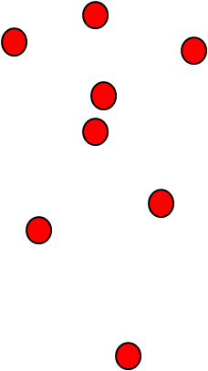
max x₁
s.t.
x₁ ≤ 6
x ∈ X
is different from
max x₁
s.t.
x₁ ≤ 6
x ∈ H(X)
x₁

Slide 49
Relationships concerning LPs
z* = Min cx
s.t Ax = b
x ∈ X
v* = Min cx
s.t Ax = b
x ∈ H(X)
L(μ) = Min cx + μ(Ax – b)
s.t x ∈ X
v(μ) = Min cx + μ(Ax – b)
s.t x ∈ H(X)
L* = max {L(μ) : μ ∈ R^{n} }
v* = max {v(μ) : μ ∈ R^{n} }
L(μ) = v(μ) ≤ L* = v* ≤ z*
Theorem 16.8. L* = v*.

Slide 50
Illustration
min - x₁
s.t.
x₁ ≤ 6
x ∈ H(X)
Lagrangian
min - x₁ + μ(x₁ – 6)
= (μ-1)x₁ - 6μ
s.t. x ∈ X
x₁
1
6
11
L(μ) = (μ-1) - 6μ = -5μ -1 if μ ≥ 1
L* = -6
L(μ) = 11(μ-1) - 6μ = 5μ -11 if μ ≤ 1

Slide 51
Integrality Property
Suppose X = {x : Dx = q , x ≥ 0, x integer}.
We say that X satisfies if the integrality property if the following LP has integer solutions for all d
Min dx
s.t x ∈ X
Fact: The LP region for min cost flow problems has the integrality property.

Slide 52
Integrality Property
Let X = {x : Dx = q x ≥ 0, x integer}.
z* = Min cx
s.t Ax = b
x ∈ X
z_{LP} = min cx
s.t Ax = b
Dx = q
x ≥ 0
L(μ) = Min cx + μ(Ax – b)
s.t x ∈ X
L* = Max L(μ)
s.t μ ∈ R^{n}
Theorem 16.10. If X has the integrality property, then z_{LP} = L*.

Slide 53
Proof of Integrality Property
Suppose X = {x : Dx = q x ≥ 0, x integer} has the integrality property.
z_{LP} = min cx
s.t Ax = b
Dx = q
x ≥ 0
L(μ) = Min cx + μ(Ax – b)
s.t x ∈ X
L(μ) = Min cx + μ(Ax – b)
s.t Dx = q
x ≥ 0
L* = Max L(μ)
s.t μ ∈ R^{n}
z_{LP} = L* by Theorem 16.6.

Slide 54
Example: Generalized Assignment
Minimize
(16.10a)
(16.10b)
(16.10c)
(16.10d)
If we relax (16.10c), the bound for the Lagrangian multiplier problem is the same as the bound for the LP relaxation.
If we relax (16.10b), the LP does not satisfy the integrality property, and we should get a better bound than z⁰.

Slide 55
Summary
A decomposition approach for Lagrangian Relaxations
Relating Lagrangian Relaxations to LPs

Slide 56
MITOpenCourseWare
http://ocw.mit.edu
15.082J / 6.855J / ESD.78J Network Optimization
Fall 2010
For information about citing these materials or our Terms of Use, visit: http://ocw.mit.edu/terms.

