Slide 1
15.082J and 6.855J and ESD.78J
November 30, 2010
The Multicommodity Flow Problem

Slide 2
Lecture overview
Notation
A small illustrative example
Some applications of multicommodity flows
Optimality conditions
A Lagrangian relaxation algorithm

Slide 3


On the Multicommodity Flow Problem
O-D version
K origin-destination pairs of nodes
(s₁, t₁), (s₂, t₂), …, (s_{K}, t_{K})
Network G = (N, A)
d_{k} = amount of flow that must be sent from s_{k} to t_{k}.
u_{ij} = capacity on (i,j) shared by all commodities
= cost of sending 1 unit of commodity k in (i,j)
= flow of commodity k in (i,j)

Slide 4
A Linear Multicommodity Flow Problem
5 units good 1
$5
5 units good 1
1
4
$1
$1
$1
2
5
u₂₅ = 5
$1
$1
2 units good 2
$6
2 units good 2
3
6
Quick exercise: determine the optimal multicommodity flow.

Slide 5



A Linear Multicommodity Flow Problem
5 units good 1
$5
5 units good 1
1
4
$1
$1
$1
2
5
u₂₅ = 5
$1
$1
2 units good 2
$6
2 units good 2
3
6

Slide 6
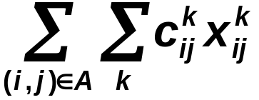
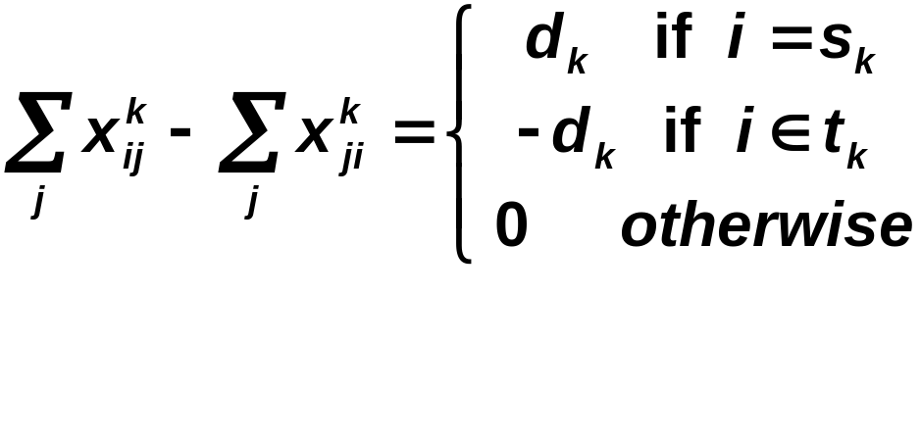
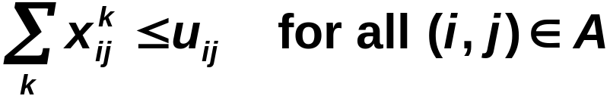

The Multicommodity Flow LP
Min
Supply/ demand constraints
Bundle constraints

Slide 7
Assumptions (for now)
Homogeneous goods. Each unit flow of commodity k on (i, j) uses up one unit of capacity on (i,j).
No congestion. Cost is linear in the flow on (i, j) until capacity is totally used up.
Fractional flows. Flows are permitted to be fractional.
OD pairs. Usually a commodity has a single origin and single destination.

Slide 8
Application areas
Type
of Network
Nodes
Arcs
Flow
Communic.
Networks
O-D pairs
for messages
Transmission
lines
message
routing
Computer
Networks
storage dev.
or computers
Transmission
lines
data,
messages
Railway
Networks
yard and
junction pts.
Tracks
Trains
Distribution
Networks
plants
warehouses,...
highways
railway tracks
etc.
trucks,
trains, etc

Slide 9
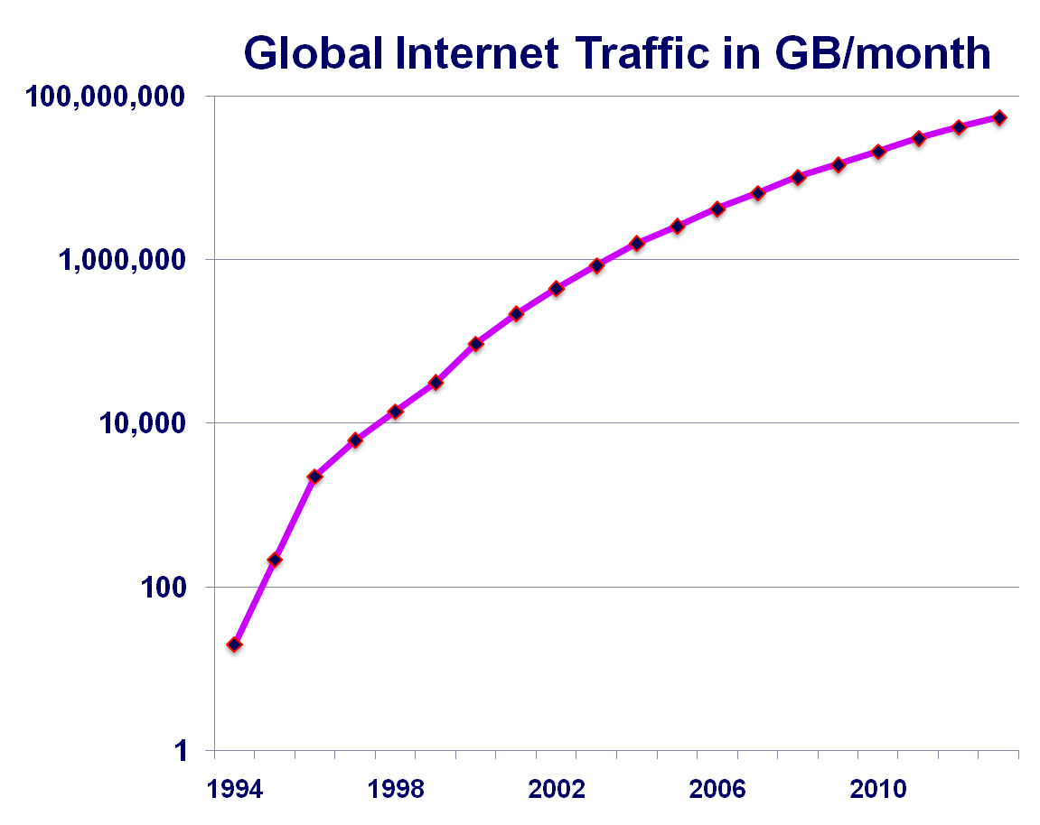
Internet Traffic
Fact: The internet protocal in most use today was developed in 1981

Slide 10
On Fractional Flows
In general, linear multicommodity flow problems have fractional flows, even if all data is integral.
The integer multicommodity flow problem is difficult to solve to optimality.

Slide 11
A fractional multicommodity flow
u_{ij} = 1 for all arcs
1 unit of flow must be sent from s_{i} to t_{i} for i = 1, 2, 3.
c_{ij} = 0 except as listed.
s₁
t₃
$2
$2
t₁
1
s₃
2
3
s₂
t₂
$2

Slide 12
A fractional multicommodity flow
u_{ij} = 1 for all arcs
1 unit of flow must be sent from s_{i} to t_{i} for i = 1, 2, 3.
c_{ij} = 0 except as listed.
s₁
t₃
$2
$2
t₁
1
s₃
2
3
Optimal solution: send ½ unit of flow in each of these 15 arcs. Total cost = $3.
s₂
t₂
$2

Slide 13
Decomposition based approaches
Price directed decomposition.
  Focus on prices or tolls on the arcs. Then solve the problem while ignoring the capacities on arcs.
Resource directive decomposition.
  Allocate flow capacity among commodities and solve
Simplex based approaches
  Try to speed up the simplex method by exploiting the structure of the MCF problem.

Slide 14
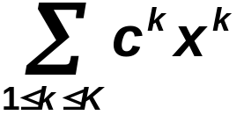
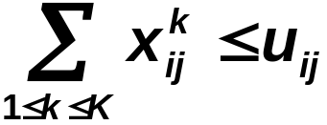




A formulation without OD pairs
Minimize
(17.1a)
subject to
(17.1b)
(17.1c)
(17.1d)

Slide 15


Optimality Conditions: Partial Dualization
Theorem. The multicommodity flow x = (x^{k}) is an optimal multicommodity flow for (17) if there exists non-negative prices w = (w_{ij}) on the arcs so that the following is true
1.
2. The flow x^{k} is optimal for the k-th commodity
if c^{k} is replaced by c^{w,k}, where
Recall: x^{k} is optimal for the k-th commodity if there is no negative cost cycle in the kth residual network.

Slide 16
A Linear Multicommodity Flow Problem
5 units good 1
$5
5 units good 1
1
4
$1
$1
$1
2
5
u₂₅ = 5
$1
$1
2 units good 2
$6
2 units good 2
3
6
Create the residual networks
Set w_{2,5} = 2

Slide 17
The residual network for commodity 1
$5
1
4
-$5
$1
-$1
-$1
$1
$3
2
5
$-3
$1
$1
$6
3
6
Set w_{2,5} = $2
There is no negative cost cycle.

Slide 18
The residual network for commodity 2
$5
1
4
$1
$1
$3
2
5
$-3
-$1
-$1
$1
$1
$6
3
6
Set w_{2,5} = $2
There is no negative cost cycle.

Slide 19

Optimality Conditions: full dualization
One can also define node potentials π so that the reduced cost
This combines optimality conditions for min cost flows with the partial dualization optimality conditions for multicommodity flows.

Slide 20
Mental Break
According to NPD Fashion World, what percentage of lingerie is returned to the store?
50%
What is the average life span for a taste bud?
10 days
Charles Osborne set the record for the longest case of the hiccups. How long did they last?
68 years. An outside source estimated that Osborne hiccupped 430 million times over the 68-year period. He also fathered 8 children during this time period.

Slide 21
Mental Break
Outside a barber’s shop, there is often a pole with red and white stripes. What is the significance of the red stripes?
It represents the bloody bandages used in blood-letting wrapped around a pole.
How many digestive glands are in the human stomach?
Around 35 million
What is the surface area of a pair of human lungs?
Around 70 meters². Approximately the same size as a tennis court.

Slide 22
Lagrangian relaxation for multicommodity flows
Min
Supply/ demand constraints
Bundle constraints

Slide 23
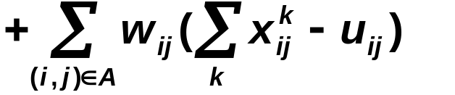
Lagrangian relaxation for multicommodity flows
Min
Supply/ demand constraints
Bundle constraints
Penalize the bundle constraints.
Relax the bundle constraints.

Slide 24
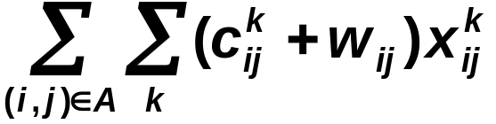
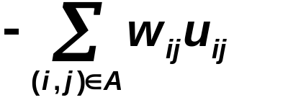
Lagrangian relaxation for multicommodity flows
L(w) = Min
Supply/ demand constraints
Bundle constraints
Simplify the objective function.

Slide 25
Subgradient Optimization for solving the Lagrangian Multiplier Problem
5 units good 1
$5
5 units good 1
1
4
$1
$1
$1
e.g., set w⁰ = 0.
2
5
u₂₅ = 5
$1
$1
u₃₂ = 2
3 units good 2
$6
3 units good 2
3
6
Choose an initial value w⁰ of the “tolls” w, and find the optimal solution for L(w).

Slide 26
Subgradient Optimization for solving the Lagrangian Multiplier Problem
5 units good 1
$5
5 units good 1
1
4
$1
$1
next: determine the flows, and then determine w¹ from w⁰
$1
2
5
$1
$1
3 units good 2
$6
3 units good 2
3
6
The flow on (2,5) = 8 > u₂₅ = 5.
The flow on (3,2) = 3 > u₃₂ = 2.

Slide 27

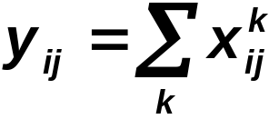




Choosing a search direction
= flow in arc (i,j)
(y-u)⁺ is called the search direction.
θ_{q} is called the step size.
So, if we choose θ₀ = 1, then
Then solve L(w¹).

Slide 28
Solving L(w¹)
5 units good 1
$5
5 units good 1
1
4
$1
$1
$4
If θ¹ = 1, then w² = 0.
2
5
$1
$2
3 units good 2
$6
3 units good 2
3
6

Slide 29
Comments on the step size
The search direction is a good search direction.
But the step size must be chosen carefully.
Too large a step size and the solution will oscillate and not converge
Too small a step size and the solution will not converge to the optimum.

Slide 30
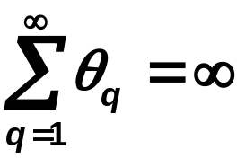
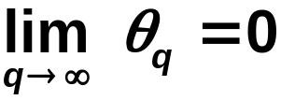
On choosing the step size
The step size θ_{q} should be chosen so that
and
(1)
e.g., take θ_{q} = 1/q.
Theorem. If the step size is chosen as on the previous slides, and if (θ_{q}) satisfies (1), then the w^{q} converges to the optimum for the Lagrangian dual.

Slide 31

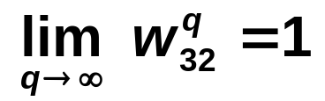
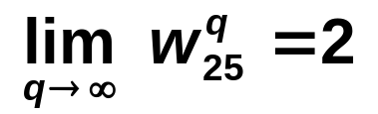
The optimal multipliers and flows.
5 units good 1
$5
5 units good 1
1
4
$1
$1
$1
2
5
u₂₅ = 5
$1
$1
u₃₂ = 2
3 units good 2
$6
3 units good 2
3
6

Slide 32


Suppose that w₃₂ = 1.001 and w₂₅ = 2.001
5 units good 1
$5
5 units good 1
1
4
$1
$1
$3.001
2
5
$2.001
$1
3 units good 2
$6
3 units good 2
3
6
Conclusion: Near Optimal Multipliers do not always lead to near optimal (or even feasible) flows.

Slide 33
Summary of MCF
Applications
Optimality Conditions
Lagrangian Relaxation
  subgradient optimization
Next Lecture: Column Generation and more

Slide 34
MITOpenCourseWare
http://ocw.mit.edu
15.082J / 6.855J / ESD.78J Network Optimization
Fall 2010
For information about citing these materials or our Terms of Use, visit: http://ocw.mit.edu/terms.

