Slide 1
15.082J and 6.855J and ESD.78J
December 2, 2010
Multicommodity Flows 2

Slide 2


On the Multicommodity Flow Problem
O-D version
K origin-destination pairs of nodes
(s₁, t₁), (s₂, t₂), …, (s_{K}, t_{K})
Network G = (N, A)
d_{k} = amount of flow that must be sent from s_{k} to t_{k}.
u_{ij} = capacity on (i,j) shared by all commodities
= cost of sending 1 unit of commodity k in (i,j)
= flow of commodity k in (i,j)

Slide 3
A Linear Multicommodity Flow Problem
5 units good 1
$5
5 units good 1
1
4
$1
$1
$1
2
5
u₂₅ = 5
$1
$1
u₃₂ = 2
3 units good 2
$6
3 units good 2
3
6

Slide 4
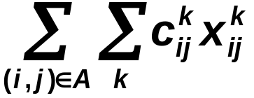
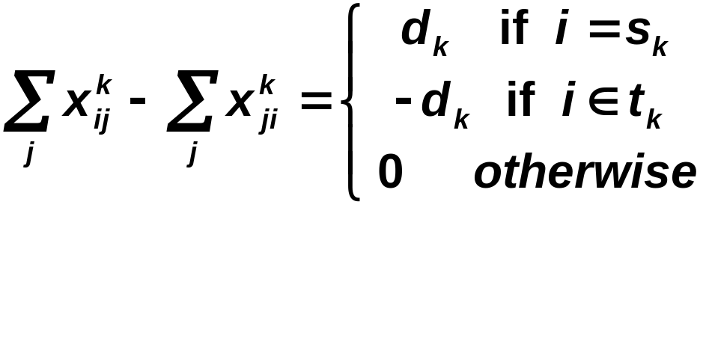
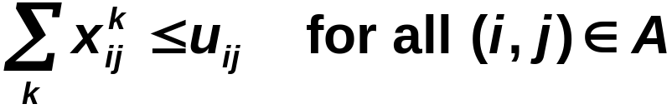

The Multicommodity Flow LP
Min
Supply/ demand constraints
Bundle constraints

Slide 5
Assumptions
Homogeneous goods. Each unit flow of commodity k on (i,j) uses up one unit of capacity on (i,j).
No congestion. Cost is linear in the flow on (i,j) until capacity is totally used up.
Fractional flows. Flows are permitted to be fractional.
OD pairs. Usually a commodity has a single origin and single destination.

Slide 6


Optimality Conditions: Partial Dualization
Theorem. The multicommodity flow x = (x^{k}) is an optimal multicommodity flow for (17) if there exists non-negative prices w = (w_{ij}) on the arcs so that the following is true
1.
2. The flow x^{k} is optimal for the k-th commodity
if c^{k} is replaced by c^{w,k}, where
Recall: x^{k} is optimal for the k-th commodity if there is no negative cost cycle in the kth residual network.

Slide 7
Another approach: path-based approach
Represent flows from s_{k} to t_{k} as the sum of flows in paths.
The resulting LP may have an exponential number of columns
Use “column generation” to solve the LP.

Slide 8
A Linear Multicommodity Flow Problem
5 units good 1
$5
5 units good 1
1
4
$1
$1
P¹ = set of paths from node 1 to node 4.
P² = set of paths from node 3 to node 6.
$1
2
5
u₂₅ = 5
$1
$1
u₃₂ = 2
3 units good 2
$6
3 units good 2
3
6
P¹ = {1-4, 1-2-5-4}
P² = {3-6, 3-2-5-6}

Slide 9
A path based formulation
c(1-4) = 5
c(1-2-5-4) = 3
c(3-6) = 6
c(3-2-5-6) = 3
f(P) = flow in path P
c(P) = cost of path P
Minimize 5 f(1-4) + 3 f(1-2-5-4) + 6 f(3-6) + 3 f(3-2-5-6)
subject to f(1-4) + f(1-2-5-4) = 5
f(3-6) + f(3-2-5-6) = 3
f(1-2-5-4) + f(3-2-5-6) ≤ u₂₅ = 5
f(3-2-5-6) ≤ u₃₂ = 2
f(P) ≥ 0 for all paths P

Slide 10
Optimal solution for the path based version
5 units good 1
$5
5 units good 1
1
4
$1
$1
f(1-4) = 2
f(1-2-5-4) = 3
f(3-6) = 1
f(3-2-5-6) = 2
$1
2
5
u₂₅ = 5
$1
$1
u₃₂ = 2
3 units good 2
$6
3 units good 2
3
6
The path based LP can be solved using the simplex method.

Slide 11
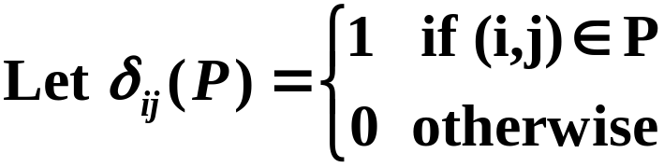
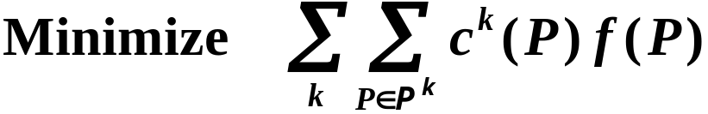
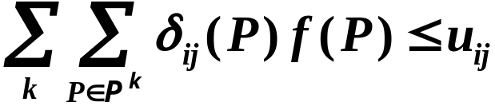

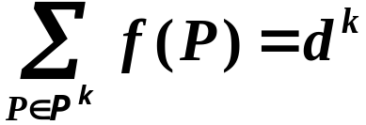

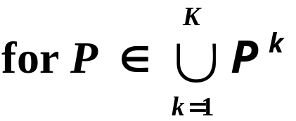

General formulation for the path based version
Let P^{k} = set of directed paths from s_{k} to t_{k}
Let c^{k}(P) = cost of path P ∈ P^{k}.
Let f(P) = flow on path P.
Master Problem

Slide 12
bundle constraints: one for each capacitated arc.
supply demand constraints: one for commodity.
variables: one for each path from origin to destination

Slide 13
On the path-based formulation
m + K constraints
exponentially many variables
There is some optimum solution where at most m + K paths have positive flow?
Key questions
How can one recognize if a solution is optimal?
How can one deal with an LP with exponentially many variables?
FACT: One can use linear programming to optimize over the path based formulation if there are not too many paths?

Slide 14
Optimality Conditions: Partial Dualization
Theorem. The multicommodity flow x = (x^{k}) is an optimal multicommodity flow for (17) if there exists non-negative prices w = (w_{ij}) on the arcs so that the following is true
1.
2. The flow x^{k} is optimal for the k-th commodity
if c^{k} is replaced by c^{w,k}, where
Recall: x^{k} is optimal for the k-th commodity if there is no negative cost cycle in the kth residual network.

Slide 15
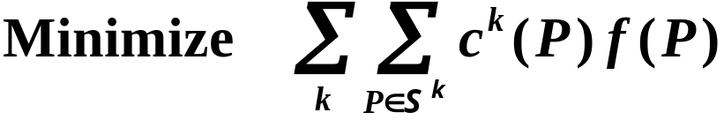
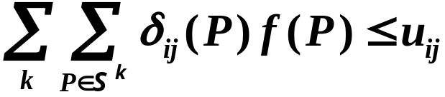

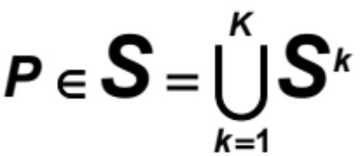
The Restricted Master Problem
Let S^{k} = subset of P^{k} = directed paths from s_{k} to t_{k}
Let c^{k}(P) = cost of path P ∈ S^{k}.
Let f(P) = flow on path P.
Restricted Master Problem

Slide 16
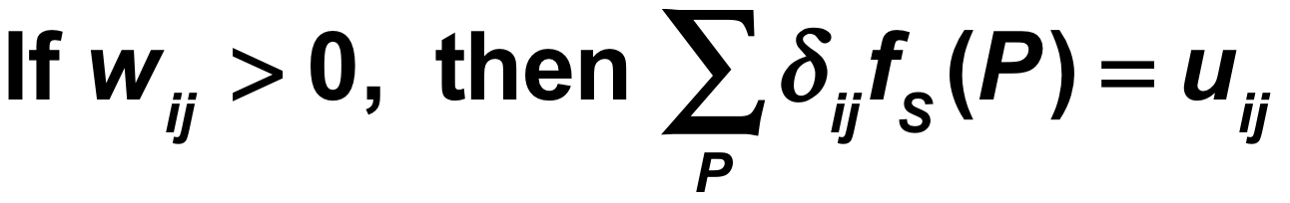

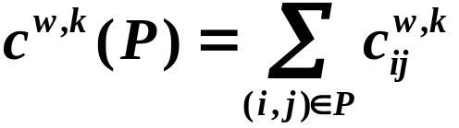
Recognizing Optimality
Let f_{S} be the optimal set of flows for the restricted master and let w = W_{S} the optimum tolls (prices) on arcs.
FACT:
Let
Theorem: f_{S} is optimum for the multicommodity flow problem if it is feasible and if the following is true:
If f_{S}(P) > 0 and P ∈ S^{k} , then P is a shortest path in from s_{k} to t_{k} with respect to P^{k}.

Slide 17


Illustration of definitions
5 units good 1
$5
5 units good 1
1
4
$1
$1
Suppose w₃₂ = 1
Suppose w₂₅ = 2.5
$1
2
5
w₂₅ = 2.5
$1
$1
w₃₂ = 1
3 units good 2
$6
3 units good 2
3
6

Slide 18
Constraint Generation for Solving the Master Problem
Let f_{S} be the optimal set of flows and W_{S} the optimum tolls (prices) on arcs for the restricted master over set S.
Let P^{k}(w) be a shortest path from s_{k} to t_{k} using costs c^{w,k}
Initialize with a set S of paths such that f(S) is feasible.
Determine f_{S} and w := W_{S}.
Yes
Is f_{S} optimal for the master problem?
Quit.
No
S := S ∪ P^{k}(w) for each k

Slide 19
Solving the Master Problem
Initialize S^{k} for each k.
Solve the restricted master problem for paths in S = ∪_{k} S^{k} obtaining solution x = (x^{k}).
Check to see if x is optimal for the master problem. If not, find new paths to add to S and return to step 2.

Slide 20
Summary of Method
Convert multicommodity flow problem to a problem on paths
Solve the path problem over a set S. Check if the solution is optimal for the original problem; if not add one or more paths to S, and repeat.
Comments
One can initialize with artificial paths with infinite capacity and very high costs.
This approach was developed by Ford and Fulkerson, and generalized by Dantzig and Wolfe to LP’s
Is often very efficient for getting close to the optimum solution. It slows down and converges slowly as more paths are generated

Slide 21
Mental Break
The expression “second string” means “replacement”, as in “he is a second string quarterback”. Where does this expression come from?
Archers in the middle ages carried a second string in case the first string of their bow broke.
How many different times is the Red Sea mentioned in the Bible?
0 times.
What are the four horsemen of the Apocalypse?
Conquest, slaughter, famine, and death.

Slide 22
Mental Break
What do the following Popes have in common: Pope Boniface IX, and Pope Benedictine XIII, and Pope Alexander V?
They all served at the same time in 1400 and were all “infallible.” They were selected by vying factions of the Catholic Church during the great schism. Two of them are now referred to as “Anti-popes.”
When was toilet paper first used?
In 1391 in China. They were sheets that were 2 ft. by 3 ft.
When was the first time that a magician sawed a woman in half?
1799. The magician was the Count de Grisley.

Slide 23
Column Generation
Restricted Master Problem (RMP)
> trillions of Variables
Constraints
Variables that were never considered
Added variables
Initial variables

Slide 24
A story of shared resources.
Tina and Donald head separate divisions for XYZ industries. They have been asked to come up with monthly plans for their divisions.
If they knew all the resources that they had, their planning problem could be written as a linear program. But they have to share resources. The difficulty arises because they are really bad at negotiating with each other.

Slide 25
Their LPs
The LPs (ignoring the shared constraints) are:
min ax
s.t. x ∈ X Tina’s LP
min cy
s.t. y ∈ Y Donald’s LP
Shared resources:
Tx + Dy ≤ b

Slide 26
I know how to make good decisions. Let me decide what resources to use.
I trust your decisions as much as I trust your choices of hair style.
Perhaps someone else could help mediate.
Perhaps I can help. I’ll use LP Dantzig-Wolfe decomposition.
Tina Brown
George Dantzig
Donald Trump
Images of Donald Trump, Tina Brown and George Dantzig removed due to copyright restrictions.

Slide 27
Your LPs are both bounded. Any solution can be represented as a convex combination of extreme points. Just send me extreme points, and I’ll find the best solution.
min ax + cy
s.t. Tx + Dy ≤ b
x = ∑_{i} λ_{i}X^{i}
y = ∑_{j} μ_{j}Y^{j}
∑_{i} λ_{i} = 1 ∑_{j} μ_{j} = 1
λ ≥ 0, μ ≥ 0
D
George Dantzig
T

Slide 28
Me neither. Besides that, the number of extreme points can be exponentially large. There is no way I’ll send you that many points.
No problem. I’ll give you prices for the shared resources. You send me your best solution, taking into account these prices. I’ll do the rest.
I have no idea what you’re talking about.
Donald Trump
George Dantzig
Tina Brown

Slide 29
And so Dantzig helped them out.
Dantzig’s first set of prices for the shared resources was very high. Tina and Donald came up with their best solutions X¹ and Y¹, taking into account the costs of the resources. Dantzig saw that the solution X¹ and Y¹ satisfied the shared resource constraint, and he was pleased.
He then set prices of 0 for the shared resources. Tina and Donald came up with solutions X² and Y² that used lots of shared resources. Dantzig saw that X² and Y² did not satisfy the resource constraints, but he was still pleased.

Slide 30
So all I need to do is solve my LP with prices p for shared resources.
Not having to negotiate with Donald is such a pleasure.
min ax + (pT)x
s.t. x ∈ X
min cy + (pD)y
s.t. y ∈ Y
Tina Brown
Donald Trump

Slide 31
I’ll keep sending them prices and they’ll keep sending me extreme points. I’ll then take combinations of the extreme points to develop good solutions.
Eventually, I’ll get the optimum solution. Or I’ll quite when I’m close enough. But first things first.
George Dantzig

Slide 32
I’ll solve the restricted master using these first four solutions. I’ll then use the prices from the LP on the shared resources. They can then give me their best solutions again.
The Restricted Master Problem.
min ax + cy
s.t. Tx + Dy ≤ b
x = λ₁X¹ + λ₂X²
y = μ₁Y¹ + μ₂Y²
λ_{i} + λ_{i} = 1 μ₁ + μ₂ = 1
λ ≥ 0, μ ≥ 0
George Dantzig

Slide 33
Dantzig-Wolfe Algorithm
Initialize with a set E_{X} of extreme points of X and a set E_{Y} of extreme points of Y.
Solve the restricted master problem, obtaining an optimal solution x’, y’ (for the restricted master) and a price vector p’ on shared resources.
Ask Tina and Donald to solve their problems while using p’ as prices on shared resources. They obtain X’ and Y’.
Replace E_{X} by E_{X} ∪ X’
Replace E_{Y} by E_{Y} ∪ Y’.
No
Yes
Is X’ in E_{X} and Y’ in E_{Y}?
Quit with an optimal solution x’ and y’

Slide 34
More on Dantzig-Wolfe Decomposition
Dantzig-Wolfe decomposition works when there are resources shared by two divisions or 1 million divisions, or even in the case of a single division.
The multi-commodity flow algorithm decomposed into problems for each commodity. The single commodity problems were solved taking into account the arc prices.
The technique works whenever solutions can be combined or mixed. It is used a lot for solving the hardest linear programs.

Slide 35
Summary
Multicommodity Flows
Column generation approach (generate variables one at a time when needed).
  Path-based generalization
  Generalization to Dantzig-Wolfe Decomposition

Slide 36
MITOpenCourseWare
http://ocw.mit.edu
15.082J / 6.855J / ESD.78J Network Optimization
Fall 2010
For information about citing these materials or our Terms of Use, visit: http://ocw.mit.edu/terms.

