Slide 1


Boundless Lecture Slides
Available on the Boundless Teaching Platform
Free to share, print, make copies and changes. Get yours at www.boundless.com

Slide 2



Using Boundless Presentations
Boundless Teaching Platform
Boundless empowers educators to engage their students with affordable, customizable textbooks and intuitive teaching tools. The free Boundless Teaching Platform gives educators the ability to customize textbooks in more than 20 subjects that align to hundreds of popular titles. Get started by using high quality Boundless books, or make switching to our platform easier by building from Boundless content pre-organized to match the assigned textbook. This platform gives educators the tools they need to assign readings and assessments, monitor student activity, and lead their classes with pre-made teaching resources.
Get started now at:
The Appendix
The appendix is for you to use to add depth and breadth to your lectures. You can simply drag and drop slides from the appendix into the main presentation to make for a richer lecture experience.
http://boundless.com/teaching-platform
Free to edit, share, and copy
Feel free to edit, share, and make as many copies of the Boundless presentations as you like. We encourage you to take these presentations and make them your own.
If you have any questions or problems please email:
educators@boundless.com
Free to share, print, make copies and changes. Get yours at www.boundless.com

Slide 3

About Boundless
Boundless is an innovative technology company making education more affordable and accessible for students everywhere. The company creates the world’s best open educational content in 20+ subjects that align to more than 1,000 popular college textbooks. Boundless integrates learning technology into all its premium books to help students study more efficiently at a fraction of the cost of traditional textbooks. The company also empowers educators to engage their students more effectively through customizable books and intuitive teaching tools as part of the Boundless Teaching Platform. More than 2 million learners access Boundless free and premium content each month across the company’s wide distribution platforms, including its website, iOS apps, Kindle books, and iBooks. To get started learning or teaching with Boundless, visit boundless.com.
Free to share, print, make copies and changes. Get yours at www.boundless.com

Slide 4
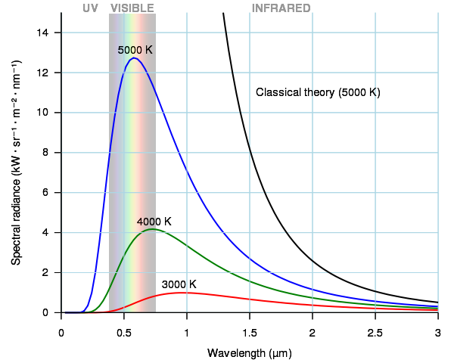
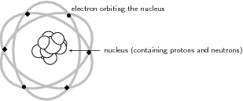
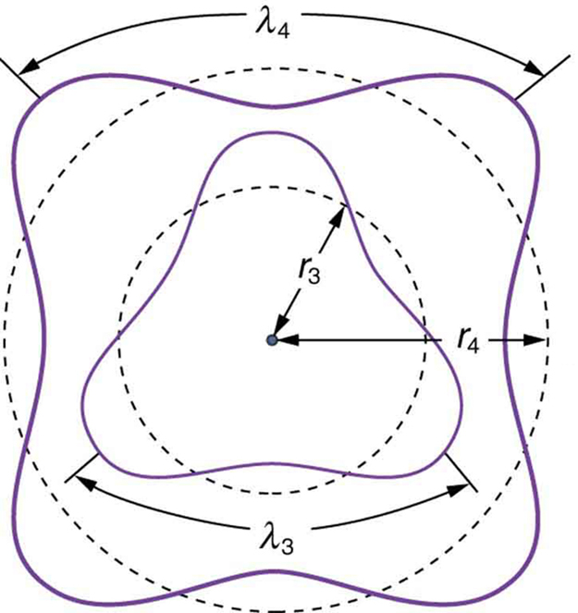
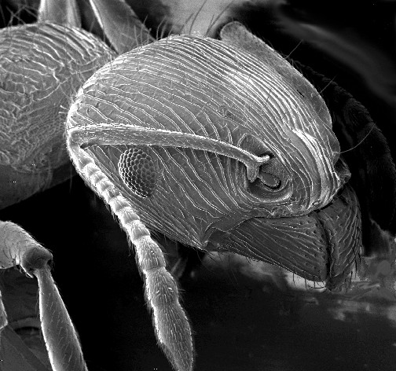
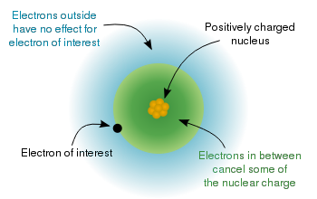

Atomic Physics
Overview
The Early Atom
Atomic Physics and Quantum Mechanics
Applications of Atomic Physics
]
Multielectron Atoms
Atomic Physics
Free to share, print, make copies and changes. Get yours at www.boundless.com

Slide 5

Overview
Atomic Physics > Overview
Planck's Quantum Hypothesis and Black Body Radiation
Free to share, print, make copies and changes. Get yours at www.boundless.com
www.boundless.com/physics/textbooks/boundless-physics-textbook/atomic-physics-29/overview-184/

Slide 6
The Early Atom
Atomic Physics > The Early Atom
The Discovery of the Parts of the Atom
Early Models of the Atom
The Thomson Model
The Rutherford Model
The Bohr Model of the Atom
Basic Assumptions of the Bohr Model
Bohr Orbits
Energy of a Bohr Orbit
Hydrogen Spectra
de Broglie and the Bohr Model
X-Rays and the Compton Effect
X-Ray Spectra: Origins, Diffraction by Crystals, and Importance
The Compton Effect
Free to share, print, make copies and changes. Get yours at www.boundless.com
www.boundless.com/physics/textbooks/boundless-physics-textbook/atomic-physics-29/the-early-atom-185/

Slide 7
Atomic Physics and Quantum Mechanics
Atomic Physics > Atomic Physics and Quantum Mechanics
Wave Nature of Matter Causes Quantization
Photon Interactions and Pair Production
Free to share, print, make copies and changes. Get yours at www.boundless.com
www.boundless.com/physics/textbooks/boundless-physics-textbook/atomic-physics-29/atomic-physics-and-quantum-mechanics-186/

Slide 8
Applications of Atomic Physics
Atomic Physics > Applications of Atomic Physics
Electron Microscopes
Lasers
Free to share, print, make copies and changes. Get yours at www.boundless.com
www.boundless.com/physics/textbooks/boundless-physics-textbook/atomic-physics-29/applications-of-atomic-physics-187/

Slide 9
Multielectron Atoms
Atomic Physics > Multielectron Atoms
Multielectron Atoms
The Periodic Table
Electron Configurations
Free to share, print, make copies and changes. Get yours at www.boundless.com
www.boundless.com/physics/textbooks/boundless-physics-textbook/atomic-physics-29/multielectron-atoms-188/

Slide 10
Appendix
Free to share, print, make copies and changes. Get yours at www.boundless.com

Slide 11
Key terms
Atomic Physics
alpha particle A positively charged nucleus of a helium-4 atom (consisting of two protons and two neutrons), emitted as a consequence of radioactivity.
alpha particle A positively charged nucleus of a helium-4 atom (consisting of two protons and two neutrons), emitted as a consequence of radioactivity; α-particle.
angular momentum A vector quantity describing an object in circular motion; its magnitude is equal to the momentum of the particle, and the direction is perpendicular to the plane of its circular motion.
atomic number The number, equal to the number of protons in an atom that determines its chemical properties. Symbol:
atomic orbital The quantum mechanical behavior of an electron in an atom describing the probability of the electron's particular position and energy.
Avogadro's number the number of constituent particles (usually atoms or molecules) in one mole of a given substance. It has dimensions of reciprocal mol and its value is equal to
black body An idealized physical body that absorbs all incident electromagnetic radiation, regardless of frequency or angle of incidence. Although black body is a theoretical concept, you can find approximate realizations of black body in nature.
black body An idealized physical body that absorbs all incident electromagnetic radiation, regardless of frequency or angle of incidence. Although black body is a theoretical concept, you can find approximate realizations of black body in nature.
cathode An electrode through which electric current flows out of a polarized electrical device.
CCD A charge-coupled device (CCD) is a device for the movement of electrical charge, usually from within the device to an area where the charge can be manipulated, for example conversion into a digital value. The CCD is a major technology required for digital imaging.
centripetal Directed or moving towards a center.
crystallography The experimental science of determining the arrangement of atoms in solids.
Free to share, print, make copies and changes. Get yours at www.boundless.com

Slide 12
Atomic Physics
de Broglie wavelength The wavelength of a matter wave is inversely proportional to the momentum of a particle and is called a de Broglie wavelength.
diffraction The bending of a wave around the edges of an opening or an obstacle.
Doppler shift is the change in frequency of a wave for an observer moving relative to its source.
double-helix structure The structure formed by double-stranded molecules of nucleic acids such as DNA and RNA.
electromagnetic force a long-range fundamental force that acts between charged bodies, mediated by the exchange of photons
electron shell The collective states of all electrons in an atom having the same principal quantum number (visualized as an orbit in which the electrons move).
electron shell The collective states of all electrons in an atom having the same principal quantum number (visualized as an orbit in which the electrons move).
element Any one of the simplest chemical substances that cannot be decomposed in a chemical reaction or by any chemical means and made up of atoms all having the same number of protons.
gamma ray A very high frequency (and therefore very high energy) electromagnetic radiation emitted as a consequence of radioactivity.
gamma ray A very high frequency (and therefore very high energy) electromagnetic radiation emitted as a consequence of radioactivity.
hydrogen-like having a single electron
inelastic scattering a fundamental scattering process in which the kinetic energy of an incident particle is not conserved
Free to share, print, make copies and changes. Get yours at www.boundless.com

Slide 13
Atomic Physics
matter wave A concept reflects the wave-particle duality of matter. The theory was proposed by Louis de Broglie.
matter wave A concept reflects the wave-particle duality of matter. The theory was proposed by Louis de Broglie.
Maxwell's equations A set of equations describing how electric and magnetic fields are generated and altered by each other and by charges and currents.
nucleus the massive, positively charged central part of an atom, made up of protons and neutrons
nucleus the massive, positively charged central part of an atom, made up of protons and neutrons
periodic table A tabular chart of the chemical elements according to their atomic numbers so that elements with similar properties are in the same column.
photoelectric effect The occurrence of electrons being emitted from matter (metals and non-metallic solids, liquids, or gases) as a consequence of their absorption of energy from electromagnetic radiation.
photoelectric effects In photoelectric effects, electrons are emitted from matter (metals and non-metallic solids, liquids or gases) as a consequence of their absorption of energy from electromagnetic radiation.
photon The quantum of light and other electromagnetic energy, regarded as a discrete particle having zero rest mass, no electric charge, and an indefinitely long lifetime.
photon The quantum of light and other electromagnetic energy, regarded as a discrete particle having zero rest mass, no electric charge, and an indefinitely long lifetime.
Planck constant a physical constant that is the quantum of action in quantum mechanics. It has a unit of angular momentum. The Planck constant was first described as the proportionality constant between the energy of a photon (unit of electromagnetic radiation) and the frequency of its associated electromagnetic wave in his derivation of the Planck's law
positron The antimatter equivalent of an electron, having the same mass but a positive charge.
Free to share, print, make copies and changes. Get yours at www.boundless.com

Slide 14
Atomic Physics
quantization The process of explaining a classical understanding of physical phenomena in terms of a newer understanding known as quantum mechanics.
quantization The process of explaining a classical understanding of physical phenomena in terms of a newer understanding known as quantum mechanics.
scintillation A flash of light produced in a transparent material by the passage of a particle.
semiclassical a theory in which one part of a system is described quantum-mechanically whereas the other is treated classically.
spectral radiance measures of the quantity of radiation that passes through or is emitted from a surface and falls within a given solid angle in a specified direction.
spectrum A condition that is not limited to a specific set of values but can vary infinitely within a continuum. The word saw its first scientific use within the field of optics to describe the rainbow of colors in visible light when separated using a prism.
standing wave A wave form which occurs in a limited, fixed medium in such a way that the reflected wave coincides with the produced wave. A common example is the vibration of the strings on a musical stringed instrument.
stimulated emission The process by which an atomic electron (or an excited molecular state) interacting with an electromagnetic wave of a certain frequency may drop to a lower energy level, transferring its energy to that field.
Thomson scattering an elastic scattering of electromagnetic radiation by a free charged particle, as described by classical electromagnetism. It is just the low-energy limit of Compton scattering
valence shell the outermost shell of electrons in an atom; these electrons take part in bonding with other atoms
Free to share, print, make copies and changes. Get yours at www.boundless.com

Slide 15
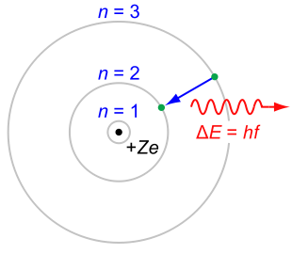

Atomic Physics
Rutherford-Bohr model
The Rutherford–Bohr model of the hydrogen atom () or a hydrogen-like ion (), where the negatively charged electron confined to an atomic shell encircles a small, positively charged atomic nucleus, and where an electron jump between orbits is accompanied by an emitted or absorbed amount of electromagnetic energy (). The orbits in which the electron may travel are shown as gray circles; their radius increases as , where is the principal quantum number. The transition depicted here produces the first line of the Balmer series, and for hydrogen () it results in a photon of wavelength 656 nm (red light).
Free to share, print, make copies and changes. Get yours at www.boundless.com
Wikipedia. "Bohr model." CC BY http://en.wikipedia.org/wiki/Bohr_model View on Boundless.com

Slide 16
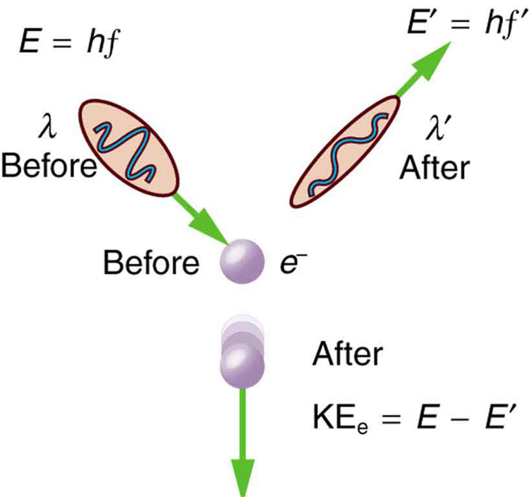
Atomic Physics
Scattering in the Compton Effect
The Compton Effect is the name given to the scattering of a photon by an electron. Energy and momentum are conserved, resulting in a reduction of both for the scattered photon. Studying this effect, Compton verified that photons have momentum.
Free to share, print, make copies and changes. Get yours at www.boundless.com
OpenStax CNX. "OpenStax College, Photon Momentum. January 28, 2013." CC BY 3.0 http://cnx.org/content/m42568/latest/ View on Boundless.com

Slide 17
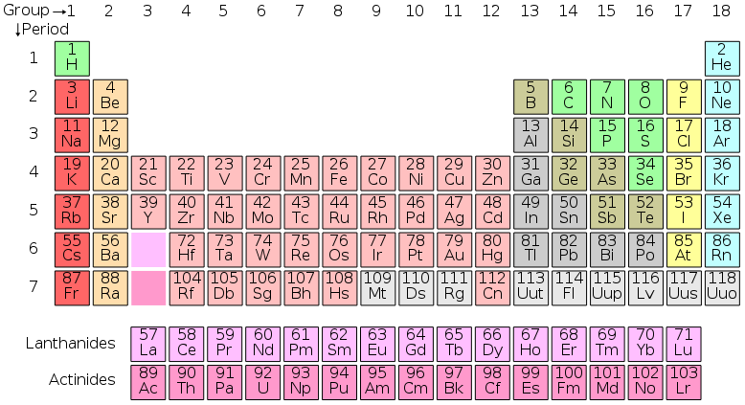
Atomic Physics
Periodic Table of Elements
The standard form of the periodic table, where the colors represent different categories of elements
Free to share, print, make copies and changes. Get yours at www.boundless.com
Wikimedia. CC BY-SA http://upload.wikimedia.org/wikipedia/commons/thumb/8/84/Periodic_table.svg/790px-Periodic_table.svg.png View on Boundless.com

Slide 18
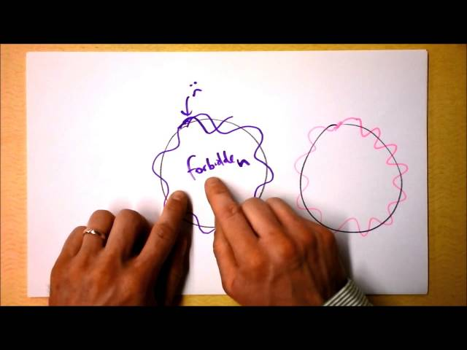
Atomic Physics
de Broglie's Matter Waves Justify Bohr's Magic Electron Orbital Radii
I include a summary of the hydrogen atom's electronic structure and explain how an electron can interfere with itself in an orbit just like it can in a double-slit experiment.
Free to share, print, make copies and changes. Get yours at www.boundless.com
View on Boundless.com

Slide 19
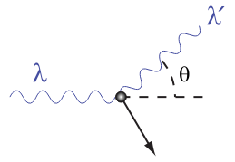
Atomic Physics
A Photon Colliding with a Target at Rest
A photon of wavelength comes in from the left, collides with a target at rest, and a new photon of wavelength emerges at an angle .
Free to share, print, make copies and changes. Get yours at www.boundless.com
Wikipedia. "Compton effect." CC BY http://en.wikipedia.org/wiki/Compton_effect View on Boundless.com

Slide 20
Atomic Physics
Fig 2
The third and fourth allowed circular orbits have three and four wavelengths, respectively, in their circumferences.
Free to share, print, make copies and changes. Get yours at www.boundless.com
OpenStax CNX. "OpenStax College, The Wave Nature of Matter Causes Quantization. January 29, 2013." CC BY 3.0 http://cnx.org/content/m42606/latest/ View on Boundless.com

Slide 21
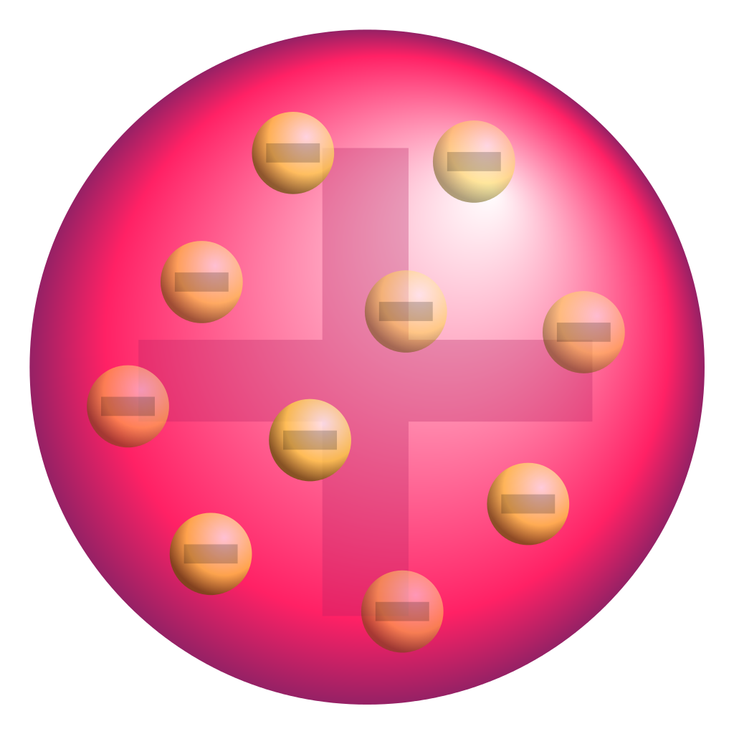
Atomic Physics
Plum pudding model of the atom
A schematic presentation of the plum pudding model of the atom; in Thomson's mathematical model the "corpuscles" (in modern language, electrons) were arranged non-randomly, in rotating rings.
Free to share, print, make copies and changes. Get yours at www.boundless.com
Wikimedia Commons. "Plum_pudding_atom.png." CC BY-SA 4.0 https://upload.wikimedia.org/wikipedia/commons/thumb/f/ff/Plum_pudding_atom.svg/1024px-Plum_pudding_atom.svg.png View on Boundless.com

Slide 22
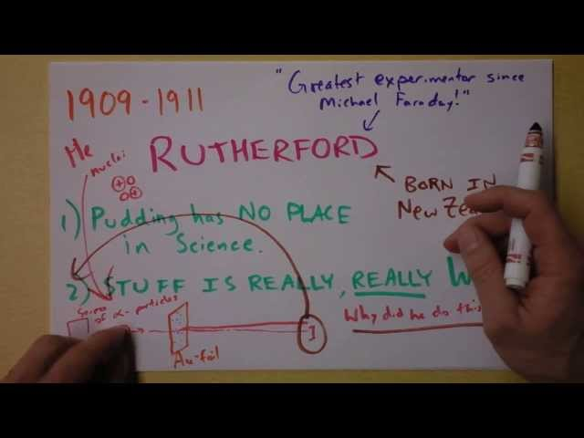
Atomic Physics
Intro to the History of Atomic Theory - The Thomson Model
Rutherford, Thomson, electrons, nuclei, and plums. I don't mean to be a bohr, but do you think pudding should have a role in serious scientific inquiry?
Free to share, print, make copies and changes. Get yours at www.boundless.com
View on Boundless.com

Slide 23
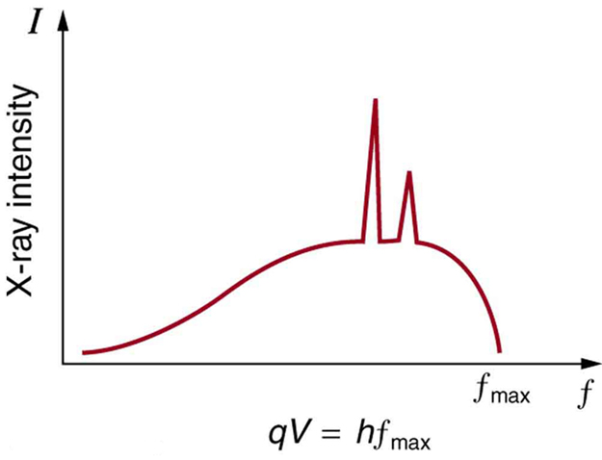
Atomic Physics
X-Ray Spectrum
X-ray spectrum obtained when energetic electrons strike a material, such as in the anode of a CRT. The smooth part of the spectrum is bremsstrahlung radiation, while the peaks are characteristic of the anode material. A different anode material would have characteristic x-ray peaks at different frequencies.
Free to share, print, make copies and changes. Get yours at www.boundless.com
OpenStax CNX. "OpenStax College, X Rays: Atomic Origins and Applications. January 28, 2013." CC BY 3.0 http://cnx.org/content/m42599/latest/ View on Boundless.com

Slide 24
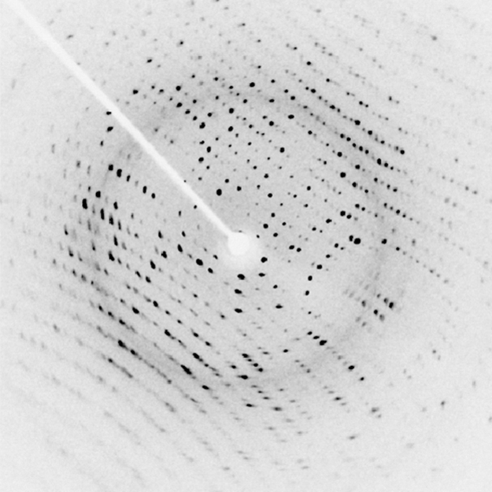
Atomic Physics
X-Ray Diffraction
X-ray diffraction from the crystal of a protein, hen egg lysozyme, produced this interference pattern. Analysis of the pattern yields information about the structure of the protein.
Free to share, print, make copies and changes. Get yours at www.boundless.com
OpenStax CNX. "OpenStax College, X Rays: Atomic Origins and Applications. January 28, 2013." CC BY 3.0 http://cnx.org/content/m42599/latest/ View on Boundless.com

Slide 25
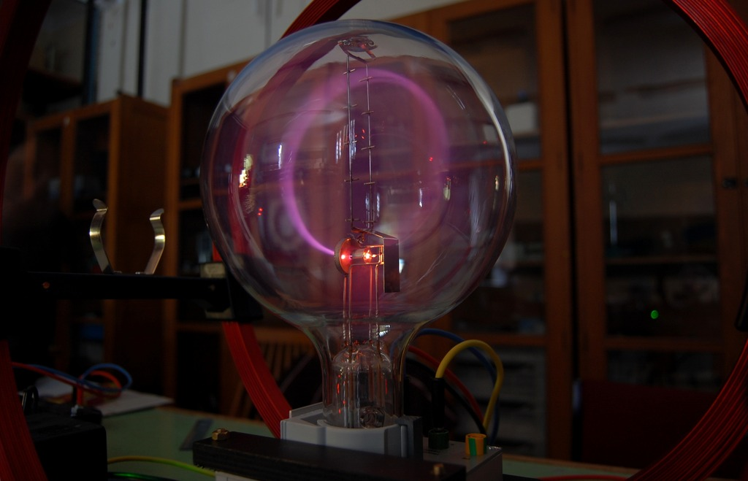
Atomic Physics
Electron Beam
A beam of electrons deflected in a circle by a magnetic field.
Free to share, print, make copies and changes. Get yours at www.boundless.com
Wikipedia. "Electron." CC BY http://en.wikipedia.org/wiki/Electron%23Discovery View on Boundless.com

Slide 26
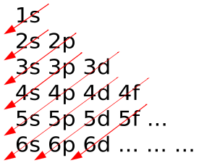
Atomic Physics
Aufbau Principle
In the Aufbau Principle, as electrons are added to atoms, they are added to the lowest orbitals first.
Free to share, print, make copies and changes. Get yours at www.boundless.com
Wikipedia. "Aufbau principle." CC BY http://en.wikipedia.org/wiki/Aufbau_principle View on Boundless.com

Slide 27
Atomic Physics
Electron Shielding Effect
A multielectron atom with inner electrons shielding outside electrons from the positively charged nucleus
Free to share, print, make copies and changes. Get yours at www.boundless.com
Wikimedia. CC BY-SA http://upload.wikimedia.org/wikipedia/commons/thumb/b/b3/Effective_Nuclear_Charge.svg/350px-Effective_Nuclear_Charge.svg.png View on Boundless.com

Slide 28
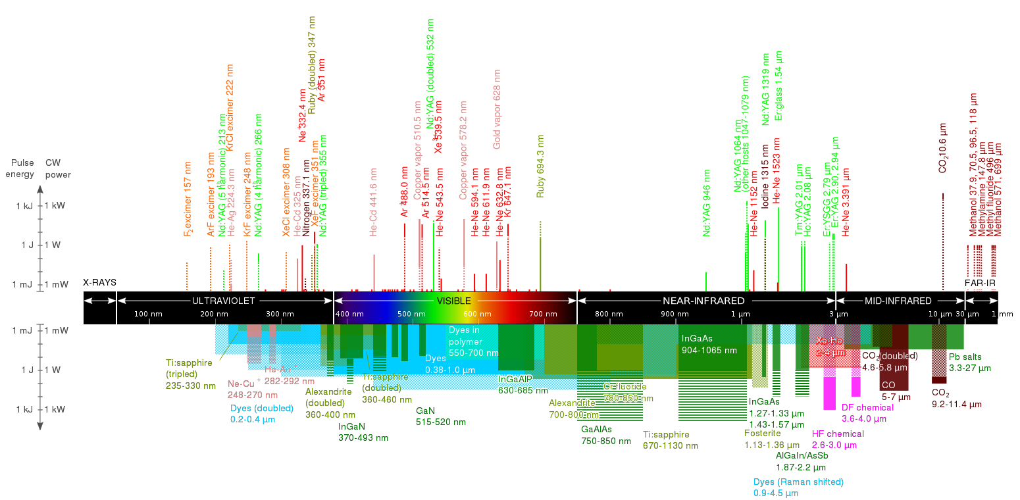
Atomic Physics
Wavelengths of Commercially Available Lasers
Laser types with distinct laser lines are shown above the wavelength bar, while below are shown lasers that can emit in a wavelength range. The height of the lines and bars gives an indication of the maximal power/pulse energy commercially available, while the color codifies the type of laser material.
Free to share, print, make copies and changes. Get yours at www.boundless.com
Wikipedia. "List of laser types." CC BY http://en.wikipedia.org/wiki/List_of_laser_types View on Boundless.com

Slide 29
Atomic Physics
Classical Atomic Model
Atomic model before the advent of Quantum Mechanics.
Free to share, print, make copies and changes. Get yours at www.boundless.com
OpenStax CNX. "Free High School Science Texts Project, The Atom - Grade 10 [CAPS]. January 27, 2013." CC BY 3.0 http://cnx.org/content/m38126/latest/ View on Boundless.com

Slide 30
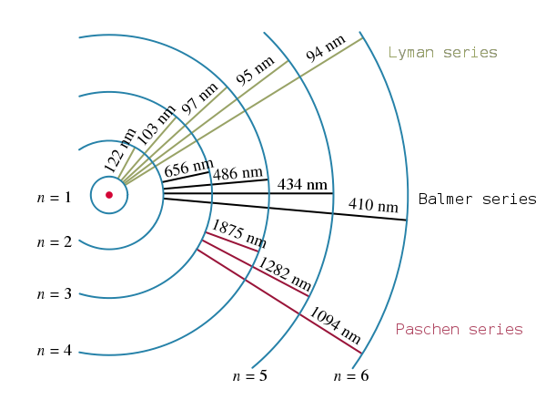
Atomic Physics
Electron transitions and their resulting wavelengths for hydrogen.
Energy levels are not to scale.
Free to share, print, make copies and changes. Get yours at www.boundless.com
Wikipedia. "Hydrogen spectral series." CC BY http://en.wikipedia.org/wiki/Hydrogen_spectral_series View on Boundless.com

Slide 31
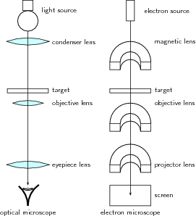
Atomic Physics
Optical and Electron Microscopes
Diagram of the basic components of an optical microscope and an electron microscope.
Free to share, print, make copies and changes. Get yours at www.boundless.com
OpenStax CNX. "Free High School Science Texts Project, Wave Nature of Matter: Electron Microscopes. January 23, 2013." CC BY 3.0 http://cnx.org/content/m39574/latest/ View on Boundless.com

Slide 32
Atomic Physics
Electron Microscope Image
An image of an ant in a scanning electron microscope.
Free to share, print, make copies and changes. Get yours at www.boundless.com
Wikipedia. "Electron microscope." CC BY http://en.wikipedia.org/wiki/Electron_microscope%23cite_note-erni-1 View on Boundless.com

Slide 33
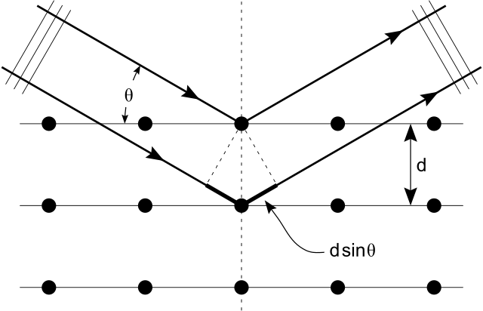
Atomic Physics
X-Ray Diffraction
Bragg's Law of diffraction: illustration of how x-rays interact with crystal lattice.
Free to share, print, make copies and changes. Get yours at www.boundless.com
Wikimedia. CC BY-SA http://upload.wikimedia.org/wikipedia/commons/thumb/c/c0/Bragg_diffraction_2.svg/640px-Bragg_diffraction_2.svg.png View on Boundless.com

Slide 34
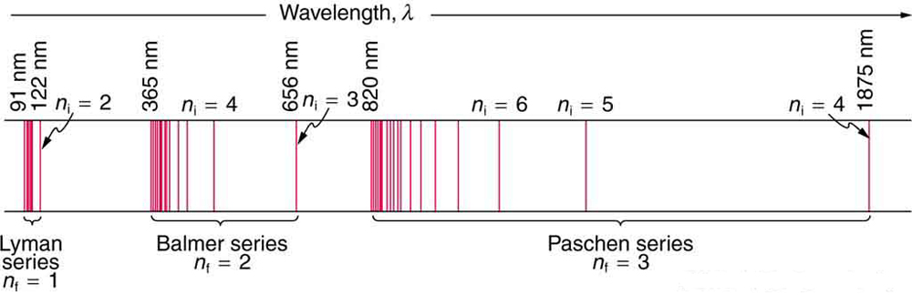
Atomic Physics
Fig 1
A schematic of the hydrogen spectrum shows several series named for those who contributed most to their determination. Part of the Balmer series is in the visible spectrum, while the Lyman series is entirely in the UV, and the Paschen series and others are in the IR. Values of nf and ni are shown for some of the lines.
Free to share, print, make copies and changes. Get yours at www.boundless.com
OpenStax CNX. "OpenStax College, Bohr’s Theory of the Hydrogen Atom. January 28, 2013." CC BY 3.0 http://cnx.org/content/m42596/latest/ View on Boundless.com

Slide 35
Atomic Physics
Black body radiation spectrum
Typical spectrum from a black body at different temperatures (shown in blue, green and red curves). As the temperature decreases, the peak of the black-body radiation curve moves to lower intensities and longer wavelengths. Black line is a prediction of a classical theory for an object at 5,000K, showing catastropic discrepancy at shorter wavelengh.
Free to share, print, make copies and changes. Get yours at www.boundless.com
Wikipedia. "Black body." GNU FDL http://en.wikipedia.org/wiki/Black_body View on Boundless.com

Slide 36
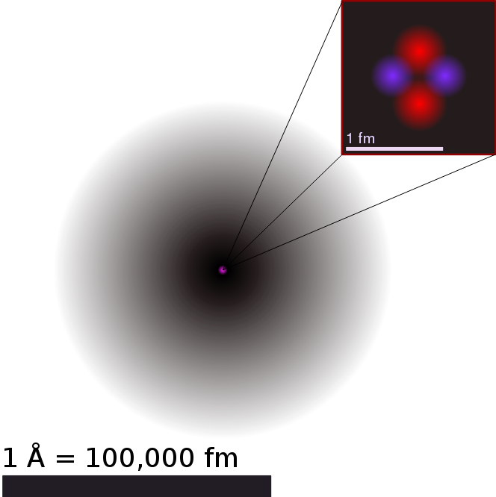
Atomic Physics
Illustration of the Helium Atom
This is an illustration of the helium atom, depicting the nucleus (pink) and the electron cloud distribution (black). The nucleus (upper right) in helium-4 is in reality spherically symmetric and closely resembles the electron cloud, although for more complicated nuclei this is not always the case. The black bar is one angstrom ( m, or 100 pm).
Free to share, print, make copies and changes. Get yours at www.boundless.com
Wikipedia. "Atom." CC BY http://en.wikipedia.org/wiki/Atom View on Boundless.com

Slide 37
Atomic Physics
Intro to the History of Atomic Theory - Intro
Rutherford, Thomson, electrons, nuclei, and plums. I don't mean to be a bohr, but do you think pudding should have a role in serious scientific inquiry?
Free to share, print, make copies and changes. Get yours at www.boundless.com
View on Boundless.com

Slide 38
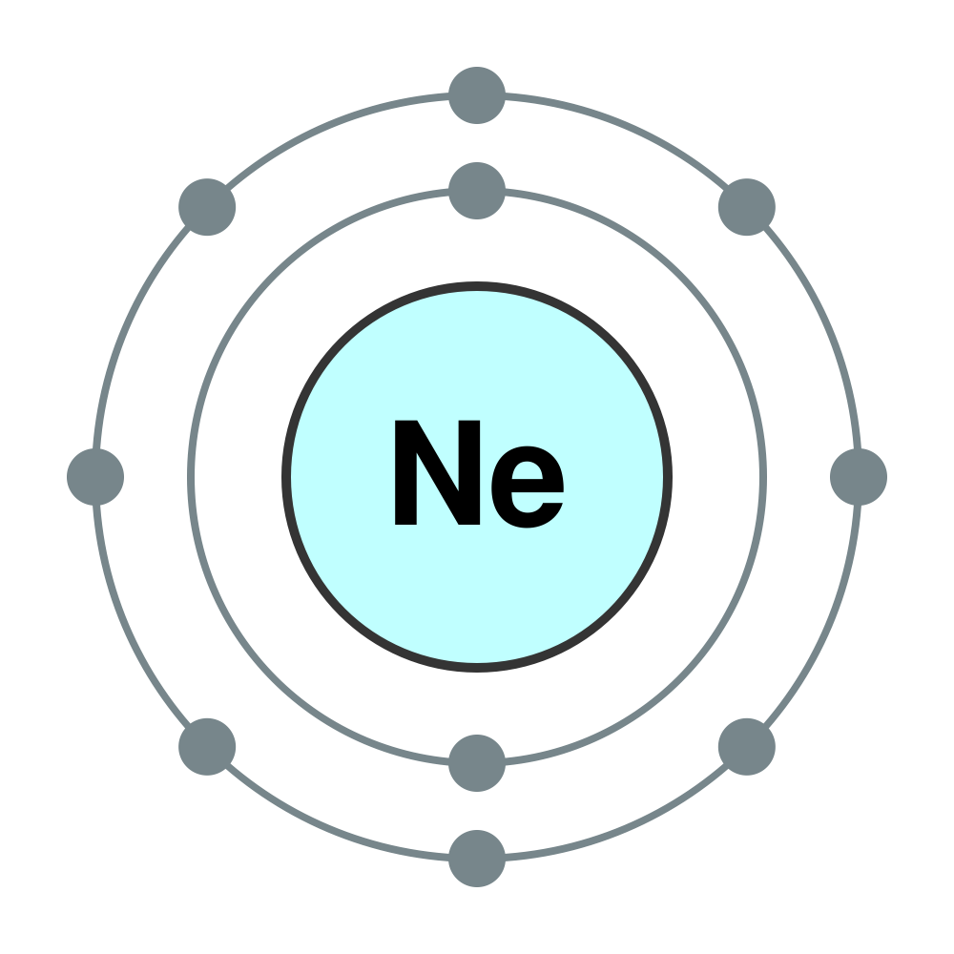
Atomic Physics
Electron Configuration of Neon Atom
Electron configuration of neon atom showing only outer electron shell.
Free to share, print, make copies and changes. Get yours at www.boundless.com
Wikimedia. CC BY-SA http://upload.wikimedia.org/wikipedia/commons/thumb/3/3e/Electron_shell_010_Neon_-_no_label.svg/600px-Electron_shell_010_Neon_-_no_label.svg.png View on Boundless.com

Slide 39
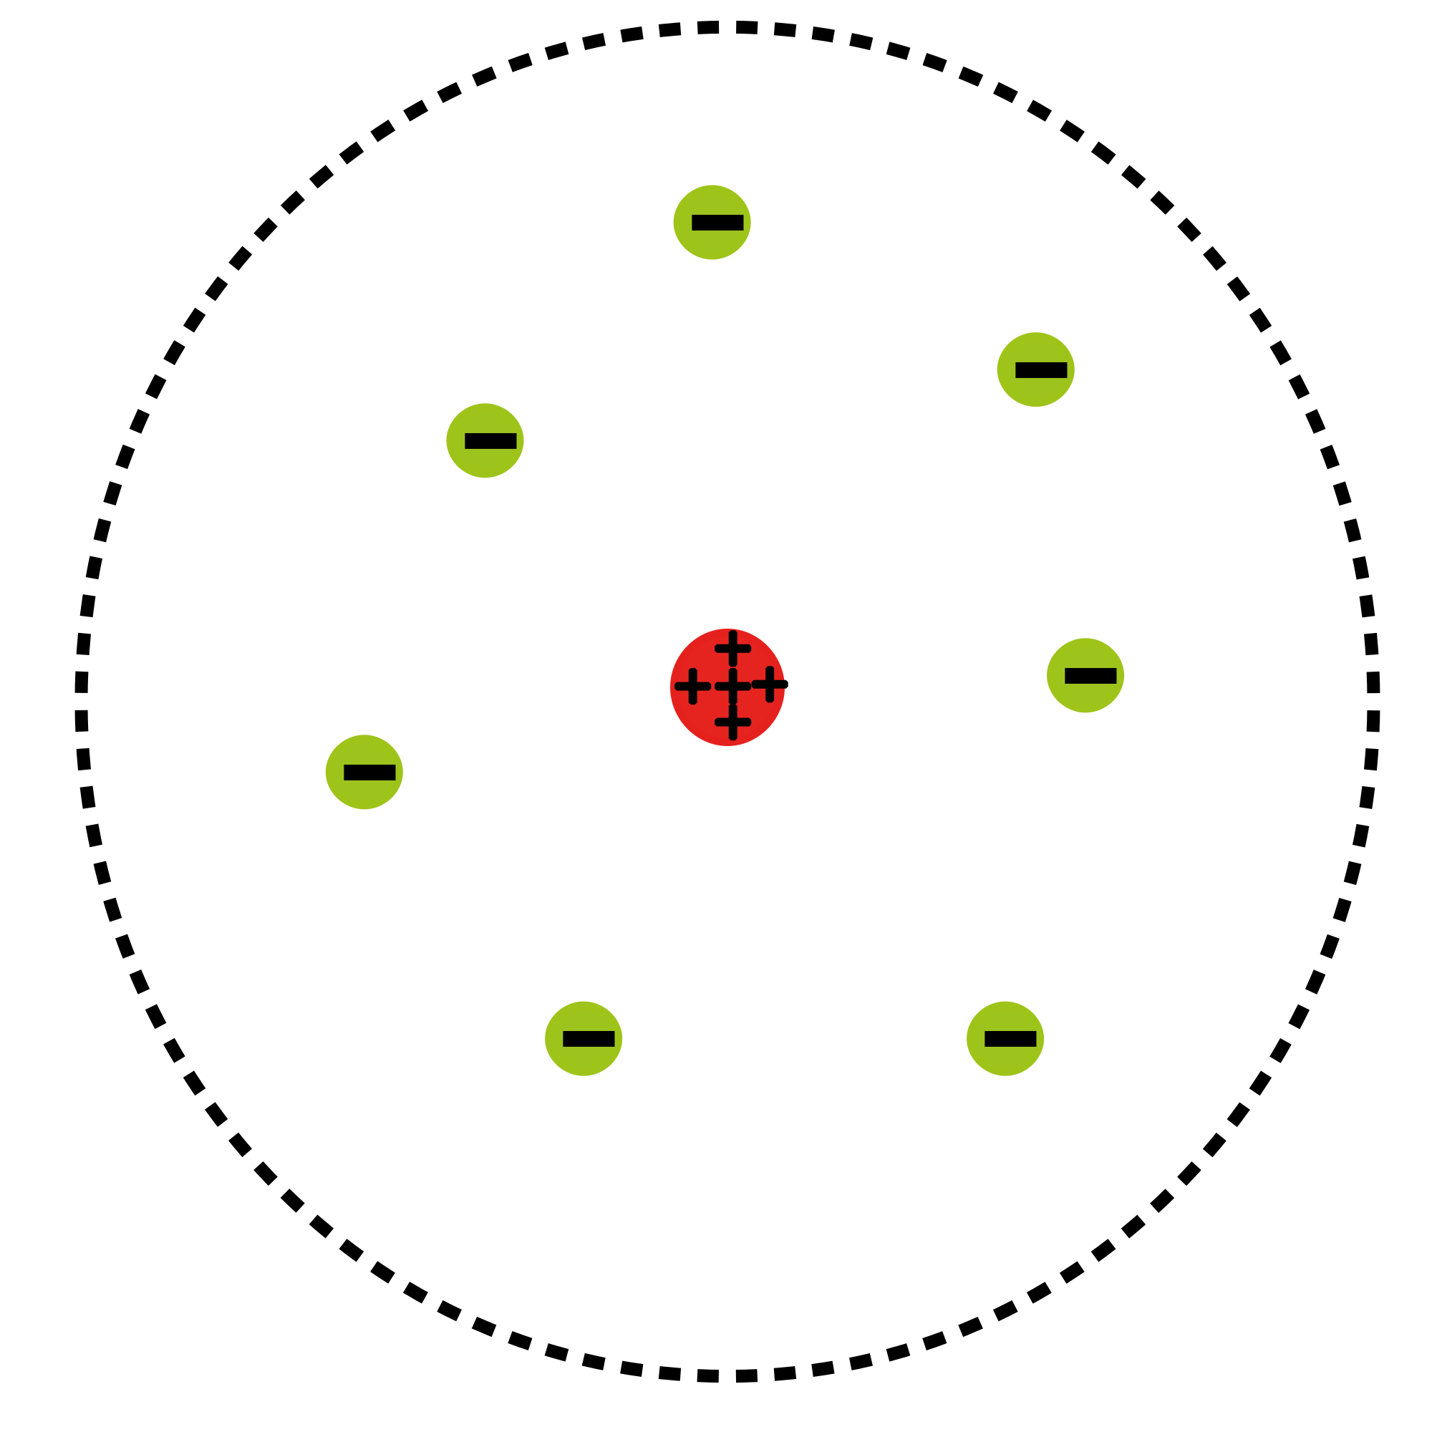
Atomic Physics
Atomic Planetary Model
Basic diagram of the atomic planetary model; electrons are in green, and the nucleus is in red
Free to share, print, make copies and changes. Get yours at www.boundless.com
Wikipedia. "Rutherford model." CC BY http://en.wikipedia.org/wiki/Rutherford_model View on Boundless.com

Slide 40
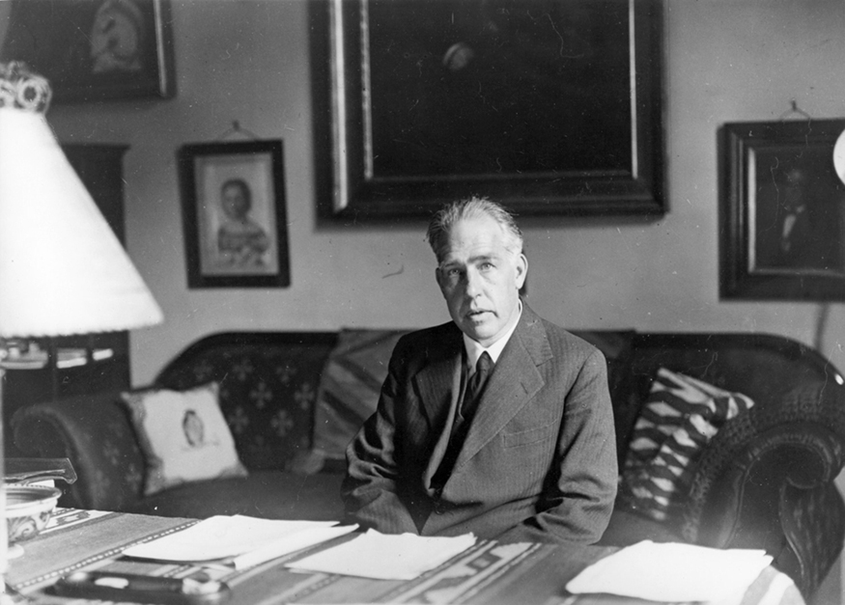
Atomic Physics
Niels Bohr
Niels Bohr, Danish physicist, used the planetary model of the atom to explain the atomic spectrum and size of the hydrogen atom. His many contributions to the development of atomic physics and quantum mechanics; his personal influence on many students and colleagues; and his personal integrity, especially in the face of Nazi oppression, earned him a prominent place in history. (credit: Unknown Author, via Wikimedia Commons)
Free to share, print, make copies and changes. Get yours at www.boundless.com
OpenStax CNX. "OpenStax College, Bohr’s Theory of the Hydrogen Atom. January 28, 2013." CC BY 3.0 http://cnx.org/content/m42596/latest/ View on Boundless.com

Slide 41
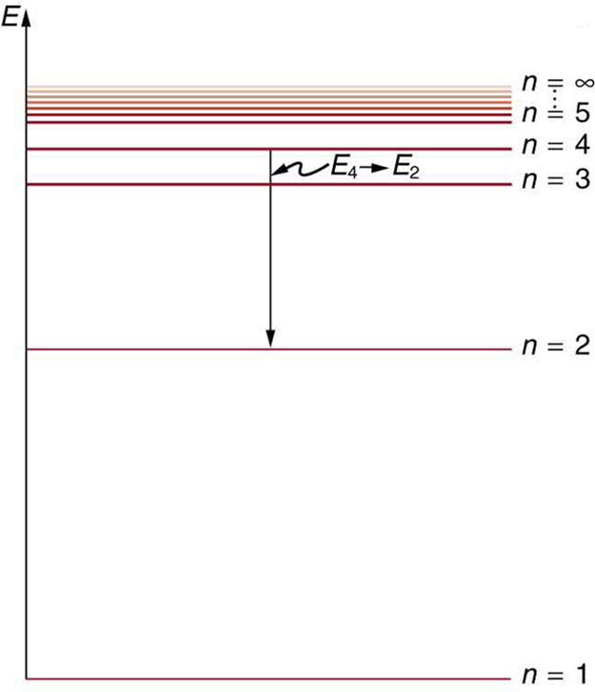
Atomic Physics
Energy-Level Diagram Plot
An energy-level diagram plots energy vertically and is useful in visualizing the energy states of a system and the transitions between them. This diagram is for the hydrogen-atom electrons, showing a transition between two orbits having energies and .
Free to share, print, make copies and changes. Get yours at www.boundless.com
OpenStax CNX. "OpenStax College, Bohr’s Theory of the Hydrogen Atom. January 28, 2013." CC BY 3.0 http://cnx.org/content/m42596/latest/ View on Boundless.com

Slide 42
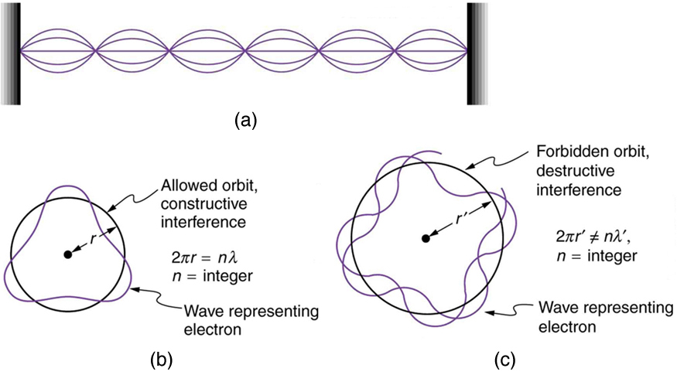
Atomic Physics
Waves on a String
(a) Waves on a string have a wavelength related to the length of the string, allowing them to interfere constructively. (b) If we imagine the string bent into a closed circle, we get a rough idea of how electrons in circular orbits can interfere constructively. (c) If the wavelength does not fit into the circumference, the electron interferes destructively; it cannot exist in such an orbit.
Free to share, print, make copies and changes. Get yours at www.boundless.com
OpenStax CNX. "OpenStax College, The Wave Nature of Matter Causes Quantization. January 28, 2013." CC BY 3.0 http://cnx.org/content/m42606/latest/ View on Boundless.com

Slide 43
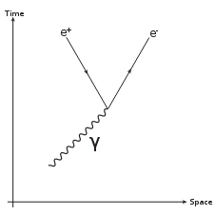
Atomic Physics
Pair Production
Feynman diagram for pair production. A photon decays into an electron-positron pair.
Free to share, print, make copies and changes. Get yours at www.boundless.com
Wikipedia. "Pair production." CC BY http://en.wikipedia.org/wiki/Pair_production View on Boundless.com

Slide 44
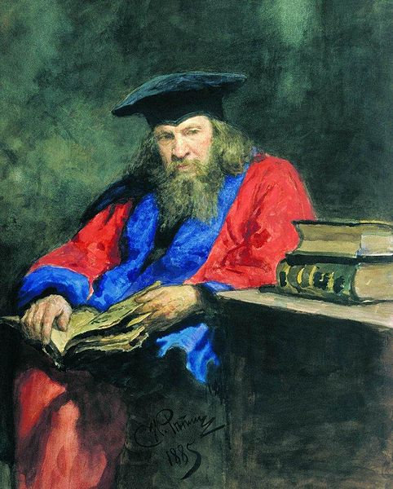
Atomic Physics
Dmitri Mendeleev
Dmitri Mendeleev is known for publishing a widely recognized periodic table.
Free to share, print, make copies and changes. Get yours at www.boundless.com
Wikimedia. CC BY-SA http://upload.wikimedia.org/wikipedia/commons/thumb/b/b3/Medeleeff_by_repin.jpg/482px-Medeleeff_by_repin.jpg View on Boundless.com

Slide 45
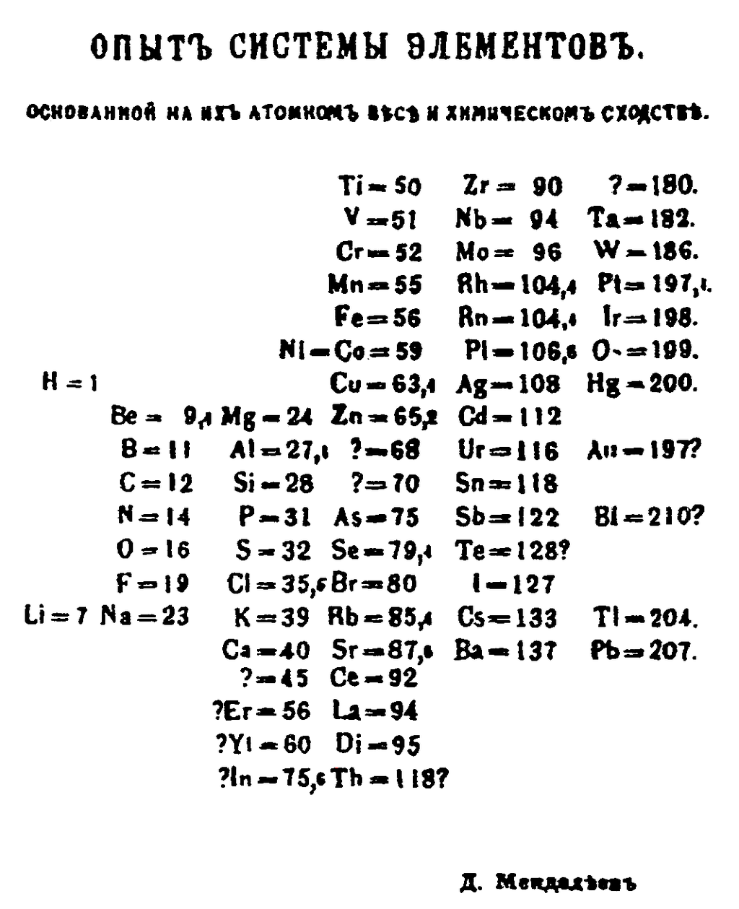
Atomic Physics
Mendeleev's 1869 Periodic Table
Mendeleev's 1869 periodic table presents the periods vertically and the groups horizontally.
Free to share, print, make copies and changes. Get yours at www.boundless.com
Wikimedia. CC BY-SA http://upload.wikimedia.org/wikipedia/commons/thumb/b/bb/Mendeleev's_1869_periodic_table.png/487px-Mendeleev's_1869_periodic_table.png View on Boundless.com

Slide 46

Atomic Physics
Thomson's Model vs. Rutherford's Model
Top: Expected results -- alpha particles pass through the plum pudding model of the atom undisturbed. Bottom: Observed results -- a small portion of the particles were deflected, indicating a small, concentrated positive charge. (Note that the image is not to scale; in reality the nucleus is vastly smaller than the electron shell. )
Free to share, print, make copies and changes. Get yours at www.boundless.com
Wikipedia. "Geiger-Marsden experiment." CC BY http://en.wikipedia.org/wiki/Geiger-Marsden_experiment View on Boundless.com

Slide 47
Atomic Physics
Intro to the History of Atomic Theory - The Rutherford Model
Rutherford, Thomson, electrons, nuclei, and plums. I don't mean to be a bohr, but do you think pudding should have a role in serious scientific inquiry?
Free to share, print, make copies and changes. Get yours at www.boundless.com
View on Boundless.com

Slide 48
Attribution
Atomic Physics
Wikipedia. "de Broglie wavelength." CC BY-SA 3.0 http://en.wikipedia.org/wiki/de%20Broglie%20wavelength
Wikipedia. "CCD." CC BY-SA 3.0 http://en.wikipedia.org/wiki/CCD
OpenStax CNX. "Free High School Science Texts Project, Wave Nature of Matter: Electron Microscopes. September 17, 2013." CC BY 3.0 http://cnx.org/content/m39574/latest/
Wikipedia. "Electron microscope." CC BY-SA 3.0 http://en.wikipedia.org/wiki/Electron_microscope%23cite_note-erni-1
Wiktionary. "atomic orbital." CC BY-SA 3.0 http://en.wiktionary.org/wiki/atomic_orbital
Wiktionary. "electron shell." CC BY-SA 3.0 http://en.wiktionary.org/wiki/electron_shell
Wikipedia. "Electronic configuration." CC BY-SA 3.0 http://en.wikipedia.org/wiki/Electronic_configuration
Wikipedia. "Electron configuration." CC BY-SA 3.0 http://en.wikipedia.org/wiki/Electron_configuration
Wikipedia. "stimulated emission." CC BY-SA 3.0 http://en.wikipedia.org/wiki/stimulated%20emission
Wikipedia. "Laser." CC BY-SA 3.0 http://en.wikipedia.org/wiki/Laser%23Uses
Wiktionary. "centripetal." CC BY-SA 3.0 http://en.wiktionary.org/wiki/centripetal
Wikipedia. "Bohr model." CC BY-SA 3.0 http://en.wikipedia.org/wiki/Bohr_model
Wikipedia. "quantization." CC BY-SA 3.0 http://en.wikipedia.org/wiki/quantization
OpenStax CNX. "OpenStax College, Bohr’s Theory of the Hydrogen Atom. September 17, 2013." CC BY 3.0 http://cnx.org/content/m42596/latest/
Wiktionary. "alpha particle." CC BY-SA 3.0 http://en.wiktionary.org/wiki/alpha_particle
Wikipedia. "Geiger-Marsden experiment." CC BY-SA 3.0 http://en.wikipedia.org/wiki/Geiger-Marsden_experiment
Wikipedia. "Rutherford model." CC BY-SA 3.0 http://en.wikipedia.org/wiki/Rutherford_model
Free to share, print, make copies and changes. Get yours at www.boundless.com

Slide 49
Atomic Physics
Wiktionary. "gamma ray." CC BY-SA 3.0 http://en.wiktionary.org/wiki/gamma_ray
Wiktionary. "positron." CC BY-SA 3.0 http://en.wiktionary.org/wiki/positron
Wikipedia. "Pair production." CC BY-SA 3.0 http://en.wikipedia.org/wiki/Pair_production
Wiktionary. "spectrum." CC BY-SA 3.0 http://en.wiktionary.org/wiki/spectrum
Wikipedia. "photon." CC BY-SA 3.0 http://en.wikipedia.org/wiki/photon
OpenStax CNX. "OpenStax College, Bohr’s Theory of the Hydrogen Atom. September 17, 2013." CC BY 3.0 http://cnx.org/content/m42596/latest/
Boundless Learning. "Boundless." CC BY-SA 3.0 http://www.boundless.com//physics/definition/photoelectric-effect
Boundless Learning. "Boundless." CC BY-SA 3.0 http://www.boundless.com//physics/definition/black-body
Wikipedia. "Bohr model." CC BY-SA 3.0 http://en.wikipedia.org/wiki/Bohr_model
Wikipedia. "Doppler shift." CC BY-SA 3.0 http://en.wikipedia.org/wiki/Doppler%20shift
Wikipedia. "Thomson scattering." CC BY-SA 3.0 http://en.wikipedia.org/wiki/Thomson%20scattering
Wikipedia. "inelastic scattering." CC BY-SA 3.0 http://en.wikipedia.org/wiki/inelastic%20scattering
Wikipedia. "Compton effect." CC BY-SA 3.0 http://en.wikipedia.org/wiki/Compton_effect
Wiktionary. "periodic table." CC BY-SA 3.0 http://en.wiktionary.org/wiki/periodic_table
Wiktionary. "atomic number." CC BY-SA 3.0 http://en.wiktionary.org/wiki/atomic_number
Wiktionary. "element." CC BY-SA 3.0 http://en.wiktionary.org/wiki/element
Wikipedia. "Periodic table." CC BY-SA 3.0 http://en.wikipedia.org/wiki/Periodic_table
Wiktionary. "standing wave." CC BY-SA 3.0 http://en.wiktionary.org/wiki/standing_wave
Wikipedia. "matter wave." CC BY-SA 3.0 http://en.wikipedia.org/wiki/matter%20wave
Free to share, print, make copies and changes. Get yours at www.boundless.com

Slide 50
Atomic Physics
OpenStax CNX. "OpenStax College, The Wave Nature of Matter Causes Quantization. September 17, 2013." CC BY 3.0 http://cnx.org/content/m42606/latest/
Wikipedia. "Bohr model." CC BY-SA 3.0 http://en.wikipedia.org/wiki/Bohr_model
Wiktionary. "nucleus." CC BY-SA 3.0 http://en.wiktionary.org/wiki/nucleus
Wikipedia. "Plum pudding model." CC BY-SA 3.0 http://en.wikipedia.org/wiki/Plum_pudding_model
Wiktionary. "electromagnetic force." CC BY-SA 3.0 http://en.wiktionary.org/wiki/electromagnetic_force
Wiktionary. "nucleus." CC BY-SA 3.0 http://en.wiktionary.org/wiki/nucleus
Wikipedia. "Avogadro's number." CC BY-SA 3.0 http://en.wikipedia.org/wiki/Avogadro's%20number
OpenStax CNX. "OpenStax College, Discovery of the Atom. September 17, 2013." CC BY 3.0 http://cnx.org/content/m42589/latest/
Wikipedia. "Atom." CC BY-SA 3.0 http://en.wikipedia.org/wiki/Atom
Wikipedia. "Atomic theory." CC BY-SA 3.0 http://en.wikipedia.org/wiki/Atomic_theory
Wikipedia. "Maxwell's equations." CC BY-SA 3.0 http://en.wikipedia.org/wiki/Maxwell's%20equations
Wikipedia. "semiclassical." CC BY-SA 3.0 http://en.wikipedia.org/wiki/semiclassical
OpenStax CNX. "OpenStax College, Bohr’s Theory of the Hydrogen Atom. September 17, 2013." CC BY 3.0 http://cnx.org/content/m42596/latest/
Wikipedia. "Bohr model." CC BY-SA 3.0 http://en.wikipedia.org/wiki/Bohr_model
Wiktionary. "gamma ray." CC BY-SA 3.0 http://en.wiktionary.org/wiki/gamma_ray
Wikipedia. "photon." CC BY-SA 3.0 http://en.wikipedia.org/wiki/photon
Wikipedia. "photoelectric effects." CC BY-SA 3.0 http://en.wikipedia.org/wiki/photoelectric%20effects
Wikipedia. "Compton effect." CC BY-SA 3.0 http://en.wikipedia.org/wiki/Compton_effect
Boundless Learning. "Boundless." CC BY-SA 3.0 http://www.boundless.com//physics/definition/angular-momentum
Free to share, print, make copies and changes. Get yours at www.boundless.com

Slide 51
Atomic Physics
Wikipedia. "matter wave." CC BY-SA 3.0 http://en.wikipedia.org/wiki/matter%20wave
Wikipedia. "quantization." CC BY-SA 3.0 http://en.wikipedia.org/wiki/quantization
OpenStax CNX. "OpenStax College, The Wave Nature of Matter Causes Quantization. September 17, 2013." CC BY 3.0 http://cnx.org/content/m42606/latest/
Wiktionary. "crystallography." CC BY-SA 3.0 http://en.wiktionary.org/wiki/crystallography
Wiktionary. "diffraction." CC BY-SA 3.0 http://en.wiktionary.org/wiki/diffraction
Wikipedia. "double-helix structure." CC BY-SA 3.0 http://en.wikipedia.org/wiki/double-helix%20structure
OpenStax CNX. "OpenStax College, X Rays: Atomic Origins and Applications. September 17, 2013." CC BY 3.0 http://cnx.org/content/m42599/latest/
Wikipedia. "Planck constant." CC BY-SA 3.0 http://en.wikipedia.org/wiki/Planck%20constant
Wikipedia. "spectral radiance." CC BY-SA 3.0 http://en.wikipedia.org/wiki/spectral%20radiance
Boundless Learning. "Boundless." CC BY-SA 3.0 http://www.boundless.com//physics/definition/black-body
Wikipedia. "Blackbody radiation." CC BY-SA 3.0 http://en.wikipedia.org/wiki/Blackbody_radiation%23Planck.27s_law_of_black-body_radiation
Wikipedia. "Planck constant." CC BY-SA 3.0 http://en.wikipedia.org/wiki/Planck_constant
Wikipedia. "Planck's law." CC BY-SA 3.0 http://en.wikipedia.org/wiki/Planck's_law
Wiktionary. "alpha particle." CC BY-SA 3.0 http://en.wiktionary.org/wiki/alpha_particle
Wikipedia. "scintillation." CC BY-SA 3.0 http://en.wikipedia.org/wiki/scintillation
Wiktionary. "cathode." CC BY-SA 3.0 http://en.wiktionary.org/wiki/cathode
Wikipedia. "Proton." CC BY-SA 3.0 http://en.wikipedia.org/wiki/Proton
Wikipedia. "Electron." CC BY-SA 3.0 http://en.wikipedia.org/wiki/Electron%23Discovery
Wikipedia. "Neutron." CC BY-SA 3.0 http://en.wikipedia.org/wiki/Neutron
Free to share, print, make copies and changes. Get yours at www.boundless.com

Slide 52
Atomic Physics
OpenStax CNX. "Gabriela Escalera, Andrew Barron, Neutron Diffraction. September 17, 2013." CC BY 3.0 http://cnx.org/content/m43582/latest/
Wiktionary. "valence shell." CC BY-SA 3.0 http://en.wiktionary.org/wiki/valence_shell
Wiktionary. "electron shell." CC BY-SA 3.0 http://en.wiktionary.org/wiki/electron_shell
Wiktionary. "hydrogen-like." CC BY-SA 3.0 http://en.wiktionary.org/wiki/hydrogen-like
Wikipedia. "Electron shielding." CC BY-SA 3.0 http://en.wikipedia.org/wiki/Electron_shielding
Wikipedia. "Effective nuclear charge." CC BY-SA 3.0 http://en.wikipedia.org/wiki/Effective_nuclear_charge
Free to share, print, make copies and changes. Get yours at www.boundless.com

